Slide 1
IBM University Engagement Project Submission
“Exploring the Power of Agentic AI with IBM Granite and IBM Bob”

Slide 2

Project Tile – Startup Blueprint Generator Agent
Domain of Project – Startup & Entrepreneurship
Student Name | Recent Passport Photo | Email ID | Mobile number [WhatsApp]
SARVESHWARAN M |  | sarvesh729.07@gmail.com | 6381880565

Slide 3
Problem Statement -
Problem Statement – Startup Blueprint Generator Agent
The Challenge
Aspiring entrepreneurs often have good startup ideas but struggle to turn them into proper business plans. Information about the market, competitors, funding, and government schemes is also scattered across different sources.
The Objective
To develop an AI-powered agent that converts a startup idea into a clear and actionable business blueprint.
The Solution
Startup Analysis – Understand the idea, problem, and target customers.
Market Research – Identify market opportunities and trends.
Competitor Analysis – Find and compare competitors.
Business Model – Create a Business Model Canvas.
Budget & Revenue – Suggest revenue models and estimated costs.
Marketing Strategy – Create a simple launch strategy.
Funding & Schemes – Find relevant funding and government schemes.
Final Blueprint – Generate a complete startup plan.

Slide 4
Proposed Solution -
The solution uses IBM Granite, IBM Cloud Lite, Agentic AI, and RAG to convert startup ideas into actionable business plans.
Specialized AI Agents:
Startup Analysis – Identifies problem, solution, customers, and USP.
Market Research – Analyzes market opportunities and trends.
Competitor Analysis – Compares competitors and their strengths.
Business Model – Generates the Business Model Canvas.
Funding Agent – Finds relevant funding and government schemes.
A user-friendly dashboard presents the market analysis, competitors, BMC, budget, GTM strategy, and funding information.
IBM Granite handles AI reasoning and generation, while RAG provides trusted and relevant information.

Slide 5
Technology Used
IBM Bob – Used to build, test, debug, and manage the application.
IBM Granite – Used for AI reasoning, startup idea analysis, and blueprint generation.
IBM Cloud Lite – Provides the required cloud environment and IBM services.
RAG – Retrieves trusted information on markets, competitors, funding, government schemes, and legal requirements.
AI Agent Architecture – Uses specialized agents for market research, competitors, business model, funding, and legal analysis.
Database – Stores user profiles, startup ideas, blueprints, and source information.

Slide 6
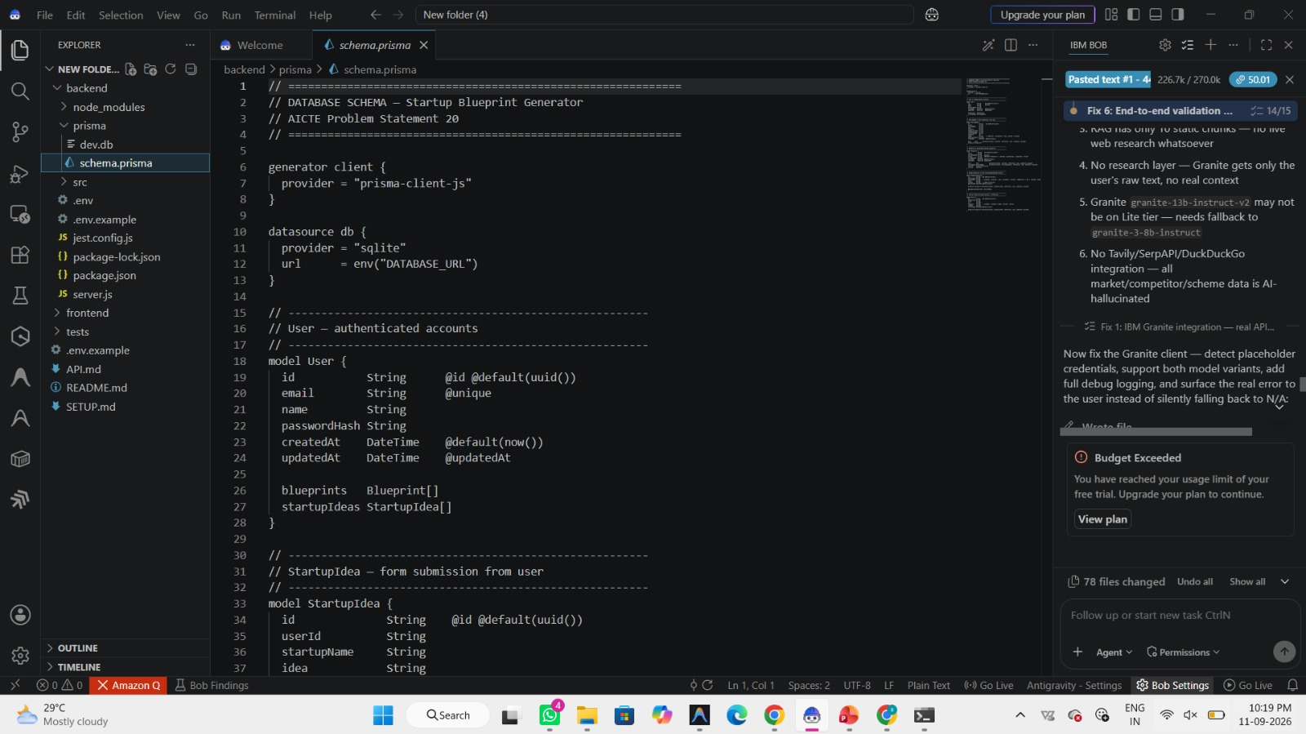
Required Files created using IBM bob -

Slide 7
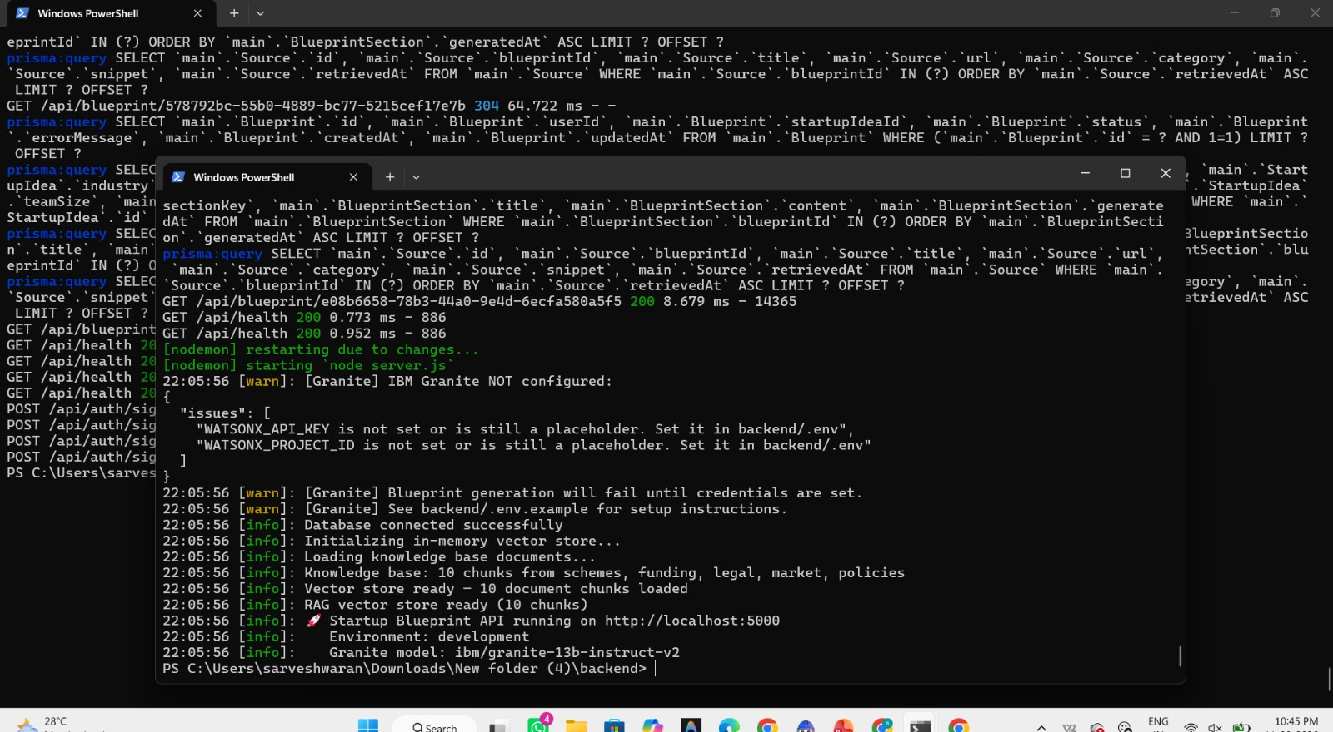
IBM Bob Screenshots:

Slide 8
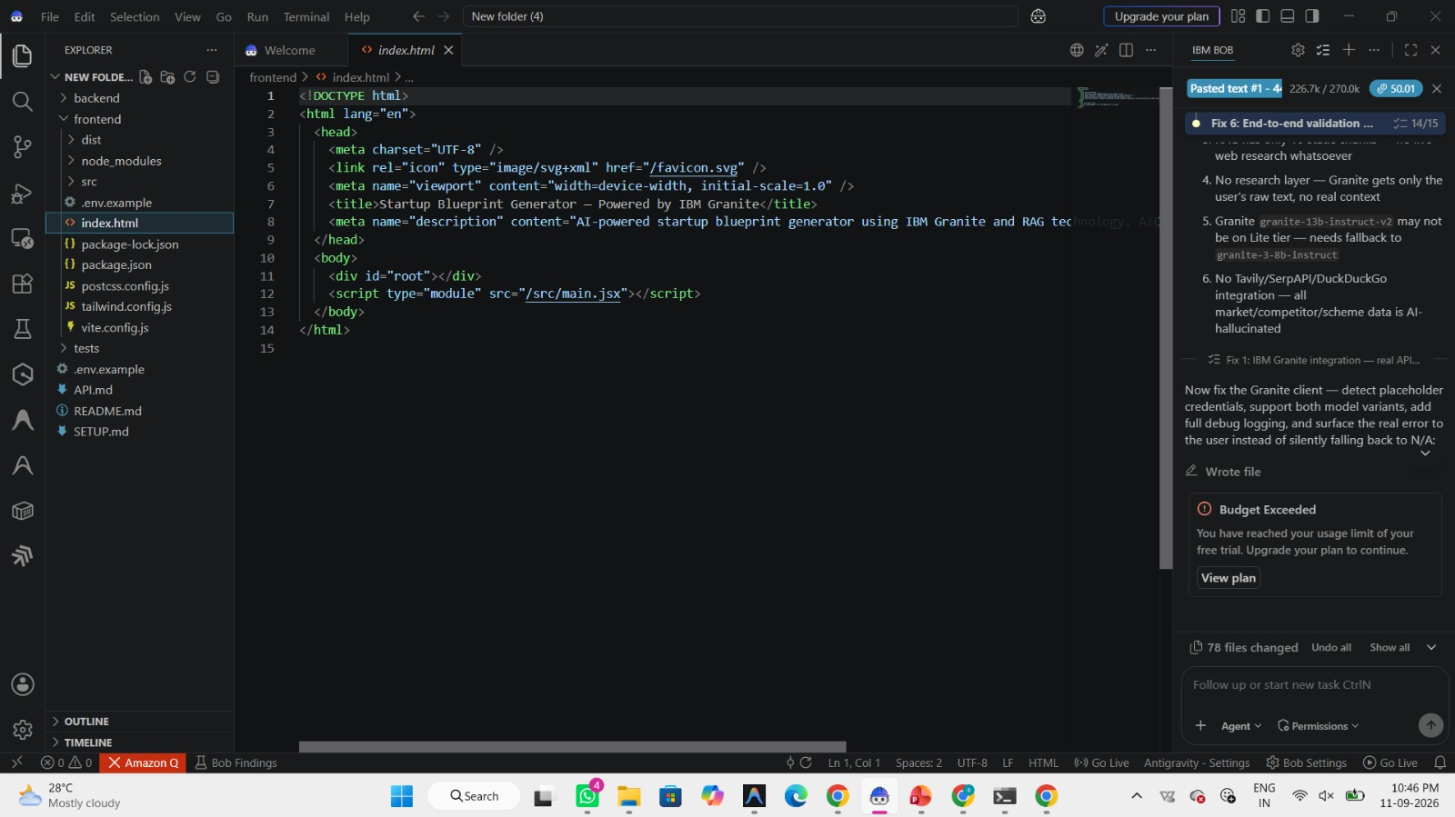
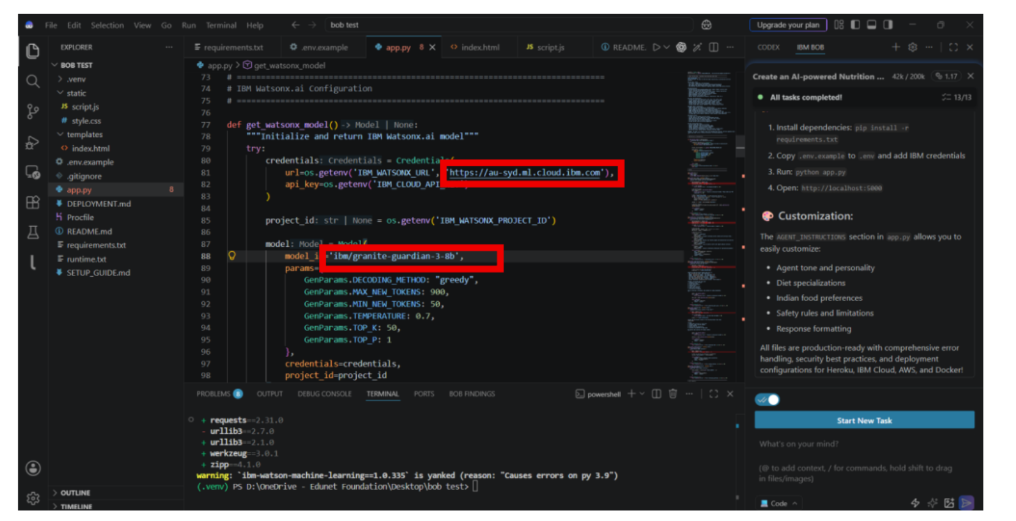

Slide 9
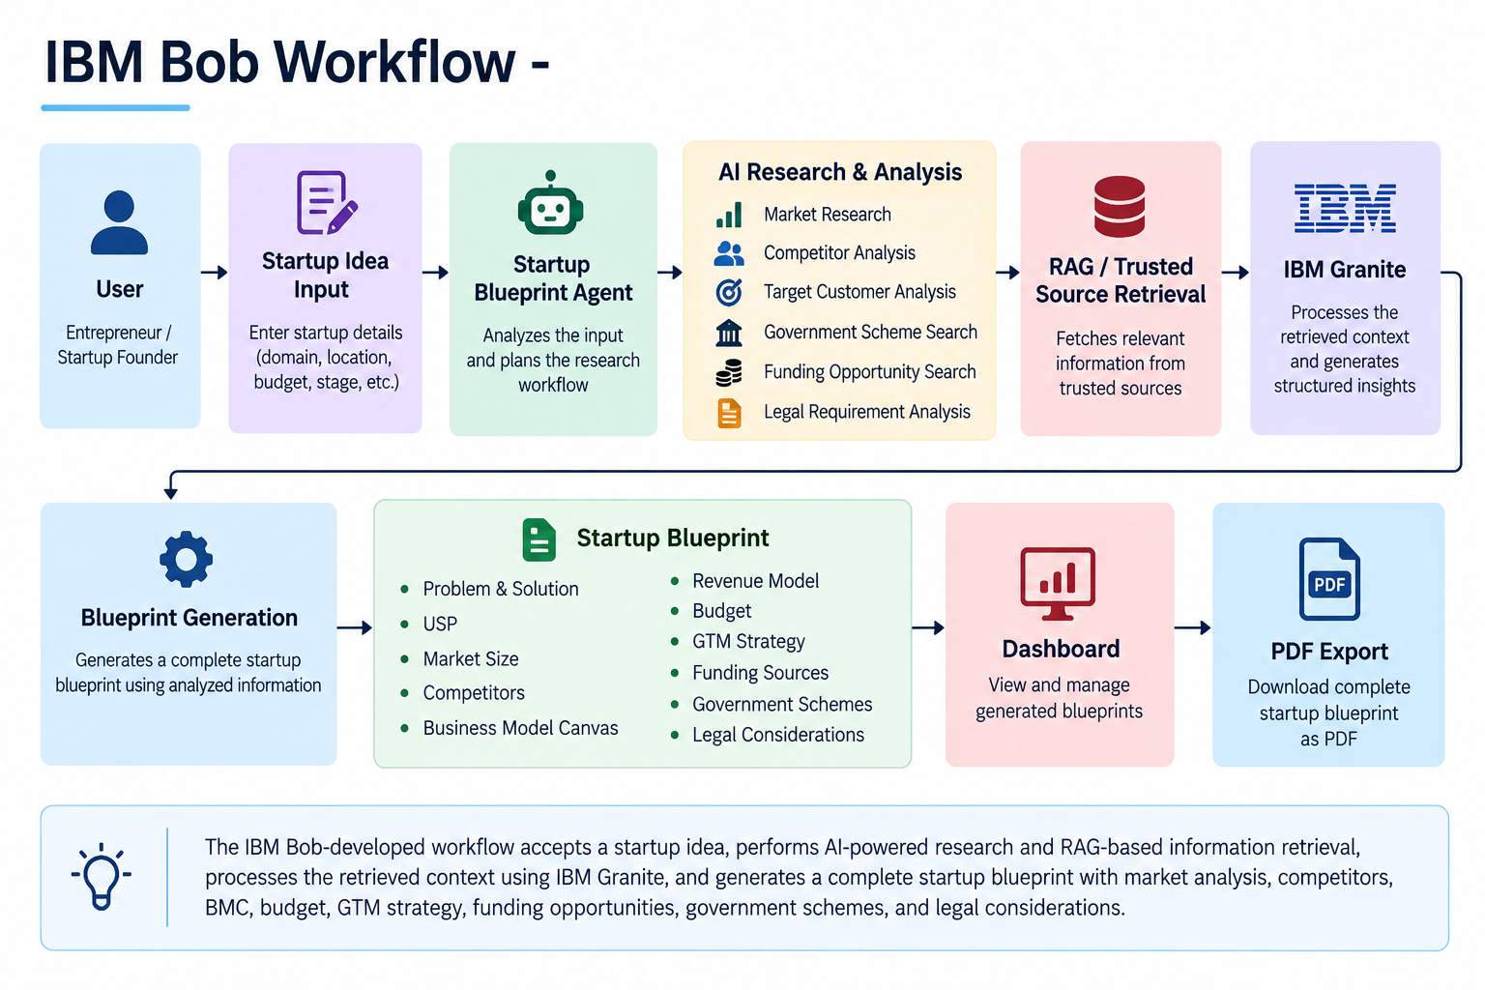
Langflow workflow -

Slide 10
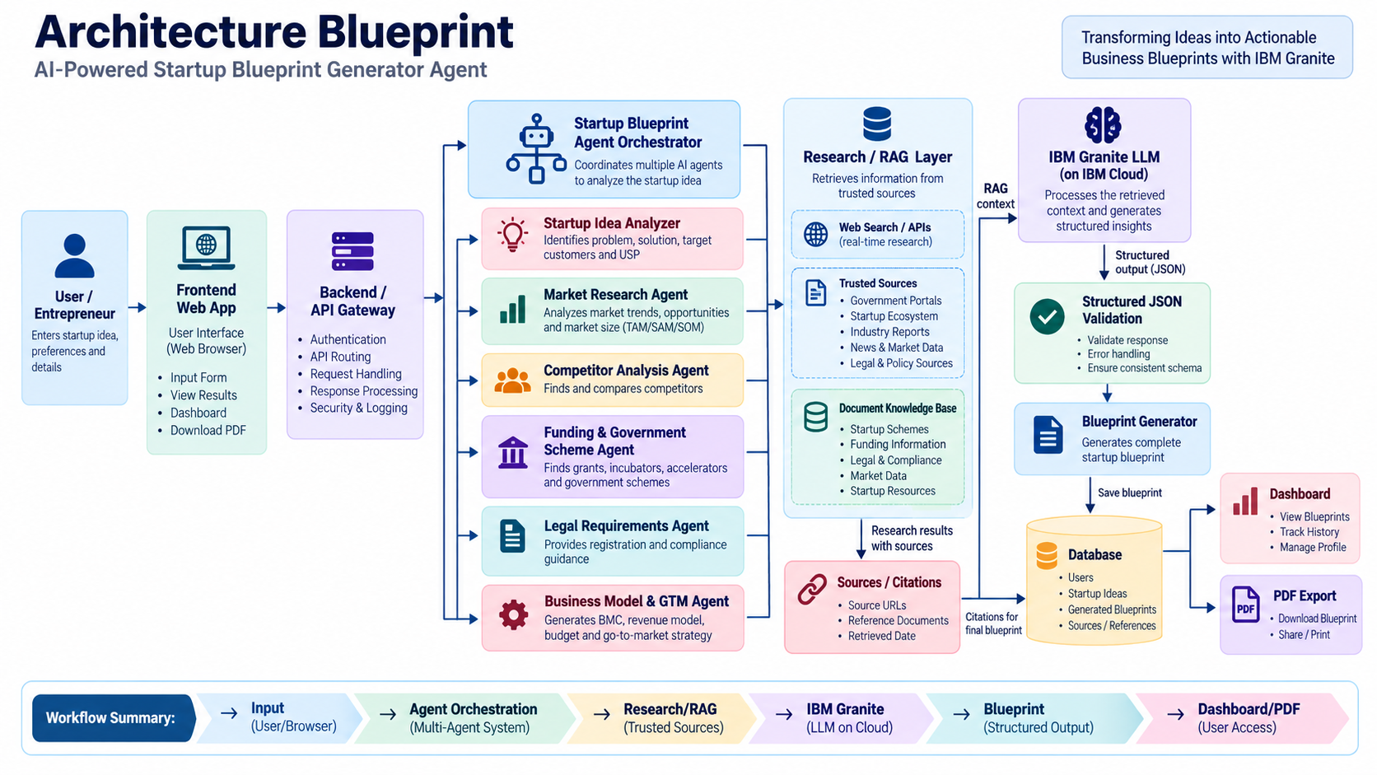
Architecture blueprint for IBM bob:

Slide 11

Role of Agentic AI in the solution
Agentic AI enables the Startup Blueprint Generator to work as an intelligent system rather than a simple chatbot. It coordinates specialized agents to analyze different aspects of a startup idea.
Startup Analysis Agent – Understands the idea, problem, solution, customers, and USP.
Market Research Agent – Analyzes market opportunities and trends.
Competitor Analysis Agent – Identifies and compares competitors.
Business Model Agent – Creates the Business Model Canvas and revenue model.
Funding Agent – Finds suitable funding opportunities and government schemes.
Legal Agent – Identifies relevant registration and compliance requirements.
Overall, Agentic AI makes the system automated, personalized, and action-oriented, helping users move from a startup idea to a practical business plan.
.

Slide 12
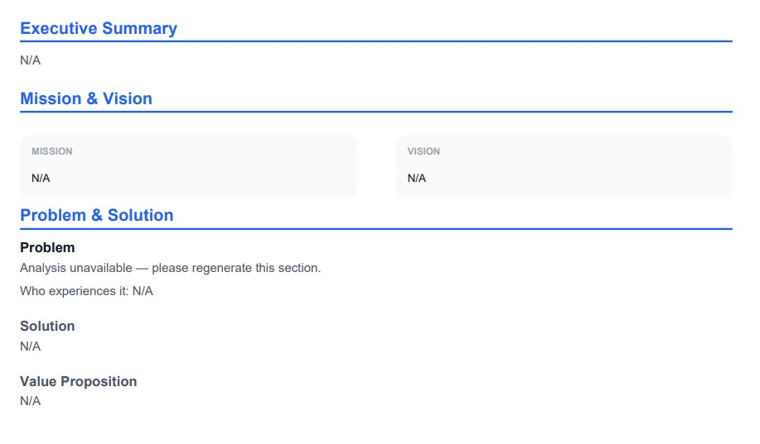
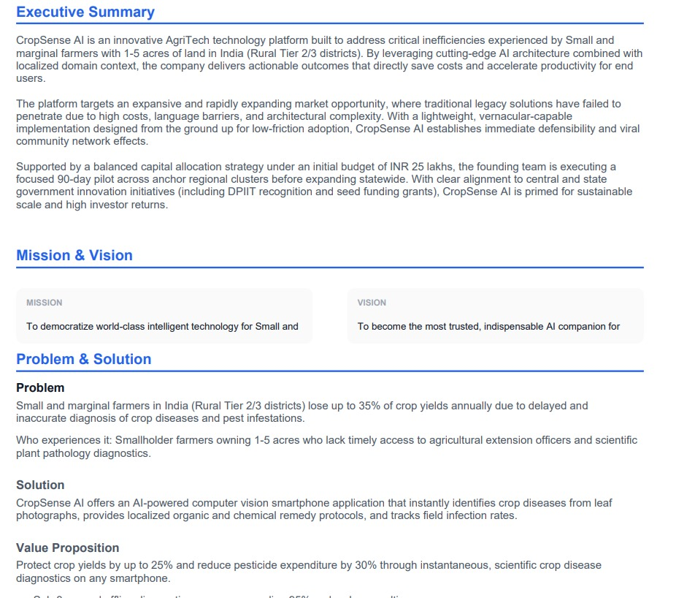

Token Usage
11,761 token are used
Before Prompt
After the Prompt
·
·
·

Slide 13
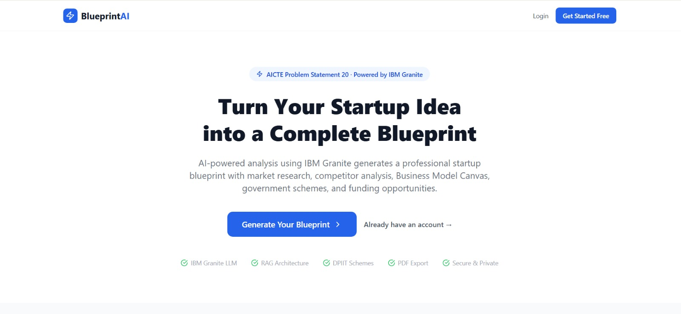
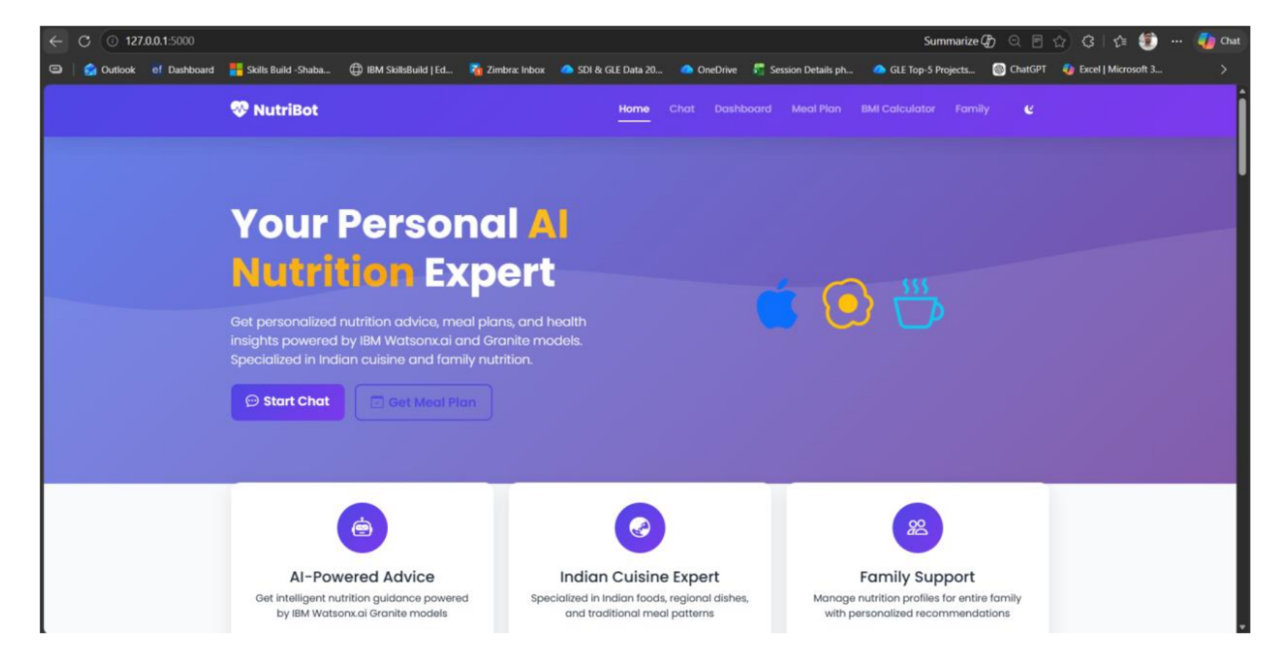
Project Output Screenshot
Please put IBM Bob output screenshots with 2-3 prompts.
You can take 2-3 more slides for each screenshot
·
·
·

Slide 14
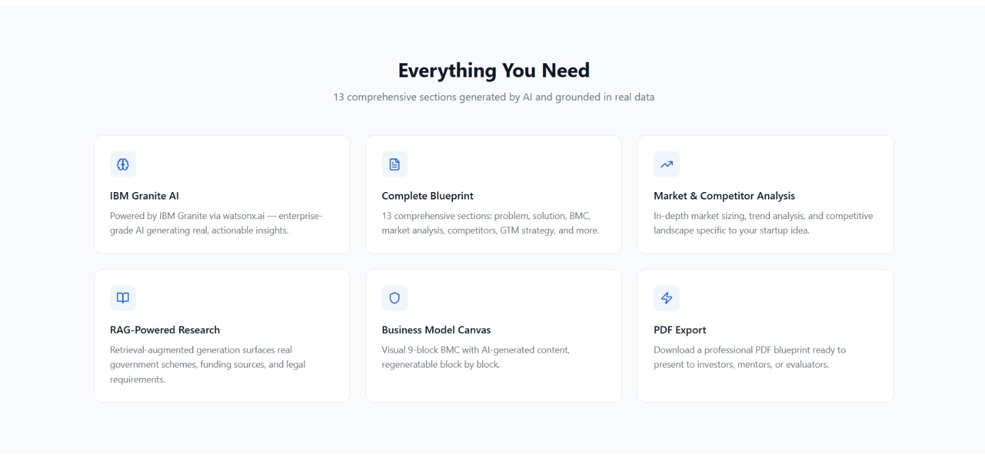
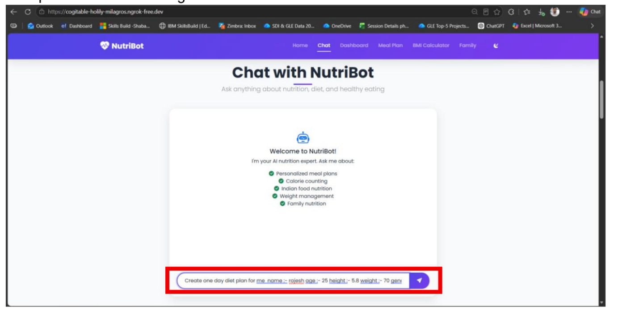
Project Output Screenshot
Please put IBM Bob output screenshots with 2-3 prompts.
You can take 2-3 more slides for each screenshot
·
·
·

Slide 15
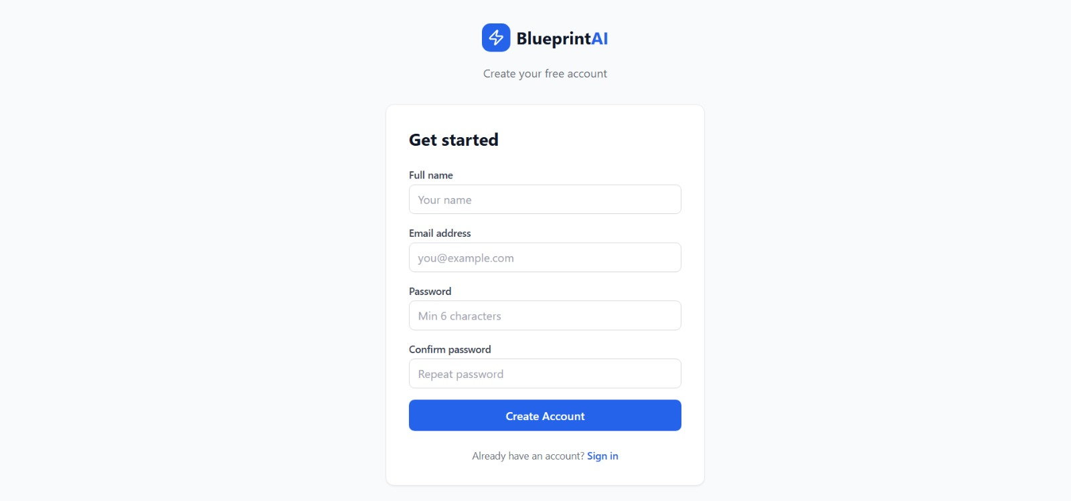
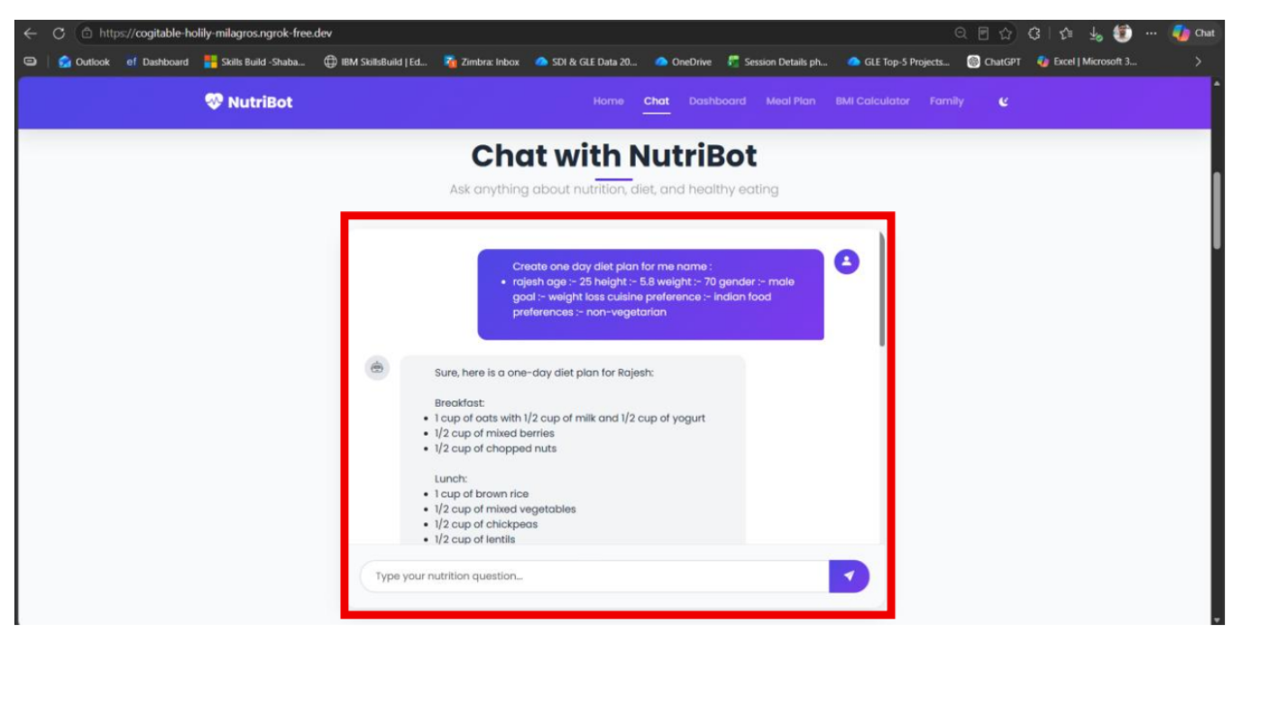
Project Output Screenshot
Please put IBM Bob output screenshots with 2-3 prompts.
You can take 2-3 more slides for each screenshot
·
·
·

Slide 16
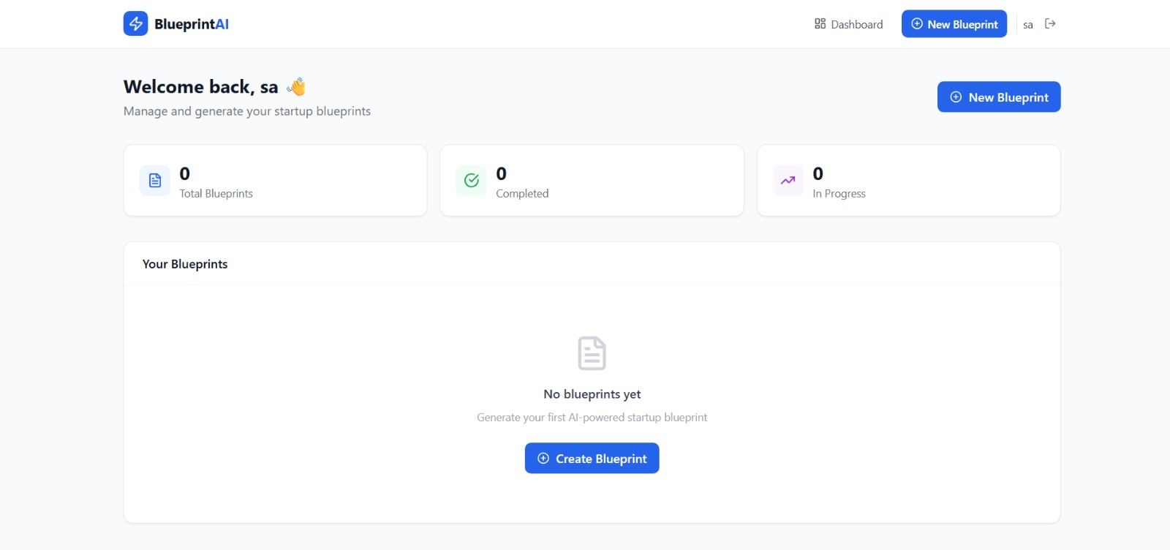

Slide 17
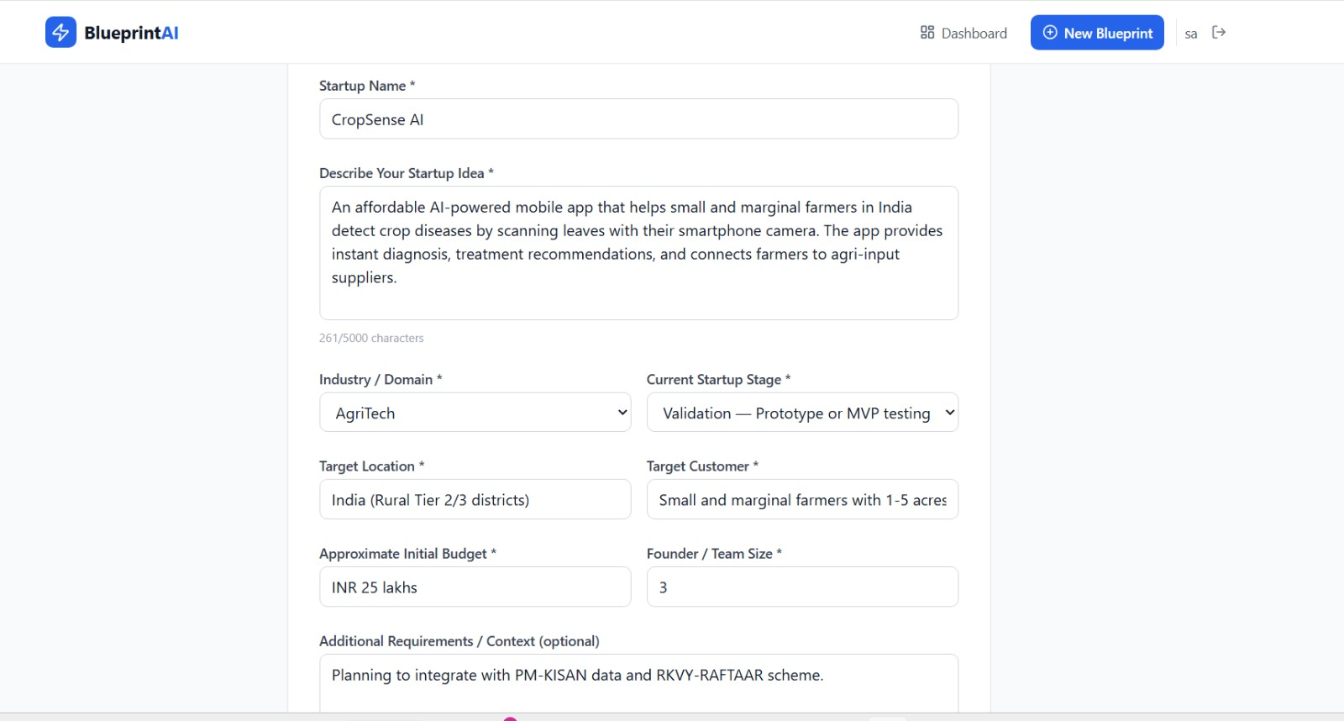

Slide 18
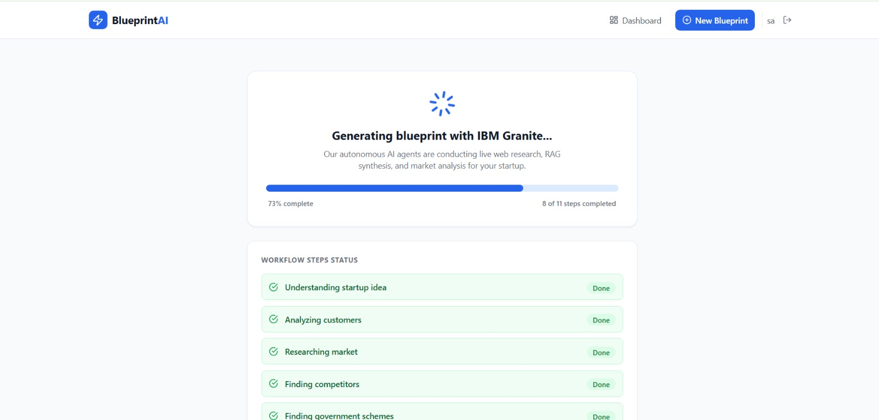

Slide 19
Novelty and Uniqueness
The proposed Startup Blueprint Generator Agent stands out by combining Agentic AI, RAG, and personalized startup planning in a single system.
Multi-Agent Intelligence – Specialized agents work together for market, competitor, business model, funding, and legal analysis.
RAG-Based Accuracy – Uses trusted information to provide relevant and reliable startup recommendations.
Personalized Planning – Generates a blueprint based on the user's startup idea, budget, target market, and industry.
Complete Business Blueprint – Covers market research, competitors, BMC, revenue, budget, marketing, funding, and legal requirements.
Action-Oriented Strategy – Provides practical go-to-market plans and next steps instead of only giving general suggestions.
Funding & Scheme Discovery – Identifies relevant grants, government schemes, incubators, and funding opportunities.
Easy-to-Use Dashboard – Presents the complete startup plan in a clear and structured format.
Overall, the solution acts as an intelligent startup planning assistant that helps users move from a raw idea to a practical and actionable business blueprint.

Slide 20
Git Hub Link
Github URL:https://github.com/sarveshwaran777/Start-up-_blueprints_generator
·
·
·

Slide 21
Future Scope
1.Real-Time Market & Funding Updates –
The system can be connected to reliable online sources to provide updated information about market trends, competitors, government schemes, grants, and funding opportunities.
2.Multilingual & Voice Support –
The agent can support multiple Indian languages and voice interaction, making startup planning easier and more accessible to users from different regions.
3.Investor & Incubator Matching –
The system can recommend suitable investors, incubators, and accelerators based on the startup idea, industry, location, and funding requirements.
·
·
·

Slide 22
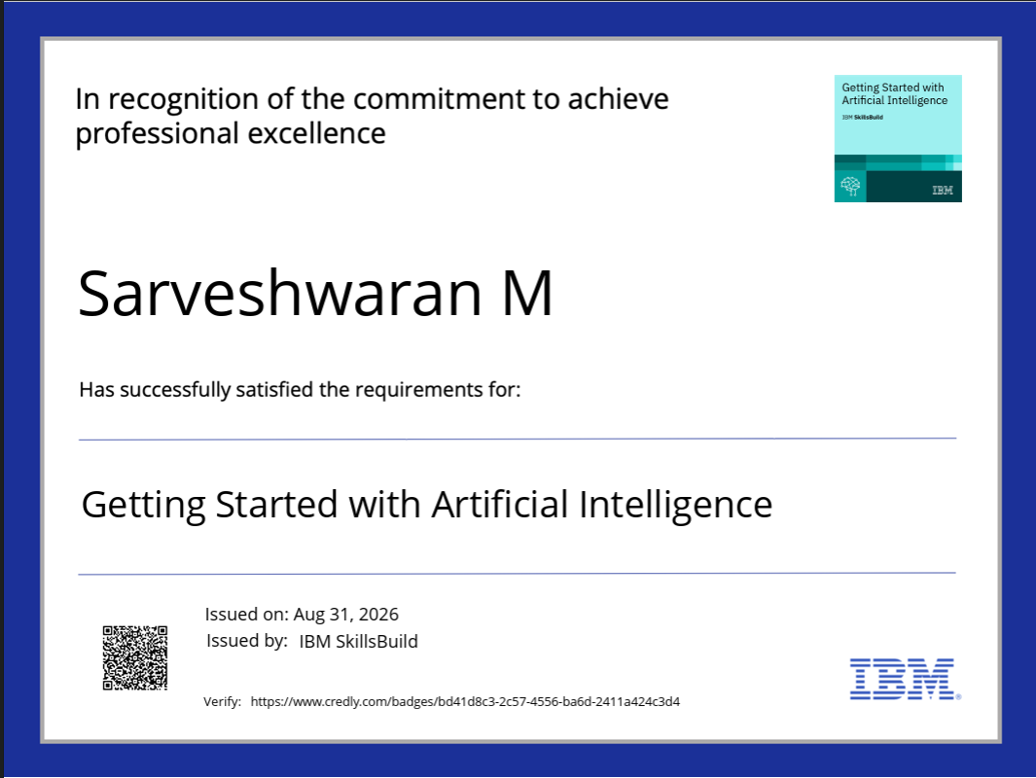
Certificates Earned:

Slide 23
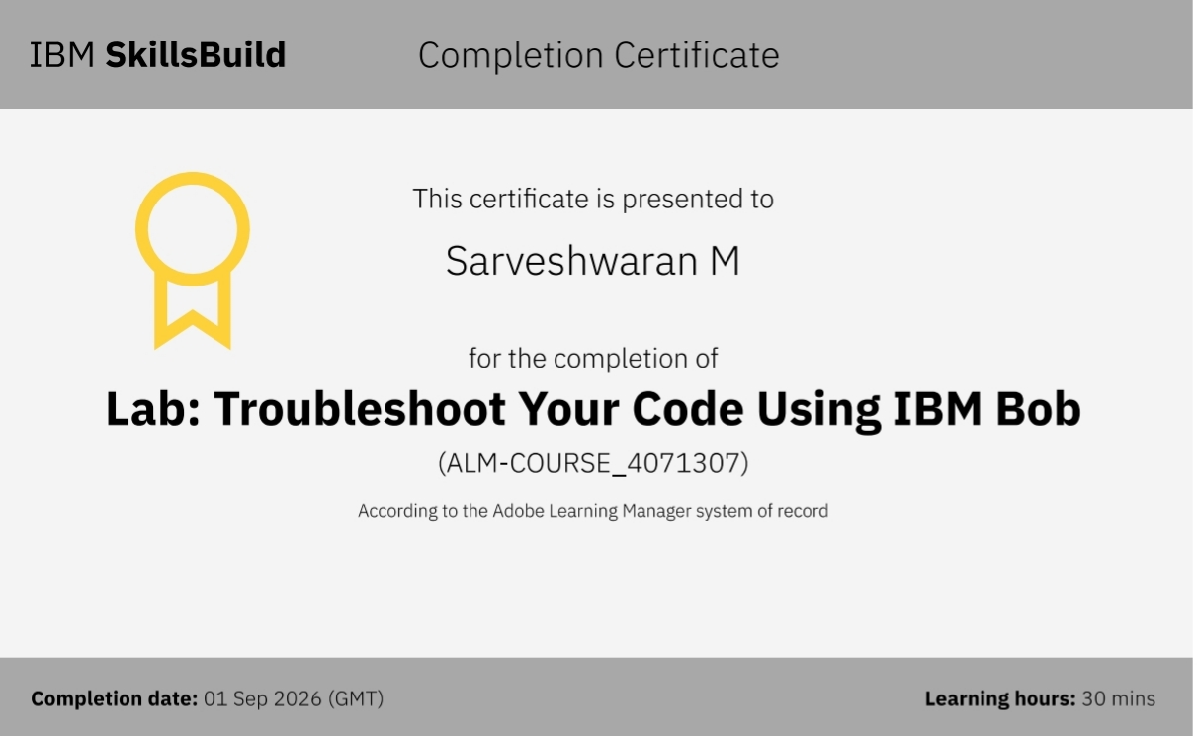
Certificates Earned:​
Add your IBM BOB Certificate

Slide 24


