Slide 1
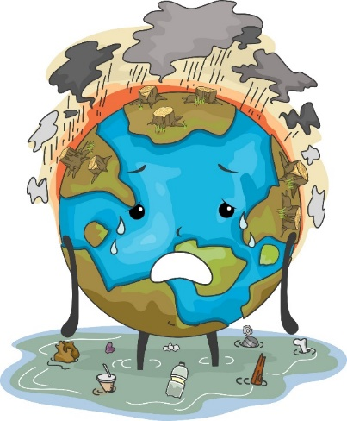
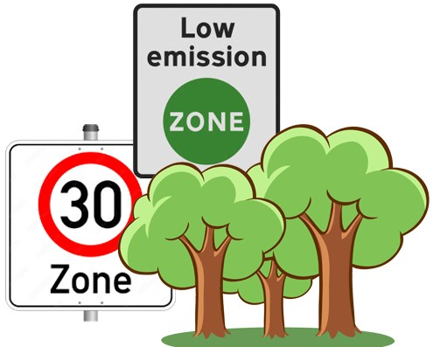
Implications of actual and perceived exposure to environmental conditions for local policy support
Sarah Gomm and Thomas Bernauer
sarah.gomm@ir.gess.ethz.ch
Sarah Gomm & Thomas Bernauer
Environmental Politics and International Political Economy Group, ETH Zurich

Slide 2
How much do actual or perceived societal conditions shape peoples’ policy preferences?
Policy support is driven by individual characteristics
And by the world individuals live in: politicians should solve real world problems
RQ:
Case:
Environmental conditions
Subtle, chronic, long-term exposure
Linked to well-being
Also to policy support?
Country: Switzerland
To what extent are policy preferences shaped by actual or perceived conditions?
Motivation
Hypotheses
Data
Results
Conclusion
Notes:
We start with the question: …
We know that policy support is to a large extent driven by individual level characteristics
But citizens also do not develop these preferences in a vacuum but are influenced by their surrounding environment, they want politicians to solve the problems they are exposed to
Yet, it is unclear to what extent these preferences are a reaction to actual OR to perceived societal conditions
This is true for various fields: e.g. think of demand for stricter immigration policies, actual or perceived crime rates,…
We look at environmental conditions, for wich previous literature in this context mainly focused on extreme wheather events, natural disasters → that come with severe implications and are clearly visible = perceptible
Yet, even this literature is inconclusive on whether actual or perceived burden drives policy support
We shift the focus to more subtle, permanently present environmental conditions as these are of relevance for a great amount of citizens in the long-term, and gradually worsening over time
In particular, we look at air pollution levels, noise and a lack of green spaces: we already know that these conditions are linked to human well-being: are they also linked to policy support?

Slide 3
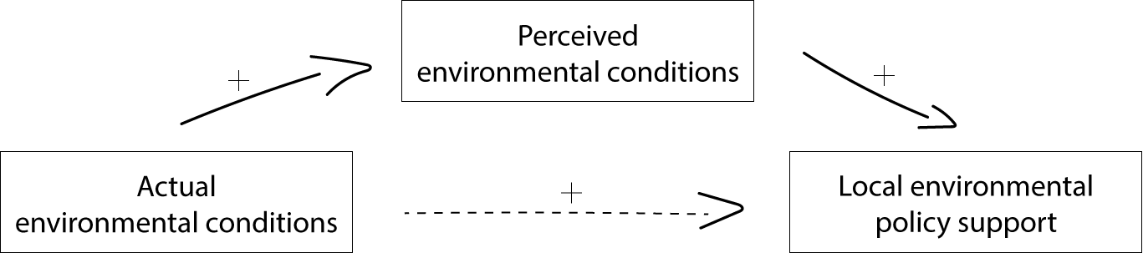
Actual and perceived environmental conditions
How much do actual or perceived environ. conditions shape peoples’ policy preferences?
H1 The higher the perceived exposure to chronic environmental stressors, the higher the demand for political interventions.
H2 Perceived chronic exposure to environmental conditions mediates the link between actual exposure and demand for political interventions.
Motivation
Hypotheses
Data
Results
Conclusion
Notes:
We begin with the premise that subjective perception is absolutely central to how environmental conditions influence policy support.
Individuals support for policies is directly shaped by their interpretation of that reality.
This idea is rooted in sociological scholarship on risk perceptions. societal responses to risks only emerge when those risks are perceived as a threat.
While perception is key, we also acknowledge that actual, objective conditions are relevant. However, we argue their influence on policy demand isn't direct. Instead, it's filtered through perception.
this means that objective conditions, like living in a polluted area, set the stage, their ultimate impact on political demand is contingent upon whether individuals actually notice the environmental problem.
So H2 proposes:

Slide 4
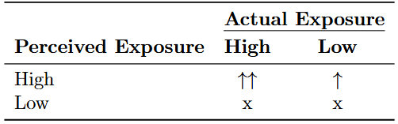
Actual and perceived environmental conditions
How much do actual or perceived environ. conditions shape peoples’ policy preferences?
H3 The correlation with policy support is … i) strongest when both actual and perceived exposure to environmental stressors are high; ii) weaker when perceived exposure is high but actual exposure is low; iii) and absent when perceived exposure is low, irrespective of the level of actual exposure.
Motivation
Hypotheses
Data
Results
Conclusion
Notes:
We formulate a third hypothesis, to get a more nuanced picture of the interplay of actual and perceived reality: Specifically, we build profiles of those overestimating their exposure, underestimating their exposure, or correctly perceiving high or low exposure
Our argument is that the strength of perceived exposure is amplified when it aligns with actual burdens
So when an environmental burden is both FELT and REAL it leads to the strongest demand for political action:
Correlation is still significant but somewhat weaker for overestimators, where actual exposure is low
And absent, if perceived exposure is low, independent of actual exposure
So this third hypothesis suggest that the power of perceived exposure to drive policy demand is MAXIMIZED when it reflects an ongoing environmental reality.

Slide 5
Broadening the scope
Do we observe spill-over effects from local environmental policy support to support for policies implemented at the national level?
Local
National
Motivation
Hypotheses
Data
Results
Conclusion
Notes:
Lastly, we also braoden the scope by not only looking at the impact on local policy demand, so support for policies that directly adresses the conditions in question
But also more broadly, if we observe a link to general support for pro-environmental political candidates

Slide 6
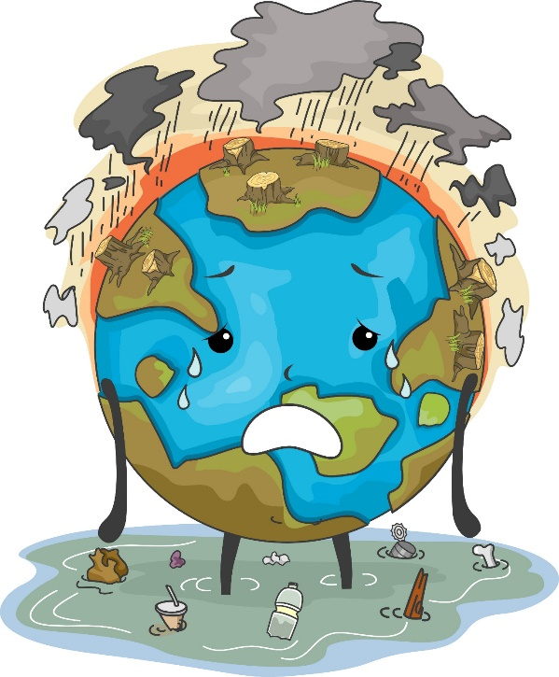
Research design
How much do actual or perceived environ. conditions shape peoples’ policy preferences?
Independent Variables Dependent Variables
Motivation
Hypotheses
Data
Results
Conclusion
Notes:
Now let me get to our research design

Slide 7
Research design
How much do actual or perceived environ. conditions shape peoples’ policy preferences?
Independent Variables Dependent Variables
Actual environmental conditions:
Air pollution: PM10
Noise in dB(A)
Precentage of surrounding green spaces
Perceived environmental conditions:
Perceived burden by air pollution
Perceived burden by noise (day/night)
Satisfaction with surrounding green in neighbourhood
Control variables
Sociodemographics, attitudes, ideology, health
DV 1: Direct items on local policy support
Air pollution: zero emission zones
Noise: Speed Limit – Tempo 30
Green: Availability of green spaces
DV 2: Choice experiment – place of residence
Which local policies matter?
DV 3: Pro-environmental voting
Local and national candidate
Motivation
Hypotheses
Data
Results
Conclusion
Notes:
We measure actual exposure at our respondents’ home adresses, so we have their exact residential location and use geodata on air pollution levels (an annual average), same for noise levels and the perecentage of surrounding green in 500m distance.
We merge the goedata with survey resonses on perceived burden at home due to air pollution, noise levels from traffic and their satisfaction with surrounding green in their neighbourhood.
While this is a correlational analysis and we cannot make any causal claims, we control for a rich set of confounding and moderating variables such as socioeconomic status or environmental concern.
We operationalize three types of dependent variables: the first one are directquestions answered on a 5-point likert scale on support for a measure to reduce air pollution, noise levels, and increase green space access.
Our second DV is a bit more nuanced: we use a conjoint to measure which of these policies respondents want to see implemented a t their place of residence: the attributes are the three policy areas, the levels are variations of e.g. an air pollution policy with respect to its stringency.
Lastly, we also have two more direct questions on general support for pro-environmental politcal candidates.

Slide 8
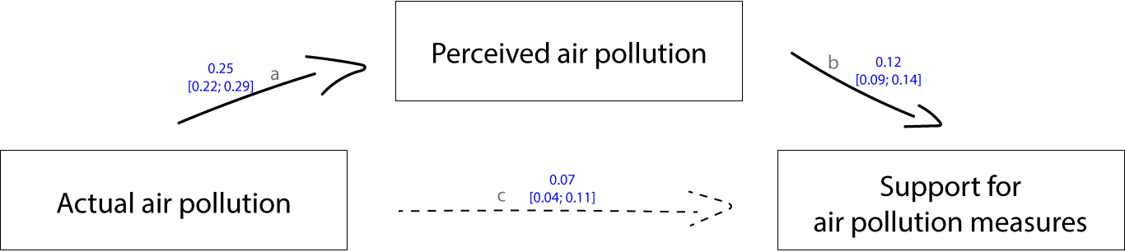
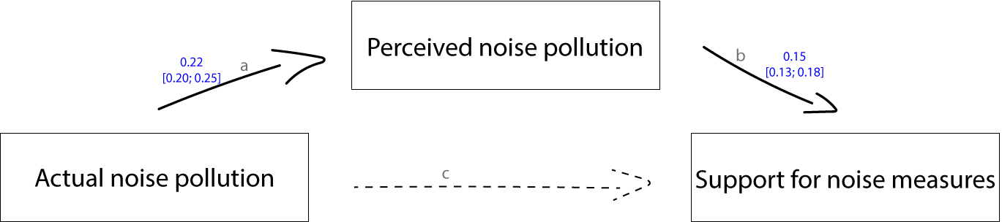
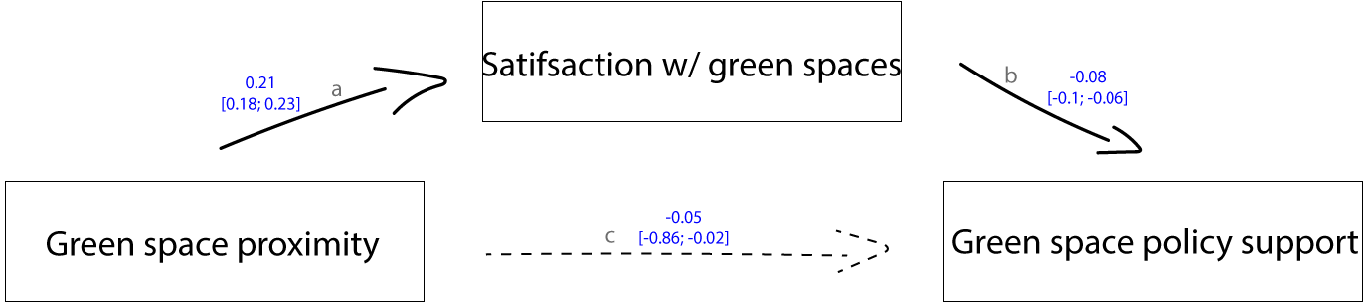
Results (H1 and H2): DV 1
Motivation
Hypotheses
Data
Results
Conclusion
Notes:
Coming now to the results, we here look at mediation models calculated with the PROCESS package in R
We see a moderate correlation between actual and perceived expsoure to air pollution, a significant link between perceptions and policy support and even a very small but significant link between actual expsoure and policy support
A similar picture results from the mediation analysis for noise levels, except that here the direct link is not significant
And for the mediation anaylsis for green spaces, where the links to policy support are then of course reversed

Slide 9
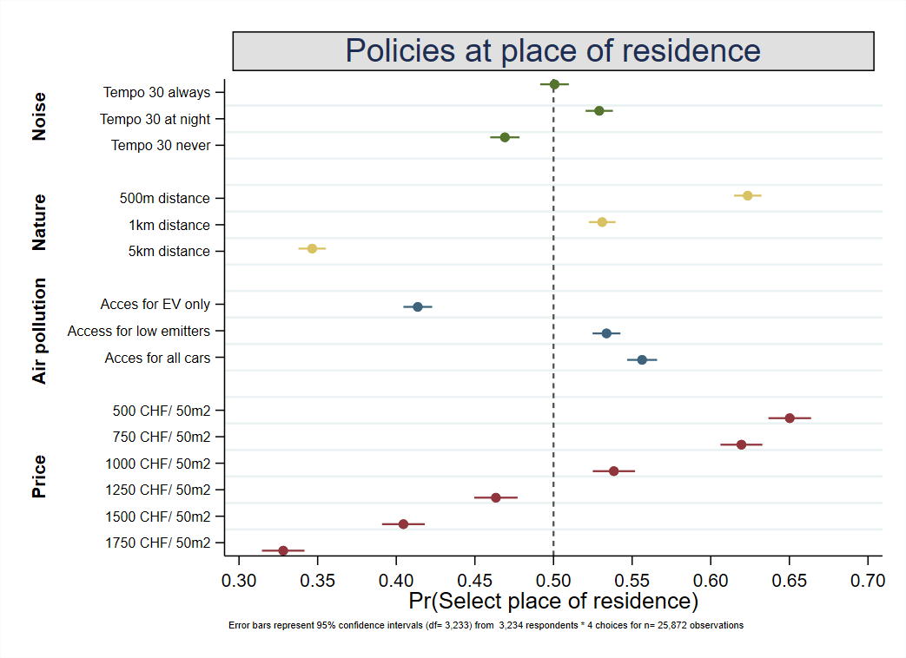
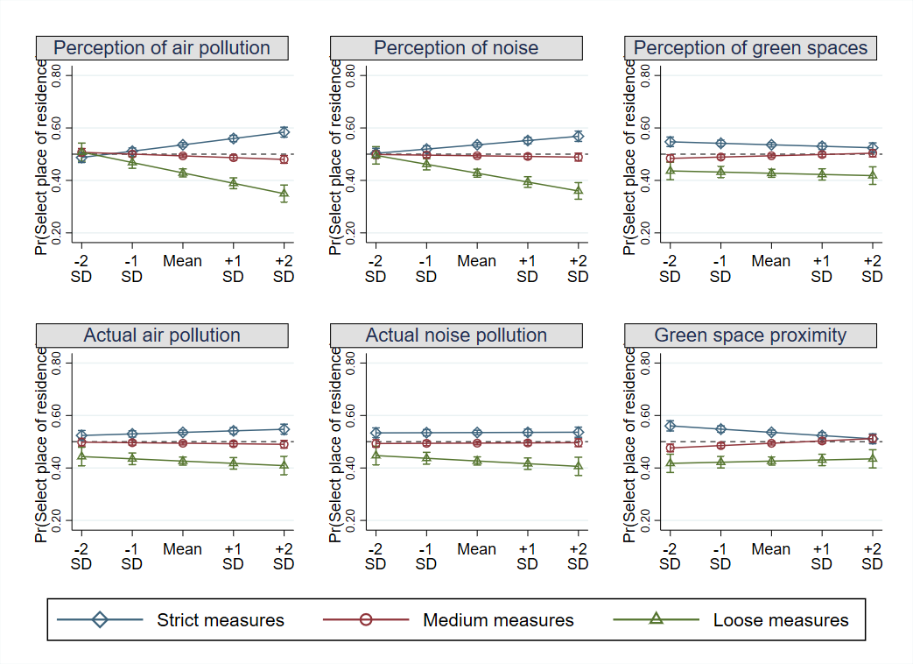
Results (H1 and H2): DV 2
Motivation
Hypotheses
Data
Results
Conclusion
Notes:
We test the same hypotheses with a different dependent variable: the conjoint experiment
It assessed which residential location respondents prefer, dependent on which policies are implemented at this location
We varied strict and loose measures for noise, green spaces, and air pollution, and also had a price attribute included
More consequential for our research question are the interaction effects, with perceived environmental conditions in the first row here: we see that for the first two columns, air pollution and noise levels, support for strict measures increases and for loose mesaures decreases with higher percieved burden. The pattern is less clear for green spaces
And also not very prononounced (not significant) for actual exposure levels, although the tendencies are still there, the interactions only hold for perceived burden levels.

Slide 10
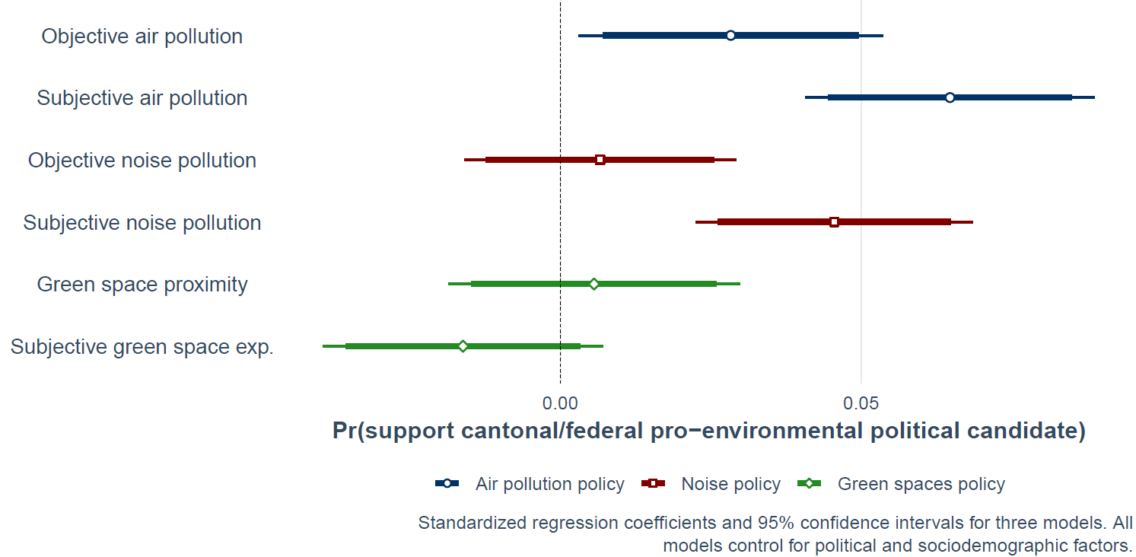
Results (H1 and H2): DV 3
Motivation
Hypotheses
Data
Results
Conclusion
Notes:
Our last DV expanded the scope to general support for pro-environmental candidates, where we again observe the strongest link, and importantly still a link, between perceived air and noise pollution.
All models control for relevant confounders such as environmental concern, education, or ideology

Slide 11
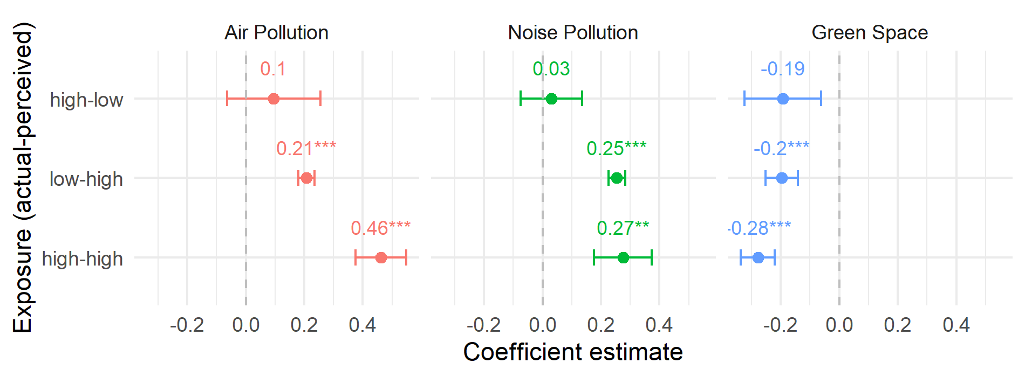
Results (H3)
Motivation
Hypotheses
Data
Results
Conclusion
Notes:
For our last hypothesis, we developed four types of exposure-perception profiles:
This analysis compares the link to policy support with the group actually being and perceiving low exposure
We see that the difference is strongest for those with high actual and perceived exposure, similarly strong for overestimators and absent for underestimators
Differences between actually exposed individuals and overestimators are only significant in the air pollution model.

Slide 12
Conclusion
Perception is paramout: perceived environmental conditions strong predictor for local policy support: Yes, in my backyard
Perceived conditions mediate the link between actual conditions and policy support
Beyond NIMBY: The impact of perceived exposure also influences support for pro-environmental candidates at both local and national levels.
Mind the Perception Gap: moderate correlation between actual and perceived environmental conditions.
No clear over/under-estimator profiles identified
Policymakers need to consider not only objective conditions but also how the public experiences their local environment.
Motivation
Hypotheses
Data
Results
Conclusion
Notes:
To conclude, our findings consistently show that perceived environmental conditions are linked to support for local environmental
We also find evidence for a mediation of actual exposure and policy support via perceived exposure
Interestingly, perceived environmental conditions are also linked to the support for pro-environmental candidates at both local and national levels. This highlights that subjective experience contributes to a wider spectrum of green political preferences.
Lastly, we see that actual and perceived exposure is only moderately correlated. We tried to identify clear profiles of WHO over- and WHO underestimates exposure but could not find clear patterns in our data
Nonetheless, this means that policymakers need to consider not only objective conditions but very much how the public experiences their local environment.

Slide 13
Implications of actual and perceived exposure to environmental conditions for local policy support
Sarah Gomm and Thomas Bernauer
sarah.gomm@ir.gess.ethz.ch
Sarah Gomm & Thomas Bernauer
Thank you!
Environmental Politics and International Political Economy Group, ETH Zurich

Slide 14
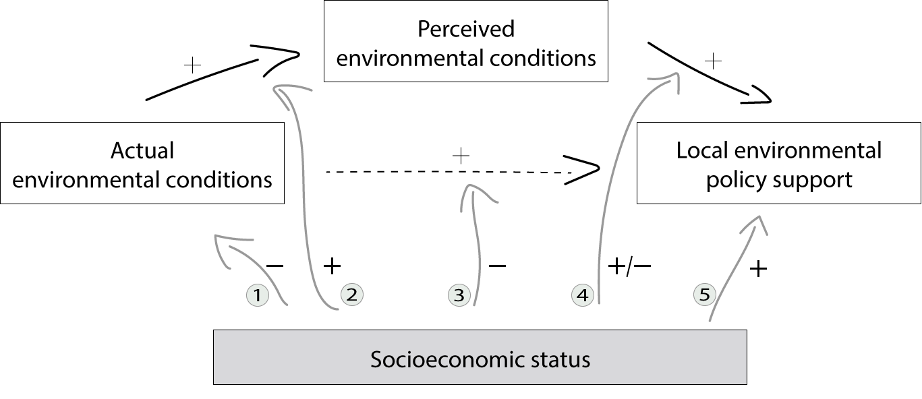
When do perceptions drive policy support?
✓
Environmental justice hypothesis
Knowledge / education
Environmental shielding hypothesis
Political efficacy
Willingness to pay (postmaterialism hypothesis)
✗
✗
✓
✗
Motivation
Hypotheses
Data
Results
Conclusion

Slide 15
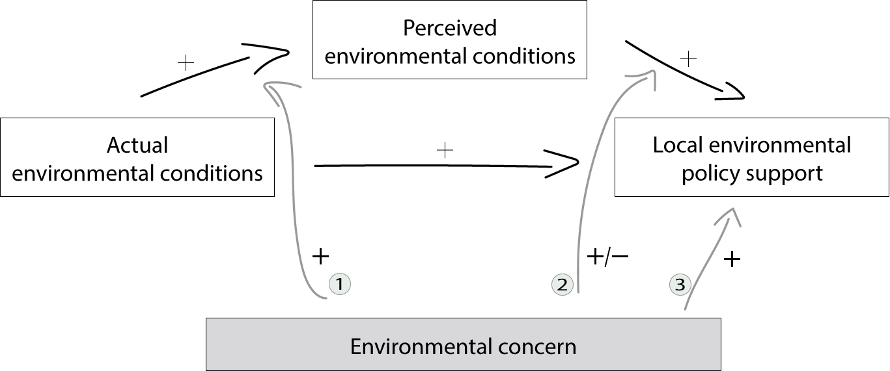
Environmental concern as a moderator
✗
Motivated reasoning / Awareness
Saliency (moderation or mediation)
Post-materialist values
✗
✓
Motivation
Hypotheses
Data
Results
Conclusion

