Slide 1
Where should the solar go?
Comparing E2 vs E3 for the solar-assisted heat pump dryer
Supervisor discussion, 20 April 2026
Agenda: base dryer → HRX → solar placement (E2 vs E3) → clipping → validation → scale-up ideas
Notes:
Opening, casual: this is a working session, not a presentation. The goal is
to walk you through how the E2 and E3 configs are set up, what the
simulations are actually doing, and why we think E2 is the better solar
placement. Then I want to open it up to discuss scaling this to 500-1000 kg
apples and whether a multi-zone chamber makes sense as the next step.
Feel free to interrupt at any slide.

Slide 2
Base dryer: Config A (HP only, closed loop)
This is the machine before we add anything
Heat pump
Ambient air
Mix
Evap (dehum.)
Cond (heat)
Chamber (10 trays)
Exhaust
recirculation r (closed loop)
• HP condenser always heats to T_set = 45 °C; chamber holds exactly that (validated, V1.1).
• Fresh apples: 22.5 kg wet ≈ 3 kg dry. Water to remove: 19.2 kg. Drying time 13.8 h.
• 10 trays in series, cross-flow, 1.1 m/s. Ambient air enters, humid exhaust leaves.
• Recirculation path shown dashed; in this discussion the r=0 (open-loop) SEC is our anchor.
Config A baseline
SEC = 0.717 kWh/kg
Kathmandu, annual, r = 0
Notes:
Talking points:
- Anchor this number in their head: 0.717 kWh of electricity per kg of water.
Every improvement from here on is referenced against this.
- Worth pointing out that the closed-loop version (r > 0) is more efficient
still (0.515 at r=0.9, from V2.1 table), but we use r=0 throughout the
solar/HRX configs because mixing is not needed once we have waste-heat
recovery from the HRX and a dedicated evap stream. Happy to discuss.
- Product spec is apple slices, 6 mm thick, 3 kg dry mass, 19.2 kg water
to remove. Current scale is small, which comes up again at the end.

Slide 3
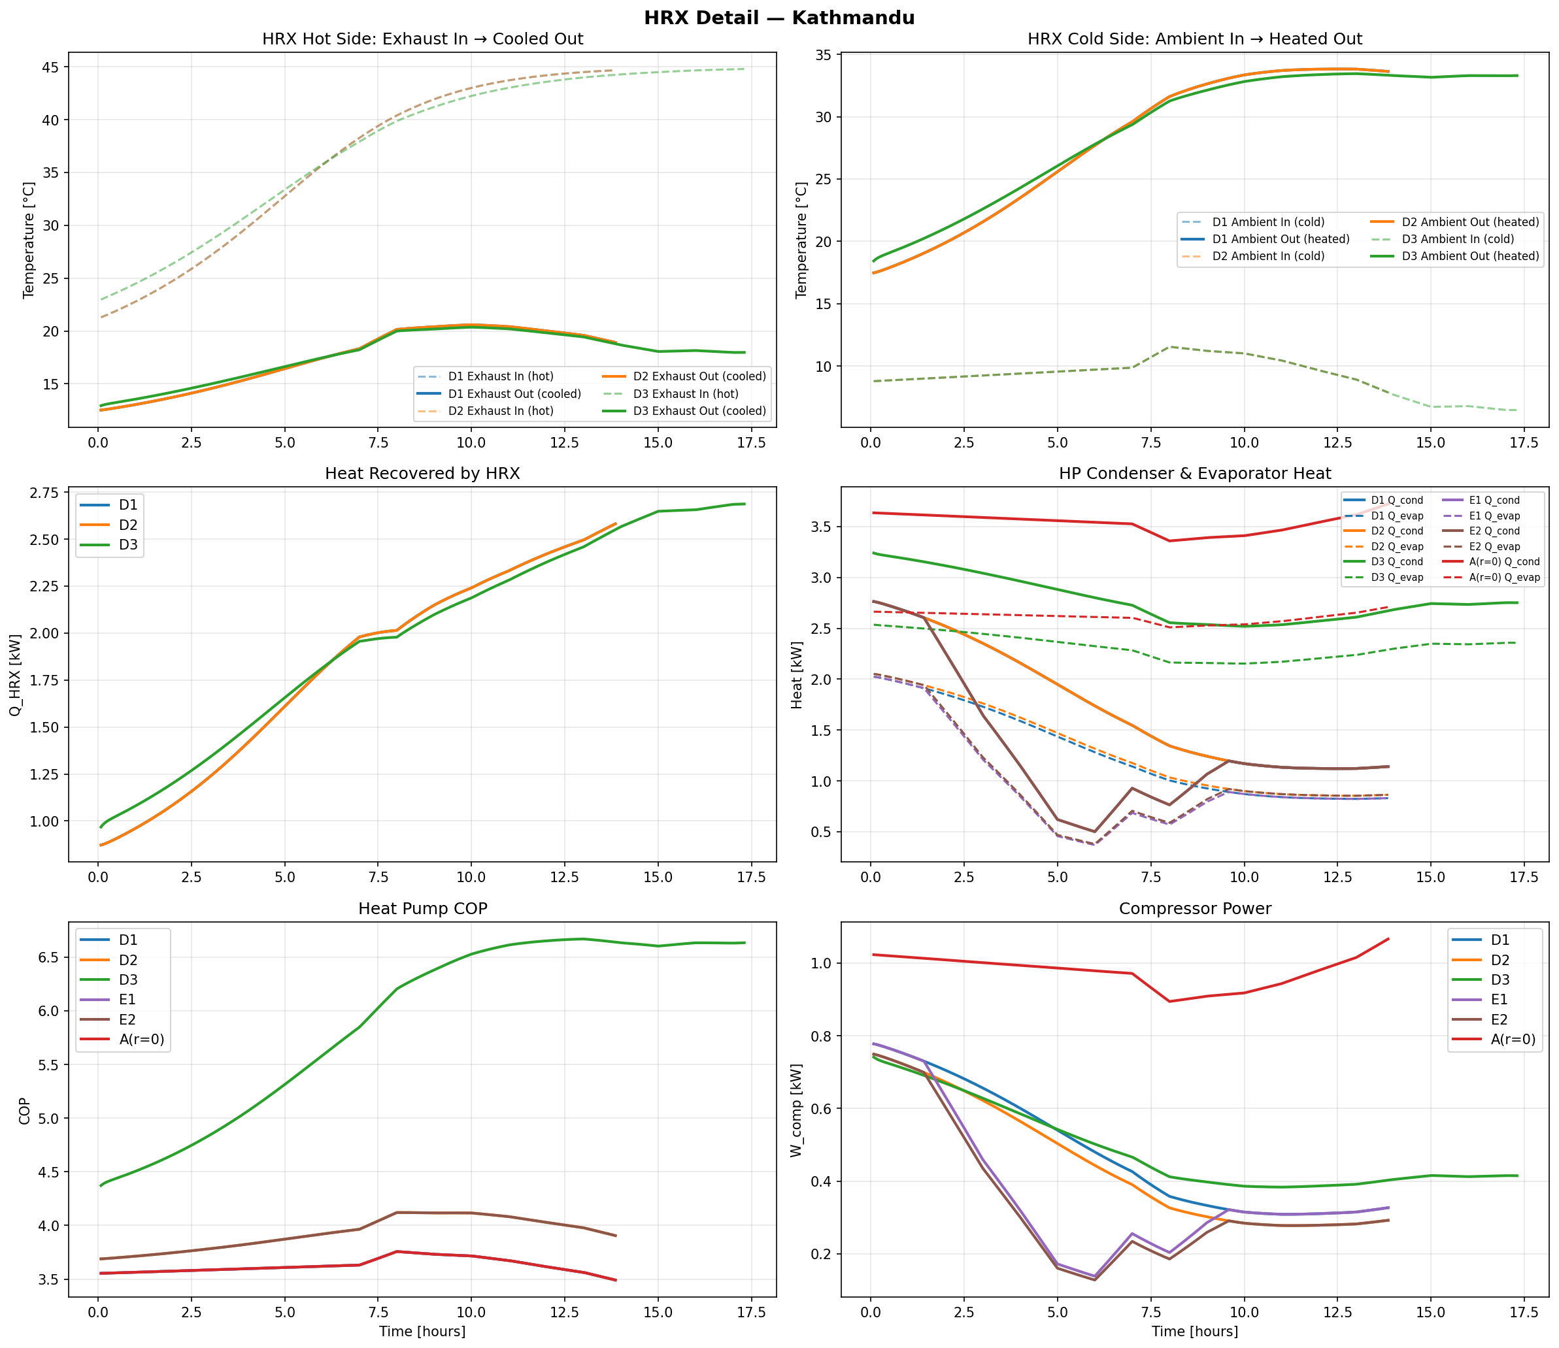
Step 1: add a heat-recovery exchanger (Config D1)
Exhaust pre-heats the condenser inlet through a 70 % effective HRX
Kathmandu annual, r = 0
Config A (HP only)
0.717
baseline
Config D1 (HP + HRX)
0.365
49 % lower than A
Config D2 (HRX + dyn evap)
0.354
3 % better than D1
HRX does the heavy lifting.
Dynamic evap (D2) only trims another
0.011 kWh/kg, a minor refinement.
Notes:
Talking points:
- The HRX is a simple air-to-air cross-flow exchanger. The warm, moist
exhaust gives up its sensible heat to the incoming cold ambient stream.
70 % effectiveness is a reasonable commercial value.
- The result is strong: 49 % SEC drop over A, from just one passive
component. No moving parts, no control logic, no electricity.
- D2 is D1 plus dynamic evaporator compensation (the evap sizes itself
based on instantaneous ambient, not a fixed approach). The incremental
benefit is tiny, about 1 percentage point. Worth flagging that we
tested it because we suspected it mattered, and the data says it does
not, which is itself a useful negative result.
- This sets up the natural next question: can we layer solar on top?

Slide 4
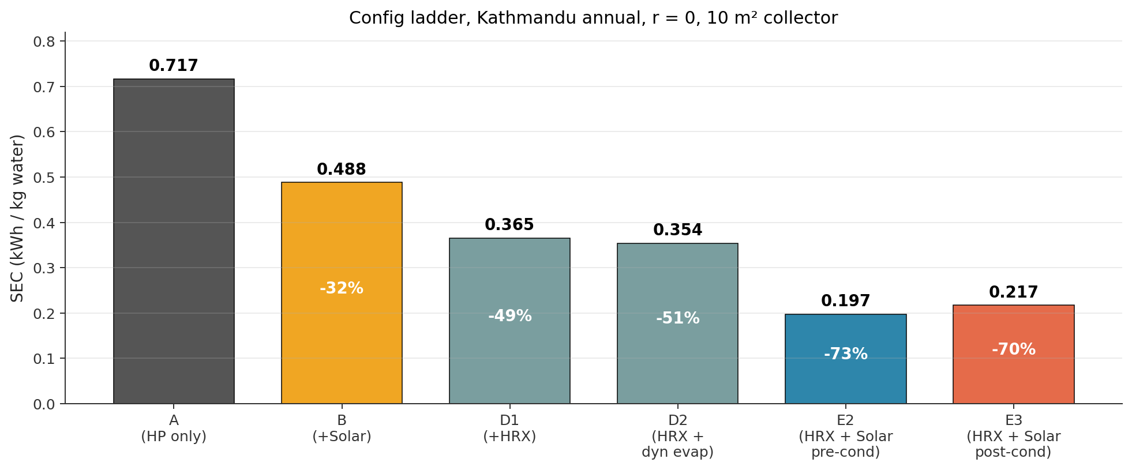
Step 2: add a solar collector (Config B)
Flat-plate collector in series before the condenser
Ambient
Solar collector
Cond
Chamber
Exhaust
• When the sun is out, solar does part of the heating. HP takes what is left to reach 45 °C.
• At night or under cloud cover, solar contributes zero and the HP runs full duty, so SEC can never be worse than Config A.
• With 10 m² collector: solar provides 32 % of total heating at Kathmandu, 46 % at Biratnagar.
• Observation: B alone beats A but does not beat D1 at Kathmandu. Solar alone < HRX alone at high altitude.
Notes:
Talking points:
- Solar is a preheat. It does not replace the HP. It just reduces the lift
the HP has to provide.
- Quick numbers: B alone gets us to 0.488 at Kathmandu. D1 alone gets us to
0.365. So at 1350 m altitude, HRX is more valuable than 10 m² of solar
by itself. That was a bit surprising when we first saw it, and it
motivated combining them (E series).
- The ladder chart tells the whole story: each component buys us something.
The open question: when we combine HRX + solar (E series), where exactly
should the solar sit in the stream?

Slide 5
The question: where does the solar go in E configs?
Both have an HRX and a solar collector, only the ordering differs
E2: Amb → HRX → Solar → Cond → Chamber
Control logic differs
Amb
HRX
Solar
Cond
Chamber
Exh
E2: Cond targets T_set
If solar delivers the air already above 45 °C, the simulator clips to T_set and HP idles (Q_cond = 0). Any extra solar heat above 45 °C is discarded (no storage).
exhaust pre-heats HRX (70 % effective)
E3: Amb → HRX → Cond → Solar → Chamber
E3: Solar-priority
HP modulates T_cond so that T_after_solar exactly equals T_set. If solar alone from the HRX output reaches T_set, HP goes OFF entirely. No clipping by design.
Amb
HRX
Cond
Solar
Chamber
Exh
exhaust pre-heats HRX (70 % effective)
Notes:
Talking points:
- This is the crux slide. Two seemingly-equivalent layouts, both deliver
45 degree air to the chamber. Naively one might guess E3 is better
because its HP can idle completely in strong sun.
- The control logic is important. In E2 the condenser is the final gate
and always targets 45. In E3 the collector is the final gate, so the
HP has to modulate its discharge pressure to leave the solar "just
enough room" to land exactly at 45.
- Both are physically defensible topologies. Nobody has published a
head-to-head comparison with a validated thermodynamic model, which is
why we spent time on it.

Slide 6
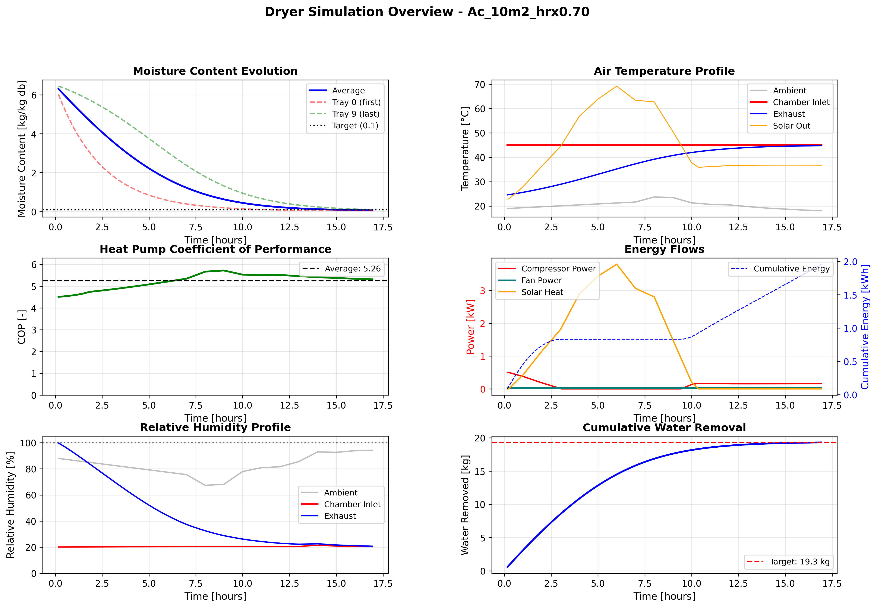
E2 in action (Kathmandu autumn, 10 m²)
Solar lifts before the condenser; condenser fills the gap to 45 °C
E2 behaviour
• T_chamber holds 45 °C the entire run
• HP runs throughout the day, solar reduces its load but rarely shuts it off
• SEC = 0.123 kWh/kg
• Mean COP over run = 5.25
• Total drying time 16.9 h
Notes:
Talking points:
- Point to T_chamber at 45 flat. That is the control law working.
- Point to W_comp: the compressor never goes to zero during daylight. It
dips when solar is strong but always keeps some load because the
condenser is the final heater.
- SEC 0.123 at 10 m2 is a very good number for this climate. The
reference Config A is 0.500 for autumn KTM at r=0. So E2 is a
75 percent reduction from the bare HP baseline in autumn alone.

Slide 7
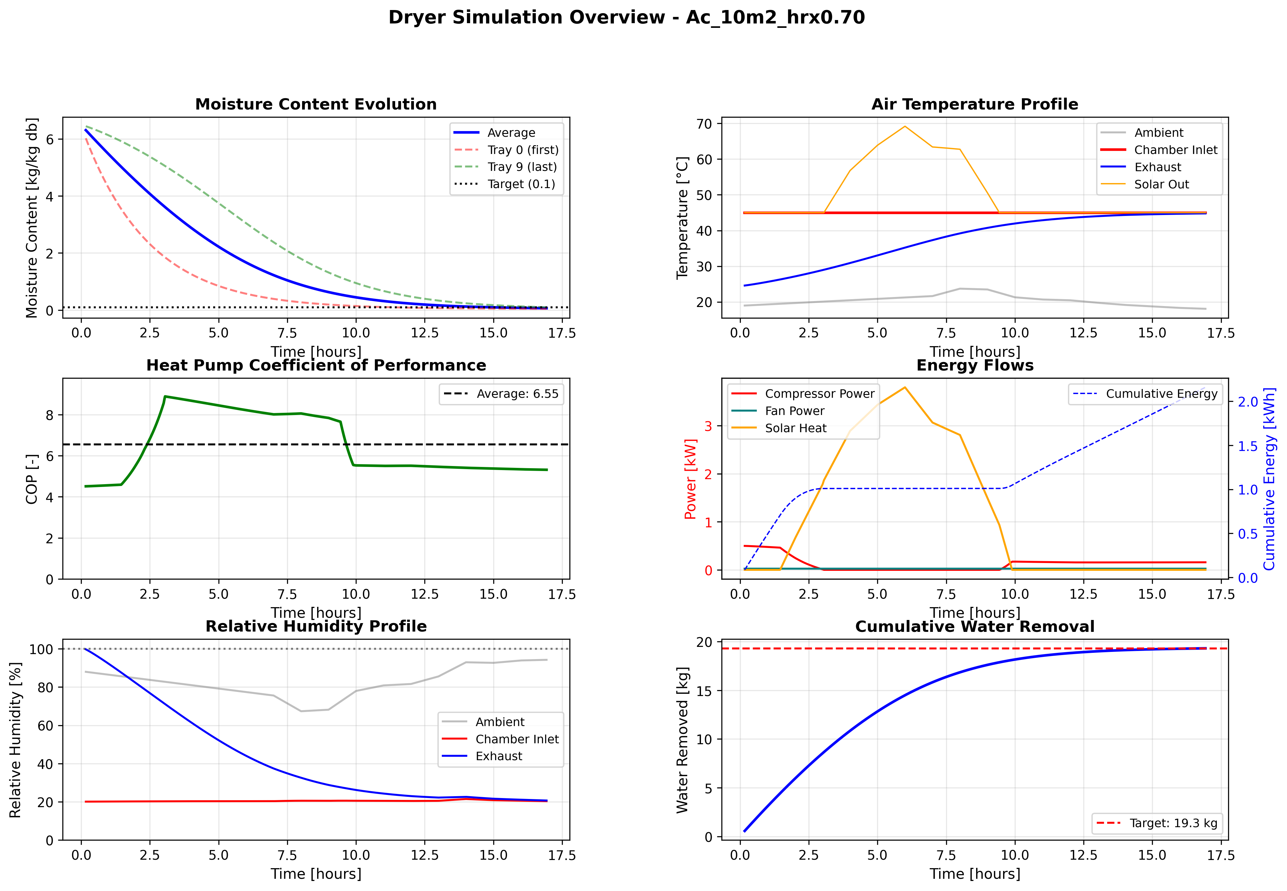
E3 in action (Kathmandu autumn, 10 m²)
HP modulates T_cond to leave solar just enough room to reach 45 °C
E3 behaviour
• T_chamber holds 45 °C (different path, same outcome)
• HP turns OFF entirely for ~1-2 h around solar noon
• SEC = 0.133 kWh/kg
• Mean COP = 6.53 (higher than E2)
• No clipping: 100 % of collected solar reaches the chamber
Notes:
Talking points:
- Look at the W_comp trace: it goes flat at zero during peak sun. That is
the HP stepping out of the way and letting solar do everything.
- Higher COP is real: when the HP does run, it runs at a much lower
pressure ratio because T_cond is modulated down. So every kWh of
compressor work delivers more Q_cond.
- Here's the puzzle: E3 has the higher mean COP AND the higher peak COP
AND no clipping. So why doesn't it win? Transition to the next slide.

Slide 8
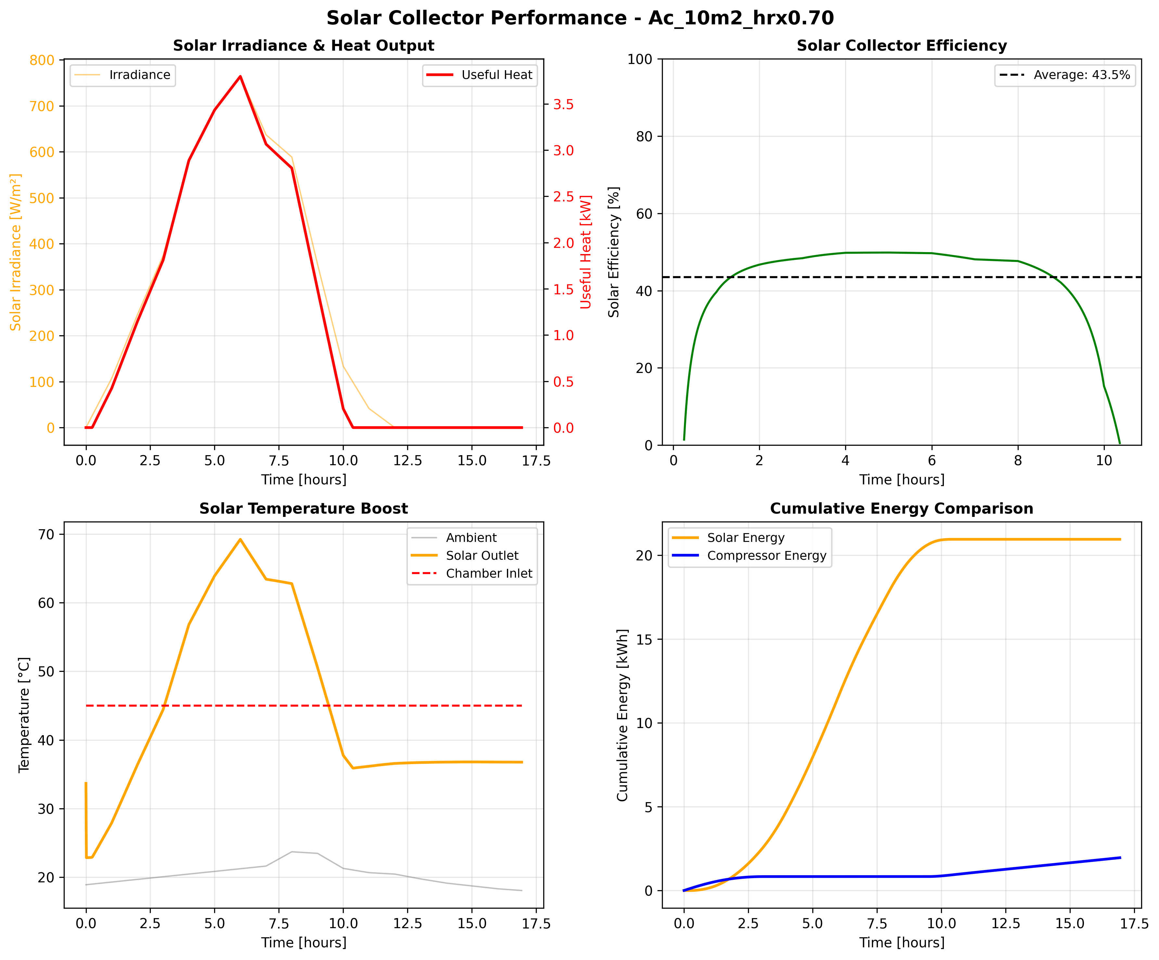

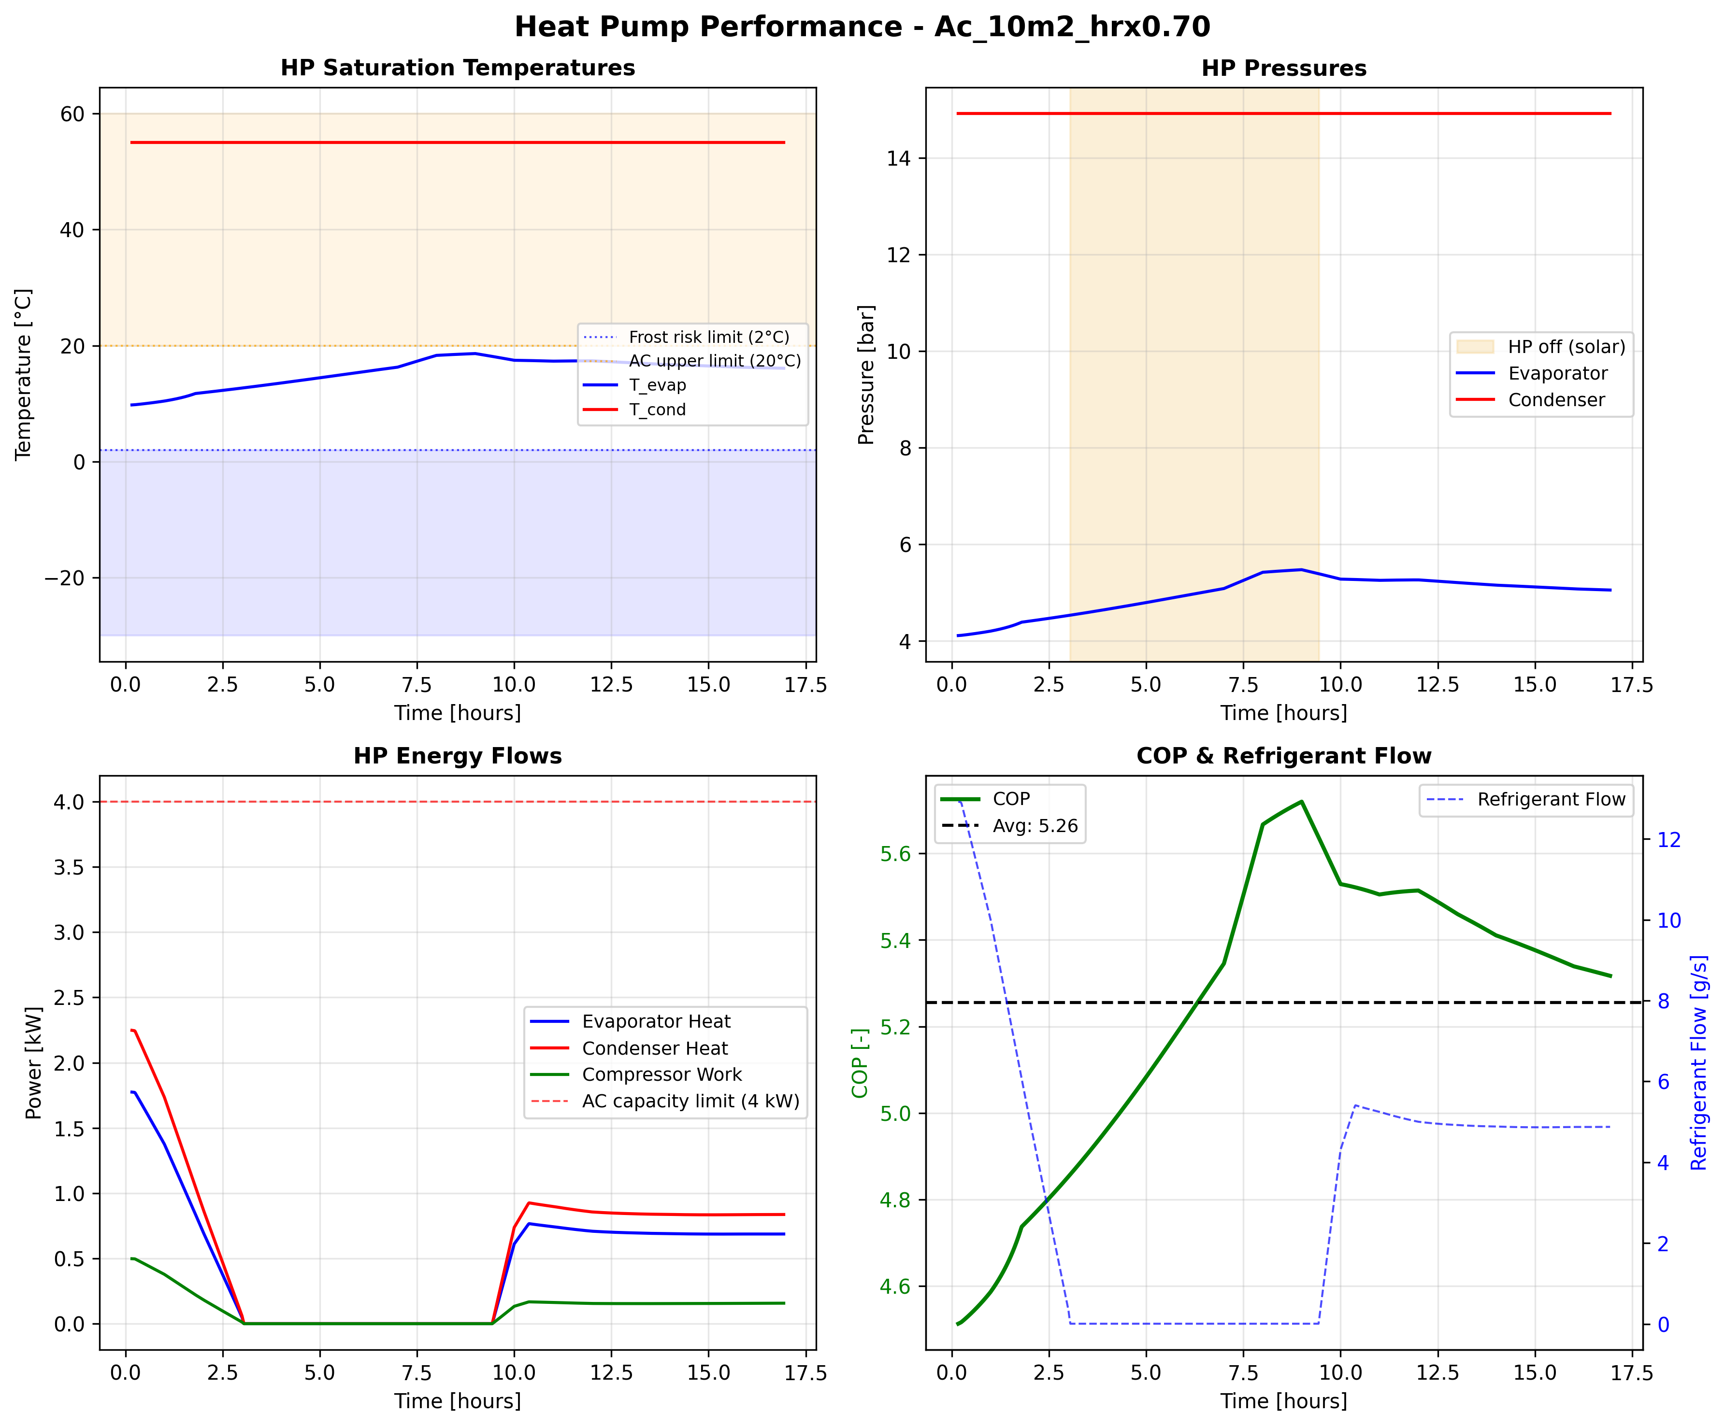
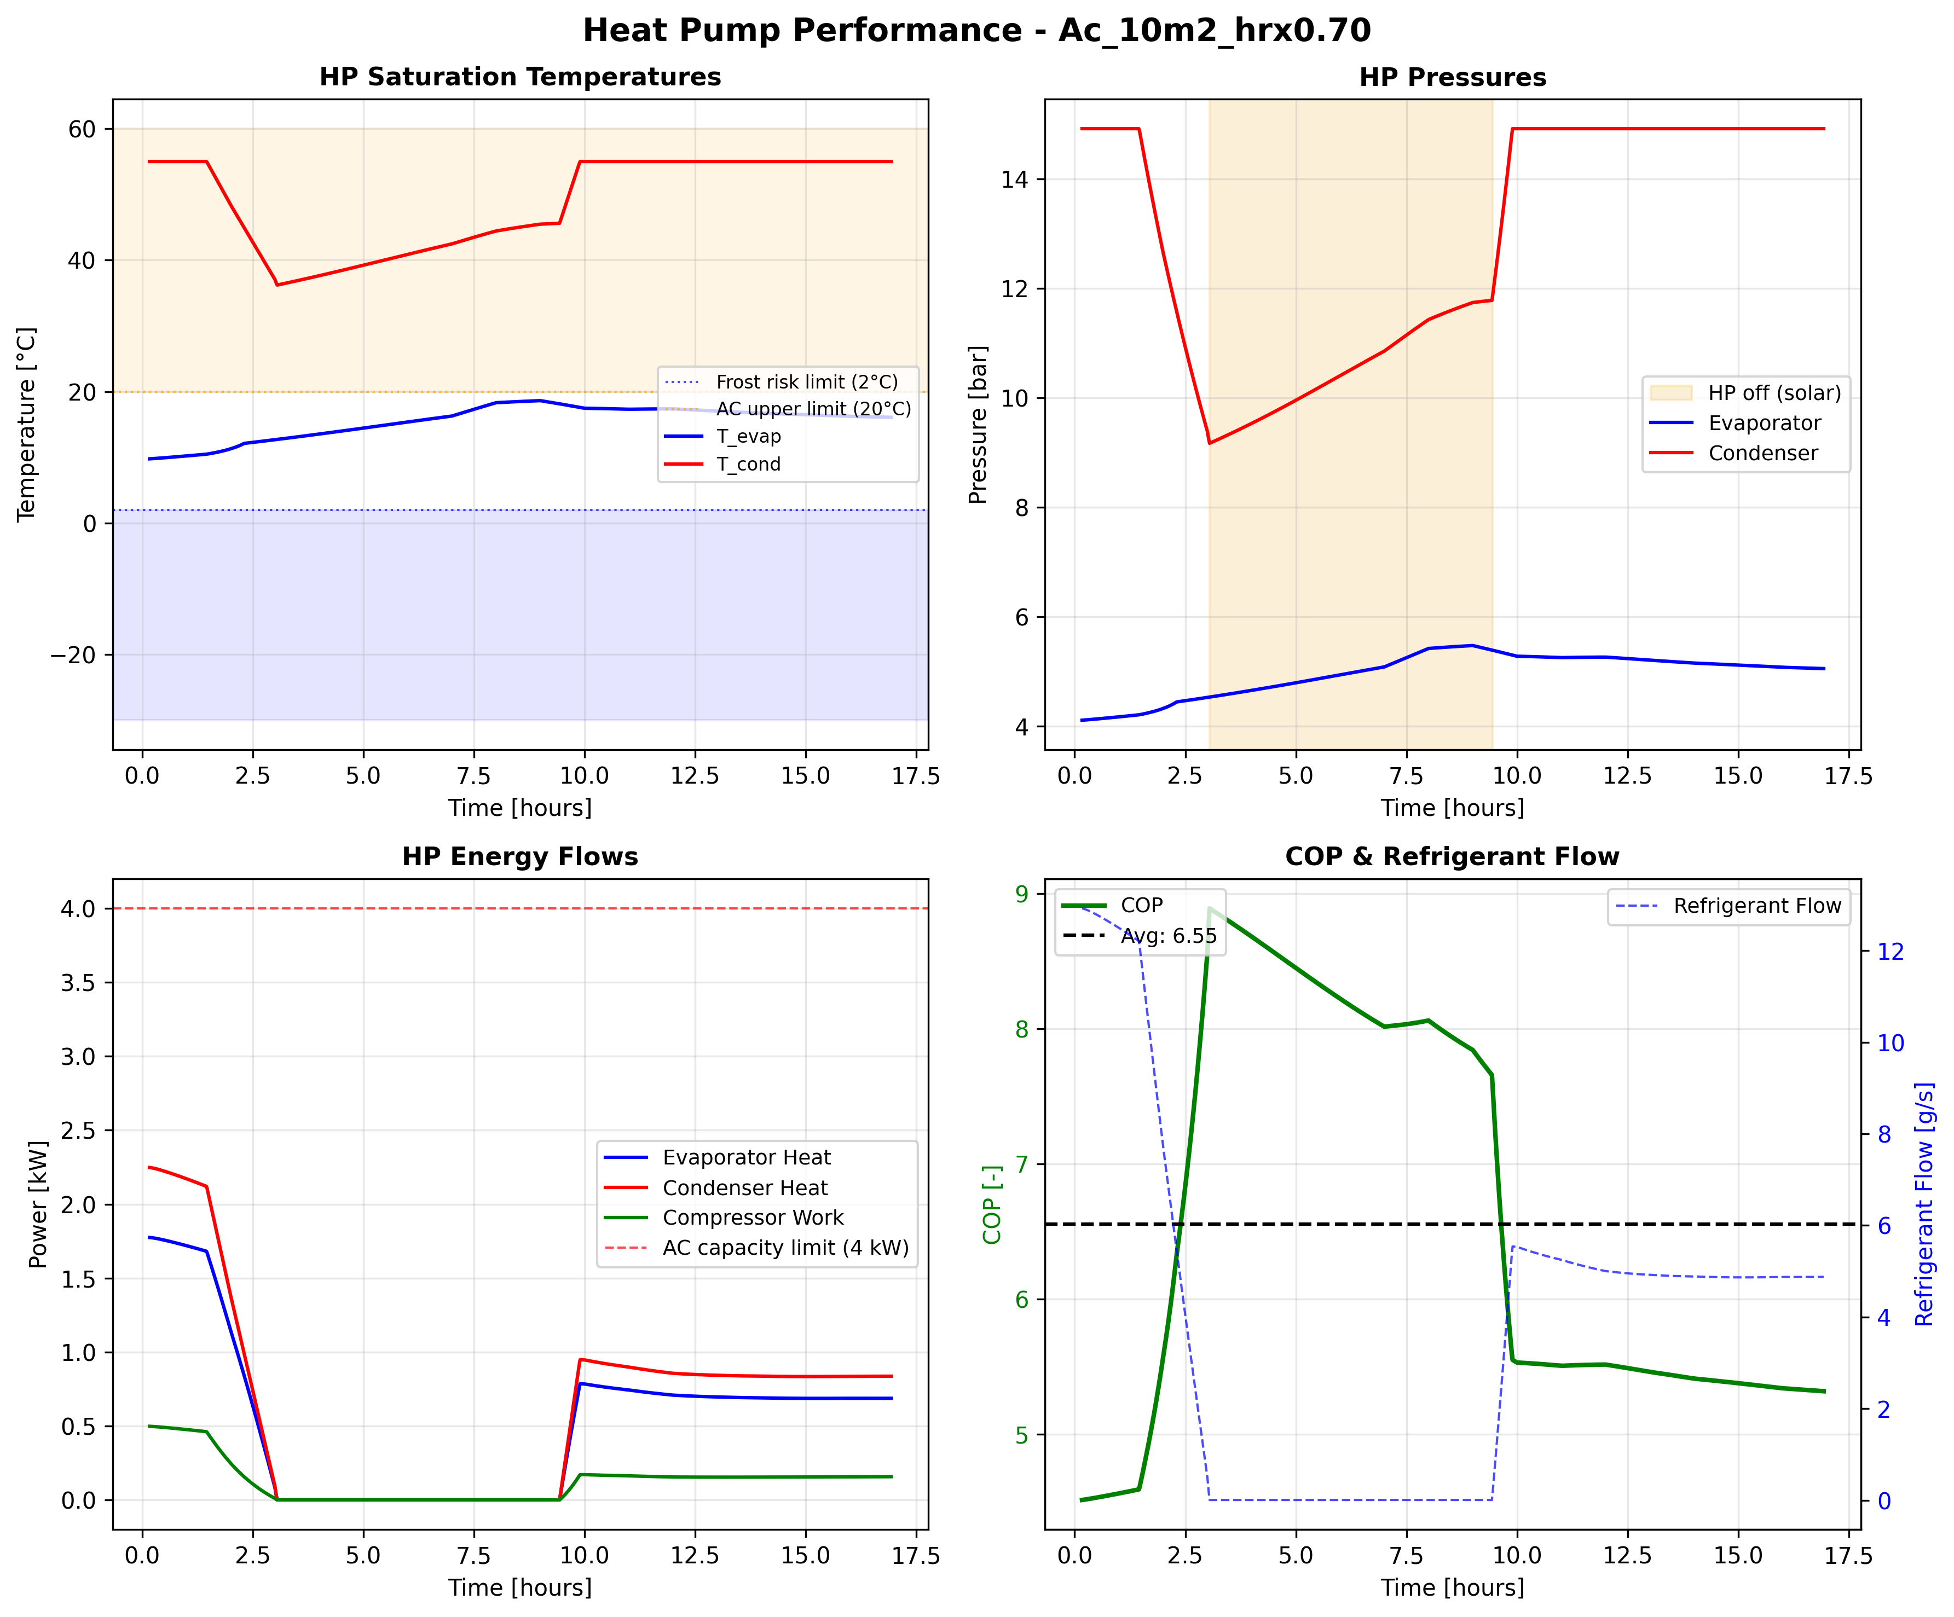
Side-by-side: what each config actually does
Autumn KTM, 10 m², r = 0, identical weather, identical drying time (16.9 h)
E2 solar
E3 solar
Cooler inlet
Hotter inlet
~32 °C (HRX only)
~37 °C (HRX + Cond)
Collected 20.95 kWh
Collected 19.77 kWh
Clipped 9.38 kWh
No clipping (design)
Usable 11.57 kWh
Usable 19.77 kWh
E2 heat pump
E3 heat pump
Runs most of day
OFF at solar noon
at moderate load
(clean zero band)
W_comp 1.96 kWh
W_comp 2.16 kWh
Mean COP 5.25
Mean COP 6.53
T_cond = 45 °C
T_cond modulated
The paradox: E3 has higher COP + no clipping + more usable solar, yet E2 uses less total W_comp (1.96 < 2.16 kWh). E2's cooler collector wins across every HP-ON hour, not just midday.
Notes:
Walk through the four plots one panel at a time. All numbers are from
master_summary.csv for autumn KTM, 10 m2, r=0.
TOP ROW (solar collector output):
- E2 collects 20.95 kWh total; E3 collects 19.77 kWh. Difference is about
6 percent. Driver: Hottel-Whillier-Bliss says collector efficiency drops
linearly with (T_inlet - T_amb). In E2 the collector sees HRX output
directly (~32 C). In E3 the collector sees HRX output plus whatever
partial lift the condenser has added (~37 C). Cooler inlet = higher
efficiency = more kWh collected.
- E2 wastes 9.38 kWh (44.8 percent of its haul) because during midday the
solar alone already pushes the stream above 45 C. Simulator clips to
T_set; excess is discarded (no storage).
- E3 has zero clipping by design: the condenser modulates T_cond so the
solar lift lands exactly at 45 C. All 19.77 kWh reaches the chamber.
- Net usable solar: E3 (19.77) beats E2 (11.57).
BOTTOM ROW (heat pump):
- E2 HP runs almost continuously at moderate power. No clean OFF zone.
T_cond pegged at 45 C, so lift is full; mean COP = 5.25.
- E3 HP has a clean OFF window around solar noon (visible as flat zero in
W_comp trace). When it runs, T_cond is modulated down so the lift is
smaller; mean COP = 6.53 (25 percent higher than E2).
THE PARADOX (bottom band):
- E3 looks better on every individual lever: higher COP, no waste, more
usable solar delivered.
- Yet simulator says W_comp_E2 (1.96 kWh) < W_comp_E3 (2.16 kWh),
and SEC follows: E2 at 0.123 vs E3 at 0.133.
- Mechanism from the memory note: E2's collector runs cooler DURING EVERY
HP-ON HOUR (not just at noon). The accumulated extra solar capture
across the run (~1.2 kWh autumn) outweighs the COP bonus E3 gets when
its HP is running.
- This is the piece I want to sanity check with you. Does the physical
story track, or should we dig into the energy decomposition by hour
before locking the headline?

Slide 9
The punchline: why E2 beats E3
Collector inlet temperature is everything (Hottel-Whillier-Bliss)
E2
E3
The physics
SEC (kWh/kg)
0.123
0.133
Hottel-Whillier-Bliss:
Mean COP
5.25
6.53
η_c = F_R(τα) − F_R U_L (T_in − T_amb) / G
Solar collected (kWh)
20.95
19.77
In E2 the collector sees air at ~32 °C (HRX output, mid-drying).
In E3 the collector sees air at ~37 °C (HRX + condenser output).
That 5 °C hotter inlet costs roughly 2.5 percentage points of energy-weighted efficiency.
E2 captures +1.2 kWh extra solar per day; E3's lower compressor work saves only ~1.0 kWh thermal. E2 nets +0.2 kWh/day.
Keep the solar upstream of the condenser.
Solar usable (kWh)
11.57
19.77
Clipping waste
44.8 %
0 %
Autumn Kathmandu, 10 m² collector
Notes:
Talking points:
- Hottel-Whillier-Bliss is the standard flat-plate collector equation.
The second term is the thermal loss: hotter collector inlet means more
heat leaks to ambient, lower efficiency.
- In E3, the stream going into the collector has already been lifted by
the condenser, so it arrives hotter. The collector runs less
efficiently because it is trying to heat an already-warm stream.
- In E2, the collector inlet is cooler (just ambient + HRX), so it runs
more efficiently. The HP then "tops off" any remaining lift.
- The COP story is a distraction. Yes E3 has higher COP. But the
collector inefficiency costs more than the COP gain buys us.
- Practical takeaway: always put the solar upstream of the condenser in
a series topology. This is the answer to "where should the solar go".

Slide 10
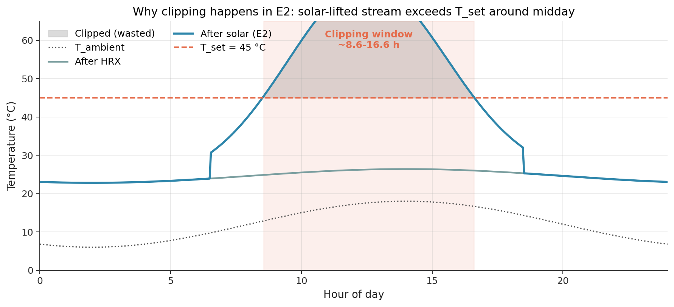
The clipping problem in E2
Solar heat above T_set has nowhere to go (no storage)
When does clipping happen?
• WHEN: peak-sun hours, roughly 10:00-15:00 (6.3 h/day at 10 m² autumn).
• WHY: stream already at 45 °C when it reaches the condenser; HP idles; excess heat is discarded.
• GETS WORSE as drying progresses: exhaust warms, HRX lifts inlet closer to T_set, even weak solar clips.
• Threshold heat: Q_solar > ~1.3 kW (stream can't accept more than ~13 K lift mid-drying).
• In irradiance: 10 m² clips above ~240 W/m²; 4 m² clips above ~600 W/m²; 2 m² never clips.
• Identity holds: Q_reported = Q_usable + Q_clipped exactly.
Notes:
Talking points:
- The shaded region on the plot is the waste. It is the slice of the
solar-lifted stream that is above the 45 set point. The simulator
reports the full Q_solar from Hottel, but physically that top slice
never makes it to the chamber.
- Clipping is bounded by the sun, but it is also bounded by the
thermodynamic state: once the stream approaches T_set from any source,
even a small solar contribution pushes it over.
- The back-of-envelope threshold: m_da * cp * (T_set - T_hrx_out). With
m_da around 0.10 kg/s and T_hrx_out around 32 at mid-drying, the
allowable solar input is about 1.3 kW. At 10 m2 that corresponds to
roughly 240 W/m2 of irradiance, which is essentially any clear-sky
daytime hour.
- Key point: this is a thermodynamic limit, not a weather problem. A
better weather forecast does not help. The fix is storage, which we
come back to on the last slide.

Slide 11
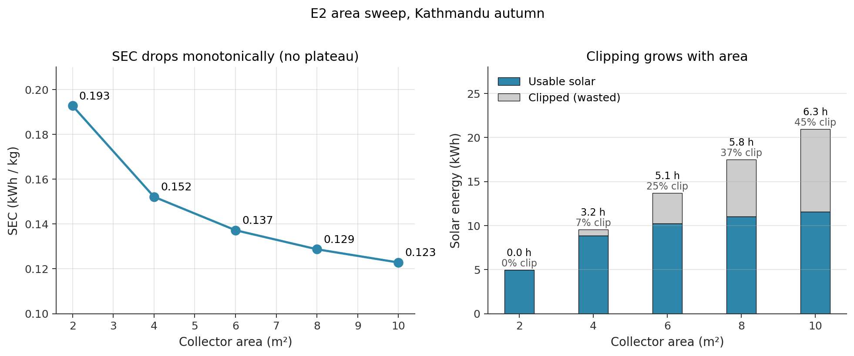
Area sweep: SEC keeps dropping even as clipping rises
Shrinking the collector to avoid clipping makes things worse
Extra area always buys extra useful solar. The HP duty cycle drops faster than clipping waste grows. Right fix: keep area, add storage, not shrink area.
Notes:
Talking points:
- One might intuitively say: clipping is waste, let's downsize the
collector. The data says the opposite. Even at 44 percent clipping,
the remaining usable fraction still does more useful work than a
smaller collector would.
- Monotonic SEC drop from 0.193 at 2 m2 to 0.123 at 10 m2. No plateau
in the 2-10 m2 range. We tried 15 and 20 m2 too and still saw small
improvements.
- Insight: the HP duty cycle drops faster than the collector efficiency
does. Every kWh of usable solar displaces HP electricity that would
otherwise have been spent, and the HP duty cycle is the dominant cost.
- The correct engineering response to clipping is thermal storage:
capture the midday surplus, release it in the evening.

Slide 12
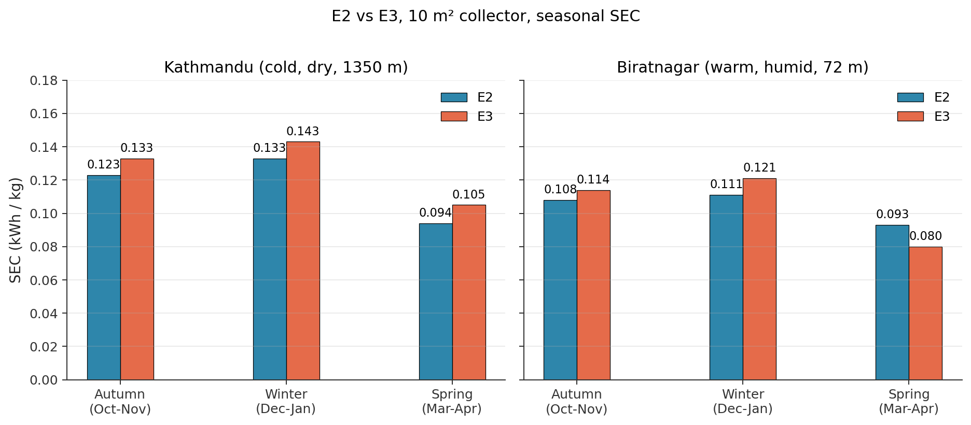
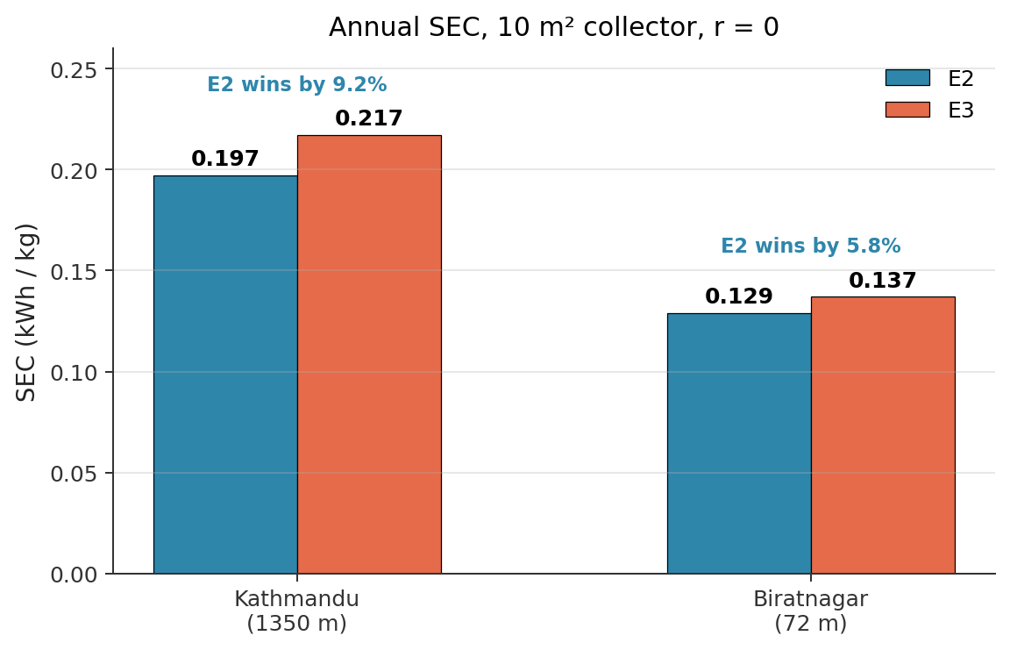
Seasonal performance across two climates
E2 beats E3 in every season, at both locations
E2 advantage is consistent: 7-9 % at Kathmandu, 6-7 % at Biratnagar. Spring is best at both (strongest irradiance, moderate ambient, best collector efficiency).
Notes:
Talking points:
- Four seasons, two climates, eight data points. E2 beats E3 on all
eight. The mechanism is universal, not a fluke of one dataset.
- Spring is the best season at both locations because the sun angle is
good and the ambient is not yet too hot (low U_L*(T_in - T_amb) loss).
- Biratnagar is always absolute-lower SEC because warmer ambient means
smaller HP lift and better collector efficiency. But the E2 vs E3
advantage is almost the same percent.
- If we had time we could run Taplejung (1820 m, even colder) but the
mechanism would play out the same way.

Slide 13
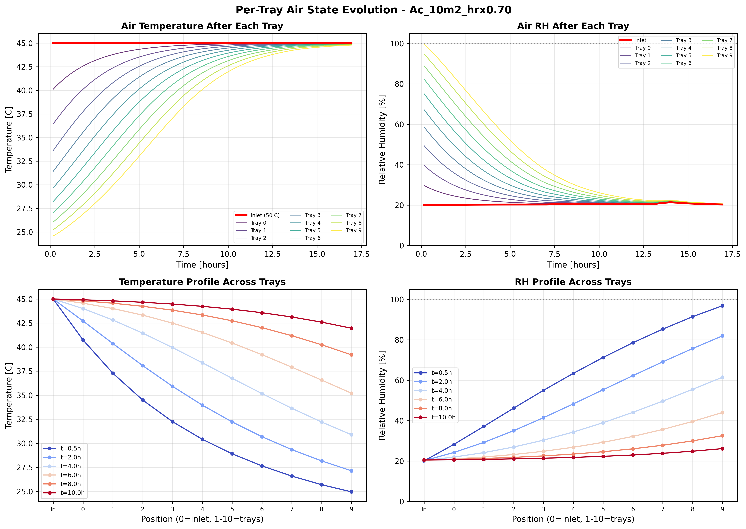
How do we trust these numbers?
Model passes all first-law and mass-balance checks
• 1st law on HP cycle: Q_cond = Q_evap + W_comp. Residual < 1.5 % (enthalpy decomposition artefact, CoolProp states are exact).
• Water mass balance: cumulative dm_w matches 19.35 kg; target was 19.2 kg. Error ~0.8 %.
• T_to_chamber holds 45.00 °C exactly across all 6 configs (condenser control validated).
• COP in physical range: 3.2 to 6.5 across configs; Carnot efficiency 0.61-0.62 (consistent with η_is = 0.75).
• Pressure ratio 4-5 for R410A (matches textbook values).
• Tray humidity gradient monotonic early to late (see plot, right).
• Psychrometric consistency: ω, RH, T_dp all close within 4 × 10⁻⁶.
• Solar energy identity: Q_reported = Q_usable + Q_clipped, exact by construction.
• Phase 3.5 validation report (Apr 2026): all 6 configs PASS.
Tray-by-tray T and RH, E2 autumn 10 m² (validation visual)
Notes:
Talking points:
- This is the slide to anchor credibility. Every config has been
instrumented with conservation checks that run every timestep.
- The 1.5 percent residual on the first law is worth explaining: it is
an accounting artifact of decomposing refrigerant enthalpy into
Q_evap + W_comp. The CoolProp state-point values themselves are
exact. If we were to use raw enthalpy differences at each state
point, it would close to zero.
- Water mass balance closes to 0.000 at the per-timestep level. The
0.8 percent discrepancy versus 19.2 kg target is because the
simulation stops slightly below X_final = 0.10 (overshoots by a small
amount).
- The tray plot on the right is a visual sanity check: air enters tray
1 hot and dry, exits tray 10 cooler and humid. The gradient is
smooth and monotonic, no numerical artifacts.

Slide 14
Key takeaways
Three things I want to leave you with
1. Put the solar upstream of the condenser.
E2 beats E3 by 7-9 % SEC in every season at both climates. Collector inlet temperature dominates the combined efficiency of a series HP+solar topology.
2. Peak COP is a distraction. SEC is what matters.
E3 has higher COP and zero clipping, yet loses on SEC. High COP on a smaller duty cycle can still cost more than low COP on a bigger one.
3. Clipping is a thermodynamic limit, not a weather problem.
Clipping happens every clear day, 6+ hours a day, because the stream state forces the HP to idle when solar alone reaches T_set. The fix is storage.
Notes:
Talking points:
- Each of the three gets about 30 seconds of discussion. The first is the
engineering answer to the research question. The second is a mental
model correction: COP has been overweighted in the SAHPD literature.
The third sets up the scale-up slide by pointing at storage as the
missing piece.
- Offer to open up: does the professor want to discuss any of these?

Slide 15
What's next: scale-up and thermal zones
Going from 3 kg dry (lab) to 500-1000 kg fresh (small commercial)
Multi-zone chamber concept (4 zones shown)
Hot-air distribution manifold (from Cond + Solar)
Capacity scaling (rough)
Dry mass
3 kg
70 kg
140 kg
Fresh mass
22.5 kg
500 kg
1000 kg
Water removed
19.2 kg
427 kg
854 kg
Scale factor
1×
22×
44×
Zone 1
Zone 2
Zone 3
Zone 4
Trays (current geometry)
10
~220
~440
trays
trays
trays
trays
Collector area (same SEC)
10 m²
220 m²
440 m²
Why thermal zones (not longer single chamber)
• Current chamber: RH rises 29 → 84 % across 10 trays in wet phase. Tray 9 barely dries.
• Doubling trays in series wastes floor space; tail trays see near-saturated air.
• Multi-inlet per zone → every zone operates in high-VPD region → shorter, more uniform drying.
• Per-zone VPD bypass control becomes natural: dry zones can go cond-direct early.
• Caveat: needs distribution manifold + multi-fan + control logic.
Exhaust plenum → back to HRX
Each zone gets fresh 45 °C air via the manifold; each zone's exhaust routes back through its own HRX branch.
Notes:
Talking points:
- Current lab scale is 3 kg dry mass. That gets us to interesting physics
but nowhere near a useful throughput. To dry even one small orchard's
apple crop in a season we need 500-1000 kg fresh per batch.
- Linear scaling (just make the chamber bigger) does not work. Our
validation data (V2.3) shows RH climbing from 29 to 84 percent across
10 trays in wet phase. Add more trays and the tail of the chamber is
just a hot humid pipe doing no useful work.
- Thermal-zone architecture: split the chamber into N zones, each with
its own hot-air inlet from a distribution manifold. Each zone sees
fresh 45 degree air instead of air that already passed through 5 wet
trays. Every zone operates in a high-VPD regime.
- This also enables per-zone control: a nearly-dry zone can switch to
condenser-direct bypass early while wet zones still dehumidify. VPD
bypass logic is already validated in Config A (V3 in the report).
- Open question for discussion: how many zones is optimal? Is there a
diminishing return? And what is the CAPEX penalty of the manifold
and multi-fan setup?
- Collector area scales roughly linearly with water mass if we want
the same SEC. 220 m2 for 500 kg fresh is a realistic rooftop number
for a small orchard processing building.
- The thermal storage retrofit from the clipping discussion fits in
here: at 220 m2 the absolute clipped energy is huge, so the case for
storage gets stronger as we scale up.

Slide 16
Discussion and next steps
Immediate
Medium term
Longer term
• Thermal storage retrofit for E2 (capture clipped midday heat).
• Quantify storage size vs SEC benefit at 10 m² and larger.
• Re-run E2 with 15, 20, 30 m² + storage to find the new knee.
• Multi-zone chamber model: 2-zone first, validate, then 4-zone.
• Per-zone control: coupled VPD bypass + solar-priority scheduling.
• Scale-up validation at 50 kg dry (pilot) before committing to 500 kg.
• Pilot at 500 kg fresh with local producer.
• Economic model: CAPEX vs annualised electricity savings in Nepal context.
Questions I'd like your input on: (1) is multi-zone worth modelling now or after thesis? (2) thermal storage tank vs PCM? (3) should we bring in Taplejung for a third climate point before freezing RQ1?
Notes:
Talking points:
- Immediate: the clipping result tells us storage is the lever. Before
building hardware, run the sim with a simple tank model to see what
storage fraction recovers the 45 percent waste.
- Medium term: multi-zone model is a bigger undertaking. Need a fresh
chamber energy/mass balance with N inlets and outlets, and a manifold
pressure-drop model. Two zone version first, validate against a
collapse-to-one-zone limit, then go to four.
- Longer term: pilot at a fraction of target capacity before going to
500 kg. Economic model is critical because Nepal electricity cost
is low, so SEC wins translate to smaller dollar savings per batch.
- Open questions to the professor at the bottom of the slide are
intentional prompts. Let him pick which direction to push.

