Slide 1
What Can We Say About The Person From 1 Minute Application Usage?
1: Sarwan Ali (Ph.D.)
2: Avais Jan (Ph.D.)
3: Shatha Alharthy (Ph.D.)

Slide 2
Table of Content
Motivation
Steps of the experiment
Challenges
Dataset Statistics
Android Application Demo
Experimental Setting
Results

Slide 3
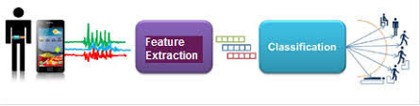
Motivation
https://cyberleninka.org/article/n/1215009.pdf
Predict what type of application the user is currently using (Facebook, Instagram, Whatsapp, Twitter)
Observe whether the user’s clicking patterns can be analyzed to extract additional information like :
What age group does this person belongs to?
Do younger people click faster?
What is the gender of the user ?
Do females have different clicking patterns than males?
Is the user left handed or right handed?
Does that affect the user experience?
Do they make more mistakes?
Do they struggle with the clicks?

Slide 4
Steps of our experiment
We have developed an android application to collect the data from the users ( 29 users)
We have done feature selections and ran the following algorithms :
Support vector machines(SVM)
Naive Bayes (NB)
Multilayer perceptron (MLP)
k-nearest neighbors (KNN)
Random Forest (RF)
Logistic regression (LR)
Decision tree (DT)

Slide 5
Challenges
Privacy Concern
Mobile Compatibility (some people have apple phone)

Slide 6
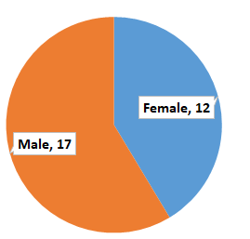
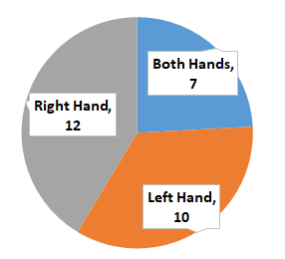
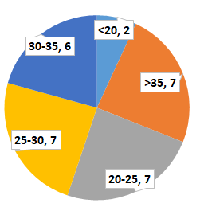
Dataset
Total Subjects: 29

Slide 7
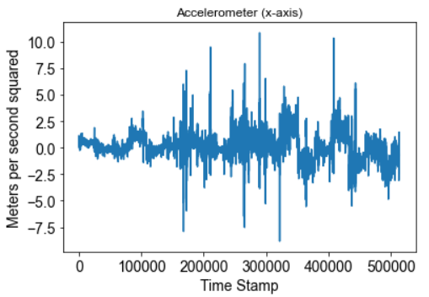
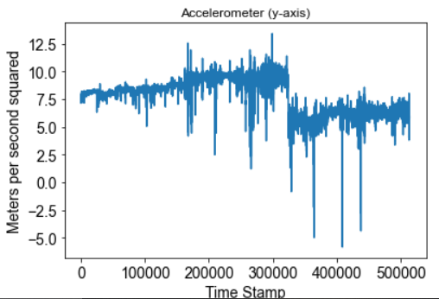
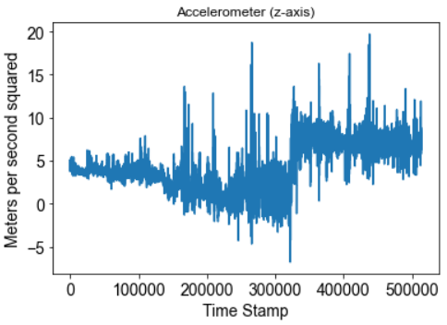
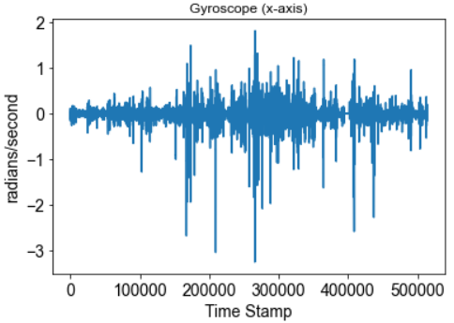
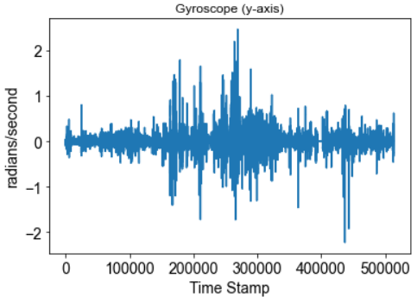
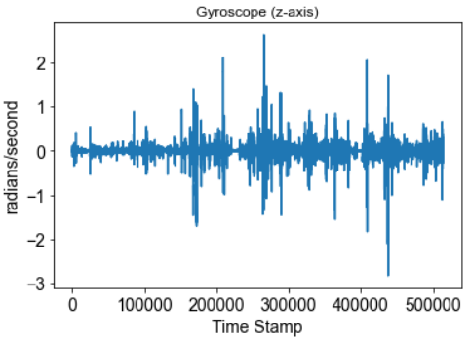
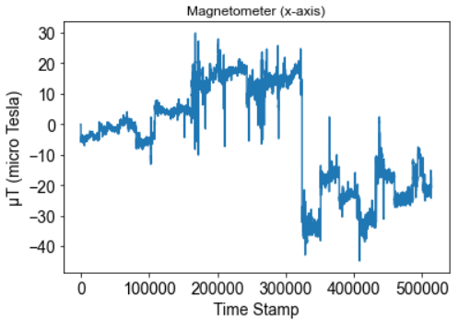
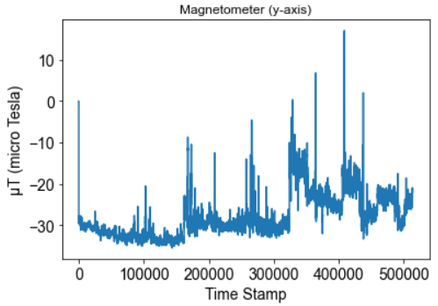
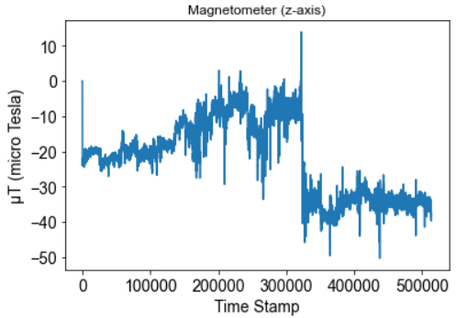

Slide 8
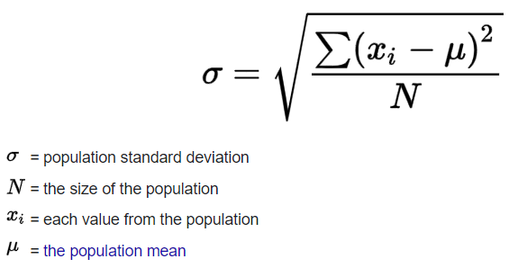
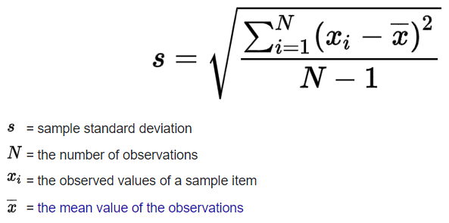
Dataset Statistics
Features Selected
Mean
Median
Mode
Quantiles (Divide data into intervals with equal probability)
Population Standard Deviation
Standard Deviation
Variance
Features for x, y, z -axis: 9 + 9 + 9 = 27
Total Features: 81
27 (Magnetometer)
27 (Accelerometer)
27 (Gyroscope)
Total Data Samples: 112

Slide 9
Android Application Demo!!

Slide 10
Experimental Setting
Train-Test Split: 70-30% (100 runs average)
Different ML Classifiers are used for Classification of different Labels
Different Evaluation Metrics are used to measure the performance of classifiers

Slide 11
Results (Gender Prediction)
 | Accuracy | Precision | Recall | F1 (weighted) | F1 (Macro) | F1 (Micro) | ROC AUC
SVM | 0.982086 | 0.984257 | 0.982086 | 0.981864 | 0.980653 | 0.982086 | 0.979801
NB | 0.791176 | 0.813939 | 0.791176 | 0.777959 | 0.753573 | 0.791176 | 0.748722
MLP | 0.979144 | 0.981026 | 0.979144 | 0.979023 | 0.976996 | 0.979144 | 0.975546
KNN | 0.905348 | 0.917049 | 0.905348 | 0.902337 | 0.893358 | 0.905348 | 0.88552
RF | 0.940909 | 0.948861 | 0.940909 | 0.939875 | 0.935202 | 0.940909 | 0.931892
LR | 0.976203 | 0.978641 | 0.976203 | 0.975929 | 0.974184 | 0.976203 | 0.97243
DT | 0.85107 | 0.861924 | 0.85107 | 0.850349 | 0.838358 | 0.85107 | 0.841616

Slide 12
Results (Hand Prediction)
 | Accuracy | Precision | Recall | F1 (weighted) | F1 (Macro) | F1 (Micro) | ROC AUC
SVM | 0.403824 | 0.451621 | 0.403824 | 0.408162 | 0.378426 | 0.403824 | 0.54833
NB | 0.403529 | 0.50364 | 0.403529 | 0.412338 | 0.392941 | 0.403529 | 0.56247
MLP | 0.415588 | 0.449502 | 0.415588 | 0.41646 | 0.39017 | 0.415588 | 0.554512
KNN | 0.330294 | 0.414839 | 0.330294 | 0.332183 | 0.321108 | 0.330294 | 0.518089
RF | 0.410294 | 0.43997 | 0.410294 | 0.405354 | 0.37374 | 0.410294 | 0.546865
LR | 0.422647 | 0.441207 | 0.422647 | 0.41267 | 0.379506 | 0.422647 | 0.556344
DT | 0.434118 | 0.461237 | 0.434118 | 0.43274 | 0.399249 | 0.434118 | 0.563229

Slide 13
Results (Application Prediction)
 | Accuracy | Precision | Recall | F1 (weighted) | F1 (Macro) | F1 (Micro) | ROC AUC
SVM | 0.364706 | 0.40224 | 0.364706 | 0.362538 | 0.357648 | 0.364706 | 0.583423
NB | 0.221176 | 0.266991 | 0.221176 | 0.217532 | 0.209166 | 0.221176 | 0.480233
MLP | 0.521176 | 0.573595 | 0.521176 | 0.520186 | 0.514551 | 0.521176 | 0.687949
KNN | 0.206471 | 0.249038 | 0.206471 | 0.196961 | 0.195991 | 0.206471 | 0.479386
RF | 0.477059 | 0.542427 | 0.477059 | 0.478461 | 0.473092 | 0.477059 | 0.66012
LR | 0.379118 | 0.430158 | 0.379118 | 0.37798 | 0.368949 | 0.379118 | 0.590918
DT | 0.420588 | 0.459573 | 0.420588 | 0.416987 | 0.411287 | 0.420588 | 0.619738

Slide 14
Results (Age Prediction)
 | Accuracy | Precision | Recall | F1 (weighted) | F1 (Macro) | F1 (Micro) | ROC AUC
SVM | 0.917353 | 0.930915 | 0.917353 | 0.916236 | 0.89287 | 0.917353 | 0.939998
NB | 0.736471 | 0.779368 | 0.736471 | 0.729843 | 0.721975 | 0.736471 | 0.82674
MLP | 0.925 | 0.938328 | 0.925 | 0.923486 | 0.904725 | 0.925 | 0.947684
KNN | 0.842647 | 0.836144 | 0.842647 | 0.824602 | 0.751581 | 0.842647 | 0.86668
RF | 0.915 | 0.924338 | 0.915 | 0.910564 | 0.88398 | 0.915 | 0.933716
LR | 0.910588 | 0.923103 | 0.910588 | 0.907284 | 0.881717 | 0.910588 | 0.932851
DT | 0.837059 | 0.855875 | 0.837059 | 0.832993 | 0.810444 | 0.837059 | 0.891466

Slide 15
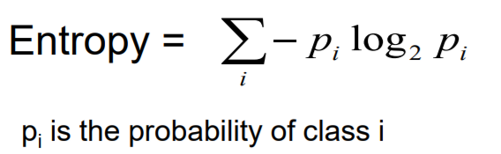
Importance of Features
Information Gain
Evaluates the worth of an attribute/feature by measuring the information gain with respect to the class
InformationGain(Class,Attribute) = H(Class) - H(Class | Attribute)
H = Entropy

Slide 16
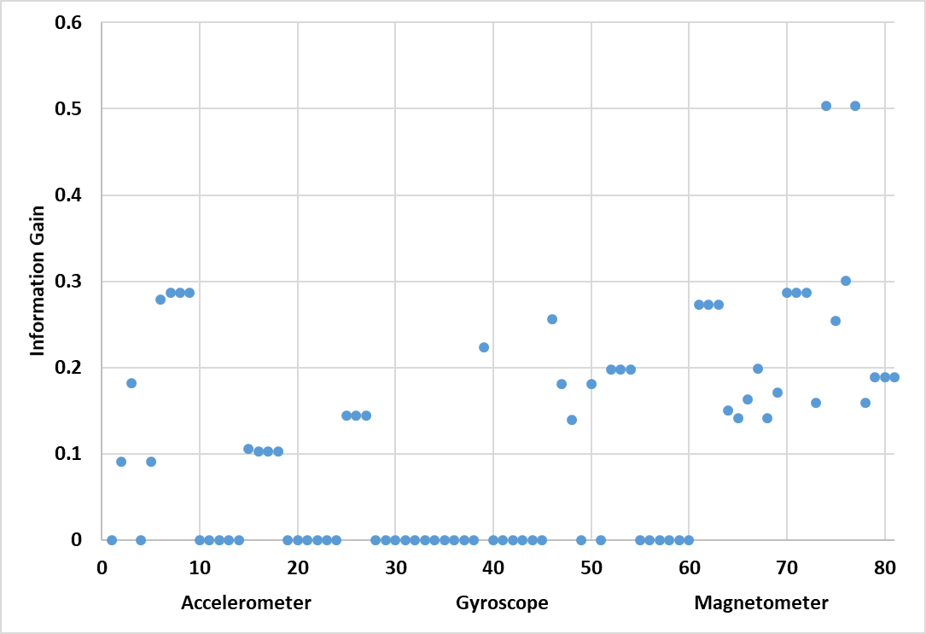
Importance of Features (Gender)

Slide 17
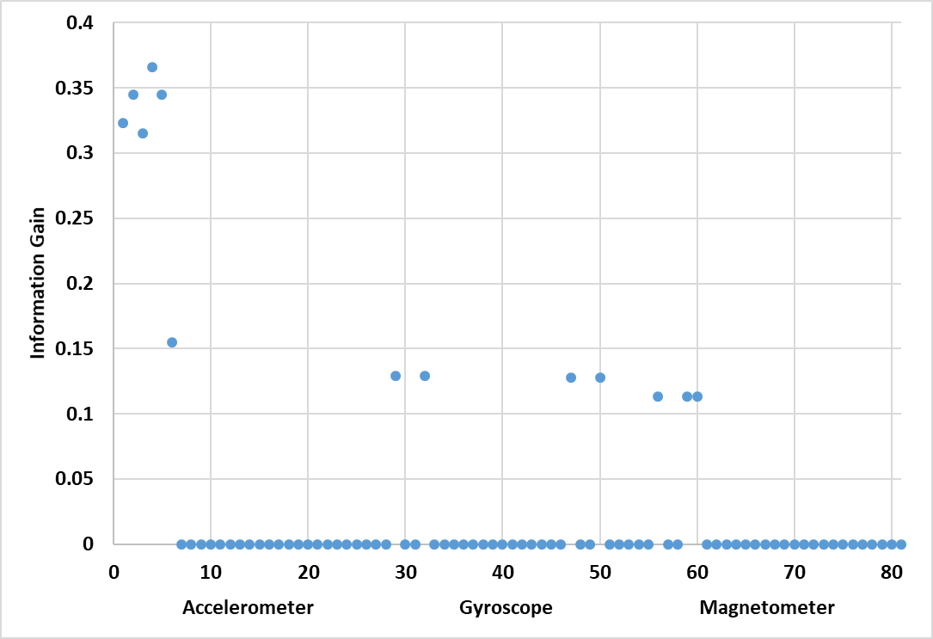
Importance of Features (Hand)

Slide 18
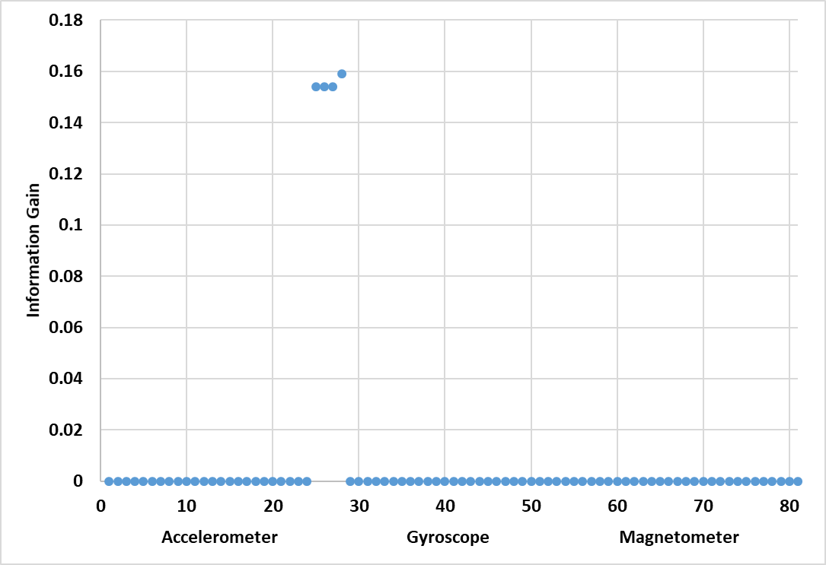
Importance of Features (Application)

Slide 19
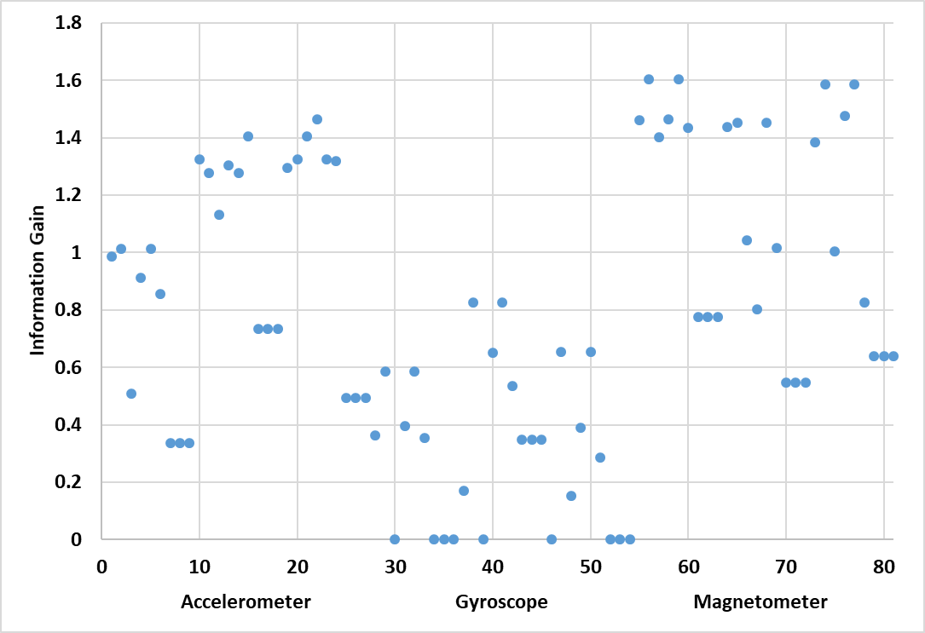
Importance of Features (Age)

Slide 20
UCI Repository Data
Human Activity Recognition Data from UCI Repository
Walking
Walking Upstairs
Walking Downstairs
Sitting
Standing
Laying
How similar the above activity signals are to our collected data?
Train on our data
Test on UCI repository data
Total Subjects: 30
Sensor Data: Accelerometer, Gyroscope
Total Entries: 2947
https://archive.ics.uci.edu/ml/datasets/human+activity+recognition+using+smartphones

Slide 21
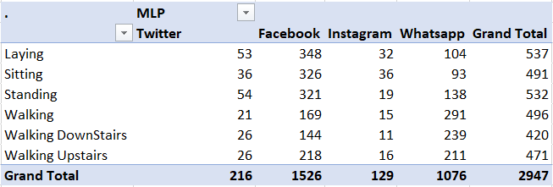
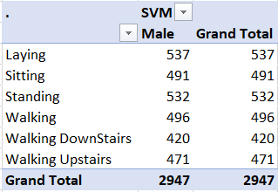
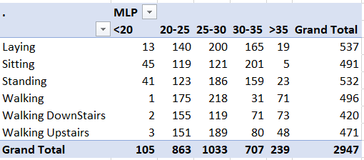
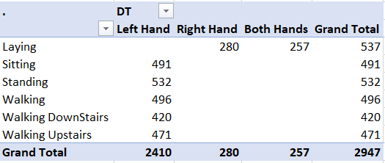
Contingency Table

Slide 22
Questions!!

Slide 23
External Resources
Code and Dataset: https://github.com/sarwanpasha/mobile_sensor_data_collection

