Slide 1
Efficient Variant Classification
Sarwan Ali (Ph.D.)
Esha Chunchu (MS)
Moulika Achhe (MS)
Sri Himaja Bharthepudi (MS)

Slide 2
Table of Content
Motivation
Problem Formulation
Real World Applications
Proposed Models
One-Hot Encoding
K-mer based model
Approximate K-mers based model
Minimizer
Ordered Minimizer
Dataset
Implementation
Results

Slide 3
Motivation
Understand and model the spread patterns
Design effective mitigation strategies
Prevent future outbreaks
Efficacy of known vaccines against each variant
Modeling the likelihood of breakthrough infections
Knowledge of mutations and variants will help identify transmission patterns of each variant that will help devise appropriate public health interventions to prevent rapid spread

Slide 4
Problem Formulation
Given a sequence (spike/nucleotide) and an alphabet Σ
Design a fixed-length numerical representation for the sequence
Problem:
Dimensionality of the fixed-length numerical representation
Sequences can be of different length (sequence alignment is required)
Order of amino acids in the sequences is important
Robustness of ML models
Scalability of model on multi-million sequences

Slide 5
Real World Applications
Genomic surveillance: Tracking the spread of pathogens in terms of genomic content
Real time identification of new and rapidly emerging variants
Track the spread of known variants in new municipalities, regions, countries and continents

Slide 6
Possible Solutions
Design an approximate representation
Remove un-important information

Slide 7
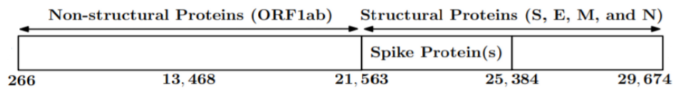
Dataset
Spike Sequences
Full Length Nucleotide Sequences
Notes:
Extra characters in Nucleotide sequence represent uncertainty
Spike Sequence length = 1274
Genome sequence length = 29,674

Slide 8
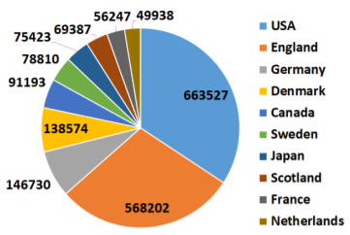
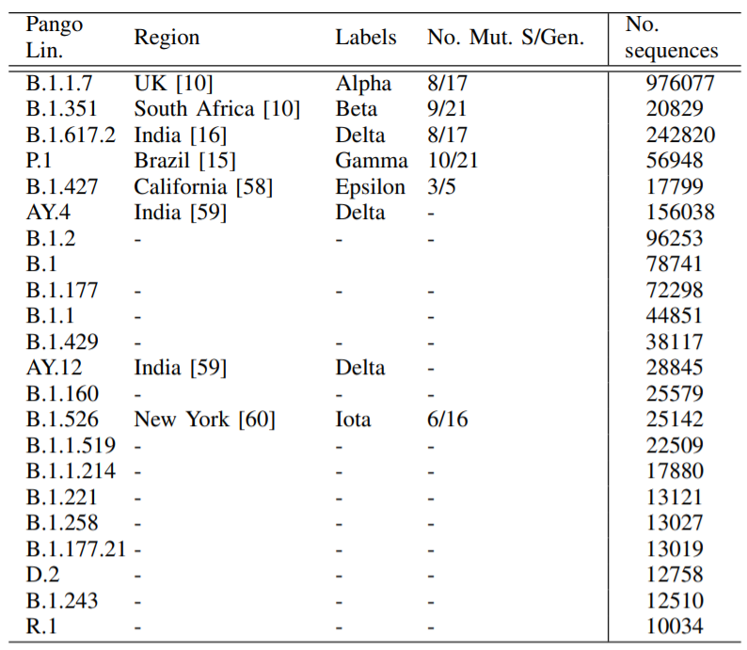
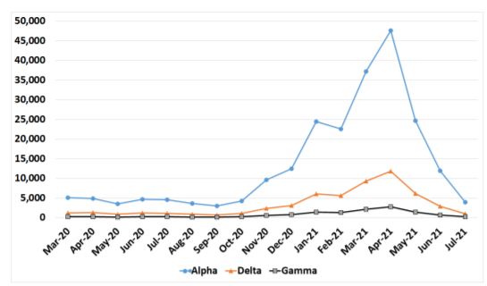
Spike Sequences
Spread pattern of Alpha (blue line), Delta (orange line), and Gamma (black line) variants in the USA from March 2020 to July 2021. The y-axis shows the total number of COVID-19 infected patients.

Slide 9
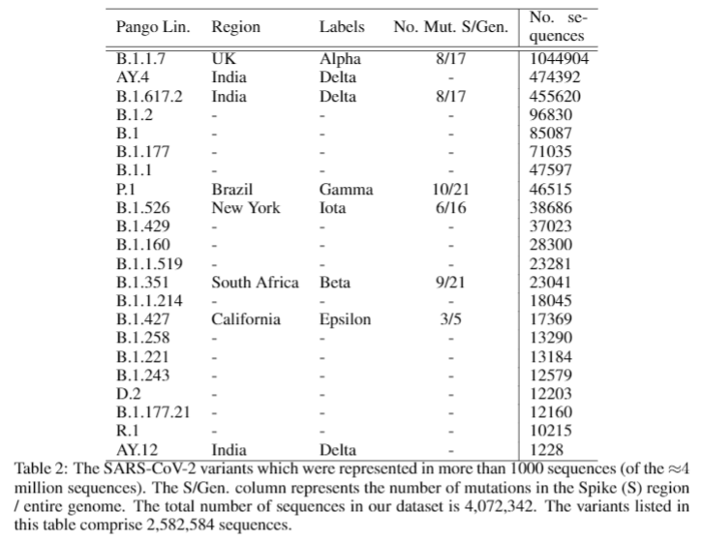
Nucleotide Sequences

Slide 10
Proposed Models
One-Hot Embedding (OHE)
K-mers based approach
Approximate K-mers based approach
Minimizer
Ordered Minimizer

Slide 11


Slide 12
1: One-Hot Encoding
What is One-Hot Encoding?
Example with Implementation
Drawback of using One-Hot Encoding

Slide 13
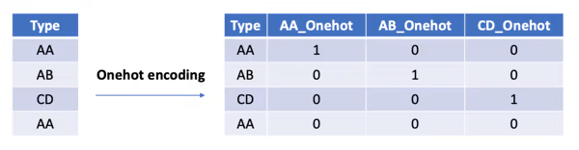
What is One-Hot Encoding
One hot encoding is a way to represent categorical data as binary vectors.
With one-hot, we convert each categorical/sequence value into a new categorical/sequence column and assign a binary value of 1 or 0 to those columns.
Each integer value is represented as a binary vector.

Slide 14
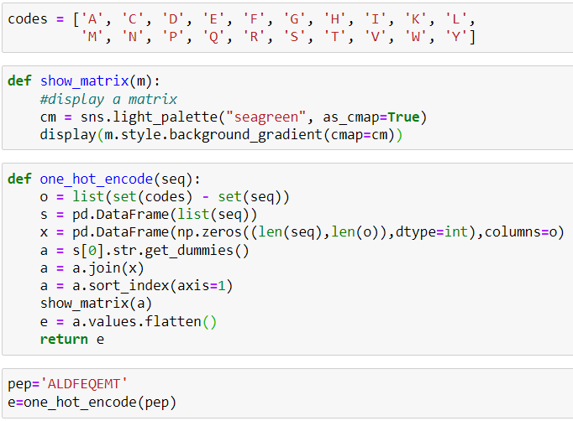
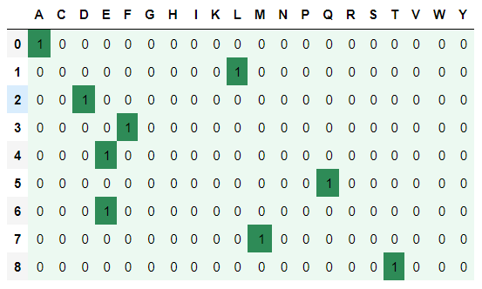
Worked Example of a One Hot Encoding
Amino acids producing a 20-column vector
Let’s consider the sequence as 'ALDFEQEMT'

Slide 15
Drawbacks of one-hot encoding?
High dimensionality,
The feature space can really blow up quickly and you start fighting with the curse of dimensionality.
Feature vector length for Spike Sequences => 21 × 1273 = 26,733
It does not preserve the order of the sequence.
Sequence alignment is very expensive.
Notes:
Nucleotide OHE Length > 500,000

Slide 16
2: K-mer based model
A k-mer is a sequence of k characters in a string (or nucleotides in a DNA sequence), where k is the user-defined parameter for the size of each mer.
To get all k-mers from a sequence we need to get first k characters, then move just a single character from the start of the next k-mer and so on.
Notes:
The term k-mer refers to all of a sequence's subsequences of length L.

Slide 17
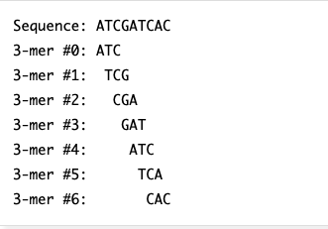
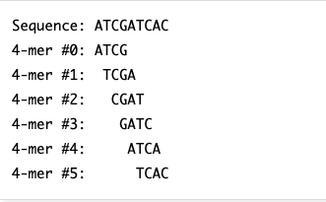
Example
Let's look at the sequence ATCGATCAC contains following 3-mers (Fig 1) & 4-mers (Fig 2)
Fig 1
Fig 2

Slide 18
Importance of K-mer
One of the key biological characteristics of SARS-CoV-2, is the presence of spike proteins that allows this virus to penetrate host cells and cause infection.
We have performed k-mers using these spike sequences to classify different variants of the coronavirus in humans.

Slide 19
Advantages of K-mer
It is easy to analyse a k-mer rather than entire sequence.
K-mer is useful in sequence-matching
Example:
To check if a sequence S comes from organism A or from organism B, assuming the genomes of A and B are known and sufficiently different, we can check if S contains more k-mers present in A or in B.
Notes:
Decomposing a sequence into its k-mers for analysis allows this set of fixed-size chunks to be analysed rather than the sequence.

Slide 20
Approach
Compute all possible K-mers
Total number of K-mers : N-k+1
Convert the K-mers information into the vectors (k-mers count)

Slide 21
Visual Example
We design a feature vector that contains the count of each k-mer in its respective spike sequence
Each sequence A is over an alphabet Σ (amino acids of the spike sequence)
These fixed length frequency vectors have length |Σ|^k (the number of possible k-mers of a spike sequence)
Since the total number of alphabets in our data are 21 (the number of amino acids), the length of each frequency vector becomes 21^3 = 9261
1 2 3 - - - - - - - - - - - - - - - - - - - - - - - - - - - - - - - - 9261
Fixed Vector
Notes:
Where N is the number of amino acids
There are only 21 proteinogenic amino acids
Unique Characters: Since we have 21 unique characters in Σ (namely ACDEFGHIKLMNPQRSTVWXY)

Slide 22
Limitations of K-mer
Overwhelms the memory capacity of standard computers.
The computation time increases.
It becomes difficult to bin match.

Slide 23
3: Approximate K-mers based model
To overcome the drawbacks faced in K-mer.
Used Locality Sensitive Hashing (LSH) which is a generic hashing technique.
It provides a method for efficient approximate nearest neighbor search algorithms in high-dimensional spaces.

Slide 24
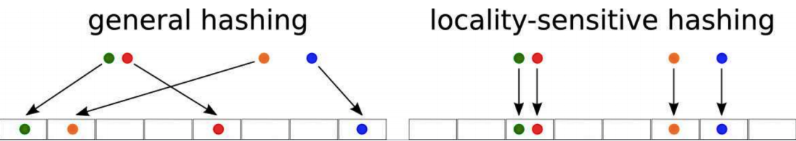
Working example
Ref. https://towardsdatascience.com/understanding-locality-sensitive-hashing-49f6d1f6134

Slide 25
Advantages
The random hash functions LSH uses are data-independent, i.e. data characteristics such as data distribution are not needed to generate these random hash functions.
In addition, the generation of these hash functions is not affected by data distribution.
Notes:
LSH can work in high dimension data effectively reducing dimensions and speeding up search in constant time.

Slide 26
Drawbacks
A hash collision occurs when a hash algorithm produces the same hash value for two different input values.
Different K-mers could go to the same bin.

Slide 27
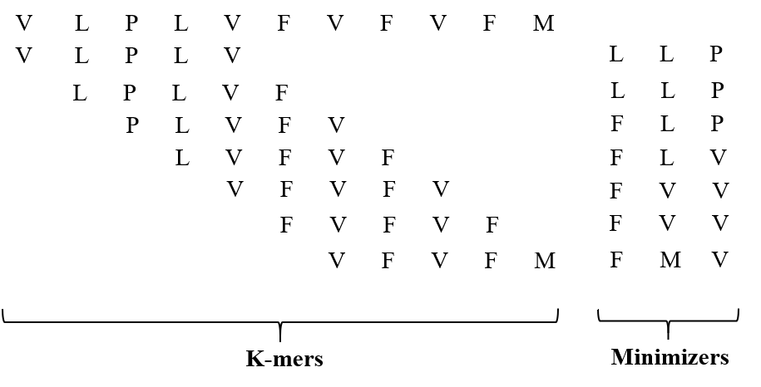
4: Minimizer

Slide 28
5: Ordered Minimizer
Take a set of m-mers minimizers corresponding to a spike/genome sequence
Consider it as a single sequence by combining all m-mers
Compute k-mers
Compute Frequency Vectors
Apply ML/DL algorithms

Slide 29
Low Dimensional Representation
For typical supervised and unsupervised classification/clustering tasks, dimensionality reduction methods such as principal component analysis, ridge regression, and lasso regression are used
Problem: Not scalable on bigger data
Solution: User Kernel method with Kernel Trick
Kernel Trick: It is used to generate features for an algorithm which depends on the inner product between only the pairs of input data points. The main idea is to avoid the need to map the input data (explicitly) to a high-dimensional feature space

Slide 30

Kernel Trick
Kernel Trick relies on the following observation:
Any positive definite function f(a,b), where a, b ∈ R^d, defines an inner product and a lifting φ so that we can quickly compute the inner product between the lifted data points
Drawback: In case of large training data, the kernel method suffers from large initial computational and storage costs.

Slide 31


Random Fourier Features (RFF)
To overcome these computational problems, we use an approximate kernel method called random Fourier features (RFF)
RFF maps the input data to a randomized low dimensional feature space (euclidean inner product space)
In this way, we can approximate the inner product between a pair of transformed points
z is low dimensional (unlike the lifting φ)
In this way, we can transform the original input data with z, which acts as the approximate low dimensional embedding for the original data
The low dimensional representation from RFF is used as an input for different ML tasks

Slide 32
Implementation Detail
ML and DL Models
Naive Bayes
Logistic Regression
Ridge Classifier
Keras Classifier
Validation
Average Accuracy
Precision
Recall
F1 (Weighted)
F1 (Macro)
ROC-AUC
Training Runtime

Slide 33
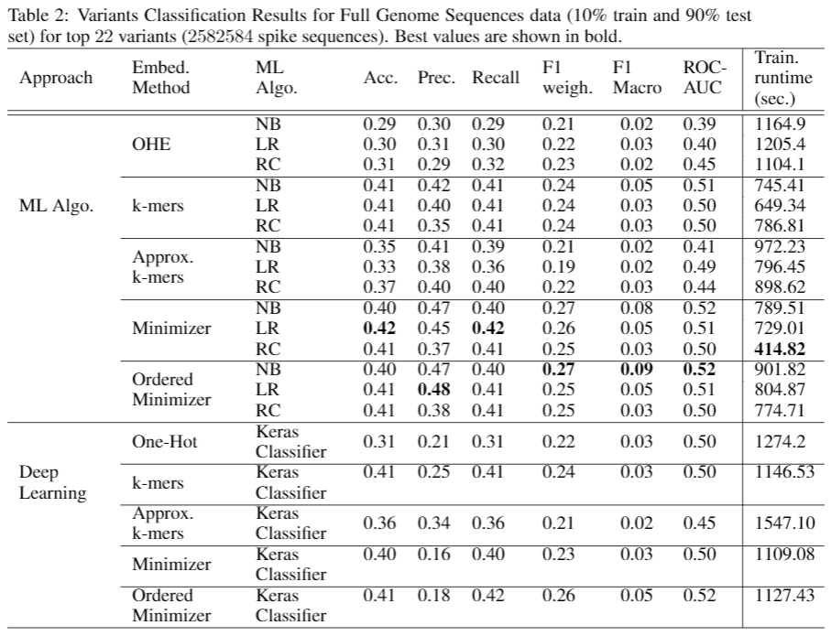
Nucleotide Sequences Results

Slide 34
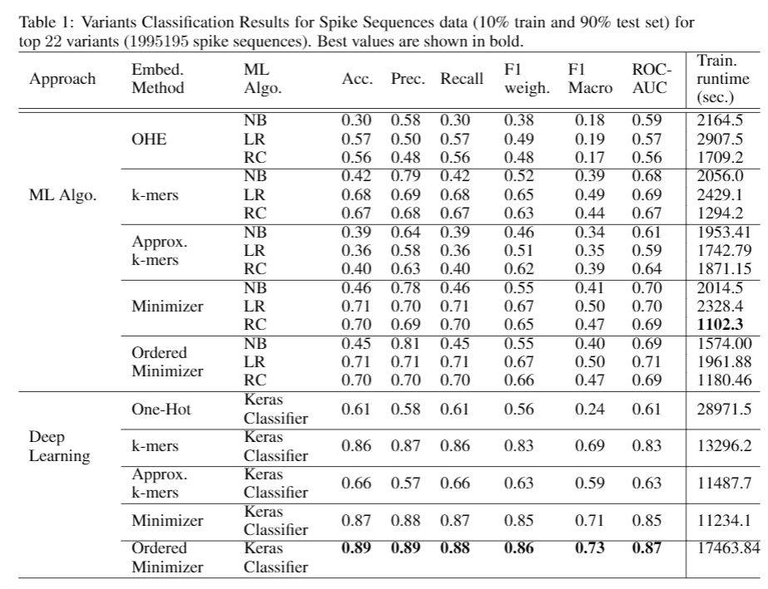
Spike Sequences Results

Slide 35
Conclusion
We propose an embedding approach that can be used to perform classification tasks on the SARS-CoV-2 sequences
We show that our model can scale to several million sequences, and it also outperforms the baseline models significantly
Since the COVID-19 disease is relatively new, we do not have enough information available for different coronavirus variants so far
In Future, we will
Explore the new (and existing) variants in more detail in the future.
Use other deep learning models to enhance the prediction performance of our approach
Use short read data to further understand the behavior of the coronavirus

Slide 36
Questions!!

Slide 37
External Resources
Dataset: https://drive.google.com/drive/folders/1-YmIM8ipFpj-glr9hSF3t6VuofrpgWUa
Code: https://github.com/sarwanpasha/Genome_Spike_Variant_Classification

