Slide 1
Real time operating system (RTOS)
Dr sarwan singh
NIELIT Chandigarh
sarwan@Nielit.gov.in

Slide 2
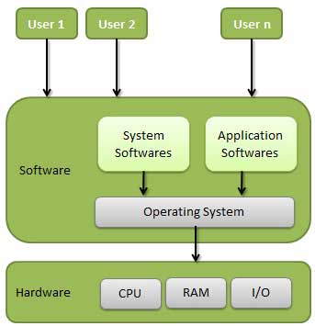
Operating System
In technical terms, It is a software which manages hardware.
An operating System (OS) is an intermediary between users and computer hardware. It provides users an environment in which a user can execute programs conveniently and efficiently.

Slide 3
Important functions of operating System
Memory Management
Processor Management
Device Management
File Management
Security
Control over system performance
Job accounting
Error detecting aids
Coordination between other software and users

Slide 4
Type of Operating System
Single-user operating system
MS-DOS, WindowsXp, etc
Multi-user operating system
UNIX, Linux, etc
Network operating System
Microsoft Windows Server 2003, Microsoft Windows Server 2008, etc
Real Time Operating System
For example : Scientific experiments, medical imaging systems, industrial control systems, weapon systems, robots, and home-appliance controllers, Air traffic control system etc.

Slide 5
Real-Time Operating System (RTOS)
RTOS is an operating system (OS) intended to serve real-time applications which process data as it comes in, typically without buffering delays.
Processing time requirements (including any OS delay) are measured in tenths of seconds or shorter increments of time.
They either are event driven or time sharing. Event driven system switches between task based on their priorities while time sharing switch the task based on clock interrupts.
www.wikipedia.org

Slide 6
Real-time OS
Real-time OS (RTOS) is an intermediate layer between hardware devices and software programming
“Real-time” means keeping deadlines, not speed
Advantages of RTOS in SoC design
Shorter development time
Less porting efforts
Better reusability
Disadvantages
More system resources needed
Future development confined to the chosen RTOS

Slide 7
Soft and Hard Real Time
Soft real-time
Tasks are performed by the system as fast as possible, but tasks don’t have to finish by specific times
Priority scheduling
Multimedia streaming
Hard real-time
Tasks have to be performed correctly and on time
Deadline scheduling
Aircraft controller, Nuclear reactor controller

Slide 8
Real Time operating System
Real time system is defines as a data processing system in which the time interval required to process and respond to inputs is so small that it controls the environment.
Real time processing is always on line whereas on line system need not be real time.

Slide 9
Example of RTOS
Keil RTX Real-Time Kernel
http://www.keil.com/arm/rl-arm/kernel.asp
Micrium µC/OS-II
http://www.micrium.com/products/rtos/kernel/rtos.html
CMX-RTX
http://www.cmx.com/rtx.htm
Express Logic ThreadX
http://www.rtos.com/
Segger ebmOS
http://www.segger.com/embos_general.html
uClinux
As distributed with the EA LPC2468 board
FreeRTOS.org
http://www.freertos.org/

Slide 10
The μC/OS-II RTOS
Dr. Sarwan Singh
NIELIT Chandigarh

Slide 11
μC/OS-II
Real-time kernel
Portable, scalable, preemptive RTOS
Ported to over 90 processors
Pronounced “microC OS two”
Written by Jean J. Labrosse of Micrium, http://ucos-ii.com
Extensive information in MicroC/OS-II: The Real-Time Kernel (A complete portable, ROMable scalable preemptive RTOS), Jean J. LaBrosse, CMP Books

Slide 12
Task States
Five possible states for a task to be in
Dormant – not yet visible to OS (use OSTaskCreate(), etc.)
Ready
Running
Waiting
ISR – preempted by an ISR
See manual for details
Dormant
Ready
Waiting
Running
ISR

