Slide 1
Correlation & Regression

Slide 2
Correlation
Finding the relationship between two quantitative variables without being able to infer causal relationships
Correlation is a statistical technique used to determine the degree to which two variables are related

Slide 3
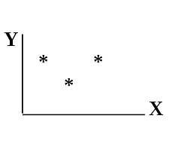
Scatter diagram
Rectangular coordinate
Two quantitative variables
One variable is called independent (X) and the second is called dependent (Y)
Points are not joined
No frequency table

Slide 4
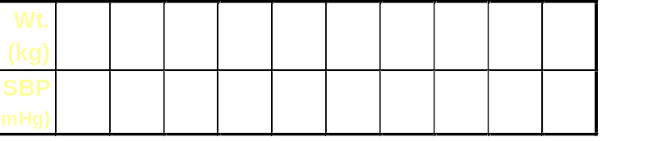
Example

Slide 5
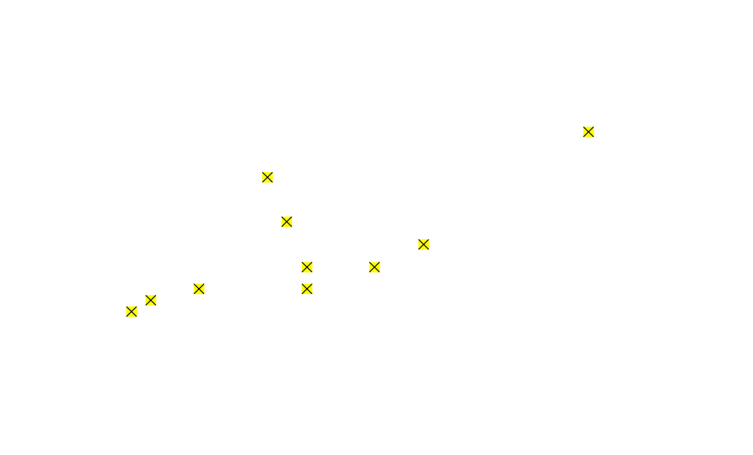
Scatter diagram of weight and systolic blood pressure

Slide 6
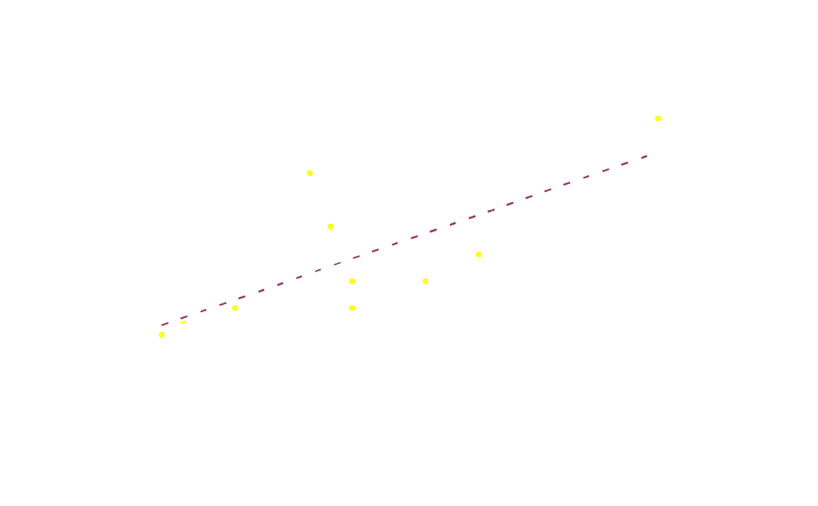
Scatter diagram of weight and systolic blood pressure

Slide 7
Scatter plots
The pattern of data is indicative of the type of relationship between your two variables:
positive relationship
negative relationship
no relationship

Slide 8
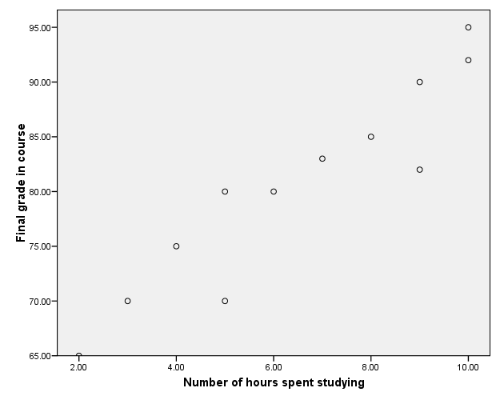
Positive relationship

Slide 9
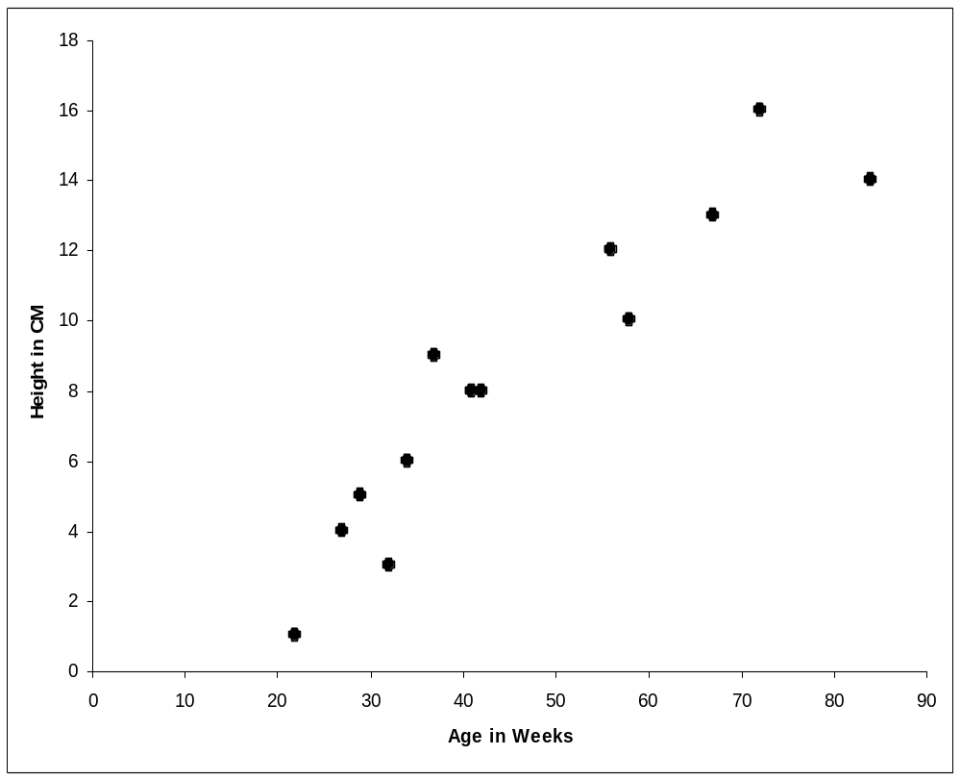

Slide 10
Negative relationship
Reliability
Age of Car

Slide 11
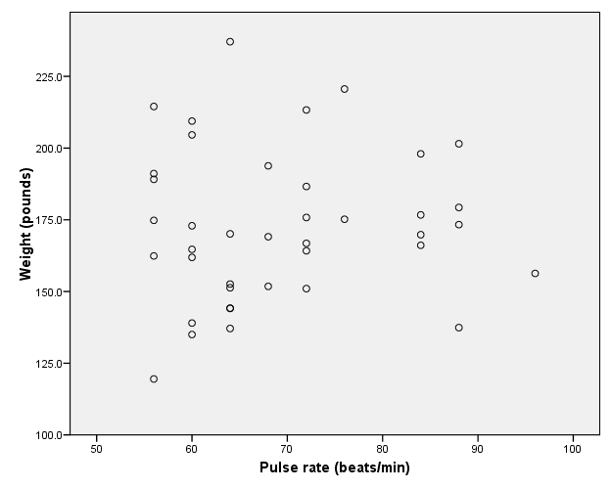
No relation

Slide 12
Correlation Coefficient
Statistic showing the degree of relation between two variables

Slide 13
Simple Correlation coefficient (r)
It is also called Pearson's correlation or product moment correlation
coefficient.
It measures the nature and strength between two variables of
the quantitative type.

Slide 14

The sign of r denotes the nature of association
while the value of r denotes the strength of association.

Slide 15
If the sign is +ve this means the relation is direct (an increase in one variable is associated with an increase in the
other variable and a decrease in one variable is associated with a
decrease in the other variable).
While if the sign is -ve this means an inverse or indirect relationship (which means an increase in one variable is associated with a decrease in the other).

Slide 16
The value of r ranges between ( -1) and ( +1)
-1 is negative perfect co-relation and 1 is positive perfect co-relation
The value of r denotes the strength of the association as illustrated
by the following diagram.
strong
intermediate
weak
weak
intermediate
strong
-1
-0.75
-0.25
0
0.25
0.75
1
indirect
Direct
perfect correlation
perfect correlation
no relation

Slide 17
If r = Zero this means no association or correlation between the two variables.
If 0 < r < 0.25 = weak correlation.
If 0.25 ≤ r < 0.75 = intermediate correlation.
If 0.75 ≤ r < 1 = strong correlation.
If r = l = perfect correlation.

Slide 18
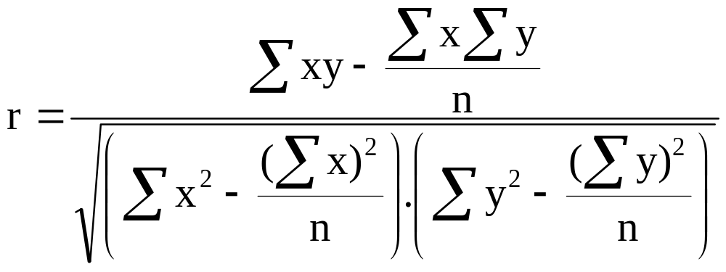
How to compute the simple correlation coefficient (r)

Slide 19
Example:
A sample of 6 children was selected, data about their age in years and weight in kilograms was recorded as shown in the following table . It is required to find the correlation between age and weight.
serial No | Age (years) | Weight (Kg)
1 | 7 | 12
2 | 6 | 8
3 | 8 | 12
4 | 5 | 10
5 | 6 | 11
6 | 9 | 13

Slide 20
These 2 variables are of the quantitative type, one variable (Age) is called the independent and denoted as (X) variable and the other (weight)
is called the dependent and denoted as (Y) variables to find the relation between age and weight compute the simple correlation coefficient using the following formula:

Slide 21
Serial n. | Age (years) (x) | Weight (Kg) (y) | xy | X² | Y²
1 | 7 | 12 | 84 | 49 | 144
2 | 6 | 8 | 48 | 36 | 64
3 | 8 | 12 | 96 | 64 | 144
4 | 5 | 10 | 50 | 25 | 100
5 | 6 | 11 | 66 | 36 | 121
6 | 9 | 13 | 117 | 81 | 169
Total | ∑x= 41 | ∑y= 66 | ∑xy= 461 | ∑x2= 291 | ∑y2= 742

Slide 22
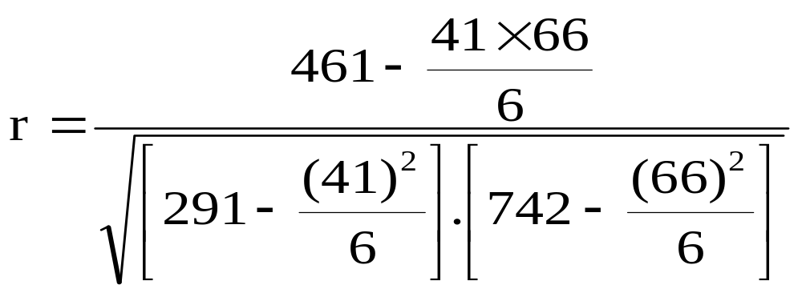
r = 0.759
strong direct correlation

Slide 23
EXAMPLE: Relationship between Anxiety and Test Scores
Anxiety (X) | Test score (Y) | X² | Y² | XY
10 | 2 | 100 | 4 | 20
8 | 3 | 64 | 9 | 24
2 | 9 | 4 | 81 | 18
1 | 7 | 1 | 49 | 7
5 | 6 | 25 | 36 | 30
6 | 5 | 36 | 25 | 30
∑X = 32 | ∑Y = 32 | ∑X² = 230 | ∑Y² = 204 | ∑XY=129

Slide 24
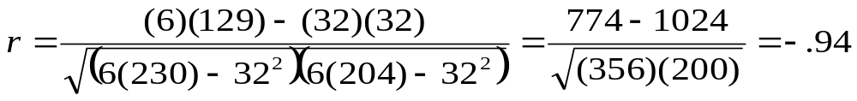
Calculating Correlation Coefficient
r = - 0.94
Indirect strong correlation

Slide 25


Spearman Rank Correlation Coefficient (r_{s})
It is a non-parametric measure of correlation.
This procedure makes use of the two sets of ranks that may be assigned to the sample values of x and Y.
Spearman Rank correlation coefficient could be computed in the following cases:
Both variables are quantitative.
Both variables are qualitative ordinal.
One variable is quantitative and the other is qualitative ordinal.

Slide 26
Procedure:
Rank the values of X from 1 to n where n is the numbers of pairs of values of X and Y in the sample.
Rank the values of Y from 1 to n.
Compute the value of di for each pair of observation by subtracting the rank of Yi from the rank of Xi
Square each di and compute ∑di2 which is the sum of the squared values.

Slide 27
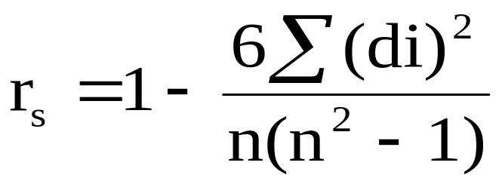
Apply the following formula
The value of r_{s} denotes the magnitude and nature of association giving the same interpretation as simple r.

Slide 28
Example
In a study of the relationship between level education and income the following data was obtained. Find the relationship between them and comment.
sample numbers | level education (X) | Income (Y)
A | Preparatory. | 25
B | Primary. | 10
C | University. | 8
D | secondary | 10
E | secondary | 15
F | illiterate | 50
G | University. | 60

Slide 29
Answer:
 | (X) | (Y) | Rank X | Rank Y | di | di²
A | Preparatory | 25 | 5 | 3 | 2 | 4
B | Primary. | 10 | 6 | 5.5 | 0.5 | 0.25
C | University. | 8 | 1.5 | 7 | -5.5 | 30.25
D | secondary | 10 | 3.5 | 5.5 | -2 | 4
E | secondary | 15 | 3.5 | 4 | -0.5 | 0.25
F | illiterate | 50 | 7 | 2 | 5 | 25
G | university. | 60 | 1.5 | 1 | 0.5 | 0.25
∑ di²=64

Slide 30
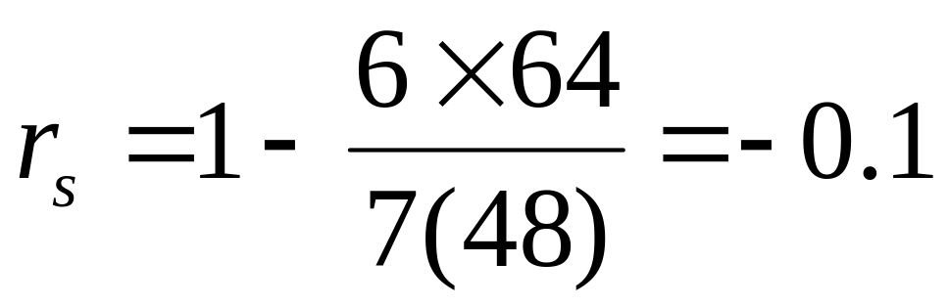
Comment:
There is an indirect weak correlation between level of education and income.

Slide 31
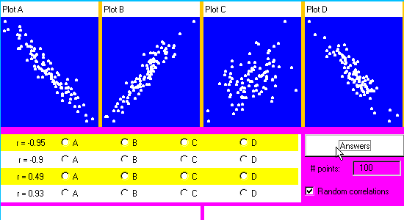
exercise

Slide 32

Regression Analyses
Regression: technique concerned with predicting some variables by knowing others
The process of predicting variable Y using variable X

Slide 33
Regression
Uses a variable (x) to predict some outcome variable (y)
Tells you how values in y change as a function of changes in values of x

Slide 34
Correlation and Regression
Correlation describes the strength of a linear relationship between two variables
Linear means “straight line”
Regression tells us how to draw the straight line described by the correlation

Slide 35
Regression
Calculates the “best-fit” line for a certain set of data
The regression line makes the sum of the squares of the residuals smaller than for any other line
Regression minimizes residuals

Slide 36
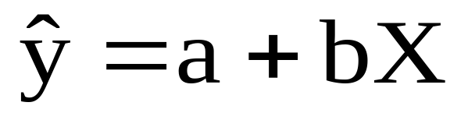
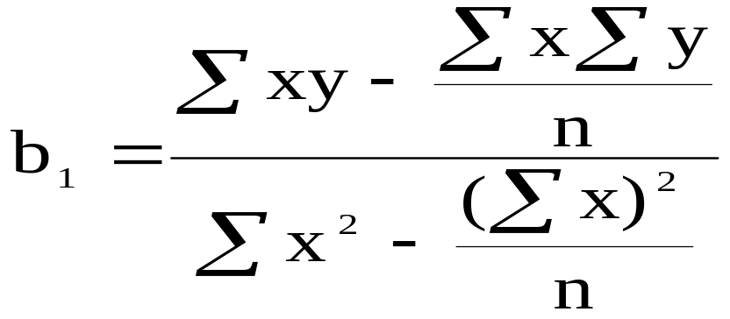
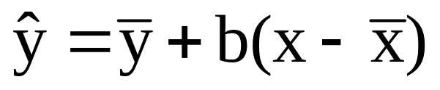
By using the least squares method (a procedure that minimizes the vertical deviations of plotted points surrounding a straight line) we are
able to construct a best fitting straight line to the scatter diagram points and then formulate a regression equation in the form of:
b

Slide 37
Regression Equation
Regression equation describes the regression line mathematically
  Intercept
  Slope

Slide 38
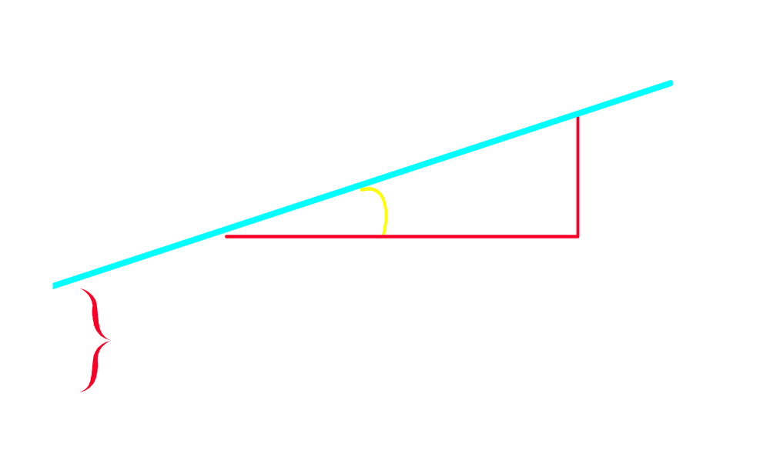
Linear Equations
Notes:
28

Slide 39
Hours studying and grades

Slide 40
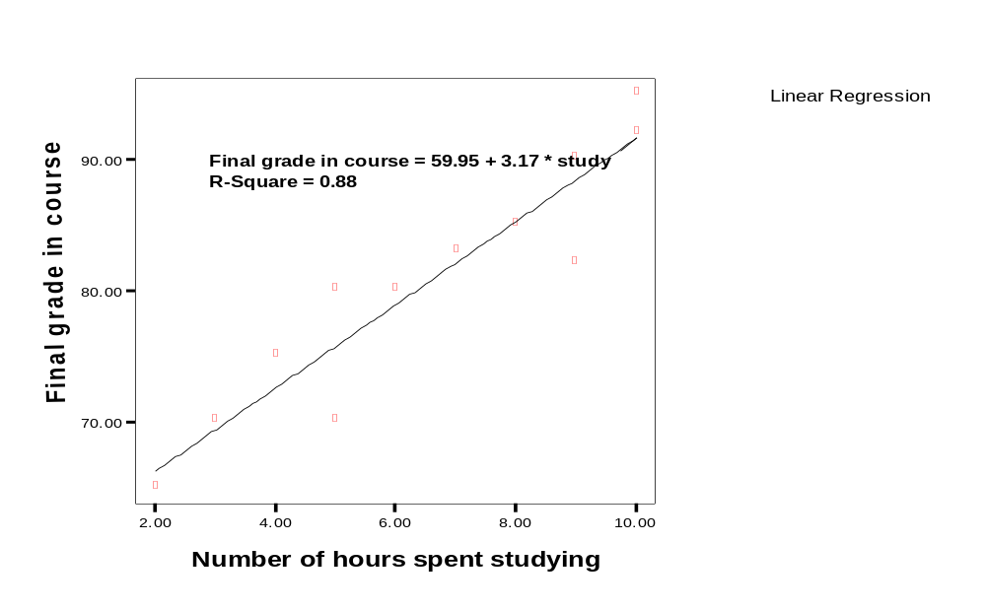
Regressing grades on hours
Predicted final grade in class =
59.95 + 3.17*(number of hours you study per week)

Slide 41
Predict the final grade of…
Predicted final grade in class = 59.95 + 3.17*(hours of study)
Someone who studies for 12 hours
Final grade = 59.95 + (3.17*12)
Final grade = 97.99
Someone who studies for 1 hour:
Final grade = 59.95 + (3.17*1)
Final grade = 63.12

Slide 42
Exercise
A sample of 6 persons was selected the value of their age ( x variable) and their weight is demonstrated in the following table. Find the regression equation and what is the predicted weight when age is 8.5 years.

Slide 43
Serial no. | Age (x) | Weight (y)
1 2 3 4 5 6 | 7 6 8 5 6 9 | 12 8 12 10 11 13

Slide 44
Answer
Serial no. | Age (x) | Weight (y) | xy | X² | Y²
1 2 3 4 5 6 | 7 6 8 5 6 9 | 12 8 12 10 11 13 | 84 48 96 50 66 117 | 49 36 64 25 36 81 | 144 64 144 100 121 169
Total | 41 | 66 | 461 | 291 | 742

Slide 45
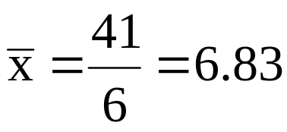
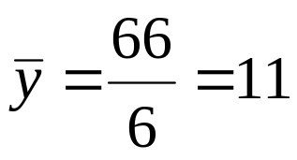
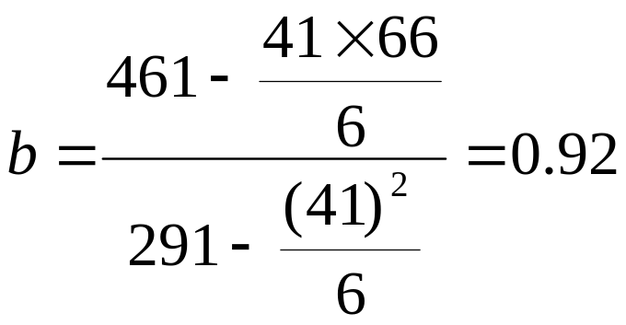
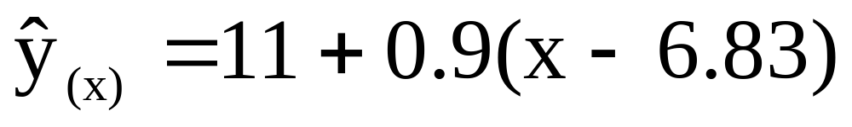
Regression equation

Slide 46
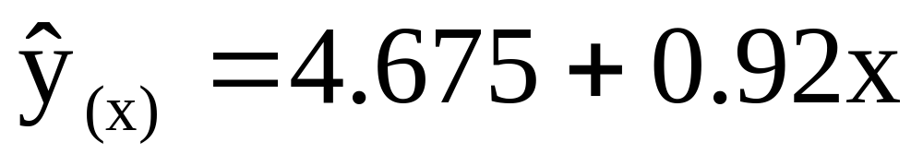
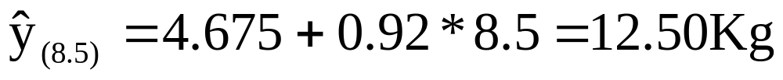
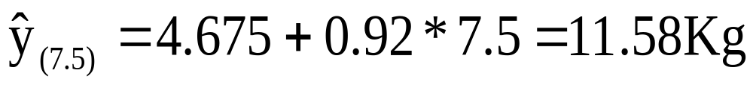

Slide 47
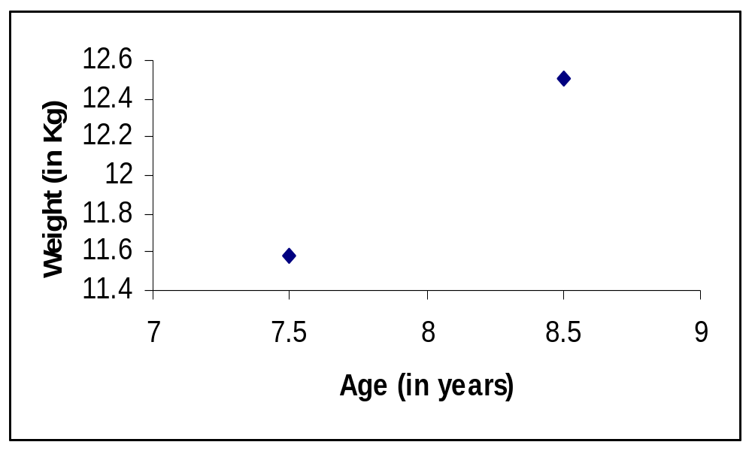
we create a regression line by plotting two estimated values for y against their X component, then extending the line right and left.

Slide 48
Exercise 2
Age (x) | B.P (y) | Age (x) | B.P (y)
20 43 63 26 53 31 58 46 58 70 | 120 128 141 126 134 128 136 132 140 144 | 46 53 60 20 63 43 26 19 31 23 | 128 136 146 124 143 130 124 121 126 123
The following are the age (in years) and systolic blood pressure of 20 apparently healthy adults.

Slide 49
Find the correlation between age and blood pressure using simple and Spearman's correlation coefficients, and comment.
Find the regression equation?
What is the predicted blood pressure for a man aging 25 years?

Slide 50
Serial | x | y | xy | x2
1 | 20 | 120 | 2400 | 400
2 | 43 | 128 | 5504 | 1849
3 | 63 | 141 | 8883 | 3969
4 | 26 | 126 | 3276 | 676
5 | 53 | 134 | 7102 | 2809
6 | 31 | 128 | 3968 | 961
7 | 58 | 136 | 7888 | 3364
8 | 46 | 132 | 6072 | 2116
9 | 58 | 140 | 8120 | 3364
10 | 70 | 144 | 10080 | 4900

Slide 51
Serial | x | y | xy | x2
11 | 46 | 128 | 5888 | 2116
12 | 53 | 136 | 7208 | 2809
13 | 60 | 146 | 8760 | 3600
14 | 20 | 124 | 2480 | 400
15 | 63 | 143 | 9009 | 3969
16 | 43 | 130 | 5590 | 1849
17 | 26 | 124 | 3224 | 676
18 | 19 | 121 | 2299 | 361
19 | 31 | 126 | 3906 | 961
20 | 23 | 123 | 2829 | 529
Total | 852 | 2630 | 114486 | 41678

Slide 52
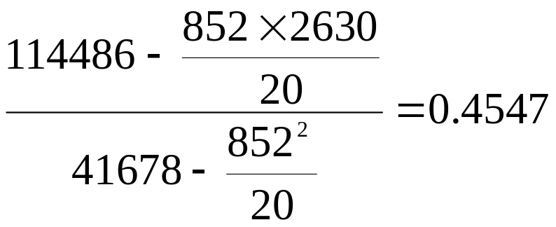
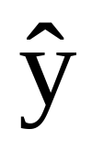
=
=112.13 + 0.4547 x
for age 25
B.P = 112.13 + 0.4547 * 25=123.49 = 123.5 mm hg

Slide 53
Multiple Regression
Multiple regression analysis is a straightforward extension of simple regression analysis which allows more than one independent variable.

Slide 54


Thank
You

