Slide 1
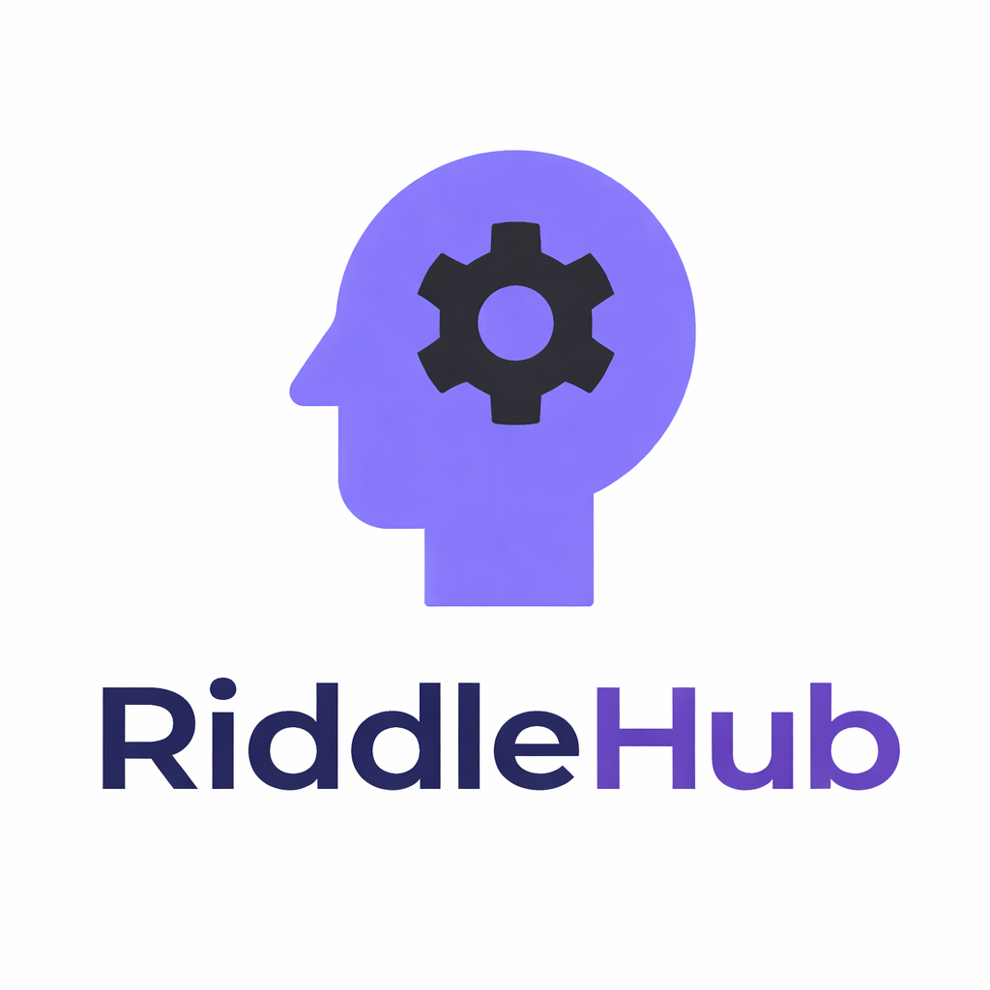
🧠 RiddleHub – Social Puzzle Platform
Android App with Firebase Integration
Presented by:
Sarweshwar Buddolla
Android Development Internship
Apex Planet Intership

Slide 2
INTRODUCTION
RiddleHub is a modern Android social application designed to create an interactive puzzle-solving community.
The app allows users to:
Post riddles and puzzle questions
Add optional hints
Set difficulty levels
Like and comment on puzzles
Follow other users
It combines social interaction with brain-training challenges using a real-time cloud backend powered by Firebase.

Slide 3
PROBLEM STATEMENT
No dedicated platform focused only on riddles & brain puzzles
Lack of interactive social puzzle communities
Limited real-time engagement in traditional puzzle apps
No structured difficulty & hint system

Slide 4
PROPOSED SOLUTION
RiddleHub provides:
Real-time puzzle feed
Social interaction system (likes, comments, follow)
Difficulty rating
Optional hints
Secure authentication
Scalable cloud backend

Slide 5
SOFTWARE REQUIREMENTS
Backend Services
Firebase Authentication
Firebase Firestore
Firebase Analytics
Version Control
Git & GitHub
Development Environment
Android Studio (Panda / latest stable version)
JDK 11 or above
Gradle Kotlin DSL
Programming Language
Kotlin
Frameworks & Libraries
Jetpack Compose
Navigation Compose
Material 3

Slide 6
HARDWARE REQUIREMENTS
Backend Services
Firebase Authentication
Firebase Firestore
Firebase Analytics
Version Control
Git & GitHub

Slide 7
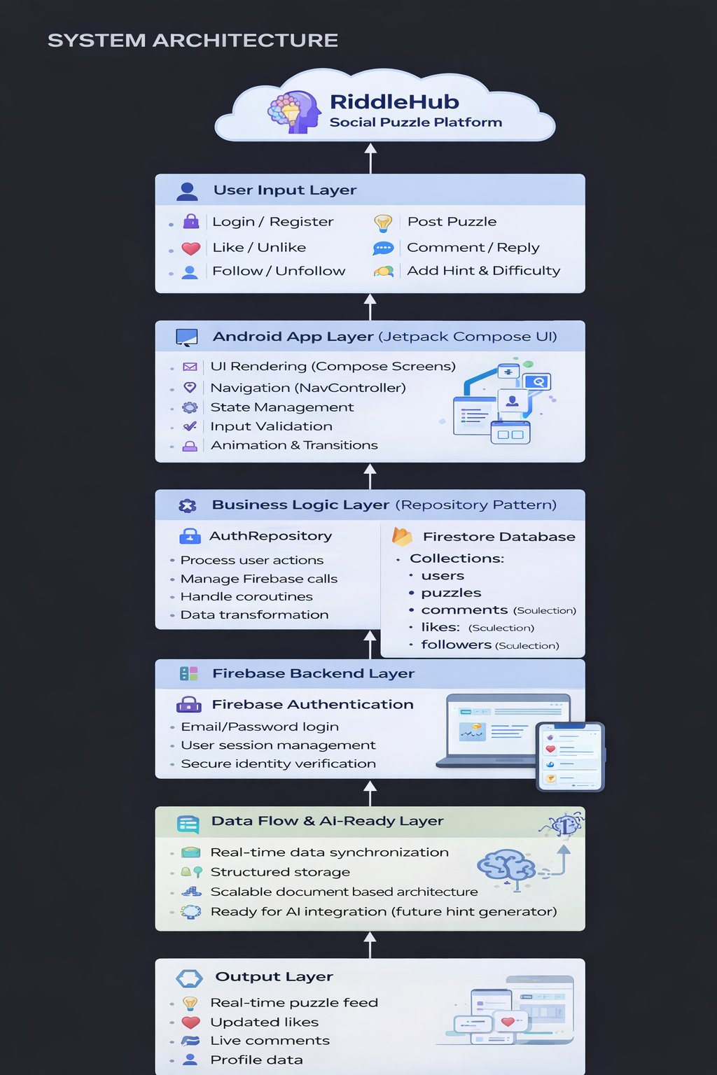
SYSTEM ARCHITECTURE

Slide 8
🟦 User Input Layer
Handles all user interactions such as authentication, puzzle posting, likes, comments, and follow actions.
🟦 Android App Layer (Jetpack Compose UI)
Manages UI rendering, navigation, state handling, animations, and user input validation.
🟦 Business Logic Layer (Repository Pattern)
Processes user actions, manages Firebase communication, and handles data transformation using coroutines.

Slide 9
🟦 Firebase Backend Layer
Provides secure authentication and real-time database services for storing and retrieving application data.
🟦 Data Flow & AI-Ready Layer
Ensures real-time synchronization and structured storage while keeping the system scalable for future AI integration.
🟦 Output Layer
Displays updated puzzle feeds, likes, comments, and user profile data instantly to the user.

Slide 10
KEY FEATURES
Email Authentication
Real-time Firestore Integration
Puzzle Posting System
Like & Comment System
Reply to Comments
Follow / Unfollow Users
Animated Splash Screen
Modern UI Design

Slide 11
DATABASE STRUCTURE
Collections:
users
puzzles
comments (subcollection)
likes (subcollection)
Data stored in structured, scalable format for real-time updates.

Slide 12
LEARNING OUTCOMES
Firebase backend integration
Secure authentication systems
Real-time database handling
Modular Android architecture
App signing & deployment process

Slide 13
FUTURE ENHANCEMENTS
AI-based hint generation
Intelligent difficulty analyzer
Push notifications
Google Sign-In
Puzzle recommendation engine

Slide 14
CONCLUSION
RiddleHub successfully integrates modern Android development with real-time cloud services to create an interactive puzzle-sharing platform. Through Firebase Authentication and Firestore, the app ensures secure user management and seamless data synchronization.
The project strengthened my understanding of backend integration, scalable architecture, and production-level app deployment. With its modular design and social features, RiddleHub is well-positioned for future enhancements such as AI-driven hints and intelligent puzzle recommendations.

Slide 15
Thank you

