Slide 1


MALLA REDDY COLLEGE OF ENGINEERING & TECHNOLOGY
(AUTONOMUS INSTITUTION –UGC, GOVT. OF INDIA)
Affiliated to JNTUH; Approved by AICTE, NBA-Tier 1 & NAAC with A-GRADE| ISO 9001:2015
LLM Safety Evaluator
Team Members Details
1. B.Sarweshwar : 24N35A6609
2. G.Maneesh : 23N31A66A3
3. J.Madhu Kiran : 23N31A66C0
III Year B.Tech-I Semester – CSE (AIML)
Under the Guidance of
Dr.B.Jyothi
Assistant Professor
1

Slide 2

Introduction
The rapid proliferation of AI language models has exposed critical security vulnerabilities through prompt injection and jailbreaking attacks. Malicious actors craft specialized prompts that bypass safety protocols, potentially extracting sensitive information or manipulating system behaviour. Existing solutions rely heavily on black-box commercial APIs or simplistic keyword filters, lacking transparency, customization, and novel attack detection capabilities.

Slide 3
Solution
Our project, “ LLM Safety Evaluator,” addresses these limitations by developing a hybrid machine learning system that combines supervised classification with anomaly detection to identify and mitigate malicious prompts in real-time. This self-hosted solution offers confidence-based scoring, and continuous learning for enterprise-grade AI security without external dependencies.

Slide 4
Abstract
This project develops an advanced security system for detecting prompt injection and jailbreaking attacks against Large Language Models (LLMs) using a custom hybrid machine learning approach. Unlike API-dependent solutions, our self-contained system employs TF-IDF vectorization with n-gram features combined with a calibrated Random Forest classifier for supervised detection of known attack patterns and Isolation Forest for unsupervised anomaly detection of novel threats. Trained on a comprehensive dataset of normal, injection, and jailbreaking prompts, the system achieves high accuracy, precision, and recall while providing real-time classification with confidence scoring. The solution features transparent decision-making through explainable AI visualizations, including feature importance charts and confidence distributions, ensuring robust protection against evolving adversarial prompts without external dependencies.

Slide 5
Requirements Specification
Software Requirements:
Frontend
Programming languages: HTML5,CSS3, JavaScript
Charting Library: Recharts or Chart.js for data
Visualizations and analytics.
Data Base : My SQL
Backend
Programming languages: Python 3.8+.
Framework: FastAPI (Python) .
Machine Learning: Scikit-learn, Pandas, and NumPy for model training and inference

Slide 6
Requirements Specification
Hardware Requirements
Processor: Intel Core i5 13420H
Memory: 16 GB RAM for running IDE, backend server, and database simultaneously.
Storage: 512 GB of available NVme SSD.

Slide 7
Existing Systems
Traditional Filtering Methods (Keyword/Regex):
Current AI security relies on commercial moderation APIs like simple keyword filters. These black-box solutions lack transparency and customization. Keyword-based systems easily fail against paraphrased attacks, while API-dependent approaches incur recurring costs and privacy risks. Both methods struggle with novel, unseen attack patterns and provide no explanatory insights into their decisions.

Slide 8
Existing System
This creates critical security gaps where sophisticated prompt injections can bypass detection, leaving AI systems vulnerable to data extraction, manipulation, and exploitation without any diagnostic capability to improve defenses against evolving threats.
These systems operate on a static rule-set or a generalized external model not tailored to specific organizational needs. The lack of a learning feedback loop means they cannot autonomously improve from encountered attacks.

Slide 9
Disadvantages of Existing System
Easily Bypassed: Attackers can bypass the rules with minor variations.
No Novel Attack Detection: Unable to identify new or unseen attack vectors.
Poor Context Understanding: Simple keyword matching fails to understand the nuance and context of a sentence, leading to both false positives (blocking safe queries) and false negatives (allowing cleverly disguised attacks).
No Confidence Scoring: Existing systems do not provide a measure of how certain they are about a classification.

Slide 10
Proposed System
We develop a hybrid AI security system that combines supervised and unsupervised learning for comprehensive threat detection. Our solution uses calibrated Random Forest for known attacks and Isolation Forest for novel patterns, providing real-time analysis with confidence scoring. The system offers full transparency through explainable AI features and continuous learning capabilities for enterprise deployment.
Department of Computational Intelligence | Application Development - 1 | B.Tech III Year – I Sem

Slide 11
Proposed system
Our self-hosted hybrid AI security system employs advanced TF-IDF vectorization with n-grams and combines Random Forest with Isolation Forest to detect malicious prompts in real-time. It ensures data privacy, eliminates API costs, provides explainable results, and achieves high accuracy under 100ms without external dependencies

Slide 12
Advantages of Proposed System
1. Hybrid Intelligence: Detects both known and zero-day attacks with dual-algorithm approach
2. Adaptive Defence: Continuously learns from new threats without requiring complete retraining
3.Confidence-Based Scoring: Outputs a probability score for each prediction, enabling organizations to set custom risk thresholds and implement a tiered review process

Slide 13
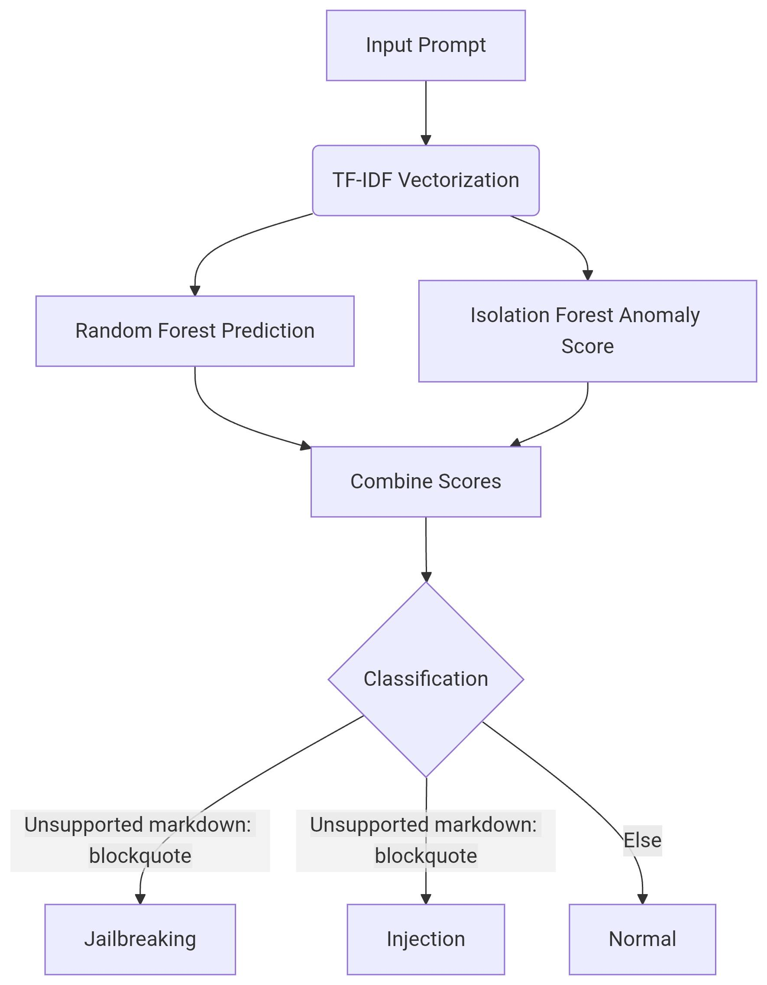
Architectural Diagram

Slide 14
UML Diagrams

Slide 15
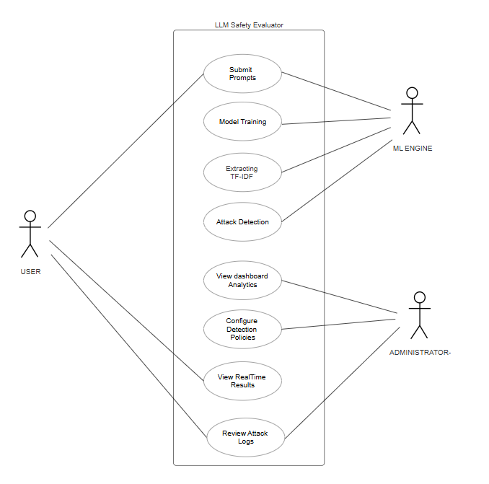
Use Case Diagram

Slide 16
Use Case Diagram
Use Case Diagram
Purpose: Shows system functionality and user interactions.
Actors: User (submits prompt), Admin (monitors system, reviews flags).
Key Use Cases: Submit Prompt for Analysis, View Detailed Report with Confidence Score, Review Flagged Anomalies, Retrain Model with New Data.
Value: Defines the system's scope from a user perspective, outlining all possible actions without technical details.

Slide 17
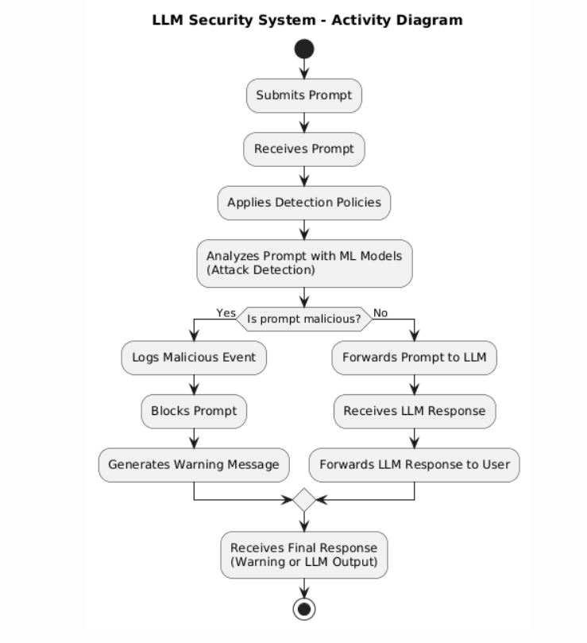
Activity Diagram

Slide 18
Activity Diagram
Activity Diagram
Purpose: Models the workflow or business logic for a single process.
Flow: Starts with Prompt Input. Checks if it's malicious via Random Forest. If not, checks for anomalies via Isolation Forest.
Decisions: Leads to end states: Block Prompt, Allow Prompt, or Flag for Review (low-confidence results).
Value: Visually explains the step-by-step decision-making process inside the "Evaluate Prompt" use case.

Slide 19
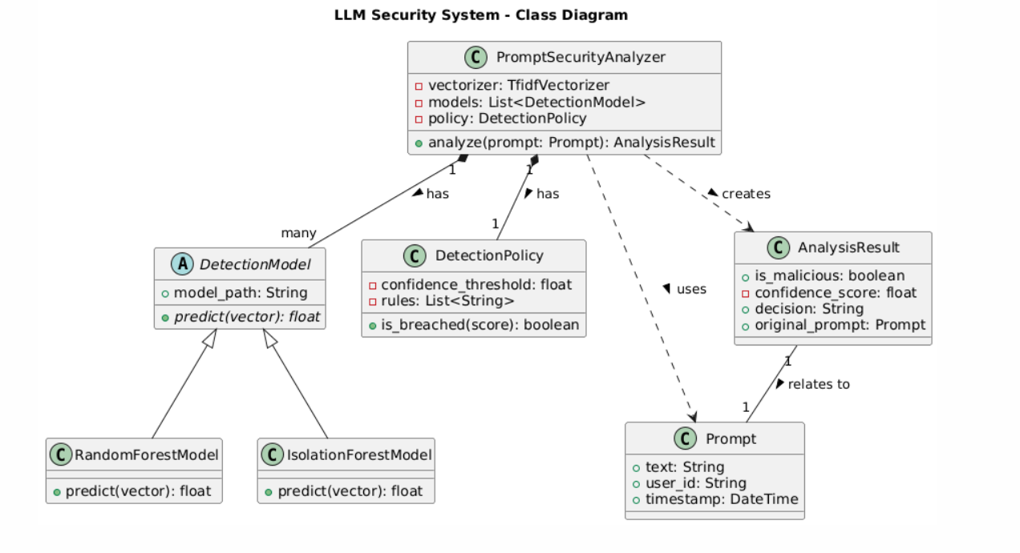
Class Diagram

Slide 20
Class Diagram
Class Diagram
Purpose: Describes the system's static structure using classes and relationships.
Key Classes: Prompt (with attributes: text, timestamp), SafetyAnalyzer (methods: evaluate(), get_confidence_score()), MLModel (parent class for RandomForestModel, IsolationForestModel).
Relationships: SafetyAnalyzer uses MLModel to analyze a Prompt.
Value: Blueprint for developers, showing core components, their attributes, methods, and how they interconnect.

Slide 21
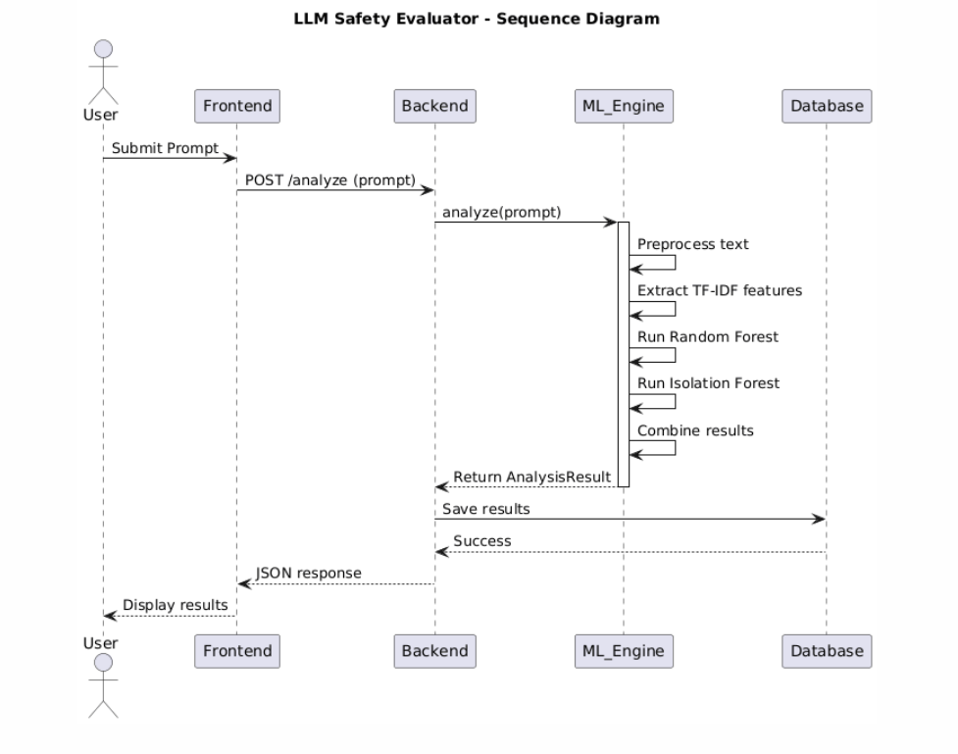
Sequence Diagram

Slide 22
Sequence Diagram
Sequence Diagram
Purpose: Illustrates how objects interact in a time-based sequence for a specific scenario.
Objects: User Interface, APIController, SafetyService, MLModel.
Interaction Sequence: User -> UI -> APIController -> SafetyService -> MLModel -> (return result back through the chain).
Value: Details the exact order of messages and method calls that happen when a user submits a prompt, crucial for understanding real-time operation.

Slide 23
Thank You

