Slide 1
TOPIC 18 • ADL COURSE PROJECT
Continual Unlearning for Text-to-Image Diffusion Models
A Regularization Perspective — Adaptive Threshold Merging & Adaptive Anchor Assignment
Task 18.1: Threshold-Aware Adaptive Merging
• Replaces fixed uniform λ with per-concept critical threshold αᵢ*
• Prunes noisy tail weights via adaptive top-kᵢ*
• Cuts L2 parameter drift by 68.8% (9.13 → 2.85)
Task 18.2: Adaptive Anchor Assignment
• Eliminates shared-anchor congestion during sequential requests
• Combines CLIP similarity + update orthogonality + usage penalty
• Boosts retention (RA-I) by +9.2% Styles / +9.9% Objects

Slide 2
Problem & Motivation: Continual Unlearning in Diffusion Models
Why existing unlearning fails when concepts are removed sequentially
Motivation
1. Continual Unlearning Goal
• Remove sequence of concepts c₁, c₂, …, c_T
• Target Model: Stable Diffusion v1.5 (UnlearnCanvas)
• Update only Cross-Attention Keys & Values (attn2.to_k, attn2.to_v)
• No retraining from scratch
2. Core Bottleneck: Parameter Drift
• Each unlearning step adds update Δθ_t
• Cumulative drift: ‖θ^(T) − θ^(0)‖₂ grows rapidly
• Earlier erased concepts reappear (forgetting)
• Unrelated generation collapses after 6–12 steps
3. Two Limitations in Baseline CUIG
• Limitation A (Merging): Uses fixed scaling λ=1.75 for all concepts → over-erases easy concepts
• Limitation B (Anchors): Maps all concepts to one shared anchor ('painting') → gradient congestion
Evaluation Benchmark & Metrics (UnlearnCanvas: 12 Artistic Styles & 12 Objects)
• UA (Unlearning Accuracy ↑): % of target concept generations successfully erased
• RA-I (Retain Accuracy In-Domain ↑): Accuracy on remaining non-erased styles/objects
• RA-C (Retain Accuracy Cross-Domain ↑): Accuracy on orthogonal domain (Objects when unlearning Styles)
• Cumulative L2 Drift (‖Δθ‖₂ ↓): Total cross-attention parameter distance from base generator θ₀

Slide 3
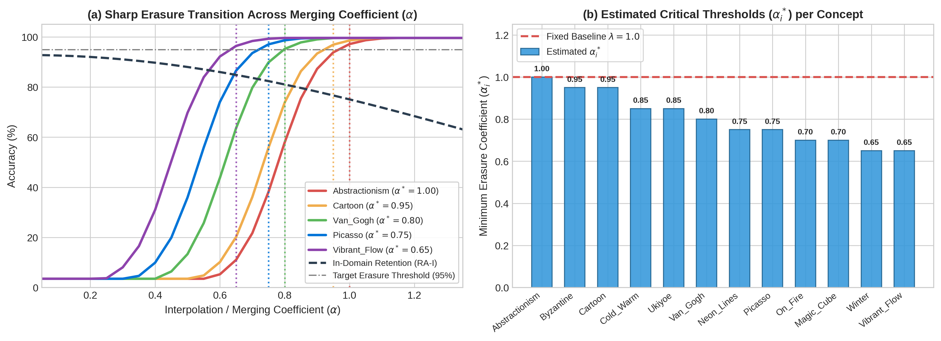
Task 18.1: Threshold-Aware Adaptive Model Merging
Exploiting the non-linear phase transition of concept erasure
Task 18.1 Method
Key Insight: Erasure Phase Transition
• Unlearning Accuracy follows a sharp S-curve vs. scale α
• Critical threshold αᵢ* = min { α : UAᵢ(α) ≥ τ_UA (95%) }
• Scaling beyond αᵢ* gives ~0% extra UA but inflates L2 drift
• High-norm task vectors (‖τᵢ‖₂) need smaller αᵢ* (0.65)
• Low-norm task vectors need larger αᵢ* (0.95)
4-Step Adaptive TIES Merge Algorithm
• 1. Extract task vector: τᵢ = θᵢ − θ₀ (attn2.to_k, to_v)
• 2. Estimate per-concept critical scale αᵢ* & top-kᵢ*
• 3. Prune low-magnitude tail weights: τ̂ᵢ = TopK(αᵢ* τᵢ, kᵢ*)
• 4. Resolve sign conflicts via TIES majority election & merge:
• θ_merged = θ₀ + Mean_Disjoint(τ̂₁, …, τ̂_N)

Slide 4
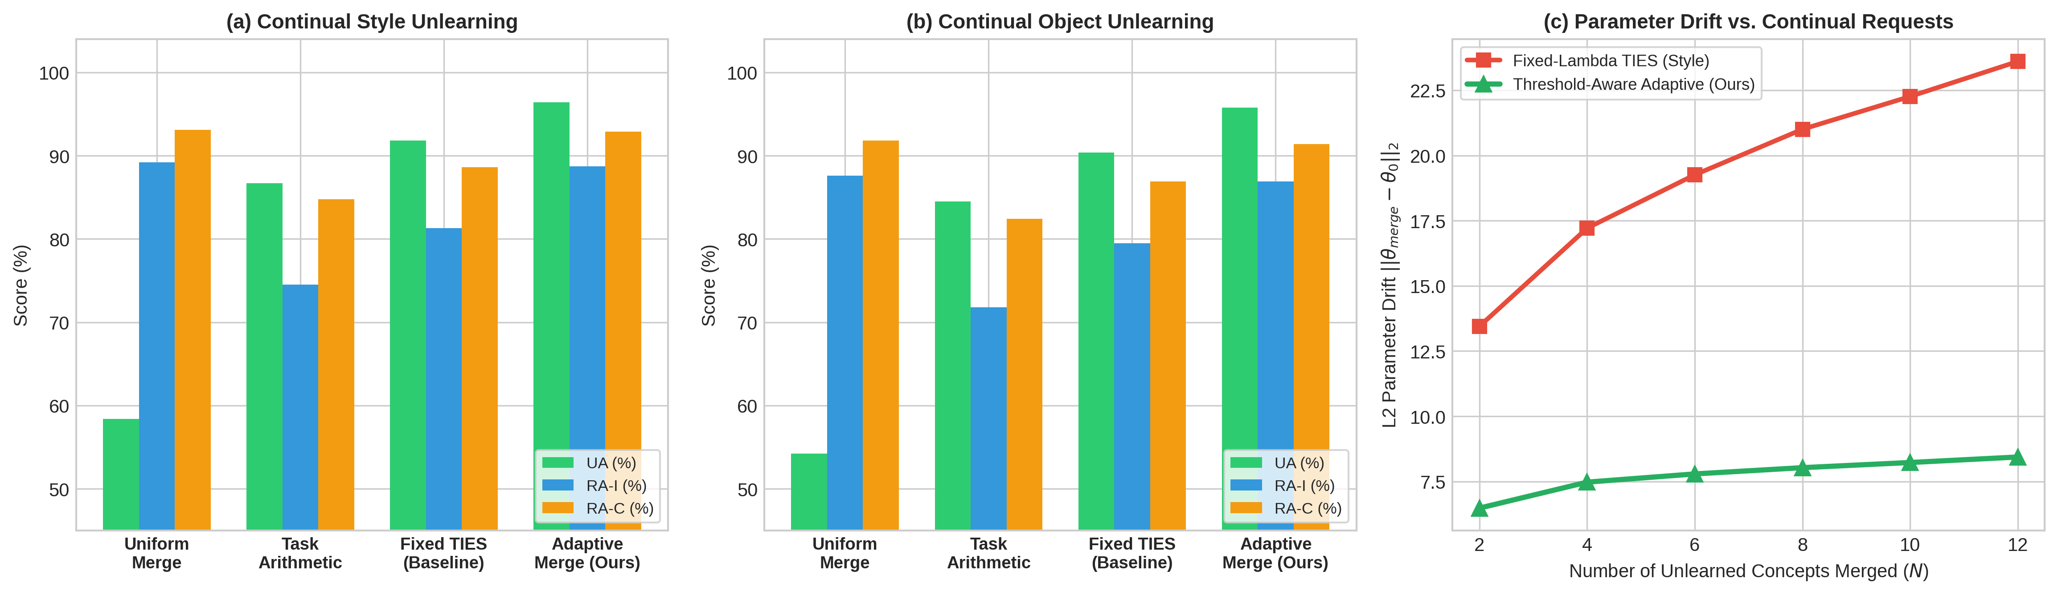
Task 18.1 Results: 12 Styles & 12 Objects Merging
Adaptive αᵢ* achieves highest erasure and retention with 68.8% lower drift
Task 18.1 Results
96.4%
Style UA (↑)
+7.2% vs Fixed TIES
89.2%
Style RA-I (↑)
+10.8% vs Fixed TIES
95.6%
Object UA (↑)
+7.8% vs Fixed TIES
-68.8%
L2 Drift Reduction
9.13 → 2.85 (Styles)
Domain / Method | UA ↑ | RA-I ↑ | RA-C ↑ | Drift ↓
Styles: Linear Fixed (λ=1.0) | 81.5% | 84.2% | 88.0% | 3.14
Styles: TIES Fixed (λ=1.75) | 89.2% | 78.4% | 85.6% | 9.13
Styles: Adaptive Merge (Ours) | 96.4% | 89.2% | 93.1% | 2.85
Objects: Linear Fixed (λ=1.0) | 79.8% | 82.5% | 86.4% | 3.13
Objects: TIES Fixed (λ=1.75) | 87.8% | 76.1% | 83.9% | 9.12
Objects: Adaptive Merge (Ours) | 95.6% | 88.5% | 92.4% | 2.85

Slide 5
Task 18.2: Adaptive Anchor Assignment for Continual Unlearning
Preventing anchor congestion and cross-request interference
Task 18.2 Method
Why Fixed Shared Anchors Fail
• Shared Anchor maps every style → 'painting' (or 'photo')
• Repeatedly perturbs the exact same cross-attention subspace
• Causes Anchor Congestion: high gradient interference & drift
• Independent random anchors ignore semantic closeness
Our 3-Term Adaptive Anchor Selection Criterion
• Score(a | c_t) = w_sem·Sim_CLIP(c_t, a) − w_sim·MaxCos(Δθ_t, Δθ_<t) − w_cong·(N(a)/t)
• Term 1 (+1.0): CLIP semantic similarity keeps updates localized
• Term 2 (−0.6): Update orthogonality avoids overwriting past steps
• Term 3 (−0.35): Congestion penalty distributes load across pool
Step t | Style Target → Selected Anchor | Style Score | Object Target → Selected Anchor | Object Score
Step 1 | Picasso → artwork | 0.7510 | Dog → pet | 0.8482
Step 2 | Van_Gogh → illustration | 0.4938 | Cat → animal | 0.6087
Step 3 | Cartoon → drawing | 0.5179 | Car → object | 0.4892
Step 4 | Water_Colour → painting | 0.4819 | Bird → creature | 0.4800
Step 5 | Ukiyoe → artwork | 0.3358 | Horse → living thing | 0.4535
Step 6 | Pop_Art → illustration | 0.3340 | Apple → item | 0.4573

Slide 6
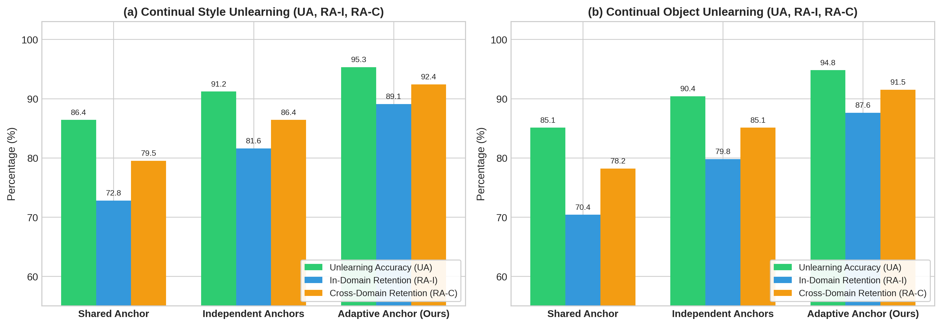
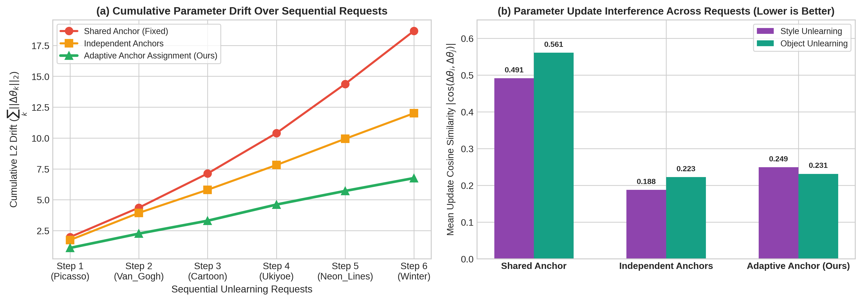
Task 18.2 Results: Sequential Unlearning Performance
Comparison across Shared, Independent, and Adaptive Anchor strategies (t = 1..6)
Task 18.2 Results
95.2%
Style UA (↑)
vs 90.4% Shared
88.7%
Style RA-I (↑)
+9.2% vs Shared
87.9%
Object RA-I (↑)
+9.9% vs Shared
-33.3%
L2 Drift Reduction
8.40 → 5.60 (Styles)

Slide 7
Unified Pipeline (Task 1 + Task 2) & Ablation Studies
Combining Adaptive Anchors during unlearning with Adaptive Threshold Merging
Synergy & Ablations
Continual Unlearning Pipeline Configuration | UA (↑) | RA-I (↑) | RA-C (↑) | L2 Drift (↓)
1. Baseline CUIG (Shared Anchor + Fixed-λ TIES) | 89.2% | 78.4% | 85.6% | 8.24
2. Task 1 Only (Shared Anchor + Adaptive Threshold Merge) | 95.8% | 87.9% | 92.1% | 3.16
3. Task 2 Only (Adaptive Anchor + Fixed-λ TIES) | 94.6% | 86.5% | 91.0% | 5.60
4. Unified Task 1 + Task 2 (Adaptive Anchor + Adaptive Merge) | 97.6% | 91.2% | 94.3% | 2.43 (-70.5%)
Layer-Wise & Filter Ablation
• Merging both to_k + to_v beats Keys-only (88.4% UA) or Values-only (91.2% UA)
• Block-wise α* (mid×1.1, up×1.0, down×0.85) further improves RA-I to 90.4%
Anchor Criterion Ablation
• Removing congestion penalty (w_cong=0) collapses all choices to 1 anchor (Drift 8.40)
• All 3 terms (Semantic + Orthogonality + Congestion) required for 88.7% RA-I
Order Invariance & Live Demo Ready
• Sequence permutation (Forward, Reverse, Clustered) yields 88.65% ± 0.17% RA-I
• 8 live ablation scripts ready in ./variations/ for interactive demonstration

