Slide 1

End Term Presentation of ELD 431: B.Tech. Project-1 on Control Tutored Q-Learning Presented By Akshat Gadhwal - 2019EE30551 Sarthak Gupta - 2019EE30296 Under the Supervision of Prof. Indra Narayan Kar DEPARTMENT OF ELECTRICAL ENGINEERING, INDIAN INSTITUTE OF TECHNOLOGY, DELHI, INDIA

Slide 2
Motivation
Q learning is increasingly used to learn control policies from data where the state and action can be represented by discrete values
In control applications, long training phases are often unacceptable, failures while learning might lead to unsafe situations
The introduction of some mathematical model of the plant can partially solve some of the issue mentioned above
In our setting, the Control Tutor supports the process of exploring the optimization landscape by suggesting possible actions based on its partial knowledge of the system dynamics

Slide 3
Problem statement
To compare Learning stage performance parameters of the Cartpole system controlled by conventional Q-Learning and Control Tutored Q-Learning
In this project we tried to simulate the Cartpole system control problem using python and tried to control it using QL and CTQL
Tools used are: Jupyter Notebook, MATLAB, Python

Slide 4
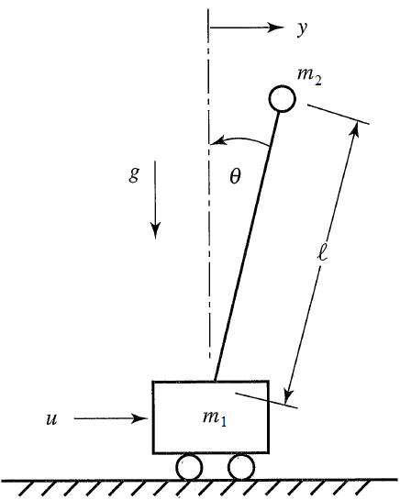
Cartpole Problem: Balancing Inverted Pendulum on Moving Cart
Modified OpenAI Cartpole System
Mass of cart = 2 kg
Mass of the pendulum = 0.1 kg
Length of the pendulum = 1 meter
g = 9.8 meter/second square
Admissible Angle Range = ±24 degree
Admissible Cart Position = ±2.4 meter
Goal = Try to maintain it in ± 5 degree

Slide 5
Problem Setting
Goal: To maintain the pole in ± 5 degree
Episode Termination Condition:
Pole Angle > ± 5 degree
Cart Position > ± 2.4
Reward > 200
Training Termination :
Successfully controlling continuously for 120 Episodes
Reward: +1 for every step taken including the Termination Step
Control Force: ±10, ± 5, 0 ;Discretised in 5 Bins
Angular Position Discretised in 6 Bins
Angular Velocity Discretised in 3 Bins

Slide 6
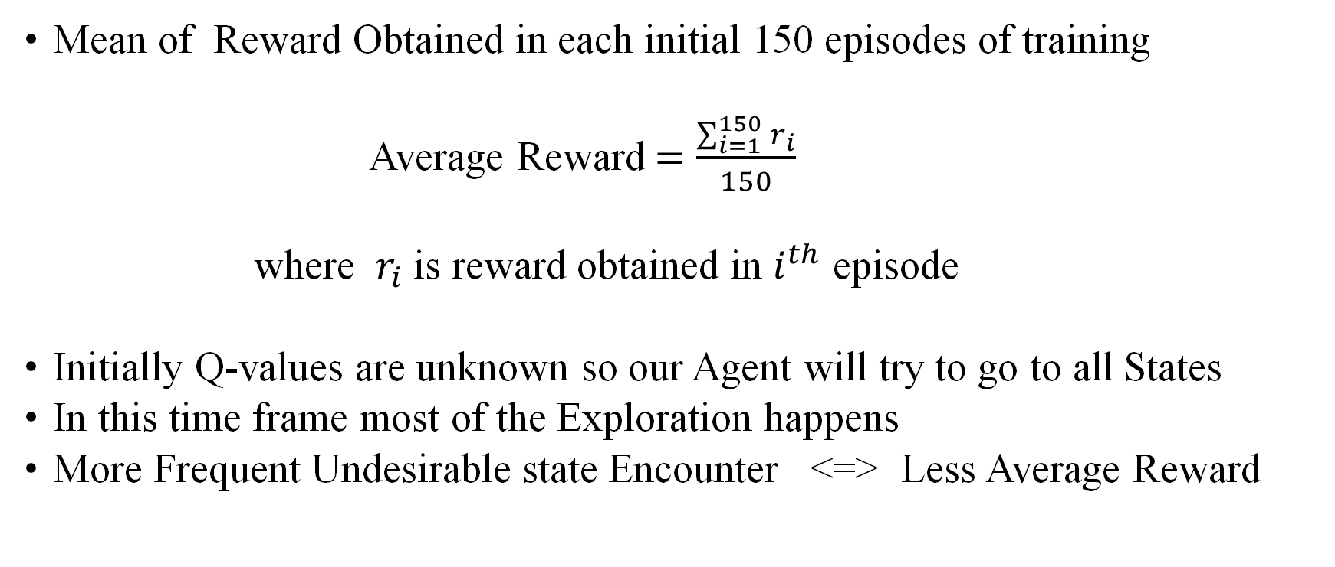
Comparison Parameter: Average Reward
Mean of Reward Obtained in each initial 150 episodes of training
Average Reward $=\frac{\sum_{i=1}^{150}{r_{i}}}{150}$
where $r_{i}$is reward obtained in $i^{th}$ episode
Initially Q-values are unknown so our Agent will try to go to all States
In this time frame most of the Exploration happens
More Frequent Undesirable state Encounter <=> Less Average Reward

Slide 7
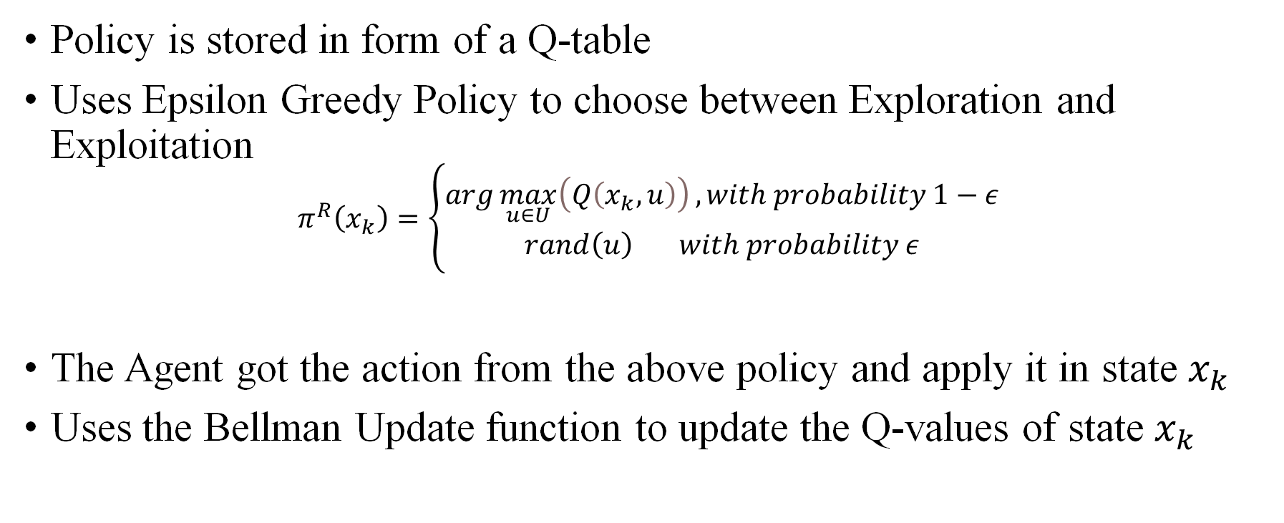
Controlling with Conventional Q-learning
Policy is stored in form of a Q-table
Uses Epsilon Greedy Policy to choose between Exploration and Exploitation
$$π^{R}\left(x_{k}\right)=\left\{\begin{aligned}\arg{\max_{u∈U}\left(Q\left(x_{k},u\right)\right)}, with probability 1−ε \\ &rand\left(u\right) with probability ε\end{aligned}\right.$$
The Agent got the action from the above policy and apply it in state $x_{k}$
Uses the Bellman Update function to update the Q-values of state $x_{k}$

Slide 8
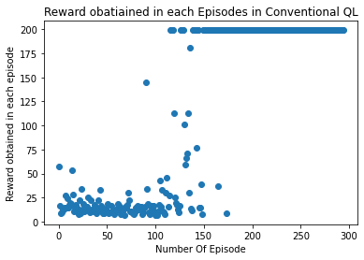

Result: Conventional Q-Learning
We ran 10 Training Sessions independently the results of these sessions are given below:
Average Reward for Initial 150 Episode = 39.81466666666667 (Average over all training Session)
Average Converging Episode = 299.1

Slide 9
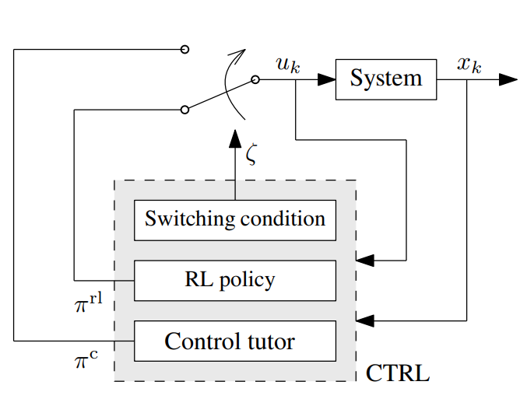
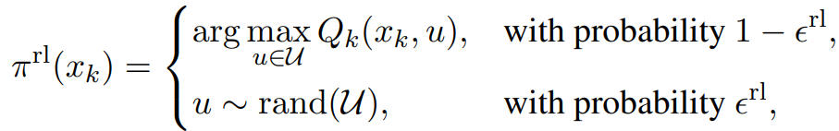
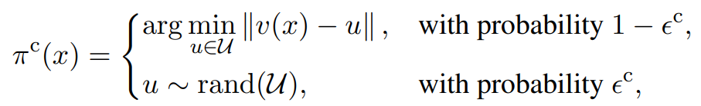
Control Tutored Q-Learning
Q-table and Bellman Update remains the same
Modified Epsilon greedy approach to incorporate Control Tutor

Slide 10
State Feedback Matrix for Control Tutor
Calculate the linearized model of the cart pole system by linearizing it With respect to Angular Position for given parameters
Used the Pole Placement Method to find the state feedback matrix K
Simulated the Response of the system in MATLAB for Non-Linear System to verify the performance
We verified the convergence by
adding random noise in the states
adding disturbance after settling time
The results are shown in next slide

Slide 11
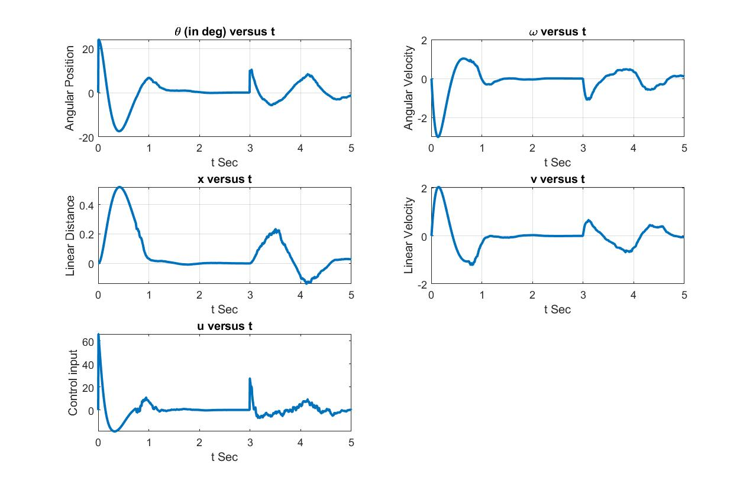

Slide 12
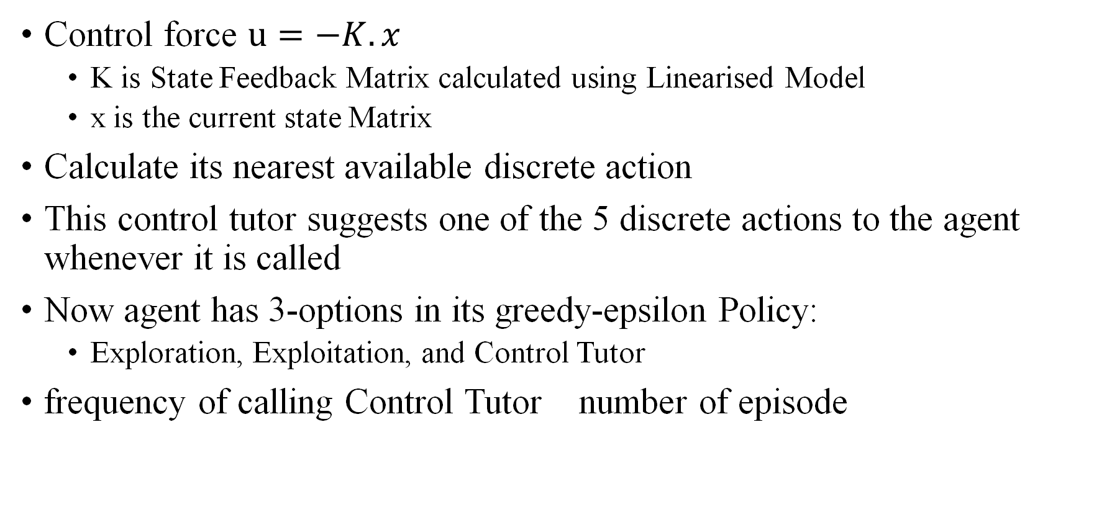
Addition of Control Tutor in Q-Learning
Control force $u=−K.x$
K is State Feedback Matrix calculated using Linearised Model
x is the current state Matrix
Calculate its nearest available discrete action
This control tutor suggests one of the 5 discrete actions to the agent whenever it is called
Now agent has 3-options in its greedy-epsilon Policy:
Exploration, Exploitation, and Control Tutor
frequency of calling Control Tutor number of episode

Slide 13
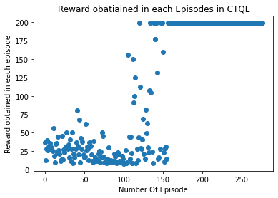

Result: Control Tutored Q-Learning
We ran 10 Training Sessions independently the results of this session are given below:
Average Reward for Initial 150 Episode = 46.95066666666666 (Average over all training Session)
Average Converging Episode = 293.1

Slide 14
Comparison and Summary
The average reward is larger in CTQL in comparison to classical QL
The training time in CTQL is better in comparison to QL
The CTQL and QL perform almost similarly in convergence
 | Conventional Q-Learning | Control Tutored Q-Learning
Average Initial Rewards | 39.815 | 46.951
Converging Episode | 299.1 | 293.1

Slide 15
Per Episode Reward Comparison

Slide 16
References
[1] F. De Lellis, G. Russo and M. Di Bernardo, "Tutoring Reinforcement Learning via Feedback Control," 2021 European Control Conference (ECC), 2021, pp. 580-585, doi: 10.23919/ECC54610.2021.9654881
[2] Ogata, Katsuhiko. Modern Control Engineering, Pearson Education Inc., 2010
[3] Watkins, Christopher & Dayan, Peter. (1992). Technical Note: Q-Learning. Machine Learning. 8. 279-292. 10.1007/BF00992698.
[4] OpenAI, OpenAI Gym Cartpole-v0, 2019. [Online]. Available: https://github.com/openai/gym/blob/master/gym/envs/classic_control/cartpole.py

Slide 17
Thank You !

Slide 18
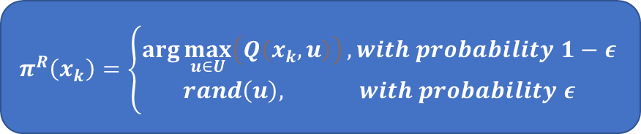
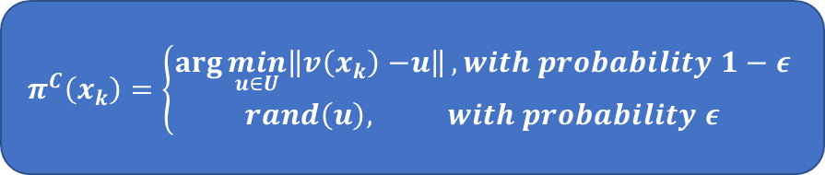
CTQL Demystified
Switching Condition
True
False
Control Policy
RL Policy
x< ε^{c}
else
else
x< ε^{rl}
$$π^{C}\left(x_{k}\right)=\left\{\begin{aligned}\arg{\min_{u∈U}\left\|v\left(x_{k}\right)−\right.\left.u\right\|}, with probability 1−ε \\ &rand\left(u\right), with probability ε\end{aligned}\right.$$
Pick a Random Action
$$π^{R}\left(x_{k}\right)=\left\{\begin{aligned}\arg{\max_{u∈U}\left(Q\left(x_{k},u\right)\right)}, with probability 1−ε \\ &rand\left(u\right), with probability ε\end{aligned}\right.$$

Slide 19
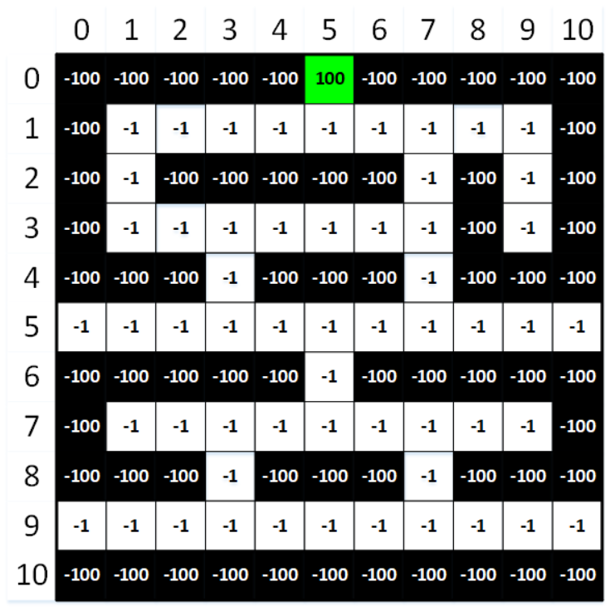
Amazon Warehouse: Environment
Environment:
State: position of the robot in warehouse
Action: Left, Right, Up, Down
Reward :
+100 for the Goal state- Packaging Area
-100 for Restricted Area
-1 for any extra step taken
Termination
Reached Goal state
Reached any restricted area
Accumulate very large negative reward

Slide 20
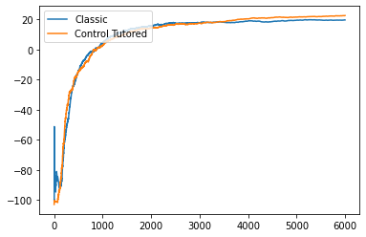

What did we find out?
Comparing Parameter: Average Reward
Average reward tells us about relatively how many optimum and poor decision were made to reach the goal
Higher average reward tells that we took comparatively less poor decisions
Less poor decisions means we took less time to reach the goal
Conclusion: Control-Tutored Q-learning is getting higher average reward

