Slide 1

Network Intrusion Detection System Using Machine Learning
STUDENT
Saryu Siriki
VP21CSCI0200073
M.Sc. Data Science
GUIDE
Dr. Chandra Sekhar Kolli
Assistant Professor
Department of Computer Science

Slide 2

OUTLINE
Introduction
Existing system
Proposed System
Aim
Objectives
Modules Description
UML Diagrams
Design
Results
Conclusion
Future Scope

Slide 3
INTRODUCTION
The digital age has brought about many advancements in technology, but it has also created new opportunities for cybercriminals to infiltrate networks and steal sensitive information.
To combat these threats, organizations rely on Network Intrusion Detection Systems(NIDS).
Network protection is mainly built upon two processes:
1.Network intrusion detection systems (NIDS) to monitor network traffic for abnormal or suspicious activity and notify security personnel of potential intrusions.
2.Intrusion Prevention System (IPS) acts upon the alert provided by the IDS, to either drop or treat the incoming attack.
With the increasing sophistication of cyber attacks, it is crucial for organizations to have a robust intrusion detection system in place to protect against potential breaches."
The proposed work examines the use of Machine learning techniques for Network IDS, with the goal of developing a system that can effectively detect and respond to a wide range of attacks.

Slide 4
EXISTING SYSTEM
Firewall : It is a traditional security measure that controls access to a network by blocking or allowing incoming and outgoing network traffic. These are primarily designed to protect against network-based attacks, such as unauthorized access, and port scanning but are not able to defend against certain types of attacks.
Intrusion detection systems based on signature matching: It identifies network threats by comparing network traffic to a database of known attack signatures. When a match is found between network traffic and a signature in the database, an alert is generated.
DRAWBACKS
Limited ability of firewall and signature matching to detect unknown or "zero-day" attacks. Signature-based detection relies on a database of known attack signatures, so it cannot detect attacks that have not been seen before and do not have a known signature.
These methods are prone to generate high numbers of false positives and and lack the capacity to perform real-time detection and response.

Slide 5
PROPOSED SYSTEM
The proposed intrusion detection system (IDS) is anomaly-based detection process to overcome the signature matching limits (maintaining an updated database and unknown attacks). It is viewed as an effective solution for network security and protection against external threats. However, the existing Intrusion Detection System often has a lower detection rate under new attacks and has a high overhead when working with audit data. Thus machine learning methods have been widely applied in intrusion detection.
In the proposed system, Decision Tree, Logistic regression, Random Forest, Naive Baye’s, SVM, and KNN are developed as learning methods to solve the classification problem of intrusion detection and classifying attacks.

Slide 6
AIM
To design and implement a Network Intrusion Detection System using Machine learning techniques that can detect and classify network intrusions , with a high level of accuracy and recall score.

Slide 7
OBJECTIVES
To develop a system that can detect and classify malicious traffic in real time, with minimal human intervention.
To improve the accuracy of network intrusion detection systems and reduce the number of false positives generated by traditional rule-based systems.
To find the best suitable algorithm to detect the intrusions.
The goal is to improve the overall security of the network by detecting and mitigating the impact of attacks as early as possible.

Slide 8
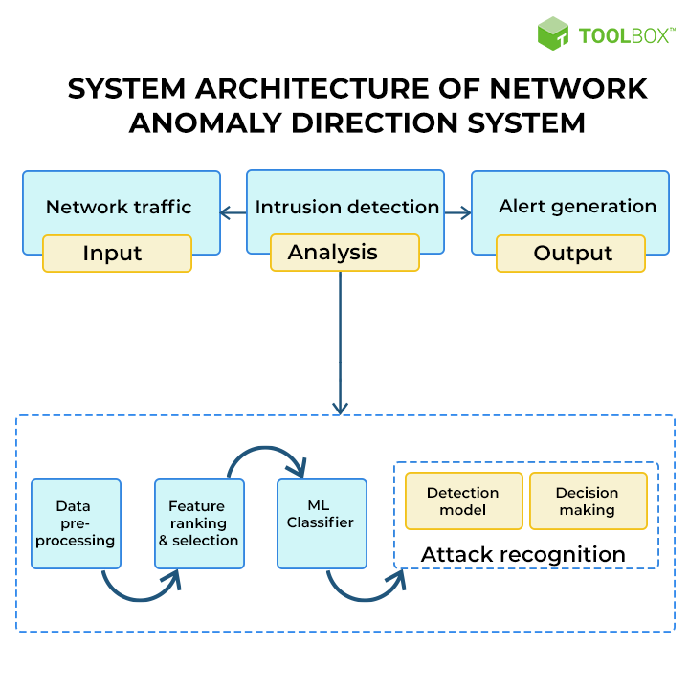
System Architecture
Performance evaluation
Fig 1: System Architecture of the proposed system

Slide 9
MODULES DESCRIPTION
MODULE 1 : NETWORK TRAFFIC ANALYSIS
This module is a critical component of the intrusion detection system. It is responsible for capturing and processing network traffic data in a format that can be used by the intrusion detection module. The KDD CUP 99 dataset contains a large number of features, including both continuous and categorical data, which need to be preprocessed to be useful for the intrusion detection module. The preprocessing include tasks such as converting categorical features into numeric values , and removing redundant or irrelevant features.

Slide 10
METHODOLOGY:
Input: Raw network traffic data from the KDD Cup 99 dataset.
Output: Processed network traffic data containing relevant features for intrusion detection.
Process:
The packet capture process is initiated to collect the network traffic data.
Once the data is collected, it undergoes processing to extract relevant features such as packet size, protocol type, source, and destination IP addresses, etc.
The output of this module is the processed network traffic data that contains all the features required for intrusion detection.

Slide 11
MODULE 2 : NETWORK TRAFFIC CLASSIFICATION
This module is responsible for classifying the network traffic data into different types, such as Denial of service (DoS), User to Root(U2R), Remote to Local (R2L), probe, and normal. It is an essential task in the field of network security, as it helps to identify potential network intrusions, malware, and other malicious activities.
DoS (Denial of Service): An attack that aims to make a network or website unavailable to users by overwhelming it with traffic or requests.
R2L (Remote to Local): An attack that targets vulnerabilities in remote access protocols to gain unauthorized access to a local system.
U2R (User to Root): An attack that exploits vulnerabilities in a user's privileges or software to gain root access and administrative control over a system.
Probe: An attack that involves scanning a network to gather information about potential vulnerabilities and targets for further attacks.

Slide 12
METHODOLOGY:
Input: Network traffic data in the form of packets, which include various features such as protocol used, source and destination IP addresses, source and destination ports, packet size, and time duration.
Output: Categorized network traffic data into different types, such as Denial of Service (DoS), User to Root (U2R), Remote to Local (R2L), Probe, and Normal traffic.
Process:
Each attack is associated with a label that indicates the type of attack it represents.
To group attacks into the four categories, the labels are examined to determine which category they belong to. For example, attacks labeled as "smurf" or "neptune" are classified as DoS attacks.
Once all the attacks have been assigned to their respective categories, the dataset can be used to train and evaluate a network intrusion detection system that is capable of identifying and classifying attacks.

Slide 13
MODULE 3 : INTRUSION DETECTION
This module is a critical component of a network security system that helps detect and prevent potential network attacks and unauthorized access to a network. It is designed to monitor and analyze network traffic data to identify and alert network administrators about any suspicious activities or patterns that indicate an intrusion attempt. It uses various machine learning algorithms, such as decision trees, random forests, Naïve Baye’s, Logistic Regression, KNN, and Support Vector Machine to detect patterns in the data that indicate an attack. To train the intrusion detection module, the KDD CUP 99 dataset is typically split into a training set and a test set. The training set is used to train the machine learning model, while the test set is used to evaluate the performance of the model.

Slide 14
METHODOLOGY:
Input: Pre-processed KDD Cup 99 dataset with labels indicating whether the traffic is normal or malicious.
Output: A trained machine learning model that can be used to detect network intrusions.
Process:
The input network traffic data undergoes analysis to identify any potential intrusion or attack.
This is achieved using machine learning-based anomaly detection algorithms.
Train the selected machine learning algorithm on the training dataset.
The output of this module is the detected network intrusion or attack.

Slide 15
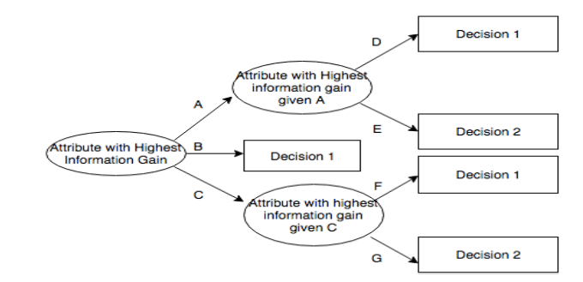
ALGORITHM DESCRIPTION
Decision Tree Algorithm: Decision tree is a type of supervised learning algorithm that is mostly used in classification problems. It works for both categorical and continuous input and output variables. In this technique, we split sample into two or more homogeneous sets based on most significant splitter / differentiator in input variables. In decision tree internal node represents a test on the attribute, branch depicts the outcome and leaf represents decision made after computing attribute.
Fig 2: Flowchart of Decision Tree Algorithm

Slide 16
MODULE 4 : PERFORMANCE EVALUATION
This module is responsible for evaluating the performance of the intrusion detection system. The performance evaluation module assesses the effectiveness of the intrusion detection module in detecting network intrusions. It will use various metrics, such as accuracy, precision, recall, and F1 score, weighted average to evaluate the performance of the system. The module will also generate a confusion matrix to provide a more detailed view of the system's performance. The performance evaluation module will help to identify the strengths and weaknesses of the system and enable the selection of the most suitable machine learning algorithm for detecting network attacks.

Slide 17
METHODOLOGY:
Input: The testing dataset with actual labels indicating whether the traffic is normal or malicious, and the trained intrusion detection model.
Output: Performance metrics of the intrusion detection model.
Process:
The input network intrusion or attack data undergoes performance evaluation.
The evaluation is done by comparing the machine learning algorithms.
Performance metrics such as accuracy, precision, recall, and F1-score are calculated.
The output of this module is the performance metrics of the intrusion detection model.

Slide 18
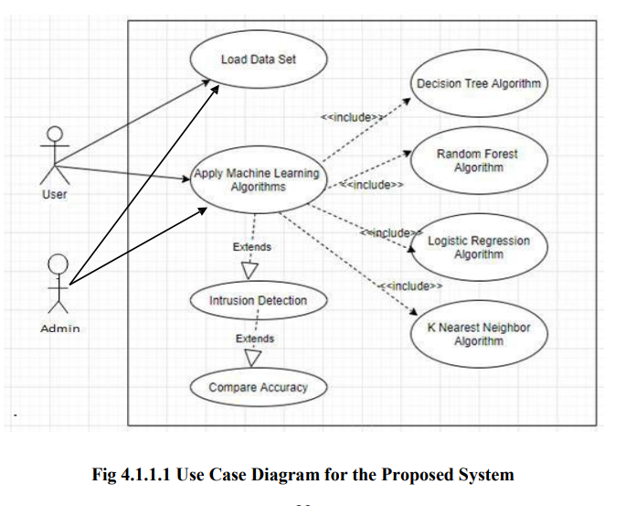
UML DIAGRAMS
Use Case Diagram:
Use Case diagram will help to identify and document the functional requirements of the network intrusion detection system. It will provide a high-level view of the system's behavior and the interactions between its components.
Fig 3: Use Case Diagram of the Proposed System

Slide 19
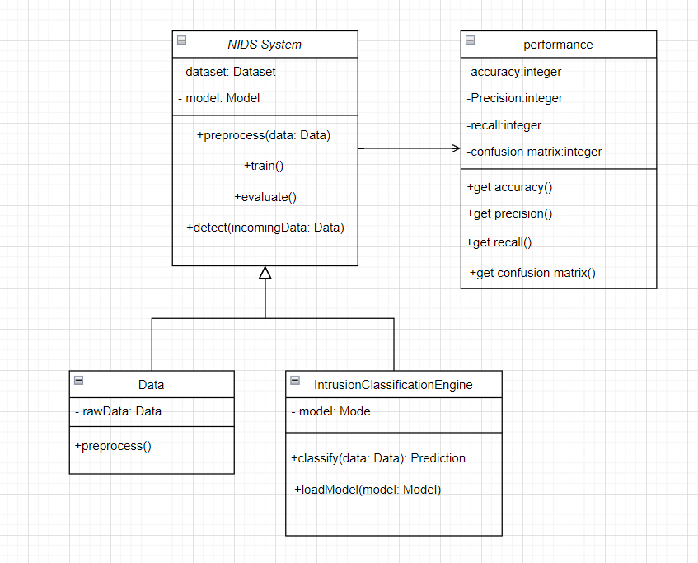
Class Diagram:
Class diagram will help to define the system's object-oriented structure, including the classes, attributes, and methods that will be used in the system.
Fig 4 : Class Diagram of IDS

Slide 20
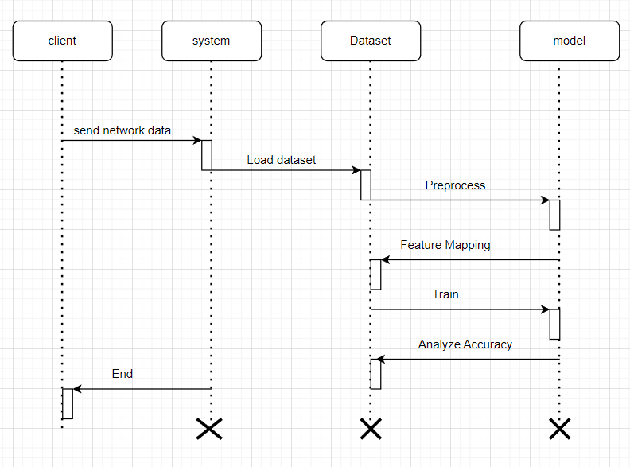
Sequence Diagram:
Sequence diagram will help to illustrate the interactions between the different components of the system during the process of detecting network intrusions.
Fig 5 : sequence Diagram of the proposed system

Slide 21
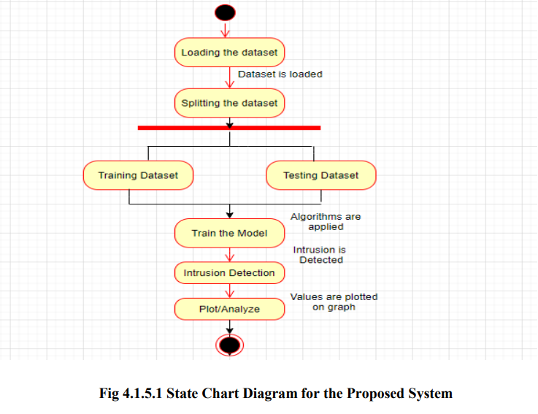
State Chart Diagram:
State Chart diagram will help to represent the different states of the system during its operation. The statechart diagram could show the different states and the transitions between these states, based on the detection of network anomalies.
Fig 6 : State Chart Diagram of the proposed system

Slide 22
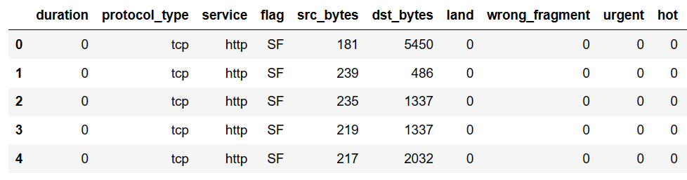
DESIGN
Data Collection: The data collection step in a network intrusion detection system involves the process of gathering network traffic data from various sources. This data is then used for analysis and classification to detect potential security threats or attacks. In the project, KDD CUP’ 99 dataset was used, which contains a large number of records of network traffic. The data for KDD Cup 1999 was collected by the Defense Advanced Research Projects Agency (DARPA) as part of an intrusion detection evaluation program.

Slide 23
KDD Dataset analysis and Pre-processing: The KDD Cup 99 dataset is a widely used dataset in the research community for evaluating the performance of IDS. It contains a set of network traffic features, including protocol type, service, flag, source IP address. The dataset includes both normal and attack traffic, and the attacks are classified into four categories, namely, DoS, Probe, U2R, and R2L. The dataset consists 4,898,431 records, including 41 features, of which 34 continuous features and 7 categorical features. It also includes a binary label indicating whether the network traffic is normal or an attack.
categories of attack | Number of Instances
DoS | 3883349
U2R | 52
R2L | 1126
Probe | 41102
Normal | 972781
Table 1: Distribution of Attacks within KDD Dataset

Slide 24
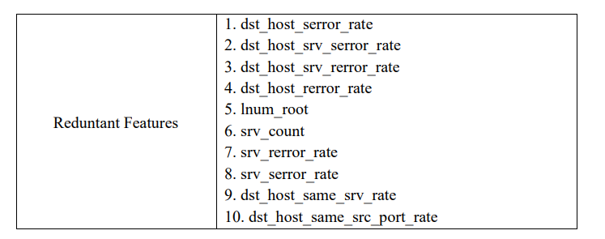
Feature Selection: The dataset is typically very large with a large number of features. The heatmap can be used to identify features that are highly correlated with each other. keeping highly correlated features can lead to overfitting and reduced model performance. Once the highly correlated features are identified, they can be dropped from the dataset. In the project, 10 columns were dropped after performing feature selection using the correlation heatmap.
Table 2 : Redundant Features within KDD dataset

Slide 25
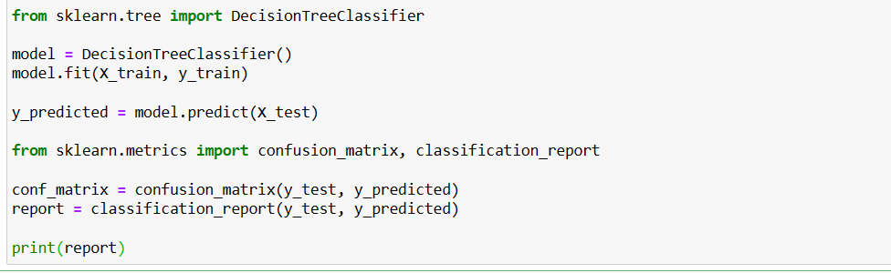
Model Training: This step involves training and testing a machine learning model using the preprocessed and selected features. The dataset was split into a training set and a testing set, with a ratio of 75% for training and 25% for testing. This can be done using a 28 library such as scikit-learn in Python, which provides a function called "train_test_split", in particular sklearn.model_selection. several machine learning algorithms such as Decision Tree, Random Forest, Naive Bayes, Logistic Regression, KNN and Support Vector Machines (SVM). were used to train and test the model.

Slide 26
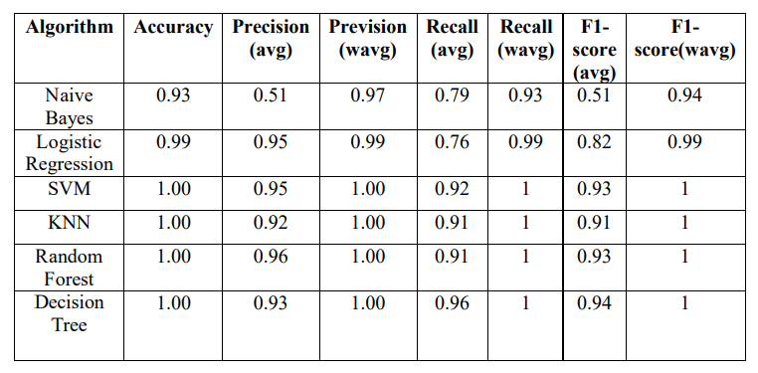
Model Evaluation: In this step, the performance of the trained machine learning model is evaluated by comparing its predictions against the ground truth. Various performance metrics were used, including accuracy, precision, recall, F1 score, and weighted average to evaluate the model. The confusion matrix is used to calculate these metrics.
Table 3 : classification report of all the algorithms

Slide 27
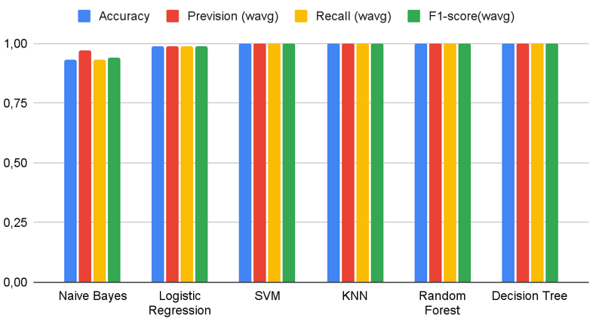
RESULTS
Overall prediction scores
Fig 7: Bar graph of the general evaluation metrics for each algorithm

Slide 28
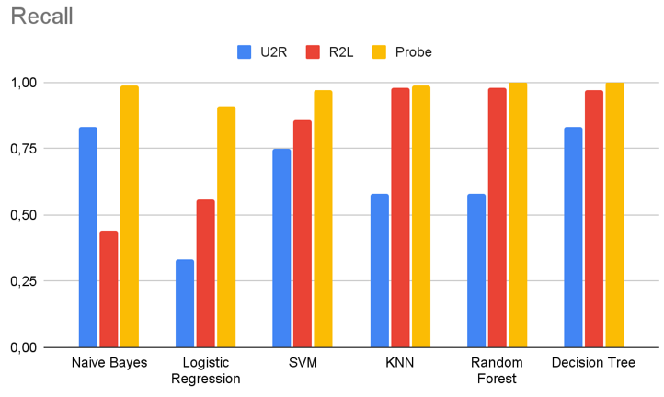
Recall on the most impactful labels
Fig 8: Bar Graph of Recall for the 3 Most Impactful Labels

Slide 29
CONCLUSION
Network intrusion detection system using machine learning is a promising approach to detect and prevent potential attacks on a network. The system employs various machine learning algorithms that are trained on labeled data to accurately detect anomalies in network traffic. The system's performance is evaluated using different performance metrics such as precision, recall, and F1-score. The results show that Decision Tree classifier performed well compared to the other models in predicting the malicious packets, especially in terms of accuracy and recall. The results of the evaluation indicate that the proposed system architecture provides an efficient and effective approach for network intrusion detection. Overall, the system has the potential to significantly enhance network security and protect against various types of cyber-attacks.

Slide 30
FUTURE SCOPE
For even better results in detecting attacks, some further steps can be taken:
Using more sophisticated algorithms: This could also improve our metrics significantly: outputs the best results using the J48 classifier, which gives a significantly better computation time compared to other algorithms. Although they use more computational power and time, deep neural networks have proven to give better accuracy results on such large datasets.
Clean and more up-to-date versions of dataset: KDD-99 is one of the oldest attempts at creating a large dataset of cyber-attacks, it aims mostly at creating NIDS (Network Intrusion Detection Systems) but is suffering from severe flaws that can make it weaker compared to more recent and cleaner datasets.

Slide 31
Thank you

