Slide 1
-Sample Only-
My GitHub: Sas-wti
G-mail: saswati.my@gmail.com
This slide uses `WorkSans` font . Please Install that for better viewing.
This slide is only for Information purpose
Design and Content by : Saswati

Slide 2

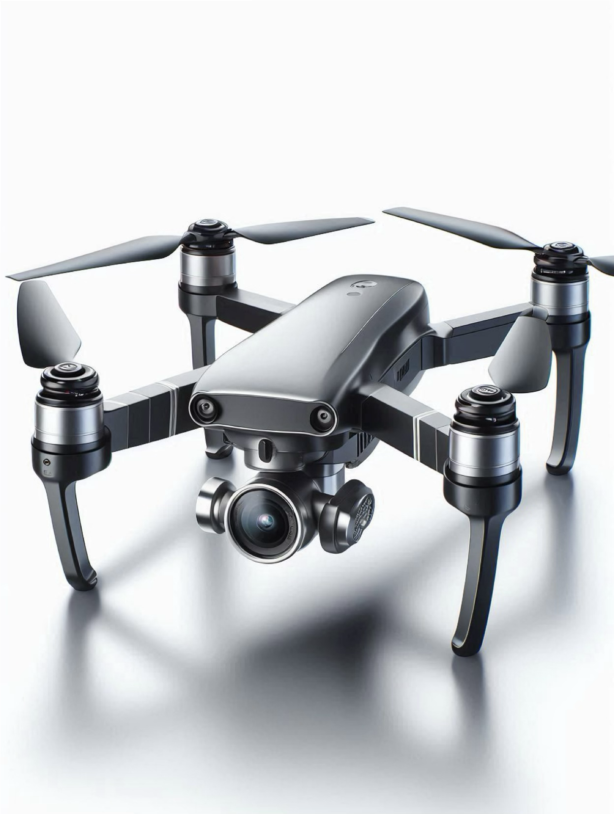
Unmanned Aerial System in Action: The Future of Logistics
Design and Content by : Saswati

Slide 3









Day 1 : Introduction and Basics of Flight
Overview of Unmanned Aerial Systems
Introduction to Logistics Drone Operations
Definition and classification of unmanned aerial systems (UAS)
Overview of logistics-specific drone operations
Importance of drones in logistics operations
Importance of drones in logistics operations
Key components: frame, motors, avionics, payload systems
Key components: frame, motors, avionics, payload systems
Basic Aerodynamics and Principles of Flight
Basics of Drone Operations and Flight Mechanics
Concepts of lift, thrust, drag, and weight.
Flight terminology: pitch, yaw, roll
Importance of drones in logistics operations
Manual vs. autonomous flight modes
Key components: frame, motors, avionics, payload systems
Key components: frame, motors, avionics, payload systems
Design and Content by : Saswati

Slide 4
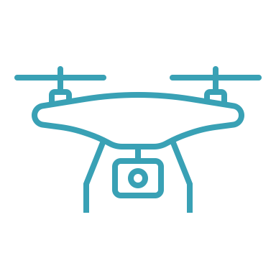

Overview of Unmanned Aerial Systems
systems combine an unmanned aerial vehicle (UAV) with a ground control station and communication links, allowing for remotely controlled or autonomous flight.
Size and Weight
Range
Altitude
Micro/Nano : <2 kg
Short-Range: Operate within 5 km
Medium-Range: Range between 5–50 km
Long-Range: Capable of flying beyond 50 km
Low-Altitude: less than 500 m
High-Altitude: Fly above 500 m
Small Drones: 2–25 kg
Classification
Medium Drones: 25–150 kg
Large Drones: >150 kg
Design and Content by : Saswati

Slide 5
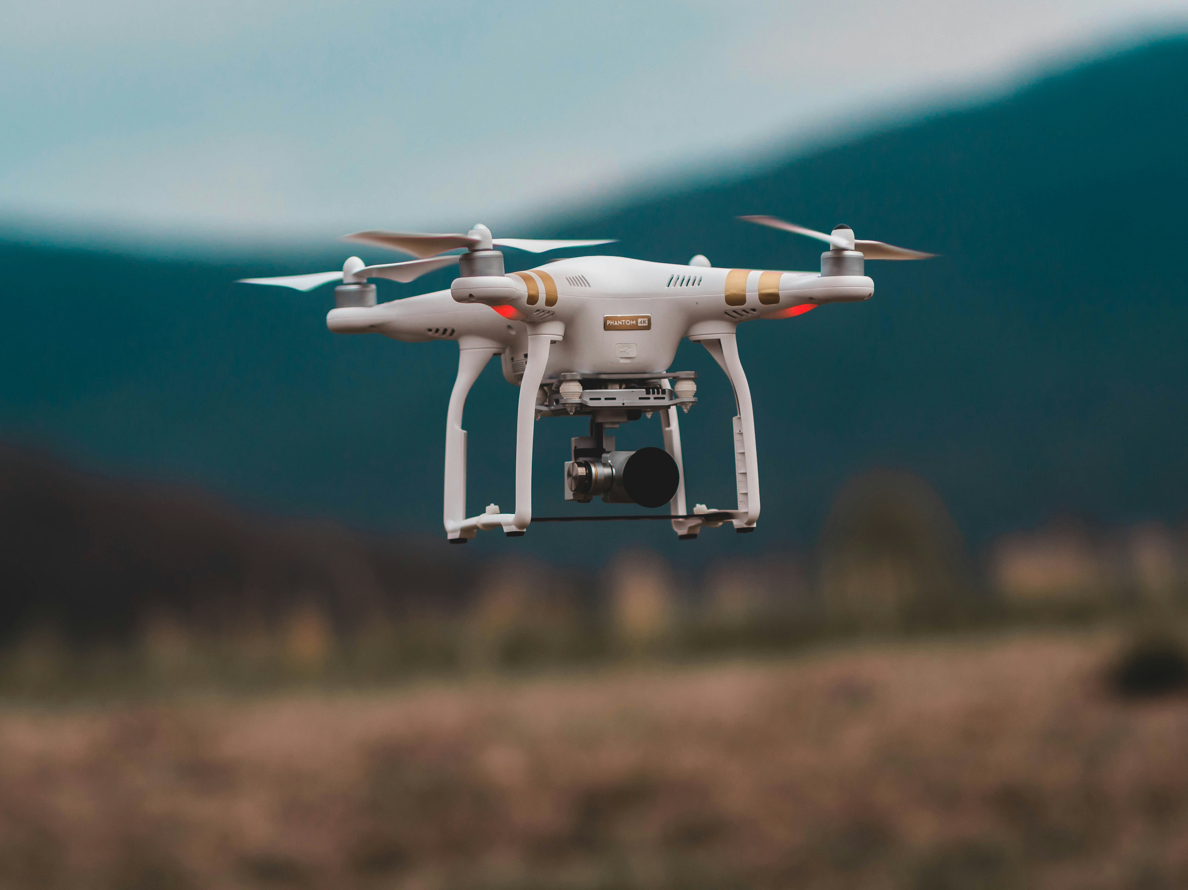
Thank You 🚀
Design and Content by : Saswati

