Slide 1

Welcome to the
Bengaluru, India

Slide 2


Our Supporters

Slide 3

If you have questions about the event or to report any issues
Use the HASHTAG
#askgab19
And the organizers and volunteers will try to support!

Slide 4
Please share our event on the WWW by any means
Use the HASHTAG
#gabblr19
extensively

Slide 5
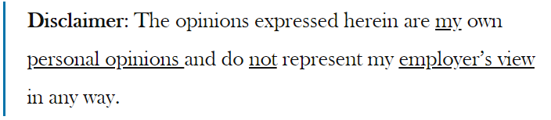
Service Mesh and Istio
Presenter: Sandeep Sachan (Itron India Pvt Ltd)
Twitter: sa_sachan
Blog: https://www.cloudgarlic.com/

Slide 6

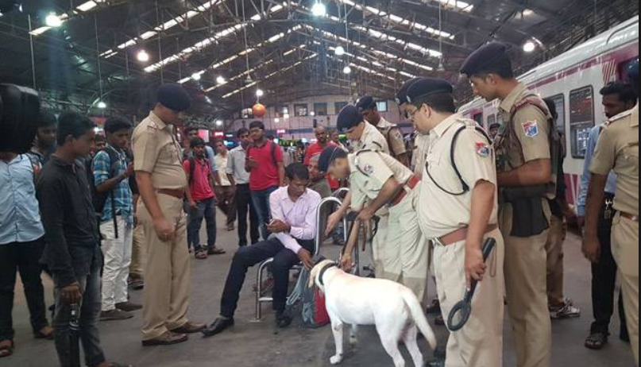
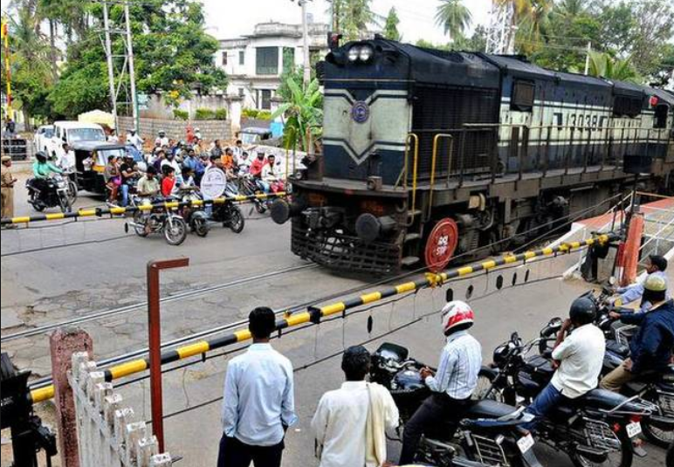
Scale
Predictable
Connected
Economical
Security
Control

Slide 7
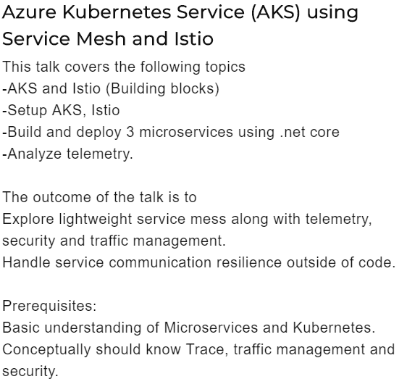
Agenda
Service mesh
Setup AKS
Setup Istio
mesh
Add-ons
Demo
Q & A

Slide 8





Microservices
Monolith
Kubernetes
Microservices & Containers
Product, Detail, Rating Review v1, Review v2, Review v3
Rolling out & back
Scaling
Resiliency
Product Page
Detail
Ratting
Review v3
Review v2
Review v1
Ratting Processor
Scheduling
Guest OS
Guest OS
Guest OS
Guest OS
Guest OS
Guest OS
Service Discovery
Health Check
Hypervisor
SQL
Host OS
Redundancy
Infrastructure
Service Fabric

Slide 9
Demo 1 – Setup AKS
https://docs.microsoft.com/en-us/azure/aks/kubernetes-walkthrough-portal
https://docs.microsoft.com/en-us/azure/aks/kubernetes-walkthrough
https://www.youtube.com/watch?v=r0uRLhrzbtU&list=PL2We04F3Y_43dAehLMT5GxJhtk3mJtkl5
Kubernetes for the Absolute Beginners

Slide 10
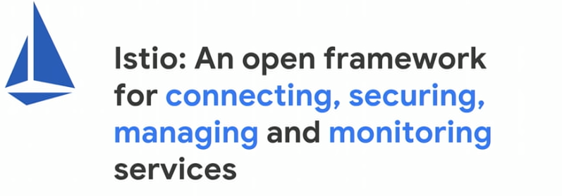

How about Day 5 with Microservices!
Fault Injection
Blue/Green Deployment
Dependancy management
Tracing
Metrics
Logging
Pre-Release
Common Policy
Product Page
Detail
Ratting
Review v3
Review v2
Review v1
Traffic flow
Security
Guest OS
Guest OS
Guest OS
Guest OS
Guest OS
Guest OS
Failover
Hypervisor
Beta testing
Host OS
Infrastructure

Slide 11
Demo 2 – Setup Istio and deploy Bookinfo
https://docs.microsoft.com/en-us/azure/aks/istio-install
https://istio.io/docs/setup/kubernetes/install/helm/
https://istio.io/docs/examples/bookinfo/

Slide 12
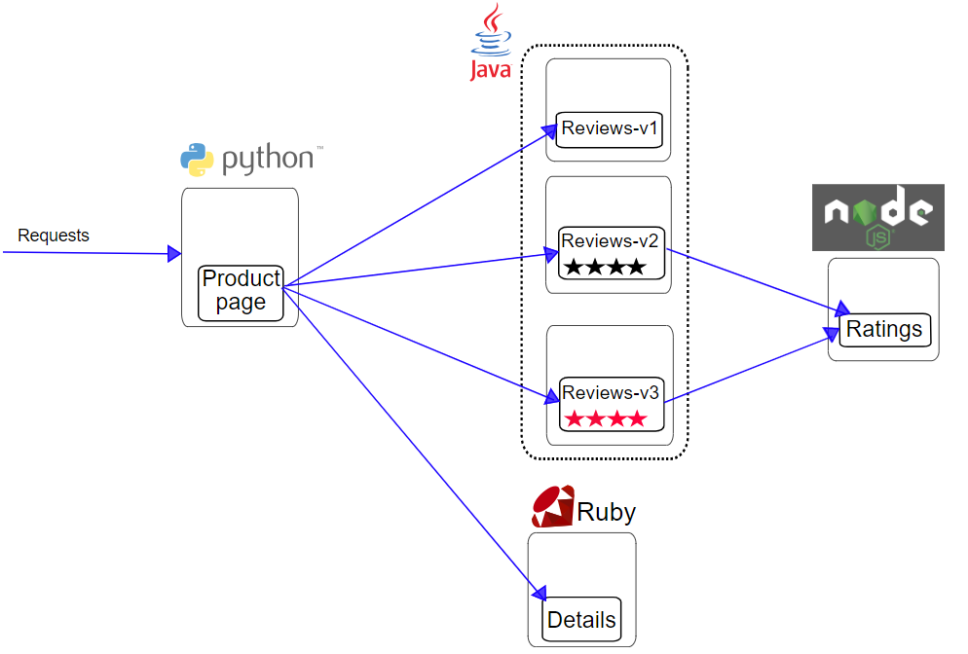
Private Ingress
Request
Proxy
Product Page
Egress
Public Ingress
Proxy
Review v1
Proxy
Review v2
Review v1
Proxy
Review v3
Review v2
Ratting
Product Page
Ratting
Proxy
Review v3
Proxy
Detail
Detail
Request flow without Istio
Request flow with Istio

Slide 13
Demo 3 – Istio the insight view?
Grafana
Jaeger
Kiali
Prometheus
Tracing
Zipkin

Slide 14
Demo 4 - Route everyone to V1
Notes:
Istio’s easy rules configuration and traffic routing lets you control the flow of traffic and API calls between services. Istio simplifies configuration of service-level properties like circuit breakers, timeouts, and retries, and makes it a breeze to set up important tasks like A/B testing, canary rollouts, and staged rollouts with percentage-based traffic splits.
With better visibility into your traffic, and out-of-box failure recovery features, you can catch issues before they cause problems, making calls more reliable, and your network more robust – no matter what conditions you face

Slide 15
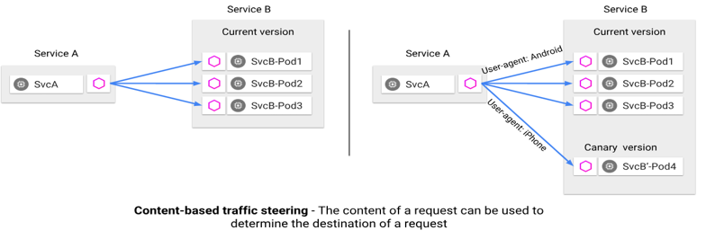
Demo -5 - Route user ‘sandeep.sachan’ to V2

Slide 16
Demo -6 - Injecting an HTTP delay fault

Slide 17
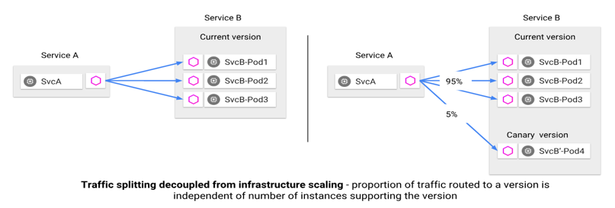
Demo 7 - Apply weight-based routing 50%
https://docs.microsoft.com/en-us/azure/aks/istio-scenario-routing

Slide 18
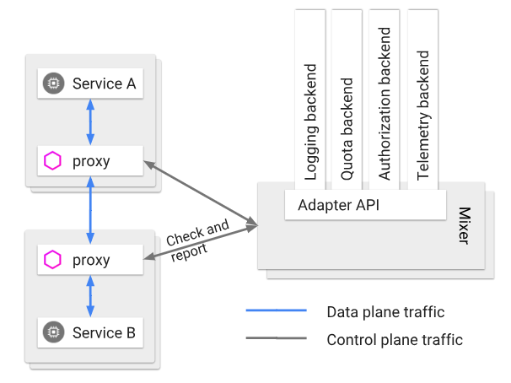
Policy & Telemetry
Features
Policy enforcement
Rate limits
Header & Routing
White/Black listing

Slide 19
Demo 8 – Rate limits

Slide 20
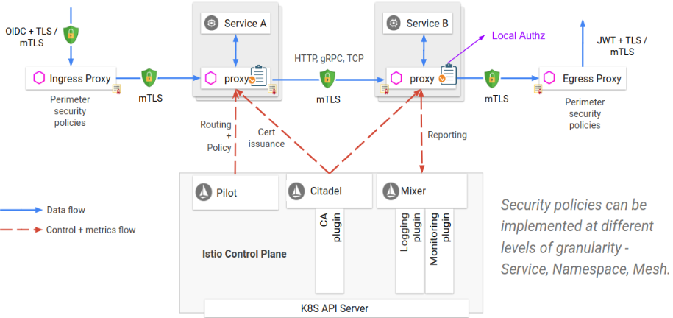
Security
Features
Auth Policy for TCP, HTTP
Support for Group, Claim (OPA)
mTLS
Certification management

Slide 21
Thanks
https://www.youtube.com/watch?v=G4F5aRFEXnU
Performance and Scale @ Istio Service Mesh
https://www.youtube.com/watch?v=IeJDjq-COjk
Envoy
https://www.youtube.com/watch?v=gQF23Vw0keg&t=557s
Envoy Internals Deep Dive - Matt Klein, Lyft

Slide 22
Q & A

Slide 23
Find all the online locations here
Join our Meetup group here
http://bit.ly/azrmeetup
Check the event photos here
http://bit.ly/gab19-photos
Note: You could also upload your selfies and other photos you have taken at the event
Check slide decks and other samples presented at the event here
http://bit.ly/gab2019-repo

