Slide 1
Natural Language Processing with Hugging Face
Diving into the World of Pretrained Language Models and AI Solutions

Slide 2

Agenda
Overview NLP and Hugging Face
Transformer Models in Hugging Face

Slide 3
What is NLP?
NLP is a field of linguistics and machine learning focused on understanding everything related to human language. The aim of NLP tasks is not only to understand single words individually, but to be able to understand the context of those words.

Slide 4
Overview

Slide 5
Common NLP Tasks
Classifying whole sentences (sentiment analysis, spam check, grammar check, etc.)
Classifying each word in a sentence
Generating text content (write article, poem, etc.)
Extracting an answer from a text (Question and Answer)
Generating a new sentence from an input text (Translation, Summarization)

Slide 6
What is Hugging Face?
Hugging Face is a leading platform and community that has revolutionized the field of Natural Language Processing (NLP) through its ground-breaking contributions and cutting-edge advancements. At its core, Hugging Face is a library called "Transformers" that houses an extensive collection of pretrained language models, enabling developers, researchers, and AI enthusiasts to tap into the immense power of state-of-the-art AI-driven language understanding. Hugging Face is for NLP what GitHub is for Software Development.

Slide 7
Hugging Face key features?
Key features and highlights of Hugging Face include:
Transformer Models: neural network architecture trained to perform NLP.
Pipelines: Hugging Face introduces the concept of pipelines, simplifying the utilization of pretrained models for specific NLP tasks. Pipelines offer a streamlined approach for text generation, sentiment analysis, translation, and more.
NLP Tasks: tasks that can be executed using Transformer Models and Pipelines (Text-to-speech, Question-Answering,
Transformers Library: The heart of Hugging Face, the Transformers library, provides easy access to a wide array of transformer models, pipelines, NLP tasks, etc.
Community Collaboration: Hugging Face has fostered a vibrant community of developers and researchers, encouraging collaboration and knowledge-sharing. This dynamic ecosystem contributes to the constant evolution and improvement of NLP capabilities.
State-of-the-Art Models: Hugging Face continually updates and releases state-of-the-art language models, enabling users to stay at the forefront of NLP advancements without the need for extensive model training.
Open-Source Philosophy: Hugging Face embraces an open-source philosophy, making its tools, libraries, and resources accessible to all, thereby democratizing the field of NLP and AI.

Slide 8
Why use Hugging Face?
Whether you're a seasoned NLP practitioner or just beginning to explore the realm of language understanding, Hugging Face empowers you with the tools, models, and community support to create innovative applications, conduct ground-breaking research, and make AI-powered language processing an integral part of your projects.

Slide 9
The Transformers Library
Hugging Face's Transformers Library is the beating heart of the platform, offering a comprehensive array of tools and models to revolutionize Natural Language Processing. The Transformers Library not only streamlines development but democratizes access to advanced language models, enabling developers and researchers to create cutting-edge NLP solutions.
Key Components:
Transformer Models: Access an extensive collection of pretrained models, from BERT to GPT-3 and beyond, for advanced NLP tasks.
Pipelines: Execute complex NLP tasks such as text generation, sentiment analysis, and translation with simple predefined workflows.
Tokenizer: Simplify data preparation by converting text into tokens understandable by models.
Training Utilities: Customize pretrained models to your needs or train custom models.
API Access: Seamlessly integrate Hugging Face models into applications through intuitive APIs.
Research Foundations: A valuable resource for the research community to experiment with new NLP techniques.

Slide 10
What is a Transformer Model?
Transformer Models represent a ground-breaking neural network architecture that has reshaped the landscape of Natural Language Processing (NLP). Introduced in the paper "Attention is All You Need," Transformers have redefined how machines understand and generate human language.

Slide 11

Transformer Model key features
Key Features of Transformers:
Attention Mechanism: Transformers leverage attention mechanisms to capture long-range dependencies in text, enabling them to grasp intricate semantic relationships across words.
Bidirectional Context: Unlike traditional models, Transformers process text in both directions, allowing them to comprehend the context before and after each word, leading to richer linguistic understanding.
Pretraining and Fine-tuning: Transformers are pretrained on massive text corpora, acquiring general language knowledge. They can then be fine-tuned for specific tasks, making them adaptable to various NLP applications.
Transfer Learning: Transformers excel at transfer learning, where knowledge from one task can be applied to another, reducing the need for extensive task-specific training.

Slide 12
What is a Pipeline?
The most basic object in the Transformers library is the pipeline() function. It connects a model with its necessary pre-processing and postprocessing steps, allowing us to directly input any text and get an intelligible answer. The pipeline function takes the model as input, however, when no specified it has a default for each given task.
Pipeline
Task
Transformer Model
Task
Pre-Processing
Transformer Model
Post-Processing

Slide 13
Pipeline key attributes
Key Attributes of Pipelines:
Task-specific Flows: Pipelines are designed for specific NLP tasks, ranging from text generation to sentiment analysis, translation, entity recognition, and more.
Automated Model Selection: Hugging Face's pipelines automatically load pretrained models tailored to the chosen task, eliminating the need for manual model selection.
Integrated Tokenization: Pipelines integrate tokenization, breaking text into manageable units for the model to process effectively.
Effortless Execution: With a simple input, pipelines execute the entire NLP process, from data preparation to model prediction, in a single step.
Ready-to-Use Results: Experience the magic as pipelines effortlessly deliver processed results, ready to be integrated into your applications or projects.

Slide 14

Pipeline Tasks
Sentiment analysis
Zero-shot classification
Question-Answer
Fill mask
Feature extraction
Named Entity Recognition
Summarization
Translation

Slide 15
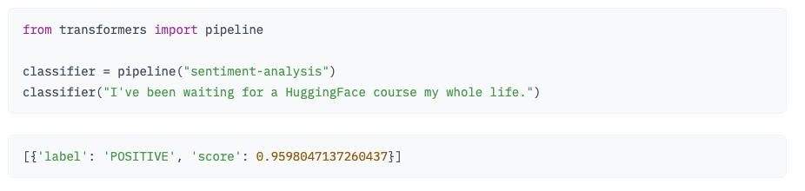
Pipeline Example

Slide 16
Transformer Models

Slide 17
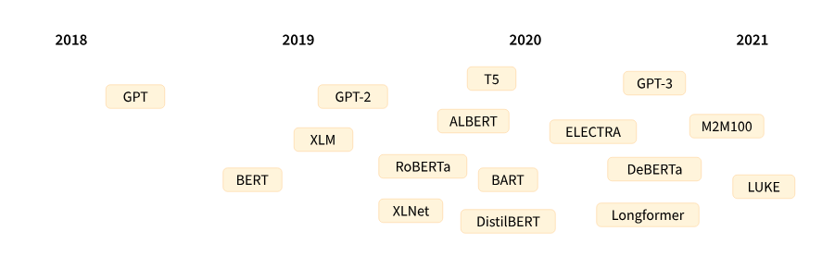
Transformer Models History (1/2)

Slide 18

Transformer Models History (2/2)
June 2017
The Transformer architecture was introduced in June 2017. The focus of the original research was on translation tasks. This was followed by the introduction of several influential models, including:
June 2018
GPT, the first pretrained Transformer model, used for fine-tuning on various NLP tasks and obtained state-of-the-art results
Oct. 2018
BERT, another large pretrained model, this one designed to produce better summaries of sentences (more on this in the next chapter!)
Feb. 2019
GPT-2, an improved (and bigger) version of GPT that was not immediately publicly released due to ethical concerns
Oct. 2019
DistilBERT, a distilled version of BERT that is 60% faster, 40% lighter in memory, and still retains 97% of BERT’s performance
Oct. 2019
BART and T5, two large pretrained models using the same architecture as the original Transformer model (the first to do so)
May 2020
GPT-3, an even bigger version of GPT-2 that is able to perform well on a variety of tasks without the need for fine-tuning (called zero-shot learning)

Slide 19
Transformer as Language Models (1/2)
All the Transformer models (GPT, BERT, BART, T5, etc.) have been trained as language models. This means they have been trained on large amounts of raw text in a self-supervised fashion. Self-supervised learning is a type of training in which the objective is automatically computed from the inputs of the model. That means that humans are not needed to label the data! This type of model develops a statistical understanding of the language it has been trained on, but it’s not very useful for specific practical tasks. Because of this, the general pretrained model then goes through a process called transfer learning. During this process, the model is fine-tuned in a supervised way — that is, using human-annotated labels — on a given task.

Slide 20
Transformer as Language Models (2/2)
Transformer Models (Language Models)
Autoregressive Models
Casual Language Models
Masked Language Models
Sequence to Sequence Models
Auto Encoding Models

Slide 21
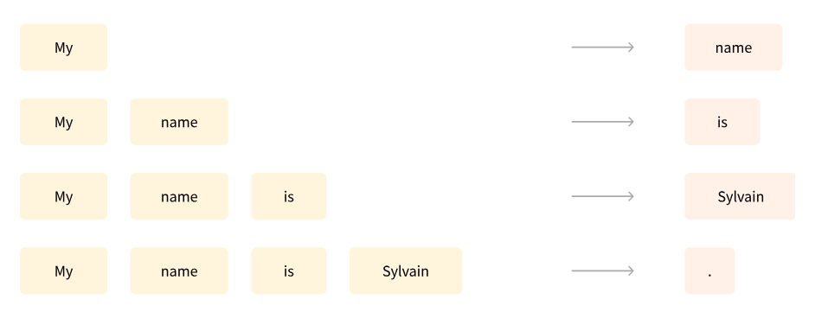
Casual Language Modeling
An example of a task is predicting the next word in a sentence having read the n previous words. This is called causal language modeling because the output depends on the past and present inputs, but not the future ones.

Slide 22
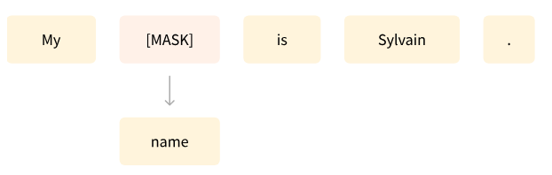
Mask Language Modeling
Another example is masked language modeling, in which the model predicts a masked word in the sentence.

Slide 23

Transformer Models are big models
The general strategy to achieve better performance is by increasing the models’ sizes as well as the amount of data they are pretrained on.
Unfortunately, training a model, especially a large one, requires a large amount of data. This becomes very costly in terms of time and compute resources.
Imagine if each time a research team, a student organization, or a company wanted to train a model, it did so from scratch. This would lead to huge, unnecessary global costs!
This is why sharing language models is paramount: sharing the trained weights and building on top of already trained weights reduces the overall compute cost of the community.

Slide 24
Transformer Models: the new paradigm
Model 1
Model 2
Model 3
Model 1
Model 2
Model 3
Deployment
Deployment
Deployment
Deployment
Deployment
Deployment
Validation
Validation
Validation
Validation
Validation
Validation
Training
Training
Training
Fine Tuning
Fine Tuning
Fine Tuning
Model Development
Model Development
Model Development
Data Eng & Labeling
Data Eng & Labeling
Data Eng & Labeling
Transformer Model
Large Scale self-supervised training
Data Selection and Curation
Data Selection and Curation
Data Selection and Curation
Data Curation and Pre-Processing
Large Amount of Data (Log, table, social, video, image, articles, etc.)
Large Amount of Data (Log, table, social, video, image, articles, etc.)

Slide 25
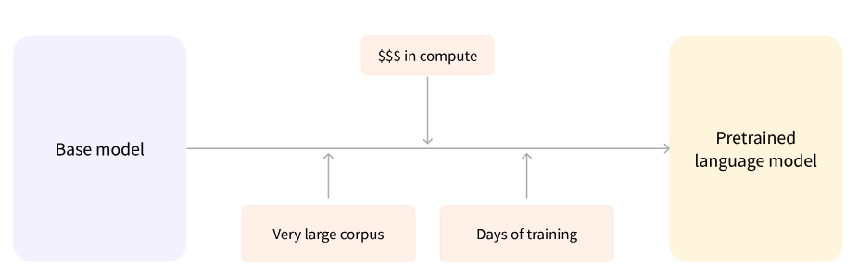
Pre-training Transform Model
Pretraining is the act of training a model from scratch: the weights are randomly initialized, and the training starts without any prior knowledge. This pretraining is usually done on very large amounts of data. Therefore, it requires a very large corpus of data, and training can take up to several weeks.

Slide 26
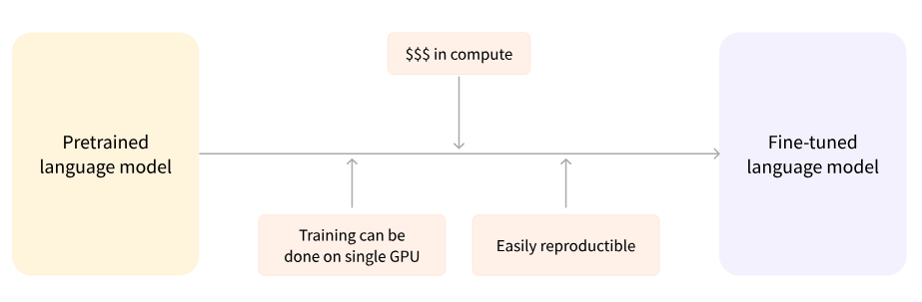
Fine Tuning Transform Model
Fine-tuning, on the other hand, is the training done after a model has been pretrained. To perform fine-tuning, you first acquire a pretrained language model, then perform additional training with a dataset specific to your task. Fine-tuning a model therefore has lower time, data, financial, and environmental costs. This process will also achieve better results than training from scratch (unless you have lots of data), which is why you should always try to leverage a pretrained model and fine-tune it.

Slide 27
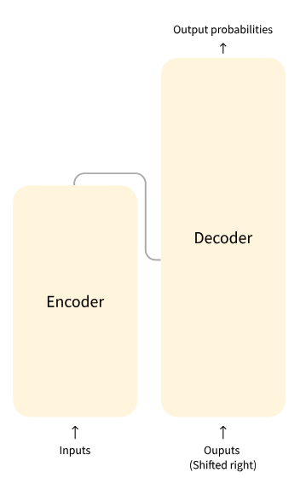
Transformer Architecture (1/2)
The Transformer Model is primarily composed of two blocks:
Encoder (left): The encoder receives an input and builds a representation of it (its features). This means that the model is optimized to acquire understanding from the input.
Decoder (right): The decoder uses the encoder’s representation (features) along with other inputs to generate a target sequence. This means that the model is optimized for generating outputs.

Slide 28
Transformer Architecture (1/2)
Each of these parts can be used independently, depending on the task:
Encoder-only models: Good for tasks that require understanding of the input, such as Sentiment Analysis and Named Entity Recognition.
Decoder-only models: Good for generative tasks such as Text Generation.
Encoder-decoder models or sequence-to-sequence models: Good for generative tasks that require an input, such as Translation or Summarization.

