Slide 1
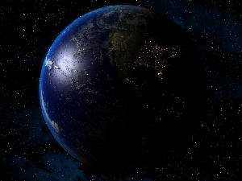
WHAT YOU ARE ABOUT TO SEE...
IS THE LATEST NEWS
IN THE WORLD...

Slide 2

IT IS THE SIZE OF A GRAIN OF RICE…
Notes:
uy890p7

Slide 3
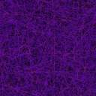
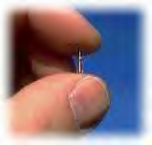
A new development which eliminates
the necessity of using currency or credit cards!

Slide 4
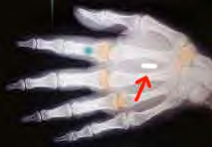
It is already being used by the wealthy as a tool to help prevent kidnapping.
You will use it for it’s advantages and to help prevent fraud and identity theft...

Slide 5
FLEE FROM IT!!!
FIND OUT WHY ...

Slide 6


MOTOROLA is the company producing the microchip for MONDEX SMARTCARD.
They developed several implants for humans using the “Bio-chip.”
TRANSPONDER IS A SYSTEM OF STORAGE FOR READING INFORMATION IN MICROCHIPS.
READING OCCURS IN WAVES LIKE A REMOTE CONTROL.
The “bio-chip” measures 7mm of length and .075mm wide, as large as a grain of rice. It contains a transponder and a rechargeable Lithium battery. The battery is recharged by a thermocouple circuit that produces an electrical current with the fluctuation of body temperature.

Slide 7

REMEMBER THIS COMPANY NAME AND LOGO!

Slide 8
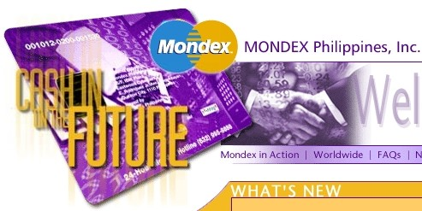
More than 250 corporations and 20 countries are involved in the distribution of MONDEX to the world and many nations are “privileged” to use this system, among them: Great Britian, Canada, U.S.A., Australia, New Zealand, Israel, Hong Kong, China, Indonesia, Macau, Malaysia, Philipines, Singapore, Thailand, India, Taiwan, Sri Lanka, Costa Rica, Guatemala, Nicaragua, Panama, Honduras,
El Salvador & Brazil.

Slide 9
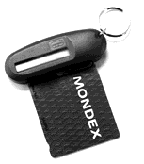
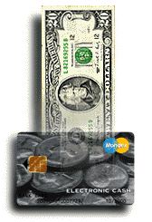

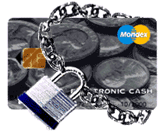
There are other SMARTCARD systems being used through MONDEX, especially since MasterCard bought 51% share of the company.

Slide 10


Then ask yourself...
in the end, what does that have to do with me?

Slide 11
They spent more than $1.5 Million Dollars in research just to discover the best place to insert the “bio-chip” into the human body. They only found two satisfactory and efficient places - THE HEAD, underneath the scalp and the backside of the hand, specifically…
THE RIGHT HAND!

Slide 12
He causes all, both small and great, rich and poor, free and slave, to receive a mark on their right hand or on their foreheads, 17 and that no one may buy or sell except one who has the mark or the name of the beast, or the number of his name.
Revelation 13:16, 17

Slide 13
t
NOT MUCH OF A COINCIDENCE?

Slide 14
One billion “bio-chips” are being produced by MONDEX a year. It’s been in production for at least a year.
They discovered that if the chip would be in a card, they will encounter serious problems. The chip could be cut and information would be changed or falsified. The value could be manipulated, stolen or lost. After you receive the card, it will expire within one to two years.
In the end, real money will be insecure in the general market.

Slide 15
There is only one solution for this problem, embraced by MOTOROLA… implanting the “bio-chip” in the right hand or the head, where it cannot be removed. If it is removed by surgery, the small capsule will burst and the individual would be contaminated by the Lithium and the chemical in the microbacteria, and the Global Positioning System (GPS) will detect if it was removed, and will alert the authorities. Notice MONDEX means “Money on your hand.”
MON = MONetary
DEX = DEXter = Right-hand side

Slide 16
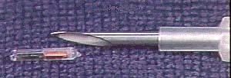
Will you take it serious?

Slide 17
If you find this message interesting, SPREAD THE WORD!
Imagine your parents, friends and siblings, everyone you know…
having to be “marked.”

Slide 18
Now that you’ve been informed, but still doubt this information, do the following. Go to www.google.com. Search for the word “VERICHIP” and read some of the links. Do the same with the words “MONDEX SMARTCARD.”
You can no longer claim ignorance. You are now accountable.
May God bless you!

