Slide 1
ACCENTURE INNOVATION CHALLENGE 2026 · ROUND 2 · PROBLEM STATEMENT 4 — DIGITALTWIN.AI
TwinForge
A live digital twin for mixed-model vehicle assembly lines
A live digital twin that simulates the line, forecasts the failure, traces the defect, and prices the fix.
THE STACK
Python 3.12
Discrete-Event Sim
NumPy · SciPy
scikit-learn
FastAPI + SSE
Vanilla JS + SVG
01 Telemetry
02 Prevent
03 Diagnose
04 Resolve
Team TwinForge · Indian Institute of Technology Madras · github.com/sasank2004/twinforge

Slide 2
THE PROBLEM — AND OUR ANSWER
A coupled flow system that fails two ways — dashboards address neither
A vehicle line is a coupled flow system: one slow station blocks upstream and starves downstream — the constraint moves ~6× a shift.
▪ Bottlenecks are reactive. Utilisation ranks a busy station and a genuinely slow one the same — the 'utilisation trap' — the wrong station, after throughput drops.
▪ Defects surface late. A drifting tool makes out-of-spec units with NO throughput change — caught dozens of stations later at QA.
▪ Coverage is uneven. Legacy + modern mix — some richly instrumented, some fully manual (dark).
▪ Trust is fragile. False alarms erode floor-level trust faster than anything.
HOW THE LINE FAILS
defect drifts unseen → caught late at QA
S1
S2
S3
S4
QA
drift origin
bottleneck
> $2M / hr downtime
~6× constraint / shift
PREVENTIVE
DIAGNOSTIC
forecast the constraint before it bites.
trace a late defect to a ranked root cause.
A plant is instrumented for utilisation — but utilisation never tells you what is costing you cars.
We don't mock a dashboard: we simulate the factory, use it as ground truth to train ML, and re-simulate every fix.

Slide 3
HOW IT WORKS, END TO END
One pipeline: pick a factory, simulate it, learn from it, act on it
1 PROBLEM (PS4)
2 FIX A FACTORY
3 SIMULATE IT
4 GROUND TRUTH
5 TRAIN ML
See bottlenecks form · predict defects early
9-station DAG · merges, splits · uneven sensors
per-second DES · CRN · real back-pressure
paired counterfactual — cars a speed-up yields
90-feature multinomial logit · T+5 forecast
02 · PREVENT
03 · DIAGNOSE
04 · RESOLVE
ML forecast — re-score the trained model on live telemetry
Backward probability graph — genealogy × quality telemetry
Counterfactual re-simulation — pure DES, decoupled from ML
Three engines, three techniques — simulation, graph algorithms, and machine learning —
on one shared, injectable case. Not a dashboard: a factory that actually runs, and a model that learns from it.

Slide 4
STEP 1 OF 4 · FIX A FACTORY
A 9-station DAG with merges, splits and heterogeneous sensors
SENSOR COVERAGE
S1
Framing
S4
Powertrain
S7
S2
Marriage
Chassis
S5
S9
Interior
Final/QA
S8
S3
Trim
S6
Paint
Battery
▪ Takt 12 s → 300 UPH design. every unit runs 4 stations on 5 balanced routes; S9 sees all flow.
▪ Utilisation < 1 healthy. yet one fault pushes a station over its own limit and propagates.
navy = quality/defect origin · clay = QA sink · edges = finite buffers (cap 8)
Topology is data, not code: stations, routes, buffer sizes and each station's sensor list live in one declarative layout.
Point TwinForge at another plant by swapping that graph — the simulator, forecast and diagnosis engines all read it, nothing is re-coded.

Slide 5
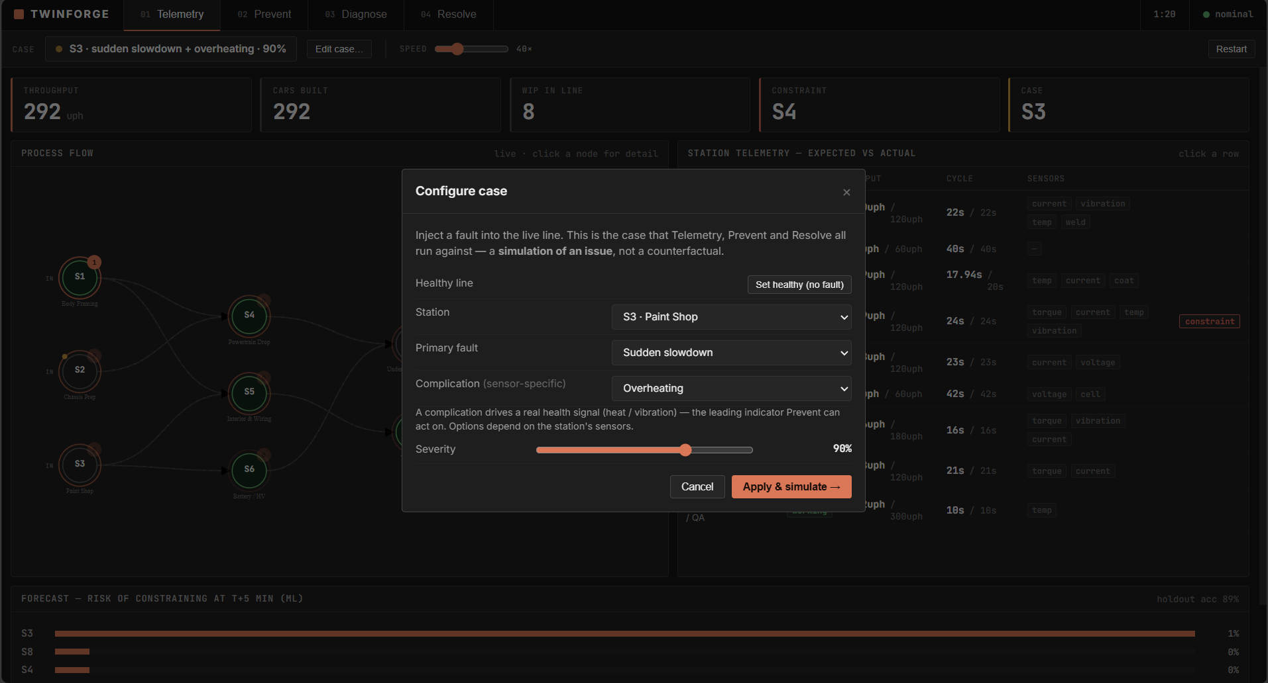
STEP 2 OF 4 · SIMULATE IT
A conservation-exact discrete-event engine — including the disruptions
▪ Per-second stepper. 9-station DAG, downstream-first; a unit is created at a source and destroyed at the sink — conservation-exact.
▪ Real back-pressure. finite buffers → a station blocks when downstream is full, starves when inputs are empty.
THE MATHS WE RUN
• Cycle time ~ lognormal(μ, σ=0.08), noise fixed per (unit, station) → CRN
• Effective CT = proc ÷ availability · lagged thermal coupling (180 s)
• Complication signal leads the slowdown over 0.4× the ramp → leading indicator
Inject a case — station, fault, complication, severity — and the whole line responds live.
FAULTS SIMULATED — EACH MAPPED TO A DISTINCT SIGNAL AND A FIX
Fault
Moves
Fix that works
Slowdown (ramp/step)
cycle time only
add operator
Outage (station down)
availability
planned stop / reroute
Overheating (complication)
temp ↑ then cycle
cool the machine
Tool wear (complication)
vibration+current ↑ then cycle
service the tool
Tool drift (quality)
spec out — NO flow change
re-calibrate the tool

Slide 6
STEP 3 & 4 · GROUND TRUTH, THEN THE MODEL
We label the sim economically — then train ML on those labels
③ ECONOMIC GROUND TRUTH
④ THE TRAINED MODEL — PREVENT
Never label the bottleneck with the detector's own statistic — that scores an identity, not a result.
Multinomial logistic regression · softmax over {NONE, S1…S9}
▪ StandardScaler → LogisticRegression. C=0.5, class_weight balanced (scikit-learn).
▪ Target = economic constraint at T+5. trained on ground truth → a real forecast.
▪ Split BY RUN. 128 runs → 5,150 train + 1,250 holdout, no leakage.
The constraint = the station whose speed-up (to 0.75× cycle time) actually makes more cars, measured by re-running the same shift under CRN.
Only knowable offline → labels & scores, never the live loop. Noise floor ≈ 1 car (CRN).
THE MODEL'S INPUT — 90 FEATURES
× 9
stations
work
starv
block
down
proc
effCT
queue
curr
vib
temp
= 90
→ softmax
flow state (4) dynamics (3) sensors (3)
The twilight between simulation and ML: the simulation manufactures its own labelled training data, and the model learns to see the failure coming.

Slide 7
THE PRODUCT
Four purpose-built workspaces over one injectable case
01
TELEMETRY
02
PREVENT
Read the living line
Forecast & fix early
Grafana-style: animated flow graph, expected-vs-actual, heterogeneous sensors, drill-down.
ML flags a station at T+5 — test a fix by re-scoring the model. Pre-failure.
03
DIAGNOSE
04
RESOLVE
Trace a late defect
Re-simulate the fix
No flow signature; a backward probability graph attributes it to producer + handlers.
Real counterfactual under identical draws; cars gained measured, not asserted.
One shared, injectable case drives all four views — inject S4 · slowdown once and it flows to every workspace.
Different tools, one source of truth — the way a professional IDE gives you many views of one project.

Slide 8
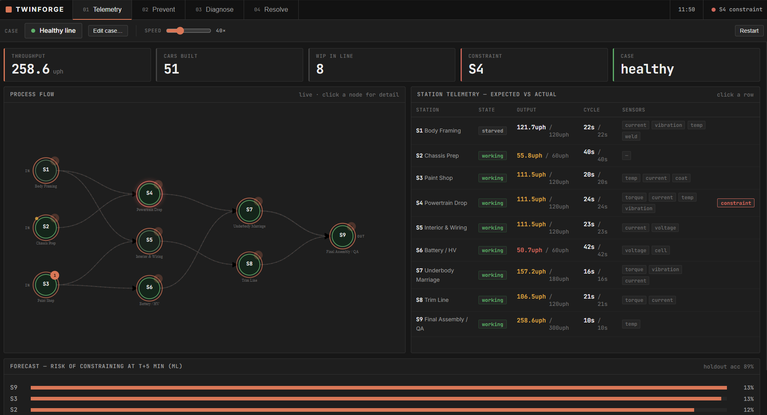
01 · TELEMETRY
Read the living line — expected vs actual, live
UNDER THE HOOD
▪ Live over SSE. state, WIP, buffer occupancy pushed every tick.
▪ Expected vs actual. throughput & cycle time per station, side by side.
▪ Heterogeneous sensors. only the channels a station physically has; manual stations dark.
▪ Provenance. every value tagged measured or inferred; click a node to drill in.
LIVE KPIs
258
8
UPH
WIP
S4
89%
CONSTRAINT
HOLDOUT ACC
Animated DAG + per-station expected-vs-actual + T+5 forecast bars — streamed live over Server-Sent Events.
A real simulation state, not a canned animation — throughput, WIP and the T+5 forecast, all computed live.

Slide 9
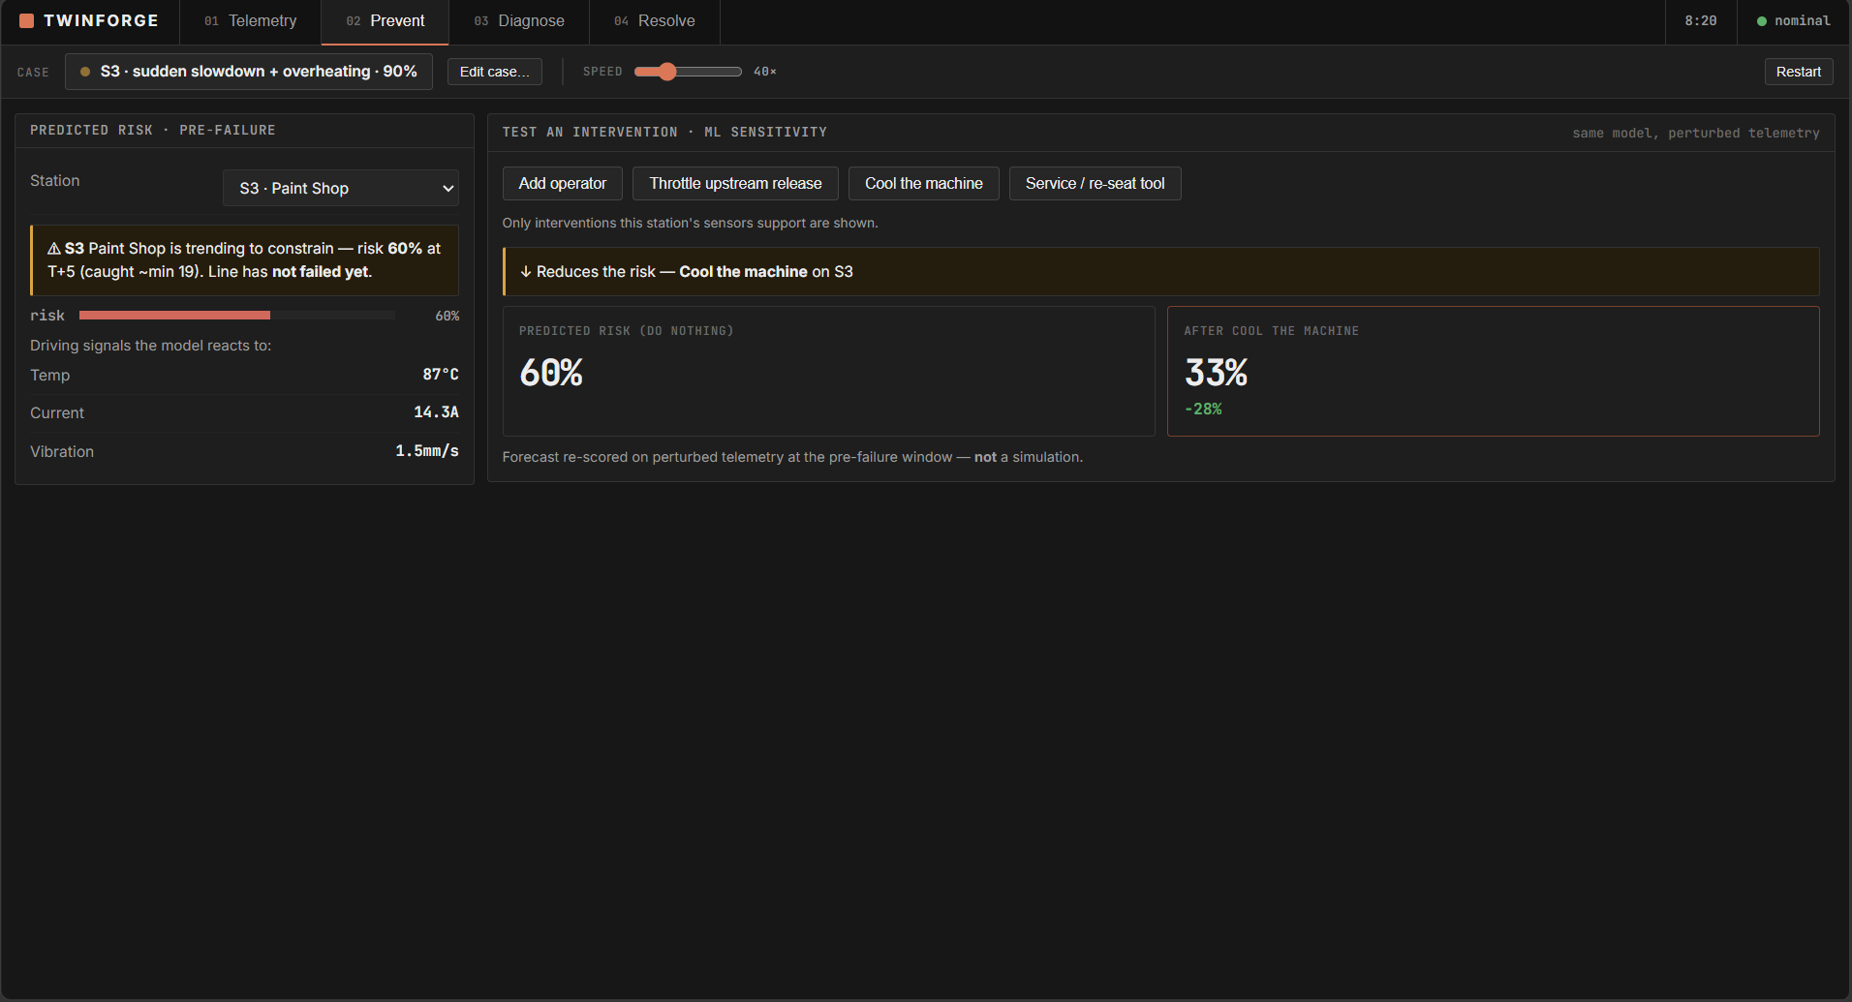
02 · PREVENT
Catch the constraint before it forms — ML sensitivity
UNDER THE HOOD
▪ Multinomial logistic regression. 90 features, trained on economic ground truth.
▪ Sensitivity, not a sim. perturb telemetry → re-score in milliseconds.
▪ Coherent by cause. cooling helps overheating (60%→33%), not a busy station.
▪ Sensor-gated. an action only shows where the station has that sensor.
PREDICTED RISK · S3 AT T+5
Do nothing
60%
Cool m/c
33%
−28% risk — coherent, sensor-gated fix
Predicted risk at T+5 while the line is still healthy; test a fix and the same model is re-scored on perturbed telemetry.
The fix only helps if its fault is present — cooling a mechanical slowdown is a no-op, by construction.

Slide 10
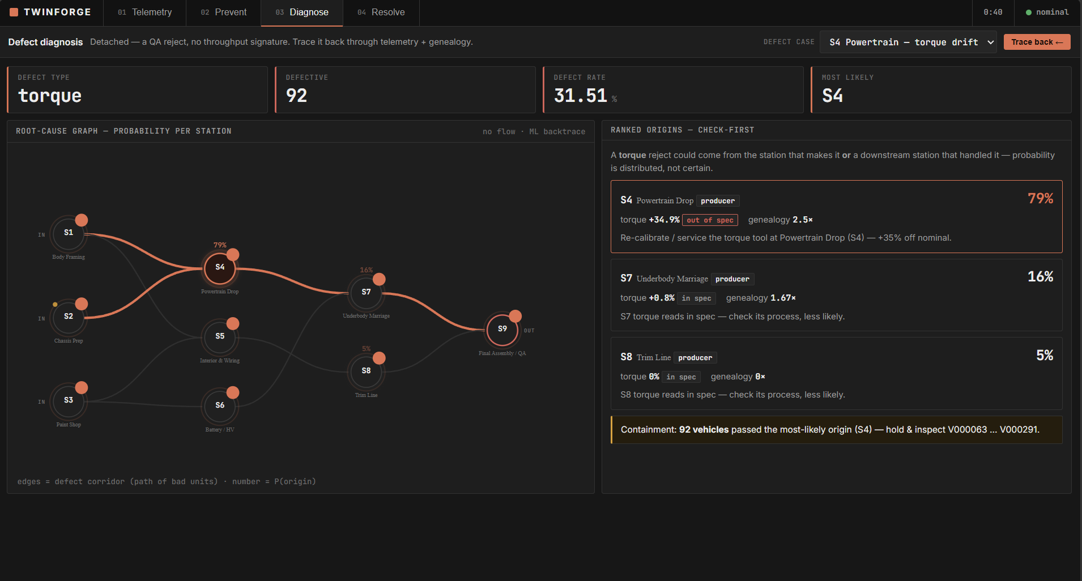
03 · DIAGNOSE
Trace a defect with no flow signature — its own engine
UNDER THE HOOD
▪ Backward graph. candidates = the producer plus stations that later handled the part.
▪ Genealogy × telemetry. which stations the bad units share × which tool is out of spec.
▪ Tempered posterior. softmax (γ=0.55) → 79% / 16% / 5%, never a false 98%.
▪ Containment. every VIN built on the suspect since it drifted.
ROOT-CAUSE POSTERIOR
S4 prod
79%
S7 hand
16%
S8 hand
5%
tempered softmax · producer + handlers
A QA reject has zero throughput signature; a backward probability graph distributes blame over producer + downstream handlers.
A drifting tool makes bad parts with no slowdown — a bottleneck detector is blind, so we use a graph, not flow.

Slide 11
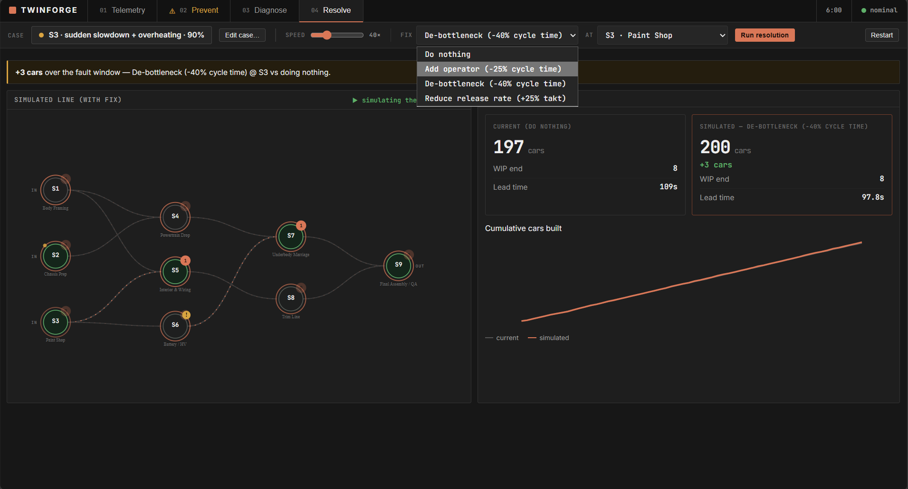
04 · RESOLVE
Price the fix with a real counterfactual — no ML
UNDER THE HOOD
▪ Two simulations, stacked. base run, then a counterfactual run with the fix — identical CRN draws.
▪ Cars measured, not asserted. de-bottleneck the true constraint → +34; the wrong one → +1.
▪ Decoupled from ML. pure discrete-event simulation, the physics engine only.
▪ Free levers too. 'do nothing' and 'reduce release rate' (CONWIP).
CARS RECOVERED — RIGHT vs WRONG
Right fix
+34
Wrong fix
+1
197 → 200 in-window · measured, not asserted
When a bottleneck has formed, re-simulate the line with the fix applied; cars-gained is measured against the paired baseline.
Prevent predicts; Resolve measures — a second simulation stacked on the base run, under identical draws.

Slide 12
ARCHITECTURE
Three systems working together — and the honest split of each
DES SIMULATOR
ECON. GROUND TRUTH
ENGINES
LIVE LOOP
FASTAPI + SSE → UI
9-station DAG · CRN
paired counterfactual
detect·forecast·diagnose
ingest→emit · drift
vanilla JS + SVG
DON'T TRAIN WHAT YOU CAN COMPUTE — TRAIN WHERE ML EARNS ITS PLACE
Capability
Method
Type
Locate the current bottleneck
Effective cycle time ÷ availability + blocked/starved walk
Arithmetic
Economic ground truth
Paired counterfactual re-sim (cars a speed-up yields)
Measured
Forecast the T+5 constraint
Multinomial logistic regression · 90 features · balanced
ML (trained)
Attribute a late defect
Genealogy lift × quality telemetry · tempered softmax
Inference
Price a fix
CRN paired discrete-event re-simulation
Simulation
FULL STACK
Python 3.12
NumPy · SciPy
pandas
scikit-learn
FastAPI
Server-Sent Events
Vanilla JS + SVG
pytest (10/10)

Slide 13
VALIDATION & RESULTS
Reproducible bit-for-bit from fixed seeds — the mechanism is proven
1.00
0.0
~90%
96%
~1
DETECTOR TOP-1
REGRET (CARS)
FORECAST T+5
SPARSE-SENSING
NOISE FLOOR (CARS)
MODEL QUALITY (%)
CARS RECOVERED — FIX
THROUGHPUT — HEALTHY vs S4 (UPH)
128 simulated shifts · 6,400 windowed samples split by run · every defect origin diagnosed with the true culprit ranked #1 · 10/10 invariant tests pass.

Slide 14
BUSINESS CASE
Illustrative, model-based value per line — payback in under six months
$4.5–12M
<6 mo
5–10×
$2M/hr
VALUE / LINE / YR
PAYBACK
FIRST-YEAR ROI
DOWNTIME AVOIDED*
VALUE LEVERS — $M / LINE / YR
VALUE MIX (%)
REFERENCE LINE
NEAR-ZERO SENSING
CONWIP LEVER
~220k units/yr · ~$3.5k contribution margin / vehicle
subscribes to existing OT — OPC-UA / MQTT / MES
same output, lower WIP & lead time, $0 capital
* Senseye/Siemens 'True Cost of Downtime' benchmark. Figures illustrative and assumption-stated, per Round 2 guidance.

Slide 15
ROADMAP & RISK
A phased, low-disruption rollout — advise-only, validated against outcomes
0 · Connect
1 · Prevent
2 · Diagnose
3 · Leadership
4 · Scale
0–2 mo
2–4 mo
4–8 mo
8–12 mo
12 mo+
Read-only OT subscription; calibrate; shadow mode
Supervisor view + T+5 forecast; alert contract
Defect backtrace + containment; retrofit plan
ROI dashboard; 2nd segment; drift monitoring
Multi-plant; retrofit optimiser; failure classifier
Key risk
Mitigation
False alarms erode trust
Economic ground truth + regret + held-out calibration + persistence filter + twin-drift recal
Legacy PLCs / live-production risk
Read-only OT subscription; NO set-point write-back; retrofits only in maintenance windows
Sparse / no sensors
Inference with provenance + confidence; costed retrofit optimiser
Model drift across sites
Topology-as-data; re-calibration transfer; scale-invariant features

Slide 16
Simulate · Forecast · Trace · Resolve.
A twin that predicts the failure, finds the defect, and prices the fix — live, on a line with realistic uneven sensors.
It simulates the line, learns the failure, traces the defect, and proves the fix — one case, no black boxes, reproducible to the seed.
TEAM TWINFORGE · IIT MADRAS
Sasanka Marthand N
Pratyush Nayak
Sannith Reddy
CE22B079
CH23B011
CE23B081
github.com/sasank2004/twinforge · Thank you.

