Slide 1
Smart City Route Optimization System
Smart City Route Optimization System
ADS Mini Project | C++17
Team members: Sasank, Venkatesh , Jhanavin, mallikarjun
Pragati Engineering College | CSE | Second Year
1 / 12

Slide 2
Introduction
• Cities contain many connected locations and roads.
• Choosing an efficient route saves travel distance and time.
• This project models a city road network as a weighted graph.
• Dijkstra's algorithm finds the shortest route between two selected locations.
2 / 12

Slide 3
Problem Statement
• A user may not know the shortest route between two places.
• Manual route comparison becomes difficult as the road network grows.
• The project provides a simple algorithm-based route finder.
• Initial version uses a predefined sample map; dynamic updates and a website are future work.
3 / 12

Slide 4
Objectives
• Represent city locations and roads using a weighted graph.
• Use an adjacency list to store road connections efficiently.
• Find the shortest route and total distance.
• Validate user input and report when no route exists.
• Provide a foundation for future road updates and web visualization.
4 / 12

Slide 5
Proposed Solution
• Create a graph in which each location is a vertex.
• Represent each road as an undirected weighted edge.
• Accept source and destination IDs from the user.
• Run Dijkstra's algorithm using a min-priority queue.
• Reconstruct and print the route using parent pointers.
5 / 12

Slide 6
Concepts and Data Structures Used
• Weighted undirected graph: models locations and roads.
• Adjacency list: stores only existing road connections.
• Min-priority queue: selects the next closest vertex.
• Distance array: stores best-known distances.
• Parent array: reconstructs the final shortest route.
6 / 12

Slide 7
Algorithm – Dijkstra
• Initialize all distances to infinity; set source distance to zero.
• Push the source into a min-priority queue.
• Extract the vertex with minimum tentative distance.
• Relax each adjacent edge and update distance and parent when improved.
• Continue until the queue is empty; reconstruct the destination path.
7 / 12

Slide 8
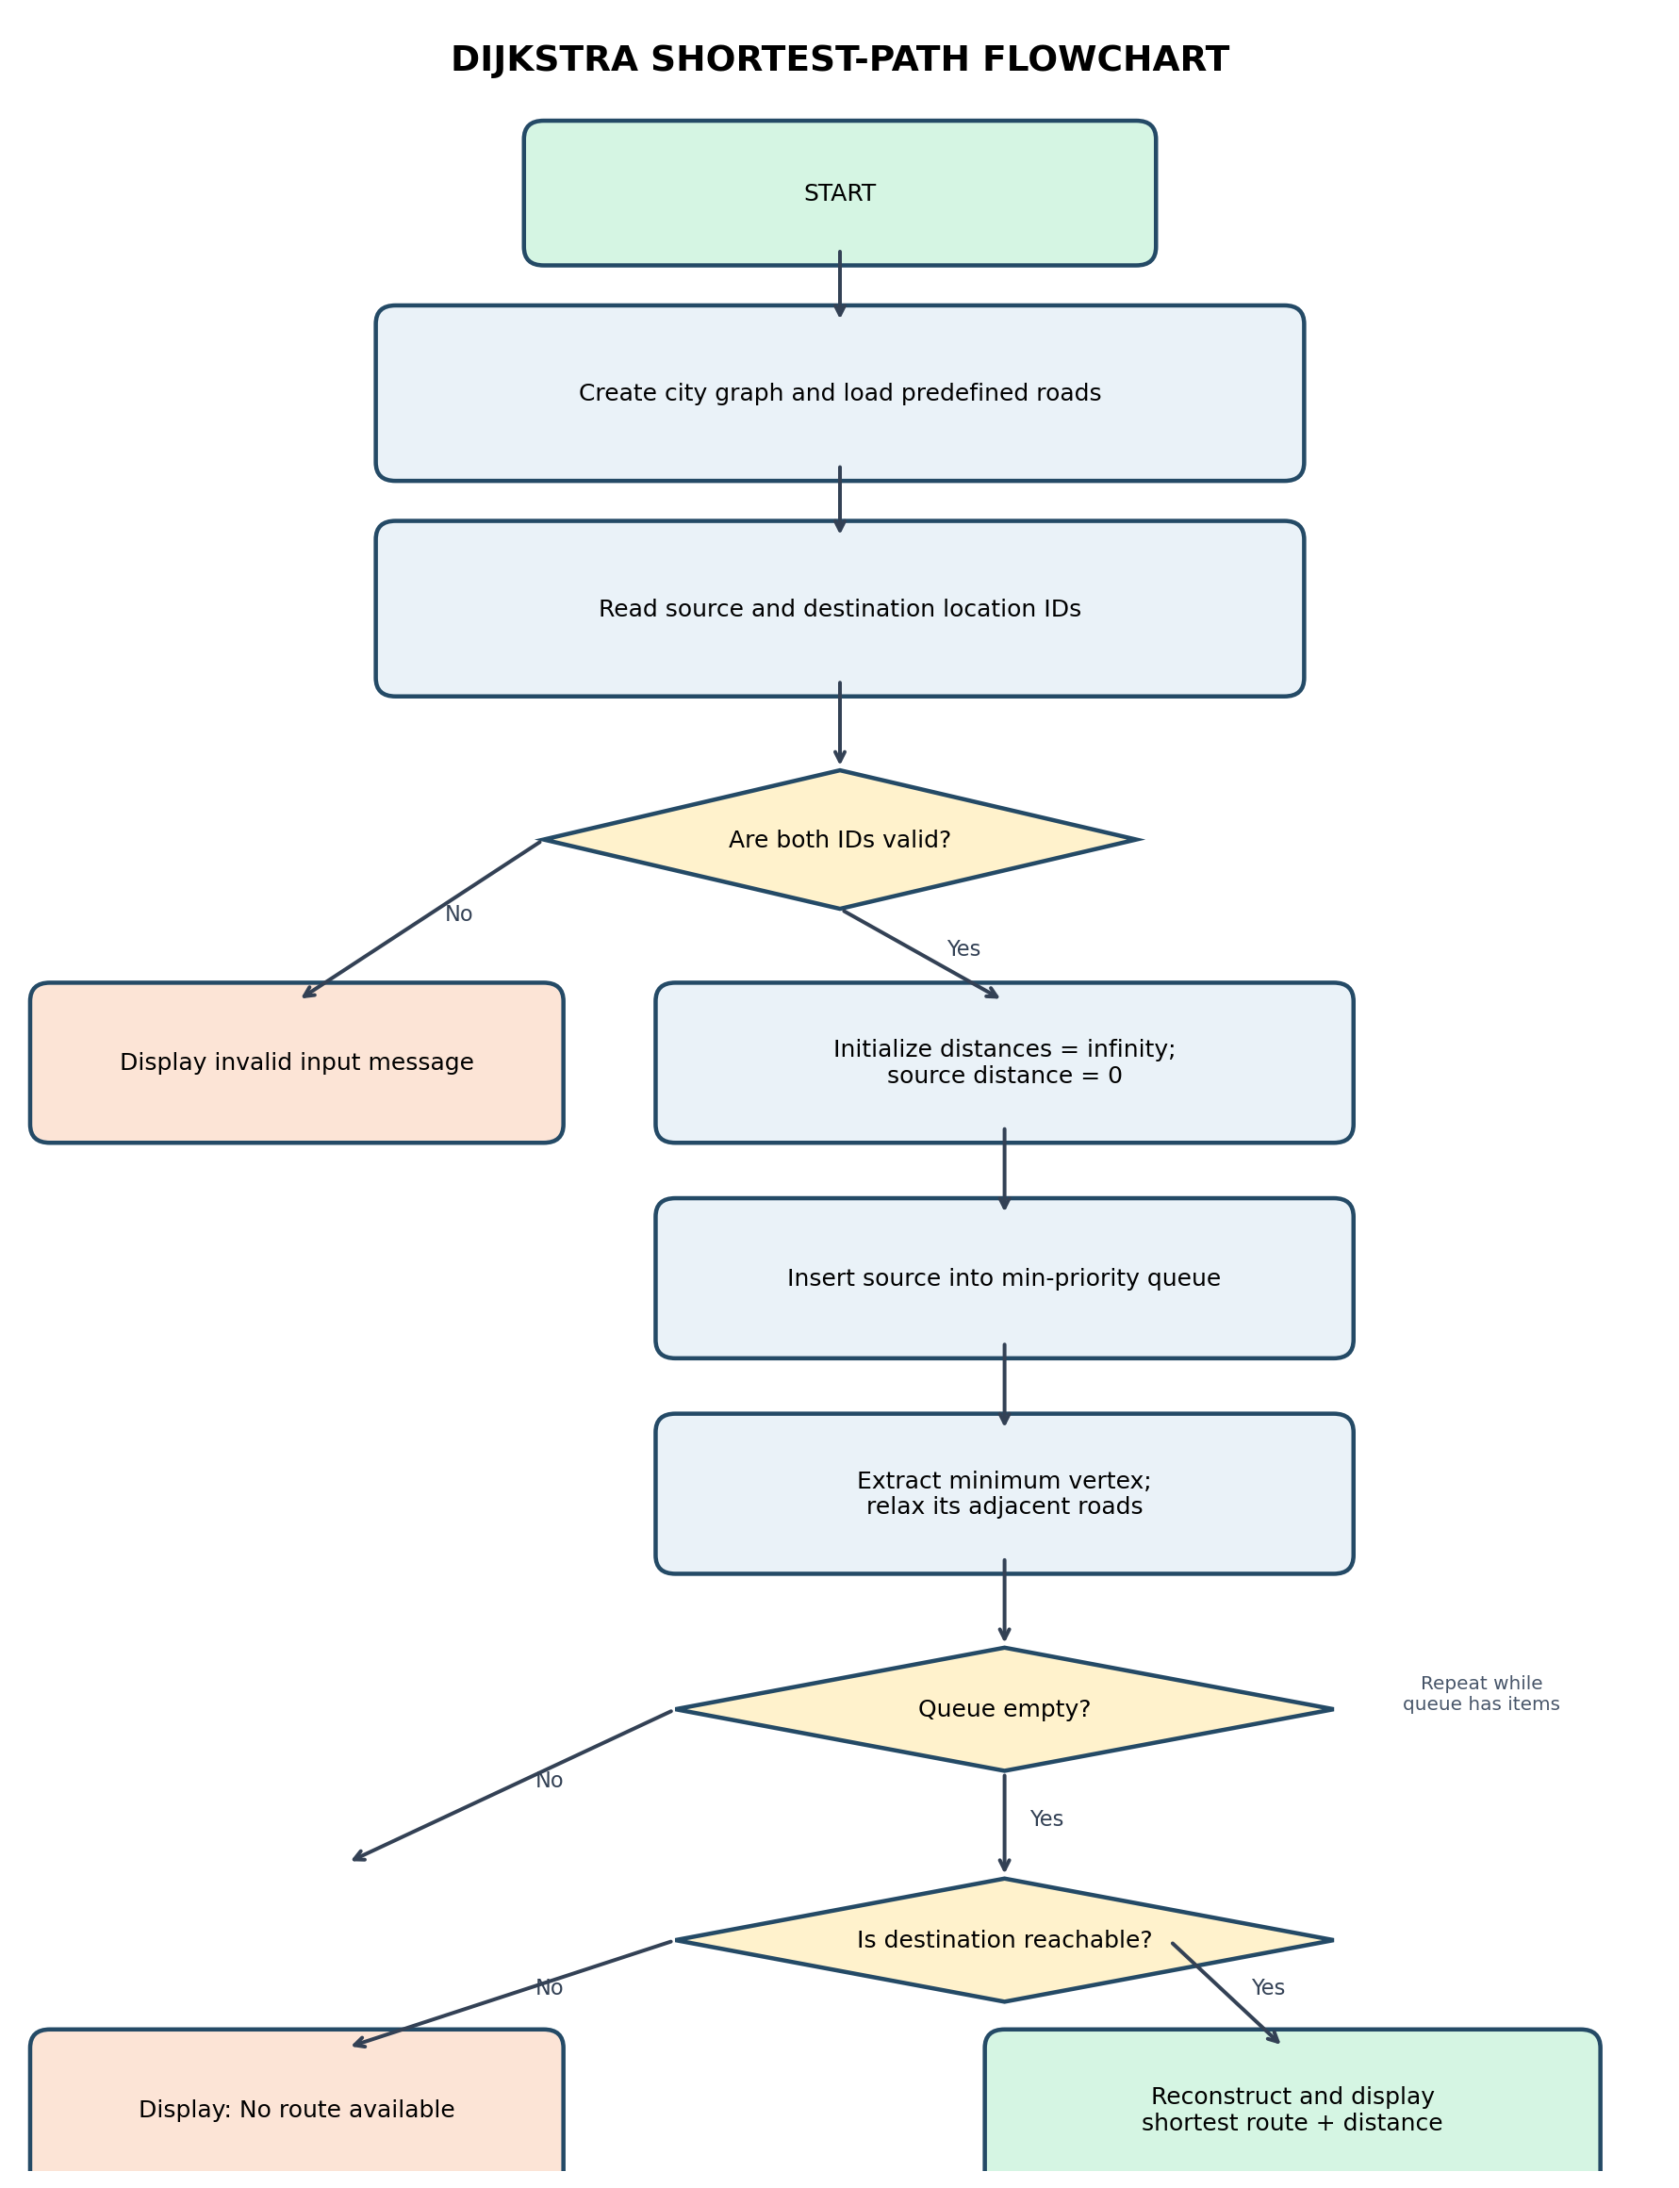
Algorithm Flowchart
The flowchart shows input validation, distance initialization, priority-queue processing, edge relaxation and route reconstruction.
If the destination remains unreachable, display a no-route message.
8 / 12

Slide 9
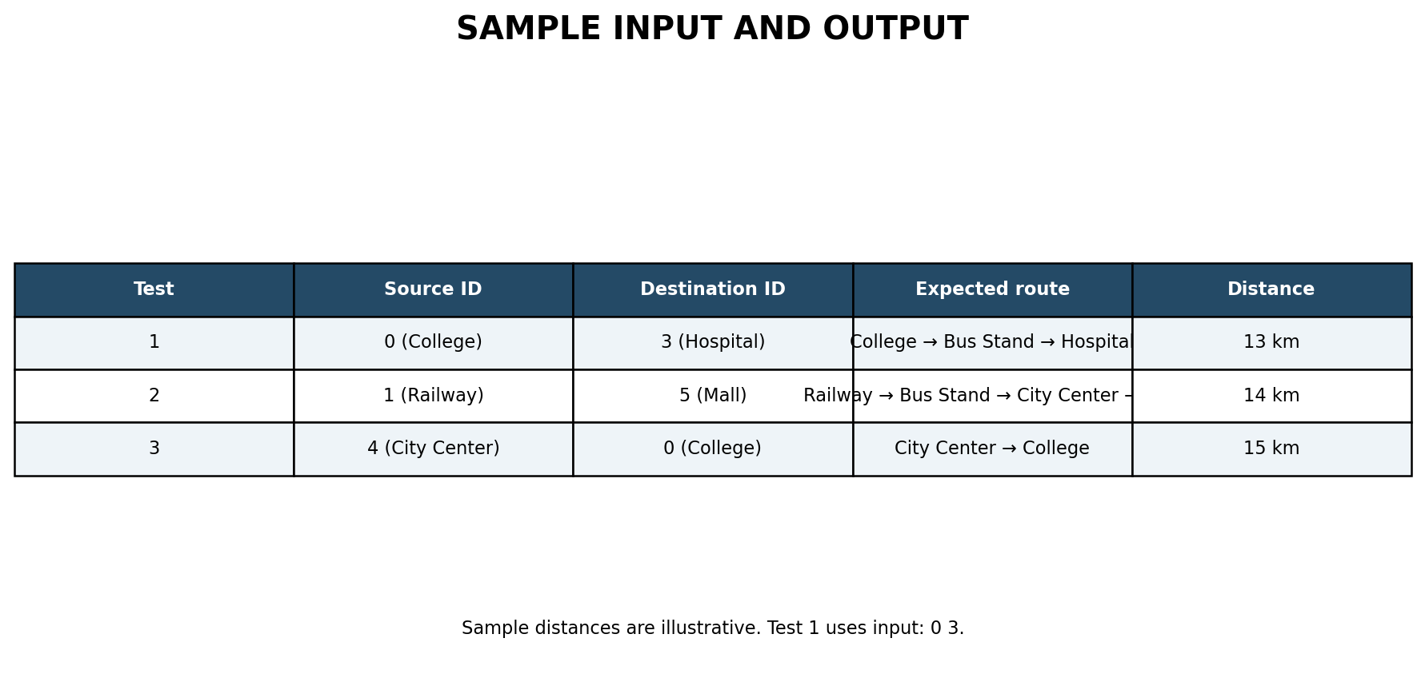
Sample Input and Output
• Sample input: source ID = 0; destination ID = 3.
• Location 0 = College; location 3 = Government Hospital.
• Expected route: College → Bus Stand → Government Hospital.
• Total distance: 13 km.
• All sample road distances are illustrative.
9 / 12

Slide 10
Complexity Analysis
• Time complexity: O((V + E) log V) using adjacency list and binary min-heap.
• Space complexity: O(V + E) including graph and auxiliary arrays.
• V = number of vertices (locations); E = number of edges (roads).
• The adjacency list is suitable for sparse road networks.
10 / 12

Slide 11
Testing and Limitations
• Tested scenarios: valid route, different source/destination, same location and invalid IDs.
• Dijkstra requires non-negative edge weights.
• The current version uses fixed sample roads and integer distances.
• It does not yet model live traffic or real-time road conditions.
11 / 12

Slide 12
Conclusion and Future Enhancements
• The project demonstrates graph representation and shortest-path computation in C++.
• Future: add/remove locations and roads, road closures and alternative routes.
• Future: BFS, DFS, Prim's MST, persistent storage and performance dashboard.
• Future: C++ REST API with a web interface and interactive map.
• Thank you
12 / 12

