Slide 1

Team Name: EcoVision
Project Title: AI Enabled Weather Prediction
simply tick the theme you have chosen
smart education
health -Tech Innvoation
Sustainable Development
Problem & Solution
Give facts and data of the problem you are solving:
This project will help us keep a track of the constant climate change
Describe your solutions in two lines:
Predicting Climate Change using AI using weather data

Slide 2





Team Members
Team Leader
Member 1
Member 2
Member 3
Sasank Chowdhary K
Aavula Kamalesh
Bellam Cherish Sai Reddy
Virinchi A S A V
Role: Neural Network Building
Not giving up
Father: Farmer
Brother: Software Developer
Role: Deployment
Silence
Father: Pawn Broker
Mother: Homemaker
Brother: Automobile Engineer
Role: Feature Engineering
Punctuality
Father: Lecturer
Mother: Homemaker
Brother: Student
Role: Model Building
My Ability to get through things
Father: Senior Executive Director
Mother: Homemaker
Sister: French Ambassy Affiliation

Slide 3
Impact
The utilization of Long Short-Term Memory (LSTM) networks in meteorological data captures long-term patterns and dependencies, which improves weather prediction accuracy. This cutting-edge method enhances daily operations, energy management, agriculture, and disaster preparedness while improving forecasting accuracy, all of which have a substantial positive impact on the economy and society.

Slide 4
Technologies Used
Python
Tensorflow
StreamLit

Slide 5
Methodology
Output
Data Acquisition
LSTM
Preprocessing

Slide 6
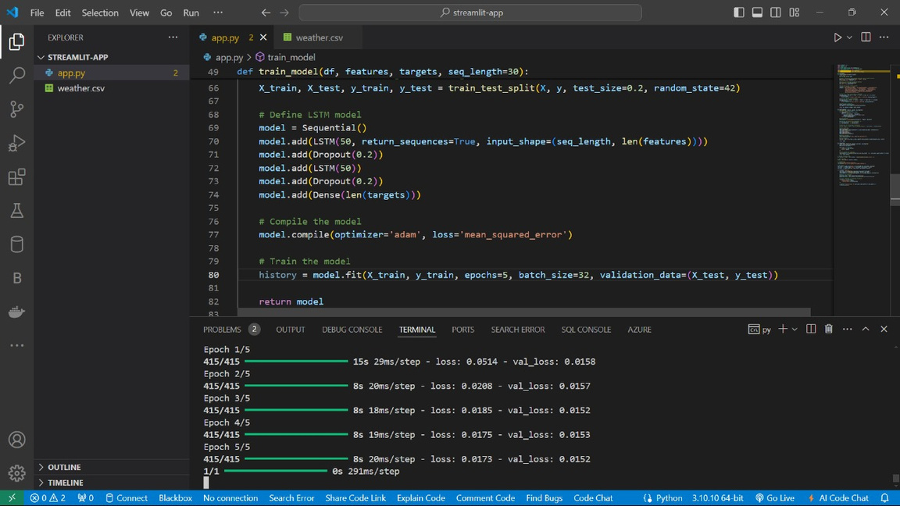
Code Snippet

Slide 7
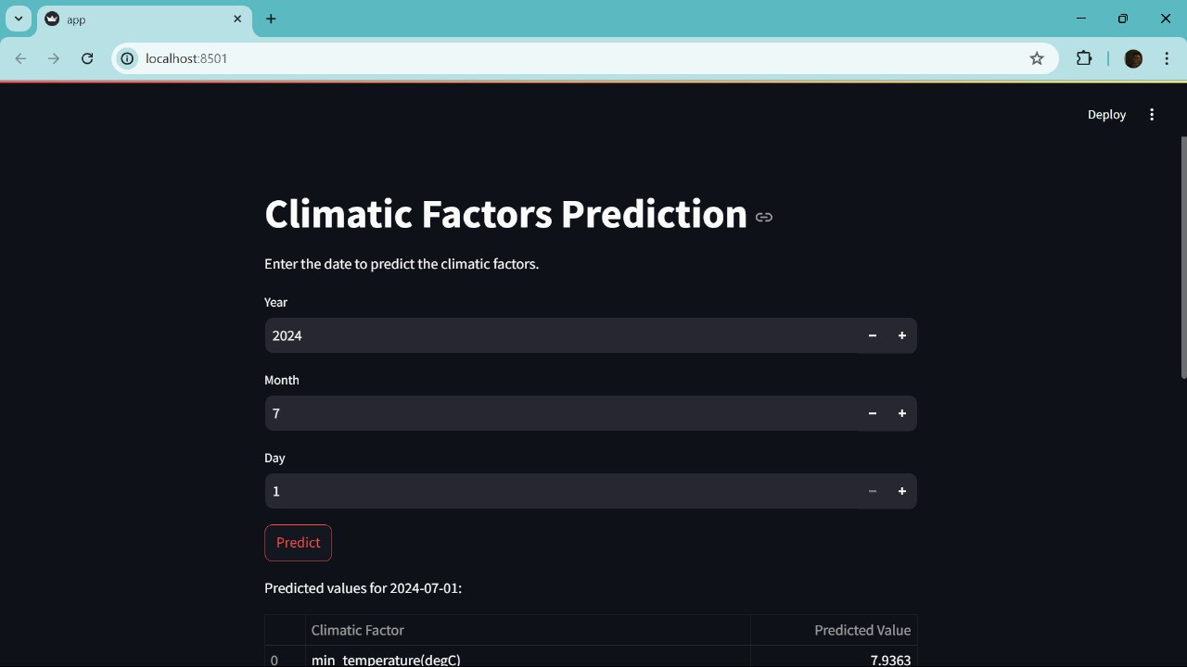
Output

Slide 8
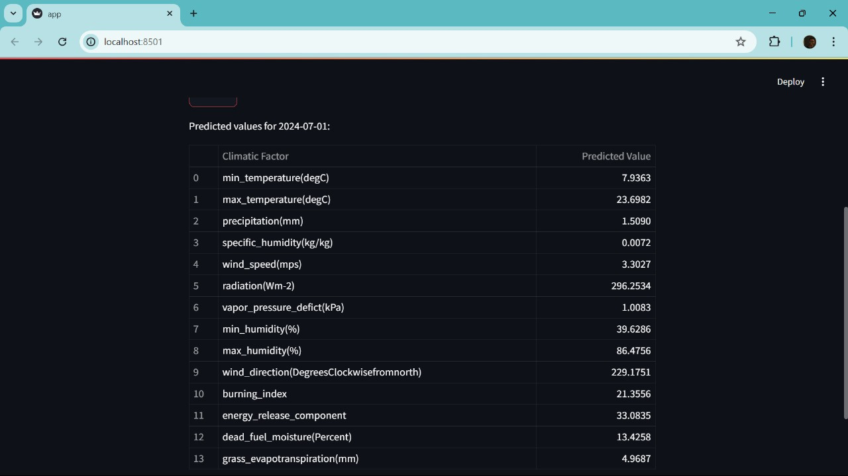
Output

Slide 9
Future Prospectus
API Integration
Satellite Imaging Prediction
Deployment

Slide 10


