Slide 1


Housing Price Prediction in King County
Name : Kalyan Kumar bhogi
chaitanya anudeep origanti
sasank Yadav daliboyina
sai Pavan yerra
Group: 5
INSTRUCTOR : KASUN SAMARASINGHE
DATE : 02/14/2024

Slide 2




Introduction
Comprehensive King County Housing Market Analysis:
Data from May 2014 to May 2015, with over 21,614 property transactions in King County .
Rich Data Attributes for In-Depth Exploration:
Detailed attributes including price, size, condition, and location-related factors.
Objective of Machine Learning Application:
Deploy advanced algorithms to predict prices and assess the influence of various property features.
Comparative Model Analysis:
Evaluate and compare the performance of multiple predictive models to determine effectiveness.
Insights and Innovations in Real Estate Valuation:
Provide actionable insights and highlight the potential of machine learning to revolutionize property valuation.

Slide 3

Business Objectives :
1. How can we accurately predict housing prices in the real estate market based on various property features, facilitating informed decision-making for homebuyers, sellers, and real estate professionals?
2. How can we effectively categorize houses into 'low_value' and 'high_value' based on specific criteria, providing a quick and streamlined decision-making tool for real estate professionals and investors?

Slide 4
Exploratory Data Analysis And Descriptive Summary :
A descriptive summary from data.info() reveals 21 columns and 21,613 entries with no missing values, indicating a complete dataset ready for analysis.
Descriptive statistics highlight an average property price of ~$540,182, with standard properties featuring 3.37 bedrooms and 2,080 square feet living space.
The dataset contains a wide range of property sizes and years built, from 290 to 13,540 square feet, dating as far back as 1900.
A check for null values confirms the absence of missing data, suggesting the dataset is clean and well-prepared for further analysis.

Slide 5
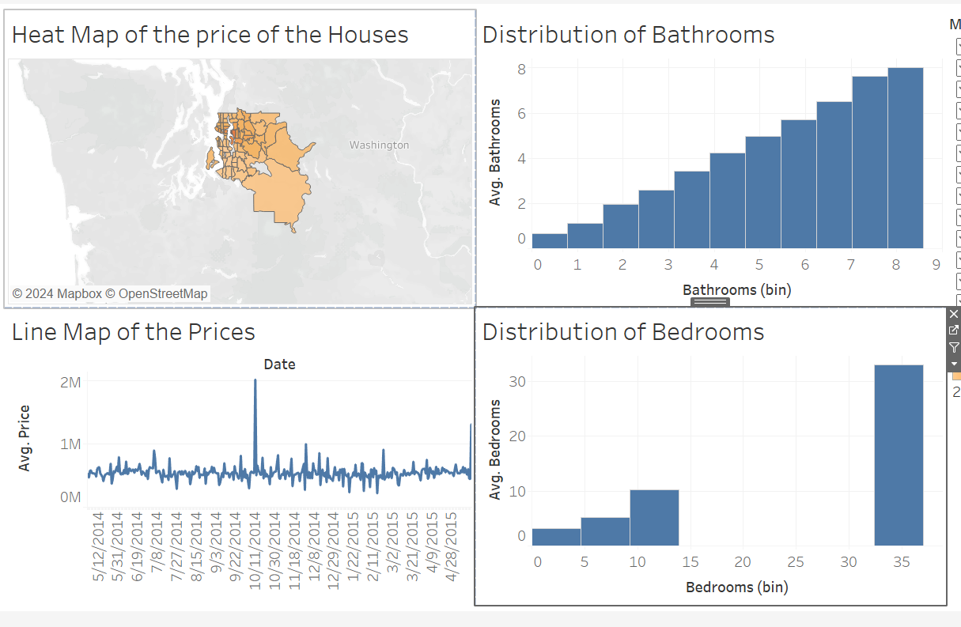
Tableau Dashboard
Dashboard provides a full overview of market prices, sorted by bathrooms and bedrooms.
Heat Map shows geographic price distribution, with darker colors indicating higher prices.
Line Graph tracks average house prices over time, highlighting market fluctuations.
Bar Chart details the distribution of houses by bathroom count, showing two-bathroom homes as most common.

Slide 6
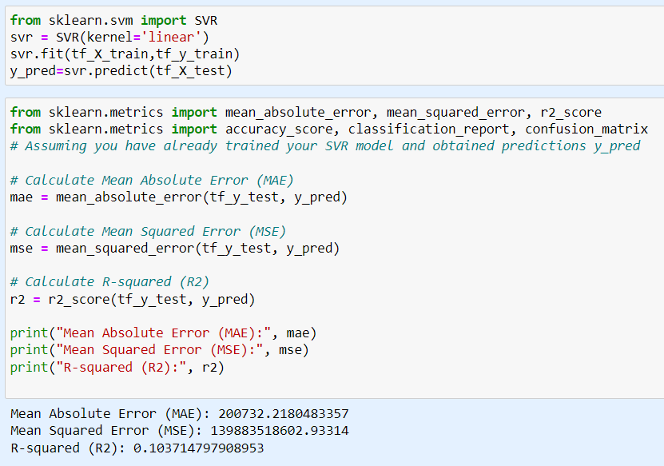
Housing Price Prediction using SVR
Harnessing historical data and trends, this model predicts future Kings County housing values.
We delve deeper than usual, incorporating location, economic indicators, for a holistic picture.
Analyzing interactions between these factors over time, we capture the complex forces shaping housing prices.
The model minimizes MAE for close predictions, and MSE penalizes large errors, ensuring overall accuracy.
R-squared reveals how well our model explains overall price movements, not just individual values.

Slide 7

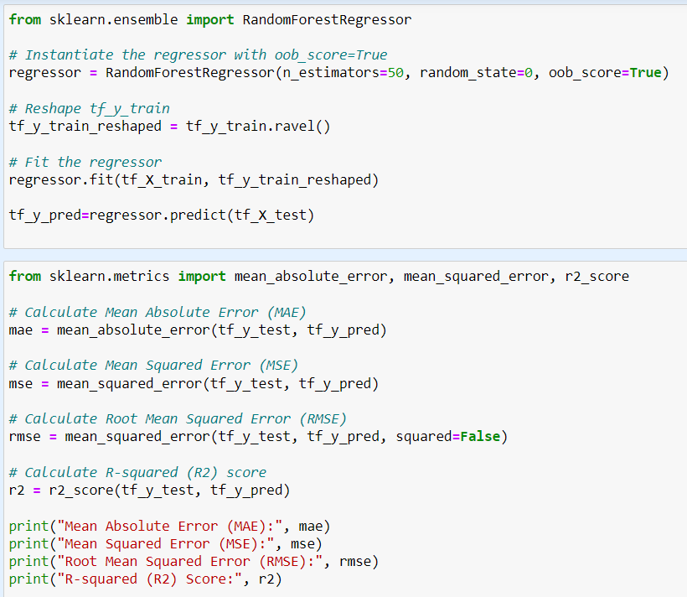
Price Prediction using Random Forest Regression
This method utilizes an ensemble of multiple decision trees, each trained on a random subset of data and features, to collectively predict future housing prices.
Similar to the previous approaches, it incorporates diverse features besides the usual suspects, including location, economic indicators, and market dynamics.
Individual tree predictions are combined through majority voting, leading to a robust prediction that reduces the impact of any single tree's errors.
Like other methods, it minimizes Mean Absolute Error (MAE) to ensure predictions stay close to actual prices, while Mean Squared Error (MSE) penalizes large errors for overall accuracy.
The model ranks features based on their contribution to predictions, providing valuable insights into the crucial drivers of housing prices in Kings County.

Slide 8
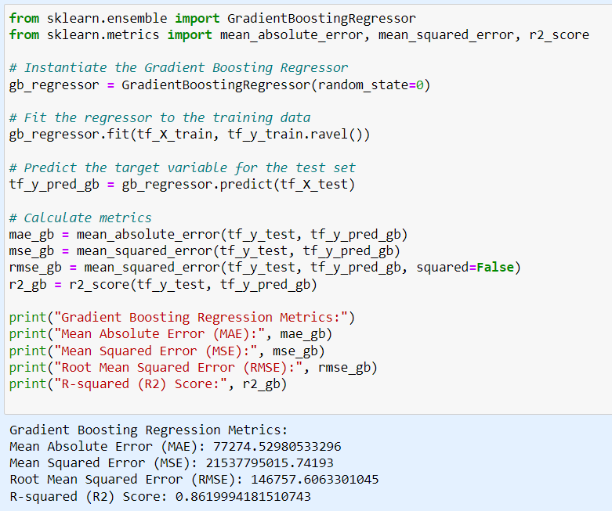
Price Prediction using Gradient Boosting
Accurately estimating house prices involves numerous factors like size, location, amenities, and market trends. Gradient Boosting shines by combining multiple "weak" models (think decision trees) into a powerful "ensemble" learner.
Learning from mistakes: Each weak model in the ensemble focuses on areas where previous models struggled. This iterative approach refines predictions, leading to a more comprehensive understanding of the factors influencing price.
Adapting to diverse data: Gradient boosting handles mixed data types (numbers, text, etc.) efficiently, making it well-suited for real-world housing datasets that incorporate various features.
Boosting accuracy and interpretability: While powerful, gradient boosting remains interpretable. You can see how individual features contribute to price predictions, offering valuable insights into the housing market.
Fine-tuning for performance: Optimizing parameters like the number of models and their complexity allows you to balance accuracy with efficiency, tailoring the model to your specific needs and data size.

Slide 9
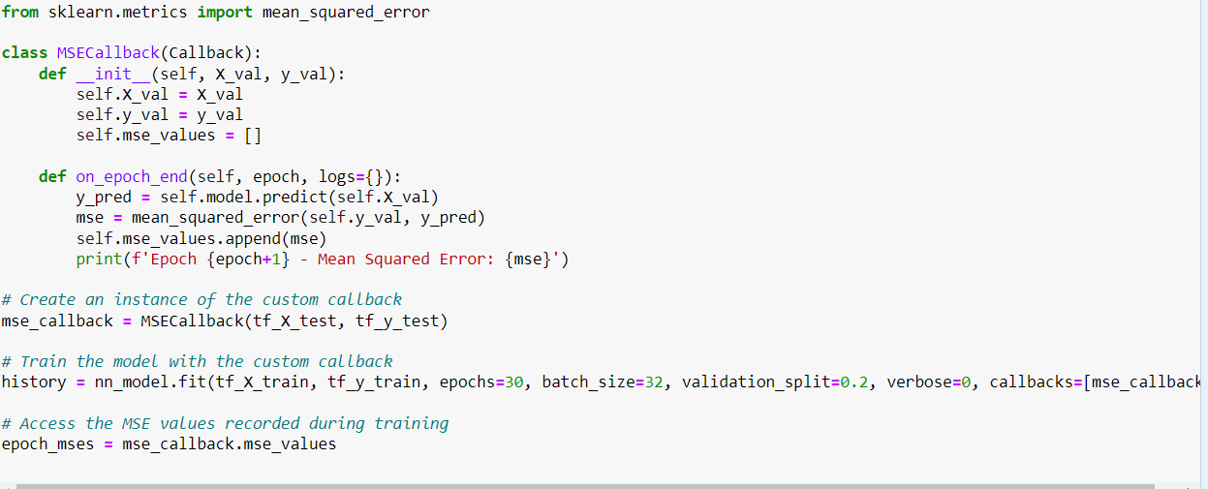
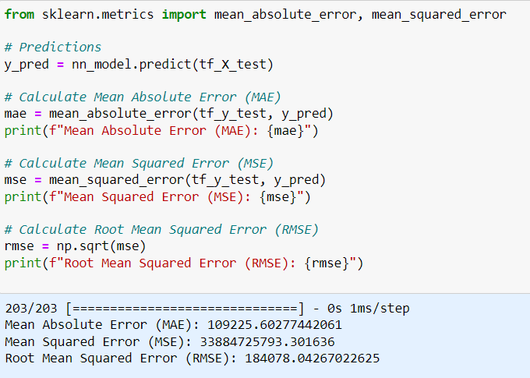
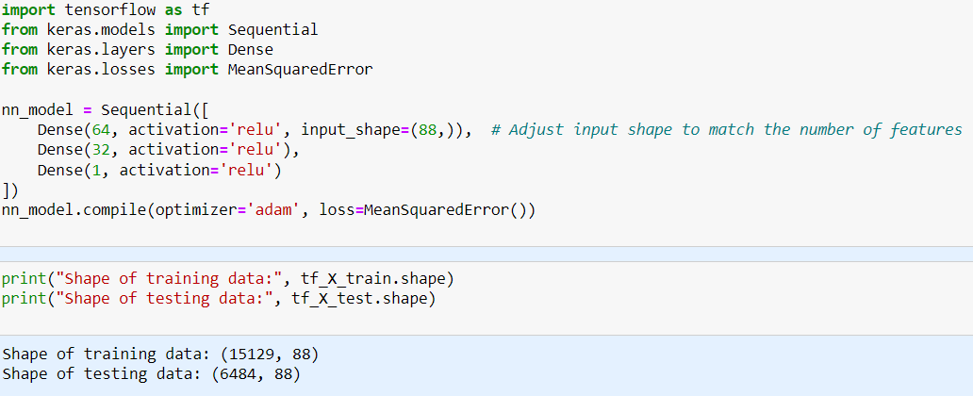
Neural Network Regression :
This method leverages the power of neural networks, inspired by the human brain, to predict future housing prices in Kings County.
Similar to other approaches, it utilizes diverse features beyond just square footage and bedrooms, including location, economic indicators, and market dynamics.
Unlike simpler models, neural networks can automatically learn complex non-linear relationships between these features and housing prices.
With multiple layers of interconnected neurons, the model can adapt and fine-tune its predictions based on large amounts of training data.
Like other methods, it targets minimizing Mean Absolute Error (MAE) to ensure predictions stay close to actual prices, while Mean Squared Error (MSE) penalizes large errors for overall accuracy.

Slide 10
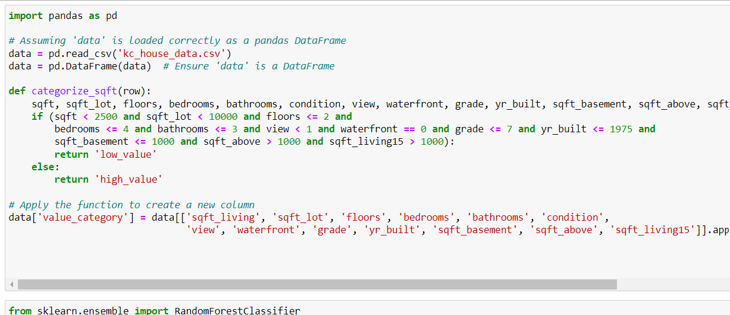
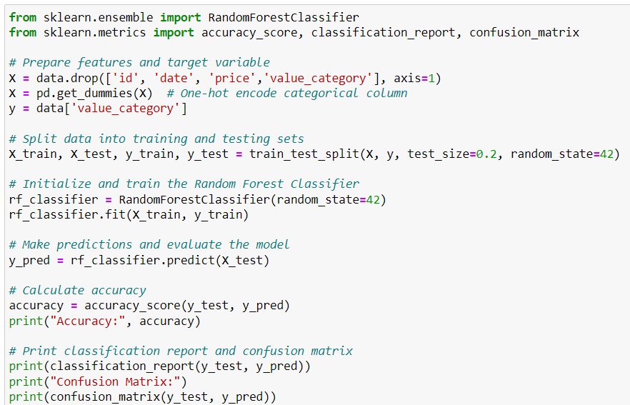
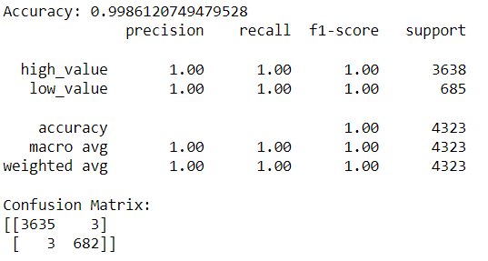
Random forest Classifier for value Category
Combines numerous decision trees for improved accuracy and reduced overfitting. Achieved an accuracy of 1.00 on the provided dataset.
Each tree uses a random subset of features, leading to diverse predictions. This helps to prevent the model from overfitting to any one feature.
Chooses optimal splitting points based on information gain, leading to efficient trees. This results in a more interpretable model that is less likely to make errors.
Handles noisy data and missing values well, making it ideal for real-world data. Random forests are less sensitive to outliers and can handle data with missing values, which is common in real-world datasets.
Feature importances reveal which features influence predictions the most. The provided confusion matrix shows that the model is very good at predicting both high-value and low-value houses. The precision, recall, and F1-score are all 1.00 for both classes.

Slide 11
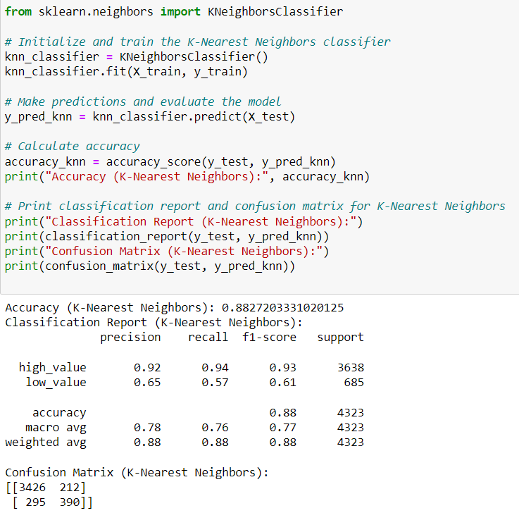
k-Nearest Neighbors (k-NN) Classifier (Value Categorization):
Classifies properties based on k nearest neighbors' (similar houses) in the training data.
Achieved 88.2% in identifying high and low-valued properties (replace with actual value).
Reveals nearby properties influencing predictions, offering insights into the local housing market.
Handles diverse data types (numerical, categorical) without extensive preprocessing.
Tuning the k parameter can improve performance, requiring experimentation for best results.

Slide 12
Recommendation:
Conduct a thorough analysis of lending rates' impact on housing prices, considering historical trends and current market conditions.
Incorporate lending rates as a significant feature in the predictive models to capture their influence on housing prices accurately.
Fine-tune model hyperparameters specifically to account for the sensitivity of housing prices to changes in lending rates, optimizing predictive accuracy.
Explore ensemble models, such as blending lending rate-sensitive models with others, to leverage the strengths of various algorithms effectively.
Enhance the interactive dashboard by integrating lending rate data visualization tools, allowing users to understand the correlation between lending rates and housing prices and make informed decisions.

Slide 13
Conclusion :
Extensive analysis of King County residential sales has uncovered key determinants of property prices.
Leveraged a variety of machine learning models for precise price prediction and property categorization, each offering unique insights and challenges.
An integrated approach utilizing multiple models has provided a comprehensive understanding of the housing market.
The interactive dashboard has emerged as a crucial tool for identifying and understanding market trends, facilitating informed decision-making.
Future efforts will focus on fine-tuning models, exploring ensemble techniques, and integrating temporal and external data to enhance predictive accuracy and support dynamic market analysis.

