Slide 1
In the name of GOD Level-2 node clustering coefficient-based link prediction
Marjan Khirkhah, Mohammad Kadkhoda, Sasan Sharifipour

Slide 2

Definition1(Clustering Coefficient)
It is a measure of the degree to which nodes of a graph tends to be clustered.
In graph theory, the clustering coefficient of a node represents its neighbor’s tendency to become a clique or complete graph
Mathematically, this measure is expressed as:
ki is the degree of the node, I
N(i) is immediate neighbors of i.

Slide 3
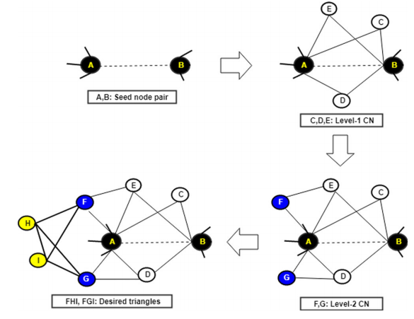
Definition2(level2 node Clustering Coefficient)

Slide 4


Link prediction based on level2 node clustering coefficient
CC(C N2) is having the usual definition of node clustering coefficient value and is computed using the formula (ci)
C N2 A is the level-2 common neighbor corresponding to node A and the common node of the pair (A, B)
C N1 is the level-1 common neighbor

Slide 5
Algorithm description
For a given simple undirected graph, the algorithm finds top-L missing links.
The main crux of the algorithm is to find level-2 common neighbors from which level-2 clustering coefficient can be calculated.
For each pair of nodes (seed node pair (A, B)) having no edge between them, the algorithm finds all common neighbors (level-1 CNs)
Level-2 common neighbors are then computed for all those node pairs
for all nodes in level-2 common neighbors, clustering coefficient values are computed and added to get final similarity score for the seed node pair (A, B)
Once scores of all non-existent node pairs have been computed, the next step arranges them in descending order
and finally, top-L node pairs are returned as predicted links

Slide 6
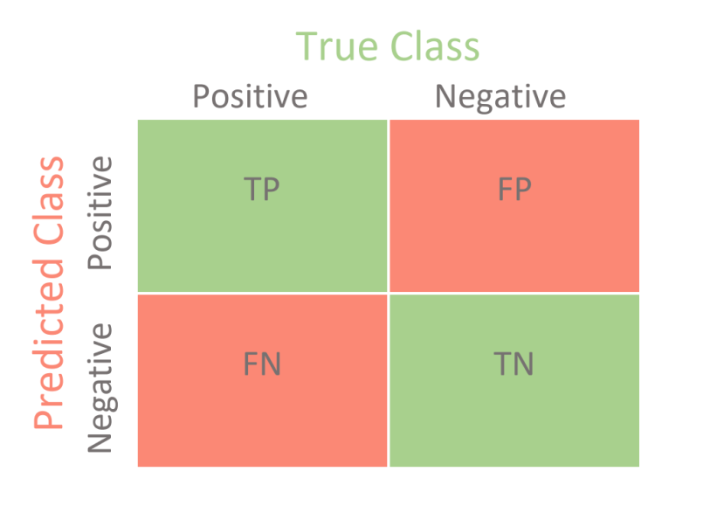
Evaluation metrics
The link prediction problem is treated as a binary classification task
Most of the evaluation metrics of any binary classification task can be used in link prediction Evaluation
The evaluation of a binary classification task having two classes can be represented as a confusion matrix
Confusion Matrix :
True Positive (TP): positive data item predicted as positive
True Negative (TN): negative data item predicted as negative
False Positive (FP): negative data item predicted as positive
False Negative (FN): positive data item predicted as negative

Slide 7

Evaluation metrics
True Positive Rate (TPR)/Recall/Sensitivity :
$\begin{matrix}TPR= & \frac{\#TP}{\#TP+\#FN}\end{matrix}$
False Positive Rate (FPR) :
$\begin{matrix}FPR= & \frac{\#FP}{\#FP+\#TN}\end{matrix}$
True Negative Rate (TNR)/Specificity
$\begin{matrix}TNR= & \frac{\#TN}{\#FP+\#TN}\end{matrix}$
Precision :
$\begin{matrix}Percision= & \frac{\#TP}{\#TP+\#FP}\end{matrix}$

Slide 8
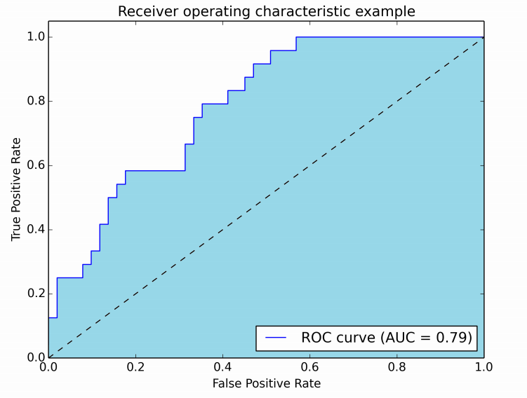
AUROC
A roc curve is a plot between the true positive rate (sensitivity) on the y-axis and the false positive rate (1- specificity) on the x-axis
The area under the roc curve is between 0 and 1
The value of the auroc of a predictor should be greater than 0.5 which is the value of a random predictor
Higher the value of auroc better the performance of the predictor

Slide 9
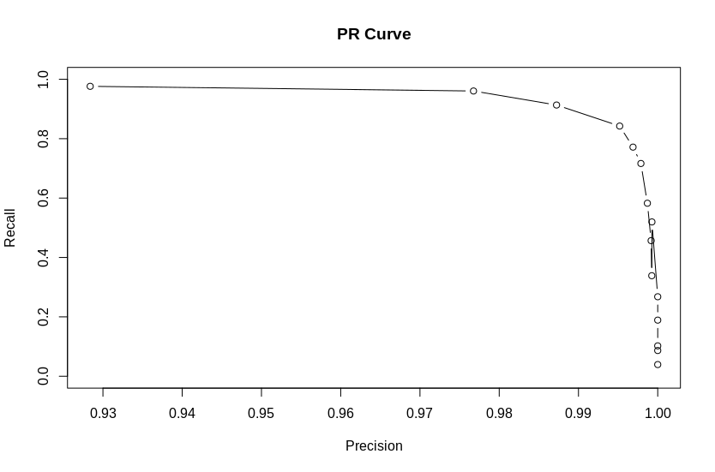
AUPR Area under the precision-recall curve
The precision-recall curve is more useful and informative when applied to binary classification on imbalanced datasets
The precision-recall curve which is a plot between the precision values on the y-axis and the recall values on the x-axis

Slide 10

Other Metrics
Average precision
single point summary value which is computed based on varying threshold values
The average precision value is equal to the precision averaged over all values of recall between 0 and 1
$\begin{matrix}average percision= & \int_{r=0}^{1}{p\left(r\right)dr}\end{matrix}$

Slide 11
Datasets
Dataset Name |  | Node | Edge
Macaque | biological network of cerebral cortex of Rhesus macaque.
Football | American football games network played between Division IA colleges during regular season Fall 2000
Celegansneural | A neural network of C. Elegans compiled by D. Watts and S. Strogatz | neuron | an edge joins two neurons if they are connected by either a synapse or a gap junction
USAir97 | an airline network of US | airport | an edge shows the connectivity between two airports
Political blogs | directed network of hyperlinks in political blogs leaning towards the conservatives and the democrats preceding the US election 2004
Yeast | biological network of proteins in a cell | protein | interaction between two proteins

Slide 12
Datasets
Dataset Name |  | Node | Edge
Amazon web graph | an informational network of web pages of Amazon.com and its sister companies.
Power grid | an undirected and unweighted network of power grid located in western states of the United States
ca-GrQc | collaboration networks of arXiv General Relativity
ca-HepTh | collaboration networks of arXiv High Energy Physics Theory
ca-HepPh | collaboration networks of arXiv High Energy Physics

Slide 13
Datasets
N : total number of nodes
E : total number of edges
D : node pairs average shortest distance
K : average degree
C : average clustering coefficient of the network
Dataset Name | N | E | D | K | C
Macaque | 91 | 1401 | 1.658 | 30.791 | 0.742
Football | 115 | 613 | 2.486 | 10.661 | 0.403
Celegansneural | 297 | 2148 | 2.447 | 14.456 | 0.308
USAir97 | 332 | 2126 | 2.738 | 12.807 | 0.749
Political blogs | 1490 | 16718 | 2.738 | 22.440 | 0.361
Yeast | 2361 | 7182 | 4.376 | 6.084 | 0.271
Amazon web graph | 2880 | 3904 | 3.433 | 2.711 | 0.818
Power grid | 4941 | 6594 | 18.989 | 2.669 | 0.107
ca-GrQc | 5242 | 14496 | 6.049 | 5.531 | 0.687
ca-HepTh | 8361 | 15751 | 7.025 | 3.768 | 0.636
ca-HepPh | 12008 | 118521 | 4.673 | 19.74 | 0.699

Slide 14



Baseline Methods
Common Neighbor (CN) :
Preferential Attachment (PA) :
Resource Allocation (RA) :

Slide 15

Baseline Methods
Node and Link Clustering Coefficient (NLC) :
Kc : degree of node c
CN(a,c) is the number of common neighbors of the nodes a and c
C(c) is the clustering coefficient of the node c

Slide 16


Baseline Methods
Local Naive Bayes based Common Neighbor (LNBCN) :

Slide 17
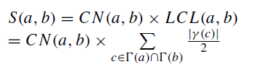
Baseline Methods
CAR Index:
LCL(a, b) refers to local community links
γ (c) is the subset of neighbors of node c that are also common neighbors of a and b

Slide 18
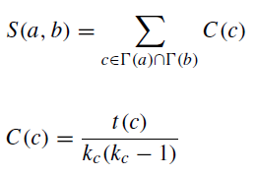
Baseline Methods
Clustering Coefficient based Link Prediction (CCLP) :
where kc is the degree of node c and t(c) is the total triangles passing through the node c

Slide 19
Baseline Methods
Node2vec:
low dimensional feature representation technique
each nodes are mapped in lower space. neighborhood of the nodes are preserved.
can be referred as network embedding technique which tries to preserve the neighborhood structure by mapping similar nodes in the input space to nearby in the representation or embedding space.
It is a semi-supervised algorithm
uses the flexible notion of a biased random walk (sampling strategy) to explore the diverse neighborhood of nodes

Slide 20
Thanks for your attention

