Slide 1
Multimedia Wireless Networks A2
ns-3 Setup & First Scenario
Sascha Furrer
F11502002
Basic Path

Slide 2
Goal
1
2
3
ns-3 running
3GPP traffic model
verified on my own run
Does EDCA prioritization still work with realistic multimedia traffic?

Slide 3
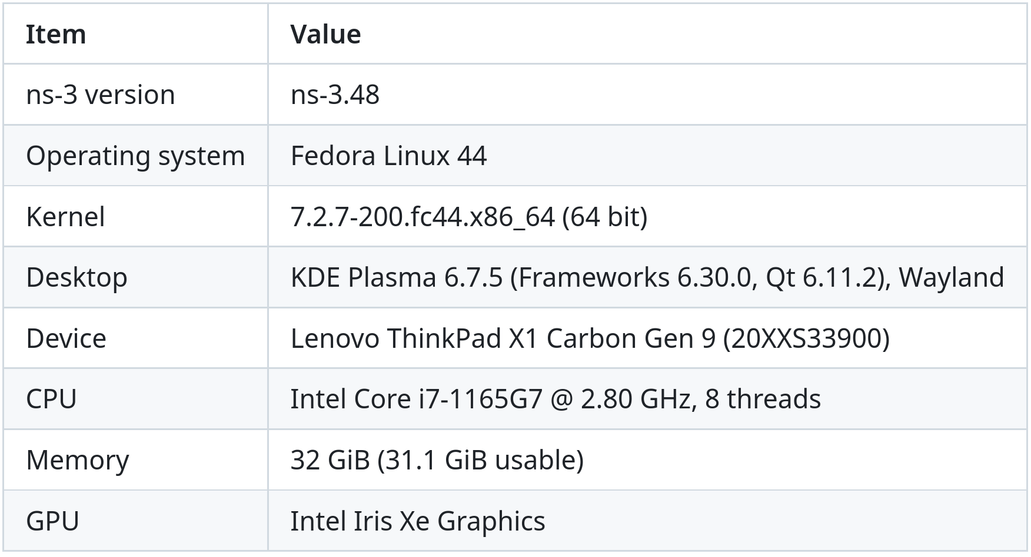
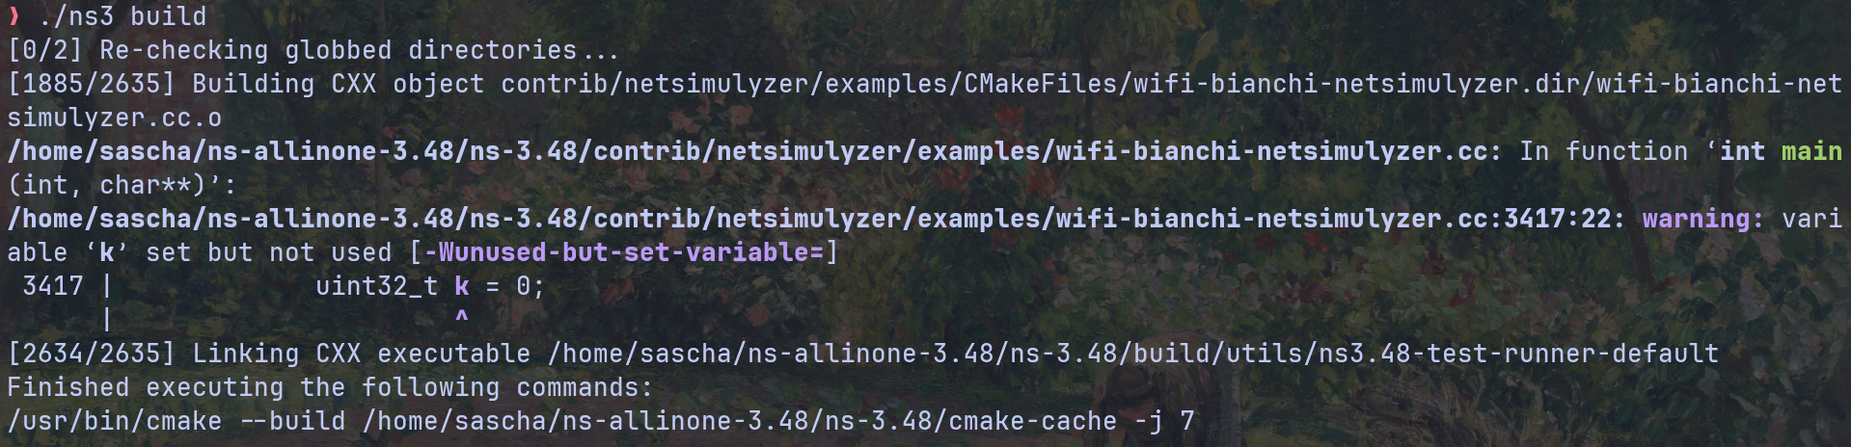
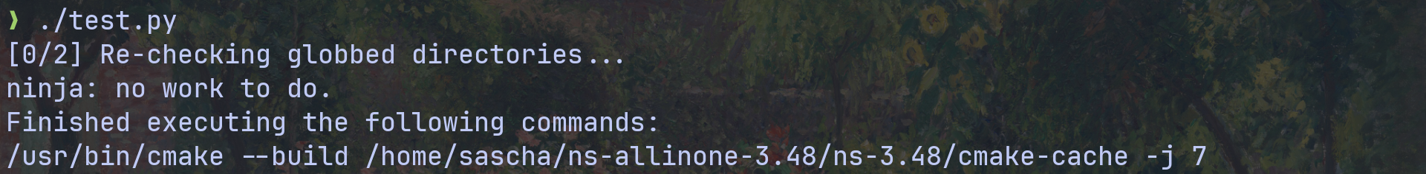
ns-3 setup

Slide 4
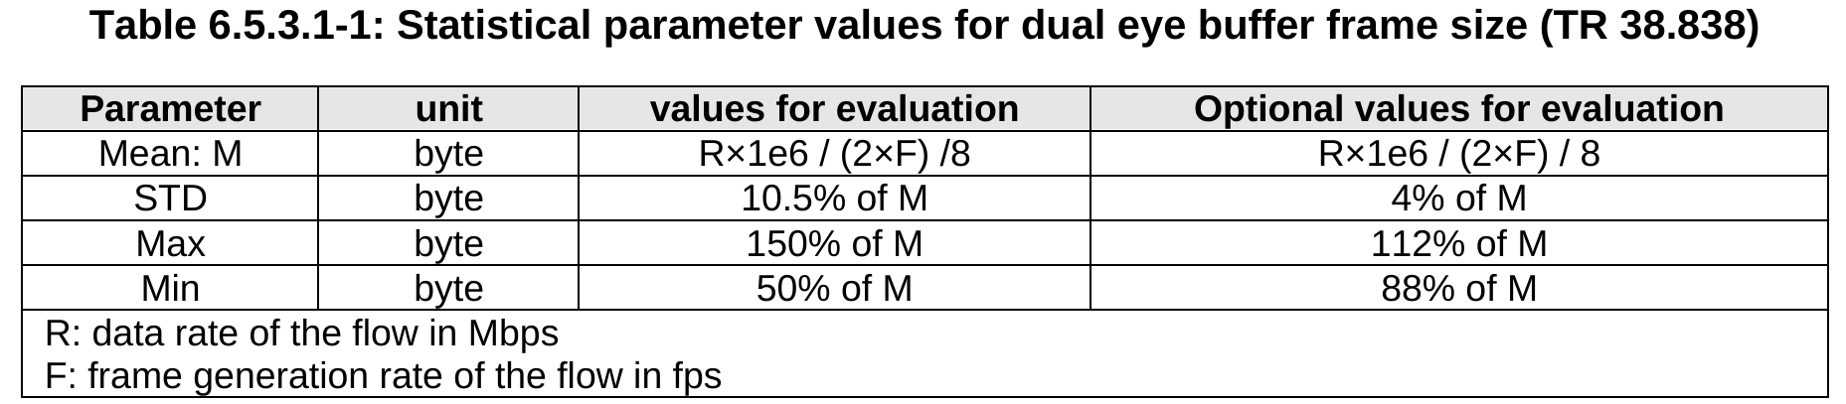
3GPP TR 26.926 V19.0.0 (Rel. 19)​
TS
Technical Specification
TR
Technical Report

Slide 5
3GPP Traffic Model
8.33
jitter
size varies
per buffer
DL eye buffers
AP → STA
t [ms]
UL pose
STA → AP
10
0
8.33
16.67
25
33.33
Frame size: truncated Gaussian, M = R · 10⁶ / (2F) / 8, STD 10.5 % of M, ±50 %
Jitter: truncated Gaussian, STD 2 ms, ±4 ms
Based on Table 6.5.3.1-1

Slide 6
Traffic Generator
DL video
R = 10 Mbit/s, F = 60 fps
TID 5
AC_VI
IP ToS
XrTrafficApp
UL pose
100 B every 10 ms
TID 6
AC_VO
IP ToS
ToS byte → 802.11 user priority (TID) → access category

Slide 7
Scenario
AP
STA
XR headset
DL video · AC_VI (TID 5)
UL pose · AC_VO (TID 6)
5 m
802.11a · 54 Mbit/s · channel 36

Slide 8
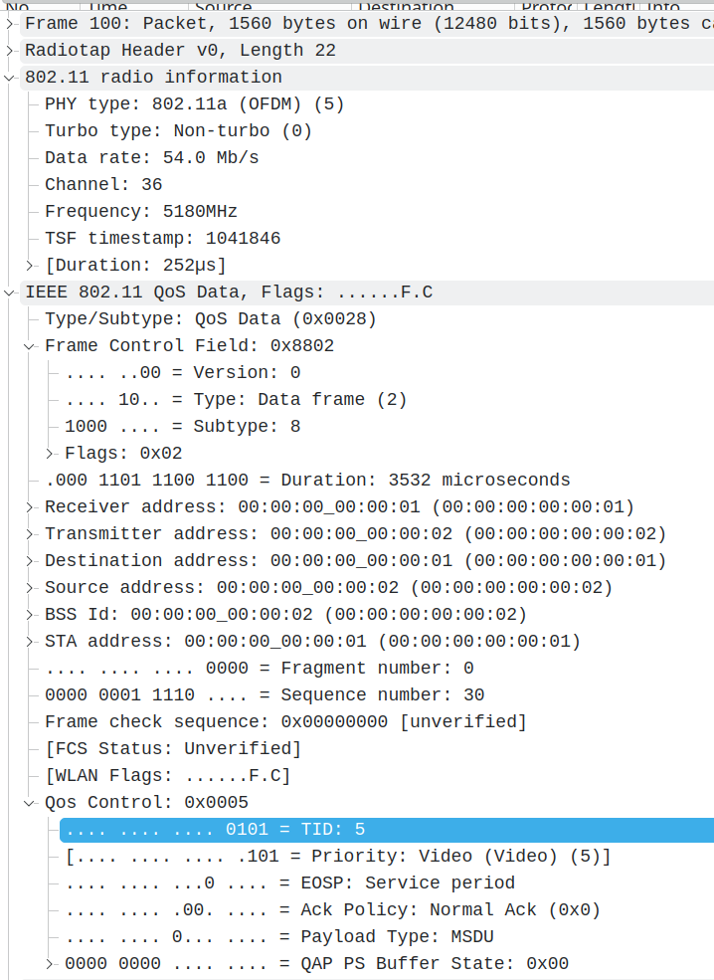
Results
 | DL video | UL pose
throughput | 10.2 Mbit/s | 0.07 Mbit/s
mean delay | 1.29 ms | 0.37 ms
loss | 0 | 0
overhead DL video: 7.58 packets/frame × 120 frames/s ≈ 909 packets/s
909 × 28 B × 8 ≈ 0.20 Mbit/s
throughput UL pose: 100 packets/s × 88 B × 8 bit = 70 400 bit/s ≈ 0.070 Mbit/s

Slide 9
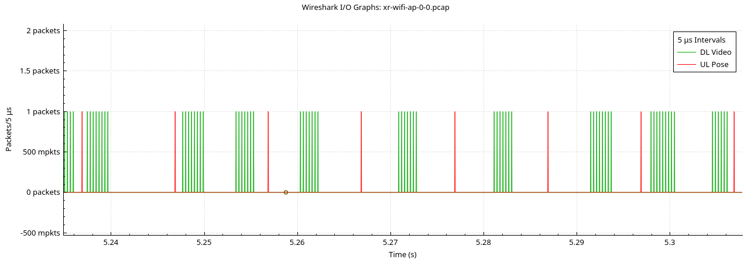
Results

Slide 10
What broke
Symptom
Cause
Fix
Jitter only in whole ms
MilliSeconds() takes only integers
Time::FromDouble
4 packets lost at start
ARP queue holds only 3 packets
ARP queue enlarged

Slide 11
Recap
1
2
3
✓
✓
✓
ns-3 running
3GPP traffic model
verified on my own run

