Slide 1
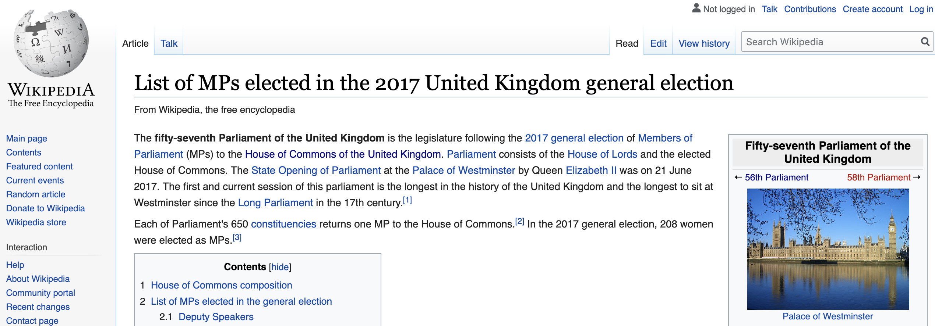

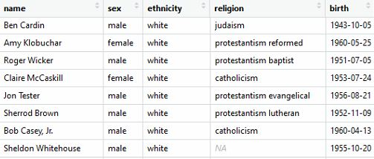
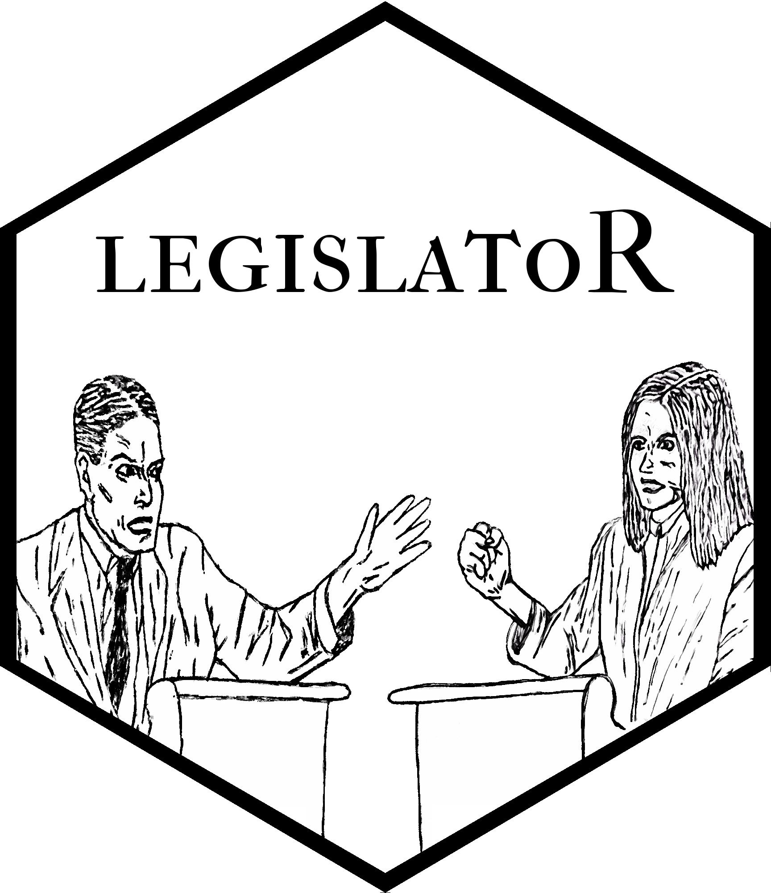

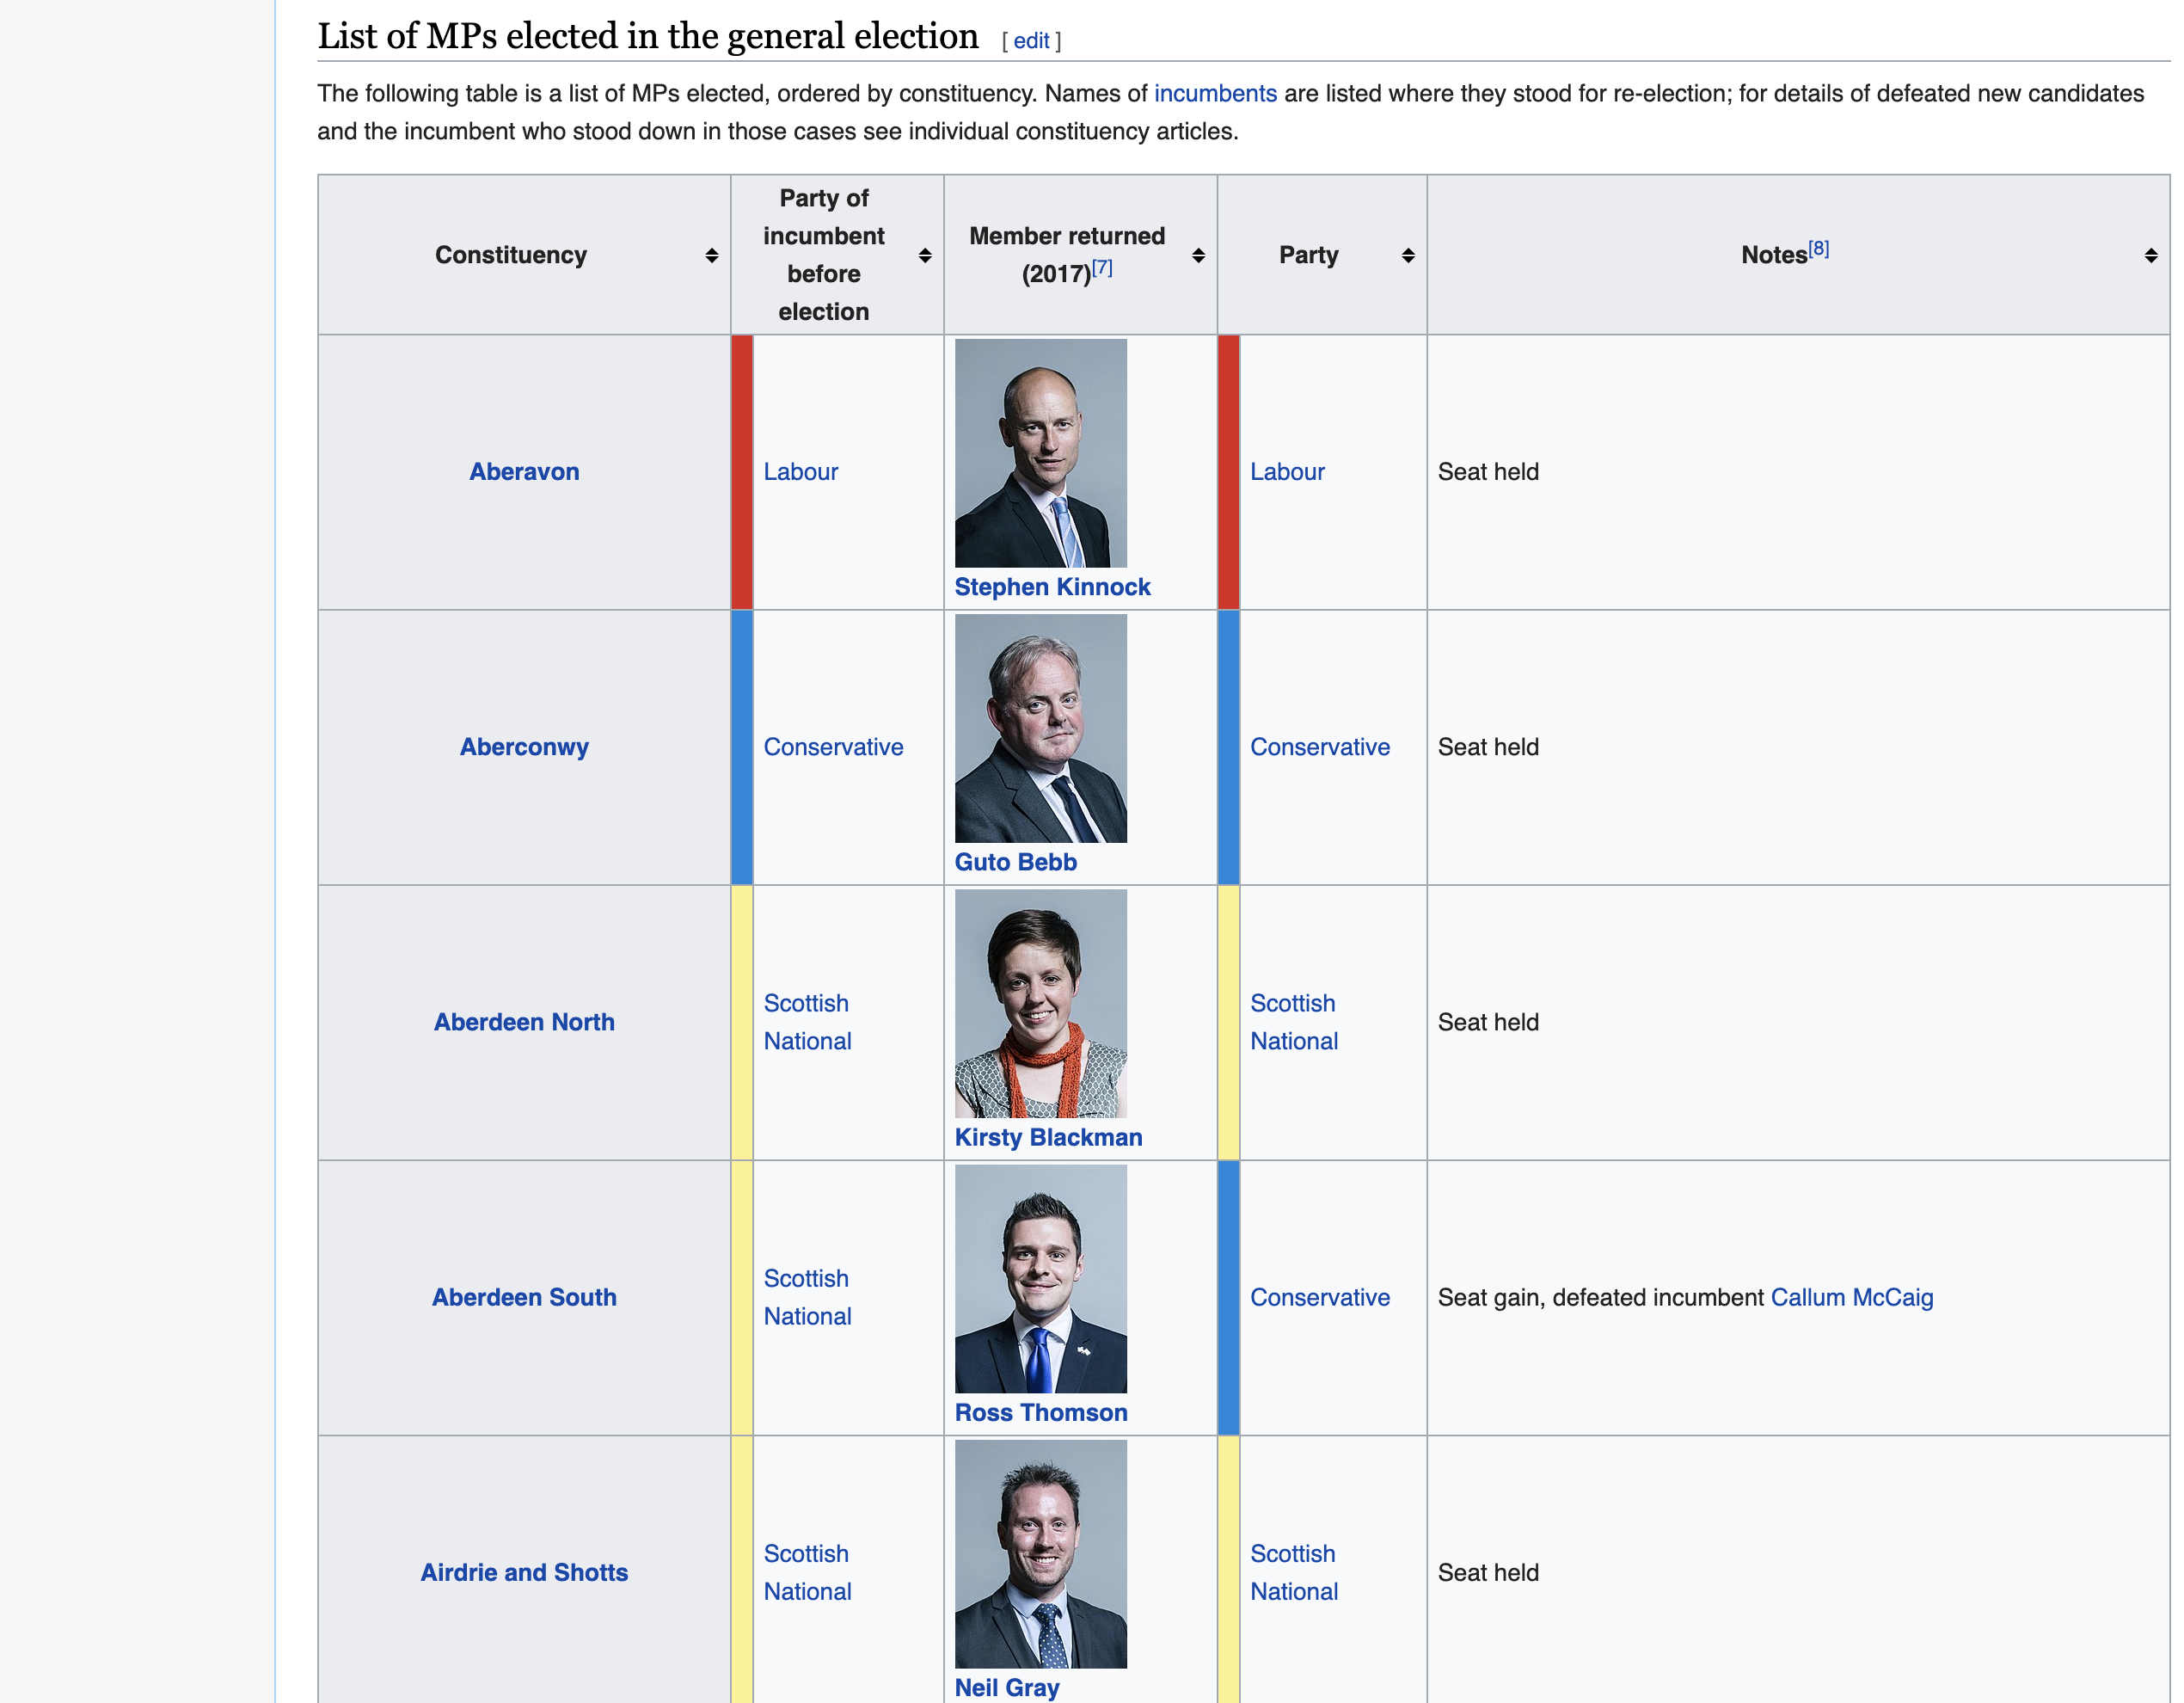




Step 1
Entity identification
Step 2
Data collection
Step 3
Cleaning, verification
Step 4
Database integration
Governmental and other data sources
Identify and scrape parliamentary members‘ index sites
Extract person-specific Wikipedia and Wikidata IDs
Scrape basic information from members‘ index sites
Automatically retrieve bulk of information using IDs with Wikidata and Wikipedia APIs
Scrape external sources for additional and missing data
Remove noise in variable values
Harmonize variables within and across legislatures
Perform checks against alternative data sources
Assemble database via Wikipedia and Wikidata IDs
Provide convenient access via R package legislatoR
A
A
A
A
B
B
B
B
C
C

