Slide 1
no symmetry finding
Lattice vectors
Atoms
Bilbao Conv? Rule User Guide.
INPUT
tell prim || conv?
conv only one?
prim only one?XXX
primitive cell prim->conv
conventional cell
conv->prim
check space group symmetry
find space group number
no spin, complex hopping terms
spin return?
advanced QM
MagSG 4: {G-G’}&{G’T},{G}&{GT},...
no 2s 3d 5pz?
C 1 1s 2s 2pz …

Slide 2
Can we Self-check? Check it!
Input：
LatVec: 3*3
Atom: NumAt*3
AtTypeInd: NumAt
Dim: 2 or 3
Check Prim or Conv?
Prim
Conv
Prim→Conv
Conv→Prim
LatVec & Atom
of Conv
Space group
…
Only one set of Conventional cell? Check it!
Only Bilbao conv is needed. Declare and Use it!
Infinite sets of Primitive cell? 1. SVP! (See SVP code) 2. How after SVP???

Slide 3
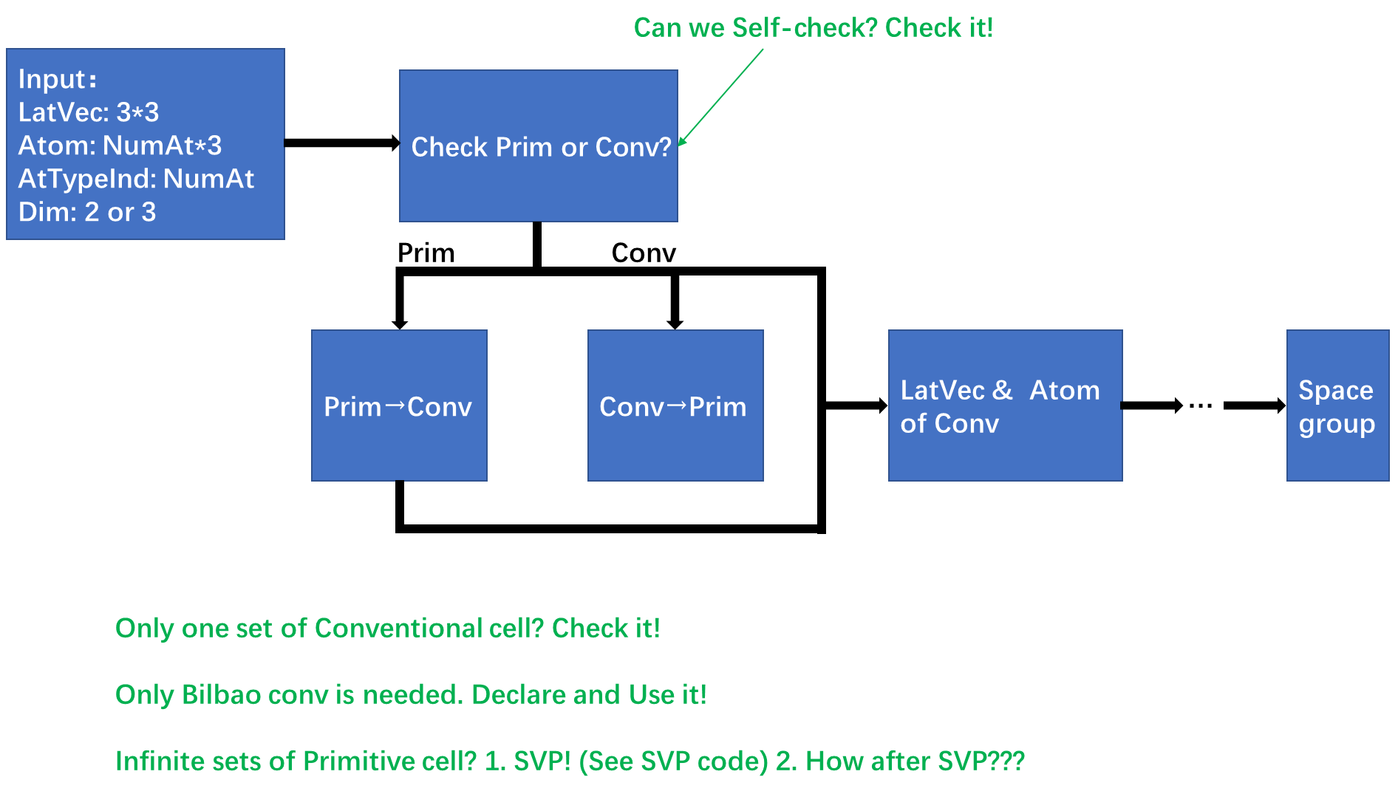

Slide 4
Conv→Prim
Input Conv
Find LatSys
Find BraLat
Get Prim

Slide 5
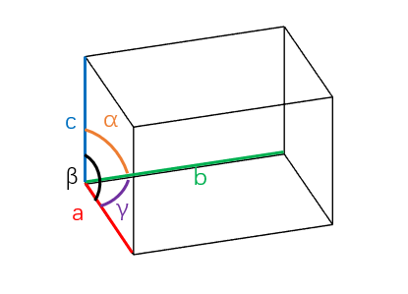
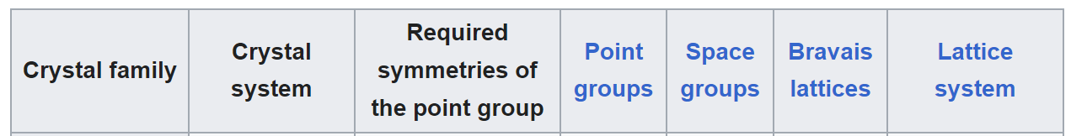
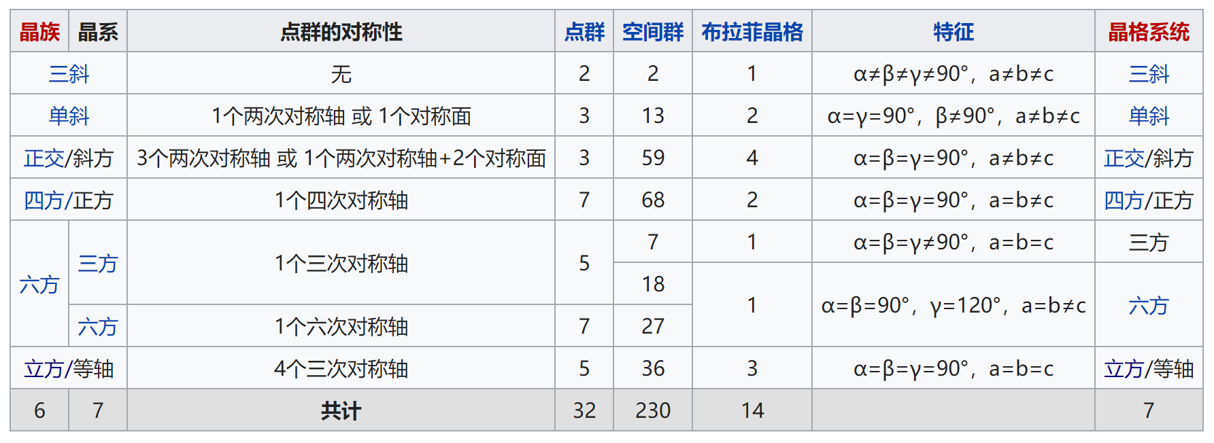

Slide 6
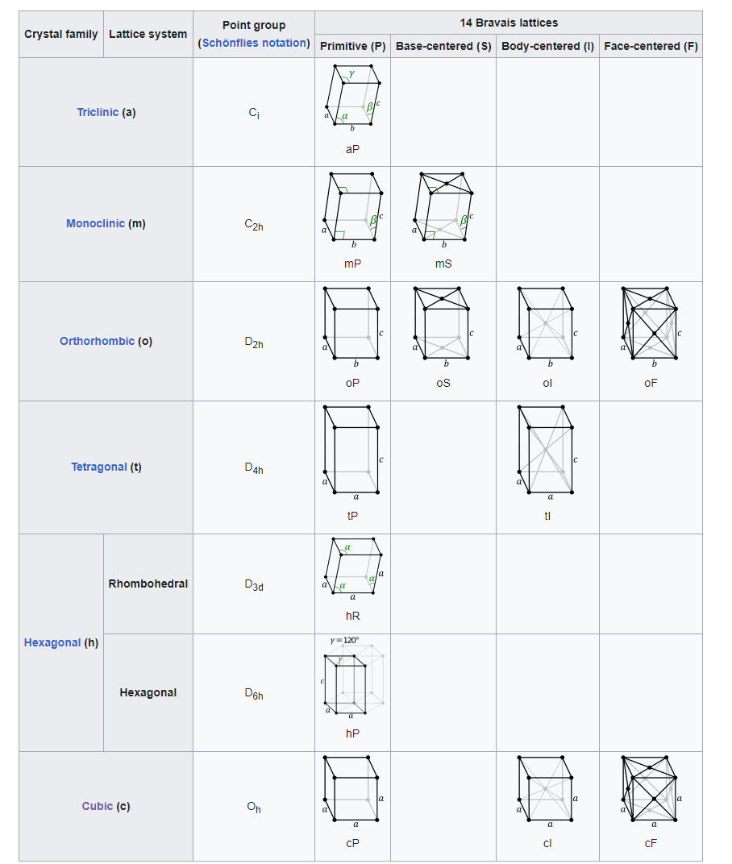

Slide 7
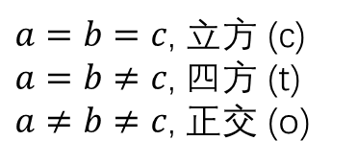
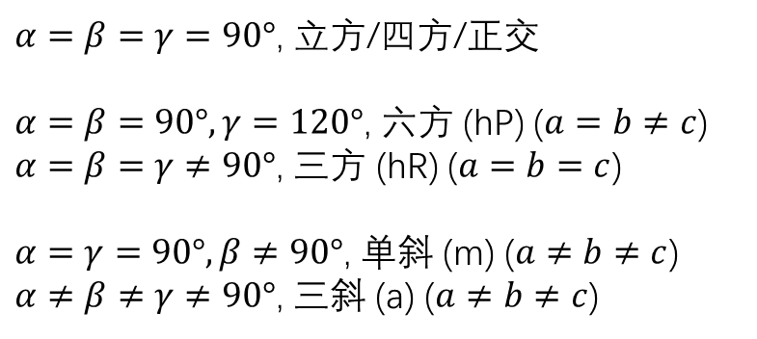
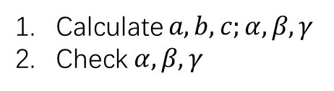
Find LatSys
Calculate $a,b,c;α,β,γ$
Check $α,β,γ$
$a=b=c$, 立方 (c)
$a=b≠c$, 四方 (t)
$a≠b≠c$, 正交 (o)
$α=β=γ=90°\text{,}$ 立方/四方/正交
$α=β=90°,γ=120°\text{,}$ 六方 (hP) ($a=b≠c$)
$α=β=γ≠90°$, 三方 (hR) ($a=b=c$)
$α=γ=90°,β≠90°\text{,}$ 单斜 (m) ($a≠b≠c$)
$α≠β≠γ≠90°\text{,}$ 三斜 (a) ($a≠b≠c$)
Order is important!
Monoclinic (m) is strange!

Slide 8
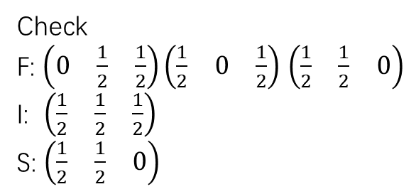
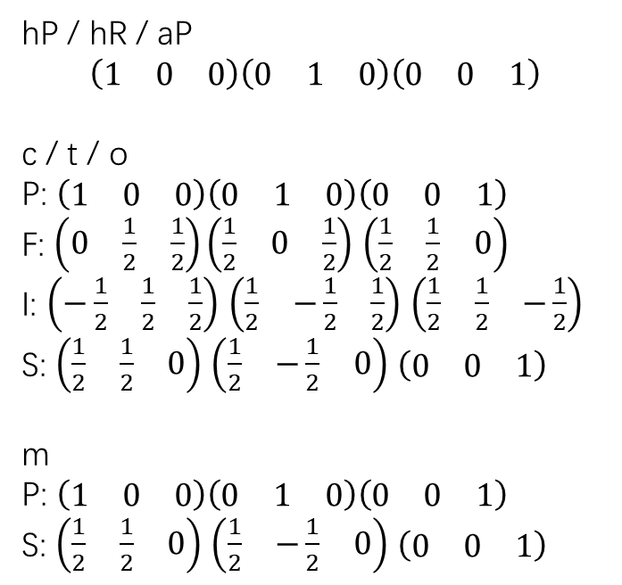
Find BraLat
Check LatSys
Calculate Prim LatVec & Atom
六方 (hP) / 三方 (hR) → hP / hR
三斜 (a) → aP
立方 (c) → cP / cI / cF
四方 (t) → tP / tI
正交 (o) → oP / oS / oI / oF
单斜 (m) → mP / mS
hP / hR / aP
$$\left(\begin{matrix}1 & 0 & 0\end{matrix}\right)\left(\begin{matrix}0 & 1 & 0\end{matrix}\right)\left(\begin{matrix}0 & 0 & 1\end{matrix}\right)$$
c / t / o
P: $\left(\begin{matrix}1 & 0 & 0\end{matrix}\right)\left(\begin{matrix}0 & 1 & 0\end{matrix}\right)\left(\begin{matrix}0 & 0 & 1\end{matrix}\right)$
F: $\left(\begin{matrix}0 & \frac{1}{2} & \frac{1}{2}\end{matrix}\right)\left(\begin{matrix}\frac{1}{2} & 0 & \frac{1}{2}\end{matrix}\right)$ $\left(\begin{matrix}\frac{1}{2} & \frac{1}{2} & 0\end{matrix}\right)$
I: $\left(\begin{matrix}−\frac{1}{2} & \frac{1}{2} & \frac{1}{2}\end{matrix}\right)$ $\left(\begin{matrix}\frac{1}{2} & −\frac{1}{2} & \frac{1}{2}\end{matrix}\right)$ $\left(\begin{matrix}\frac{1}{2} & \frac{1}{2} & −\frac{1}{2}\end{matrix}\right)$
S: $\left(\begin{matrix}\frac{1}{2} & \frac{1}{2} & 0\end{matrix}\right)$ $\left(\begin{matrix}\frac{1}{2} & −\frac{1}{2} & 0\end{matrix}\right)$ $\left(\begin{matrix}0 & 0 & 1\end{matrix}\right)$
m
P: $\left(\begin{matrix}1 & 0 & 0\end{matrix}\right)\left(\begin{matrix}0 & 1 & 0\end{matrix}\right)\left(\begin{matrix}0 & 0 & 1\end{matrix}\right)$
S: $\left(\begin{matrix}\frac{1}{2} & \frac{1}{2} & 0\end{matrix}\right)$ $\left(\begin{matrix}\frac{1}{2} & −\frac{1}{2} & 0\end{matrix}\right)$ $\left(\begin{matrix}0 & 0 & 1\end{matrix}\right)$
Check BraLat
Check
F: $\left(\begin{matrix}0 & \frac{1}{2} & \frac{1}{2}\end{matrix}\right)\left(\begin{matrix}\frac{1}{2} & 0 & \frac{1}{2}\end{matrix}\right)$ $\left(\begin{matrix}\frac{1}{2} & \frac{1}{2} & 0\end{matrix}\right)$
I: $\left(\begin{matrix}\frac{1}{2} & \frac{1}{2} & \frac{1}{2}\end{matrix}\right)$
S: $\left(\begin{matrix}\frac{1}{2} & \frac{1}{2} & 0\end{matrix}\right)$

