Slide 1
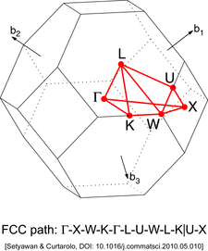
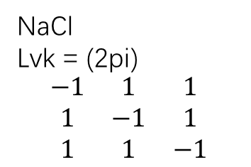


NaCl
Lvk = (2pi)
$$\begin{matrix}−1 & 1 & 1 \\ 1 & −1 & 1 \\ 1 & 1 & −1\end{matrix}$$
z
b1,b2,b3
000 C
5/8 1/4 5/8 U
3/8 3/8 3/4 K
1/2 1/4 3/4 W
1/2 1/2 1/2 L
1/2 0 1/2 X
$$\sqrt{3}$$
0.0000 0.0000 0.0000 ${\Gamma}$
0.6250 0.2500 0.6250 U
0.3750 0.3750 0.7500 K
0.5000 0.2500 0.7500 W
0.5000 0.5000 0.5000 L
0.5000 0.0000 0.5000 X
$$1$$
y
x

