Slide 1
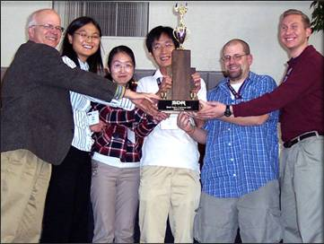
Cognitive Wireless Technology Team
Continues Its Winning Streak
Alexander R. Young, student team captain
Charles W. Bostian, faculty advisor
{alex.young, bostian}@vt.edu
25 September 2009
Notes:
Tell a story!!!!!!!!!!!!
Avoid acronyms

Slide 2
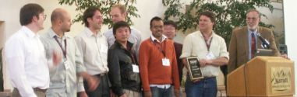
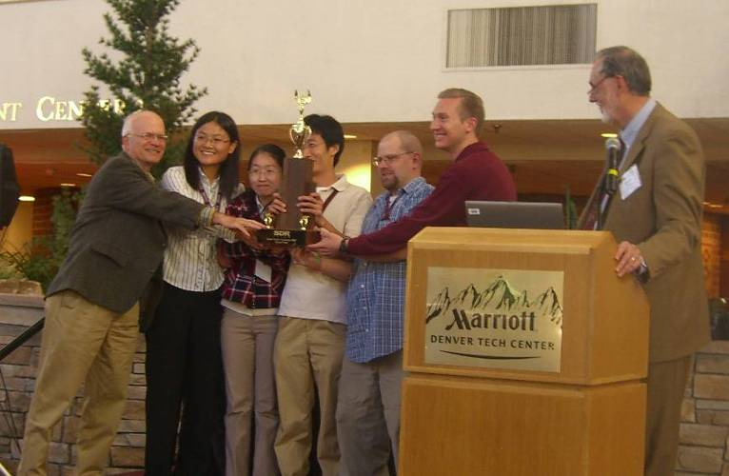
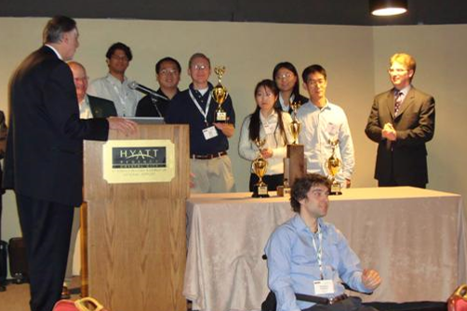
VT Students and the Tradition of Success
2007
2007
2008

Slide 3
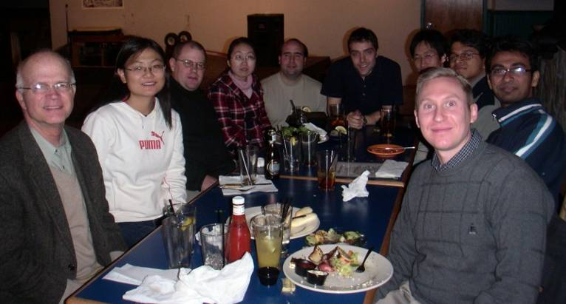
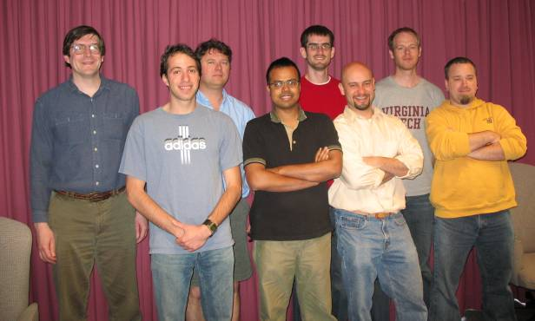
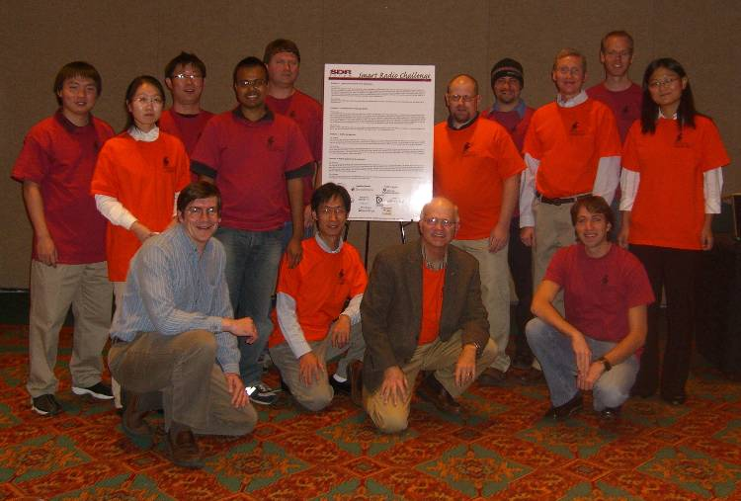
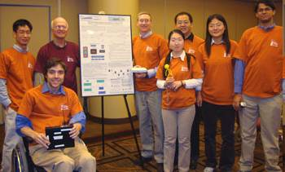
Teamwork

Slide 4
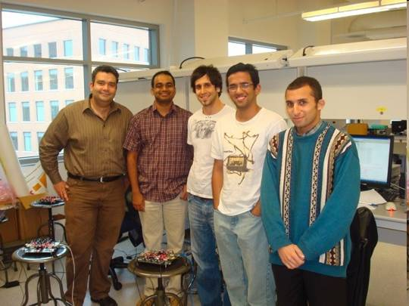

VT Partners
University of California – Irvine
http://warp.rice.edu/trac/attachment/wiki/Projects/UCI_NIJ-SDR/Files/UCI_Team_big.jpg
Notes:
Hardware useful in poor signal
Preexisting relationships,
How they complement

Slide 5
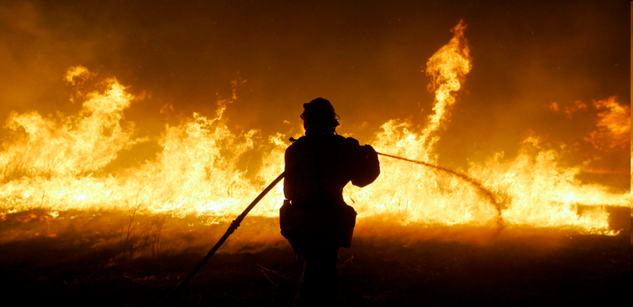
Past Smart Radio Challenge Problems
Spectrum access for first responders
  2007 San Diego County forest fires
http://asapblogs.typepad.com/photos/uncategorized/2007/10/22/fire.jpg
Notes:
How the system could be used in
Personal, humanistic

Slide 6
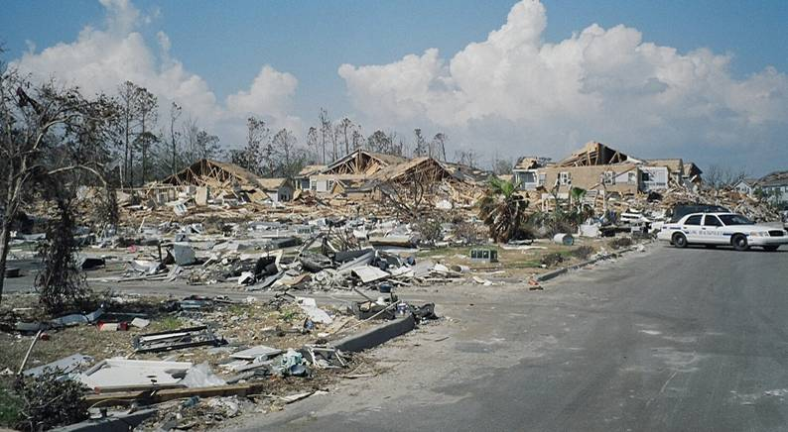
Past Smart Radio Challenge Problems
Communications from an infrastructure-damaged area
  2005 Hurricane Katrina
http://blog.lib.umn.edu/olso4158/architecture/Hurricane%2520Katrina%2520Response2%5B1%5D.jpg
Notes:
Personalize the story

Slide 7
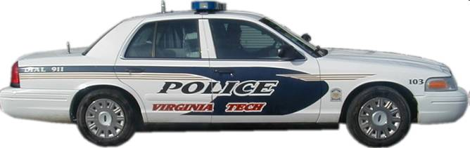
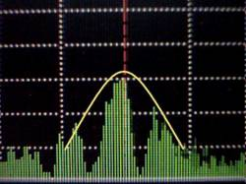
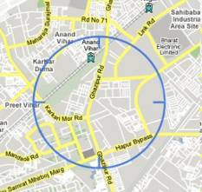
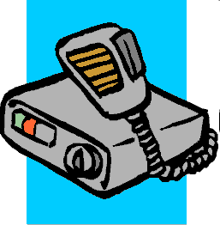
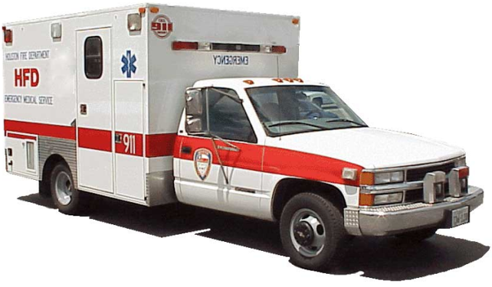
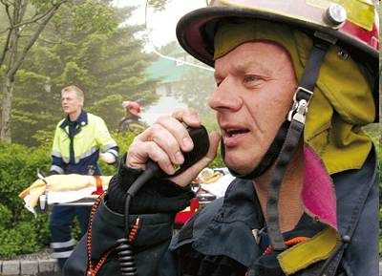
The 2009 Challenge Problem
Spectrum management and communications facilitation

Slide 8
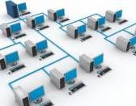
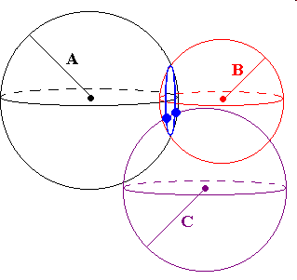
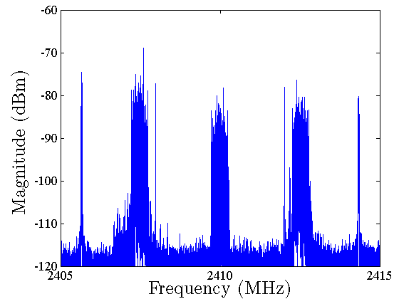
Required Technology & Skills
Advanced digital communications & networking
Geolocation
Policy & shared resource (spectrum) management
Systems simulation
Notes:
Skill sets
Geolocation – stranded in a car
Policy – lack of communication
April 16 – brings it home

Slide 9
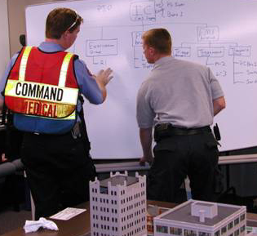
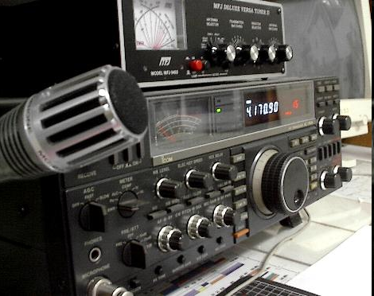
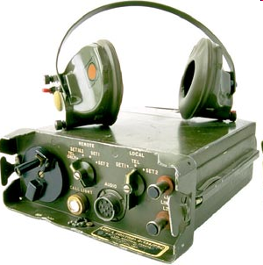
Required Technology & Skills
Public safety/emergency response operations
Systems integration
Real world implementation & testing
http://www.incidentmt.com/images/incident_commander_and_aide.jpg

Slide 10

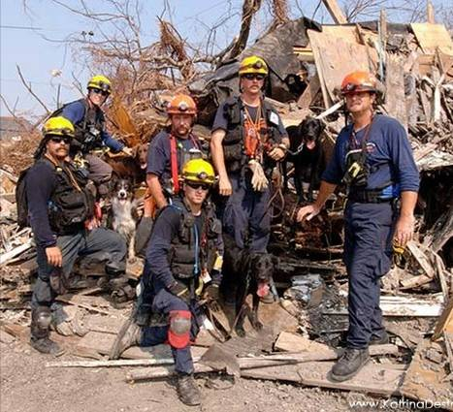
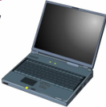
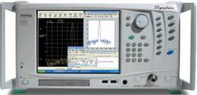

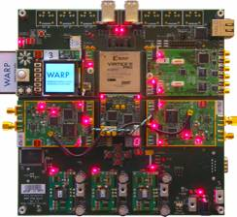
System Diagram
Geolocation
Sensor 1
API
DSA Broker
UCS Sensor
Cognitive Controller
UCI MIMO

Slide 11
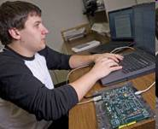
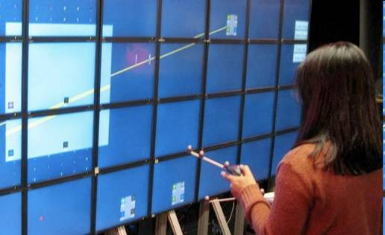
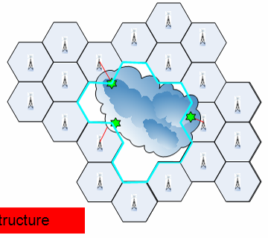
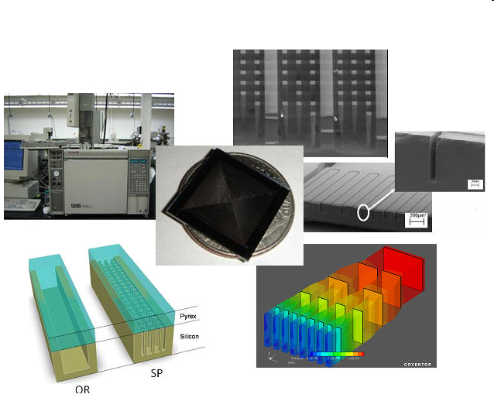
Benefits
Students
  Exposure to advanced technology
  Involvement in new research
Current research
  New and exciting directions

Slide 12
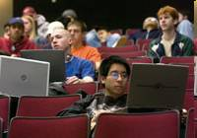
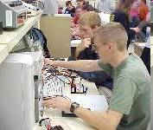
Where Next?
Team development and growth
  Fully supported and integrated program
  Department or college level

Slide 13
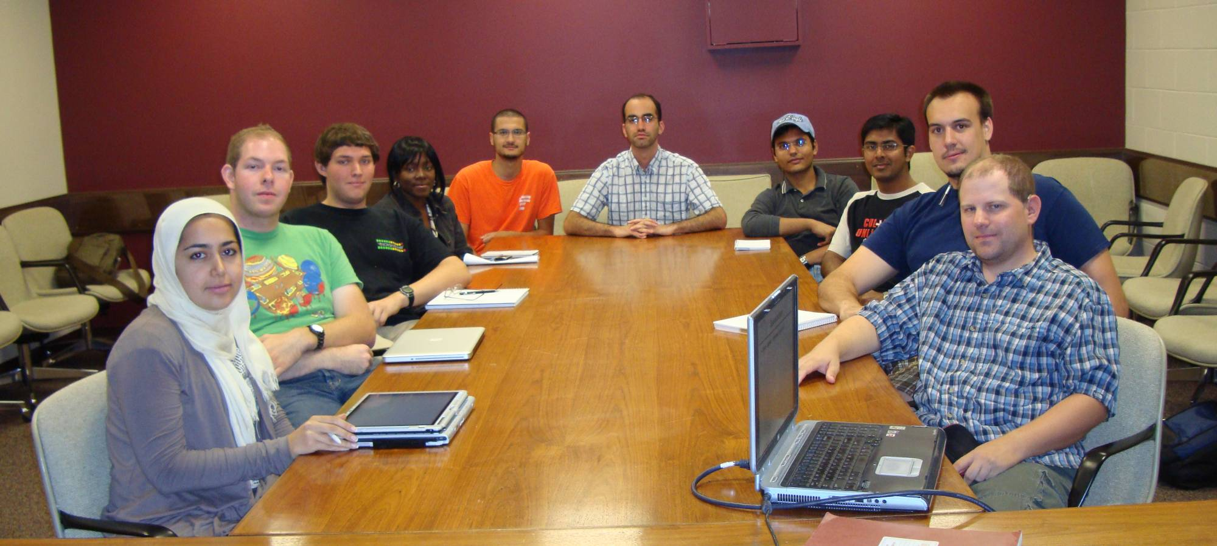
VT’s 2009 Smart Radio Team
Notes:
ECE ham radio, theatre sound department, football player, honors, Viasat, computer engineering, burrus events, TA’s, karate, triathlete, runner
Currently have x undergrad , x grad
Currently ece, but looking to expand
Brand new team,

Slide 14
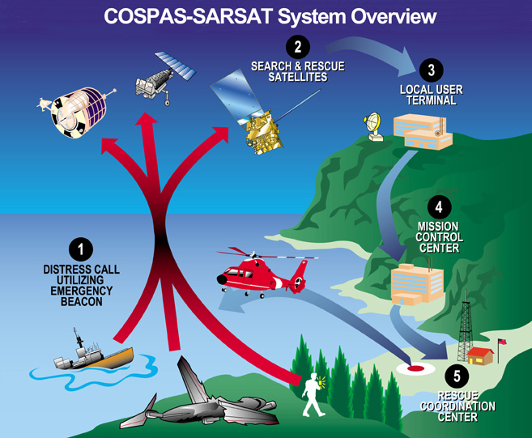
SARSAT System

Slide 15
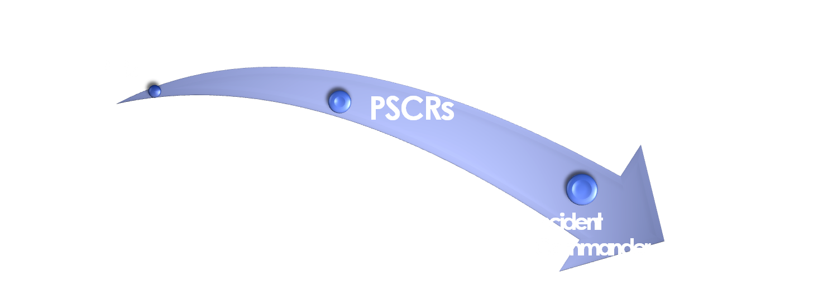

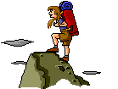
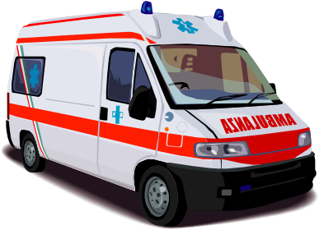

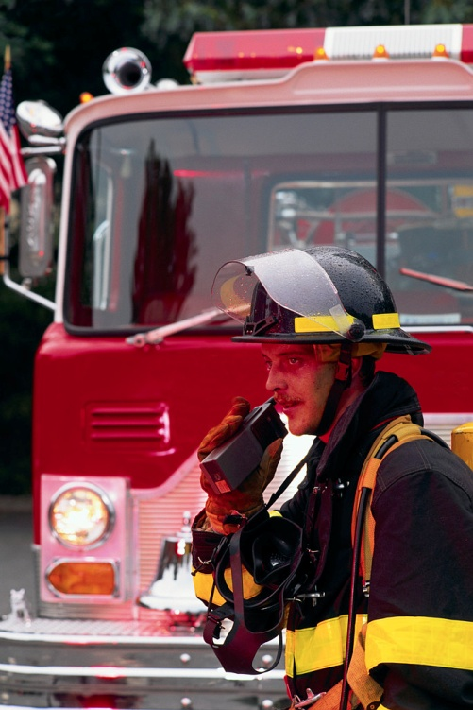
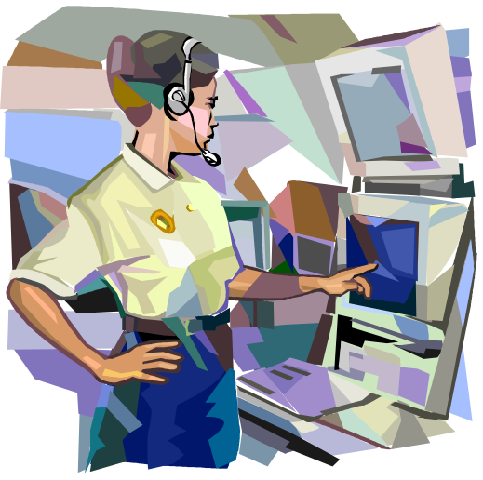


Slide 16
Thank you

