Slide 1
Final Presentation for Project Sponsors
Titanic
Dmitry Makarenko, Alexander Ivanyushenko, Ivan Fedotov, Artem Lyan, Alexandra Tsvetkova
19.01.2017

Slide 2
Project Goals
Analyze parameters of survival and make the appropriate results
Compare the use of different methods
Visualize statistics of survivors in this disaster

Slide 3
Situation & Project Goals
Situation
Apply the tools of machine learning to predict which passengers survived the tragedy of Titanic on April 15, 1912
The survival probability of passengers depending on the number of variables can be used by insurance companies in calculation of a insurance
Implication of this research can decrement disasters on water
Project Goals
Research what sorts of people were likely to survive on Titanic
Compose a picture of the average statistical Titanic passenger
Compare the results of different algorithms

Slide 4
Executive summary
Research the classification of survivors
Algorithms that have been used:
Classification by logistic regression
Basic random forest model
Neural network
Dataset
Logistic regression
Random forest
Neural network
Result

Slide 5
Approach
Use dataset with gender, male, age and fare
Estimation values of this variables for survival
Developed different models to make visualization
Evaluation of the accuracy of models
Made available visualization of results to analyze probability to survive on Titanic according granted parameters

Slide 6
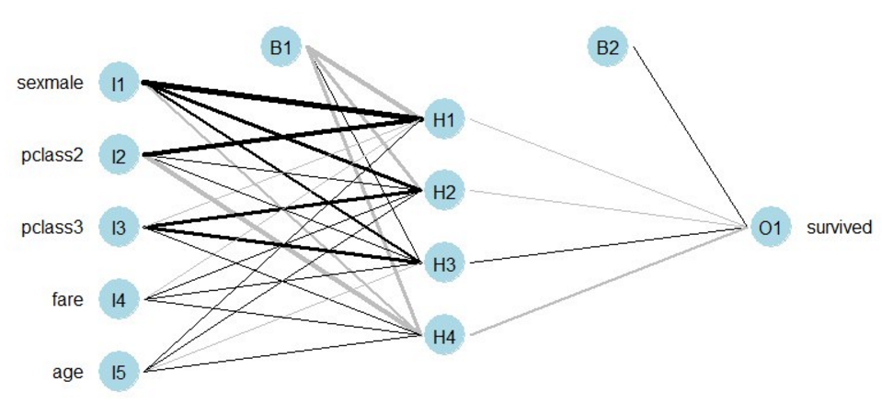
Description of models
Basic random forest model
Accuracy :84%
Using R functions for Decision Tree models
Classification by logistic regression
Accuracy :79.77%
Research of depending of influence of various parameters on survival
Using parameters: age, gender, ticket fare
Neural network
Accuracy :72%
Using neural network methods to predict the probability of
surviving
Common information:
891 Titanic passenger
11 variables

Slide 7
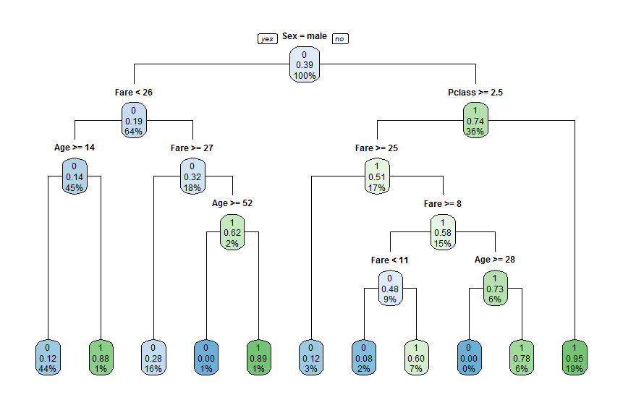
Key points
Basic random forest model has shown more accuracy and its visualization more comfortable for understanding. As seen from the picture, poor young man and rich woman have the highest probability of survival.

Slide 8
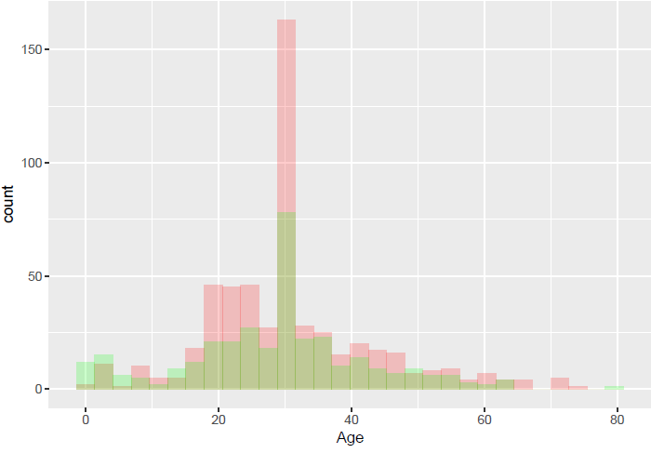
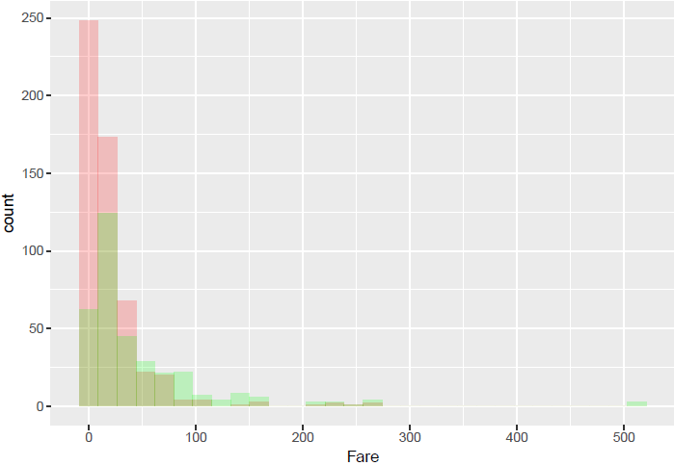
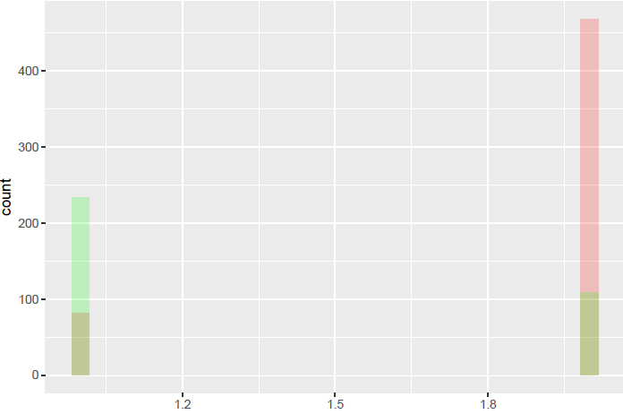
Key points
Classification by logistic regression is not so obviously and has less accuracy than random forest model. On graphics red means dead and green – survived.
Gender

Slide 9
Recommendations
Take into account that the distribution of the survivors was investigated only for the one shipwreck and there is no accurate probability for random cruise
Provide researches on another shipwrecks
Consider not historical, but more recent incident for using in nowadays cases
Not all 11 variables were taken into account in building model
Use the maximum number of variables in future research
Find more parameters of passengers
Information were used not for all passengers because of lack of it
Try to find more information
Validation of used information may lead to increasing accuracy
Ideal count of researched passengers – 891

