Slide 1
Final Presentation for Analysts
EMC Education Services
Data Science & Big Data Analytics
Titanic task solution (Kaggle project)
Tsvetkova Alexandra, Makarenko Dmitriy, Lyan Artem, Ivanushenko Alexandr, Fedotov Ivan
19.01.17
Notes:
EMC Ed Services CA and DCA Launch Master V8

Slide 2
Project Goals
The sinking of the RMS Titanic is one of the most infamous shipwrecks in history. We will apply the tools of machine learning to predict which passengers survived the tragedy.
Prepare different solutions of the problem to find the most accurate one.
Visualize the data for further analysis.

Slide 3
Situation & Project Goals
Situation
On April 15, 1912, during her maiden voyage, the Titanic sank after colliding with an iceberg, killing 1502 out of 2224 passengers and crew.
Nowadays this project is used mostly for educational purpose, but the survival statistics analysis can be used to lower your chances of death in a shipwreck.
If you ever buy a ticket to the ship, you will know what seat to prefer.
Goals of Titanic Project
Make an accurate prediction if a passenger is likely to die
Show some statistics and visualization to give survival advices
Reduce the number of deaths in shipwrecks (long-going consequence)

Slide 4
Executive Summary
We found out that the decision tree was the most accurate method
The accuracy of the
methods was:
  Logistics regression – 79,77%
  Decision tree – 84%
  Neural network – 72%
Fare and passenger class at first seemed to be the same thing, but they turned out to increase the accuracy together
We found the statistics that more relatives you had, less likely you will survive, but our models didn’t show any correlation.

Slide 5
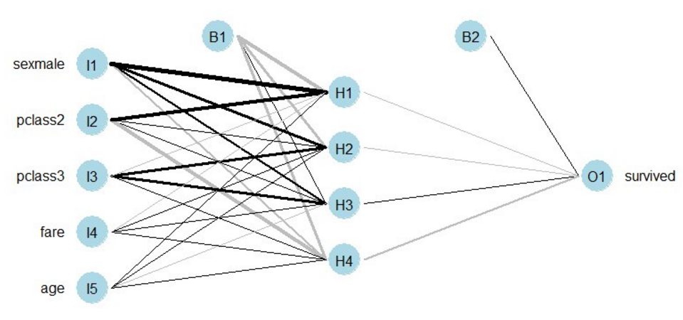
Approach
Found Titanic data sets of passengers and their parameters
Made some analysis about what parameters
Developed three models in R
  Logistics regression
    Decision based on 3 parameters: Sex, Age, Ticket fare
  Decision tree
    4 parameters (Age, Sex, Passenger class, Ticket fare) turned out to be the most important
    Unimportant (<1%) solutions are
    dropped to simplify the analysis
  Neural network
    Decision based on 3 parameters: Age, Sex,
    Passenger class, Ticket fare
    Network with 2 neurons and 1 hidden layer
Scored all the models over a test group to find out the most accurate one

Slide 6
Model Description
Description for the most accurate model
Overview of Basic Methodology: predict the likelihood of death for each passenger using machine learning models. The model learns on the passenger data and is tested on the rest of data.
Model: Decision tree model
Dependent variable: : Age, Sex, Passenger class, Fare
Scope:
  891 Titanic passenger with personal data
Sampling
  Training sample: 75% passengers
  Testing sample: 25% passengers
The model developed has predictive power 84%
  We created a baseline model without fare variable and got good results.
  Fare variable was added to the model and that further increased its predictive power.

Slide 7
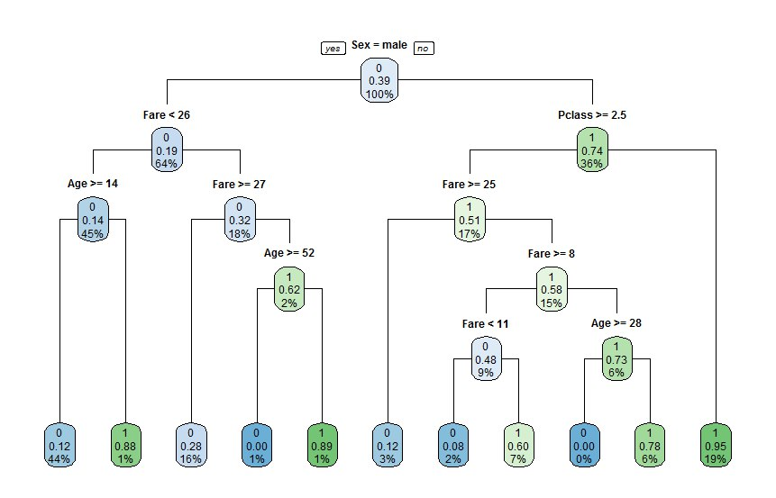
Key Points
It turned out that to survive you had to be a rich woman (2nd or 3rd class) or a poor young woman. Male children and male passengers under 52 with fare of 27 also had good chances to survive.

Slide 8
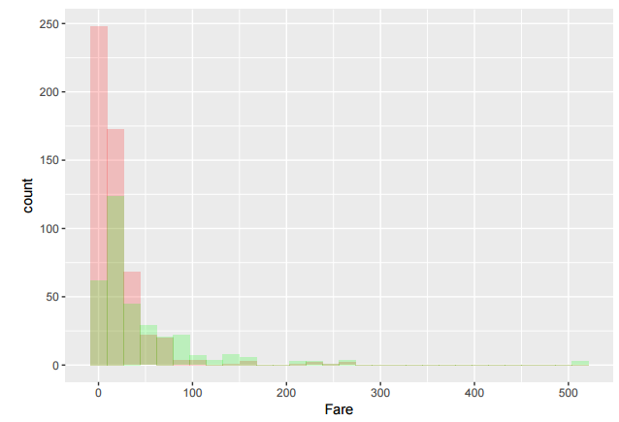
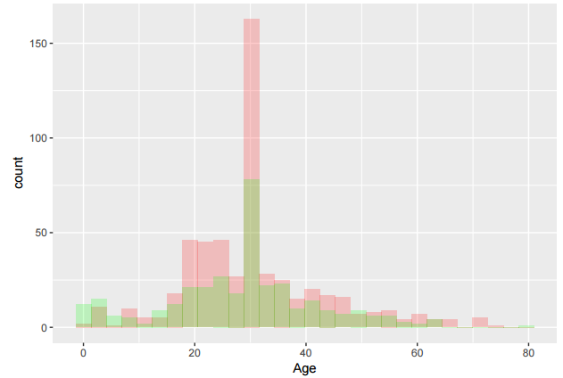
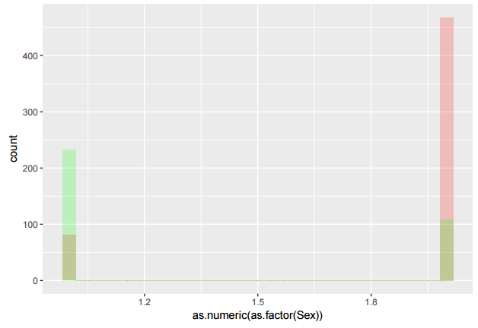
Model Details
We found the most appropriate variables for analysis through visual and common sense (women and children first, rich ones first) analysis of the situation
Model built in R :
fit <- rpart(Survived ~ Age + Sex + Pclass + Fare + SibSp + Parch, method="class", data=train,
  control=rpart.control(minsplit=1))

Slide 9
Recommendations
Further development of the model increasing predictive power
  Combine 3 existing solutions
  Add some new features
Тут мои идеи иссякли совсем!!! Run the predictive model daily or weekly to be proactive on customer churn
  In-database scorer can score large datasets in a matter of minutes and can be run daily
  Each customer retained via early warning trigger saves 4 hours of account retention efforts & 50k in new account acquisition costs
Develop targeted customer surveys to investigate the causes of churn, which will make the collection of data for investigation into the causes of churn easier.

