Slide 1
Final Presentation for Project Sponsors
EMC Education Services
Data Science & Big Data Analytics
[project subtitle]
[Names of the people who did the work]
[Date]
Notes:
EMC Ed Services CA and DCA Launch Master V8

Slide 2
Project Goals

Slide 3
Situation & Project Goals
Situation
[Give a one-sentence overview of the situation that has led to the analytical project]
[Complication: Give a one-sentence overview of the need for addressing this now. ]
[Implication: One-sentence overview of the impact of the complication. ]
Goals of YoyoDyne “Churn Project”

Slide 4
Executive Summary
[main message]
Key point 1
  Sub point
Insert graphic to support your main points
Key point 2
Key point 3

Slide 5
Approach
Example for Sponsors, using Yoyodyne scenario
Interviewed 14 members of retail lending team to understand Yoyodyne’s lending policies and marketing practices for customer retention
Collaborated with IT to identify relevant data sets, assess data quality and availability
Developed churn model to identify customers most likely to leave the bank
  Identify most influential factors
  Provides greater explanatory power for analyzing impact of different factors on churn
Mined and added social media data to the model to improve predictive power
Worked with IT to simulate model performance within Yoyodyne’s production environment

Slide 6
Model Description
Example from Yoyodyne scenario
Overview of Basic Methodology: predict the likelihood of churn for each customer. Identify customers with a greater probability for churn then compare with actual churn outcomes to train the algorithm and enable predictions for existing customers.
Model: Logistic regression model
Dependent variable: Binary variable, of churn/no churn
Scope:
  500,000 Yoyodyne bank customers, based on churn within a 150 day period after 1/31/2011
  500,000 Customers with all churners through 6/30/11, plus a random sample of 45,000 accounts
  All selected customers were Active, Suspended or Pending as of 2011-01-31
  Call History detail data extracted from Call Data Record Warehouse for customers from 1/31/11 to 6/30/11
Sampling
  Training sample: 50,000 subscribers
  Testing sample: 100,000 subscribers
The model developed has predictive power at least as good as the bank’s current churn model
  We created a baseline model without social networking variables and the bank’s marketing analytics team verified that the predictive power was at least as good as the current model
  Social networking variables were added to the model and that further increased its predictive power

Slide 7
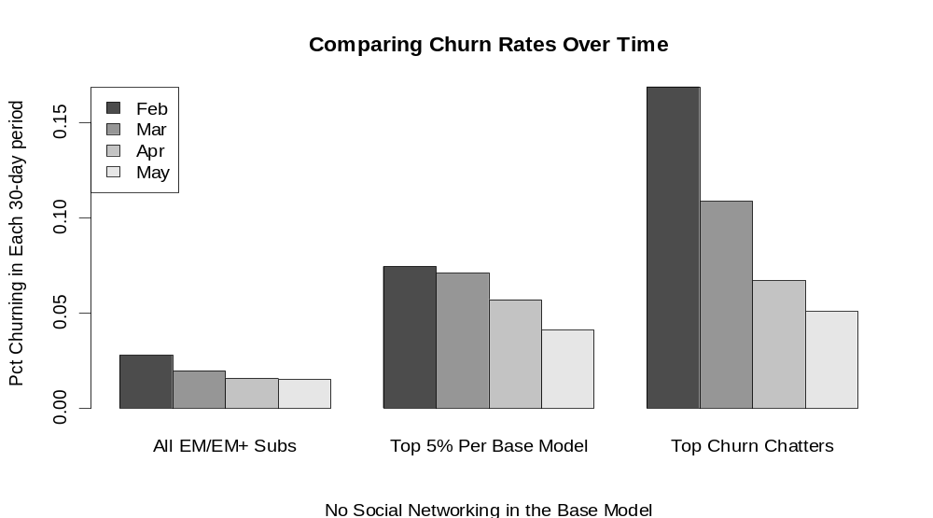
Key Points
Example of Key Points Using Yoyodyne Scenario
Implementing an early churn model can identify 30% of likely churners

Slide 8
Recommendations
Example from Yoyodyne scenario
Implement the model as a pilot, before more wide-scale rollout – test and learn from initial pilot on performance and precision.
  Addressing these promptly can potentially save more customers from churning over time and also prevent more networking that seems to drive additional churn.
  An early churn warning trigger can be set up based on this model.
Run the predictive model daily or weekly to be proactive on customer churn
  In-database scorer can score large datasets in a matter of minutes and can be run daily
  Each customer retained via early warning trigger saves 4 hours of account retention efforts & 50k in new account acquisition costs
Develop targeted customer surveys to investigate the causes of churn, which will make the collection of data for investigation into the causes of churn easier.

