Slide 1


Seagate S3 Log Migration to Azure Monitor
Team members:
Tamir Dresher & Yaron Sarig

Slide 2
You can’t Improve
what you don’t measure
You can’t measure
without proper tools

Slide 3
Solution Details
Give the customer clear up-to-date picture of the storage data/usage/capacity/failures
Ingest LyveCloud logs directly to Azure Monitor service
Allow the customer to build sophisticated Log Analytics queries/charts to help her to optimize the use of Seagate storage service

Slide 4
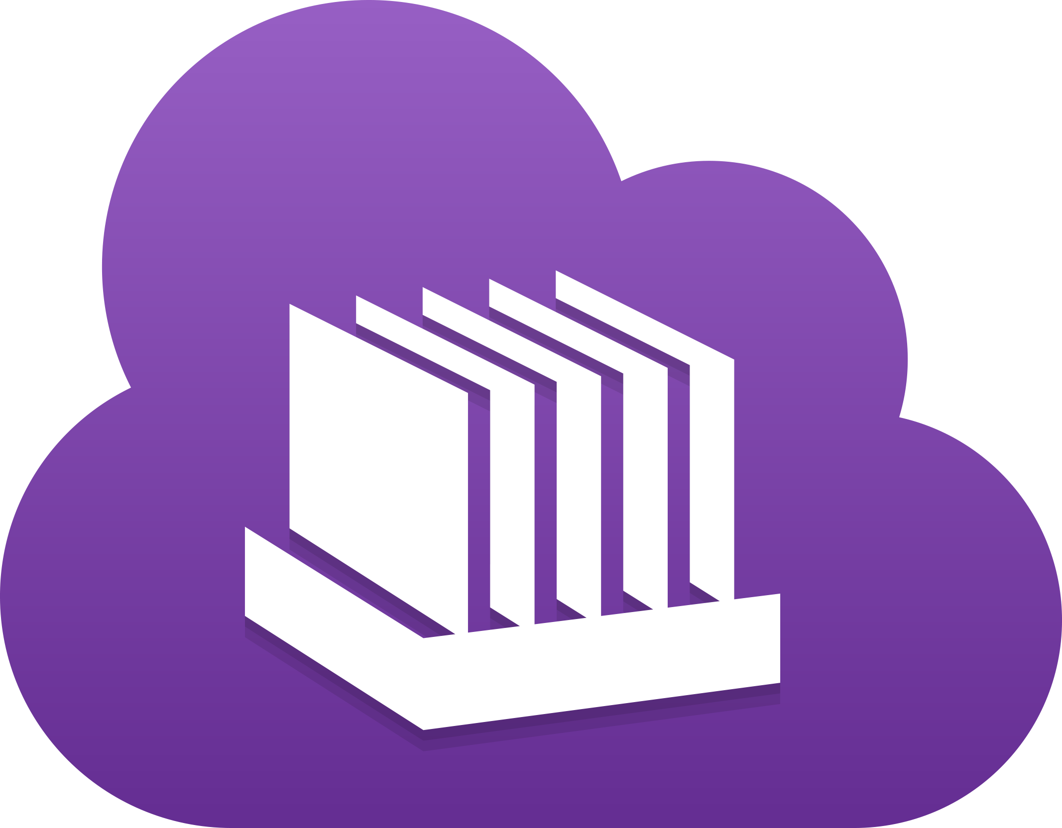

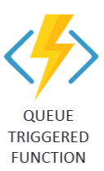
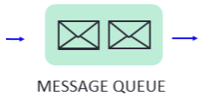

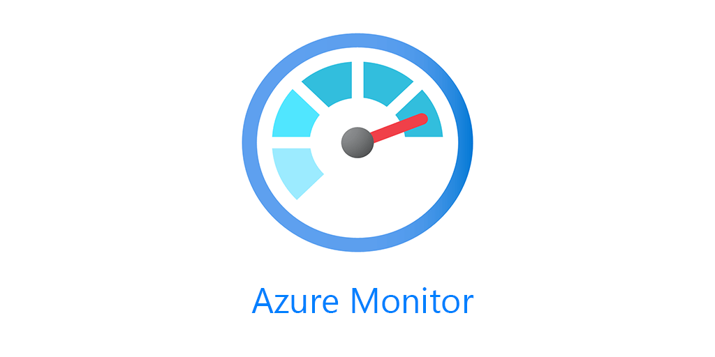

Architecture
The serverless design is simple and efficient, based on Azure Functions, Azure Tables and queuing services
Azure function scheduled to rise every X minutes scan the bucket for new logs
The log files are added to the queue and a checkpoint is stored
Every new item in the queue triggers another function that stream the data to Azure Monitor
Checkpoint

Slide 5
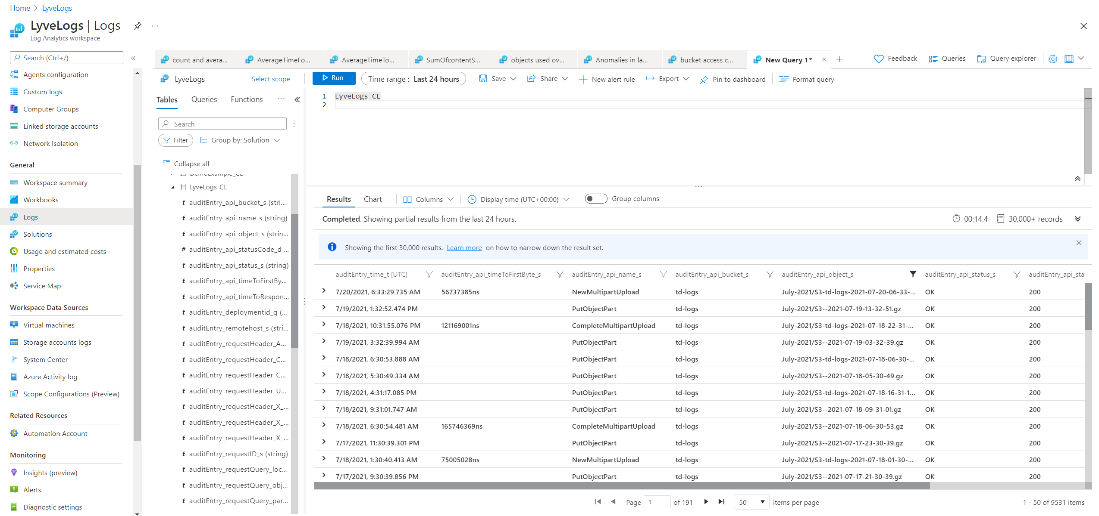
Simple observability

Slide 6
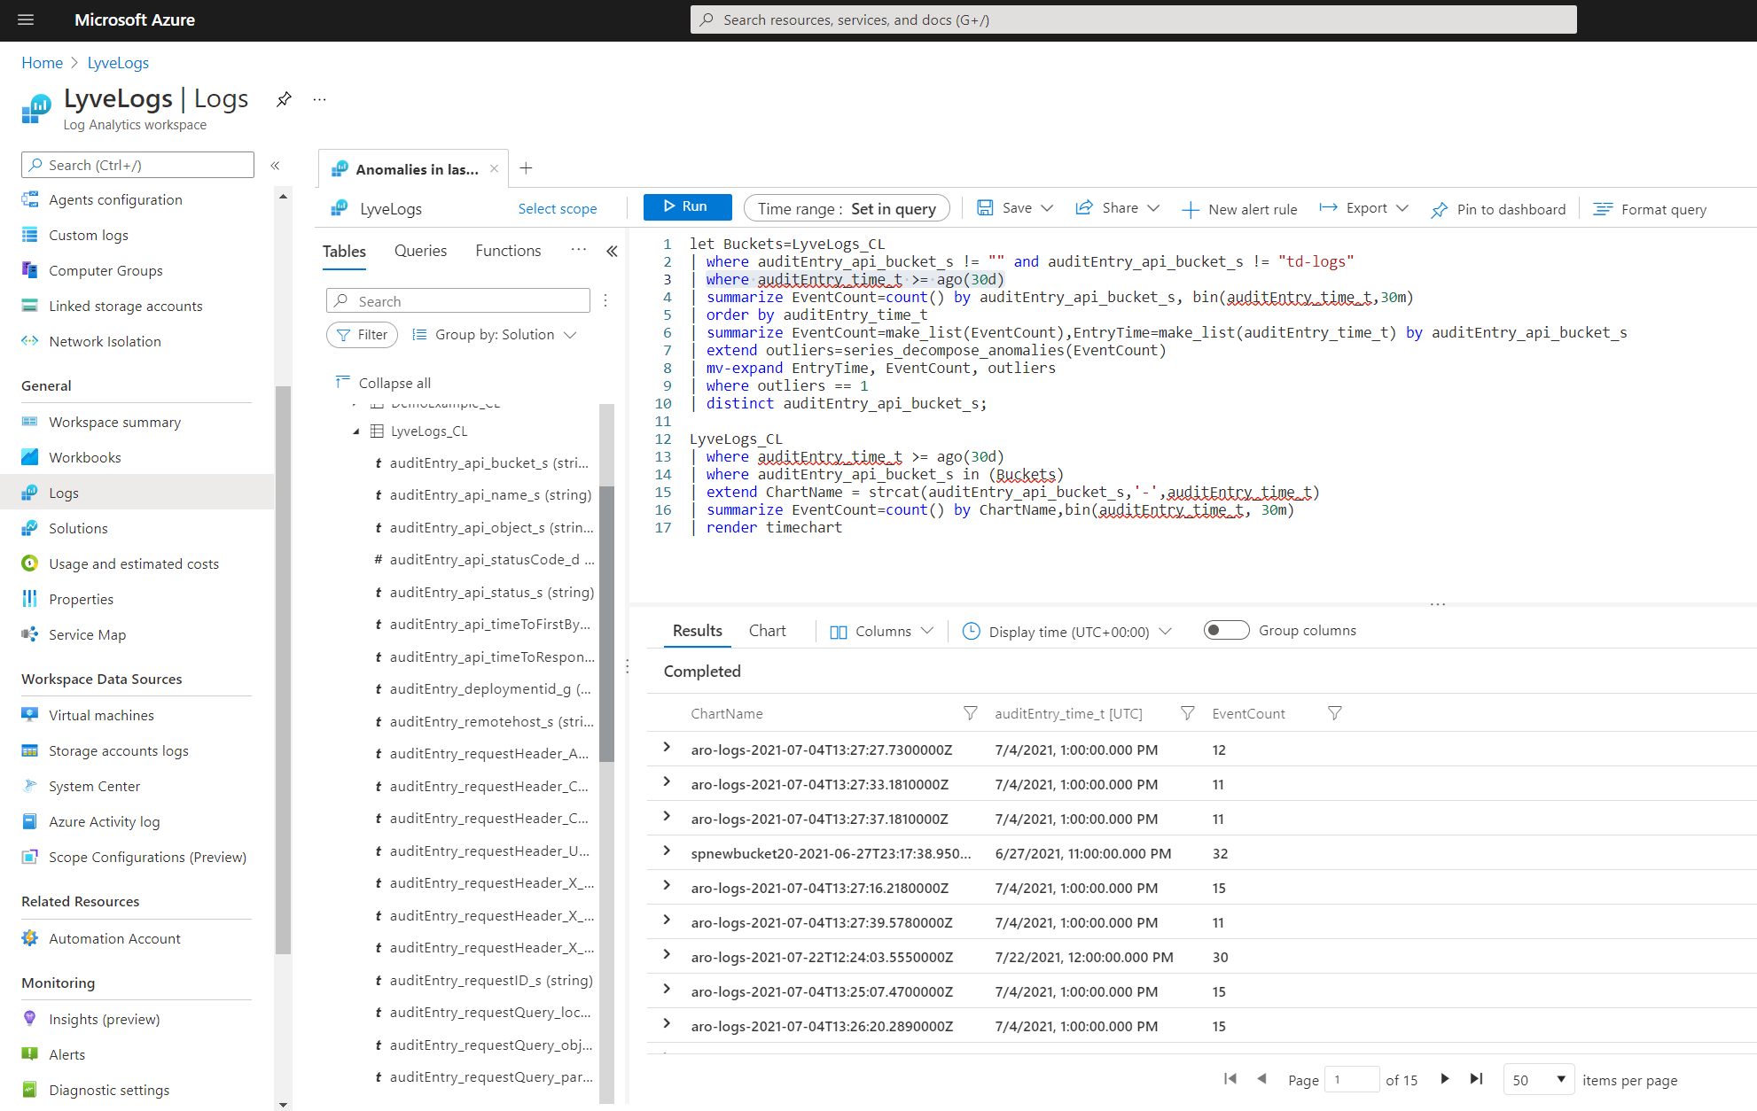
Advanced Querying

Slide 7
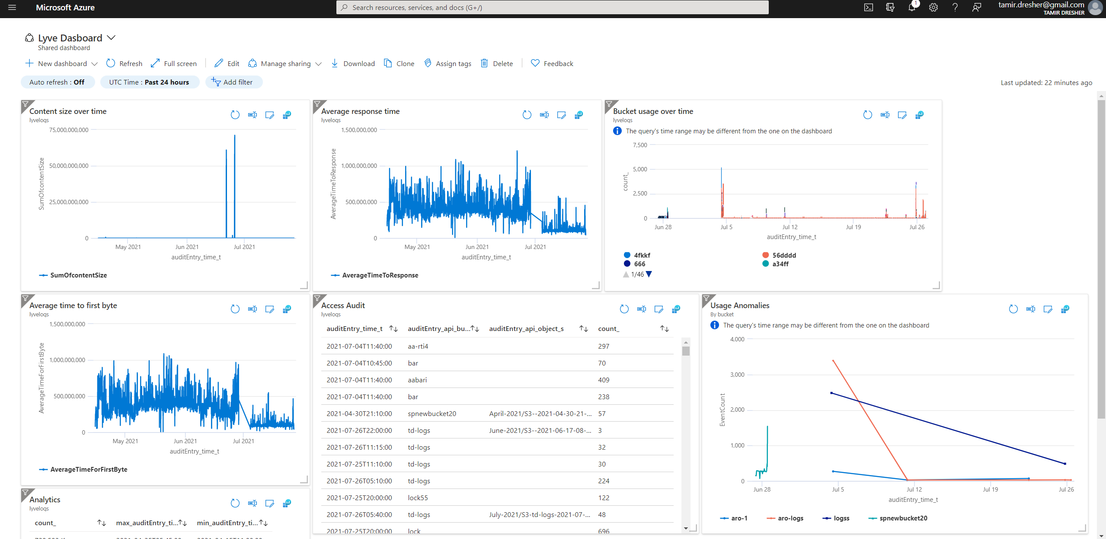
Informative Visualization

Slide 8
Future roadmap
Build automated deployment procedure
Enable filtering on bucket or logtype level

Slide 9
Thank you!
https://github.com/tamirdresher/SeagateLyveCloudHackathon

