Slide 1
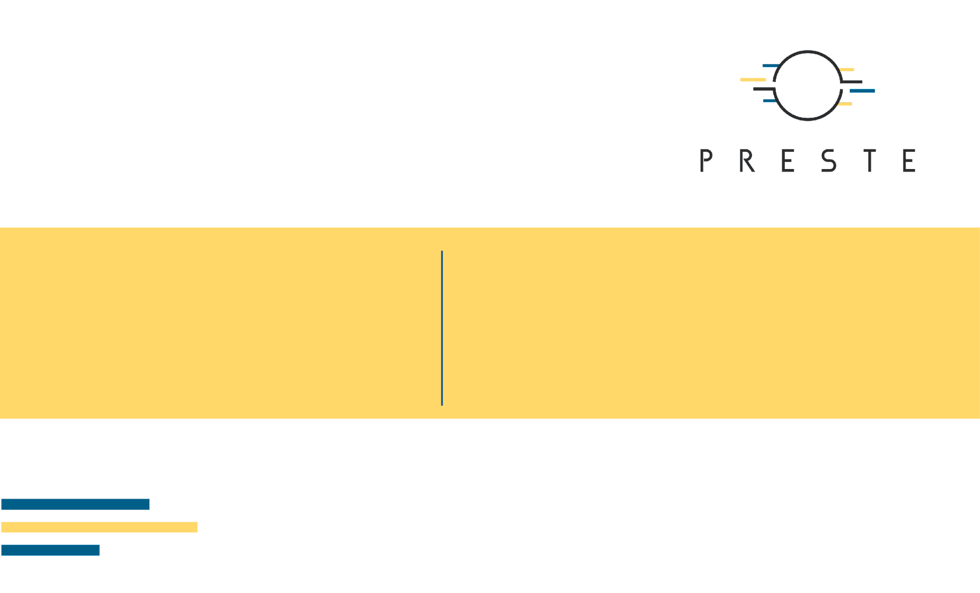
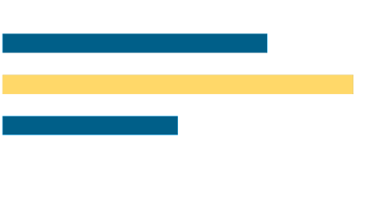
Tree-Based Machine Learning
and Model Optimization
Decision Trees · Bagging · Random Forest · Gradient Boosting · XGBoost · LightGBM · Isolation Forest · Hyperparameter Optimization

Slide 2
What's for today
• Build a decision tree from the idea of recursive feature-space partitioning.
• Understand how bagging and Random Forest reduce variance.
• Contrast independent ensembles with sequential gradient boosting.
• Connect classical GBM to XGBoost and LightGBM.
• Use tree logic for anomaly detection with Isolation Forest.
• Move from manual tuning to cross-validation, Grid, Random and Bayesian optimization.
• Bonus: combine different models using stacking.

Slide 3

1. Decision Trees
Just ask a set of questions.

Slide 4
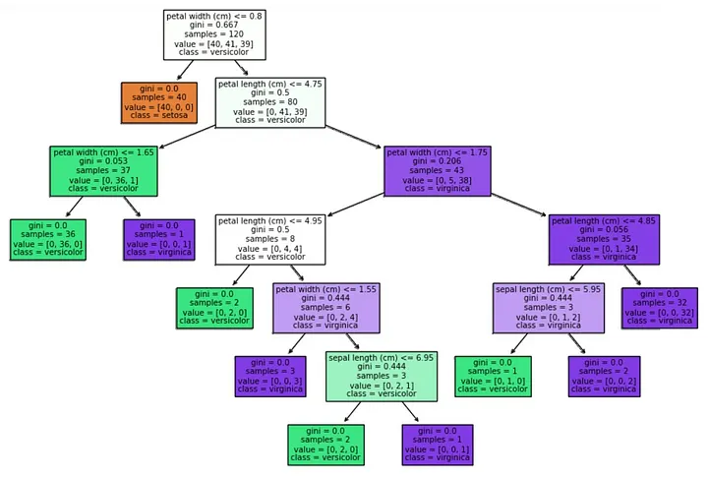
Decision tree

Slide 5
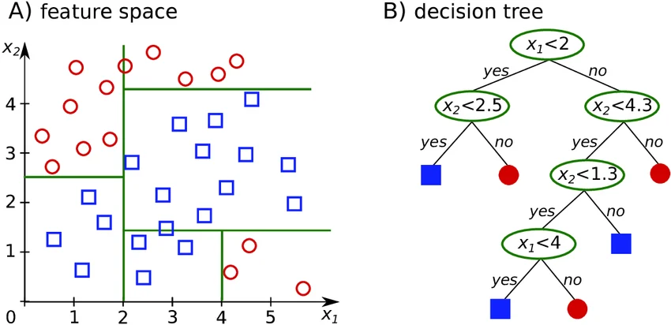
A tree partitions feature space
• Each internal node asks a rule such as xⱼ < t.
• The rule divides observations into increasingly homogeneous regions.
• Leaves contain the final class prediction or regression value.
• A tree is therefore both a predictive model and a piecewise partition of feature space.

Slide 6
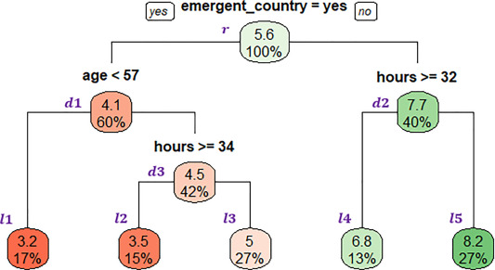
Classification and regression use the same machinery
• Classification leaves predict class probabilities / majority class.
• Regression leaves predict a mean or another constant response within the region.
• The main difference is the criterion used to judge a candidate split.
• Classification: impurity; regression: reduction in squared error / variance.

Slide 7
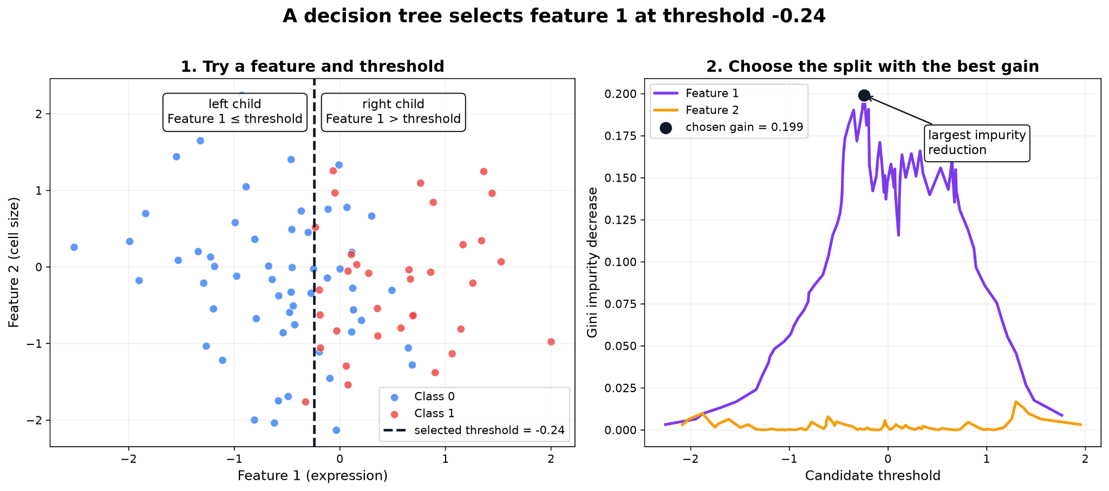
How does a tree choose a split?
• Try candidate features and thresholds.
• Calculate impurity before and after the split.
• Prefer the split producing the largest impurity reduction.

Slide 8
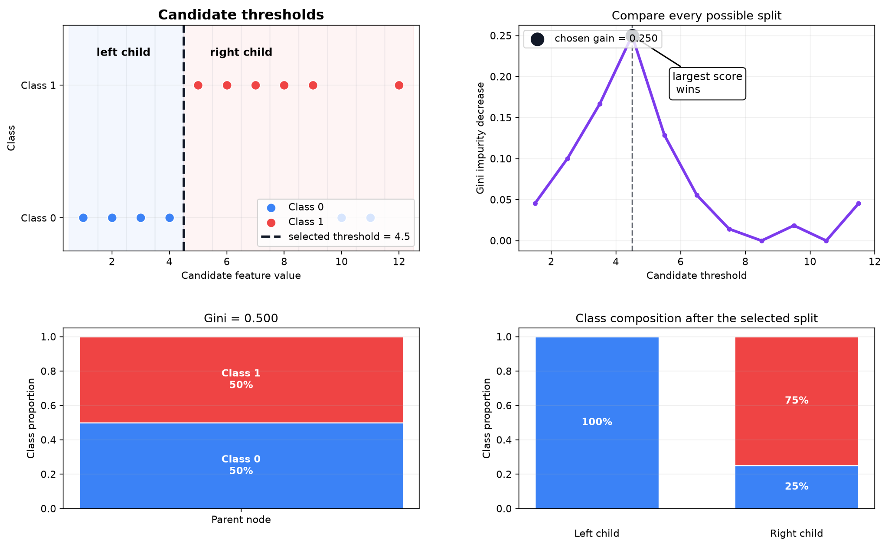
Gini impurity
• Gini = 1 − Σₖ pₖ².
• Gini = 0 when a node contains only one class.
• Impurity increases as classes become more mixed.
• A split is useful when its children are purer than their parent.
• Entropy: H = −Σₖ pₖ log₂(pₖ).
• Information gain measures the reduction in entropy after splitting.
• Gini and entropy often produce similar trees in practice.

Slide 9
Regression trees
• Candidate splits are evaluated by how much they reduce within-node prediction error.
• A common criterion is squared error around the node mean.
• The final model is piecewise constant unless additional modelling is used inside leaves.
• This makes nonlinear relationships possible without an explicit polynomial equation.

Slide 10
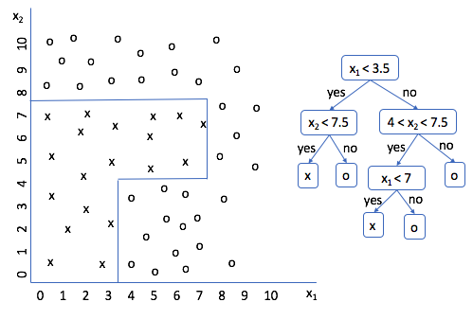
Recursive partitioning creates complexity
• After the first split, the same procedure is repeated independently in each child node.
• Deep trees can create highly irregular decision boundaries.
• This flexibility gives trees low training error but potentially high variance.
• An unrestricted tree can effectively memorize small datasets.

Slide 11
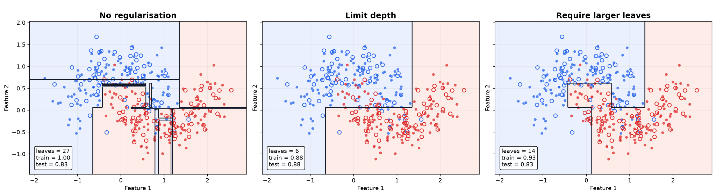
Regularizing a tree before it grows
• max_depth limits the number of sequential decisions.
• min_samples_split prevents splitting very small nodes.
• min_samples_leaf requires enough observations in terminal regions.
• max_features limits the features considered at a split.
• Cost-complexity pruning balances fit against tree complexity - ccp_alpha.

Slide 12
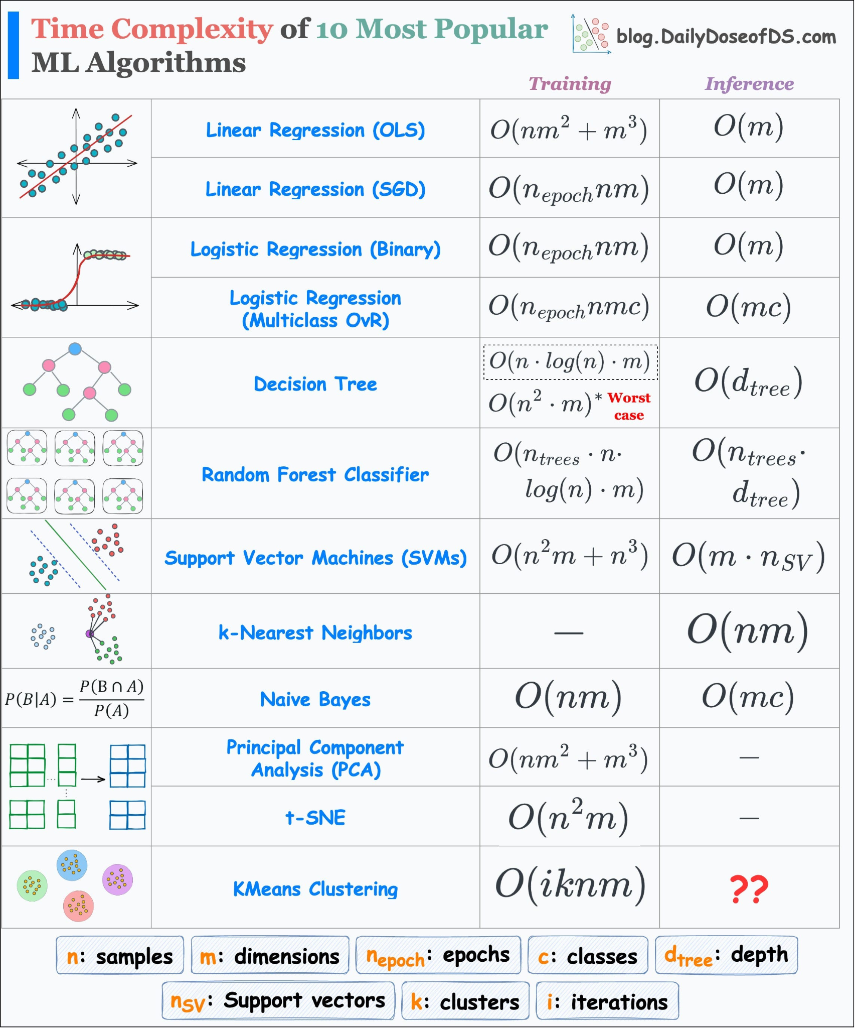
Why trees are effective for biological data
• Nonlinear thresholds can resemble biological decision rules.
• Interactions emerge naturally: one split changes which split becomes useful next.
• Feature scaling is generally unnecessary for ordinary decision-tree splits.
• But instability is important: a small data change can produce a different tree.

Slide 13

2. Bagging and Random Forest
Democracy is the worst form of government, except for all the others

Slide 14
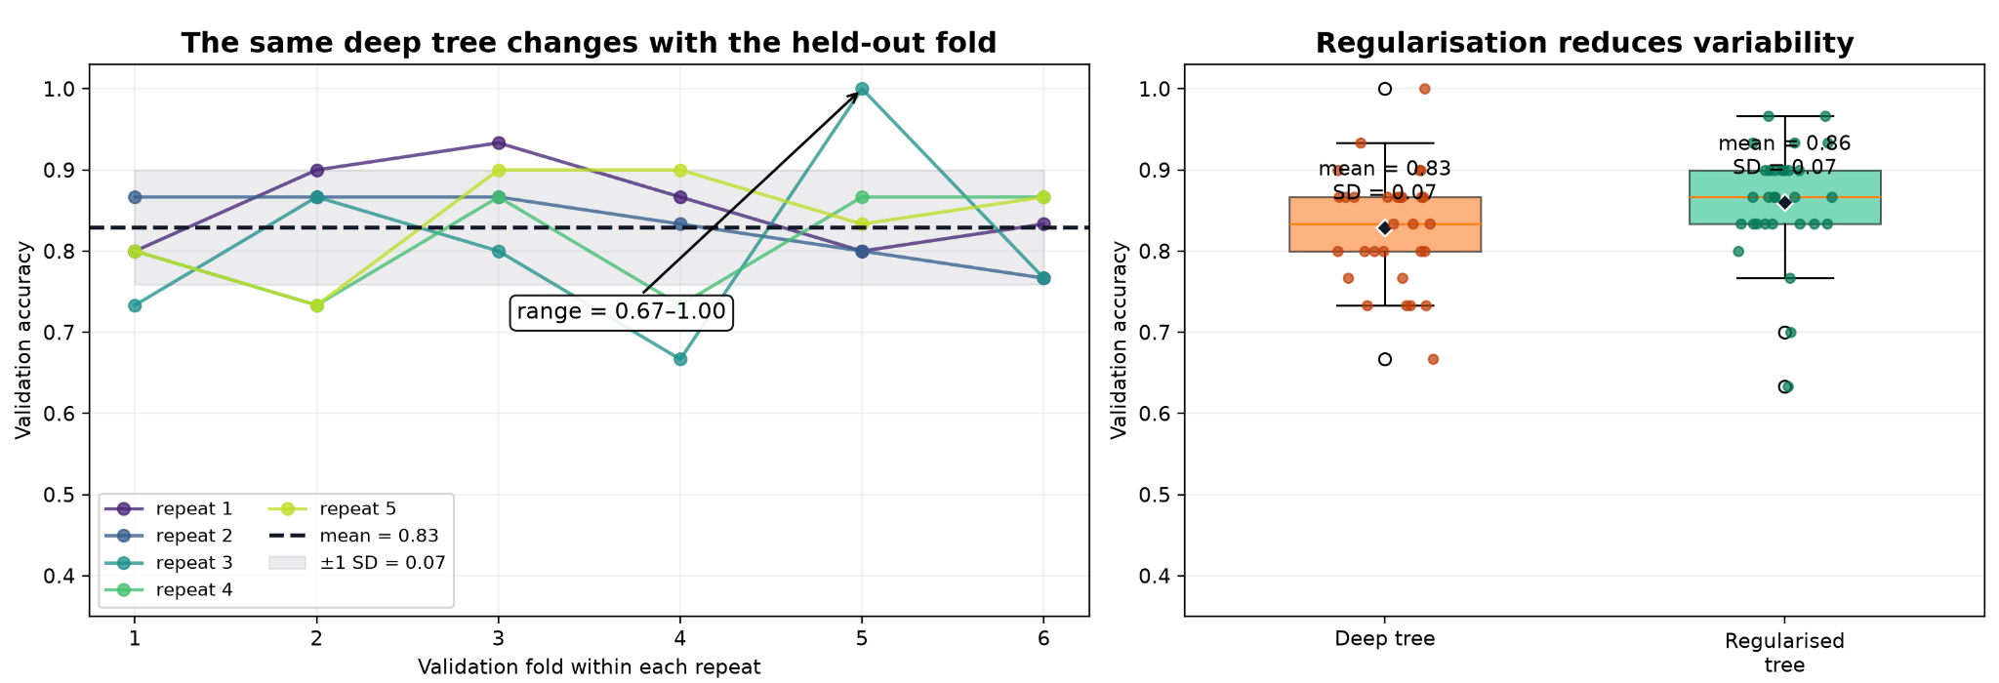
The problem: trees have high variance
• A deep tree can fit training data extremely well.
• Small changes in observations can alter early splits and restructure the whole tree.
• Instead of relying on one unstable model, we can average many related models.
• This is the motivation for bagging.

Slide 15
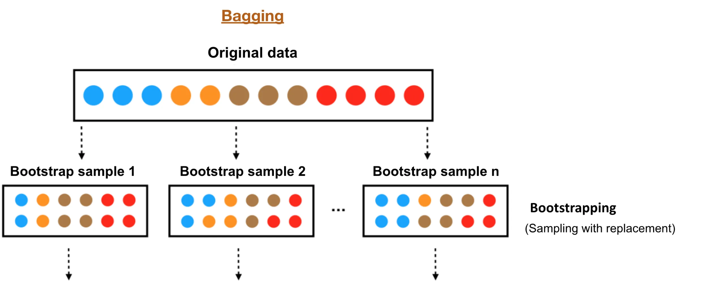
Bootstrap aggregation
• Generate B bootstrap samples from the training dataset.
• Fit one tree independently to each bootstrap sample.
• Regression: average predictions; classification: average probabilities / vote.
• Individual trees can have high variance.
• Averaging reduces variance when their errors are not perfectly correlated.
• Bagging mainly attacks variance rather than systematically reducing bias.
• The trees can be trained independently.

Slide 16
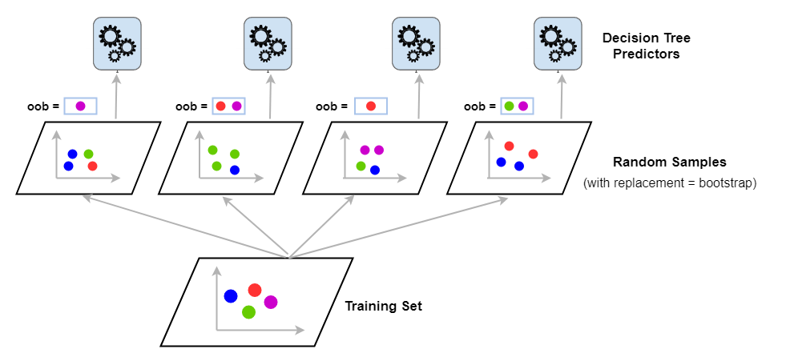
Random Forest = bagging + feature randomnes
• At each split, only a random subset of features is considered.
• This decorrelates trees that would otherwise repeatedly choose the same dominant predictor.
• The final prediction aggregates many diverse trees.
• Unused observations for a tree are its out-of-bag samples used to asses tree accuracy.

Slide 17
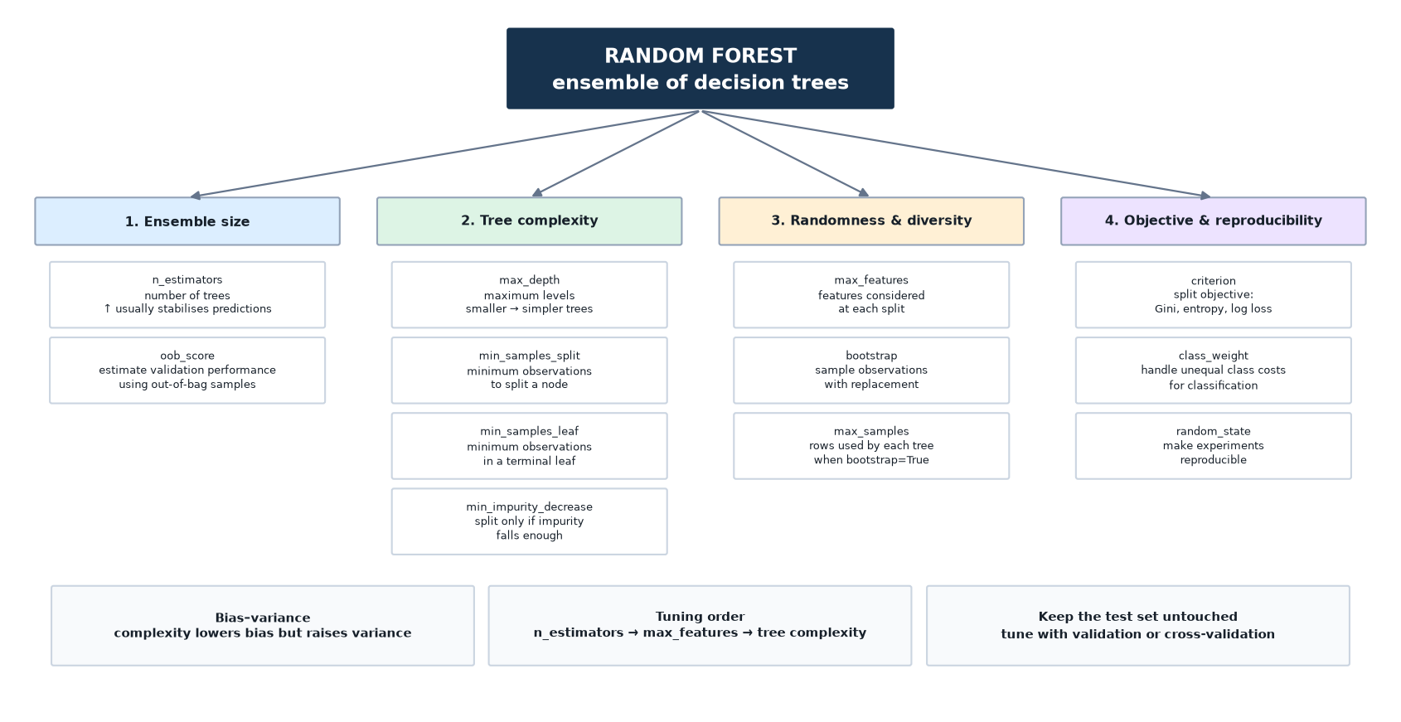
Random Forest hyperparameters

Slide 18
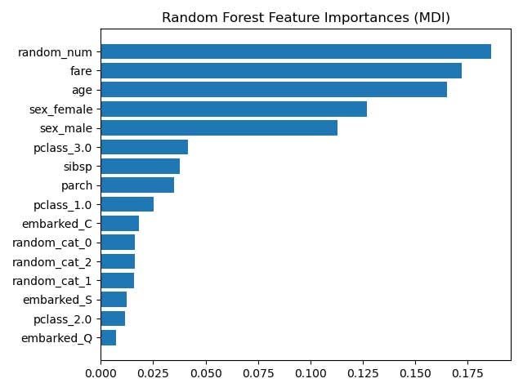
Feature importance: useful, but easy to misuse
• Impurity-based importance is fast and built into many tree models.
• It can favor variables with many possible split points or high cardinality.
• Permutation importance asks how much predictive performance drops when a feature is shuffled.

Slide 19
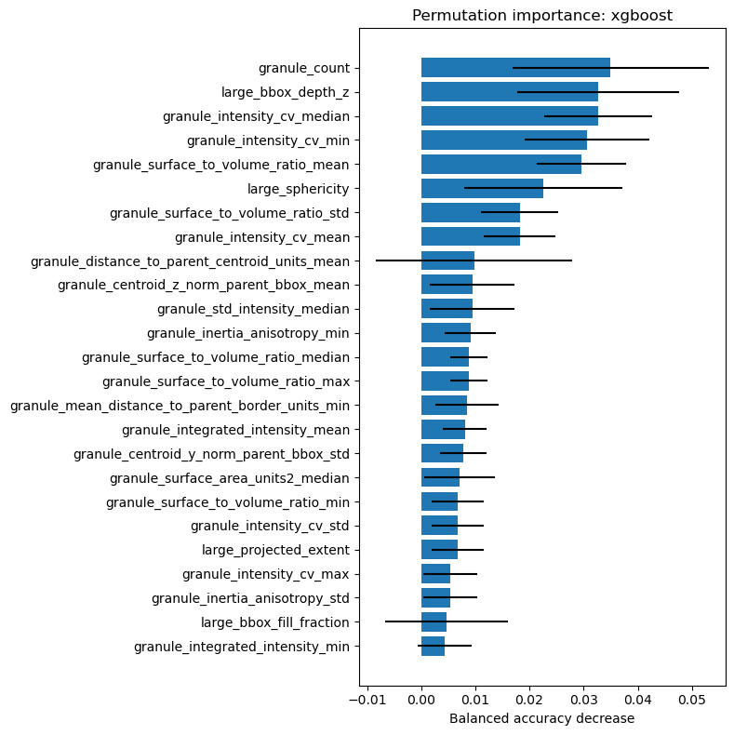
predictive importance is not the same as mechanism
• A gene can be predictive because it correlates with the true biological driver.
• Batch, tissue composition or technical covariates can also become highly predictive.
• Feature importance does not establish causality.
• Candidate biomarkers still require biological and external validation.

Slide 20

3. Boosting
Instead of independent trees, learn from previous errors.

Slide 21
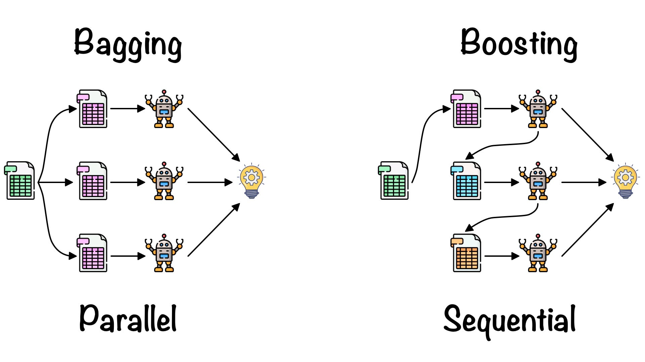
Bagging and boosting solve different problems
• Bagging: train many models independently and average them.
• Boosting: add models sequentially so each new learner improves the current ensemble.
• Bagging primarily reduces variance.
• Boosting can reduce bias while controlling complexity through many weak learners.

Slide 22
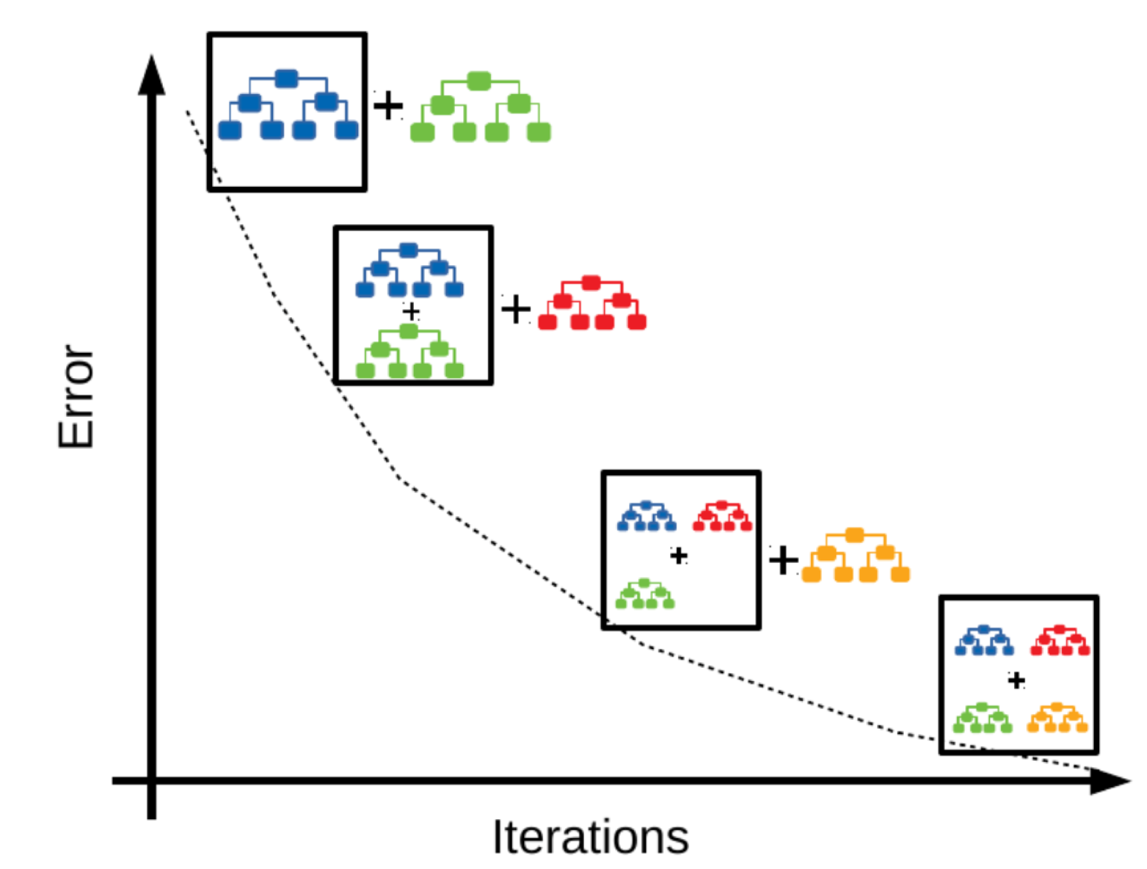
Gradient Boosting essentials
• Start with a simple initial prediction F₀(x).
• Measure the errors / negative gradients of the current ensemble.
• Fit a small tree hₘ(x) to that remaining signal.
• Update: Fₘ(x) = Fₘ₋₁(x) + η hₘ(x).

Slide 23
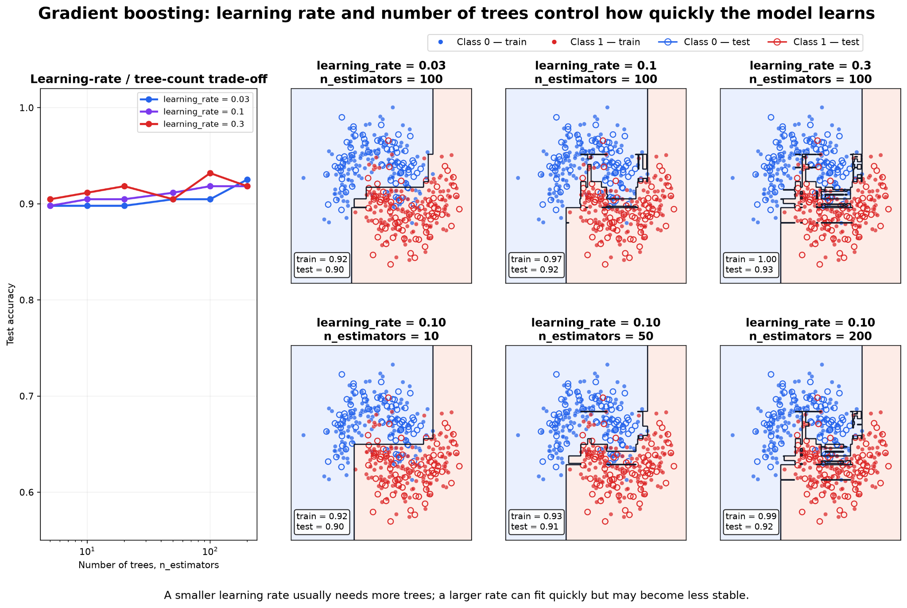
Learning rate and number of trees
• n controls how strongly each new tree changes the ensemble.
• Small learning rates usually require more trees.
• Large learning rates learn faster but can overfit or become unstable.
• n_estimators and learning_rate therefore interact strongly.

Slide 24
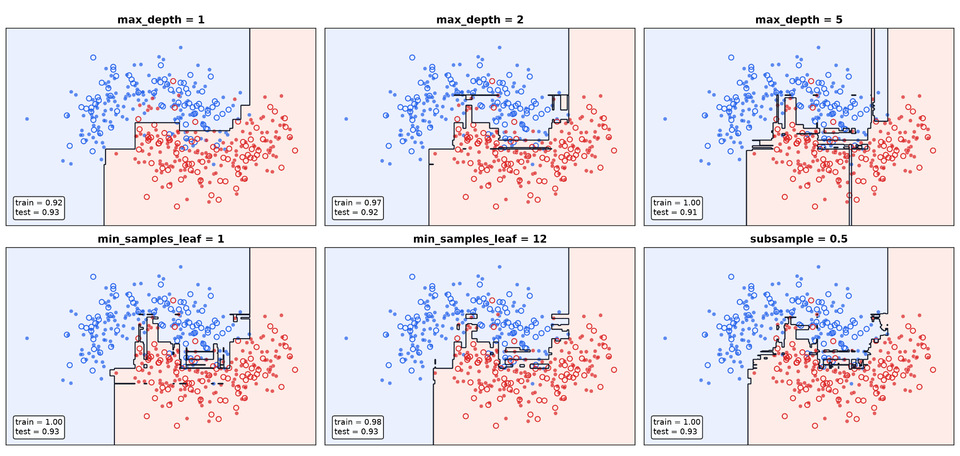
Tree depth means something different in boosting
• Boosting often uses shallow trees as weak learners.
• Depth controls the order of interactions a tree can represent.
• Very deep boosted trees can fit complex noise patterns.
• Regularization should be considered jointly with learning rate and number of rounds.

Slide 25
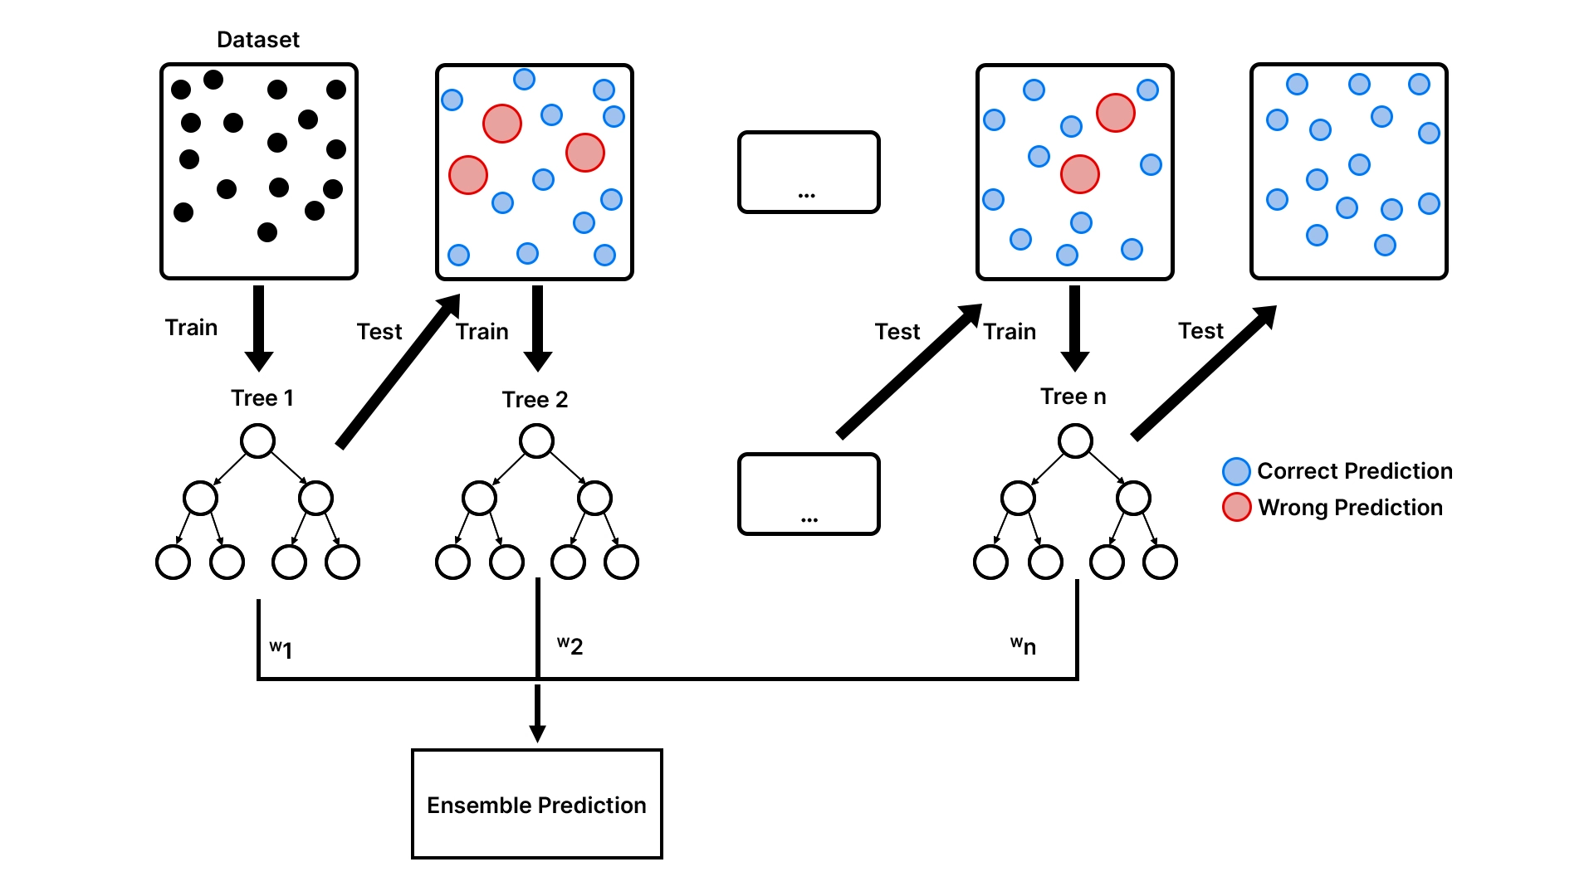
From Gradient Boosting to XGBoost
• XGBoost implements regularized gradient boosting with highly optimized training.
• It includes explicit penalties on tree complexity.
• It supports row/feature subsampling, missing-value handling and efficient split finding.
• The key conceptual model remains sequential gradient boosting.

Slide 26
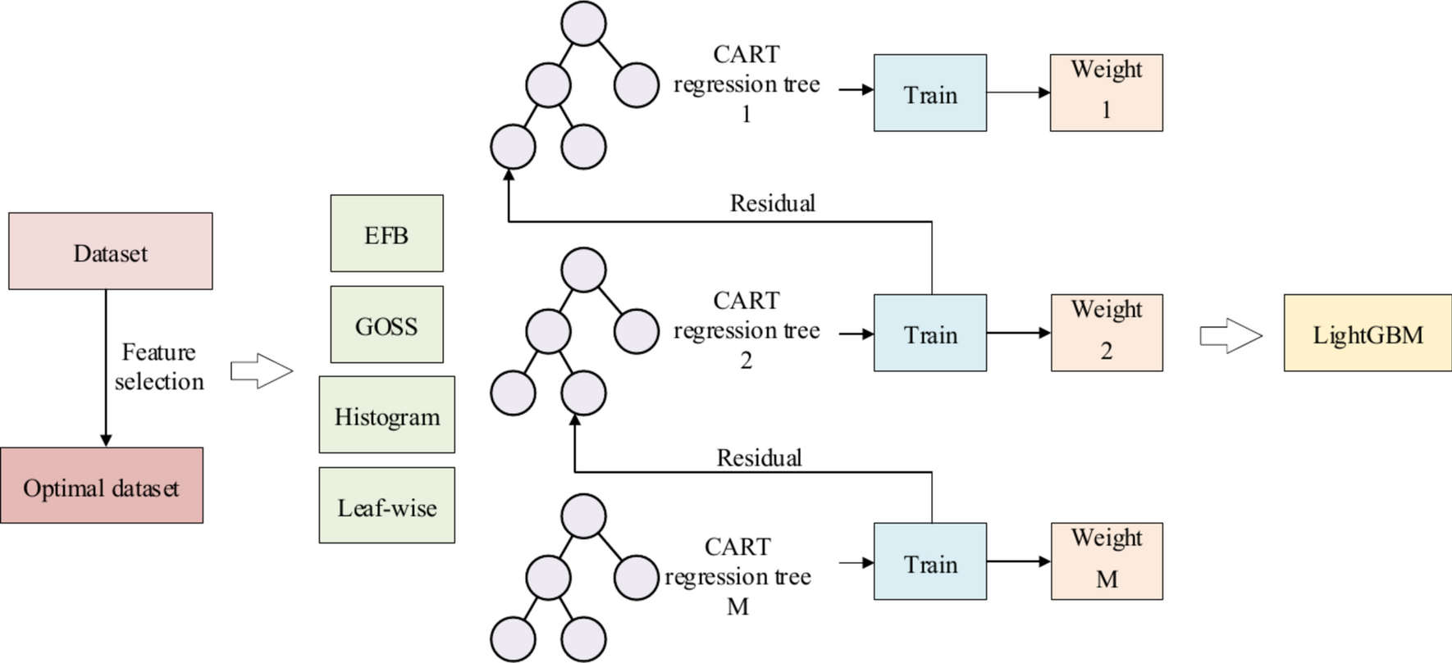
LightGBM
• LightGBM is another optimized gradient-boosting implementation.
• Histogram-based splitting reduces computational cost.
• Its characteristic leaf-wise growth expands the leaf with the largest gain.
• This can be efficient and powerful, but unconstrained growth can overfit small datasets.

Slide 27
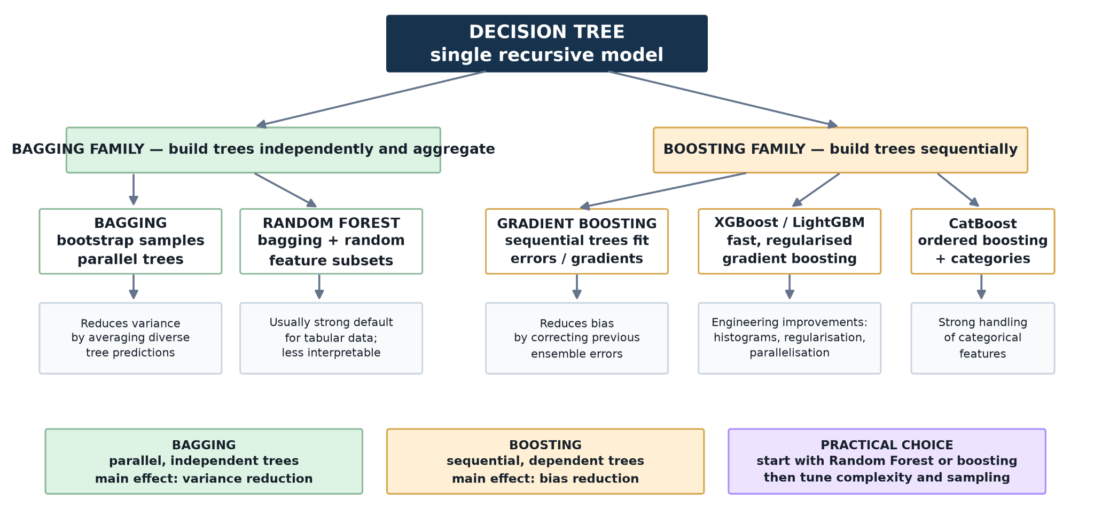
Tree ensemble map

Slide 28

4. Isolation Forest
You don't actually need labels with RF.

Slide 29
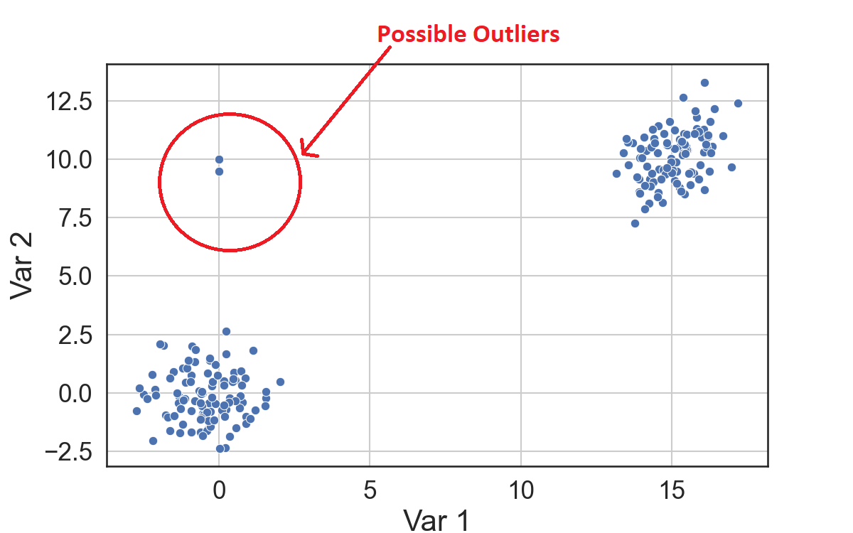
Anomaly detection is not classification
• Often we do not have reliable labels for every possible abnormal observation.
• Anomaly detection asks which samples differ strongly from the dominant data structure.
• Examples: QC failures, unusual cells, contaminated assays or rare morphology.
• An unusual observation is not automatically an erroneous observation.

Slide 30
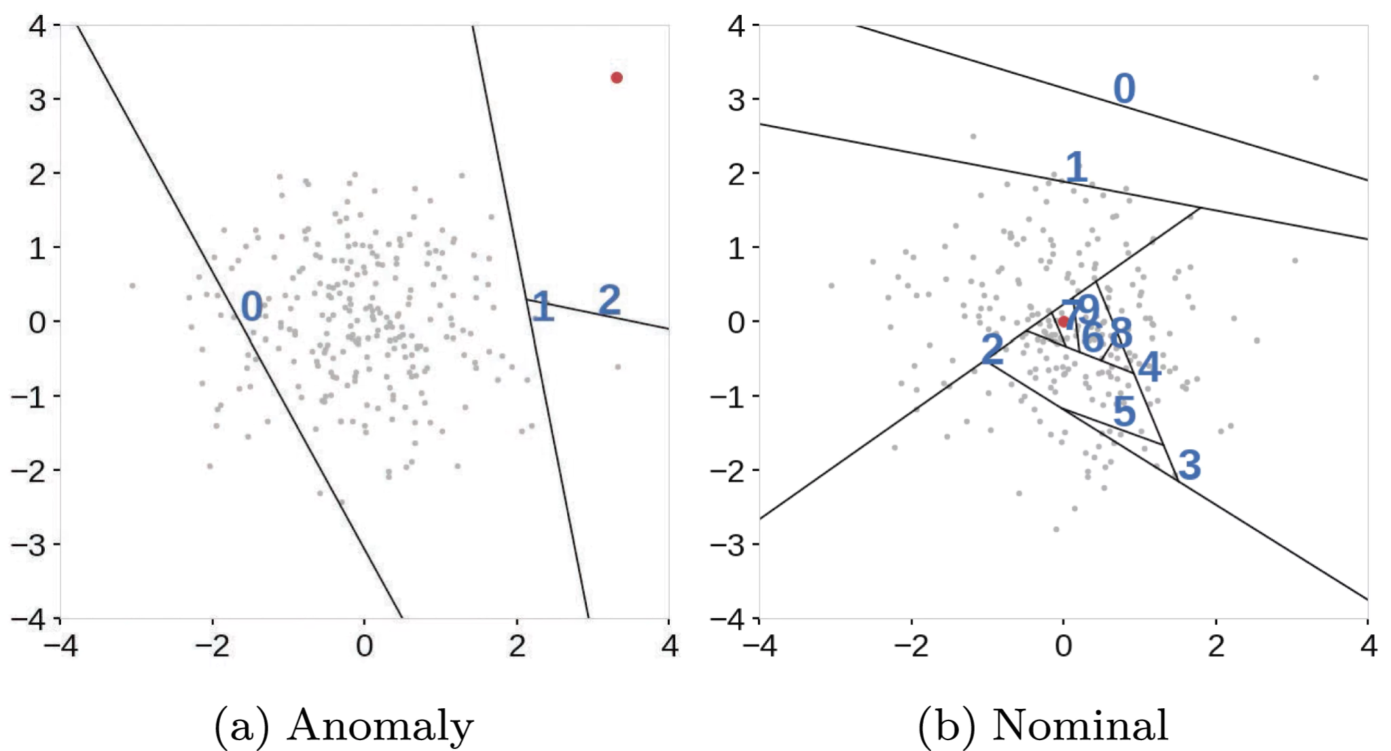
Isolation Forest intuition
• Choose a feature and split value randomly.
• Repeat until an observation becomes isolated.
• Rare/extreme observations generally require fewer random splits to isolate.
• Short average path length therefore corresponds to stronger anomaly evidence.

Slide 31

5. Validation and hyperparameter optimization
Where is the loss function minimum.

Slide 32
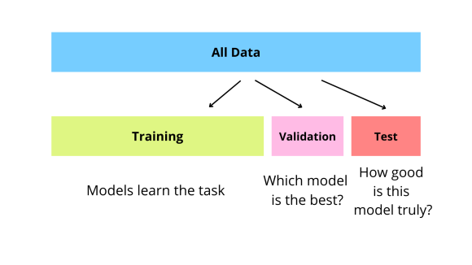
Why a single validation split can be fragile
• Performance can depend strongly on which observations happen to enter the validation set.
• This is especially problematic for small biological datasets.
• Cross-validation repeatedly changes the validation subset.
• The average across folds provides a more stable estimate for model selection.

Slide 33

K-fold cross-validation
• Split training data into K folds.
• Train on K−1 folds and validate on the remaining fold.
• Repeat until every fold has served as validation data.
• Aggregate the validation metric across folds.

Slide 34
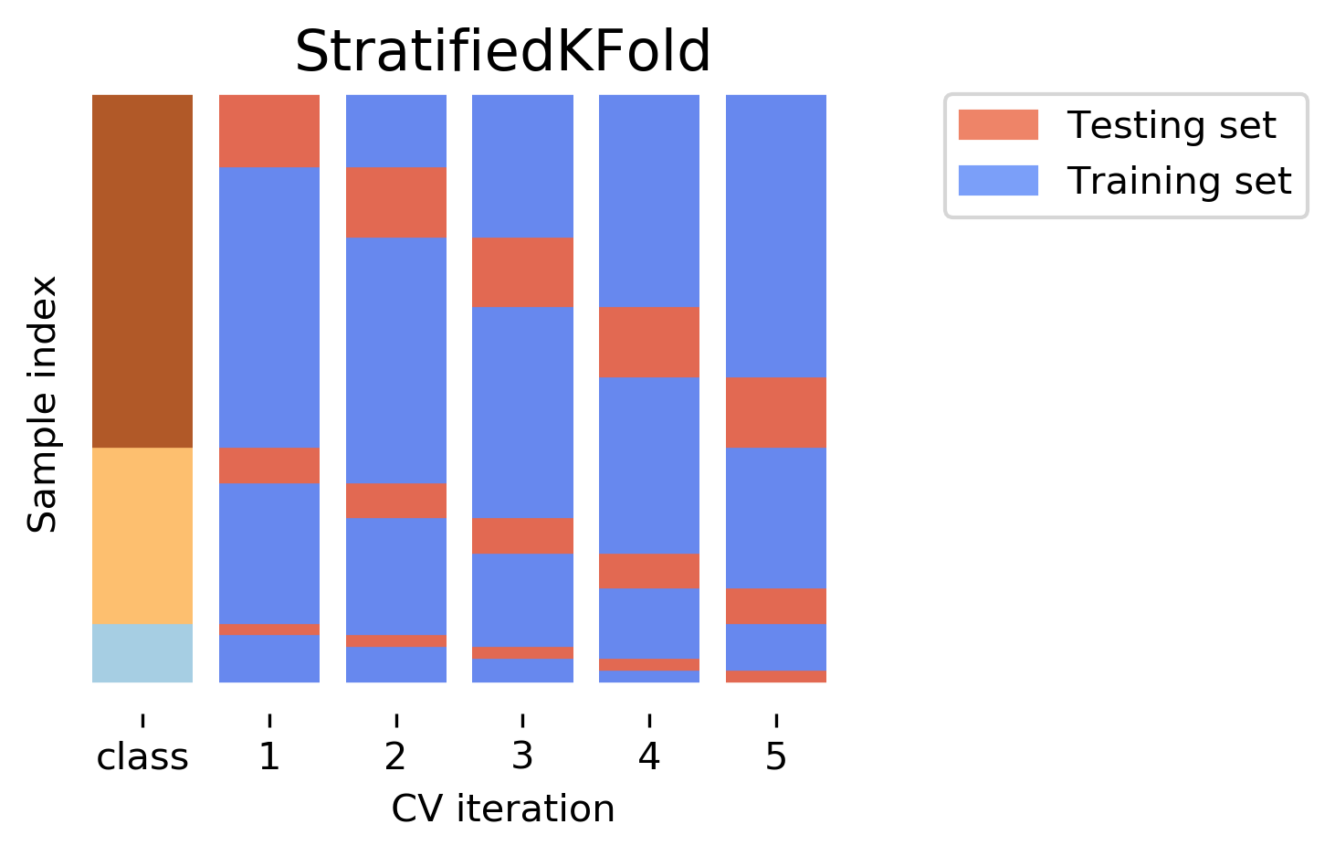
Hierarchy requires split-aware CV
• StratifiedKFold preserves class proportions for classification.
• GroupKFold keeps related observations together multiple measurements from one patient.
• Donor, animal, plate, batch or site structure may define the correct grouping unit.
• Randomly splitting pseudoreplicates can produce severe information leakage.

Slide 35
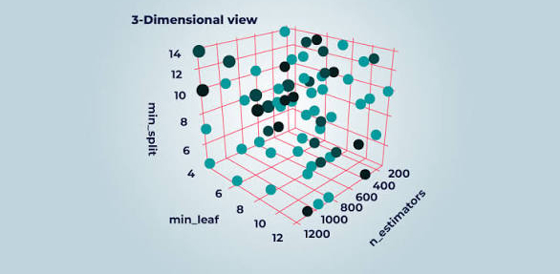
Hyperparameters define a search space
• Decision tree: depth, minimum leaf size, pruning strength.
• Random Forest: number of trees, feature subset size, tree complexity.
• Boosting: learning rate, rounds, depth/leaves, subsampling, regularization.
• Optimization chooses among configurations using validation/CV performance.

Slide 36
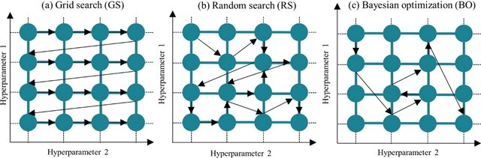
Grid vs Random vs Bayesian
• Grid: exhaustive over a predefined discrete grid.
• Random: broad stochastic exploration under a fixed trial budget.
• Bayesian/TPE: adaptive search informed by previous trials.
• The search strategy cannot rescue a flawed validation design.

Slide 37

6. Bonus - stacking
Can several models be better than one?

Slide 38
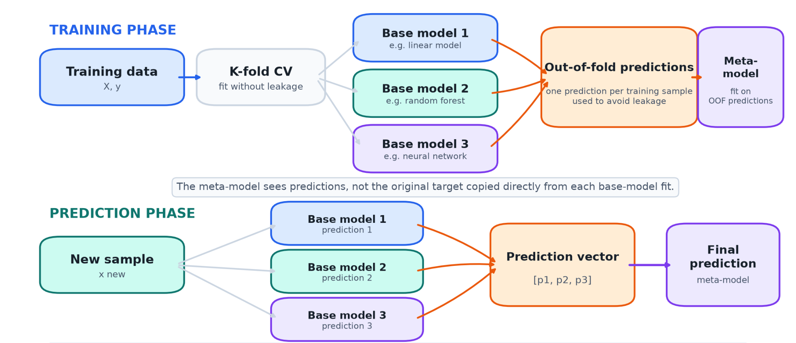
Voting, averaging and stacking
• Voting/averaging combines model predictions using a fixed rule.
• Stacking trains a meta-model to learn how base-model predictions should be combined.
• Base models should ideally make complementary errors.
• Example: Random Forest + XGBoost + SVM = logistic-regression meta-model.

Slide 39
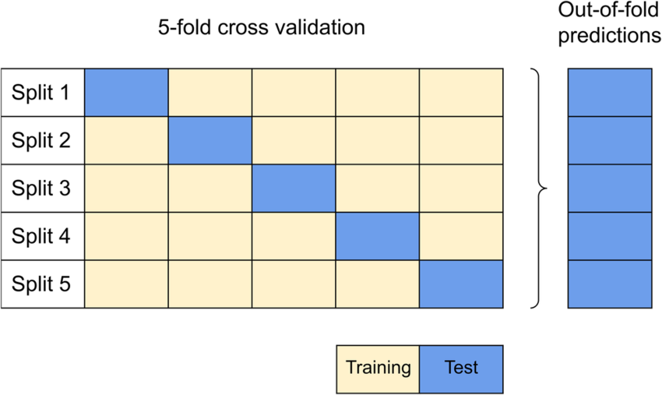
Stacking requires out-of-fold predictions
• Training the meta-model on in-sample base-model predictions causes leakage/overfitting.
• Instead, generate base-model predictions for observations that were held out from fitting that base model.
• Combine these out-of-fold predictions into the meta-model training matrix.
• Refit base learners on all training data only after the stacking design is fixed.

Slide 40
Practical 5
• Fit and visualize a single classification/regression tree.
• Manually change depth and leaf-size parameters to observe overfitting.
• Compare bagging, Random Forest, Gradient Boosting, XGBoost and LightGBM.
• Inspect impurity/permutation feature importance.
• Use Isolation Forest on a small biological anomaly-detection example.
• Compare Grid, Random and Bayesian optimization under the same validation design.
• Bonus: demonstrate stacking using out-of-fold predictions.

