Slide 1
SCHEDULING OF BATCH OPERATIONS – MODEL BASED OPTIMIZATION APPROACH
Lisyansky Alexander IS/m-11

Slide 2
BATCH PROCESS FEATURES
For years, continuous operations have been the most prevalent mode in chemical processing. In recent years, however, there has been a renewed interest in batch processes for a variety of reasons.
The manufacture of all chemical products involves three key elements:
a process or recipe, which describes the set of chemical and physical steps, required to make product,
a plant comprising a set of equipment within which these steps are executed,
a market, which defines the amounts, timing and qualities of the product, required.

Slide 3
THE SCHEDULING PROBLEM
The scheduling problem involves three closely linked elements:
Assignment of units and resources to tasks
Sequencing of the tasks assigned to specific units
Determination of the start and stop times for the execution of all tasks.

Slide 4
SOLUTION ALGORITHMS – MODEL-BASED OPTIMIZATION
The categories of solution algorithms which have been advanced for the solution of scheduling problems include:
rule-based dispatching methods,
randomized search methods,
artificial intelligence related methods,
simulation approaches,
model-based optimization methods.

Slide 5
SOLUTION ALGORITHMS – MODEL-BASED OPTIMIZATION
Model-based optimization employs a mathematical model of the application as the basis for conducting a systematic search of the solution domain using numerical and logical methods, such as linear programming. The advantage of a model is that it offers a rigorous measure of the quality. However, model formulation may require considerable expertise and the optimization process can be quite computationally intensive

Slide 6
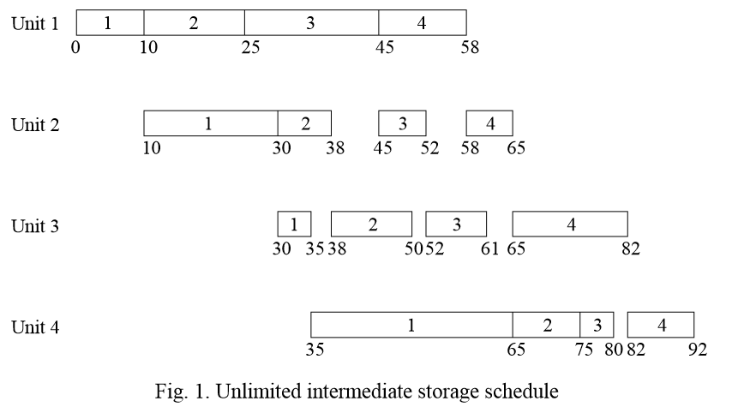
SOLUTION ALGORITHMS – MODEL-BASED OPTIMIZATION

Slide 7
CONCLUSION
Production scheduling is of immense importance in noncontinuous processes of the chemical process industry. Application of the scheduling methodology can significantly improve the productivity and cost-effectiveness of batch processes
The advantage of a model-based optimization approach is that it offers a rigorous measure of the quality and the feasibility of any solution that is obtained.

Slide 8
Thank you for attention

