Slide 1
Product Sales & Returns Dashboard
Power BI Project Summary
By Mohammad Khaja Pasha

Slide 2
📌 Objective
Build an interactive Power BI dashboard for business stakeholders that:
- Tracks product sales and refunds
- Identifies high-performing categories
- Analyzes revenue trends and return behavior
- Supports decision-making through clean visuals and filters

Slide 3
📁 Dataset Overview
- Source: Kaggle - Product Sales and Returns Dataset
- Records: 70,051 after cleaning
- Key Fields:
• Item Name, Category, Version
• Final Revenue, Refunds, Sales Tax
• Purchased & Refunded Item Counts

Slide 4
🔑 Key KPIs Tracked
- Total Quantity Sold
- Total Transaction
- Overall Revenue
- Refunded Item
- Refunded Amount
- Total Revenue

Slide 5
📊 Visuals Included
- Revenue vs Refund by Category
- Top 10 Products by Final Revenue
- Refund Trend Over Time (Line Chart)
- Revenue Trend Over Time (Line Chart)
- Slicers: Category, Version, Date Range

Slide 6
🧹 Data Cleaning Performed
- Removed duplicate rows
- Replaced negative refund values with zero
- Created cleaned columns:
• Clean Refund Amount
• Clean Refunded Item Count

Slide 7
✅ Final Outcome
Delivered a professional and interactive Power BI dashboard that:
- Supports exploration of refund and sales behavior
- Enables slicing data across time, product, and category
- Ready for stakeholder presentation.

Slide 8
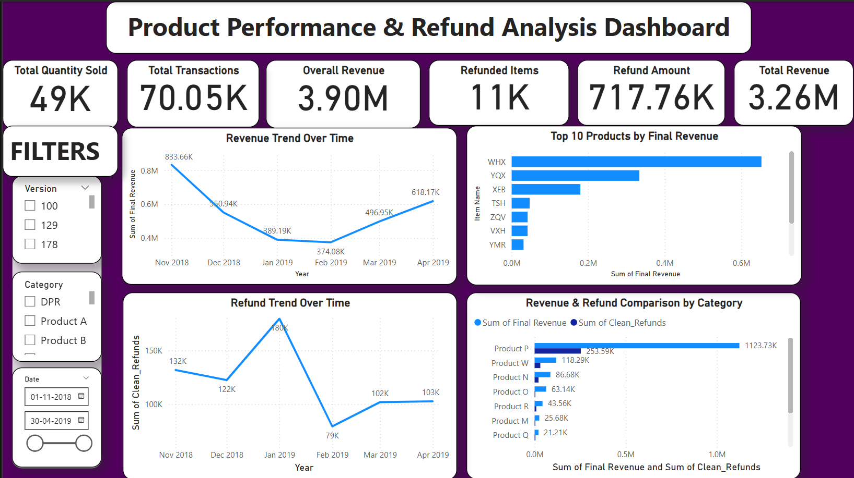
Dashboard Screenshot

