Slide 1
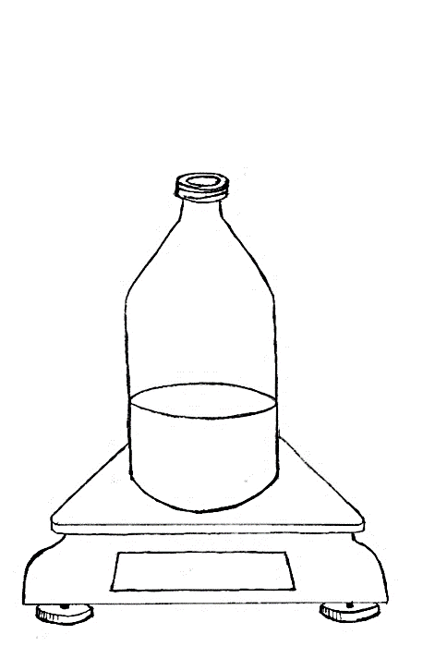
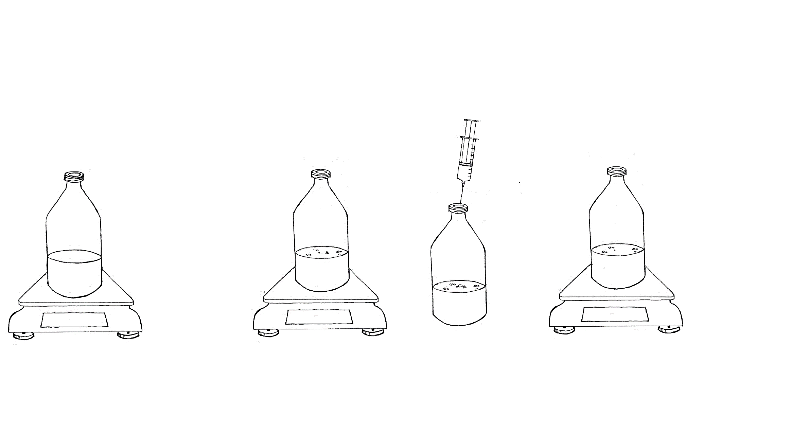
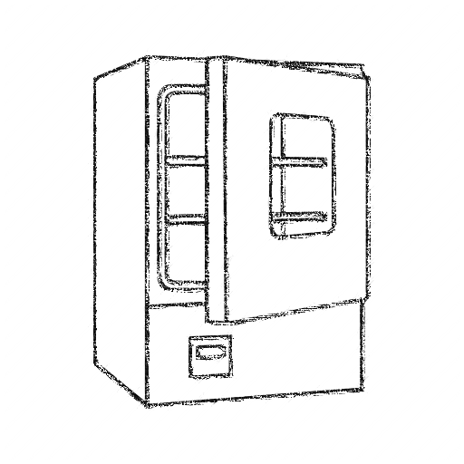
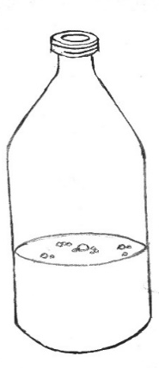


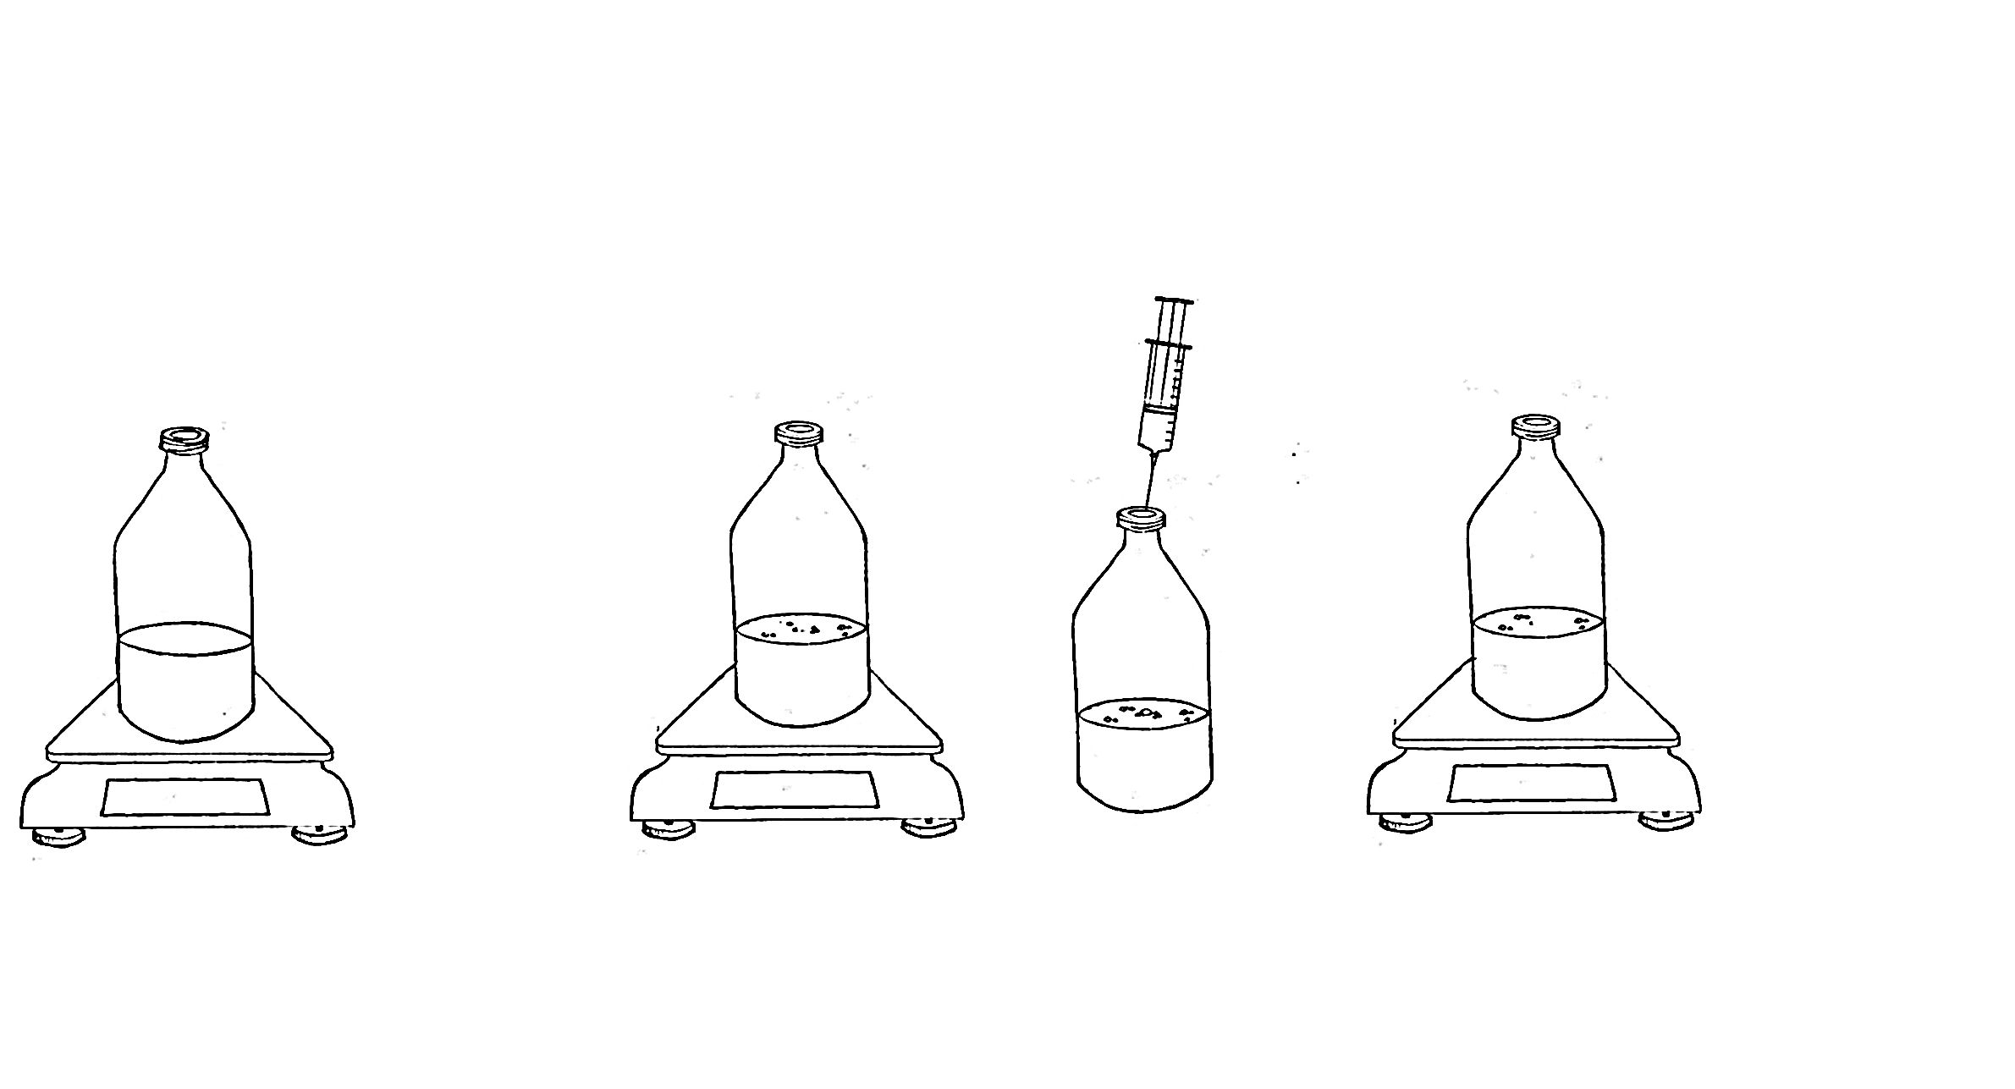
Step 4
Step 5
470.41 g
470.40 g
Repeat to BMP test completion
Weigh twice after setup is complete
Incubate between sampling events
Mix by swirling
Weigh bottle
Step 8
Step 7
Step 6
469.96 g
469.96 g
Weigh bottle
Vent bottle (release biogas)
Take sample for gas analysis

