Slide 1
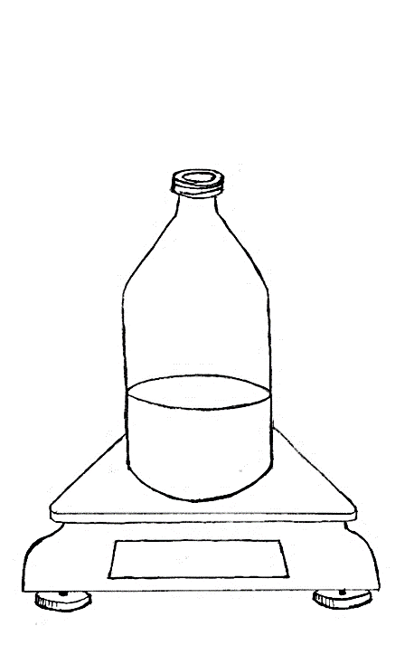
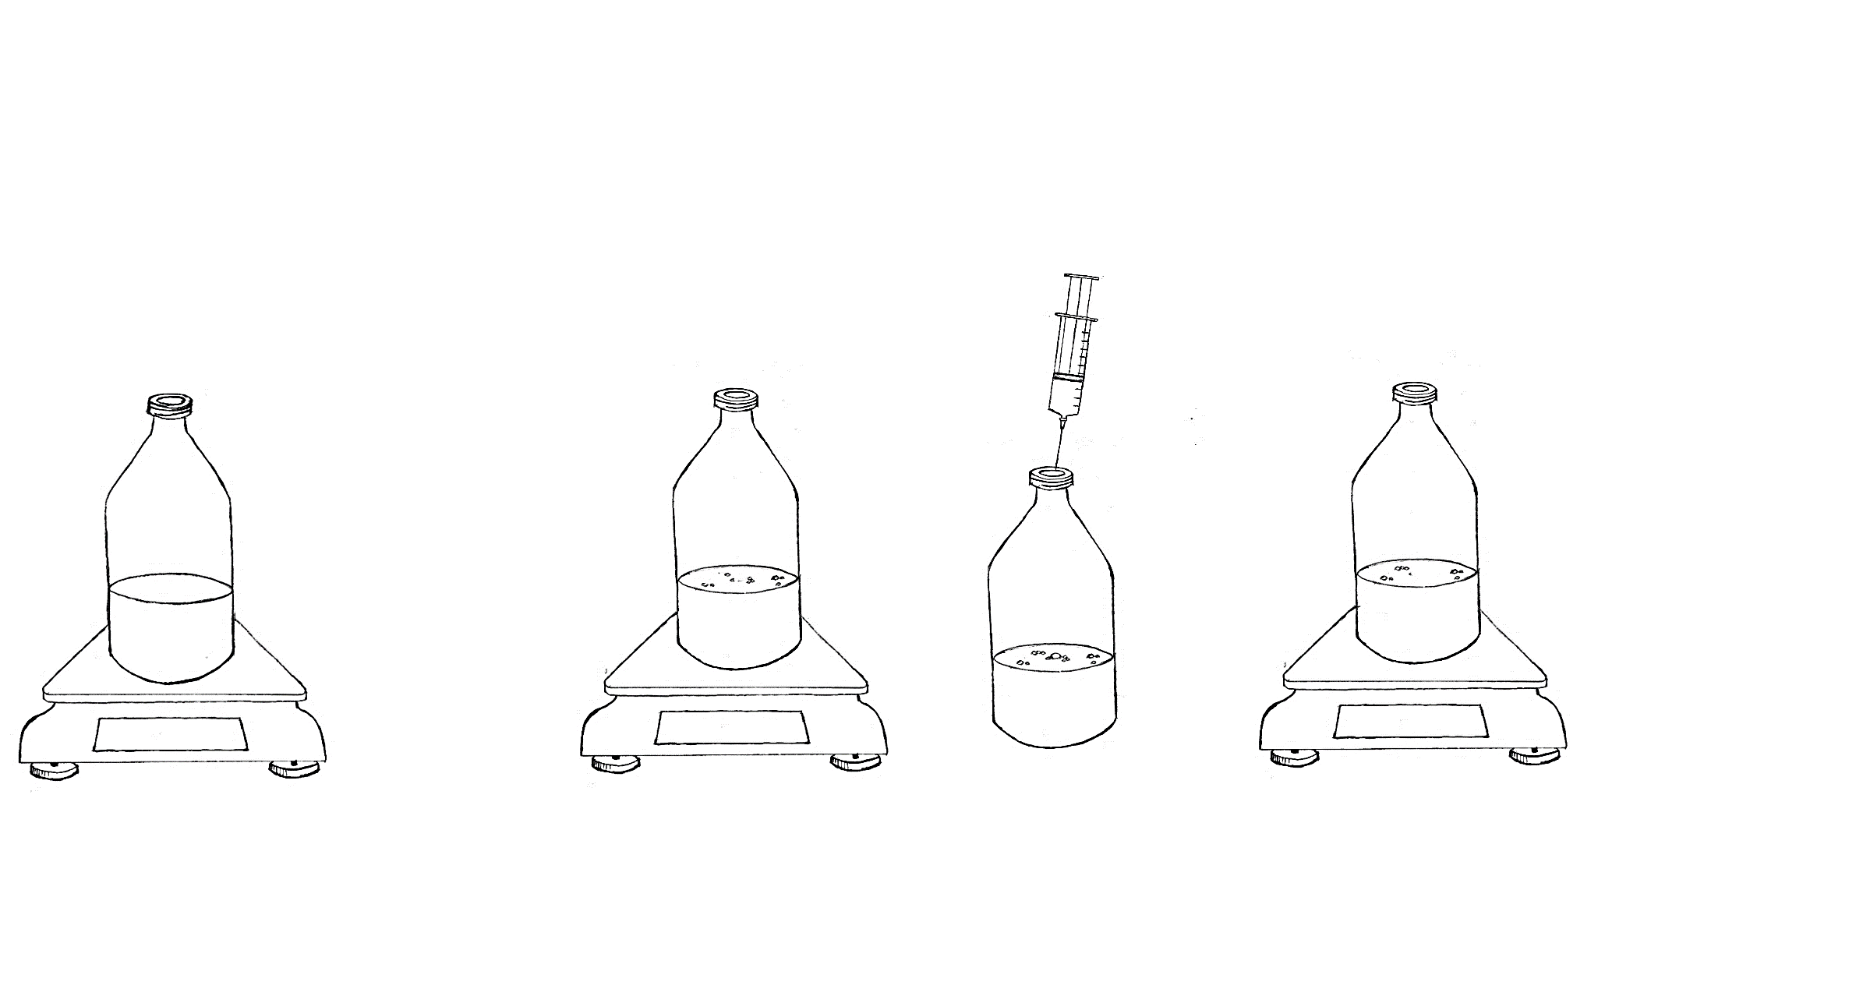
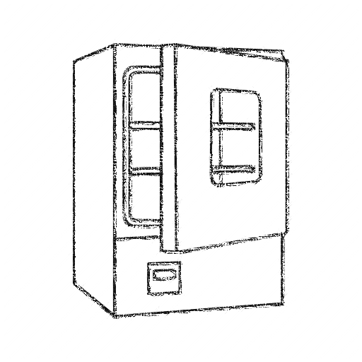
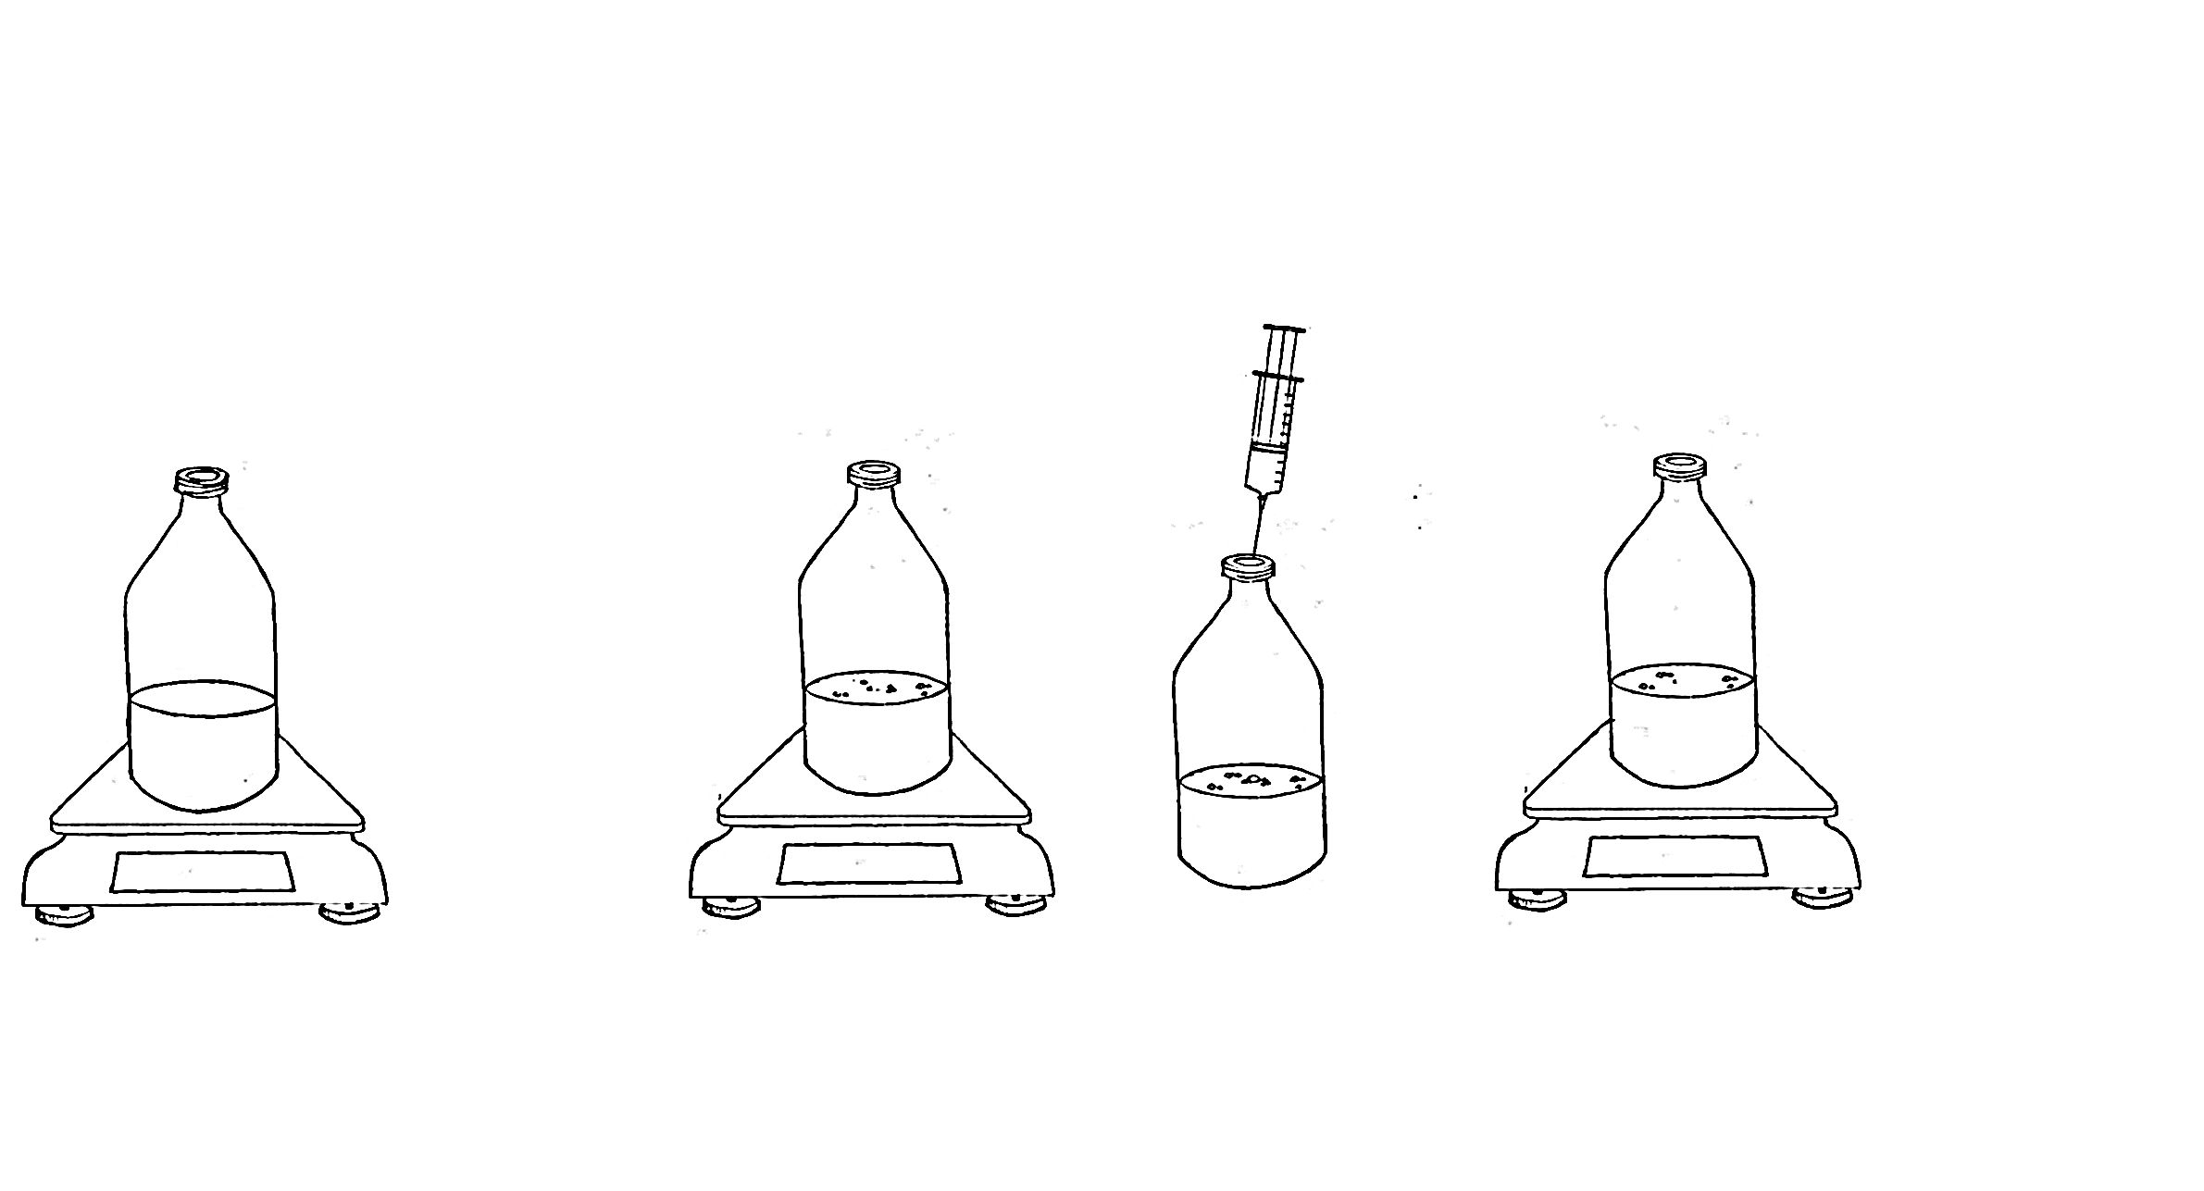
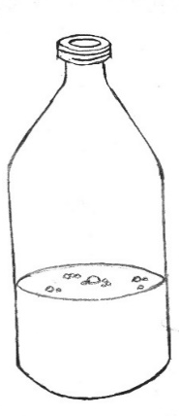

Step 4
Step 5
Step 6
Step 7
Step 8
470.41 g
469.96 g
470.40 g
469.96 g
Weigh twice after setup is complete
Incubate between sampling events
Mix by swirling
Weigh bottle
Take sample for gas analysis
Vent bottle (release biogas)
Weigh bottle
Repeat to BMP test completion

