Slide 1
Data Literacy in the Age of Machine Learning Course Review

Slide 2
Outline
Part 1: The Mechanics of Prediction
Visualizing data systematically
Regression with a single and multiple feature(s)
Non-linear regression
Logistic regression with two and multiple features
Non-linear logistic regression - Support Vector Machines and Neural Networks
Part 2: The Science of Machine Learning
Models, parameters and hyper-parameters
Training, validation and test datasets
Measuring model bias and variance
Validation curves
Learning curves
Measuring model performance

Slide 3
Outline
Part 3: The Art of Machine Learning
Similarity and clustering
Feature Engineering: Feature selection/extraction/representation

Slide 4
Visualizing Data Goals
Knowing the dataset
Structure of the data (rows, columns, feature types)
Missing data
Order of magnitude
Representativeness
Data investigation
Visualize numerical features
Visualize categorical features
Relationship between features

Slide 5
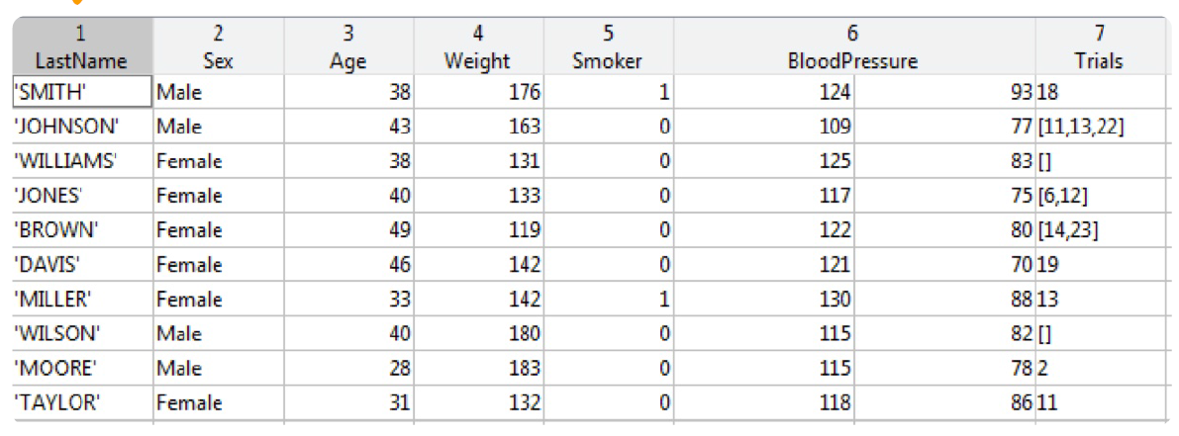
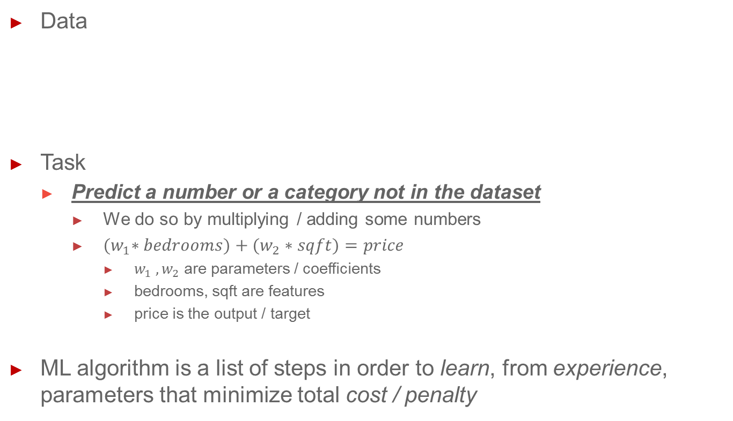
Data, Task and Machine Learning
Data
Task
Predict a number or a category not in the dataset
We do so by multiplying / adding some numbers
${(w}_{1}∗bedrooms)+(w_{2}∗sqft)=price$
$w_{1} , w_{2}$ are parameters / coefficients
bedrooms, sqft are features
price is the output / target
ML algorithm is a list of steps in order to learn, from experience, parameters that minimize total cost / penalty

Slide 6
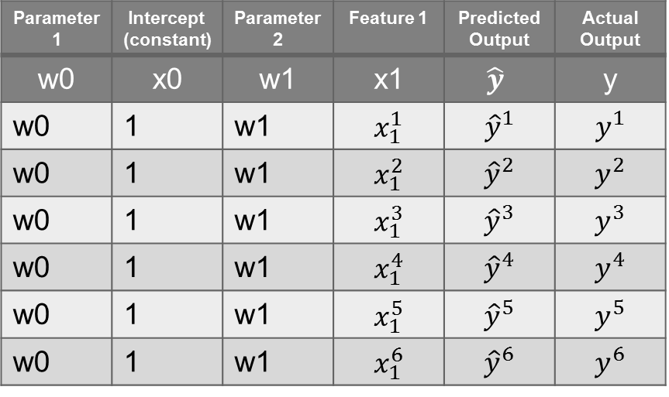

Regression with a single and multiple feature(s)
${(w}_{0}∗x_{0})+{(w}_{1}∗x_{1})=y$
${(w}_{0}∗x_{0})+{(w}_{1}∗x_{1})+{(w}_{2}∗x_{2})=y$
${(w}_{0}∗x_{0})+{(w}_{1}∗x_{1})+{(w}_{2}∗x_{2})+ …+{(w}_{n}∗x_{n})=y$
Parameter1 | Intercept (constant) | Parameter2 | Feature 1 | Predicted Output | Actual Output
w0 | x0 | w1 | x1 | $$\hat{y}$$ | y
w0 | 1 | w1 | $$x_{1}^{1}$$ | $${\hat{y}}^{1}$$ | $$y^{1}$$
w0 | 1 | w1 | $$x_{1}^{2}$$ | $${\hat{y}}^{2}$$ | $$y^{2}$$
w0 | 1 | w1 | $$x_{1}^{3}$$ | $${\hat{y}}^{3}$$ | $$y^{3}$$
w0 | 1 | w1 | $$x_{1}^{4}$$ | $${\hat{y}}^{4}$$ | $$y^{4}$$
w0 | 1 | w1 | $$x_{1}^{5}$$ | $${\hat{y}}^{5}$$ | $$y^{5}$$
w0 | 1 | w1 | $$x_{1}^{6}$$ | $${\hat{y}}^{6}$$ | $$y^{6}$$

Slide 7
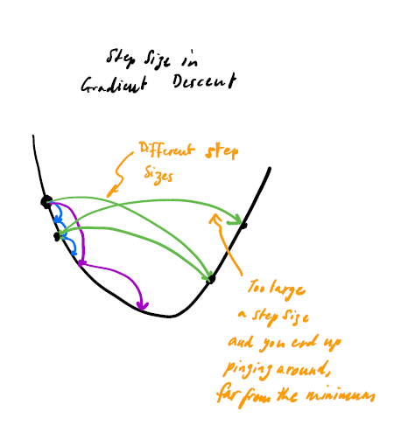

Cost / Penalty
Penalty for each row $={(y^{i}−{\hat{y}}^{i})}^{2}$
Total Penalty = $\sum_{1}^{n}{{(y^{i}−{\hat{y}}^{i})}^{2}}$
Goal: Use optimization algorithm (e.g. gradient decent) to minimize total penalty
Let’s review Assignment 1 in Orange

Slide 8

Non-linear regression
${(w}_{0}∗x_{0})+{(w}_{1}∗x_{1})=y$
${(w}_{0}∗x_{0})+{(w}_{1}∗x_{1})+{(w}_{2}∗x_{2}^{2})=y$
${(w}_{0}∗x_{0})+{(w}_{1}∗x_{1})+{(w}_{2}∗x_{2}^{2})+ …+{(w}_{n}∗x_{n}^{n})=y$
Features need to be “constructed”
Finding the cost / penalty is the same

Slide 9
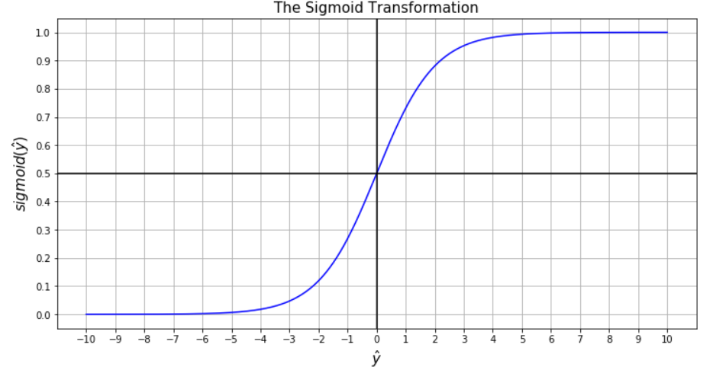
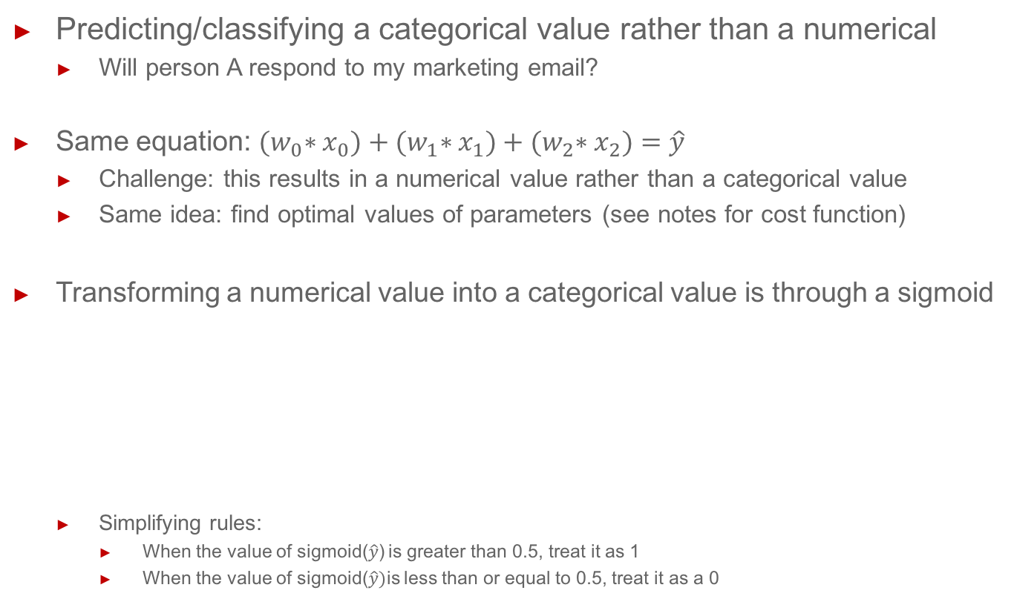
Logistic regression
Predicting/classifying a categorical value rather than a numerical
Will person A respond to my marketing email?
Same equation: ${(w}_{0}∗x_{0})+{(w}_{1}∗x_{1})+{(w}_{2}∗x_{2})=\hat{y}$
Challenge: this results in a numerical value rather than a categorical value
Same idea: find optimal values of parameters (see notes for cost function)
Transforming a numerical value into a categorical value is through a sigmoid
Simplifying rules:
When the value of sigmoid($\hat{y}$) is greater than 0.5, treat it as 1
When the value of sigmoid($\hat{y})$is less than or equal to 0.5, treat it as a 0
Always less than 1
Always more than 0

Slide 10

Non-linear logistic regression
Second degree ($x_{1}^{2} , x_{1}∗x_{2} , x_{2}^{2})$
In Orange: Polynomial Classification
Other models:
Support Vector Machine (SVM)
Neural Network

Slide 11
Test and Training Datasets
“Training” dataset -
Used to build the model
Used to measure the penalty of learning algorithm
“Test” dataset
Used to test the model
Used to measure performance of the machine learning model

Slide 12
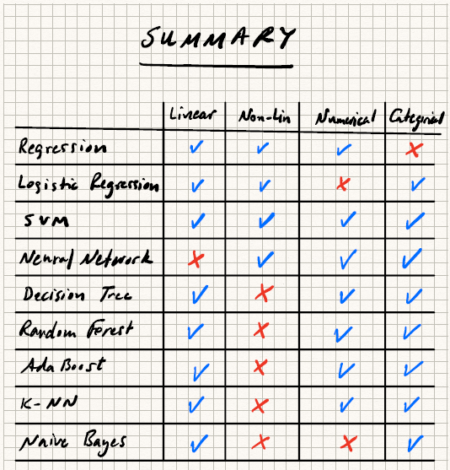
Models in Machine Learning

Slide 13
Model Performance
Regression Models
Mean Square Error (MSE)
Root Mean Square Error (RMSE)
Mean Absolute Error (MAE)
R-squared (R2)
Logistic Models
Area Under Receiver Operating Characteristic Curve (AUC)
Classification Accuracy (CA)
Precision
Recall
F1 (harmonic mean of precision and recall)
Best model performs the best on the test dataset
Let’s look at “choosing-a-model” in Orange

Slide 14
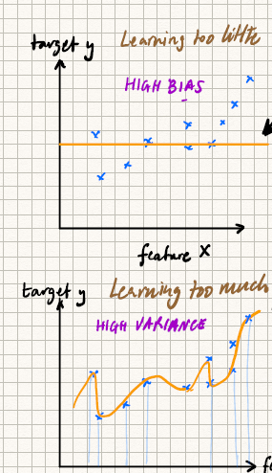
Validation Curves
High bias = Learning too little = Low complexity
High variance = Learning too much = High complexity
Complexity of model is a function of:
Features
Model hyper-parameters (see class notes)
Amount of training data

Slide 15
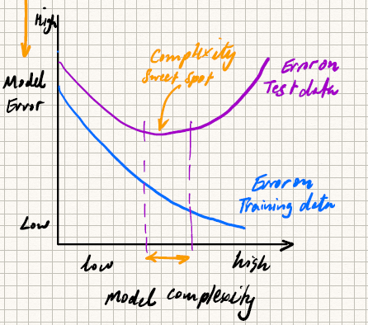
Validation Curves
Is the model adequate to represent the structure / complexity of the data?
Use the model tuned to the right complexity of the test dataset.
Caution: A high F1 score is low model error.

Slide 16
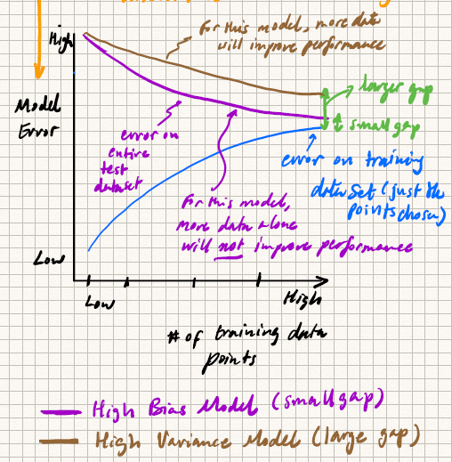
Learning Curves
Which way to tune the complexity of a model?

Slide 17
Feature Engineering
What is feature engineering?
Feature Creation. Create better features by combining existing features (including taking the square, cube, etc. of existing features)
Feature Selection. Pick features that make a difference and drop the rest.
Why select features?
Noise reduction
The curse of dimensionality
too many features
too few training examples

Slide 18
Feature Selection / Dimensionality Reduction
Projection
Principal Component Analysis
First it’s a feature transformation algorithm
Also a feature reduction method (reduction in the number of original features)
Manifold Learning
Sequential Backward/Forward Selection
Randomly removing/adding features and seeing how it affects the prediction
Random Forest Ranking

Slide 19
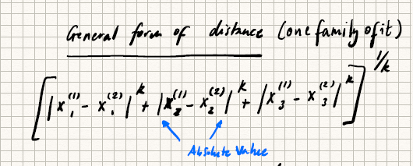
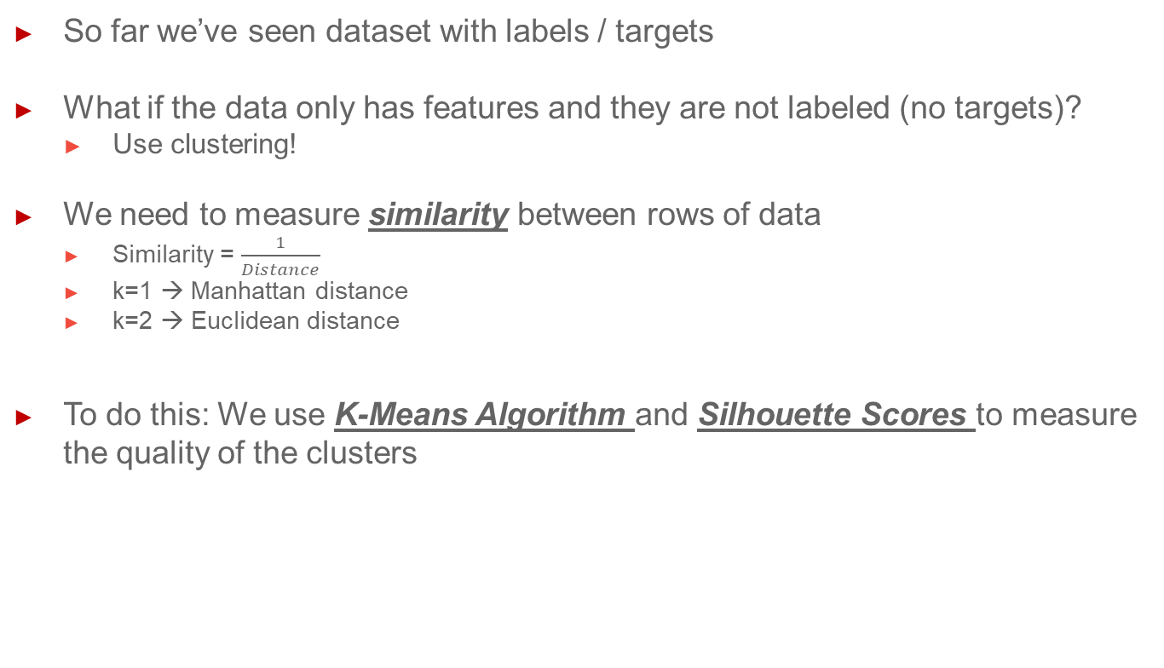
Grouping / Clustering
So far we’ve seen dataset with labels / targets
What if the data only has features and they are not labeled (no targets)?
Use clustering!
We need to measure similarity between rows of data
Similarity = $\frac{1}{Distance}$
k=1 → Manhattan distance
k=2 → Euclidean distance
To do this: We use K-Means Algorithm and Silhouette Scores to measure the quality of the clusters

