Slide 1
Data Literacy in the Age of Machine Learning MGMT E5072 Course Review 2
Fall 2018

Slide 2
Outline
Part 1: The Mechanics of Prediction (covered in Review Session 1)
Visualizing data systematically
Regression with a single and multiple feature(s)
Non-linear regression
Logistic regression with two and multiple features
Non-linear logistic regression - Support Vector Machines and Neural Networks
Part 2: The Science of Machine Learning (covered in Review Session 1)
Models, parameters and hyper-parameters
Training, validation and test datasets
Measuring model bias and variance
Validation curves
Learning curves
Measuring model performance

Slide 3
Outline
Part 3: The Art of Machine Learning (covered in this review)
Ensembles and aggregation of results
Feature Engineering
Data compression
Part 4: Select Topics in Machine Learning (covered in this review)
Similarity and clustering
Learning from Text

Slide 4
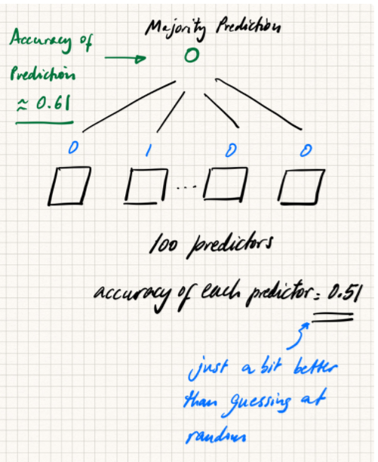
Ensemble Prediction Techniques
“Ensembles” are a powerful way of improving accuracy
Given that each predictor is slightly better than random
What if not?
Simple majority sharing scheme

Slide 5
Ways to Create Ensembles
Copy the same classifier/model.
Use a different subset of the training dataset to train each of the models.
Bagging (w replacement) and Pasting (w/o replacement) - Rows
Random Forest – Columns
Boosting – its sequential rather than parallel and doesn’t scale as well as the other two
Use different classifiers
Train each classifier on the same training dataset
Stacking
NOTE: Ensemble methods work best when each model's prediction is independent of the others and the errors made by one model is different from the errors made by any of the others
Let’s see this in Orange

Slide 6
Feature Engineering
What is feature engineering?
Feature Creation. Create better features by combining existing features (including taking the square, cube, etc. of existing features)
Feature Selection. Pick features that make a difference and drop the rest.
Why select features?
Noise reduction
The curse of dimensionality
too many features
too few training examples

Slide 7
Feature Selection / Dimensionality Reduction
Projection
Principal Component Analysis
First it’s a feature transformation algorithm
Also a feature reduction method (reduction in the number of original features)
Manifold Learning
Sequential Backward/Forward Selection
Randomly removing/adding features and seeing how it affects the prediction
Random Forest Ranking
Let's do Homework 6 in Orange

Slide 8
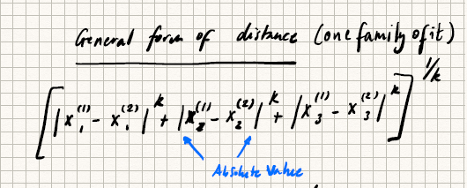
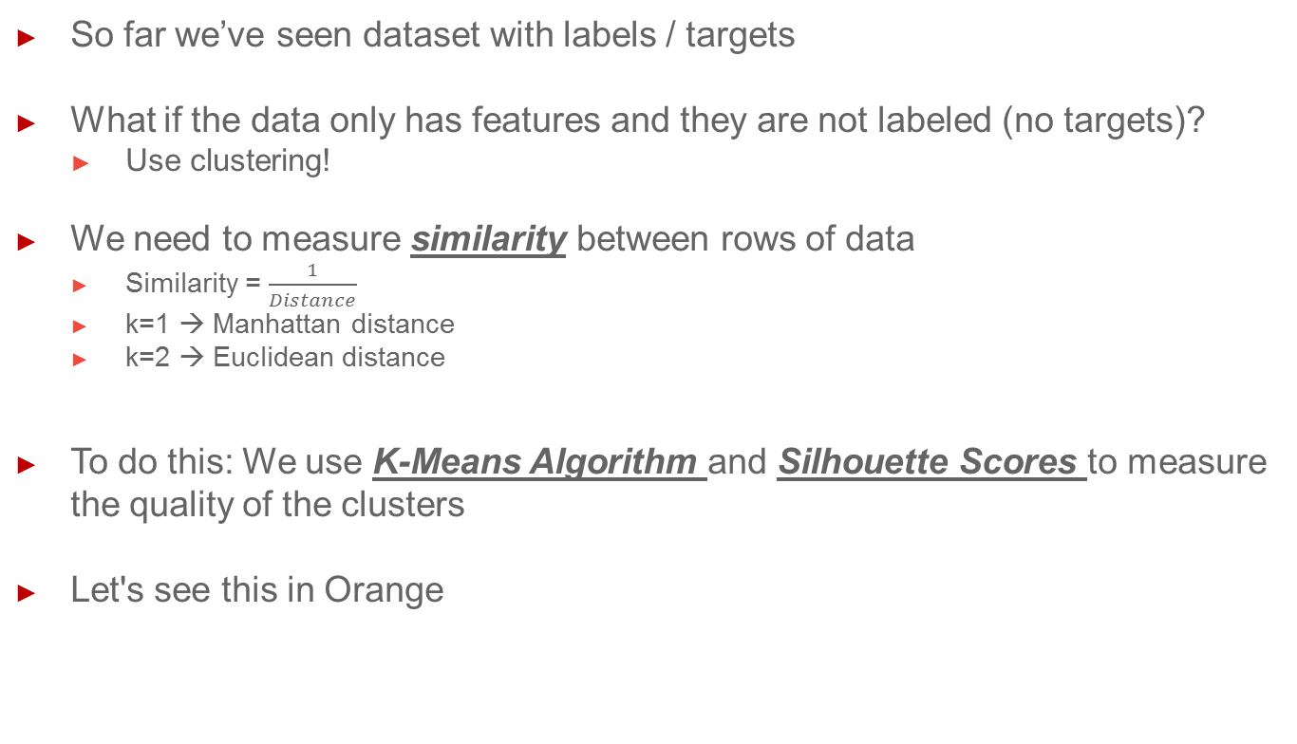
Grouping / Clustering
So far we’ve seen dataset with labels / targets
What if the data only has features and they are not labeled (no targets)?
Use clustering!
We need to measure similarity between rows of data
Similarity = $\frac{1}{Distance}$
k=1 → Manhattan distance
k=2 → Euclidean distance
To do this: We use K-Means Algorithm and Silhouette Scores to measure the quality of the clusters
Let's see this in Orange

Slide 9
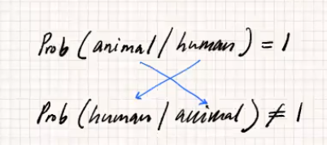
Naïve Bayes Classifier & Learning from Text
Bayes’ Theorem
Spam
Usual Approach: Use logistic regression (we reviewed how this is done)
New approach using the Bayes’ Theorem: Probability of target value being spam or not given existence of certain words
Let’s look at an example in Orange

