Slide 1
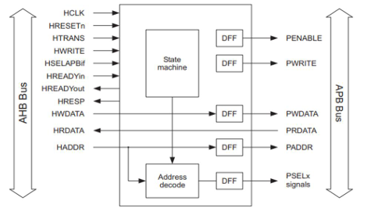
ECE 560 Assertion Based Verification
Electrical and Computer Engineering Department Maseeh College of Engineering and Computer Science

Slide 2
AHB to APB Bridge Verification
TEAM-3
Yashaswi Katne
<katne@pdx.edu>
Prasanna Kumar Panchada
<prapanch@pdx.edu>
Naveen Kumar Reddy Thummala
<naveenkt@pdx.edu>
Maheswar Reddy Kamalapuram
<Maheswar@pdx.edu>

Slide 3
Introduction
The objective of this project and the verification plan is to outline the strategies, methodologies, and findings of our efforts in verifying the efficiency and performance capabilities of the AHB-APB bridge design.
We’re verifying the AHB to APB bridge using the AMBA specifications. We are basically writing an assertion IP (AIP) based on the AMBA ARM specs and testing/applying it on an RTL.

Slide 4
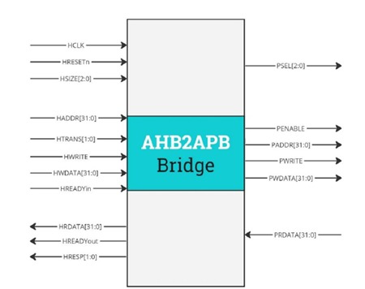
Block Diagram

Slide 5
Bus Bridge Description:
AHB to APB bridge provides an interface between the high speed AHB and the low power APB.
Read and write transfers on the AHB are converted into equivalent transfers on the APB.
It has AHB slave bus interface, APB transfer state machine, which is independent of the device memory map, and APB output signal generation.
It buffers address, controls, and data from the AHB, drives the APB peripherals and returns data along with a response signal to the AHB.
APB data bus is divided into read (PRDATA), where data travels from the peripherals to the bridge and write (PWDATA), where data travels from the bridge to the peripherals.
Data transfers can have 3 different sizes (HSIZE) Byte, halfword or full word.
Data transfers are either sent as a single transfer or can be sent in a burst (HBURST). Bursts can be incremental or wrapping bursts with 4 or 8-beats.

Slide 6
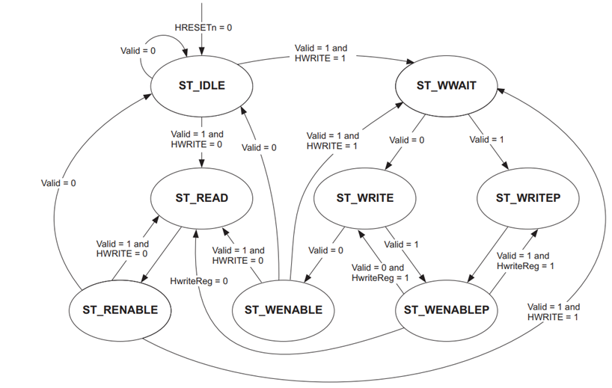
State Machine

Slide 7
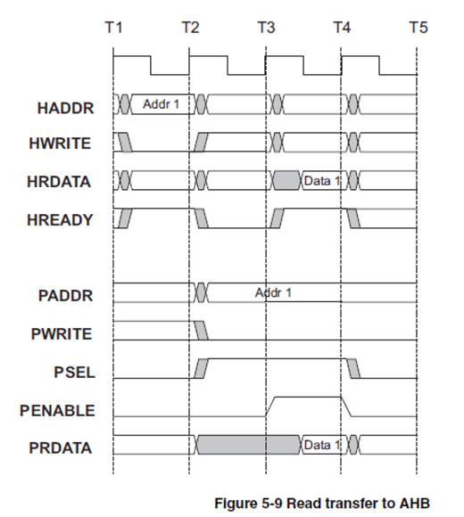
Read transfer to AHB
HWRITE - Low for Read
HREADY - AHB asserted with HWRITE then strobed once
PSEL - Asserted for two cycles along with PWRITE starting in T3 - Enter SETUP
PENABLE is asserted in T4, the cycle after PSEL is asserted - Enter ENABLE
The following cycle, T5, PSEL and PENABLE deasserted. - Single Read

Slide 8
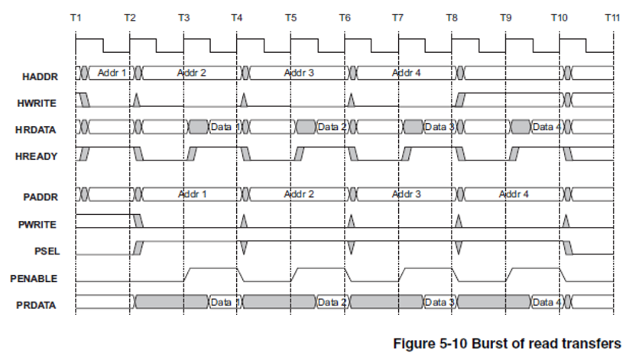
Burst of Read Transfers
HWRITE - Held low for Seq Read
HREADY - AHB asserted with HWRITE then strobed during burst
PSEL - Asserted along with PWRITE in T3 - Enter SETUP
PENABLE is asserted in T4, the cycle after PSEL is asserted - Enter ENABLE
The following cycle, T5, PENABLE deasserted. Strobed for burst
PSEL held high for burst

Slide 9
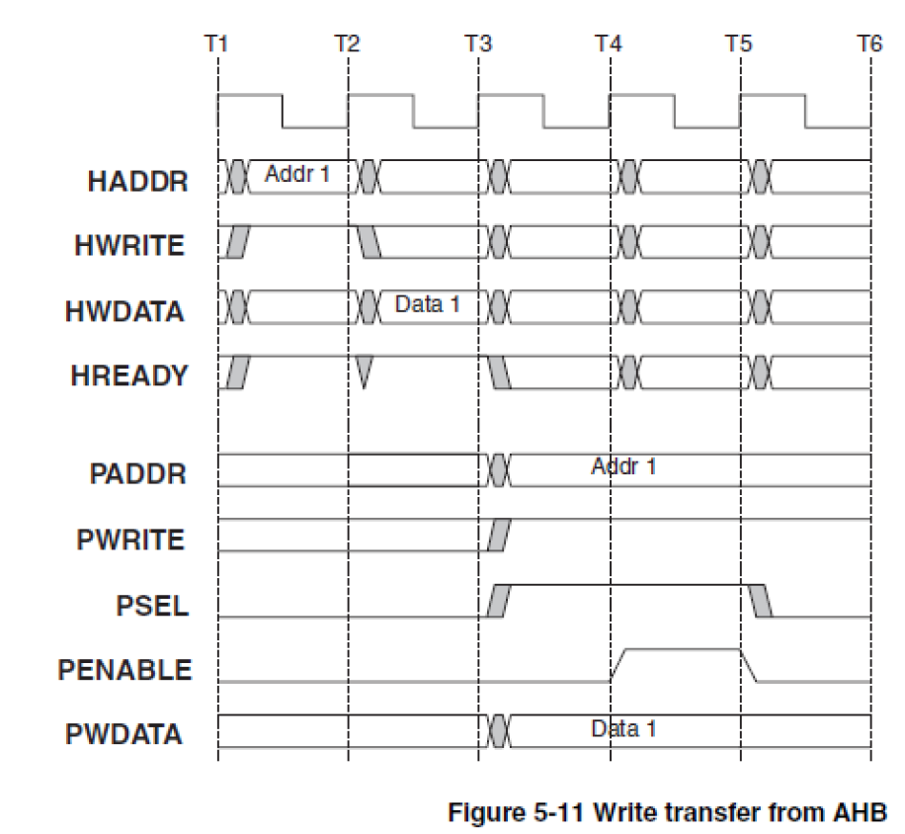
Write Transfer from AHB
HWRITE - High for Read
HREADY - AHB asserted for two cycles
PSEL - Asserted for two cycles along with PWRITE starting in T4 - Enter SETUP
PENABLE is asserted in T5, the cycle after PSEL is asserted Enter ENABLE
The following cycle, T6, PSEL and PENABLE deasserted. - Single Read

Slide 10
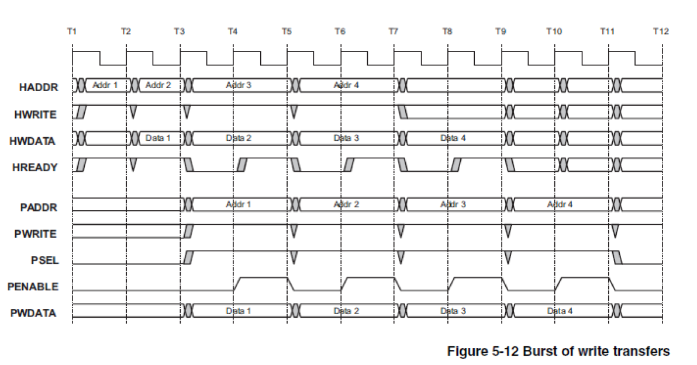
Burst of write Transfers
HWRITE - Held high for Seq Read
HREADY - AHB asserted with HWRITE then strobed during burst
PWRITE - Low in T2, after AHB asserts HREADY
PSEL - Asserted along with PWRITE - Enter SETUP
PENABLE is asserted in T3, the cycle after PSEL is asserted - Enter ENABLE
The following cycle, T4, PENABLE deasserted. Cycles high and low for burst
PSEL held high for burst

Slide 11
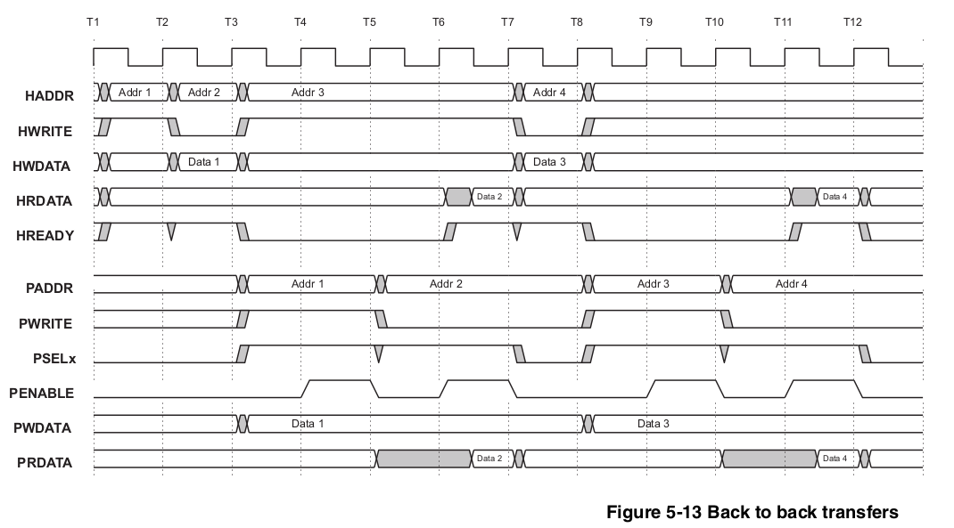
Read after Write Transfer

Slide 12
Specifications and Assertions
What Are We Verifying?
AHB Slave Interface (AHB_SI):
- Valid signal logic based on AHB protocol.
Address decoding for tempselx logic based on Haddr.
Invalid ranges resetting tempselx to 0.
2. APB Controller (APB_CTRL):
State machine transitions (e.g., ST_IDLE → ST_WWAIT).
Consistency between PRESENT_STATE and NEXT_STATE.
Valid read/write transactions and sequence properties.

Slide 13
Specifications and Assertions
3. Bridge Top-Level Module:
Data consistency between AHB and APB (e.g., Hrdata == Prdata).
Address-based PSEL logic (addr0, addr1, addr2).
Handling back-to-back transactions, wait states, and reset behavior.

Slide 14
Specifications and Assertions
Key Verification Properties
Address Decoding:
Correct tempselx assignment based on Haddr ranges.
Invalid ranges result in tempselx reset to 3'b000.
2. State Machine Transitions (APB_CTRL):
Every state transition follows specified conditions.
Transitions like ST_WWAIT → ST_WRITE and ST_READ → ST_RENABLE.
3. Data Integrity (Bridge):
Hrdata matches Prdata during enable cycle.
Pwrite aligns with Hwrite for read/write transactions.

Slide 15
Specifications and Assertions
4. Back-to-Back Transfers:
Read after write ensures 3 wait states.
Supports bursts of reads, writes, and mixed sequences.
Coverage Goals:
Reset Validation: All signals are zeroed post-reset.
Address Validation: Correct PSEL signals based on address ranges. Burst and Back-to-Back Scenarios: Multiple transactions for performance validation.

Slide 16
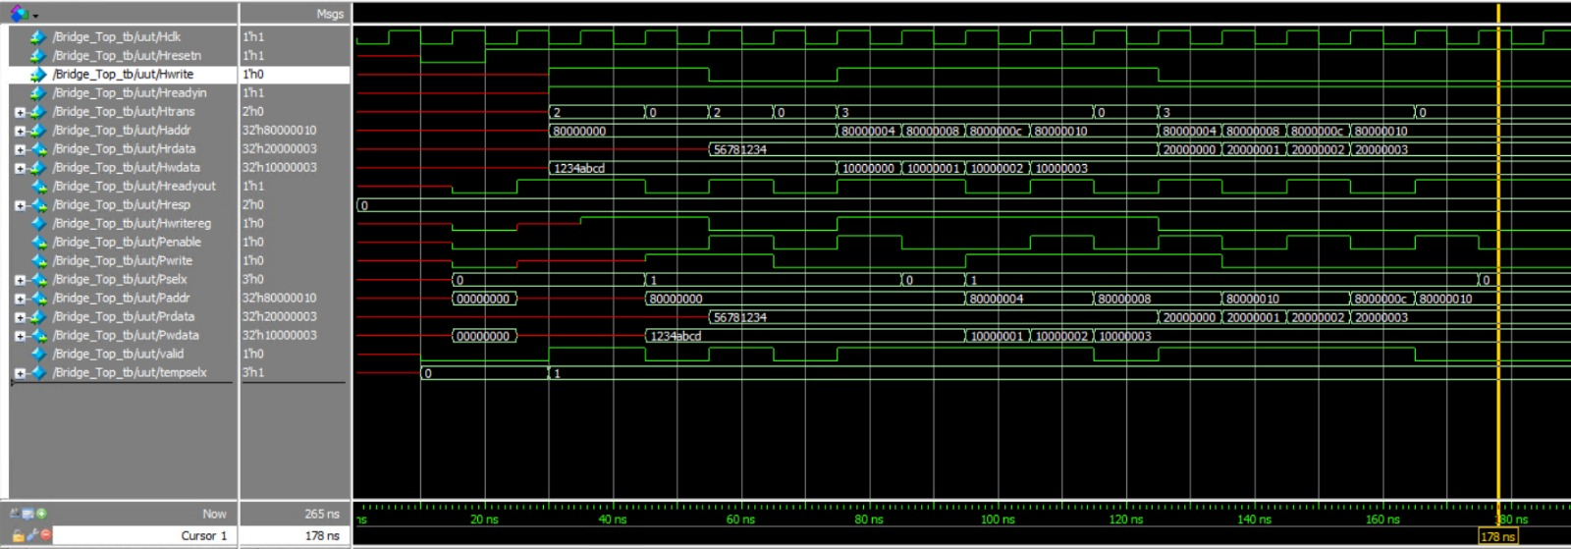
Simulation Timing diagram

Slide 17
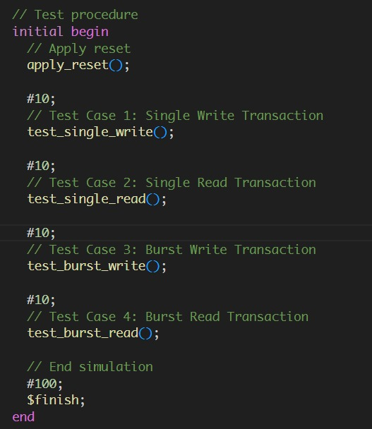
Simulation Timing diagram

Slide 18
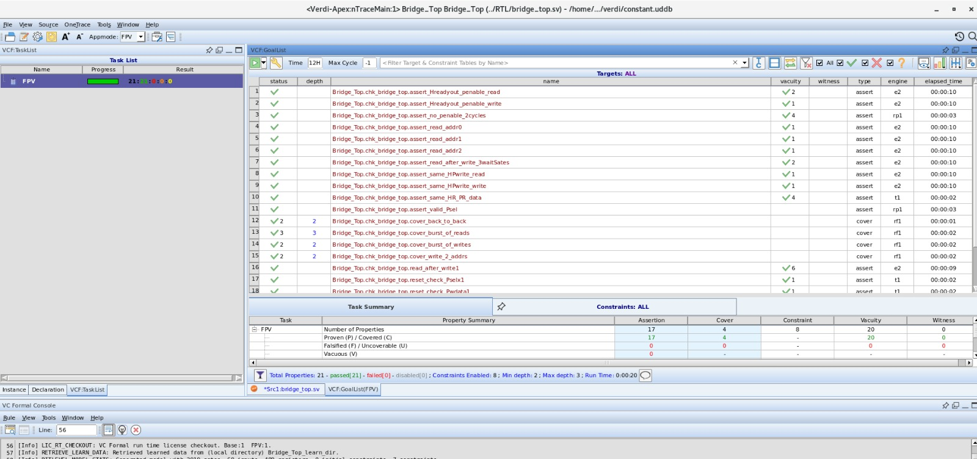
Formal Property Verification : FPV_Bridge

Slide 19
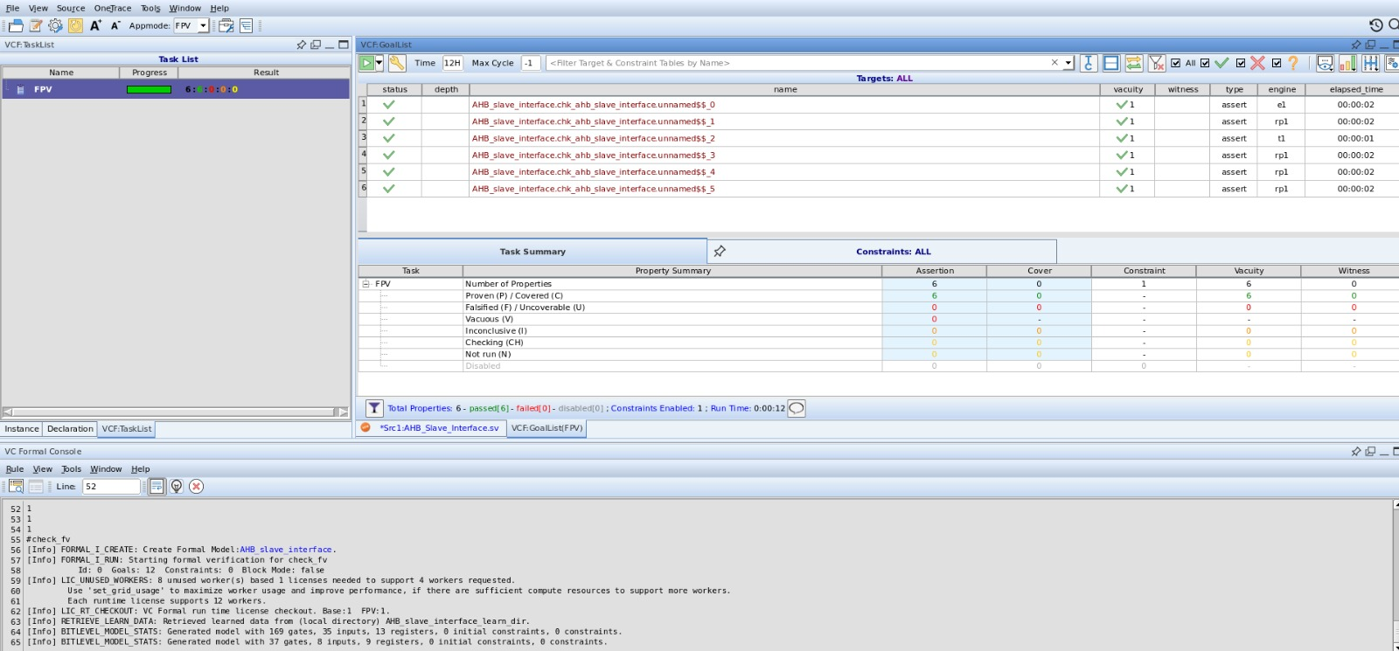
Formal Property Verification : FPV_AHB

Slide 20
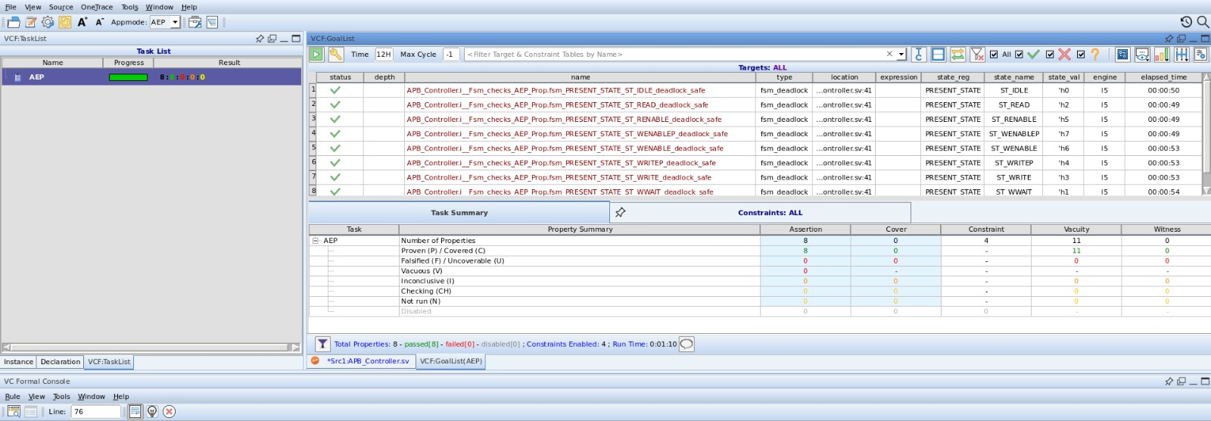
AEP_AHB

Slide 21
Conclusion
The AHB to APB Bridge is an essential component in many embedded systems. Verification using assertions and coverage properties ensures that it functions as expected, enhancing the reliability of the system design.

Slide 22
References
Github
Lecture Recordings
Chat-gpt
ARM Spec Document

Slide 23


