Slide 1
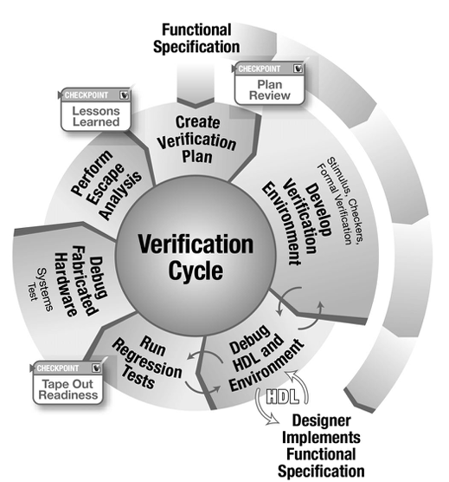


ECE 593 Fundamentals of Pre-Silicon Validation
Venkatesh Patil Electrical and Computer Engineering Department Maseeh College of Engineering and Computer Science

Slide 2
Design and Verification of Asynchronous FIFO Spring 2024 – Session 1 – Group 03
Yashaswi Katne
Email Id : katne@pdx.edu
PSU ID : 963584934
Term : 2nd term
Graduation Date : Dec 2025
Naveen Kumar Reddy Thummala
Email Id : naveenkt@pdx.edu
PSU ID : 925540576
Term : 2nd term
Graduation Date : Dec 2025

Slide 3
Design and Verification of Asynchronous FIFO Spring 2024 – Session 1 – Group 03
Maheswar Reddy Kamalapuram
Email Id : maheswar@pdx.edu
PSU ID : 922596735
Term : 2nd term
Graduation Date : Dec 2025
Anurag Ranga
Email Id : anuragr@pdx.edu
PSU ID : 965691727
Term : 2nd term
Graduation Date : Dec 2025

Slide 4
Project Introduction
Yashaswi Katne
System Verilog
Top Design
Class Based Verification
Randomized Test cases
Coverage
Verification Document
UVM Verification Environment
Coverage
Test cases
Bug Injection
HLDS Document
Anurag Ranga
System Verilog
FIFO Write
Class Based Verification
Driver
Transaction
Scoreboard
UVM Verification Environment
Agent
Scoreboard
Transaction
Verification Document

Slide 5
Project Introduction
Naveen Kumar Reddy Thummala
System Verilog
FIFO Memory
Synchronizer
Class Based Verification
Generator
Interface
Environment
UVM Verification Environment
Environment
Interface
Sequence
Verification Document
Maheshwar Reddy Kamalapuram
System Verilog
FIFO Read
Testbench
Class Based Verification
Finalized RTL
Class based Testbench
UVM Verification Environment
UVM Architecture
Top Module
Test
HLDS Document
Verification Document

Slide 6
Project Introduction
An asynchronous FIFO is a buffer that allows data to be written in one clock domain and read in another, with both clock domains operating independently.
This is essential for efficient and reliable data transfer in asynchronous systems, such as those dealing with different clock frequencies.
Asynchronous FIFOs ensure orderly data flow in digital systems characterized by asynchronous operations.
Specification
Producer clk1 freq = 80 Mhz
Consumer clk2 freq = 50 Mhz
Max write Burst size = 120
FIFO Depth = 45

Slide 7
Project Introduction
Producer is writing at 0 clock cycle.
Consumer is reading at 0 clock cycles.
Time required to write one data item = 1/80Mhz = 12.5 ns.
Time required to write all data items = 120 * 12.5 = 1500ns.
Time required to read one data item = 1/50Mhz = 20 ns.
No of data items that can be read in a period of 1500 ns = 1500/20 =75.
Thus, the number of data items needs to be stored = 120–75=45.
Therefore, logarithm of 64 with base 2 will result in 6 bits. Thus, we can either choose a FIFO that is 64 in depth or design a FIFO with 45 in size. The Width of the FIFO is 6 bits.

Slide 8
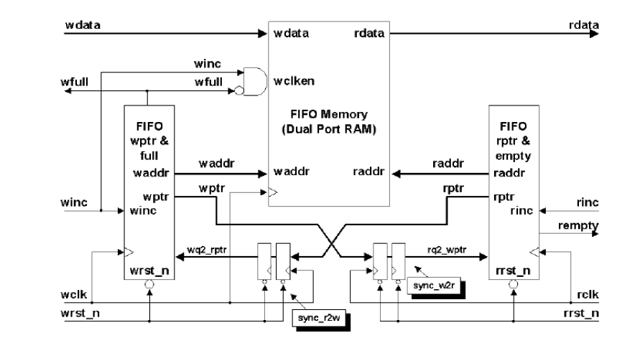
Design Implementation
Talk about design Implementation
Source of design
Your groups contribution over the source of design
Quick specification of your design to be verified

Slide 9
Design Implementation
Full and Empty Conditions:
Empty Condition: The FIFO is considered empty when the read and write pointers are both equal.
Full Condition: Design correctly identifies the FIFO as full when the write pointer has wrapped around and caught up to the read pointer. The write pointer will increment the unused MSB while setting the rest of the bits back to zero.

Slide 10
Design Implementation
An extra bit is used for analyzing the FULL and EMPTY conditions.
Gray code is employed, and the MSB of the pointers is compared to check these conditions.
On reset, both write and read pointers are set to zero.
After writing to the memory location pointed to by the write pointer, the write pointer is incremented to point to the next location.
The FIFO is empty when the read and write pointers are equal (either at reset or when the read pointer catches up to the write pointer).
A FIFO is FULL when the pointers are again equal, which occurs when the write pointer wraps around and catches up to the read pointer.

Slide 11
Design Implementation
Design Modules
SV TB/ UVM TB
Asynchronous FIFO Modules
Interface

Slide 12
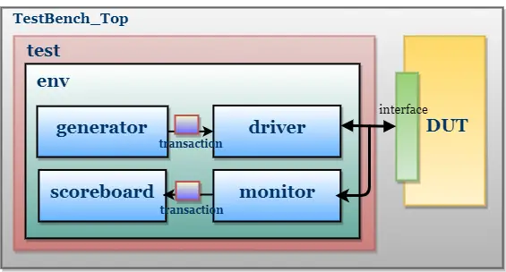
Design Implementation

Slide 13
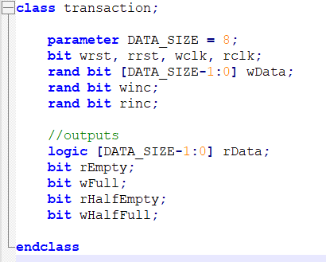
Class based Verification
Transaction Class

Slide 14
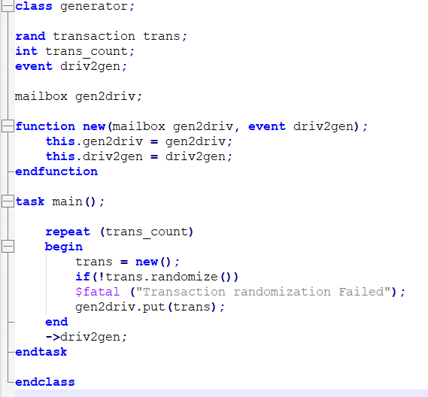
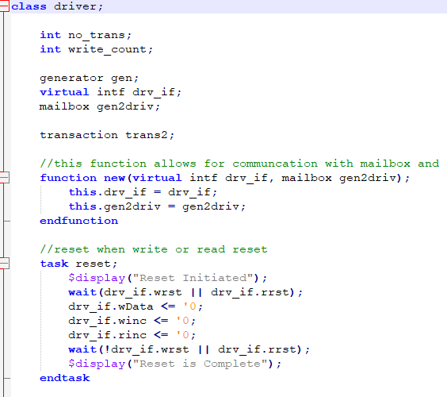
Class based Verification
Generator
Driver

Slide 15
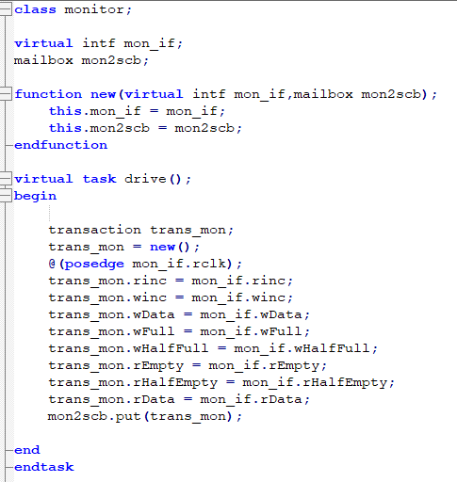
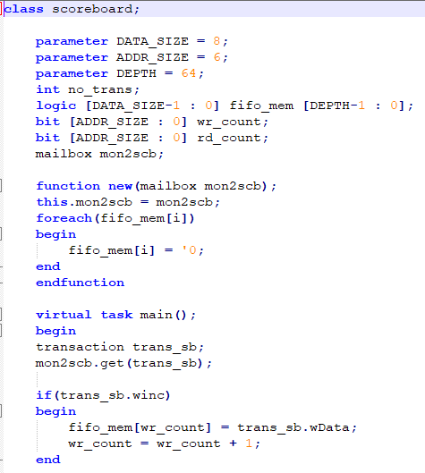
Class based Verification
Monitor
Scoreboard

Slide 16
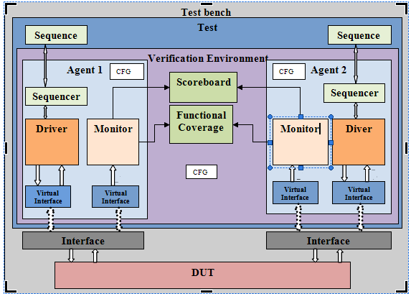
UVM based Verification

Slide 17
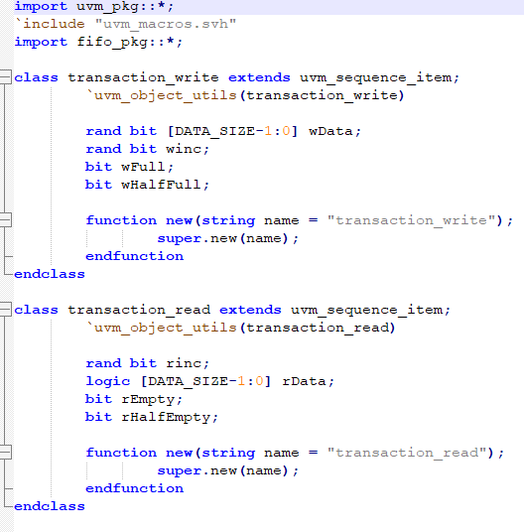
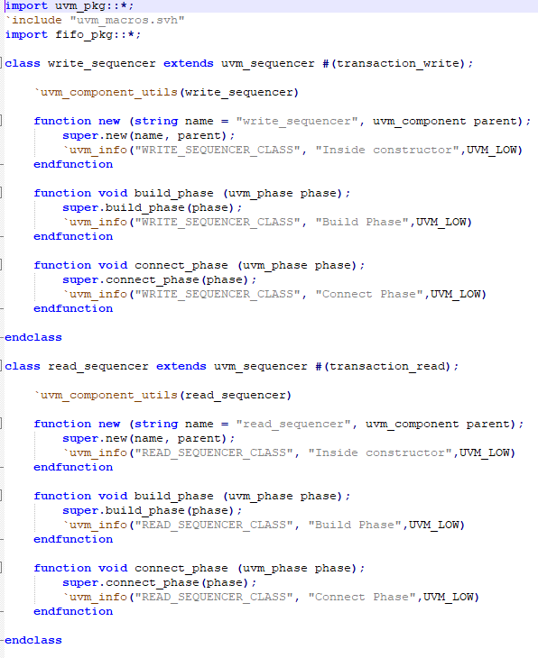
UVM based Verification
Sequence item
Sequencer

Slide 18
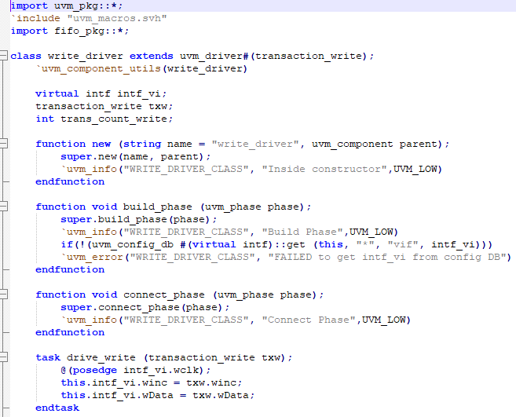
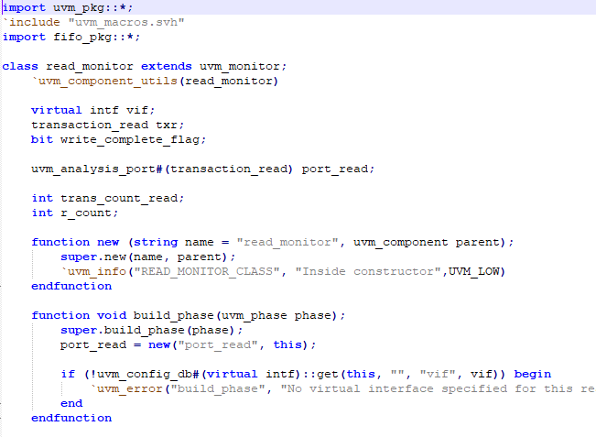
UVM based Verification
Driver
Monitor

Slide 19
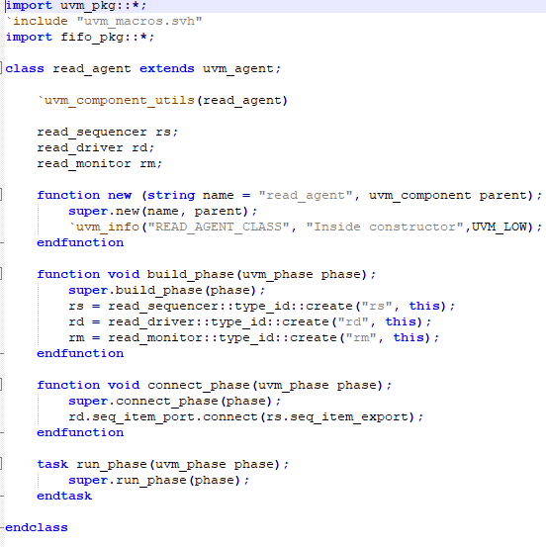
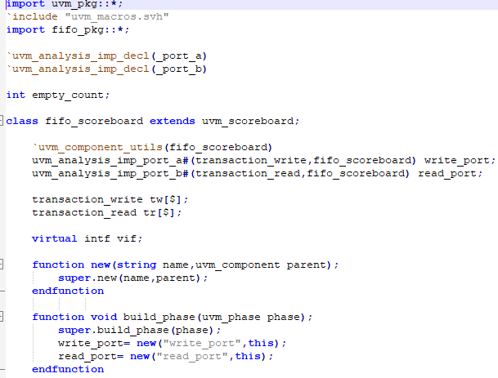
UVM based Verification
Agent
Scoreboard

Slide 20
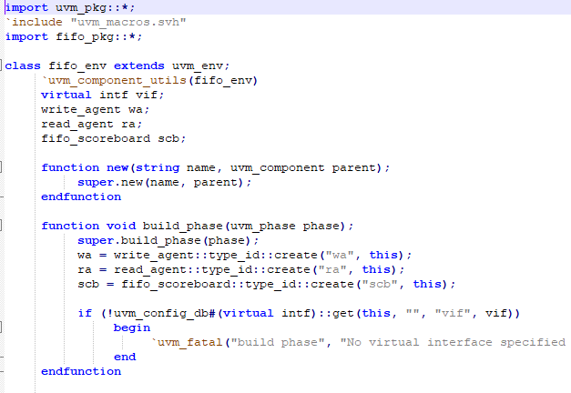
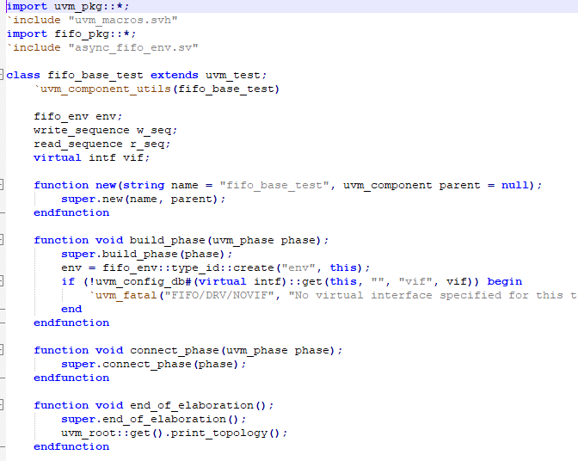
UVM based Verification
Environment
Test

Slide 21
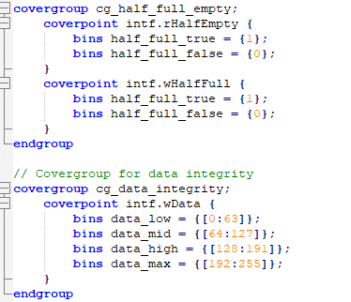
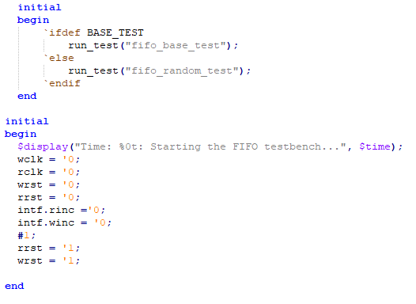
UVM based Verification
Coverage
Top

Slide 22
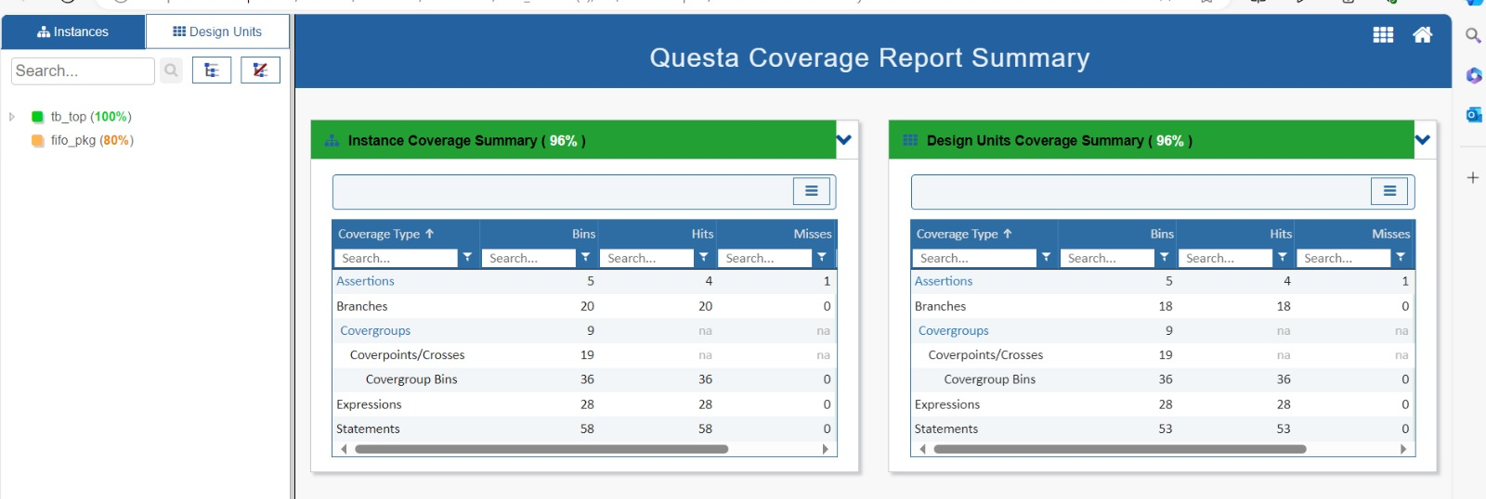
Test Scenarios and Coverage

Slide 23
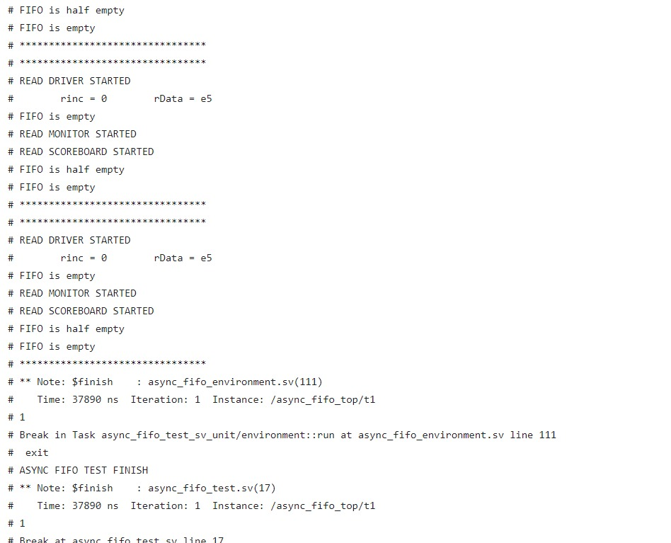
Simulation Results
SV Class based Results

Slide 24
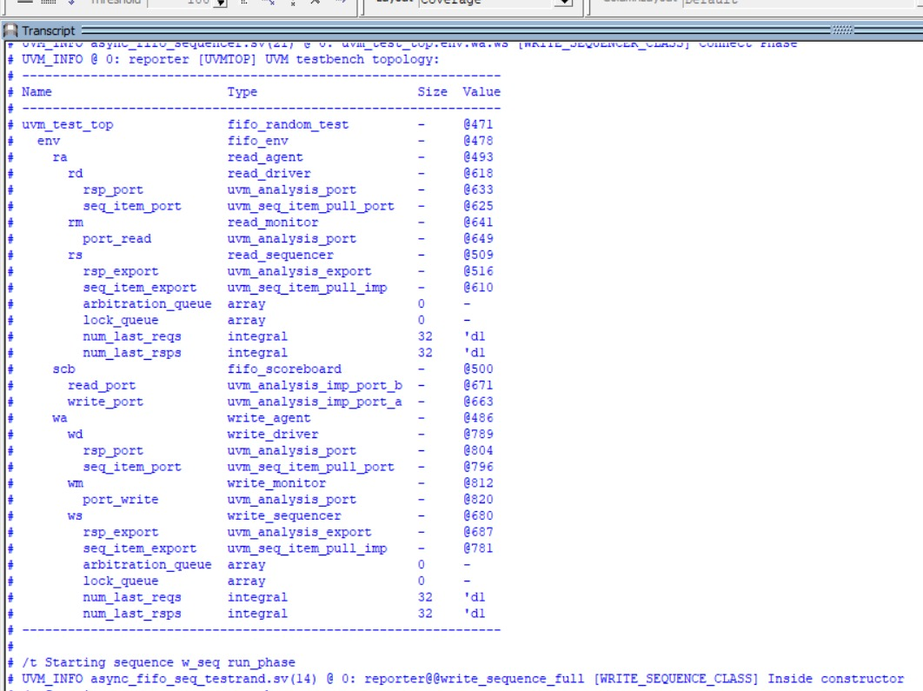
Simulation Results
UVM Results

Slide 25
Challenges faced
During our initial run, we quickly realized there was an issue. The data_out value was incorrectly received as 'x' due to an improper connection during the setup. It was disheartening to see the read address increment values being completely off.
After completing the read and write transfers, we were expecting to see the correct full and empty signals, but they just didn’t appear. Each read transfer should have allowed the system to extract the latest data from the monitor and driver, but that didn’t happen. It felt like the system was stuck, unable to update properly.
One major issue was the absence of an error detection and repair system. Without it, confirming the asynchronous FIFO accurately was impossible. We also encountered race conditions between the write and read points, which created chaos and confusion. The worst part was the system’s inability to revert to its previous working state, leaving us with a non-functional setup and a lot of frustration.

Slide 26
Conclusion
Design and verification of asynchronous FIFO using SV and UVM ensure correctness and reliability.
Techniques include code functional coverage, assertions, and meticulous design implementation.
SV and UVM facilitate modularity, reusability, and scalability in verification.
Directed testing targets critical scenarios, while random testing uncovers edge cases.
Integration of these techniques ensures the design meets requirements and operates reliably.
The coverage achieved in this project is around 96% including code and functional coverage.

Slide 27
References and Citations
1. S. Cummings, "FIFOs: Fast, predictable, and deep," in Proceedings of SNUG, 2002. [Online]. Available:http://www.sunburst-design.com/papers/CummingsSNUG2002SJ_FIFO1.pdf
2. S. Cummings, "FIFOs: Fast, predictable, and deep (Part II)," in Proceedings of SNUG, 2002. [Online]. Available: http://www.sunburst-design.com/papers/CummingsSNUG2002SJ_FIFO2.pdf
3. Putta Satish, "FIFO Depth Calculation Made Easy," [Online]. Available: https://hardwaregeeksblog.files.wordpress.com/2016/12/fifodepthcalculationmadeeasy2.pdf
4. A. Author et al., "Title of the Paper," in Proceedings of the Conference, 2015, pp. 123-456. [Online]. Available: https://ieeexplore.ieee.org/abstract/document/7237325.

Slide 28
References and Citations
5. M. Last Name et al., "Designing Asynchronous FIFO," [Online]. Available: https://d1wqtxts1xzle7.cloudfront.net/56108360/EC109-libre.pdf.
6. A. Author et al., "Title of the Paper," in Proceedings of the Conference, 2011, pp. 789-012. [Online]. Available: https://ieeexplore.ieee.org/stamp/stamp.jsp?arnumber=6041338
7. “Youtube," [Online]. Available: https://www.youtube.com/watch?v=UNoCDY3pFh0 8. Open AI, "Chat GPT," [Online].
8. [1] Chip Verify. [Online]. Available: https://www.chipverify.com

