Slide 1
Update: HO Display classification with ML
All data collected!
Data makes sense
Previous classifier replicated

Slide 2
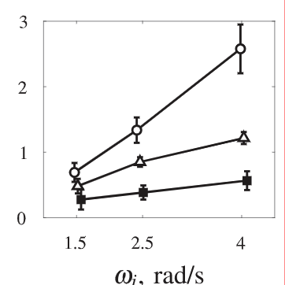
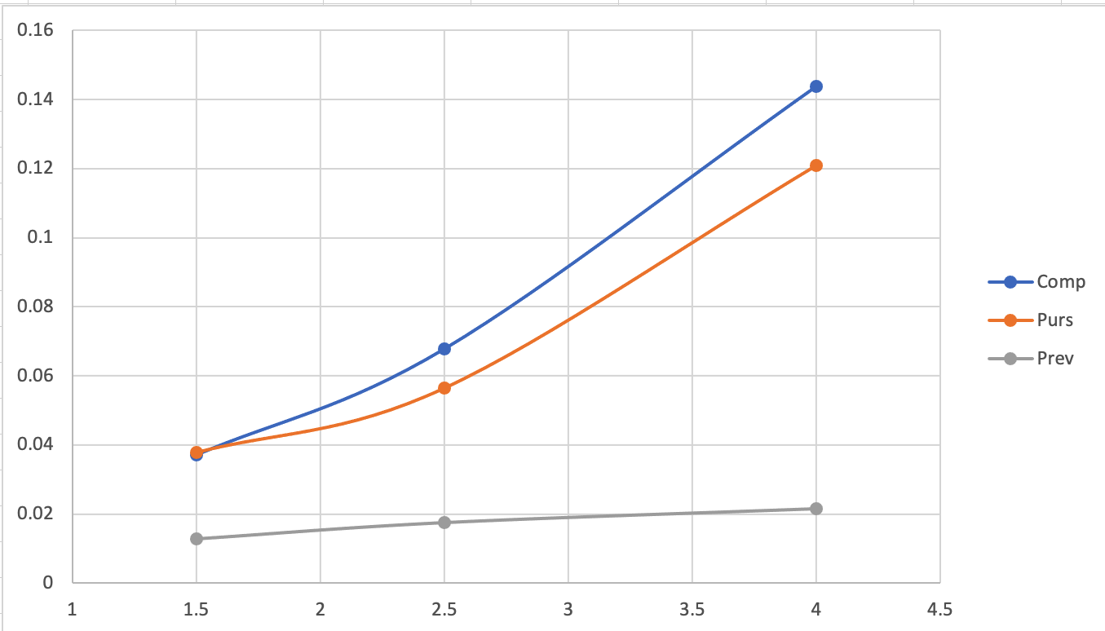
Data collected
Mean Square Error, per condition
(all runs all subjects)
All experiments completed succesfully
No problems with any subjects
Data at first glance looks good
TODO:
Process data to .mat file
Compare individual participant
Angluar frequency (rad/s)

Slide 3
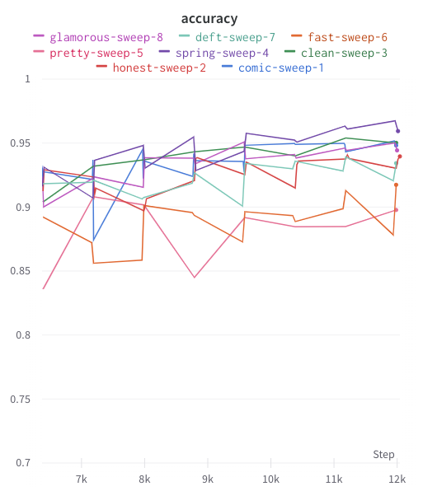
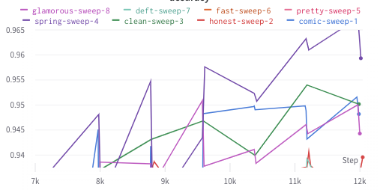
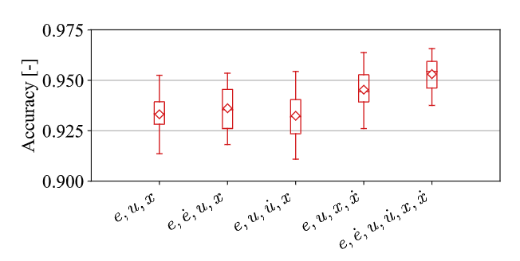
Classifier replicated, accuracies
6/8 Runs within bounds, 1 even exceeds
NB: double the sample rate

Slide 4
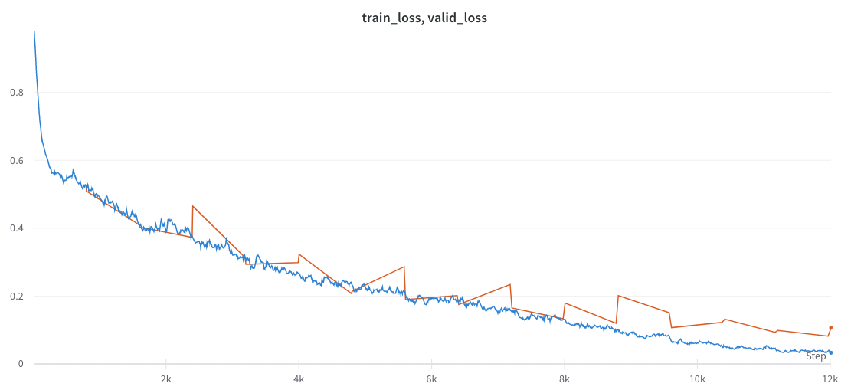
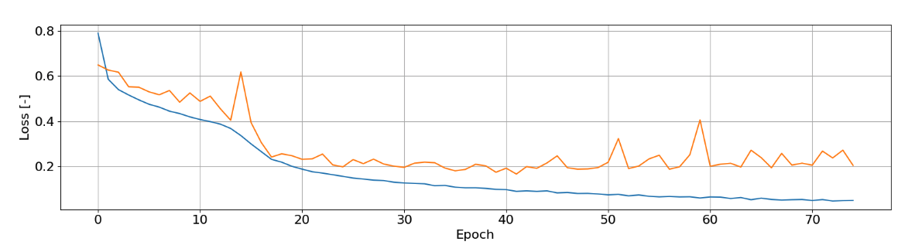
Classifier replicated 2, train and validation loss
/ 15 Epochs

Slide 5
TODO Classifier:
Rerun best parameters multiple times, for more epochs
Apply classifier to new data

