Slide 1
Transformer
Презентацию подготовил
Лопушанский Александр
Группа 7307

Slide 5
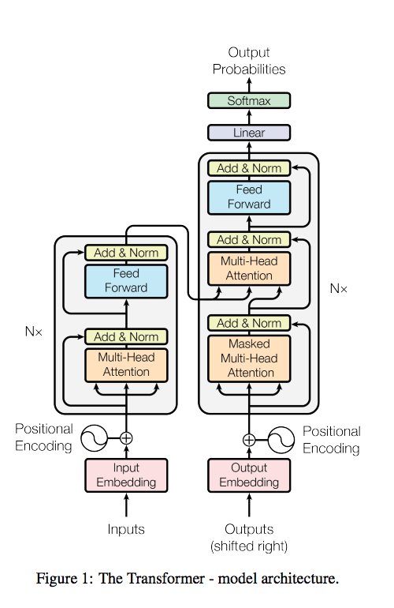

Slide 7
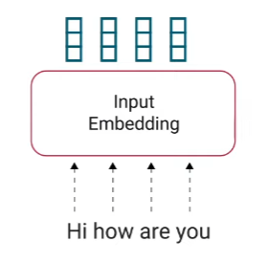
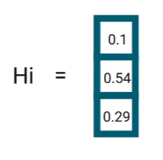
1. Input Embedding

Slide 8
1. Input Embedding

Slide 9
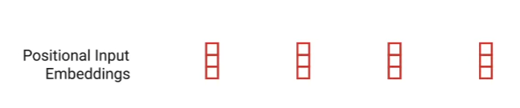
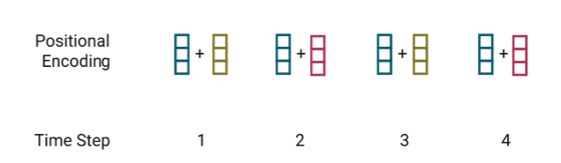
2. Positional Encoding

Slide 10
2. Positional Encoding

Slide 11
3-4. Encoder Layer

Slide 12
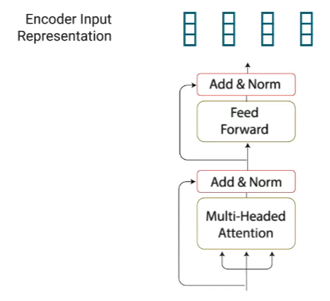
3-4. Encoder Layer

Slide 13
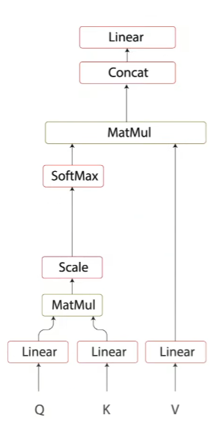
3. Multi-headed Attention
Hi
how
are
you

Slide 14
3. Multi-headed Attention
3.1. Self-Attention
Hi
how
are
you

Slide 15
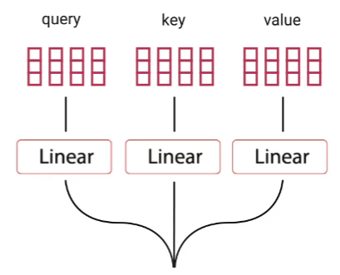
3. Multi-headed Attention
3.1. Self-Attention

Slide 16
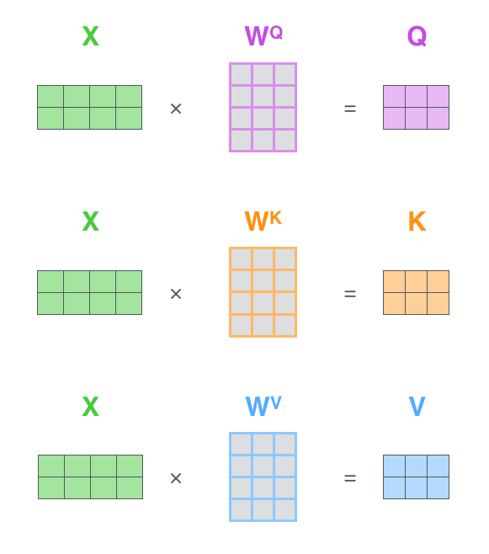

Slide 17
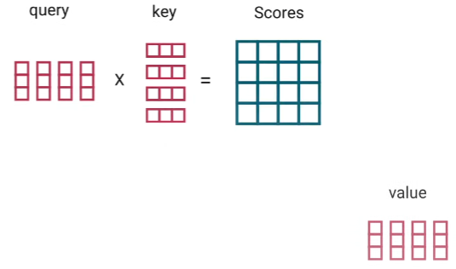
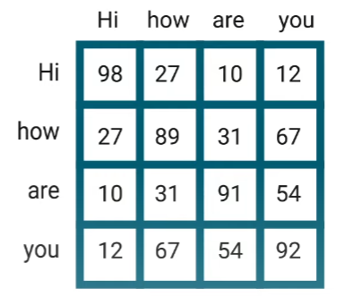
3. Multi-headed Attention
3.1. Self-Attention

Slide 18
3. Multi-headed Attention
3.1. Self-Attention

Slide 19
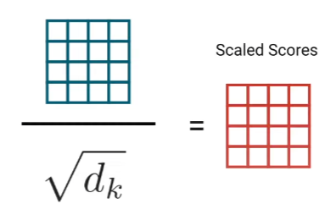
3. Multi-headed Attention
3.1. Self-Attention

Slide 20
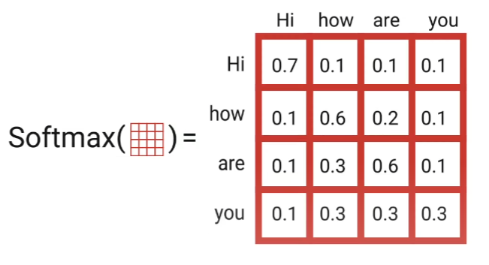
3. Multi-headed Attention
3.1. Self-Attention

Slide 21
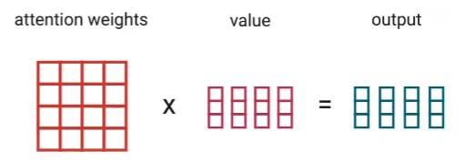
3. Multi-headed Attention
3.1. Self-Attention

Slide 22

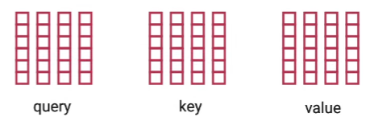
3. Multi-headed Attention

Slide 23
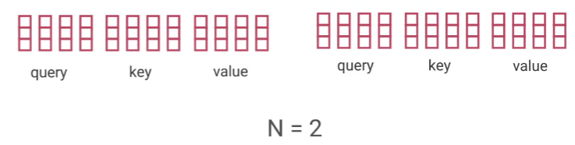
3. Multi-headed Attention

Slide 24
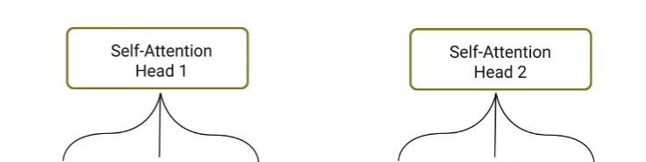
3. Multi-headed Attention

Slide 25
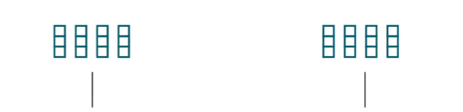
3. Multi-headed Attention

Slide 26
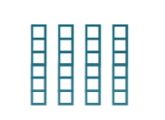
3. Multi-headed Attention

Slide 27
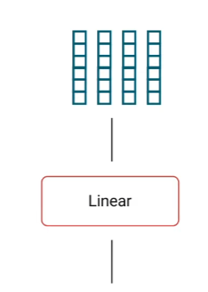
3. Multi-headed Attention

Slide 28
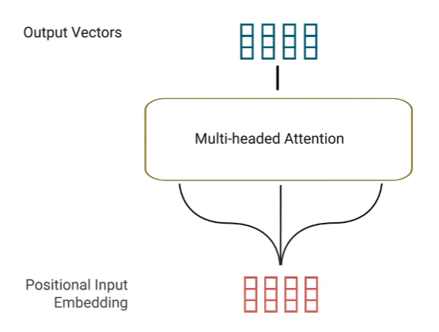
3. Multi-headed Attention

Slide 29
4. Residual Connection, Layer Normalization & Pointwise Feed Forward

Slide 30
4. Residual Connection, Layer Normalization & Pointwise Feed Forward

Slide 31
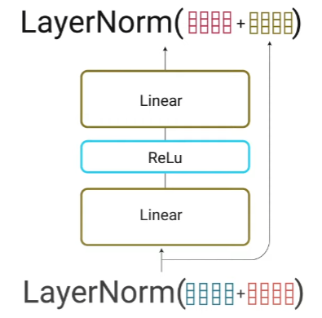
4. Residual Connection, Layer Normalization & Pointwise Feed Forward

Slide 32
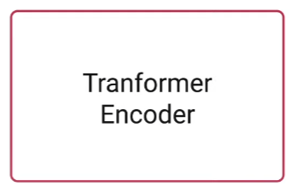

Slide 35
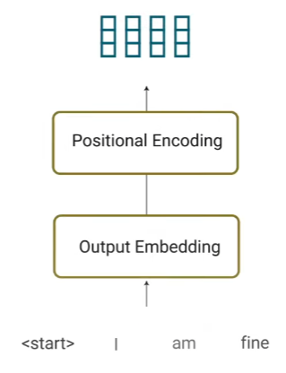
5. Output Embedding & Positional Encoding

Slide 36
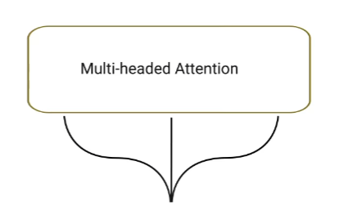
6. Decoder Multi-Headed Attention

Slide 37
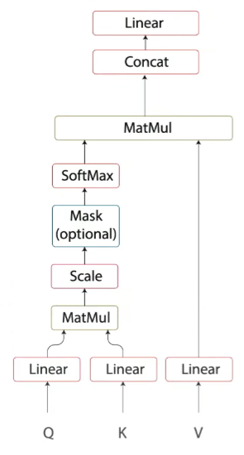
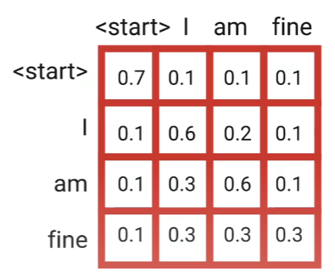
6. Decoder Multi-Headed Attention

Slide 38
6. Decoder Multi-Headed Attention

Slide 39
6. Decoder Multi-Headed Attention

Slide 40
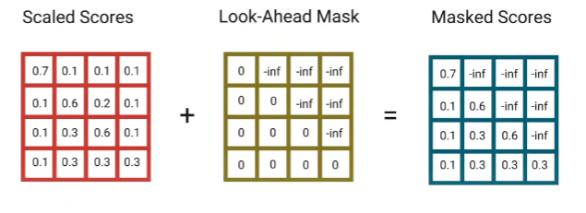
6. Decoder Multi-Headed Attention
6.1. Look-Ahead Mask

Slide 41
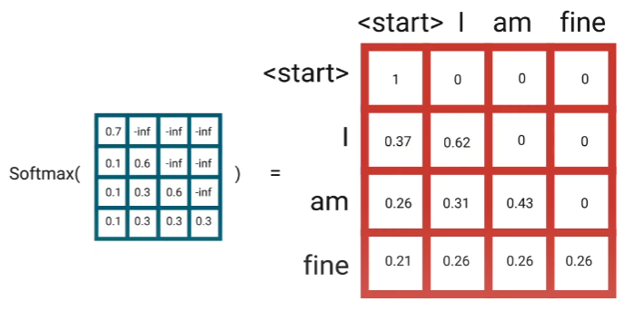
6. Decoder Multi-Headed Attention
6.1. Look-Ahead Mask

Slide 44
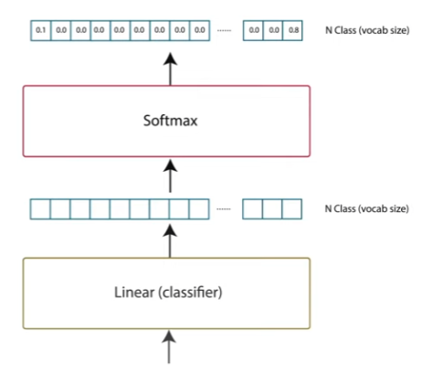
7. Linear Classifier

