Slide 1









Health Data Healers (HDH)
Sara Yavari
Taraka Paruchuru
Zeeshan Mawani
Sashank Makanaboyina
Online News Popularity

Slide 2
Introduction
We focus on the Online News Popularity dataset which offers a valuable resource for research and academic purposes.
The primary objective is to predict the number of shares in social networks (popularity) as a regression problem.
In regression, the goal is to predict a continuous variable (in this case, the number of shares) based on other features in the dataset.
Health Data Healers (HDH)
Sara Yavari
Taraka Paruchuru
Zeeshan Mawani
Sashank Makanaboyina
Data Science Wheel

Slide 3
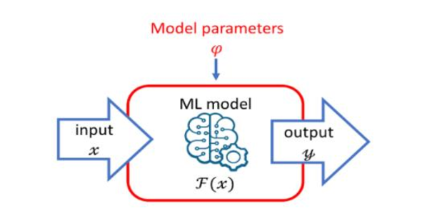
Problem Statement
Predicting the popularity of articles published by Mashable using the Online News Popularity dataset.
Data Science Wheel

Slide 4
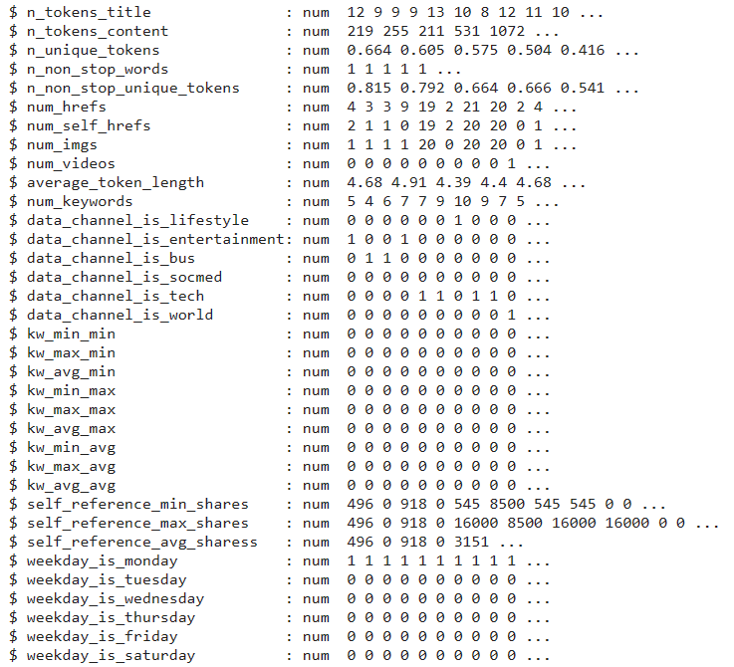

Data Description
The dataset encompasses metadata for around 39,000 articles published by Mashable over a span of two years.
This wealth of data allows for an extensive exploration of online content and engagement.
We have a heterogeneous set of features, including 61 attributes which provides a comprehensive view of each article.
For example, we have details on the title and content's word count, the number of unique and continuous words, the number of links, photos, and videos, as well as the subjectivity and sentiment polarity of the text.
Data Science Wheel

Slide 6
Data Preprocessing
Main Steps Taken:
Filtered out data to remove extraneous columns (url, timedelta)
Dropped necessary columns based on the correlation metrics and VIF values
Log transformation of necessary columns based on residual analysis
Created interaction appropriate terms between n_unique_tokens and n_non_stop_unique_tokens
Used stepwise regression to select all significant independent variables
Data Science Wheel
Notes:
Filtered out data to contain URL which have content – We mean to say that we are removing rows based the the n_tokens_content column. Which tells us the number of tokens in a url and if its zero it means that the url has no content
Removed IV’s based on Correlation values >0.9 and VIF values greater than >10

Slide 7
Simple Model
Used 43 Independent variables to create a simple model
Statistical Significance: The analysis yielded a low p-value and a F statistic of 16.41, indicating the statistical significance of the results.
Model's Explained Variability: The adjusted R-squared value of 0.01655 suggests that the model explains a modest proportion of the variability in the number of shares an article receives.
Notably, elements like the number of links in the article, the presence of images, and certain types of content (like lifestyle, entertainment, business, social media, technology, and world news) significantly affect how often an article is shared. Surprisingly, the day of the week when the article is published doesn't seem to have a strong impact on shares.
Data Science Wheel

Slide 8
Data Science Wheel

Slide 9
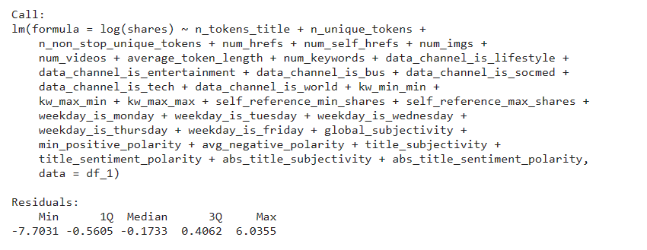

Variable Transformation
Log Transformation of the dependent variable “shares” based on residual analysis
Improved Model Performance: The final model, which used a logarithmic transformation for the dependent variable, showed an improved adjusted R-squared value of 0.09234. This indicates a better fit and explanation of the variability in article shares compared to the initial model.
Higher F Statistic: The increase in the F statistic to 94.16 suggests that the model's predictors are collectively significant in explaining the variability in the number of shares an article receives.
Data Science Wheel
Notes:
n_non_stop_unique_tokens,shares we have performed log transformation to reduce the hetrosadaticity
Interaction Term: n_unique_tokens * data1$n_non_stop_unique_tokens

Slide 10
Step Wise Model
Backward AIC step wise regression model was performed to the select features which are the most significant
From a total of 43 independent variables, we went down to 33 variables based on t test with an alpha value of 0.05
This improved the adjusted R-Squared value improved by 4 percent.
Data Science Wheel

Slide 11
Regularization
Feature Selection in Lasso: The Lasso model is effective in selecting the most important features, reducing the coefficients of less important ones to zero, which aids in feature selection and model simplicity.
Mean Squared Error (MSE): The model has a MSE of 0.7769744, indicating the average squared difference between the estimated values and the actual value.
Root Mean Squared Error (RMSE): The RMSE of the model is 0.8814615.
Data Science Wheel
R-squared Value: With an R-squared value of 0.09286953 (an increase of 0.0004 over stepwise), the model explains about 9.29% of the variability in the dependent variable, which is still bad!
Notes:
Ridge 0.059, Lasso 0.09286 and elastic net 0.09281

Slide 12
Logistic Regression
Since we didn’t achieve a good Adjusted R Squared value even after regularization. And to create a business case for our model, we create a new dependent variable called engagement
Engagement Column is derived from the previous share's column where the data below the median of 1400 is considered as Low Engagement and shares above the median is taken as High Engagement
Accuracy: ~63%.
Precision: ~61%.
Sensitivity: ~63%.
F1-score: 62%.
Accuracy: The model has an accuracy of 62.42%, predicting engagement levels correctly for approximately 62% of the articles.
Sensitivity - The model's ability to capture "high engagement" instances which is 62.57%. This means the model successfully identifies about 62.57% of all articles that truly have "high engagement.“
The Specificity is approximately 62.29%. This means the model is about 62.29% accurate in correctly identifying articles with "low engagement" among all the instances that are actually "low engagement
Mean Squared Error (MSE): The MSE is 0.2269
Root Mean Squared Error (RMSE): With an RMSE of 0.4763
Data Science Wheel
Notes:
You have to say these metrics were cross validated. Recall: Focuses on the model's ability to capture all positive cases, minimizing false negatives.
Precision: Focuses on the model's ability to avoid falsely labeling negative cases as positive, minimizing false positives.

Slide 13
Results
Cross-Validation Method: The results were obtained using a 5-fold cross-validation approach, which helps in assessing the model's robustness and consistency across different subsets of the data.
Training Set Performance:
Correctly identified 8,980 low engagement articles.
Correctly identified 8,149 high engagement articles.
Misclassified 5,055 articles as high engagement.
Misclassified 4,741 articles as low engagement
Test Set Performance
Correctly identified 3,800 low engagement articles.
Correctly identified 3,482 high engagement articles.
Misclassified 2,226 articles as high engagement.
Misclassified 2,030 articles as low engagement.
Data Science Wheel
Accuracy: ~63%.
Precision: ~61%.
Sensitivity: ~63%.
F1-score: 62%.
Notes:
You say these performance metrics have come from the confusion metrics
Interpretation: High precision indicates that an algorithm returned substantially more relevant results than irrelevant ones. It’s particularly important in scenarios where false positives are more costly than false negatives.
High recall indicates that an algorithm returned most of the relevant results. It is crucial in situations where missing a positive instance is more detrimental than mistakenly labeling negative instances as positive.

Slide 14
Take Home & Future Work
Word Count in Title: Titles with 7-13 words are indicative of higher engagement levels in articles.
Weekend Publishing: Articles published on weekends, particularly on Sundays, tend to have significantly lower engagement.
Robust Model Recommendation: There's a suggestion to develop a more robust model that considers data points within the Interquartile Range (IQR) to improve reliability
Data Quality Issue: The presence of articles with 0 n_tokens_content but actual content suggests we could create a script to scrap the data from these urls to fill the missing data
Data Science Wheel

Slide 15

Trivia
Why did the data scientist break up with the statistician?
Because every time they met, the statistician just couldn't stop bringing up their "significant" other

