Slide 1

ZeroShield AI: An Explainable Framework for Zero-Day Threat Detection
Project Phase-1 19EAC498
EVALUATION 1
Presented by:
Sarah Thomas-BL.EN.U4EAC23049
Samvrudha RR-BL.EN.U4EAC23052
Sashank Abburru-BL.EN.U4EAC23053
Guided by:
Dr. Susmitha Vekkot

Slide 2
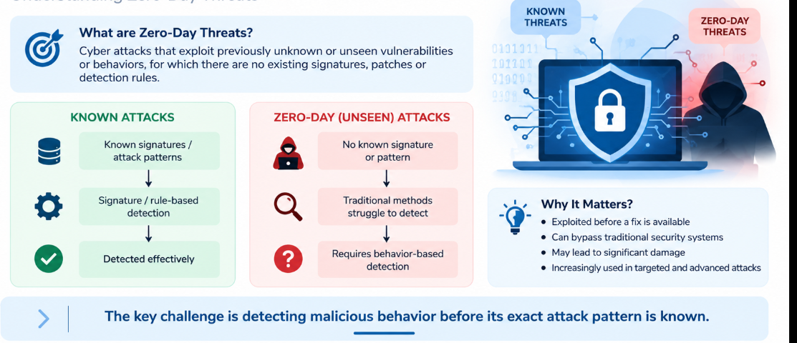
Introduction

Slide 3
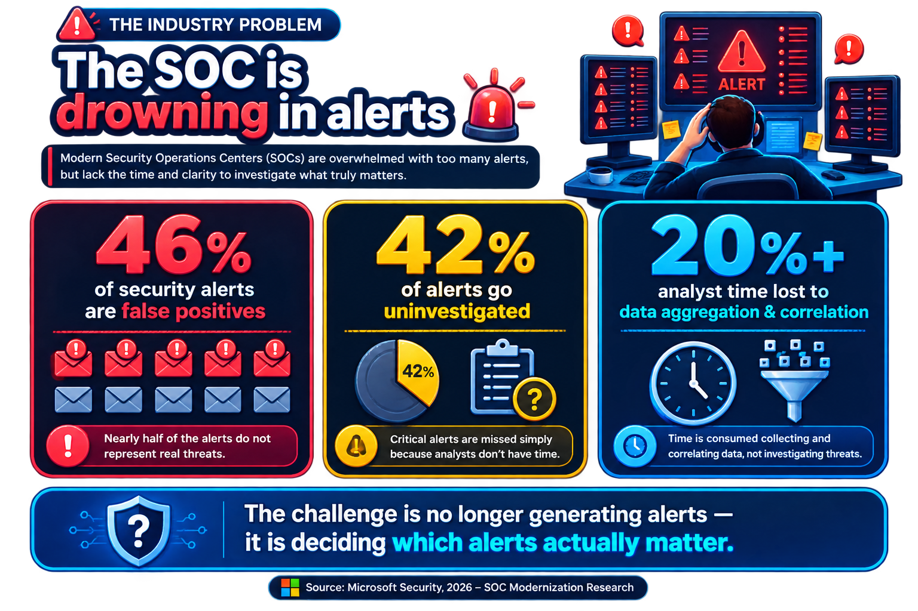
THE INDUSTRY PROBLEM
WHY IT MATTERS
Too many alerts
↓
Limited analyst attention
↓
Important threats can be missed
The real challenge is not alert generation — it is prioritizing and understanding the alerts that matter.

Slide 4
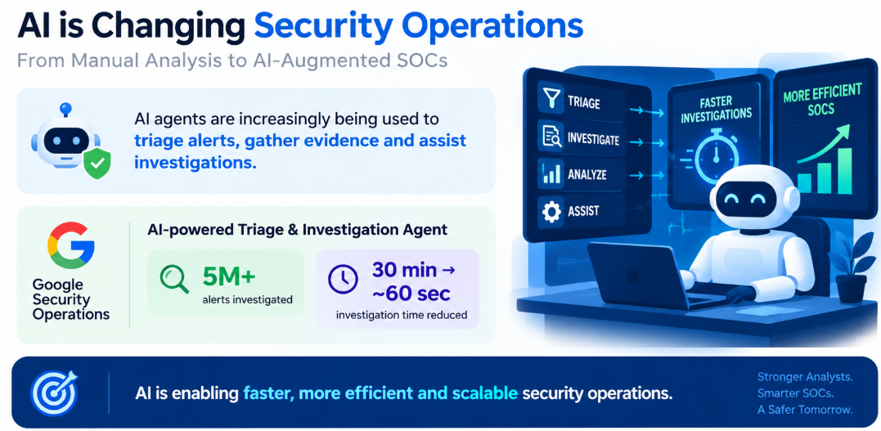
AI is Changing Security Operations

Slide 5

Can We Trust the AI's Verdict?”

Slide 6
Motivation
Detect
Detect unseen attack behaviors
Reduce
Reduce SOC alert overload & false positives
Make
Make AI-generated security reasoning trustworthy
Provide
Provide evidence-backed security decisions

Slide 7
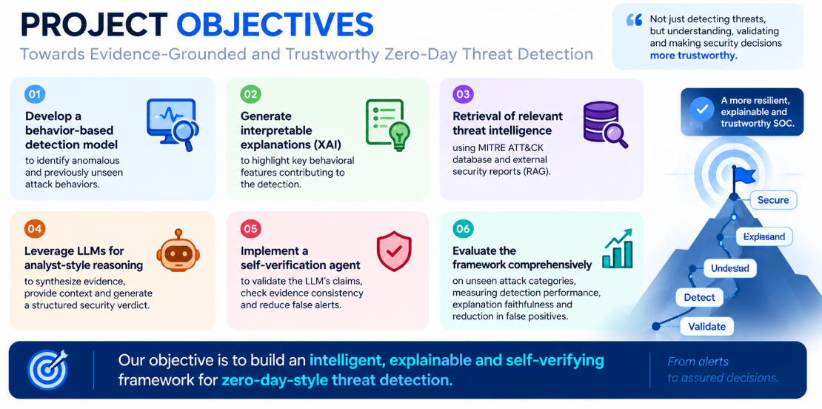

Slide 8
Literature Survey & Summary
Paper details | Problem | What is it doing? | How is it doing it? | Result | Research Gap
M. Lisha, V. Agarwal, S. Kamthania, P. Vutkur, and M. S. Chari, “Benchmarking LLM for zero-day vulnerabilities,” in Proc. 2024 IEEE Int. Conf.Electronics, Computing and Communication Technologies (CONECCT), Bengaluru, India, 2024, pp. 1–6, doi:10.1109/CONECCT62155.2024.10677338. | Detecting zero-day vulnerabilities that are not available in conventional CVE/NVD databases. | Benchmarks GPT-3, T5, BERT and XLNet for vulnerability detection and generation of mitigation recommendations. | Fine-tunes the models using the CISA 2022 vulnerability dataset and evaluates them through unstructured queries, threat analysis and semantic search. | GPT-3 and T5 performed best, especially for unrecorded/zero-day vulnerabilities; BERT and XLNet performed comparatively weaker. | Limited hardware and computational resources; needs better scalability, continual learning, robustness and explainability for evolving threats.

Slide 9
Literature Survey & Summary
Paper details | Problem | What is it doing? | How is it doing it? | Result | Research Gap
Enhancing network security through deep learning: Mitigating feature engineering and zero-day attacks,” inProc. 4th Int. Conf. Intelligent Cybersecurity (ICSC), Valencia, Spain, 2024, pp. 127–131, doi: 10.1109/ICSC63108.2024.10895964. | Traditional IDS relies on handcrafted features, which are time-consuming, require expert knowledge and may fail against unseen/zero-day attacks. | Uses raw network traffic flows to detect malicious traffic, classify malware and identify unseen attacks without manual feature engineering. | Converts PCAP traffic into sessions/flows, represents bytes numerically, selects the first two packets and feeds them to a 1D-CNN. Zero-day detection is simulated by excluding one malware class during training and testing on it. | 100% malicious-traffic detection, 97% classification of 10 malware types, and 99.6% detection on malware from a separate dataset. | Needs validation on larger and more diverse network conditions. Real-time deployment, scalability and integration with real-time detection/response systems remain open.

Slide 10
Literature Survey & Summary
Paper details | Problem | What is it doing? | How is it doing it? | Result | Research Gap
C. K. Sruthi, A. Ravikumar, and H. Sriraman, “Enhancing zero-day attack detection with XAI-driven ML models and SMOTE analysis,” in Proc. 3rdInt. Conf. Artificial Intelligence for Internet of Things (AIIoT), 2024, pp. 1–5, doi: 10.1109/AIIoT58432.2024.10574566. | Detecting zero-day attacks in IoT networks, where attack patterns are absent from the training data. Also addresses class imbalance and lack of model interpretability. | Compares ML/DL models for binary and multiclass zero-day attack detection, while using XAI to understand which features influence predictions. | Uses BoT-IoT, applies SMOTE to balance classes, trains multiple ML/DL models, and uses SHAP to explain important features contributing to predictions. | CNN performed best for binary unknown-attack detection: 99.95% / 98.53%. However, multiclass detection remained difficult, especially for unseen Service Scan and Fingerprinting attacks. | Multiclass zero-day detection still needs improvement. Requires better generalization to unseen attack types, and the authors suggest grouping similar attacks and using XAI to improve/retrain models.

Slide 11
Literature Survey & Summary
Paper details | Problem | What is it doing? | How is it doing it? | Result | Research Gap
B. E. Özkan and İ. B. Tolga, “Zero-day operational cyber readiness,” in Proc. 15th Int. Conf. Cyber Conflict: Meeting Reality (CyCon), Tallinn,Estonia, 2023, pp. 199–215, doi: 10.23919/CyCon58705.2023.10181814. | Detecting zero-day attacks in IoT networks, where attack patterns are absent from the training data. Also addresses class imbalance and lack of model interpretability. | Proposes a Zero-Day Readiness model to evaluate and improve an organization's ability to detect, respond to and recover from emerging cyber threats. | Builds readiness around resilience, detection, response, recovery, threat hunting, training, automation and offensive testing/red-teaming. | Emphasizes that detection and response capability, rather than only preventive security, is essential for zero-day readiness. | It is primarily a strategic/operational framework, not an end-to-end AI-based zero-day detection system. It leaves scope for automated, AI-driven detection, response and real-time implementation.

Slide 12
Literature Survey & Summary
Paper details | Problem | What is it doing? | How is it doing it? | Result | Research Gap
Pooja N. G., Vijayalakshmi A. Lepakshi, Kavitha M., Monika M., and Deeksha, “A review of unsupervised learning techniques for zero-day attack detection,” in Proc. 3rd Int. Conf. Innovations in Cybersecurity and Data Science (ICICDS), 2026. | Traditional signature-based and supervised methods struggle with unknown attacks because there are no signatures or training samples for new attack types. | Reviews existing unsupervised learning techniques for zero-day attack detection and organizes them into a structured taxonomy. | Analyzes One-Class Classification, Autoencoder-based Deep Learning, and Ensemble/Hybrid approaches, along with network-, host- and log-based detection methods. | Unsupervised methods can identify unknown/anomalous behavior without predefined attack signatures and show strong potential for zero-day detection. | Challenges remain in scalability, accuracy, false positives, limited datasets, real-time detection and adaptability. Future work should focus on adaptive, continual, hybrid and automated AI-based systems.

Slide 13
Literature Survey & Summary
Paper details | Problem | What is it doing? | How is it doing it? | Result | Research Gap
I. El Didi, F. Trad, and A. Chehab, “Enhancing network security through deep learning: Mitigating feature engineering and zero-day attacks,” inProc. 4th Int. Conf. Intelligent Cybersecurity (ICSC), Valencia, Spain, 2024, pp. 127–131, doi: 10.1109/ICSC63108.2024.10895964. | Traditional IDS relies on handcrafted features, which are time-consuming, require expert knowledge and may fail against unseen/zero-day attacks. | Uses raw network traffic flows to detect malicious traffic, classify malware and identify unseen attacks without manual feature engineering. | Converts PCAP traffic into sessions/flows, represents bytes numerically, selects the first two packets and feeds them to a 1D-CNN. Zero-day detection is simulated by excluding one malware class during training and testing on it. | 100% malicious-traffic detection, 97% classification of 10 malware types, and 99.6% detection on malware from a separate dataset. | Needs validation on larger and more diverse network conditions. Real-time deployment, scalability and integration with real-time detection/response systems remain open.

Slide 14
Literature Survey & Summary
Paper Details | Problem | What is it doing? | How is it doing it? | Result | Research Gap
H. Teymourlouei, D. Stone, and L. Jackson, “Identifying zero-day attacks with machine learning and data reduction methods,” in Proc. 2023Congress in Computer Science, Computer Engineering, & Applied Computing (CSCE), Las Vegas, NV, USA, 2023, pp. 2285–2290, doi:10.1109/CSCE60160.2023.00372. | Zero-day attacks are difficult to detect because their behavior is previously unknown and generates large volumes of network events. | It uses data reduction and deep-learning classification to identify suspicious events and reduce the workload for security analysts. | It uses statistical event reduction and a neural network with SGD, trained using the MTA-KDD dataset and network traffic features. | Data reduction decreased 1,924 events to 20, while the deep-learning model achieved over 97% accuracy but still produced false positives | It lacks threat contextualization, explainable evidence, LLM-based reasoning, and automated verification of security decisions.

Slide 15
Literature Survey & Summary
Paper Details | Problem | What is it doing? | How is it doing it? | Result | Research Gap
S. Mohanta, S. K. Mohapatra, R. K. Mohanta, S. Tewary, S. Bharadwaj, and S. Chakravarty, “An adaptive framework with optimized machine learning models for real-time zero-day cyber threat detection,” in Proc. 1st Int. Conf. Intelligent Computing, Networks and Security (IC-ICNS), 2026,doi: 10.1109/IC-ICNS68863.2026.11537623. | The paper addresses the challenge of detecting previously unseen zero-day threats that can bypass traditional signature-based security mechanisms. | It develops an optimized ML framework using CIC-Darknet2020 to classify suspicious darknet network traffic. | It combines multiple ML classifiers with Optuna hyperparameter optimization and voting/stacking ensemble techniques. | The stacking ensemble achieved 98.36% accuracy, demonstrating strong performance in zero-day threat classification. | It focuses on detection accuracy but lacks behavioral explainability, threat-intelligence context, and self-verification of security verdicts.

Slide 16
Literature Survey & Summary
Paper Details | Problem | What is it doing? | How is it doing it? | Result | Research Gap
R. Kalakoti, S. Nõmm, and H. Bahsi, “In-depth feature selection for the statistical machine learning-based botnet detection in IoT networks,”IEEE Access, vol. 10, pp. 94518–94535, 2022, doi: 10.1109/ACCESS.2022.3204001. | IoT botnet detection can involve many features, increasing computational cost and potentially reducing detection efficiency. | It identifies optimal feature subsets for binary and multiclass botnet detection across IoT datasets. | It compares filter/wrapper feature-selection methods with Decision Tree, Random Forest, Extra Trees and k-NN classifiers. | The study achieved over 99% detection performance using a substantially reduced number of features. | It focuses on feature selection and classification, without threat contextualization, LLM reasoning, or evidence-based verification.

Slide 17
Literature Survey & Summary
Paper Details | Problem | What is it doing? | How is it doing it? | Result | Research Gap
M. Arul, R. Kishore Kumar, S. Santhosh, M. Boomika, J. Bhavana Shree, and K. Shree Durga, “A multi-model deep learning approach for advanced cybersecurity threat detection,” in Proc. 2nd Int. Conf. Multi-Agent Systems for Collaborative Intelligence (ICMSCI), 2026, pp. 386–391,doi: 10.1109/ICMSCI67830.2026.11469498. | Traditional IDS approaches struggle with complex, multi-stage and previously unseen attacks due to limited spatial and temporal understanding. | It proposes a hybrid Autoencoder + Capsule Network + Transformer architecture for advanced threat detection. | The Autoencoder detects anomalies, CapsNet captures hierarchical patterns, and the Transformer learns temporal dependencies before adaptive fusion. | The framework achieved above 98% accuracy, with reported zero-day detection performance of approximately 92–96%. | It improves detection but lacks external threat context, LLM-based reasoning, and a dedicated mechanism for verifying generated security decisions.

Slide 18
Literature Survey & Summary
Paper Details | Problem | What is it doing? | How is it doing it? | Result | Research Gap
S. Subash Chandra Bose, V. Shanmugapriya, N. Mahadev, M. Pyingkodi, R. Natarajan, and N. Thangarasu, “AI-driven cybersecurity defense for military networks,” in Proc. 2025 IEEE Int. Conf. Women in Innovation, Technology & Entrepreneurship (ICWITE), 2025, pp. 1–6, doi:10.1109/ICWITE64848.2025.11307120. | Military networks face adaptive and sophisticated cyberattacks requiring autonomous detection and rapid defensive responses. | It proposes an Adaptive Autonomous Cyber Defense System (AACDS) combining detection, zero-day identification and automated response. | It integrates Isolation Forest, few-shot learning, DQN reinforcement learning, federated learning and XAI. | AACDS achieved 99.40% accuracy, 97.70% precision, 97.63% recall and 96.20% F1-score, with reduced response time. | Although it includes XAI and autonomous response, it lacks RAG-based threat contextualization and evidence-grounded self-verification.

Slide 19
Literature Survey & Summary
Paper | Problem | What is it doing? | How is it doing it? | Result | Research Gap
J. Roy and S. K. Singh, “AgentSOC: A multi-layer agentic AI framework for security operations automation,” in Proc. 2026 IEEE 5th Int. Conf. AI inCybersecurity (ICAIC), Houston, TX, USA, 2026, pp. 1–7, doi: 10.1109/ICAIC67076.2026.11395783. | SOCs face massive alert volumes, difficulty correlating multi-stage attacks, and difficulty selecting safe responses; existing SIEM/SOAR/LLM systems still depend heavily on human analysts. | Proposes an agentic AI framework that automates alert enrichment, attack-intent reasoning, feasibility checking, and risk-aware response selection. | Uses a Narrative Counterfactual Engine for attack hypotheses, Structural Simulation Engine for validating attack paths against network topology, and Risk Scoring & Evaluation Module for selecting safe responses. | The LANL-based POC achieved 506 ms runtime, reduced manual triage, filtered infeasible LLM outputs, and improved reasoning about attacker intent. | Evaluation was limited to a fixed LANL dataset and a 50-node simulated enterprise; responses were only tested in dry-run mode, with rule-based ATT&CK mapping and simplified business-impact scoring.

Slide 20
Literature Survey & Summary
Paper | Problem | What is it doing? | How is it doing it? | Result | Research Gap
T. Zebin, S. Rezvy, and Y. Luo, “An explainable AI-based intrusion detection system for DNS over HTTPS (DoH) attacks,” IEEE Trans. Inf. ForensicsSecurity, vol. 17, pp. 2339–2349, 2022, doi: 10.1109/TIFS.2022.3183390. | DNS over HTTPS encrypts DNS traffic, making it difficult for network administrators to detect malicious DNS tunneling and DoH-based attacks. | Develops an explainable intrusion detection system capable of detecting and classifying malicious DoH traffic while showing why the model made its decision. | Uses the CIRA-CIC-DoHBrw-2020 dataset, a balanced stacked Random Forest classifier, and SHAP to identify the contribution of individual features to each prediction. | Achieved 99.91% precision, 99.92% recall and 99.91% F1-score, while distinguishing DoH traffic from normal HTTPS with about 99.9% accuracy; SHAP provided feature-level explanations. | The system mainly distinguishes browser-based DoH traffic and was evaluated on one public dataset; future work needs to handle DoH generated by other applications, DGA/botnet-based DoH, and deep neural network models.

Slide 21
Literature Survey & Summary
Paper | Problem | What is it doing? | How is it doing it? | Result | Research Gap
K. Ahi and S. Valizadeh, “Large language models (LLMs) and generative AI in cybersecurity and privacy: A survey of dual-use risks, AI-generatedmalware, explainability, and defensive strategies,” arXiv preprint arXiv:2607.06963, 2026. | LLMs create a dual-use problem in cybersecurity: they can improve threat detection and defense but can simultaneously be abused to generate malware, discover vulnerabilities, and automate attacks. | Provides a broad survey of LLM/GenAI applications, risks, explainability, zero-day detection, DevSecOps, federated learning, synthetic content, and defensive strategies. | Reviews 70+ academic papers, industry reports, technical documents, and real-world case studies covering platforms such as Microsoft Defender, Google Play Protect, AWS, GitHub and others. | The survey identifies both defensive and offensive capabilities of GenAI and recommends watermarking, adversarial defense, explainability, responsible deployment, and cross-industry collaboration. | Since this is a survey rather than a new detection system, it does not provide a single experimentally validated cybersecurity architecture.

Slide 22
Literature Survey & Summary
Paper | Problem | What is it doing? | How is it doing it? | Result | Research Gap
M. Niveditha, M. D. Swetha, M. Siva Rama Krishna, S. Rashmi, B. Pallavi, and M. Lakshmi Neelima, “Smart cyber threat intelligence system forautonomous threat aggregation and reporting,” in Proc. 2026 Int. Conf. AI-Driven Innovations & Applications (IC-AIDA), 2026, doi: 10.1109/IC-AIDA68291.2026.11564311. | Traditional CTI platforms depend on signature-based feeds and delayed indicator distribution, making it difficult to process the huge volume of rapidly changing and unstructured threat information. | Develops an AI-powered CTI system that automatically aggregates threats, correlates vulnerabilities, prioritizes severity, recommends mitigation, and generates structured intelligence reports. | Combines real-time OSINT/API data with a multi-agent architecture using specialized agents for threat analysis, CVE research, incident response and report generation, using CrewAI, LangChain and Llama 3.1 | The system produced timely threat assessments, prioritized recommendations and professional Markdown/PDF CTI reports while reducing manual analysis and improving early threat visibility. | The system still needs stronger adaptive learning and continuous adaptation to evolving attacks.

Slide 23
Literature Survey & Summary
Paper | Problem | What is it doing? | How is it doing it? | Result | Research Gap
M. Yadav, “The role of large language models in cybersecurity: Strengths, vulnerabilities, and mitigation strategies,” in Proc. 3rd Int. Conf.Sustainable Computing and Smart Systems (ICSCSS), 2025, pp. 1983–1990, doi: 10.1109/ICSCSS64956.2025.11500704. | Conventional rule/signature-based cybersecurity struggles with evolving threats such as zero-days and polymorphic malware, while LLM-based systems themselves introduce risks such as prompt injection, model inversion, data leakage and bias. | Examines the benefits, vulnerabilities and mitigation strategies associated with using LLMs for threat detection, malware/phishing detection, incident response and SOC automation. | Analyzes approaches including transfer learning, fine-tuning, adversarial training, XAI, privacy protection and hybrid AI architectures to improve robustness and security. | The study concludes that LLMs can improve automated detection and response, but secure deployment requires stronger adversarial robustness, privacy protection, interpretability and hybrid AI approaches. | There is a need for benchmarking across diverse environments, integration with live SOC infrastructure, adversarial stress testing, cybersecurity-specific LLMs, reinforcement-learning-based response and better LLM explainability.

Slide 24
Literature Survey & Summary
Paper | Problem | What is it doing? | How is it doing it? | Result | Research Gap
Y. Ma, G. Zeng, P. Zhang, Y. Huang, F. Zhang, R. Lin, and H. Qian, “TrapLLM: An LLM-powered interactive log-based honeypot for real-worldnetwork attacks,” in Proc. 2025 IEEE 24th Int. Conf. Trust, Security and Privacy in Computing and Communications (TrustCom), 2025, pp. 1578–1585, doi: 10.1109/TrustCom66490.2025.00183. | Traditional honeypots rely heavily on static responses and struggle to capture sophisticated, evolving attacks; heterogeneous honeypot logs also make attacker-intent analysis difficult. | Proposes TrapLLM, an adaptive LLM-powered honeypot that analyzes attacker behavior, reconstructs attack chains, recognizes intent and dynamically generates deceptive responses. | Uses RAG, LLM-based intent recognition, semantic association, multi-turn context tracking, adaptive response generation and dynamic traffic shaping to modify deception according to attacker behavior. | In a 25-day real-world deployment, it captured 1.39 million logs and 4,521 high-risk malicious requests, achieving a 40.5% increase in diverted traffic, 89.1% increase in detected high-risk requests, 95.2% accuracy and 98.8% recall. | Centralized LLM inference may not scale to hundreds of honeypot nodes; the system remains vulnerable to prompt injection and attacker probing, requires labor-intensive template/model maintenance, and lacks an efficient honeypot-prioritization mechanism.

Slide 25
Problem statement
Existing security systems can generate large volumes of alerts and may struggle to detect previously unseen attack behaviors. Although AI-assisted SOC systems improve investigation efficiency, their generated explanations and verdicts may contain unsupported or inconsistent reasoning.
Therefore, there is a need for a behavior-based framework that can detect unseen attack behaviors and produce evidence-grounded, explainable and verifiable security decisions.

Slide 26
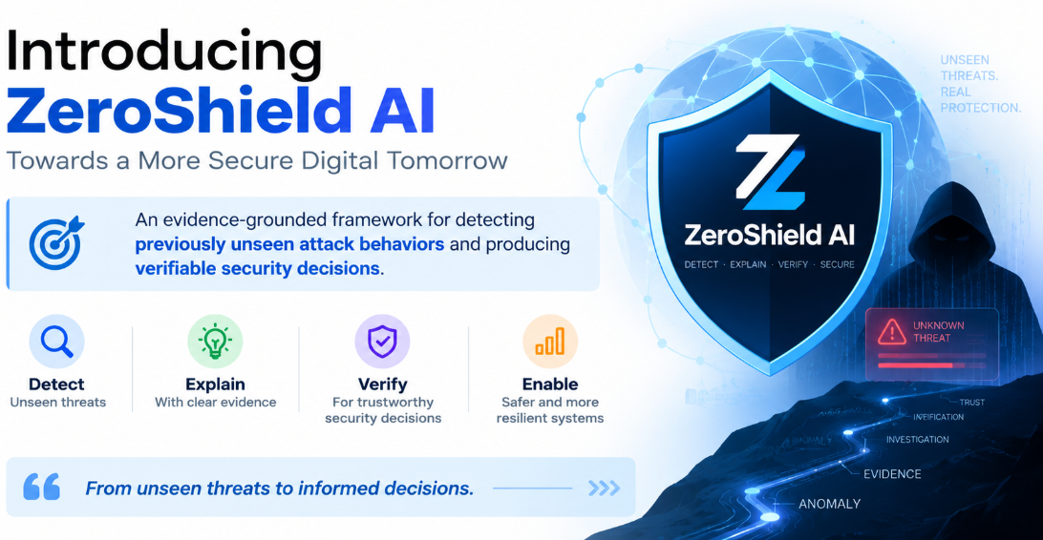
Introducing ZeroShield AI
An evidence-grounded framework for detecting previously unseen attack behaviors and producing verifiable security decisions.

Slide 27
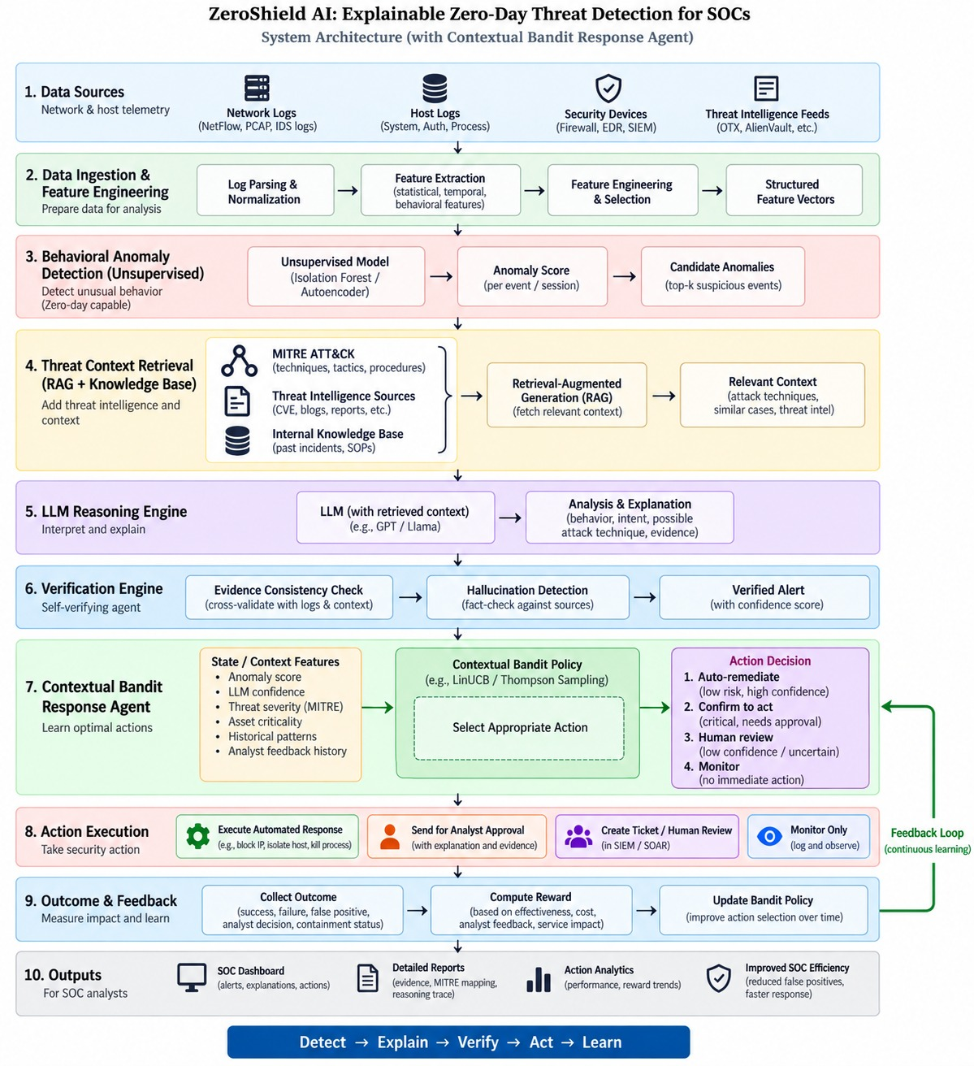

Slide 28
Time Plan
August 2026 : Dataset & Detection Setup
Literature survey completion, dataset preparation, preprocessing, feature analysis, attack-label analysis, train/test strategy, and implementation of the behavior-based anomaly detection model.
September 2026: Unseen Attack Detection & XAI
Hold out selected attack categories to simulate zero-day attacks, train and evaluate anomaly models, optimize detection, and implement SHAP/LIME-based behavioral evidence extraction.
October 2026 :Threat Context & LLM Reasoning
Build the MITRE ATT&CK + Threat Intelligence knowledge base, implement vector database/RAG retrieval, integrate the LLM reasoning layer, and generate security verdicts, confidence scores and attack mappings.

Slide 29
Step 1)
Dataset: CIC-IoT-2023
Canadian Institute for Cybersecurity — 105 real IoT devices, 33 attacks across 7 categories
What is this dataset about ?
169 CSV files containing 44M+ network-flow records
47 original features representing traffic, timing, TCP flags, packet statistics and protocol information
//data preprocessing
Binary labeling introduced:
0 → Benign
1 → Attack
Removed timestamps.
33 attack types across 7 attack categories
Memory-Safe Data Processing
Redundancy Removal
Spearman correlation:
|ρ| ≥ 0.90

Slide 30
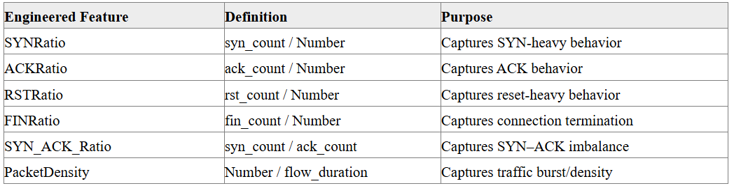
2)Feature Engineering

Slide 31
2)split Zero-Day Attack Experimental Setup
Instead of randomly hiding individual samples, we completely excluded two behaviorally different attack groups from model training:
Held-out categories:
Mirai
  Mirai-greeth_flood
  Mirai-udpplain
  Mirai-greip_flood
Web-Based
  SQL Injection
  Command Injection
  Backdoor Malware
  Uploading Attack
  XSS
  Browser Hijacking
  These attacks are never presented to the anomaly detector during training.

Slide 32
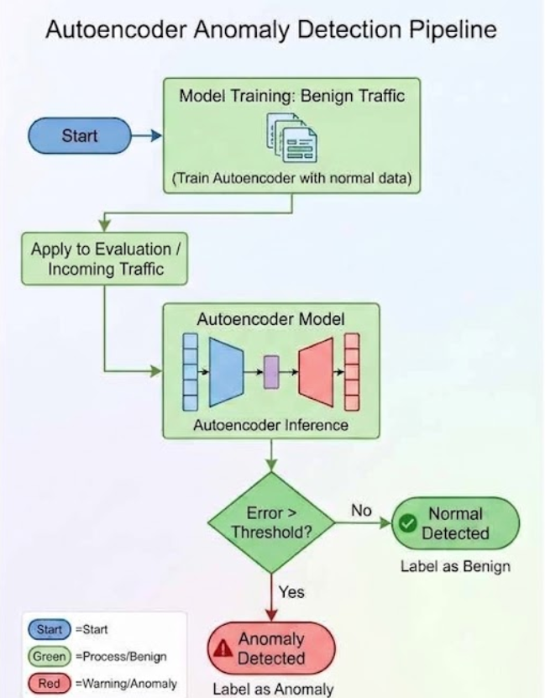
Two Models Evaluated
Autoencoder

Slide 33
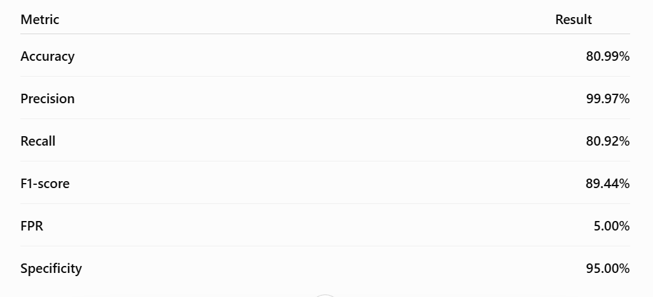
Partial results
Zero-Day Evaluation
Total zero-day samples: 2,658,953
Detected: 2,157,598
Missed: 501,355
Detection rate: 81.14%

Slide 34
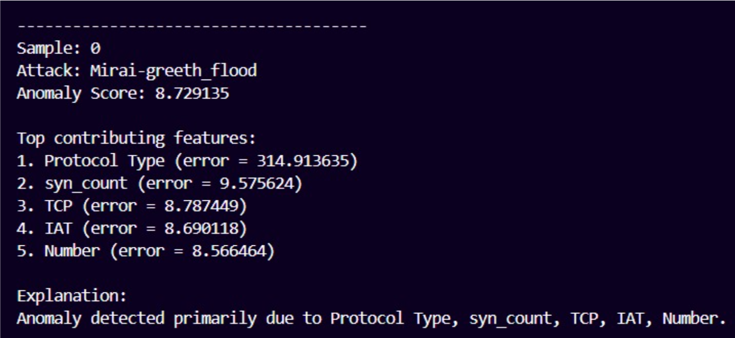

Slide 35
Isolation Forest

Slide 36
References
[1] R. Kalakoti, S. Nõmm, and H. Bahsi, “In-depth feature selection for the statistical machine learning-based botnet detection in IoT networks,” IEEE Access, vol. 10, pp. 94518–94535, 2022, doi: 10.1109/ACCESS.2022.3204001.
[2] M. Arul, R. Kishore Kumar, S. Santhosh, M. Boomika, J. Bhavana Shree, and K. Shree Durga, “A multi-model deep learning approach for advanced cybersecurity threat detection,” in Proc. 2nd Int. Conf. Multi-Agent Systems for Collaborative Intelligence (ICMSCI), 2026, pp. 386–391, doi: 10.1109/ICMSCI67830.2026.11469498.
[3] Pooja N. G., Vijayalakshmi A. Lepakshi, Kavitha M., Monika M., and Deeksha, “A review of unsupervised learning techniques for zero-day attack detection,” in Proc. 3rd Int. Conf. Innovations in Cybersecurity and Data Science (ICICDS), 2026.
[4] J. Roy and S. K. Singh, “AgentSOC: A multi-layer agentic AI framework for security operations automation,” in Proc. 2026 IEEE 5th Int. Conf. AI in Cybersecurity (ICAIC), Houston, TX, USA, 2026, pp. 1–7, doi: 10.1109/ICAIC67076.2026.11395783.
[5] S. Subash Chandra Bose, V. Shanmugapriya, N. Mahadev, M. Pyingkodi, R. Natarajan, and N. Thangarasu, “AI-driven cybersecurity defense for military networks,” in Proc. 2025 IEEE Int. Conf. Women in Innovation, Technology & Entrepreneurship (ICWITE), 2025, pp. 1–6, doi: 10.1109/ICWITE64848.2025.11307120.
[6] T. Zebin, S. Rezvy, and Y. Luo, “An explainable AI-based intrusion detection system for DNS over HTTPS (DoH) attacks,” IEEE Trans. Inf. Forensics Security, vol. 17, pp. 2339–2349, 2022, doi: 10.1109/TIFS.2022.3183390.
[7] M. Lisha, V. Agarwal, S. Kamthania, P. Vutkur, and M. S. Chari, “Benchmarking LLM for zero-day vulnerabilities,” in Proc. 2024 IEEE Int. Conf. Electronics, Computing and Communication Technologies (CONECCT), Bengaluru, India, 2024, pp. 1–6, doi: 10.1109/CONECCT62155.2024.10677338.
[8] I. El Didi, F. Trad, and A. Chehab, “Enhancing network security through deep learning: Mitigating feature engineering and zero-day attacks,” in Proc. 4th Int. Conf. Intelligent Cybersecurity (ICSC), Valencia, Spain, 2024, pp. 127–131, doi: 10.1109/ICSC63108.2024.10895964.

Slide 37
References
[9] C. K. Sruthi, A. Ravikumar, and H. Sriraman, “Enhancing zero-day attack detection with XAI-driven ML models and SMOTE analysis,” in Proc. 3rd Int. Conf. Artificial Intelligence for Internet of Things (AIIoT), 2024, pp. 1–5, doi: 10.1109/AIIoT58432.2024.10574566.
[10] H. Teymourlouei, D. Stone, and L. Jackson, “Identifying zero-day attacks with machine learning and data reduction methods,” in Proc. 2023 Congress in Computer Science, Computer Engineering, & Applied Computing (CSCE), Las Vegas, NV, USA, 2023, pp. 2285–2290, doi: 10.1109/CSCE60160.2023.00372.
[11] S. Mohanta, S. K. Mohapatra, R. K. Mohanta, S. Tewary, S. Bharadwaj, and S. Chakravarty, “An adaptive framework with optimized machine learning models for real-time zero-day cyber threat detection,” in Proc. 1st Int. Conf. Intelligent Computing, Networks and Security (IC-ICNS), 2026, doi: 10.1109/IC-ICNS68863.2026.11537623.
[12] K. Ahi and S. Valizadeh, “Large language models (LLMs) and generative AI in cybersecurity and privacy: A survey of dual-use risks, AI-generated malware, explainability, and defensive strategies,” arXiv preprint arXiv:2607.06963, 2026.
[13] M. Niveditha, M. D. Swetha, M. Siva Rama Krishna, S. Rashmi, B. Pallavi, and M. Lakshmi Neelima, “Smart cyber threat intelligence system for autonomous threat aggregation and reporting,” in Proc. 2026 Int. Conf. AI-Driven Innovations & Applications (IC-AIDA), 2026, doi: 10.1109/IC-AIDA68291.2026.11564311.
[14] M. Yadav, “The role of large language models in cybersecurity: Strengths, vulnerabilities, and mitigation strategies,” in Proc. 3rd Int. Conf. Sustainable Computing and Smart Systems (ICSCSS), 2025, pp. 1983–1990, doi: 10.1109/ICSCSS64956.2025.11500704.
[15] Y. Ma, G. Zeng, P. Zhang, Y. Huang, F. Zhang, R. Lin, and H. Qian, “TrapLLM: An LLM-powered interactive log-based honeypot for real-world network attacks,” in Proc. 2025 IEEE 24th Int. Conf. Trust, Security and Privacy in Computing and Communications (TrustCom), 2025, pp. 1578–1585, doi: 10.1109/TrustCom66490.2025.00183.
[16] B. E. Özkan and İ. B. Tolga, “Zero-day operational cyber readiness,” in Proc. 15th Int. Conf. Cyber Conflict: Meeting Reality (CyCon), Tallinn, Estonia, 2023, pp. 199–215, doi: 10.23919/CyCon58705.2023.10181814.

