Slide 1

Adapting Large Language Models via Reading Comprehension
Daixuan Cheng, Shaohan Huang, Furu Wei
ICLR 2024 Conference

Slide 2
Steps
What are General purpose language models?
Current techniques to teach domain specific knowledge.
What you are doing, Learning via Reading Comprehension.
Doing, AdaptLLM for 3 common domains.
Results -> Careful experimental settings.
Results -> Comparisons of performance.
Results -> How do general instructions add value?
Results -> Quantifying domain knowledge vs prompting ability tradeoff.
What you did, Conclude with why this is the right way to move forward.

Slide 3




General-Purpose llms

Slide 4
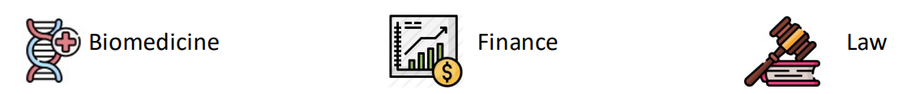


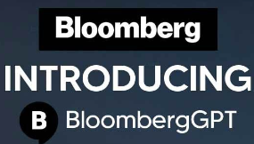


Domain-specific llms

Slide 5

domain-adaptive pretraining
Continued pre-training on domain-specific unlabeled data consistently improves performance on tasks from the target domain.

Slide 6
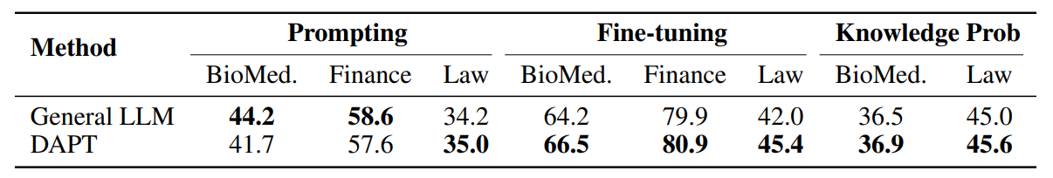
issues with domain-adaptive pretraining
Domain Knowledge 📈
Prompting Ability 📉

Slide 7
ADAPTING LARGE LANGUAGE MODELS VIA READING COMPREHENSION

Slide 8
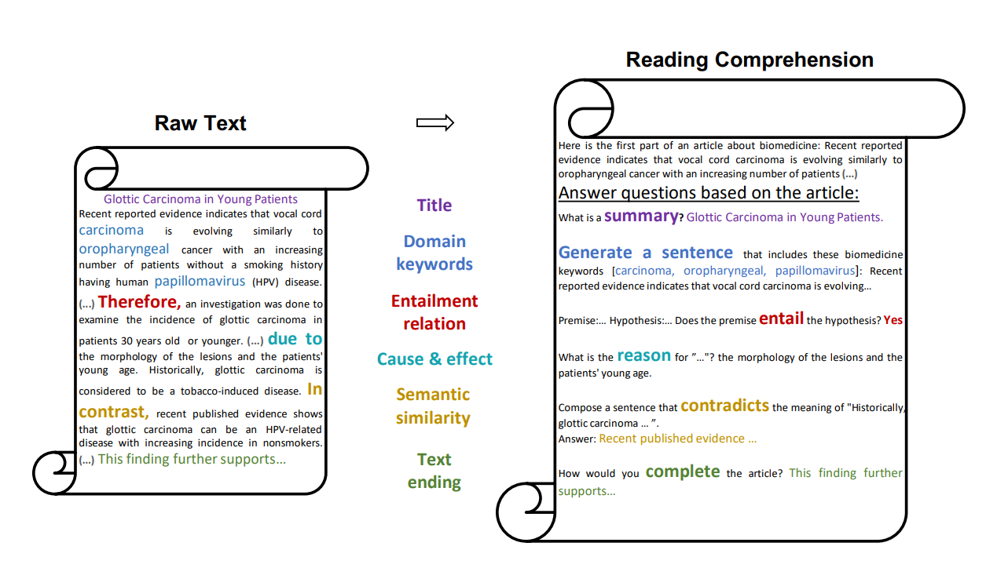
READING COMPREHENSIONs

Slide 9
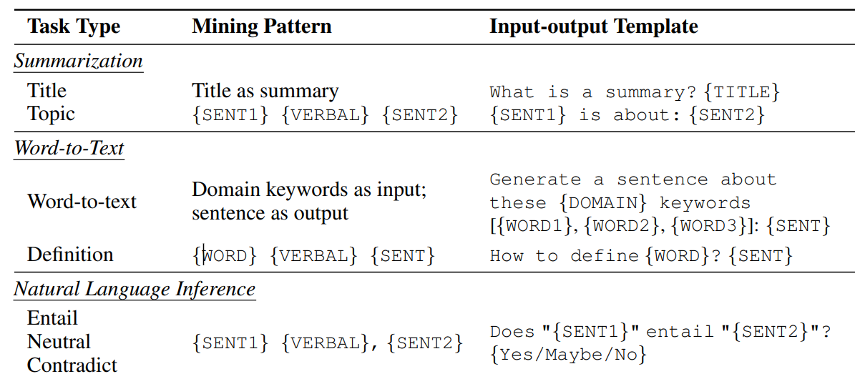
READING COMPREHENSIONs

Slide 10

general instructions
Input-output templates and task reversals to enhance prompting ability aren’t enough.
Mixing in general instructions to cover a wider range of input-output patterns.

Slide 11
Results
We compare 4 types of models, each trained on different types of the same data, such as:
Raw Text
Reading Comprehension only
General Instructions only
Reading Comprehension + General Instructions

Slide 12
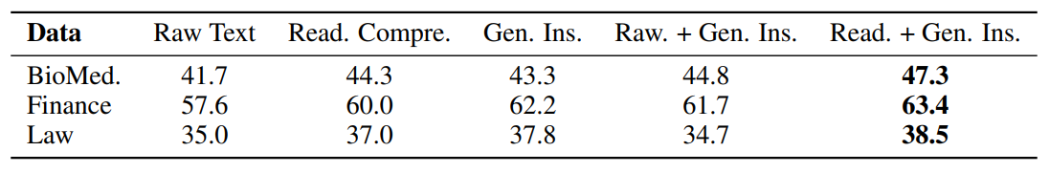
Findings

Slide 13
ADAPTllm

Slide 14
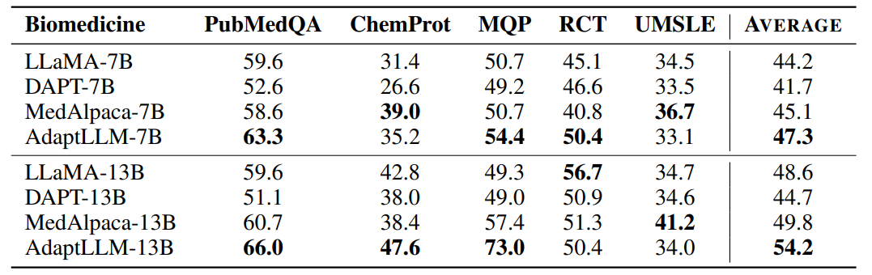
BIOMEDICINE

Slide 15
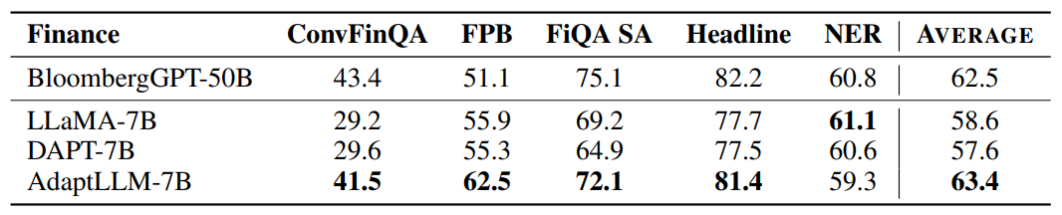
FINANCE

Slide 16
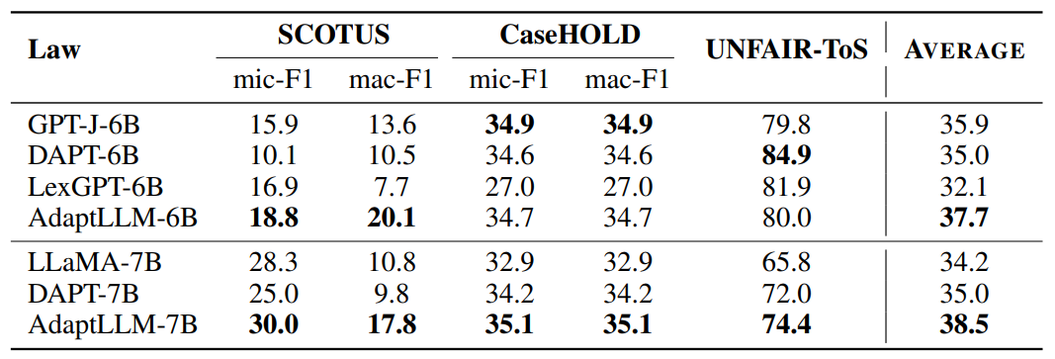
LAW

Slide 17
issues with domain-adaptive pretraining?
Domain Knowledge 📈
Prompting Ability 📉

Slide 18
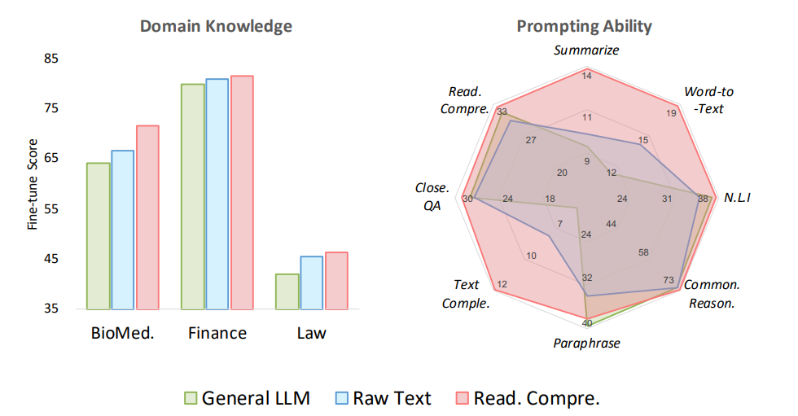
Conclusive results

