Slide 1

Internet Sentiment Using Fine-tuned Financial Large Language Models (LLMs)
Project Proposal – CS7290
Sashank Vasepalli

Slide 2
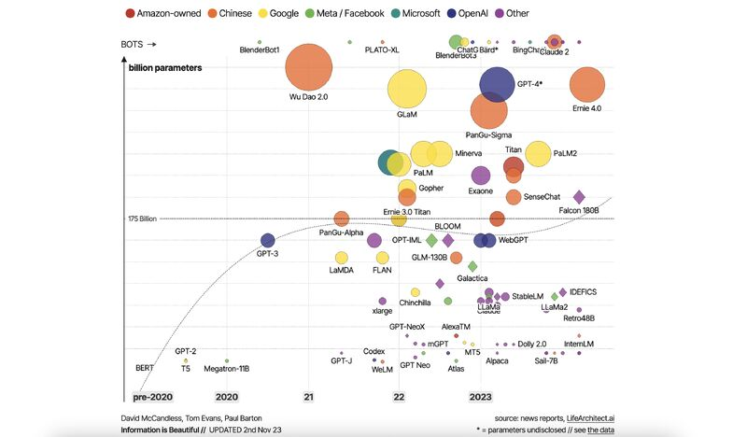

Slide 3
Slow Adoption of LLMs in finance
Risk-averse nature
“If it isn't broke, don’t fit it” mindset
Insufficient infrastructure
Data privacy concerns

Slide 4
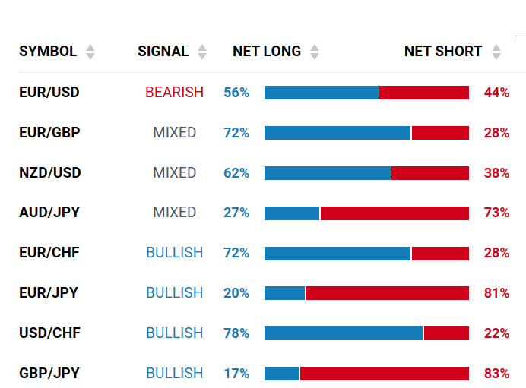
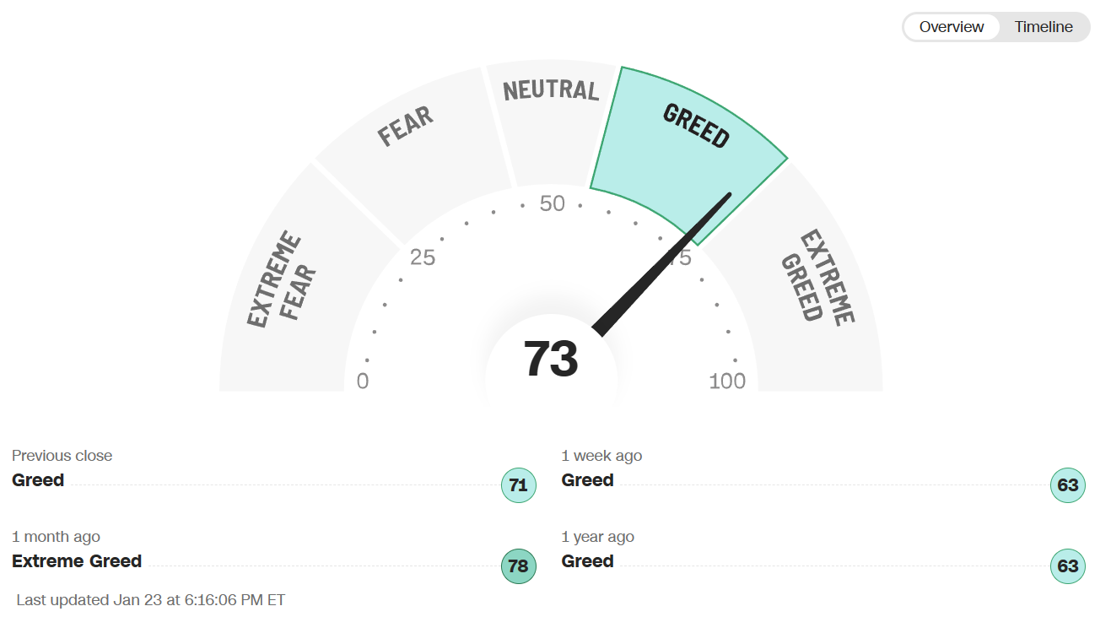
Current PUBLIC Tools
Equity
Forex

Slide 5
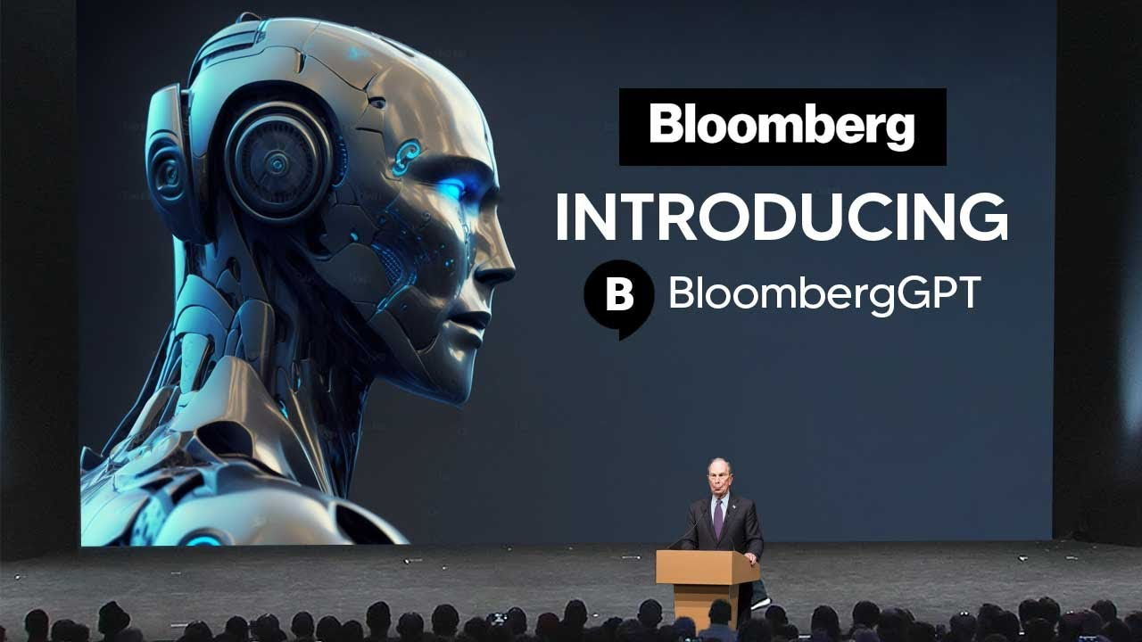

Slide 6

OPEN-SOURCE MARKET SENTIMENT DASHBOARD

Slide 7
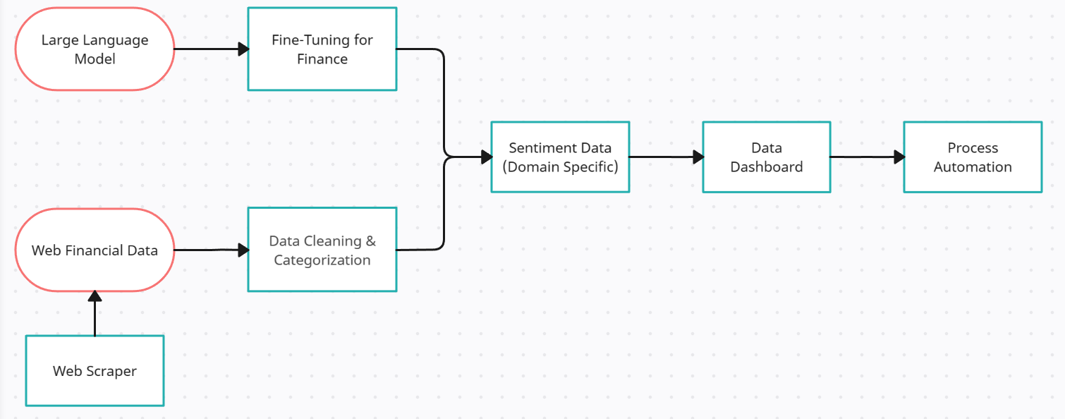

Slide 8

High-Quality sentiment data for algorithmic trading

