Slide 1

Fear & Greed Index – LLM Edition
Sashank Vasepalli
CS 7290 – April 16th, 2024

Slide 2
Presentation Timeline
Why does it matter? (3 Minutes)
How does it work? (7 Minutes)
Where can it be used? (2 Minutes)

Slide 3
Are individual investors informed?

Slide 4
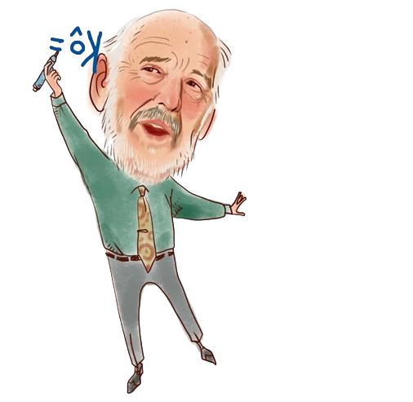

Jim Simons,
CEO of Renaissance Technologies

Slide 5

Jim Simons,
CEO of Renaissance Technologies
Average Gen Z Trader,
Chief Meme Officer, YOLO Capital Mgmt.

Slide 6
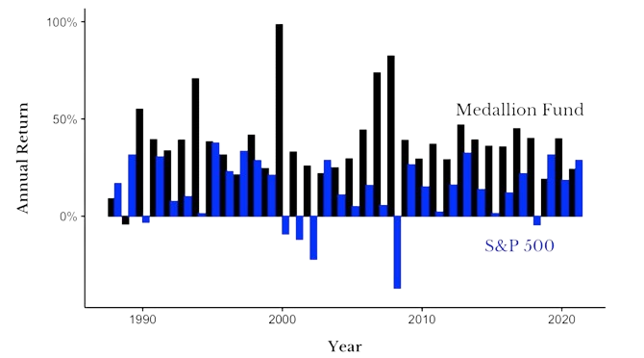
Annual Returns from 1988-2021

Slide 7
Renaissance Technologies
Teams of Ivy League Quants
Infinite Budget for SOTA Trading Algorithms
Enormous amounts of Data

Slide 8
Renaissance Technologies
Teams of Ivy League Quants
Infinite Budget for SOTA Trading Algorithms
Enormous amounts of Data

Slide 9




Slide 10
Using LLMs to bridge the gap!
Providing high-quality market sentiment data using LLMs through an easy-to-interpret Fear & Greed Index.
Enabling individual investors to make more informed decisions.

Slide 11
How does my Fear & Greed Index work?

Slide 12
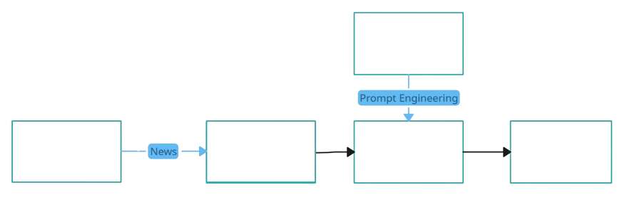
Fear & Greed Index System Schema
Large Language Model (Phi-2)
Sentiment Analysis
Fear & Greed Index
Web Scraper
Data Cleaning

Slide 13
Fear & Greed Index System Schema
Large Language Model (Phi-2)
Sentiment Analysis
Fear & Greed Index
Web Scraper
Data Cleaning

Slide 14
Web Scraper
Purpose: To obtain the latest news articles from the internet
Website scraped: Wall Street Journal
Implementation: Beautiful Soup to obtain HTML content, along with data scraping to obtain news articles and metadata

Slide 15
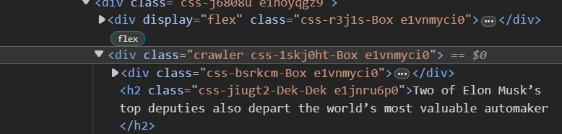
Web Scraper
HTML
CSV
Title | Time | Link
Tesla to Cut More Than 10â€™% of Global Workforce | 4/15/2024 17:01 | https://www.wsj.com/tech/tesla-layoffs-elon-musk....

Slide 16
Fear & Greed Index System Schema
Large Language Model (Phi-2)
Sentiment Analysis
Fear & Greed Index
Web Scraper
Data Cleaning

Slide 17
Data Cleaning
Purpose: To format and remove duplicate news articles
Implementation: Python Regex and Pandas
Title | Time | Link
Tesla to Cut More Than 10â€™% of Global Workforce | 4/15/2024 17:01 | https://www.wsj.com/tech/tesla-layoffs-elon-musk....
Title | Time | Link
Tesla to Cut More Than 10% of Global Workforce | 4/15/2024 17:01 | https://www.wsj.com/tech/tesla-layoffs-elon-musk....

Slide 18
Fear & Greed Index System Schema
Large Language Model (Phi-2)
Sentiment Analysis
Fear & Greed Index
Web Scraper
Data Cleaning

Slide 19

Phi-2 Large Language Model
What it is: Smaller sized LLM (2.78 B) by Microsoft
Purpose: To perform sentiment analysis on the news articles
Implementation: Prompt Engineering with Two-shot prompting

Slide 20
Phi-2: Prompt Experiments
Dataset Used: Financial Phrasebank
Dataset Description: 4,850 financial news articles. 60% neutral, 28% positive, and 12% negative sentiments.
Objective: Verify sentiment classification accuracies for Phi-2

Slide 21
Phi-2: Experimental Findings 1
Extreme sensitivity to small changes
Prompt | Output Acc.
Classify the sentiment of the news article as a single number. | Error ❌
Classify the sentiment of the news article as a single number from 1 to 3. | 0.389
Classify the sentiment of the news article as a single number from 0 to 2. | 0.596
Classify the sentiment of the news article as a single number from 0 to 2. \n | 0.675
Classify the sentiment of the news article as a single number 0, 1 or 2. \n | Error

Slide 22
Phi-2: Experimental Findings 1
Extreme sensitivity to small changes
Prompt | Output Acc.
Classify the sentiment of the news article as a single number. | Error ❌
Classify the sentiment of the news article as a single number from 1 to 3. | 0.389 ✅
Classify the sentiment of the news article as a single number from 0 to 2. | 0.596 ✅
Classify the sentiment of the news article as a single number from 0 to 2. \n | 0.675
Classify the sentiment of the news article as a single number 0, 1 or 2. \n | Error

Slide 23
Phi-2: Experimental Findings 1
Experiment with various combinations!
Prompt | Output Acc.
Classify the sentiment of the news article as a single number. | Error ❌
Classify the sentiment of the news article as a single number from 1 to 3. | 0.389 ✅
Classify the sentiment of the news article as a single number from 0 to 2. | 0.596 ✅
Classify the sentiment of the news article as a single number from 0 to 2. \n | 0.675 ✅
Classify the sentiment of the news article as a single number 0, 1 or 2. \n | Error ❌

Slide 24
Phi-2: Experimental Findings 2
Quality of examples prompted matter!
Prompt Example | Output Acc.
Finnish electronics manufacturing services EMS company Elcoteq SE posted a net loss of 66.4 mln euro | 0.61 ✅
In January-September 2009 , the Group 's net interest income increased to EUR 112.4 mn from EUR 74.3 mn in January-September 2008 | 0.687 ✅
Two-shot prompting (combining the above two) | 0.736
Three-shot prompting (adding a third well-performing prompt) | 0.588

Slide 25
Phi-2: Experimental Findings 2
Quality of examples prompted matter!
Prompt Example | Output Acc.
Finnish electronics manufacturing services EMS company Elcoteq SE posted a net loss of 66.4 mln euro | 0.61 ✅
In January-September 2009 , the Group 's net interest income increased to EUR 112.4 mn from EUR 74.3 mn in January-September 2008 | 0.687 ✅
Two-shot prompting (combining the above two) | 0.736 ✅
Three-shot prompting (adding a third well-performing prompt) | 0.588

Slide 26
Phi-2: Experimental Findings 2
Use the most generalized examples available!
Prompt Example | Output Acc.
Finnish electronics manufacturing services EMS company Elcoteq SE posted a net loss of 66.4 mln euro | 0.61 ✅
In January-September 2009 , the Group 's net interest income increased to EUR 112.4 mn from EUR 74.3 mn in January-September 2008 | 0.687 ✅
Two-shot prompting (combining the above two) | 0.736 ✅
Three-shot prompting (adding a third well-performing prompt) | 0.588 ❌

Slide 27
Fear & Greed Index System Schema
Large Language Model (Phi-2)
Sentiment Analysis
Fear & Greed Index
Web Scraper
Data Cleaning

Slide 28
Feature Engineering
Purpose 1: Obtain sentiment scores for news
Purpose 2: Categorize news into subgroups like ‘Real-Estate’
Purpose 3: Obtain daily, weekly, and monthly sentiment scores using aggregation algorithms for each subgroup.
Implementation: NLP, Pandas, EMA Algorithm

Slide 29
Feature Engineering
Title | Time | Link | Subgroup | Sentiment
Tesla to Cut More Than 10% of Global Workforce | 4/15/2024 17:01 | https://www.wsj.com/tech/tesla-layoffs-.... | Tech | 0

Slide 30
Fear & Greed Index System Schema
Large Language Model (Phi-2)
Sentiment Analysis
Fear & Greed Index
Web Scraper
Data Cleaning

Slide 31
Fear & Greed Index
Purpose: Provide an overall online sentiment for different economic sectors
Implementation: Plotly, Streamlit

Slide 32
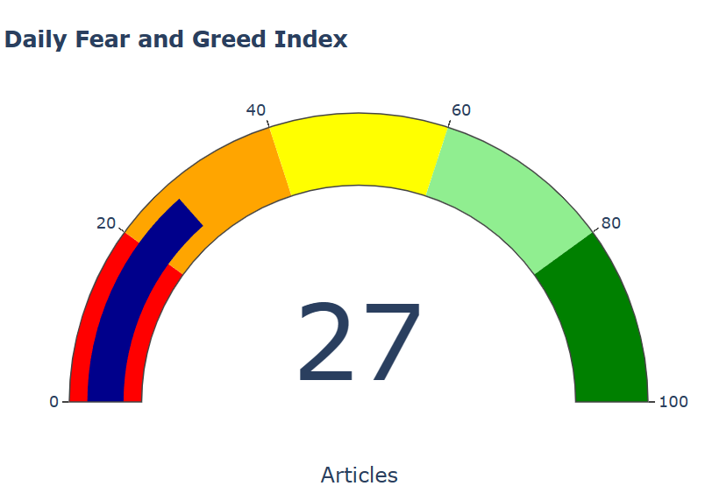
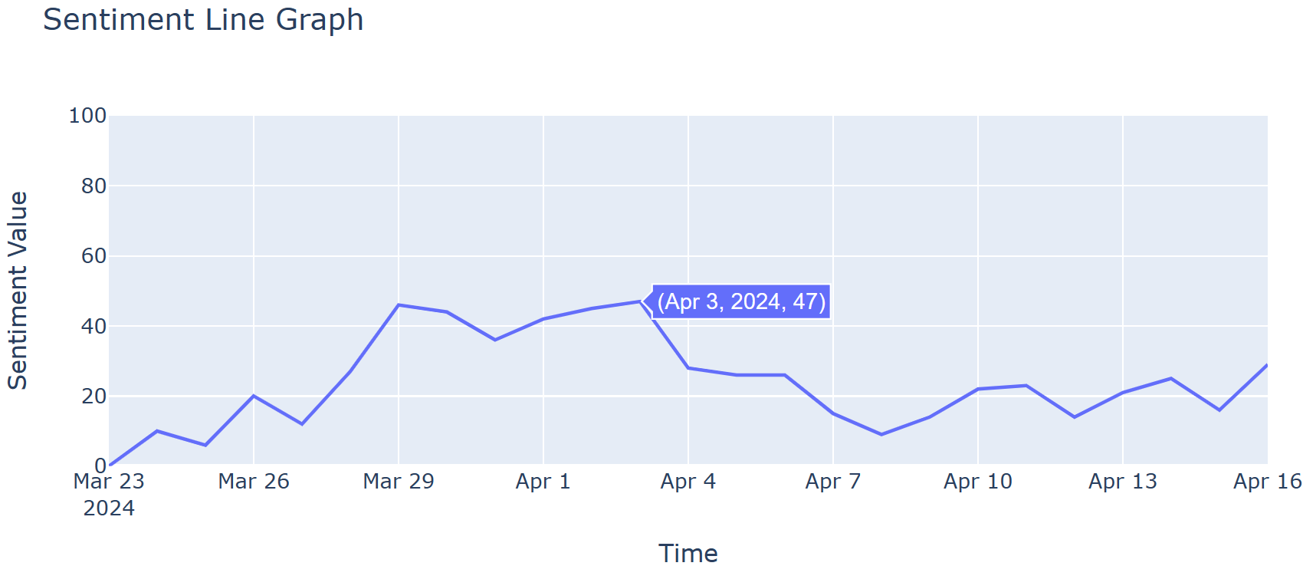
Fear & Greed Index
Greed
Neutral
Fear

Slide 33
Where can it be used?

Slide 34
Should be used:
Market Sentiment Analysis
Market Timing
Confirmation Tool
Shouldn’t be used:
Predicting Market Movements
Sole Indicator
Short-Term Trading

Slide 35
Thank you

