Slide 1

StrataSearch
An Intelligent Document Search and Analysis Platform
PBL Review – 2 | 17 August 2026
Project Guide: Aftab Yaseen
Team Members:
J Sasank 2510030267
V Rithvik 2510030126
N Arnavi 2510030040

Slide 2

Why Document Search Needs More Than Keywords
Problem Statement
The Challenge
"Develop an efficient platform to search and analyze multiple research documents using DSA-based techniques."
Research documents contain large amounts of text
Manually finding relevant information across multiple documents is time-consuming
Basic keyword search does not provide deeper pattern and document analysis
Efficient search requires string-matching and text-processing algorithms
Search Query
Refined keywords or phrases
Multiple Documents
Relevant Results
Collection of research files
Ranked, concise matches

Slide 3
Objectives of StrataSearch
3
Document Search
Pattern Matching
Efficient Algorithms
Search across uploaded research documents
Perform pattern and phrase matching
Use efficient string-matching algorithms
Relevance Ranking
Similarity Detection
Relationship Analysis
Rank documents by relevance
Detect similar and duplicate documents
Analyze research-paper relationships
Benchmarking
Algorithm visualization and performance benchmarking

Slide 4

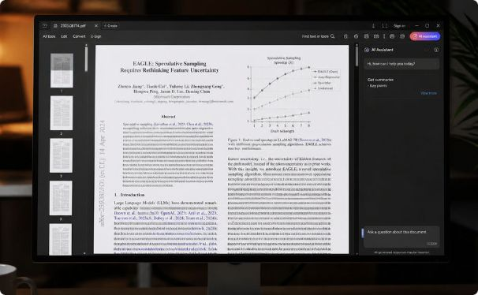


Study of Existing Academic Search Platforms
Google Scholar
Semantic Scholar
ResearchGate
Academic search and literature discovery
Citation tracking
Related publications
Large scholarly coverage
Semantic research discovery
Paper recommendations
AI-assisted summaries
Citation relationships
Research-paper discovery
Publication sharing
Citation information
Academic networking
Existing systems are strong in research discovery, but their underlying algorithmic processing is not exposed to users.

Slide 5
Existing Systems vs StrataSearch
Feature
Google Scholar
Semantic Scholar
ResearchGate
StrataSearch
Academic Search
✓
✓
✓
✓
Pattern / Phrase Search
Limited
Limited
Limited
✓
String Matching
Not exposed
Not exposed
Not exposed
KMP, Rabin-Karp
Text Analysis
Limited
✓
Limited
✓
Similarity / Duplicate Detection
Limited
Limited
Limited
✓
Citation Analysis
✓
✓
✓
✓
Algorithm Visualization
—
—
—
✓
Benchmarking
—
Limited
—
✓
Existing platforms focus mainly on retrieval, recommendation, and citation, while StrataSearch adds an integrated DSA-driven analysis layer.

Slide 6
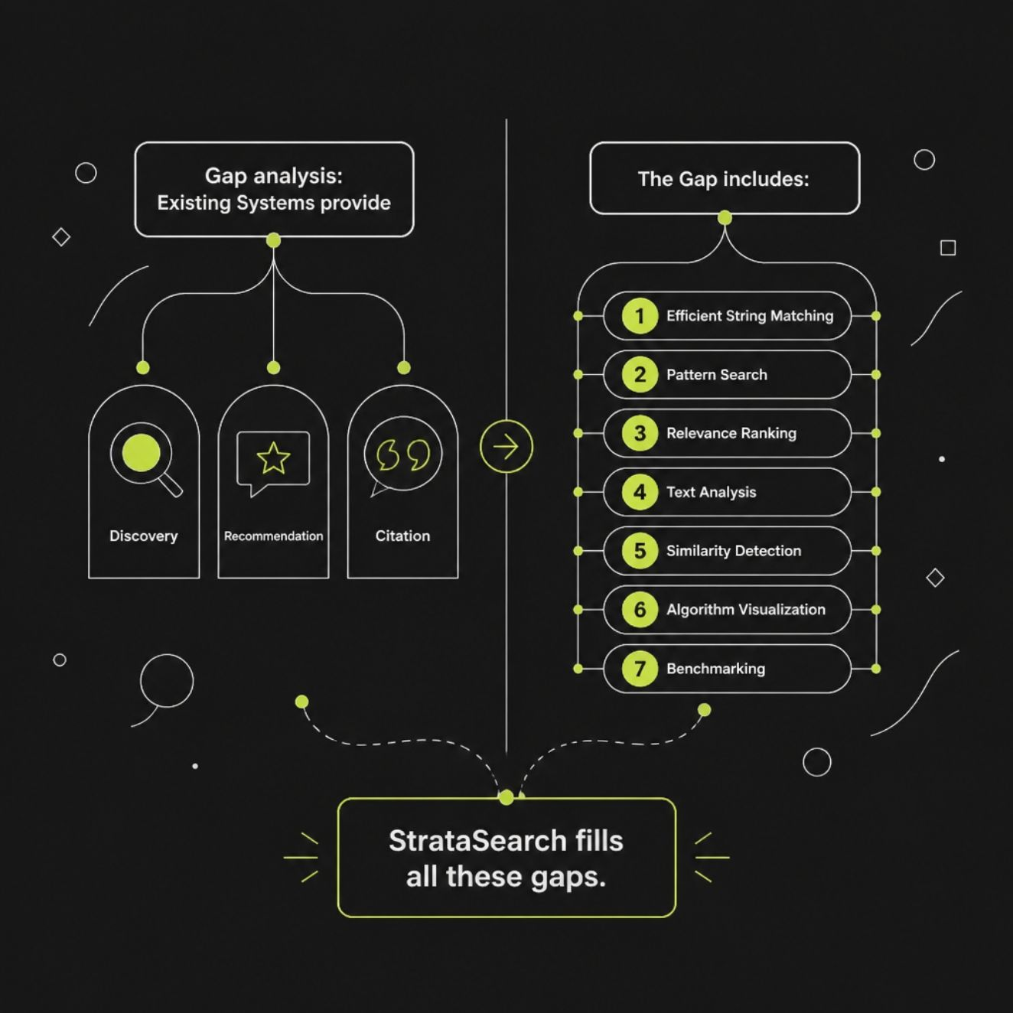
Identified Research Gap
Existing Approach
Discovery + Recommendation + Citation
Missing Integrated Capabilities
Efficient string matching
Pattern & phrase search
Relevance ranking
Advanced text analysis
Similarity & duplicate detection
Citation analytics
Algorithm visualization
Performance benchmarking
There is a need for a unified DSA-oriented platform that combines document retrieval, analysis, and algorithmic visualization.

Slide 7




StrataSearch — Proposed Approach
Search Engine Core
KMP · Rabin-Karp · Pattern Search · Phrase Search · Relevance Ranking
Advanced Text Analysis
Z Algorithm · Aho-Corasick · Suffix Array & LCP · Similarity · Duplicate Detection
Analytics & Visualization
Edit Distance · LCS · Citation Graph · Recommendation · Benchmark Dashboard

Slide 8
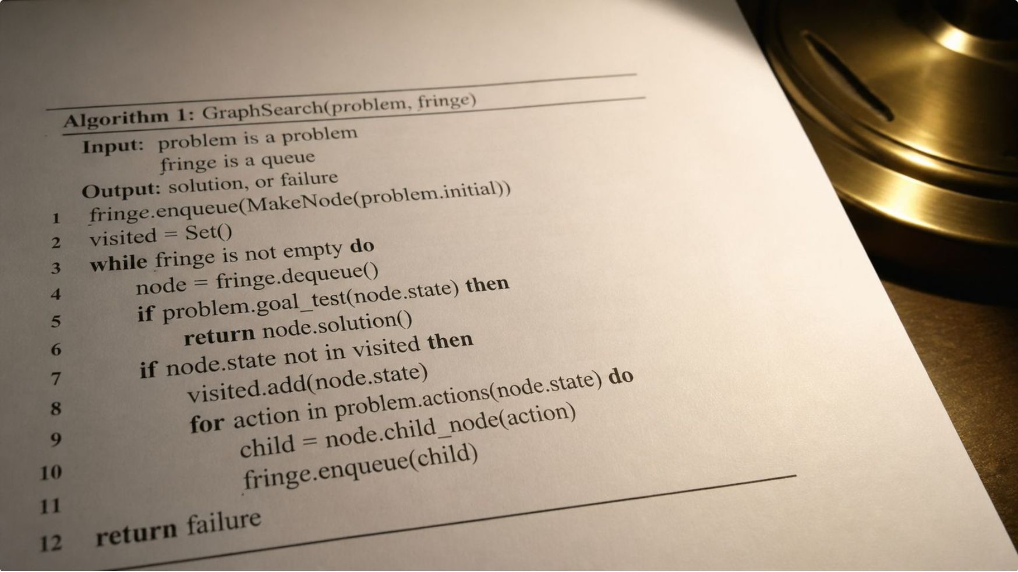
Algorithms Powering StrataSearch
Algorithm
Purpose
KMP
Efficient exact pattern matching
Rabin-Karp
Hash-based pattern matching
Z Algorithm
Pattern preprocessing
Aho-Corasick
Multiple-pattern matching
Suffix Array + LCP
Substring and prefix analysis
Edit Distance
Measure text differences
LCS
Find common text sequences
Different algorithms are used for different stages of search and document analysis.

Slide 9

Three Technical Modules. One Integrated Platform.
SEARCH
ANALYZE
COMPARE
VISUALIZE
01 — Search Engine Core
02 — Advanced Text Analysis
03 — Analytics & Visualization
KMP · Rabin-Karp · Pattern & Phrase Search · Relevance Ranking · Search API
Z Algorithm · Aho-Corasick · Suffix Array · LCP · Similarity · Duplicate Detection
Edit Distance · LCS · Recommendation · Citation Graph · Benchmark Dashboard · Algorithm Visualization

Slide 10

Conclusion
Literature
Gap
Existing platforms provide strong academic search, discovery, recommendations, and citation features.
They lack a unified environment combining DSA-based search, document analysis, visualization, and benchmarking.
StrataSearch
Integrates: Efficient Search + Text Analysis + Similarity + Citation Analytics + Visualization
StrataSearch aims to make research-document retrieval not only efficient, but also analyzable and explainable.

Slide 11
References
01
02
03
Google Scholar — Academic Search Platform
Semantic Scholar — AI-Assisted Research Discovery
ResearchGate — Research Sharing & Networking
04
05
06
Knuth, Morris & Pratt — Fast Pattern Matching in Strings
Karp & Rabin — Efficient Randomized Pattern-Matching Algorithms
Aho & Corasick — Efficient String Matching
07
Gusfield — Algorithms on Strings, Trees, and Sequences

