Slide 1
Blood Bank Database
Karen Mani & Sasha Smolyansky

Slide 2
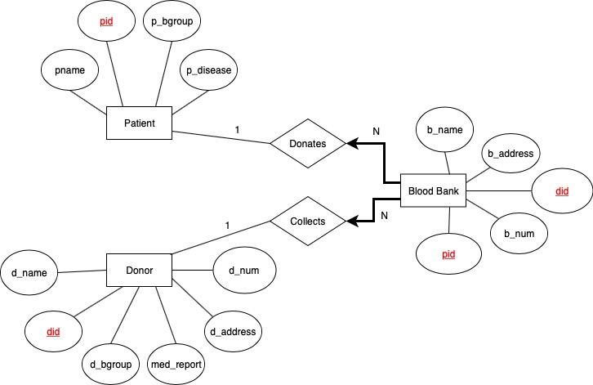
Project 1 Review
Patient (pid: integer, p_name: string, p_bgroup: string, p_disease: string)
Donor (did: integer, d_name: string, d_bgroup: string, med_report: string, d_address string, d_num: string)
Blood Blank (pid: integer, did: integer, b_name: string, b_address: string, b_num: string)

Slide 3
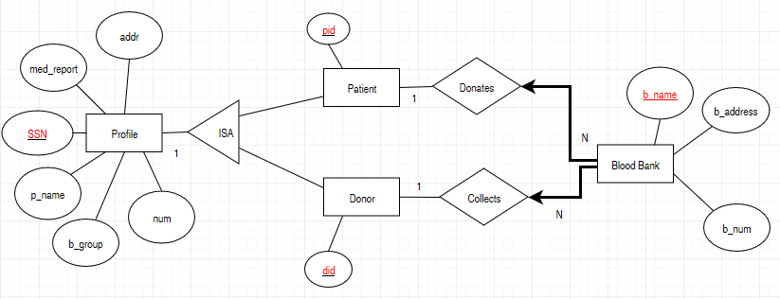
Project 2 - Updated ERD & Schema
Patients (pid: integer)
Donors (did: integer)
Blood Blank (b_name: string,
b_address: string, b_num:
string)
Profile (SSN: integer, p_name:
string, b_group: string,
med_report: string, addr: string, num: string)
Donates(did integer, b_name
string)
Collects(pid integer, b_name
string)

Slide 4
Normalization
Patient (pid) P → S, in BCNF Form
(SP)
Donor (did) D → S, in BCNF Form
(SD)
Donates(did, b_name): No FDs, in BCNF Form
Collects(pid, b_name): No FDs, in BCNF Form
Blood Blank (b_name, b_address, b_num) N → AX
(NAX)
N → AX is not in BCNF
N → AX is in 3NF because there are no transitive dependencies in this case
Profile(SSN, p_name, b_group, med_report, addr, num) S → NBREY
(SNBREY)
S → NBREY is not in 3NF because it has transitive dependencies (P → S and D→ S and S → NBREY)
Therefore, S → NBREY is in 2NF
In order to put this back into 3NF, transitive dependencies must be removed and be functionally dependent on the key → R1 = {P, D, S} and R2 = {S, N, B, R, E Y}.

Slide 5
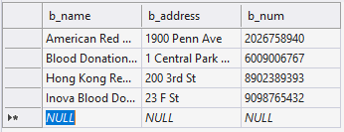
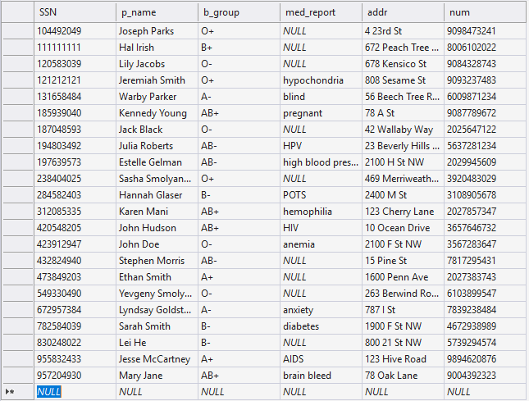
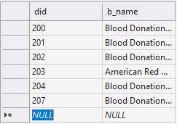
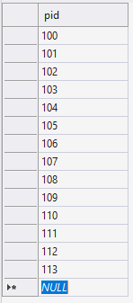

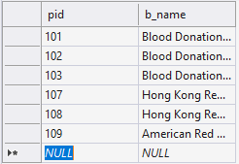
Database Tables

Slide 6
GUI Design Presentation

