Slide 1

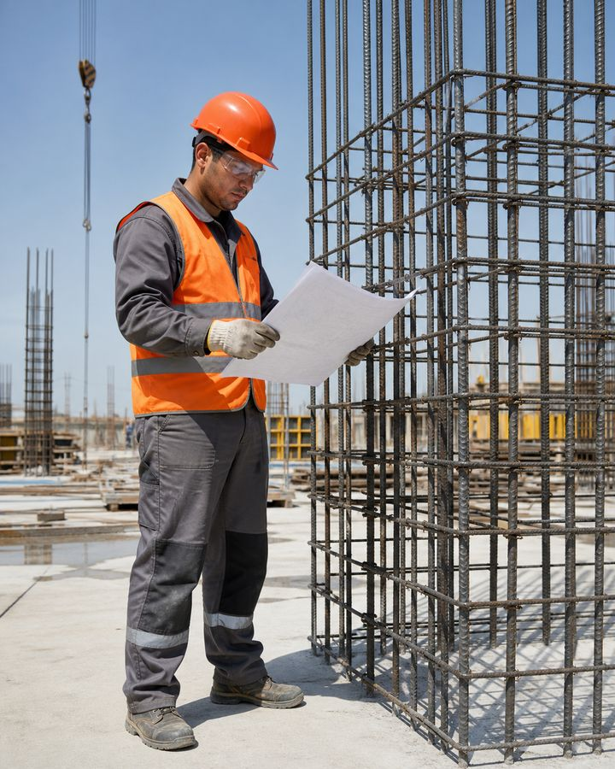
TRAINING COURSE
Rebar worker
Technology, quality and safe performance of reinforcement work
Training course for workers and line personnel
Rebar worker
01
Notes:
[Sources]
- SafetyHub canonical RU slide source: content/source-materials/derived/armaturshchik/presentation.pptx
- Reviewed EN text map: content/localizations/staged-2026-09-01/presentations/armaturshchik/en/text-map.json

Slide 2
After the course worker will be able to
01
Prepare material, tools and work area according to the project and assignment.
reinforcement steel works in the structure only with precise position and reliable connection.
02
Safely straighten, cut, bend and tie reinforcement and assemble the rebar frame.
03
Distinguish between connection methods and do not replace the design solution.
04
Check quality, recognize hazardous condition and stop operation.
Rebar worker
02
Notes:
[Sources]
- SafetyHub canonical RU slide source: content/source-materials/derived/armaturshchik/presentation.pptx
- Reviewed EN text map: content/localizations/staged-2026-09-01/presentations/armaturshchik/en/text-map.json

Slide 3
Course logic
01
Materials, design and preparation.
COURSE
02
Technological sequence.
5
03
Connections and installation of the frame.
04
Quality control and typical defects.
semantic blocks
05
Risks, PPE and stopping conditions.
Rebar worker
03
Notes:
[Sources]
- SafetyHub canonical RU slide source: content/source-materials/derived/armaturshchik/presentation.pptx
- Reviewed EN text map: content/localizations/staged-2026-09-01/presentations/armaturshchik/en/text-map.json

Slide 4
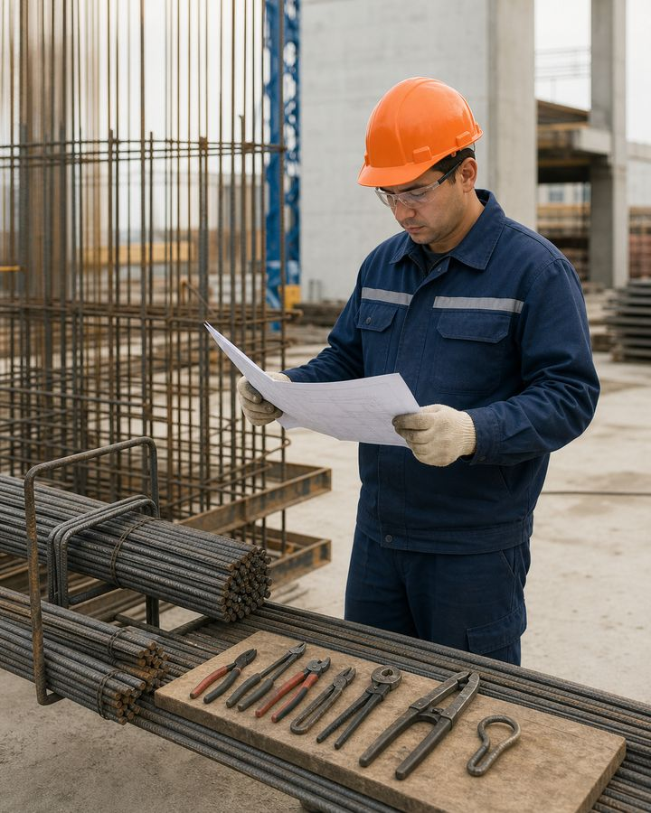
01
Task, material and preparation
Before processing, you need to understand the project, organize movement and exclude unauthorized substitutions.
Rebar worker
04
Notes:
[Sources]
- SafetyHub canonical RU slide source: content/source-materials/derived/armaturshchik/presentation.pptx
- Reviewed EN text map: content/localizations/staged-2026-09-01/presentations/armaturshchik/en/text-map.json

Slide 5
Rebar Forms the Load-Bearing System
• The rebar worker prepares, assembles and installs reinforcement elements for reinforced-concrete structures.
• The work follows specified dimensions, reinforcing-bar positions, connections and concrete cover.
• Diameter, spacing, shape or connection method may be changed only under an approved design decision.
• Frame readiness is confirmed by inspection before concreting.
An error hidden after concreting must be identified in advance.
Rebar worker
05
Notes:
[Sources]
- SafetyHub canonical RU slide source: content/source-materials/derived/armaturshchik/presentation.pptx
- Reviewed EN text map: content/localizations/staged-2026-09-01/presentations/armaturshchik/en/text-map.json

Slide 6
The complexity of the work increases with the rank
• Grades 2–3: basic preparation, straightening, cutting, reinforcement tying and assistance with assembly.
• Grades 4–5: complex frames, installation, connections and reading work drawings.
• Grades 6–7: particularly complex spatial frames and critical structures.
• The actual assignment depends on qualifications, authorization and the site-specific method.
The rank confirms competence, but does not replace the project and safety briefing.
Rebar worker
06
Notes:
[Sources]
- SafetyHub canonical RU slide source: content/source-materials/derived/armaturshchik/presentation.pptx
- Reviewed EN text map: content/localizations/staged-2026-09-01/presentations/armaturshchik/en/text-map.json

Slide 7
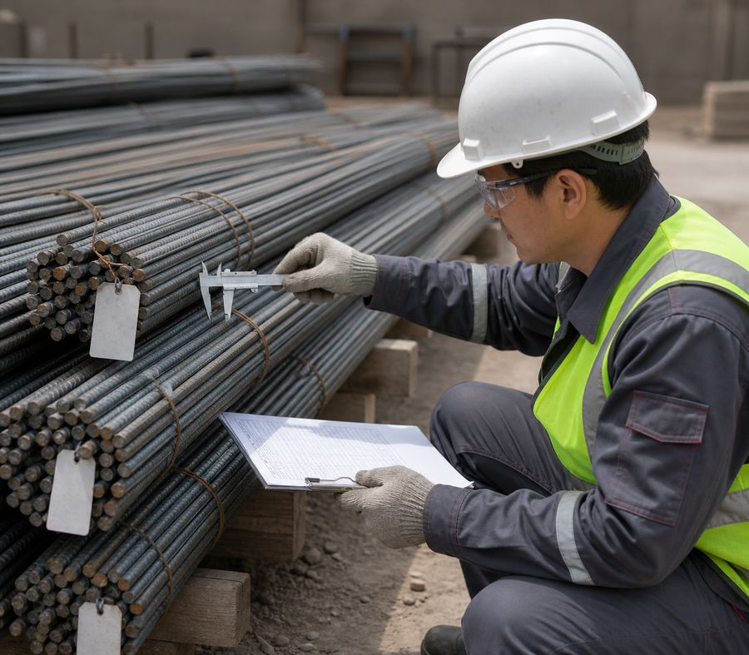
Material is identified before processing
• Check the batch marking, diameter, profile, surface condition and delivery documents.
• Store reinforcing bars, mesh, tying wire, spacers and connectors separately and stably.
• Record severe corrosion, contamination, deformation and nonconformity with the design before work.
• Do not use an unapproved material substitution.
The reinforcement grade and diameter are determined by the design, not by what is available in stock.
Rebar worker
07
Notes:
[Sources]
- SafetyHub canonical RU slide source: content/source-materials/derived/armaturshchik/presentation.pptx
- Reviewed EN text map: content/localizations/staged-2026-09-01/presentations/armaturshchik/en/text-map.json

Slide 8
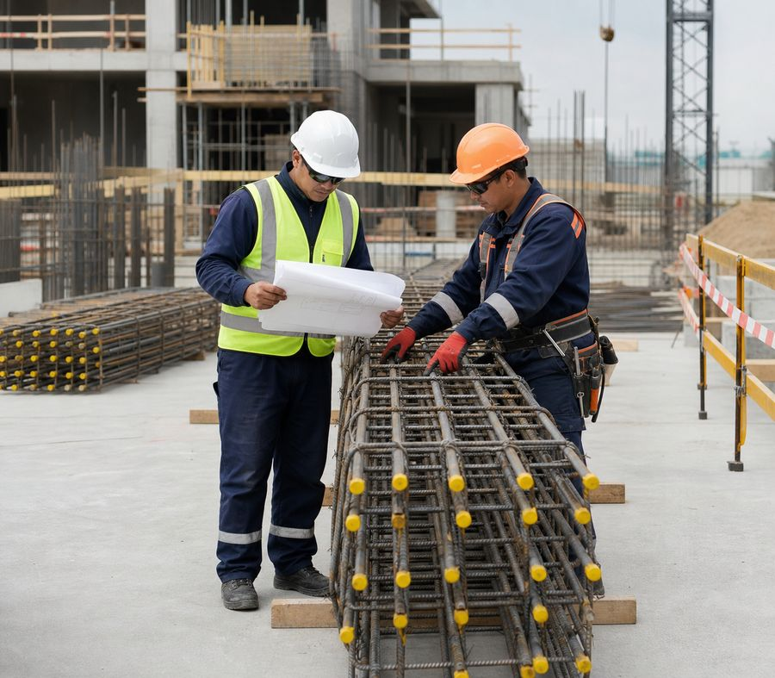
Project Defines Frame Shape and Position
• Before starting, verify the drawing, specification, erection scheme, sequence and inspection points.
• Set out from the established datum, checking units of measurement and reference dimensions.
• Report any unclear detail, dimensional conflict or missing element to the supervisor.
• Prepare the workplace for the specific operations and safe movement of workpieces.
Doubts in the drawing are resolved before cutting and bending.
Rebar worker
08
Notes:
[Sources]
- SafetyHub canonical RU slide source: content/source-materials/derived/armaturshchik/presentation.pptx
- Reviewed EN text map: content/localizations/staged-2026-09-01/presentations/armaturshchik/en/text-map.json

Slide 9
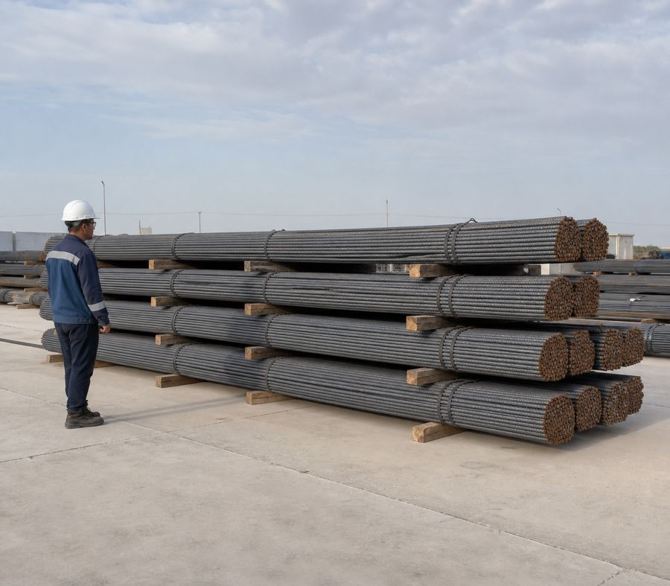
Storing prevents rolling
• Place rebar bundles on stable dunnage with chocks and preserve their markings.
• Keep walkways, vehicle access, slinging points and machinery operating zones clear.
• Plan manual handling by mass, length and number of workers; carry a long reinforcing bar in coordination.
• Never stand beneath a raised bundle or between a load and a fixed object.
Before lifting, determine the route, crew and safe stowage area.
Rebar worker
09
Notes:
[Sources]
- SafetyHub canonical RU slide source: content/source-materials/derived/armaturshchik/presentation.pptx
- Reviewed EN text map: content/localizations/staged-2026-09-01/presentations/armaturshchik/en/text-map.json

Slide 10
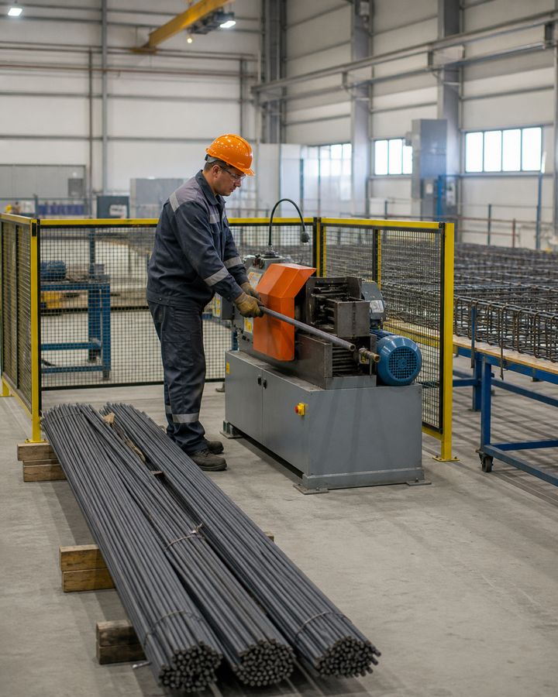
02
Prep and Assembly
The process sequence preserves dimensions, quality and control of hazardous energy.
Rebar worker
10
Notes:
[Sources]
- SafetyHub canonical RU slide source: content/source-materials/derived/armaturshchik/presentation.pptx
- Reviewed EN text map: content/localizations/staged-2026-09-01/presentations/armaturshchik/en/text-map.json

Slide 11
Straightening and Cleaning Precede Marking
1
2
3
4
Inspect
Secure
Straighten
Check
Determine deformation, contamination and surface condition.
Install material and equipment protection devices.
Use the established method without jerking and without standing in the line of tension.
Check straightness and suitability for further operation.
Hand straightening a long rod without a stable support is dangerous.
Rebar worker
11
Notes:
[Sources]
- SafetyHub canonical RU slide source: content/source-materials/derived/armaturshchik/presentation.pptx
- Reviewed EN text map: content/localizations/staged-2026-09-01/presentations/armaturshchik/en/text-map.json

Slide 12
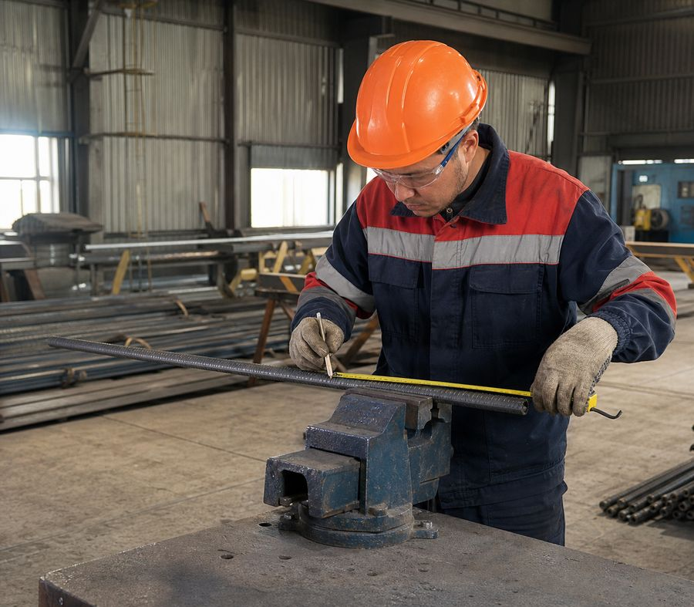
Measurement and Cutting Use One Datum
• Check the marking against the specification and account for the part's shape after bending.
• Secure the workpiece; clear people and combustible materials from the cut-off and spark fly-off zone.
• Tooling must suit the reinforcing-bar diameter and material and the equipment's permitted parameters.
• Identify the measured element after cutting to prevent mix-ups.
Rechecking the size is cheaper and safer than remaking the frame.
Standard: Tool Safety — Order No. 204
Rebar worker
12
Notes:
[Sources]
- SafetyHub canonical RU slide source: content/source-materials/derived/armaturshchik/presentation.pptx
- Reviewed EN text map: content/localizations/staged-2026-09-01/presentations/armaturshchik/en/text-map.json

Slide 13
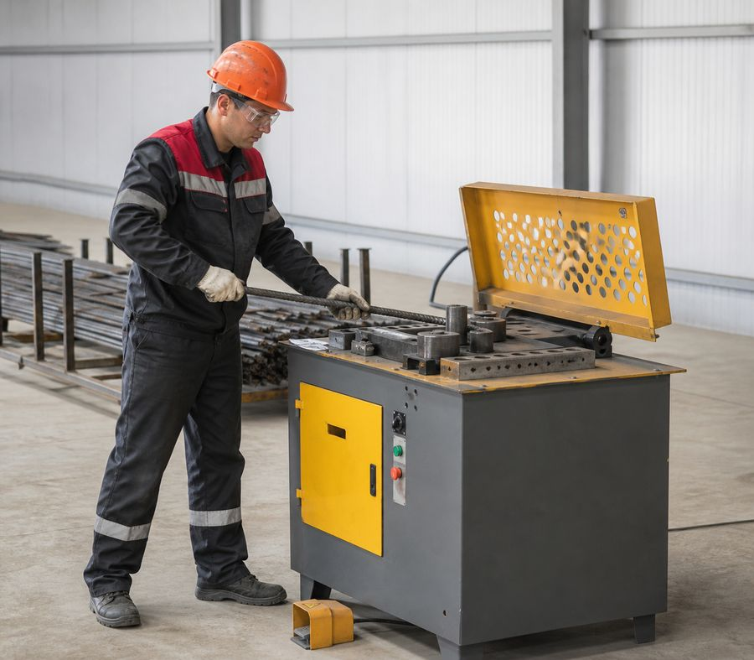
Bending is performed using standard equipment
• Check the stops, drive, guards and work zone of the bending equipment.
• Place the reinforcing bar according to the scheme without holding it by hand near a moving machine part.
• The bending radius, angle and direction are specified by the design and method.
• Correcting a finished part by re-bending is permitted only under an approved method.
You cannot be in the plane of possible ejection of the rod.
Rebar worker
13
Notes:
[Sources]
- SafetyHub canonical RU slide source: content/source-materials/derived/armaturshchik/presentation.pptx
- Reviewed EN text map: content/localizations/staged-2026-09-01/presentations/armaturshchik/en/text-map.json

Slide 14
The frame is assembled from a stable base
1
2
3
4
Lay Out
Secure
Connect
Check
Prepare elements according to markings and assembly order.
Install templates, stops and temporary connections.
Carry out the specified reinforcement tying or another connection required by the design.
Check geometry, stability and readiness to move.
The spatial frame is not released until it is temporarily fixed.
Rebar worker
14
Notes:
[Sources]
- SafetyHub canonical RU slide source: content/source-materials/derived/armaturshchik/presentation.pptx
- Reviewed EN text map: content/localizations/staged-2026-09-01/presentations/armaturshchik/en/text-map.json

Slide 15
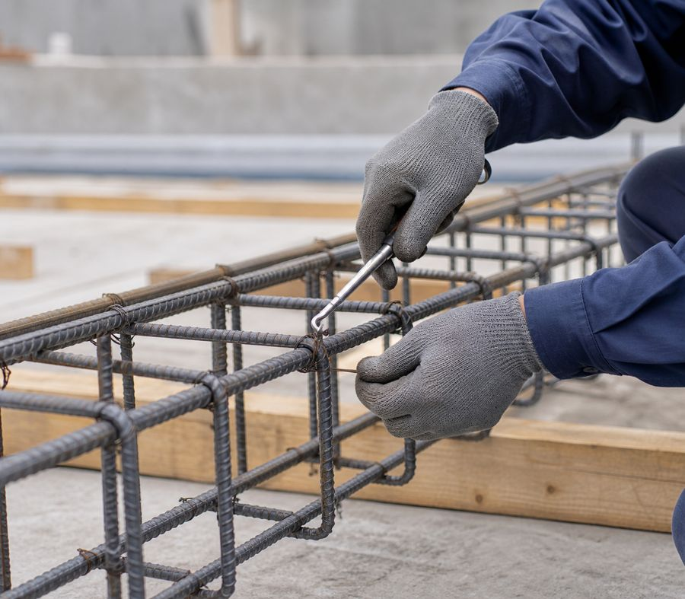
Tying Preserves the Design Position
• Select the tying wire and knot method according to the method statement and the connection's purpose.
• Secure the reinforcing bars before tightening to prevent finger pinching and bar displacement.
• Bend wire ends inward and do not leave them in a walkway or contact zone.
• Assess quality by knot stability and preservation of the specified geometry.
Excessive tightening does not compensate for incorrect rod position.
Rebar worker
15
Notes:
[Sources]
- SafetyHub canonical RU slide source: content/source-materials/derived/armaturshchik/presentation.pptx
- Reviewed EN text map: content/localizations/staged-2026-09-01/presentations/armaturshchik/en/text-map.json

Slide 16
Tying Wire and Tools: Cut and Puncture Hazards
• Cut wire ends are placed in a container immediately and are not left on the working platform or in the frame.
• Hooks, pliers and powered tying tools are checked before use.
• Keep the hand and wrist outside the possible snap-back line; do not jerk the wire toward yourself.
• Hand protection is used only where it does not create an entanglement hazard with moving parts.
The sharp end of the wire must be controlled from cutting to disposal.
Rebar worker
16
Notes:
[Sources]
- SafetyHub canonical RU slide source: content/source-materials/derived/armaturshchik/presentation.pptx
- Reviewed EN text map: content/localizations/staged-2026-09-01/presentations/armaturshchik/en/text-map.json

Slide 17
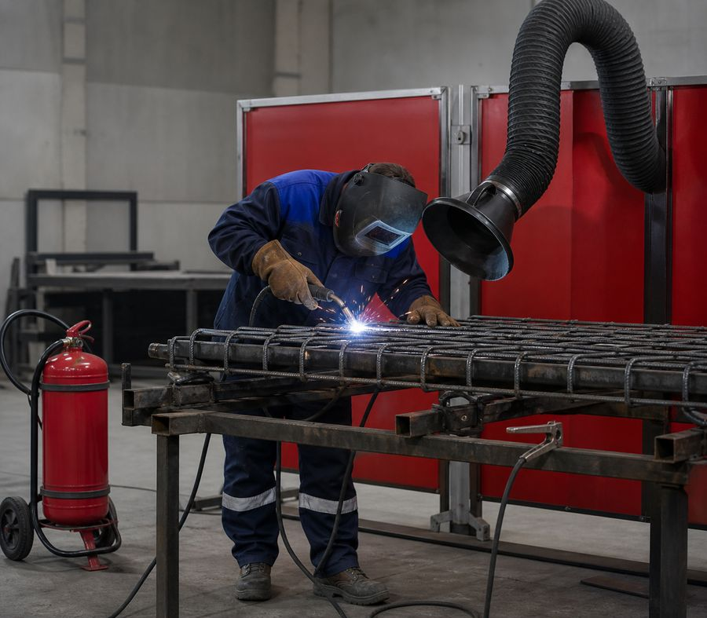
Welding Needs Design Specs and Authorization
• Weldability of the material, type of seam and preparation are determined by the design and technology.
• The work is performed by an approved welder with proper equipment and area protection.
• Fire risks are controlled by a permit where it is required.
• The quality of the connection is checked using the established method, and the defect is not masked with additional metal.
Reinforcement tying and welding are not freely interchangeable.
Standard: Fire safety rules
Rebar worker
17
Notes:
[Sources]
- SafetyHub canonical RU slide source: content/source-materials/derived/armaturshchik/presentation.pptx
- Reviewed EN text map: content/localizations/staged-2026-09-01/presentations/armaturshchik/en/text-map.json

Slide 18
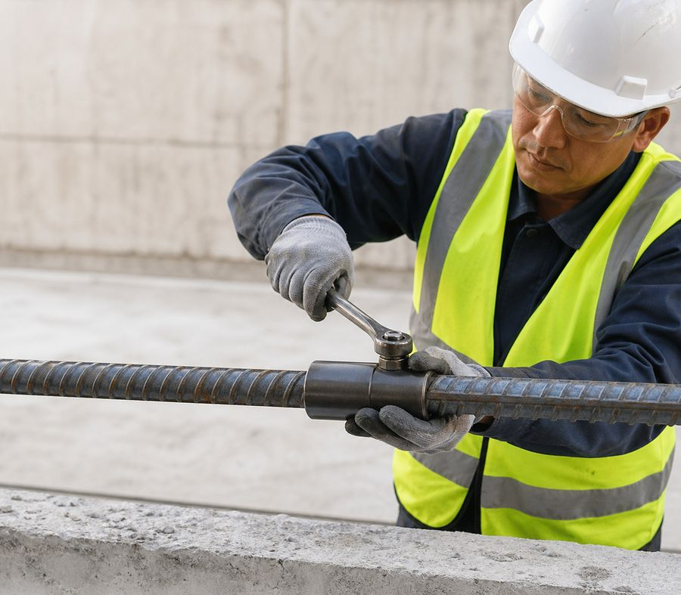
Rebar Couplers Are Used as a Specified System
• Coupler type, bar-end preparation and permitted tolerances are defined by the design and manufacturer's instructions.
• Threaded, swaged and other mechanical systems are not interchangeable.
• Before connection, check component cleanliness, geometry and marking.
• Perform tightening, swaging and inspection with the specified tool and method.
The connection is considered ready after inspection, and not after visual matching of the parts.
Rebar worker
18
Notes:
[Sources]
- SafetyHub canonical RU slide source: content/source-materials/derived/armaturshchik/presentation.pptx
- Reviewed EN text map: content/localizations/staged-2026-09-01/presentations/armaturshchik/en/text-map.json

Slide 19
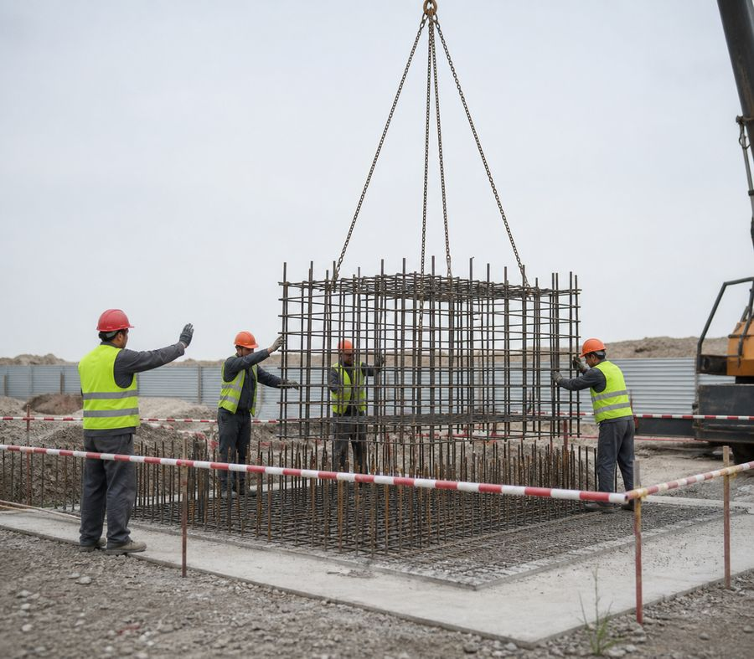
The frame is fixed before concreting
• Coordinate the slinging arrangement, lifting points, commands and safe positions for workers.
• After installation, secure the frame, spacers and temporary ties against displacement and overturning.
• Do not allow anyone beneath the load or in a pinch-point zone.
• Before concreting, confirm the geometry, stability and accessibility of the specified elements.
Load-handling attachments may be released only after the frame has been secured stably.
Rebar worker
19
Notes:
[Sources]
- SafetyHub canonical RU slide source: content/source-materials/derived/armaturshchik/presentation.pptx
- Reviewed EN text map: content/localizations/staged-2026-09-01/presentations/armaturshchik/en/text-map.json

Slide 20
The protective layer is specified by the project
• Maintain reinforcement position with the specified spacers and supports.
• Do not apply one universal concrete-cover value to every structure.
• Before concreting, check distances, stability and that spacers have not shifted.
• Use improvised pads only when the approved method expressly provides for them.
The dimensions of the protective layer and pitch are taken from the specific project.
Rebar worker
20
Notes:
[Sources]
- SafetyHub canonical RU slide source: content/source-materials/derived/armaturshchik/presentation.pptx
- Reviewed EN text map: content/localizations/staged-2026-09-01/presentations/armaturshchik/en/text-map.json

Slide 21
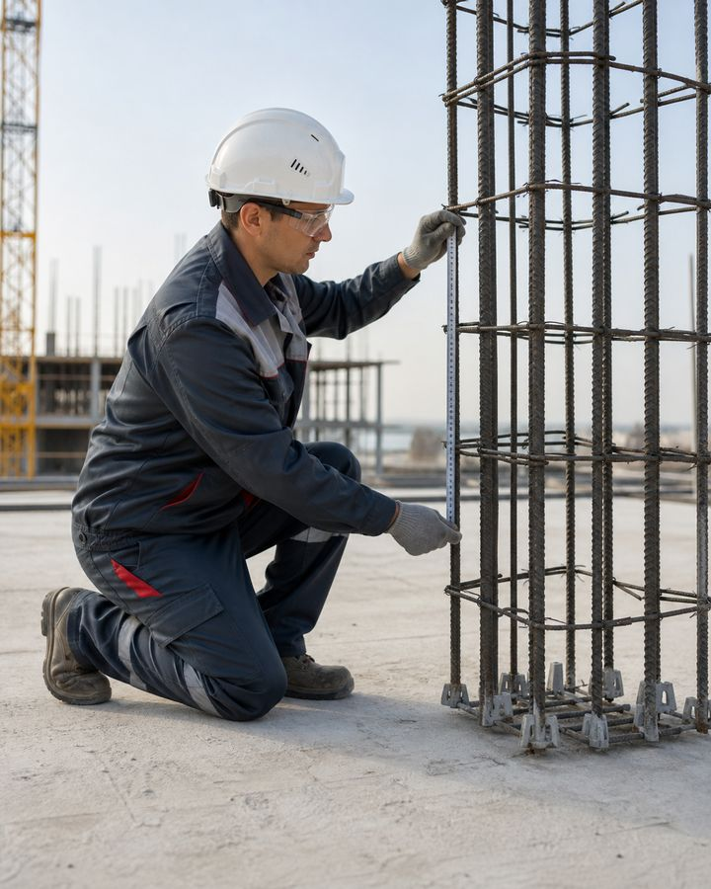
03
Quality and safety
Quality control simultaneously prevents design defects and dangerous alterations.
Rebar worker
21
Notes:
[Sources]
- SafetyHub canonical RU slide source: content/source-materials/derived/armaturshchik/presentation.pptx
- Reviewed EN text map: content/localizations/staged-2026-09-01/presentations/armaturshchik/en/text-map.json

Slide 22
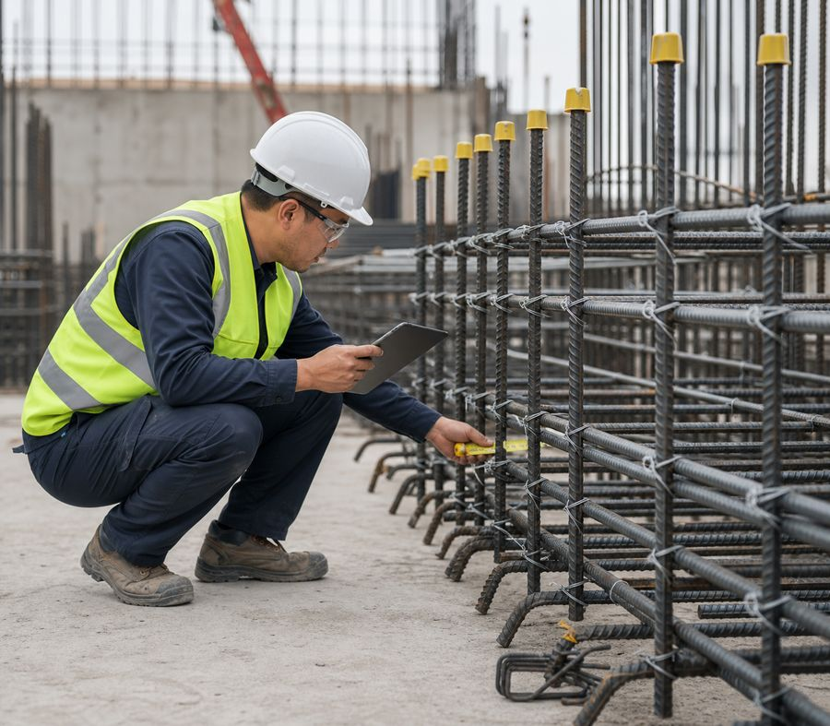
Inspection Is Completed Before Work Is Concealed
• Check the type, quantity, position and marking of elements with the project.
• Check dimensions, geometry, connections, fasteners and temporary connections.
• Monitor the cleanliness of the reinforcement and readiness for concreting.
• Inconsistencies are recorded and eliminated according to an agreed decision.
A photograph or recording of the inspection is not a substitute for an actual frame inspection.
Rebar worker
22
Notes:
[Sources]
- SafetyHub canonical RU slide source: content/source-materials/derived/armaturshchik/presentation.pptx
- Reviewed EN text map: content/localizations/staged-2026-09-01/presentations/armaturshchik/en/text-map.json

Slide 23
Typical defects have specific causes
risk / SOURCE
CONSEQUENCE
CONTROL MEASURE
Displacement of bars
Poor fixation or shock during installation
Restore the position according to the design and strengthen the fixation
Incomplete connection
The reinforcement tying, welding or coupler-connection procedure has been violated
Stop acceptance and perform approved correction
Insufficient stability
Structural ties or supports are missing
Do not lift the frame or begin concreting until it has been secured
Sharp protrusions
Rebar Ends and Tying Wire Are Unprotected
Fence, mark and protect
A defect must not be corrected by a method that is not specified in the design.
Rebar worker
23
Notes:
[Sources]
- SafetyHub canonical RU slide source: content/source-materials/derived/armaturshchik/presentation.pptx
- Reviewed EN text map: content/localizations/staged-2026-09-01/presentations/armaturshchik/en/text-map.json

Slide 24
Complex work is planned separately
• Assess large spatial frames, confined areas and nonstandard joints in advance.
• Define the assembly sequence, temporary stability measures and safe access.
• Coordinate lifting, welding, work at height and crew interaction in one overall plan.
• Reassess risk when conditions change.
The more complex the frame, the more important is temporary stability at each stage.
Rebar worker
24
Notes:
[Sources]
- SafetyHub canonical RU slide source: content/source-materials/derived/armaturshchik/presentation.pptx
- Reviewed EN text map: content/localizations/staged-2026-09-01/presentations/armaturshchik/en/text-map.json

Slide 25
Main risks vary by operation
risk / SOURCE
CONSEQUENCE
CONTROL MEASURE
Cutting and bending
Bar Fly-Off, Entanglement and Ejection
Fencing, securing, safe area
Welding
Burn, smoke, fire, electric shock
Approval, ventilation, protection, hot work control
Lifting
Falling load and pinching
Lifting plan, banksman, zone prohibition
Installation
Fall from height, loss of stability
Collective Protection, Structural Ties, Safe Access
One set of measures does not cover all stages of reinforcement work.
Rebar worker
25
Notes:
[Sources]
- SafetyHub canonical RU slide source: content/source-materials/derived/armaturshchik/presentation.pptx
- Reviewed EN text map: content/localizations/staged-2026-09-01/presentations/armaturshchik/en/text-map.json

Slide 26
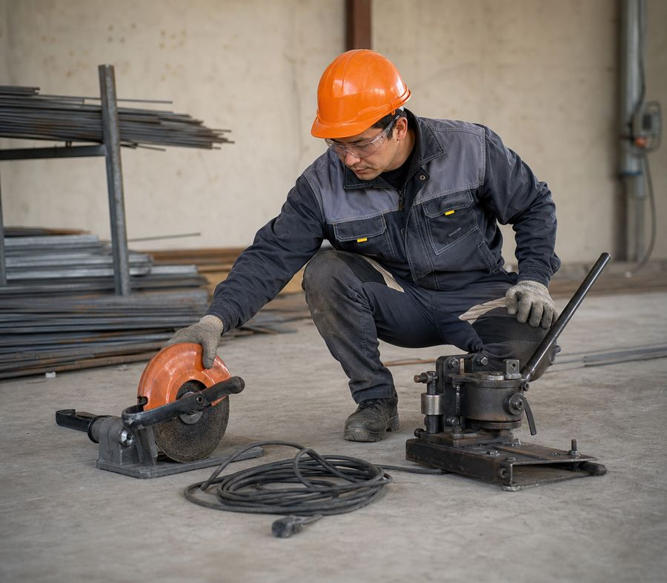
Tools are checked before each shift
• Hand tools are checked for handles, cutting edges and suitability for operation.
• A power tool has a housing, cable, switch, guard and accessories.
• Adjustments, cleaning and replacement of equipment are carried out after a power outage.
• The faulty tool is taken out of use and reported to the responsible person.
Serviceability is confirmed by inspection and the prescribed check, and not by trial risk.
Standard: Tool Safety — Order No. 204
Rebar worker
26
Notes:
[Sources]
- SafetyHub canonical RU slide source: content/source-materials/derived/armaturshchik/presentation.pptx
- Reviewed EN text map: content/localizations/staged-2026-09-01/presentations/armaturshchik/en/text-map.json

Slide 27
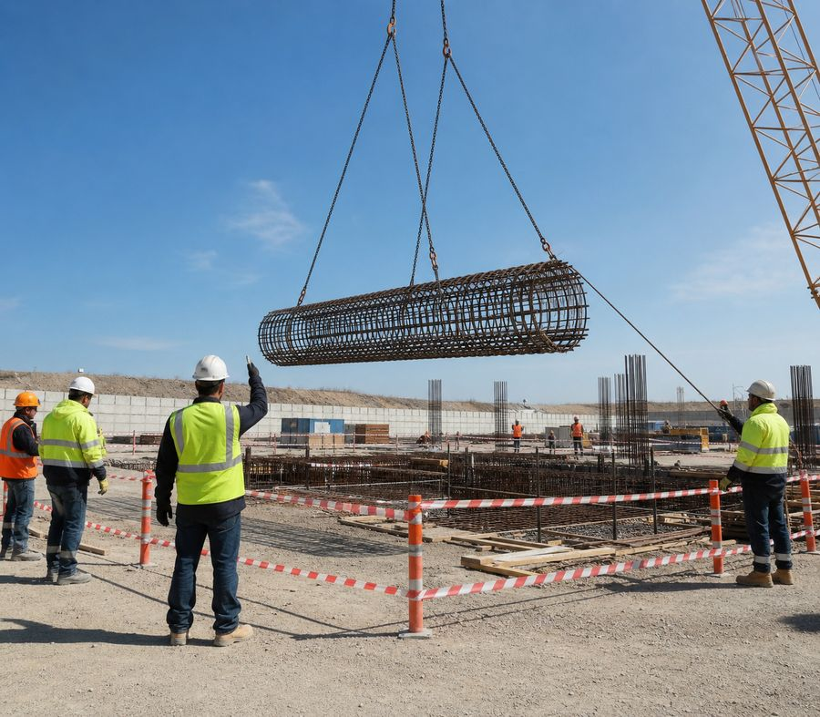
Height and lifting require overall coordination
• Safe access and collective protection must be in place before the worker ascends.
• The worker must not stand beneath a load or guide a suspended frame by hand while in the danger zone.
• A designated person gives the commands; communication and signals are agreed before the operation begins.
• Tools and small parts are secured against falling.
The installer and operator must understand the same sequence and the same signals.
Standard: Work at Height — Order No. 109
Rebar worker
27
Notes:
[Sources]
- SafetyHub canonical RU slide source: content/source-materials/derived/armaturshchik/presentation.pptx
- Reviewed EN text map: content/localizations/staged-2026-09-01/presentations/armaturshchik/en/text-map.json

Slide 28
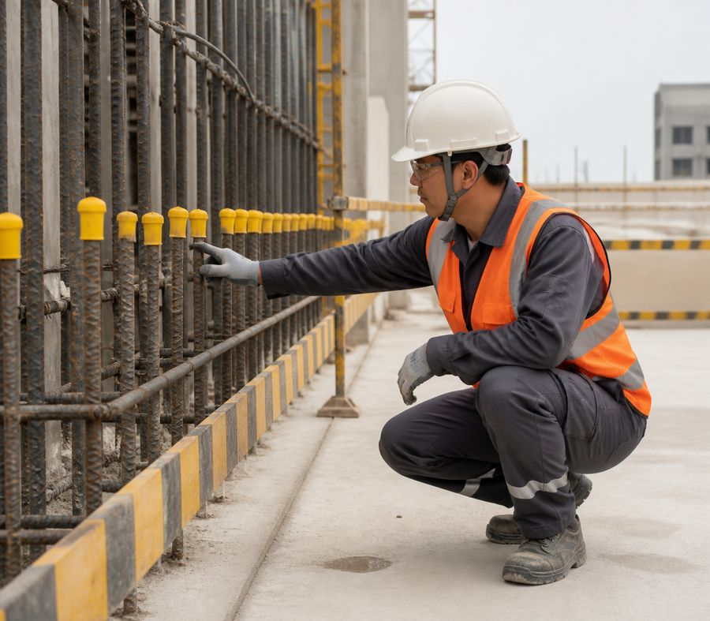
Protruding ends are protected immediately
• Guard, mark or cap hazardous ends with the specified protection.
• Do not route walkways through areas of protruding reinforcement or wire offcuts.
• Protect hands from cuts and keep the body out of pinch zones between elements.
• When moving long reinforcing bars, maintain separation and use agreed commands.
The protective cap does not replace a guard where it is possible to fall onto the reinforcement.
Rebar worker
28
Notes:
[Sources]
- SafetyHub canonical RU slide source: content/source-materials/derived/armaturshchik/presentation.pptx
- Reviewed EN text map: content/localizations/staged-2026-09-01/presentations/armaturshchik/en/text-map.json

Slide 29
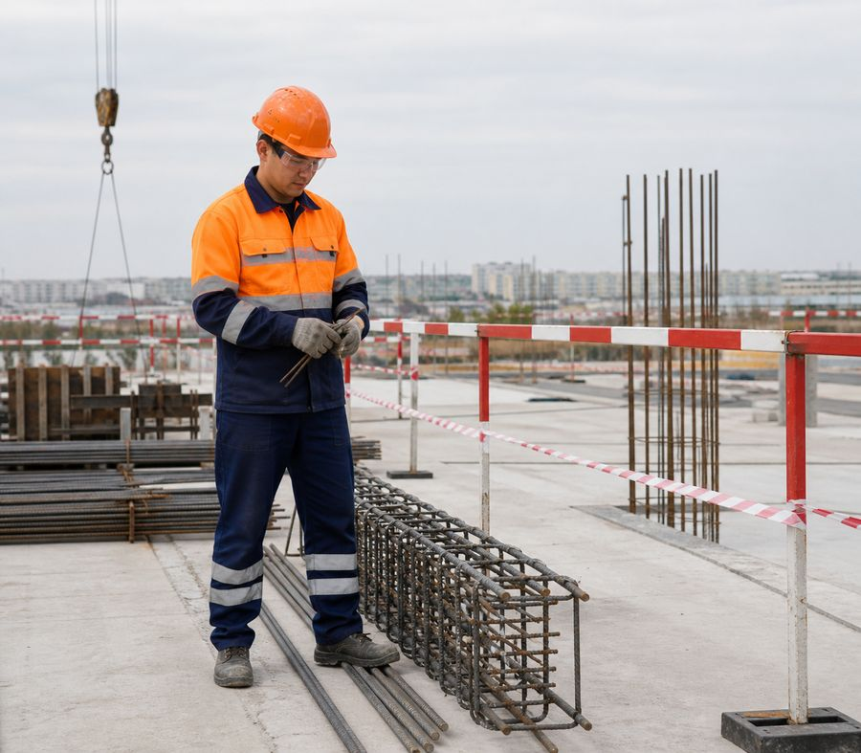
PPE complement technical measures
• Hard hat, protective footwear and clothing must suit site conditions.
• Eye and face protection is required for cutting, grinding, tensioning and welding.
• Select gloves for tying wire, sharp edges and the tools used.
• For work at height and welding, use specialized systems and PPE selected from the risk assessment.
PPE does not make work safe when guarding, securing and authorization are absent.
Norm: Labor Code of the Republic of Kazakhstan
Rebar worker
29
Notes:
[Sources]
- SafetyHub canonical RU slide source: content/source-materials/derived/armaturshchik/presentation.pptx
- Reviewed EN text map: content/localizations/staged-2026-09-01/presentations/armaturshchik/en/text-map.json

Slide 30
Operation is stopped when conditions change
• The design or assembly is unclear, the material is not identified, or a discrepancy is found.
• No fencing, stable support, temporary connections or safe access.
• Tools, fixtures, welding or lifting equipment are defective.
• People are in a hazardous area, communication is lost, or weather is preventing safe operation.
STOP
Stop - fence - report - resume after permission.
Norm: Labor Code of the Republic of Kazakhstan
Rebar worker
30
Notes:
[Sources]
- SafetyHub canonical RU slide source: content/source-materials/derived/armaturshchik/presentation.pptx
- Reviewed EN text map: content/localizations/staged-2026-09-01/presentations/armaturshchik/en/text-map.json

Slide 31
Final rebar worker checklist
✓
The design, material and sequence are clear.
✓
The work area, storage and movement route are safe.
✓
Tools, equipment and fixtures are in good working order.
✓
The frame is stable, connections and position are checked before concreting.
✓
In the event of a threat, malfunction or non-compliance, operation is stopped.
Click “Start Test”
Updated: 08/21/2026
Notes:
[Sources]
- SafetyHub canonical RU slide source: content/source-materials/derived/armaturshchik/presentation.pptx
- Reviewed EN text map: content/localizations/staged-2026-09-01/presentations/armaturshchik/en/text-map.json

