Slide 1


TRAINING COURSE
occupational safety and health (BIOT)
Practical principles of safe work and industrial safety
Training course for workers and line personnel
occupational safety and health (BIOT)
01
Notes:
[Sources]
- SafetyHub canonical RU slide source: content/source-materials/derived/biot/presentation.pptx
- Reviewed EN text map: content/localizations/staged-2026-09-01/presentations/biot/en/text-map.json

Slide 2
After the course worker will be able to
01
Recognize hazards, evaluate risk and select control measures.
The main goal of BIOT is to prevent injury, accident and occupational disease.
02
Understand the responsibilities of the employee, employer and manager.
03
Properly report hazards, incidents, injuries and accidents.
04
Perform basic actions at a hazardous production facility.
Norm: Labor Code of the Republic of Kazakhstan • Law “On Civil Protection”
occupational safety and health (BIOT)
02
Notes:
[Sources]
- SafetyHub canonical RU slide source: content/source-materials/derived/biot/presentation.pptx
- Reviewed EN text map: content/localizations/staged-2026-09-01/presentations/biot/en/text-map.json

Slide 3
Five parts of the course
01
Fundamentals of occupational safety and health.
COURSE
02
Labor legislation in a practical context.
5
03
Occupational safety and health management system.
04
Accidents and emergency preparedness.
semantic blocks
05
Fundamentals of industrial safety.
occupational safety and health (BIOT)
03
Notes:
[Sources]
- SafetyHub canonical RU slide source: content/source-materials/derived/biot/presentation.pptx
- Reviewed EN text map: content/localizations/staged-2026-09-01/presentations/biot/en/text-map.json

Slide 4
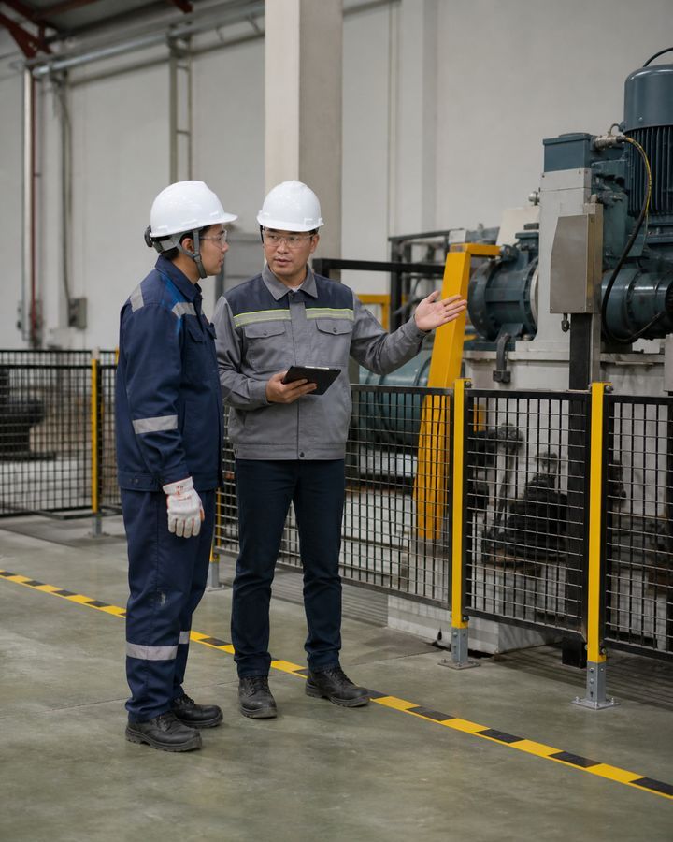
I
BIOT Basics
Safety is created by the joint actions of the employee, employer and manager.
occupational safety and health (BIOT)
04
Notes:
[Sources]
- SafetyHub canonical RU slide source: content/source-materials/derived/biot/presentation.pptx
- Reviewed EN text map: content/localizations/staged-2026-09-01/presentations/biot/en/text-map.json

Slide 5
Working conditions - entire work context
• Work environment: equipment, materials, air, noise, lighting and temperature.
• Work process: actions, load, pace, posture, shift and interaction of people.
• Organization: instructions, training, supervision, maintenance and emergency preparedness.
• Changing any element can change risk.
Safe equipment does not guarantee safe operation if poorly organized.
occupational safety and health (BIOT)
05
Notes:
[Sources]
- SafetyHub canonical RU slide source: content/source-materials/derived/biot/presentation.pptx
- Reviewed EN text map: content/localizations/staged-2026-09-01/presentations/biot/en/text-map.json

Slide 6
Hazardous factors act in different ways
risk / SOURCE
CONSEQUENCE
CONTROL MEASURE
Physical
Moving parts, height, noise, temperature, electricity
Fencing, isolation, distance, mode
Chemical
Dust, vapors, gases and liquids
Replacement, sealing, ventilation, control
Biological
Microorganisms and biomaterial
Hygiene, isolation, regulations
Psychophysiological
Overload, monotony, fatigue
Planning, breaks, task distribution
First, the source and route of exposure are determined, then protection is selected.
occupational safety and health (BIOT)
06
Notes:
[Sources]
- SafetyHub canonical RU slide source: content/source-materials/derived/biot/presentation.pptx
- Reviewed EN text map: content/localizations/staged-2026-09-01/presentations/biot/en/text-map.json

Slide 7
A dangerous situation develops in a chain
1
2
3
4
Condition
Action
Event
Consequence
Faulty, poorly organized or unsafe environment.
Error, violation, haste or wrong decision.
Loss of control over energy, matter or movement.
Injury, damage, accident or health impact.
It is easier to break the chain at an early stage - when a danger is identified.
occupational safety and health (BIOT)
07
Notes:
[Sources]
- SafetyHub canonical RU slide source: content/source-materials/derived/biot/presentation.pptx
- Reviewed EN text map: content/localizations/staged-2026-09-01/presentations/biot/en/text-map.json

Slide 8
BIOT preserves life and health
• occupational safety and health combines legal, organizational, technical, sanitary and preventive measures.
• Occupational safety means worker protection from dangerous and harmful factors.
• The requirements are mandatory for employers and employees in Kazakhstan.
• Costs for BIOT activities are borne by employer.
BIOT is not a separate safety briefing, but a permanent work management system.
Standard: Labor Code of the Republic of Kazakhstan, section 4
occupational safety and health (BIOT)
08
Notes:
[Sources]
- SafetyHub canonical RU slide source: content/source-materials/derived/biot/presentation.pptx
- Reviewed EN text map: content/localizations/staged-2026-09-01/presentations/biot/en/text-map.json

Slide 9
Responsibilities assigned to roles
• employer creates conditions, organizes training, control, medical examinations and protection.
• The manager plans the task, communicates safety measures and responds to changes.
• worker complies with requirements, applies protection and reports hazards.
• BIOT services help the system, but do not replace the responsibility of managers and employees.
Safety cannot be completely delegated to one specialist.
Norm: Labor Code of the Republic of Kazakhstan, articles 181–182
occupational safety and health (BIOT)
09
Notes:
[Sources]
- SafetyHub canonical RU slide source: content/source-materials/derived/biot/presentation.pptx
- Reviewed EN text map: content/localizations/staged-2026-09-01/presentations/biot/en/text-map.json

Slide 10
If there is a threat, work is stopped
• Stop the action or leave the danger area without creating additional risk.
• Warn people and notify immediate supervisor.
• worker has the right to refuse work in a situation that poses a threat to life or health, notifying the employer.
• Resumption is possible after the cause has been eliminated and safe conditions have been confirmed.
STOP
The right to safe work is accompanied by the obligation to report a threat.
Norm: Labor Code of the Republic of Kazakhstan, Article 181
occupational safety and health (BIOT)
10
Notes:
[Sources]
- SafetyHub canonical RU slide source: content/source-materials/derived/biot/presentation.pptx
- Reviewed EN text map: content/localizations/staged-2026-09-01/presentations/biot/en/text-map.json

Slide 11
worker must act safely
• Comply with BIOT, fire, industrial safety and sanitation requirements.
• Complete training, safety briefing, knowledge testing and mandatory medical examinations.
• Correctly use the provided protective equipment and take care of the equipment.
• Report a threat, malfunction, incident or deterioration in health.
Hidden hazard deprives the organization of the ability to prevent the incident.
Norm: Labor Code of the Republic of Kazakhstan
occupational safety and health (BIOT)
11
Notes:
[Sources]
- SafetyHub canonical RU slide source: content/source-materials/derived/biot/presentation.pptx
- Reviewed EN text map: content/localizations/staged-2026-09-01/presentations/biot/en/text-map.json

Slide 12
employer is required to manage risks
• Ensure that buildings, equipment, processes and work areas are in a safe condition.
• Organize training, safety briefing, knowledge control and permission to work.
• Provide and maintain the necessary collective and individual protective equipment.
• Investigate incidents, eliminate causes and inform workers of risks.
Issuing PPE is only one part of the employer's responsibility.
Norm: Labor Code of the Republic of Kazakhstan, article 182
occupational safety and health (BIOT)
12
Notes:
[Sources]
- SafetyHub canonical RU slide source: content/source-materials/derived/biot/presentation.pptx
- Reviewed EN text map: content/localizations/staged-2026-09-01/presentations/biot/en/text-map.json

Slide 13
Report Hazards Accurately and Immediately
1
2
3
4
What
Where
To
What's done
hazard, malfunction, incident, injury or change in conditions.
A precise location, installation, area or work operation.
To the manager and other persons regarding the emergency or local procedure.
Stop, fencing, assistance and current zone status.
Report facts immediately; The reason will be determined after security has been ensured.
occupational safety and health (BIOT)
13
Notes:
[Sources]
- SafetyHub canonical RU slide source: content/source-materials/derived/biot/presentation.pptx
- Reviewed EN text map: content/localizations/staged-2026-09-01/presentations/biot/en/text-map.json

Slide 14

II
Labor legislation
The employee does not need article numbers, but an understanding of rights, responsibilities and the connection between working conditions and safety.
occupational safety and health (BIOT)
14
Notes:
[Sources]
- SafetyHub canonical RU slide source: content/source-materials/derived/biot/presentation.pptx
- Reviewed EN text map: content/localizations/staged-2026-09-01/presentations/biot/en/text-map.json

Slide 15
Requirements are fixed at different levels
• The Labor Code establishes the basic rights, obligations and requirements of BIOT.
• Rules and technical regulations disclose requirements for individual work and risks.
• The collective agreement and employer acts clarify the order within the organization.
• Local instructions cannot override a mandatory legal requirement.
For practical action, a current document related to a specific work is used.
Norm: Labor Code of the Republic of Kazakhstan
occupational safety and health (BIOT)
15
Notes:
[Sources]
- SafetyHub canonical RU slide source: content/source-materials/derived/biot/presentation.pptx
- Reviewed EN text map: content/localizations/staged-2026-09-01/presentations/biot/en/text-map.json

Slide 16
Admission requires fulfillment of conditions
• The employment contract defines the job function and conditions, but does not replace professional clearance.
• Before independent work, training, safety briefing and knowledge testing to the established extent are required.
• Individual jobs require medical examination, qualification, group or permit-to-work.
• The employee is suspended if the required clearance conditions are not met.
Being present at the site does not authorize a person to perform every operation.
Standard: Labor Code of the Republic of Kazakhstan • BIOT training - order No. 1019
occupational safety and health (BIOT)
16
Notes:
[Sources]
- SafetyHub canonical RU slide source: content/source-materials/derived/biot/presentation.pptx
- Reviewed EN text map: content/localizations/staged-2026-09-01/presentations/biot/en/text-map.json

Slide 17
Working mode affects the probability of error
• Working hours, night and overtime work are taken into account when planning hazardous tasks.
• Breaks and shifts should allow you to restore attention and performance.
• Fatigue, lack of sleep and overheating are signs of increased risk, not personal weakness.
• The manager reassigns a task if an employee's condition interferes with safe work.
The production plan should not be based on constant overwork.
Norm: Labor Code of the Republic of Kazakhstan
occupational safety and health (BIOT)
17
Notes:
[Sources]
- SafetyHub canonical RU slide source: content/source-materials/derived/biot/presentation.pptx
- Reviewed EN text map: content/localizations/staged-2026-09-01/presentations/biot/en/text-map.json

Slide 18
Medical Exams and Compensation Relate to Risk
• Mandatory medical examinations confirm suitability and help identify exposure factors.
• employer provides guarantees for the duration of mandatory procedures.
• Compensation for hazardous conditions is not a substitute for risk reduction.
• Changes in well-being due to exposure should be reported without waiting for a routine examination.
Copayment does not make the hazardous exposure acceptable.
Norm: Labor Code of the Republic of Kazakhstan
occupational safety and health (BIOT)
18
Notes:
[Sources]
- SafetyHub canonical RU slide source: content/source-materials/derived/biot/presentation.pptx
- Reviewed EN text map: content/localizations/staged-2026-09-01/presentations/biot/en/text-map.json

Slide 19
Violation entails liability
• Responsibility depends on the role, authority, nature of the violation and consequences.
• Disciplinary action does not replace the cause investigation and corrective action.
• worker reserves the right to information about risks and safe working conditions.
• Disputes over pay, leave and other rights are handled separately from immediate security arrangements.
The main goal of analyzing a violation is to eliminate repetition, and not to hide the problem.
Norm: Labor Code of the Republic of Kazakhstan
occupational safety and health (BIOT)
19
Notes:
[Sources]
- SafetyHub canonical RU slide source: content/source-materials/derived/biot/presentation.pptx
- Reviewed EN text map: content/localizations/staged-2026-09-01/presentations/biot/en/text-map.json

Slide 20
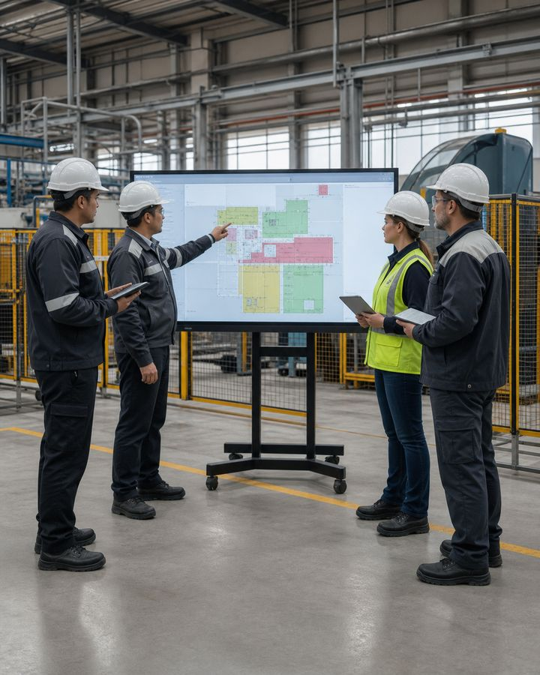
III
OSH Management System
Risks are reduced by consistent management: from eliminating the hazard to monitoring the use of PPE.
occupational safety and health (BIOT)
20
Notes:
[Sources]
- SafetyHub canonical RU slide source: content/source-materials/derived/biot/presentation.pptx
- Reviewed EN text map: content/localizations/staged-2026-09-01/presentations/biot/en/text-map.json

Slide 21
The policy specifies specific responsibilities
• Management establishes goals, resources, authority and controls.
• Hazards are identified before work and at every significant change.
• Measures are included in the plan, performers are assigned and the result is checked.
• Employees participate through messages, suggestions and feedback.
Policy only works when it is defined who does what and when.
occupational safety and health (BIOT)
21
Notes:
[Sources]
- SafetyHub canonical RU slide source: content/source-materials/derived/biot/presentation.pptx
- Reviewed EN text map: content/localizations/staged-2026-09-01/presentations/biot/en/text-map.json

Slide 22
Risk assessment begins with the task
1
2
3
4
Define
Reveal
Rate
Manage
What work is performed, where, by whom and with what equipment.
Energy sources, substances, altitude, movement and human factors.
Probability of contact and severity of possible consequences.
Select measures, assign controls and revise if changes occur.
risk are assessed for real-life conditions, not for an abstract profession.
occupational safety and health (BIOT)
22
Notes:
[Sources]
- SafetyHub canonical RU slide source: content/source-materials/derived/biot/presentation.pptx
- Reviewed EN text map: content/localizations/staged-2026-09-01/presentations/biot/en/text-map.json

Slide 23
Control Hierarchy Sets the Right Priority
1
2
3
4
Eliminate
Replace
Isolate
Organize and protect
Eliminate hazard or the operation itself.
Use a less hazardous material, method or equipment.
Fencing, automation, ventilation and collective protection.
Procedures, clearance, training and then necessary PPE.
PPE are used after more reliable measures, and not instead of them.
occupational safety and health (BIOT)
23
Notes:
[Sources]
- SafetyHub canonical RU slide source: content/source-materials/derived/biot/presentation.pptx
- Reviewed EN text map: content/localizations/staged-2026-09-01/presentations/biot/en/text-map.json

Slide 24
Plan and instructions must be current
• Planning defines sequence, roles, equipment and control points.
• Production control checks compliance and system condition.
• The instructions describe safe actions before, during, after work and in case of an accident.
• When technology changes, documents and safety briefing are revised.
Instructions that do not reflect actual equipment do not control risk.
occupational safety and health (BIOT)
24
Notes:
[Sources]
- SafetyHub canonical RU slide source: content/source-materials/derived/biot/presentation.pptx
- Reviewed EN text map: content/localizations/staged-2026-09-01/presentations/biot/en/text-map.json

Slide 25
Training ends with an understanding check
• Employees undergo training, safety briefing and knowledge testing in the prescribed manner.
• The list of professions and works is determined by employer, taking into account the nature and working conditions.
• After transfer within an occupation, retraining may not be required if working conditions are maintained.
• Practical clearance confirms the ability to safely perform a specific job.
Changing the conditions is more important than the formal coincidence of the job title.
Standard: Occupational Safety and Health Training — Order No. 1019 • 2026 Changes
occupational safety and health (BIOT)
25
Notes:
[Sources]
- SafetyHub canonical RU slide source: content/source-materials/derived/biot/presentation.pptx
- Reviewed EN text map: content/localizations/staged-2026-09-01/presentations/biot/en/text-map.json

Slide 26
safety briefing choose according to the situation
• Introductory introduces the general risks and rules of the organization.
• Workplace primary refers to specific work and equipment.
• Repetition maintains knowledge; unscheduled is needed for changes, incidents or breaks according to the rules.
• Targeting is carried out before one-time or specially organized work.
The signature confirms the fact of the instruction, but safety confirms the understanding of the actions.
Standard: Occupational Safety and Health Training — Order No. 1019
occupational safety and health (BIOT)
26
Notes:
[Sources]
- SafetyHub canonical RU slide source: content/source-materials/derived/biot/presentation.pptx
- Reviewed EN text map: content/localizations/staged-2026-09-01/presentations/biot/en/text-map.json

Slide 27
permit-to-work links risk and measures
• A permit-to-work defines the location, scope, time, conditions, crew and responsible persons.
• It records isolation, atmosphere monitoring, barriers, communications, PPE and emergency measures.
• It is valid only within the stated conditions and boundaries.
• A change in conditions requires work to stop and the permit to be reviewed.
permit-to-work is not permission to ignore the new hazard.
Standard: Work at height - definition of work permit
occupational safety and health (BIOT)
27
Notes:
[Sources]
- SafetyHub canonical RU slide source: content/source-materials/derived/biot/presentation.pptx
- Reviewed EN text map: content/localizations/staged-2026-09-01/presentations/biot/en/text-map.json

Slide 28
Medical Exam and Certification: Different Tasks
✚
medical examination
✓
Workplace Conditions Certification
Evaluates the worker's health in light of relevant factors and the work performed.
Result: medical restrictions, fitness and clearance for work, and preventive recommendations.
Evaluates working conditions and influencing production factors.
Result: improvement measures, guarantees and control of conditions.
Neither medical examination nor certification assessment replace the current risk assessment: the changed workplace is checked again.
occupational safety and health (BIOT)
28
Notes:
[Sources]
- SafetyHub canonical RU slide source: content/source-materials/derived/biot/presentation.pptx
- Reviewed EN text map: content/localizations/staged-2026-09-01/presentations/biot/en/text-map.json

Slide 29
Collective protection applies to the source
• Guards, interlocks, ventilation, isolation and remote control protect a group of workers.
• The protective device must be functional and not bypassed for the sake of convenience.
• Removal or disconnection is only permitted under a controlled procedure.
• Failure of collective protection affects permission to work.
First they protect the workplace, then a specific person.
occupational safety and health (BIOT)
29
Notes:
[Sources]
- SafetyHub canonical RU slide source: content/source-materials/derived/biot/presentation.pptx
- Reviewed EN text map: content/localizations/staged-2026-09-01/presentations/biot/en/text-map.json

Slide 30
PPE select, issue and control
• Type PPE corresponds to the hazard, exposure level and compatibility with other products.
• worker is trained on donning, adjustment, inspection and application limitations.
• PPE inspected before use, maintained and stored according to instructions.
• Damaged or expired product is replaced and not repaired randomly.
PPE is only effective if properly selected and actually applied.
Norm: Labor Code of the Republic of Kazakhstan
occupational safety and health (BIOT)
30
Notes:
[Sources]
- SafetyHub canonical RU slide source: content/source-materials/derived/biot/presentation.pptx
- Reviewed EN text map: content/localizations/staged-2026-09-01/presentations/biot/en/text-map.json

Slide 31
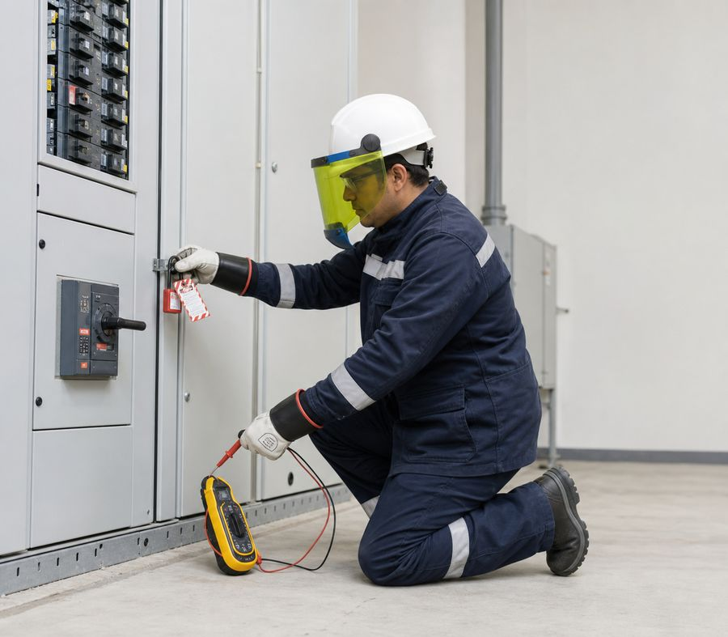
Electricity requires energy removal
• Work is planned taking into account voltage, environment, equipment condition and personnel qualifications.
• Before intervention, disconnect, block and check the absence of dangerous energy according to the procedure.
• Damaged cables, plugs, housings and protective devices are taken out of service.
• The victim is not touched until the current is safely removed.
Control off does not always mean voltage is off.
Standard: Tool Safety — Order No. 204
occupational safety and health (BIOT)
31
Notes:
[Sources]
- SafetyHub canonical RU slide source: content/source-materials/derived/biot/presentation.pptx
- Reviewed EN text map: content/localizations/staged-2026-09-01/presentations/biot/en/text-map.json

Slide 32
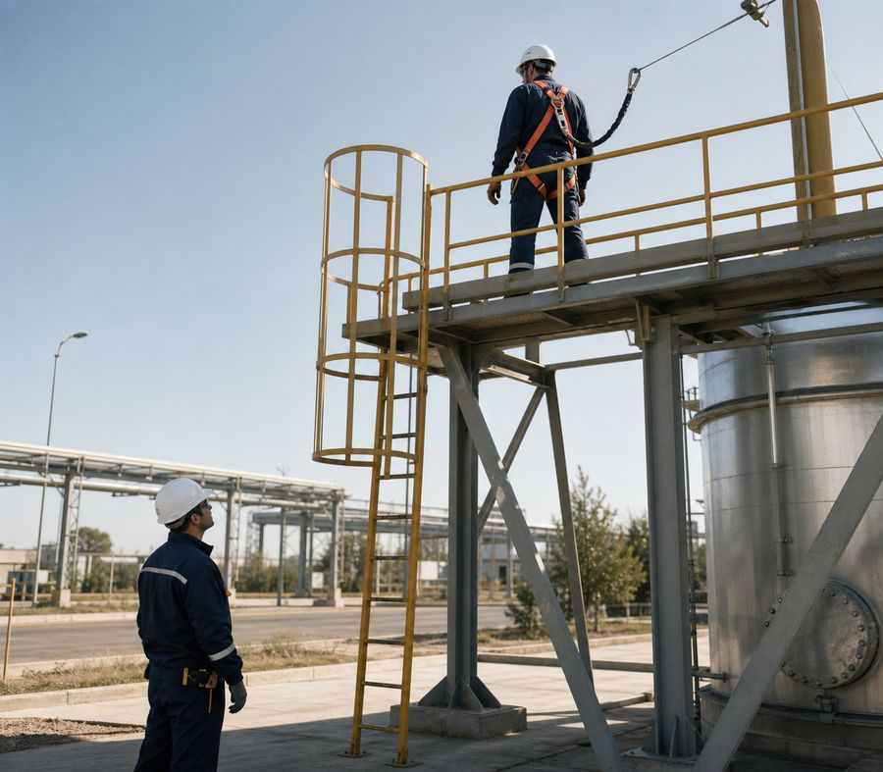
Work at height is planned before lifting
• Define safe access, work area and collective protection.
• If necessary, select the fall arrest system, anchor and rescue plan.
• Tools and materials protect against falling; the dangerous area below is fenced off.
• Weather and changing conditions may require a stop.
Fall protection is incomplete without a safe anchorage point and a rescue plan.
Standard: Work at Height — Order No. 109
occupational safety and health (BIOT)
32
Notes:
[Sources]
- SafetyHub canonical RU slide source: content/source-materials/derived/biot/presentation.pptx
- Reviewed EN text map: content/localizations/staged-2026-09-01/presentations/biot/en/text-map.json

Slide 33
first aid starts with safety
1
2
3
4
Rate
Call
Help
Send
Do not enter the danger zone without stopping exposure.
Report 112, location, nature of the event and number of victims.
Check condition and act within the limits of training and equipment.
Meet help and report completed actions and known facts.
The rescuer should not become a second victim.
occupational safety and health (BIOT)
33
Notes:
[Sources]
- SafetyHub canonical RU slide source: content/source-materials/derived/biot/presentation.pptx
- Reviewed EN text map: content/localizations/staged-2026-09-01/presentations/biot/en/text-map.json

Slide 34
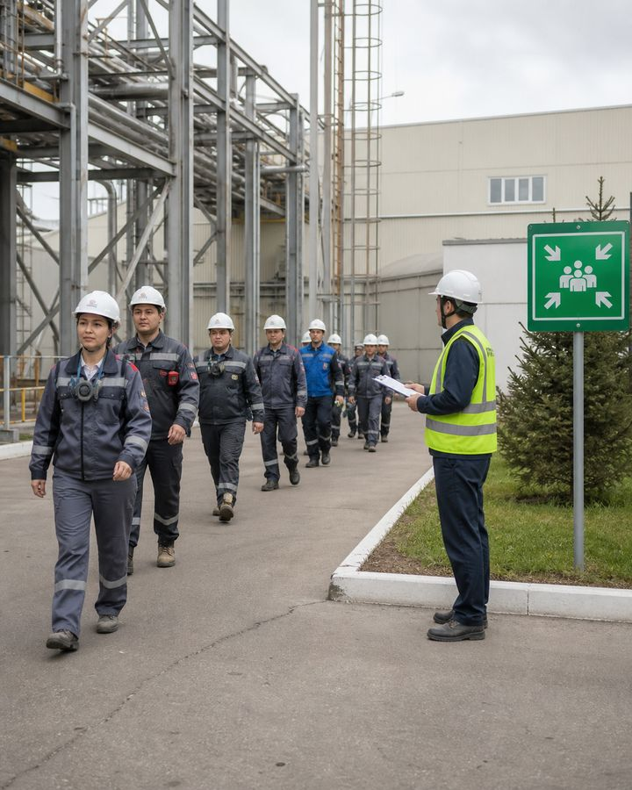
IV
Incidents and preparedness
After an incident, people are protected first, then facts are preserved and systemic causes are addressed.
occupational safety and health (BIOT)
34
Notes:
[Sources]
- SafetyHub canonical RU slide source: content/source-materials/derived/biot/presentation.pptx
- Reviewed EN text map: content/localizations/staged-2026-09-01/presentations/biot/en/text-map.json

Slide 35
hazard, incident and occupational accident
• A hazardous condition or activity creates the possibility of harm.
• incident is a loss of control event that could or has resulted in damage.
• occupational accident is associated with exposure and injury, impairment or poisoning.
• All levels are important to prevent recurrence.
Reporting a non-injury event helps prevent a more severe event.
Norm: Labor Code of the Republic of Kazakhstan
occupational safety and health (BIOT)
35
Notes:
[Sources]
- SafetyHub canonical RU slide source: content/source-materials/derived/biot/presentation.pptx
- Reviewed EN text map: content/localizations/staged-2026-09-01/presentations/biot/en/text-map.json

Slide 36
Following an incident, priorities are followed
1
2
3
4
Stop hazard
Help people
Report
Save facts
Stop energy, movement or influence without risk to yourself.
Call for help, organize first aid and evacuation.
Notify the manager and services according to the established scheme.
Do not change the situation, except to save people and prevent the development of events.
Rescue and prevention of further harm is more important than maintaining the same situation.
Norm: Labor Code of the Republic of Kazakhstan
occupational safety and health (BIOT)
36
Notes:
[Sources]
- SafetyHub canonical RU slide source: content/source-materials/derived/biot/presentation.pptx
- Reviewed EN text map: content/localizations/staged-2026-09-01/presentations/biot/en/text-map.json

Slide 37
Investigation establishes causes
• Gather facts about conditions, task, equipment, operations, training and management.
• Separate the immediate event from organizational and technical reasons.
• The result is compiled and taken into account in the prescribed manner.
• Corrective actions are prescribed with responsible persons and effectiveness check.
The explanation “employee inattention” rarely reveals the entire system of causes.
Norm: Labor Code of the Republic of Kazakhstan - investigation and accounting
occupational safety and health (BIOT)
37
Notes:
[Sources]
- SafetyHub canonical RU slide source: content/source-materials/derived/biot/presentation.pptx
- Reviewed EN text map: content/localizations/staged-2026-09-01/presentations/biot/en/text-map.json

Slide 38
Impact may occur gradually
• Occupational disease is associated with prolonged or repeated exposure to factors.
• Acute poisoning may require immediate evacuation, decontamination and medical attention.
• Symptoms and circumstances are reported to supervisor and health care provider.
• Data from medical surveillance and environmental monitoring are used for prevention.
The absence of injury at the time of the shift does not mean the absence of harm to health.
occupational safety and health (BIOT)
38
Notes:
[Sources]
- SafetyHub canonical RU slide source: content/source-materials/derived/biot/presentation.pptx
- Reviewed EN text map: content/localizations/staged-2026-09-01/presentations/biot/en/text-map.json

Slide 39
Insurance is not a substitute for prevention
• Compulsory insurance protects the property interests of the employee in the event of an accident.
• The payment procedure depends on the established procedure and circumstances.
• An insured event does not cancel the investigation, recording and elimination of causes.
• employer continues the duty to prevent exposure.
Compensation for consequences is not a risk management measure.
Norm: Labor Code of the Republic of Kazakhstan
occupational safety and health (BIOT)
39
Notes:
[Sources]
- SafetyHub canonical RU slide source: content/source-materials/derived/biot/presentation.pptx
- Reviewed EN text map: content/localizations/staged-2026-09-01/presentations/biot/en/text-map.json

Slide 40
Corrective action must change the system
• Eliminate the source or technical cause, not just remind the rule.
• Review technology, fencing, maintenance, training and supervision.
• Determine the deadline, the person responsible and the method of confirming the result.
• Check whether measure risk has been transferred to another operation.
Repeated safety briefing without eliminating the fault does not close the cause.
occupational safety and health (BIOT)
40
Notes:
[Sources]
- SafetyHub canonical RU slide source: content/source-materials/derived/biot/presentation.pptx
- Reviewed EN text map: content/localizations/staged-2026-09-01/presentations/biot/en/text-map.json

Slide 41
Emergency preparedness is tested by training
1
2
3
4
Plan
Preparation
Training
Improvement
Scripts, roles, notification, routes, resources and service interactions.
Personnel training and readiness of communications and protection systems.
Practical testing of actions without creating real danger.
Review, corrective action and re-inspection.
A plan that no one has worked out cannot be considered confirmed.
Norm: Law “On Civil Protection”
occupational safety and health (BIOT)
41
Notes:
[Sources]
- SafetyHub canonical RU slide source: content/source-materials/derived/biot/presentation.pptx
- Reviewed EN text map: content/localizations/staged-2026-09-01/presentations/biot/en/text-map.json

Slide 42

V
industrial safety
This section applies to work at hazardous production facilities and with dangerous technical devices.
Norm: Law “On Civil Protection”
occupational safety and health (BIOT)
42
Notes:
[Sources]
- SafetyHub canonical RU slide source: content/source-materials/derived/biot/presentation.pptx
- Reviewed EN text map: content/localizations/staged-2026-09-01/presentations/biot/en/text-map.json

Slide 43
industrial safety in the system
• It is aimed at preventing the harmful effects of hazardous production factors.
• Requirements are established by law, technical regulations, rules and instructions.
• The organization conducts production controls and prepares for accidents.
• worker complies, receives training, and reports an accident or incident.
industrial safety manages the risk of a major man-made event.
Norm: Law “On Civil Protection”
occupational safety and health (BIOT)
43
Notes:
[Sources]
- SafetyHub canonical RU slide source: content/source-materials/derived/biot/presentation.pptx
- Reviewed EN text map: content/localizations/staged-2026-09-01/presentations/biot/en/text-map.json

Slide 44
HPF is determined by danger signs
• The characteristics include the production, use, storage or transportation of certain hazardous substances.
• Flammable, explosive, toxic and other hazardous substances are taken into account.
• Signs also include individual technological processes and hazards.
• Identification is carried out by the organization according to established rules.
An object is recognized as dangerous based on its actual characteristics, and not on its everyday name.
Norm: Law “On Civil Protection”, Article 70
occupational safety and health (BIOT)
44
Notes:
[Sources]
- SafetyHub canonical RU slide source: content/source-materials/derived/biot/presentation.pptx
- Reviewed EN text map: content/localizations/staged-2026-09-01/presentations/biot/en/text-map.json

Slide 45
Dangerous devices: accounting and control
• Dangerous technical devices include categories of equipment established by law.
• The organization identifies, accounts for and releases them to applicable requirements.
• worker checks visible markings, status and enabled mode before action.
• Unaccounted for, faulty or expired equipment is not introduced without permission.
The technical data sheet and registration identify the controlled equipment, but serviceability is confirmed by inspections.
Norm: Law “On Civil Protection”
occupational safety and health (BIOT)
45
Notes:
[Sources]
- SafetyHub canonical RU slide source: content/source-materials/derived/biot/presentation.pptx
- Reviewed EN text map: content/localizations/staged-2026-09-01/presentations/biot/en/text-map.json

Slide 46
Examination and declaration: control
• Expertise in the field of industrial safety is used in cases established by law.
• Permitting and accounting procedures depend on the object, device and activity performed.
• The declaration reflects the nature and extent of the danger and protective measures.
• It is important for the worker to be aware of the restrictions, signals and actions that apply to his or her area.
Review of procedures does not give the employee authority to substitute for expert judgment.
Norm: Law “On Civil Protection”
occupational safety and health (BIOT)
46
Notes:
[Sources]
- SafetyHub canonical RU slide source: content/source-materials/derived/biot/presentation.pptx
- Reviewed EN text map: content/localizations/staged-2026-09-01/presentations/biot/en/text-map.json

Slide 47
PLA determines actions in case of emergency
• The emergency response plan includes the rescue of people and the actions of personnel and emergency services.
• It allocates responsibilities, sequence, communication and necessary resources.
• worker knows its signal, route, rally point and prohibitions.
• The plan is verified by drills and emergency drills.
In the event of an accident, they perform a previously practiced role, and do not improvise in a dangerous area.
Norm: Law “On Civil Protection”
occupational safety and health (BIOT)
47
Notes:
[Sources]
- SafetyHub canonical RU slide source: content/source-materials/derived/biot/presentation.pptx
- Reviewed EN text map: content/localizations/staged-2026-09-01/presentations/biot/en/text-map.json

Slide 48
Organization Follows the Plan in an Emergency
1
2
3
4
Notify
Protect
Interact
Investigate
Transmit a signal and accurate information via an established channel.
Stop the process, isolate the energy and evacuate according to the role.
Meet and support emergency services.
Maintain facts, establish causes and take action.
worker does not return to the danger zone without a command from a responsible person.
Norm: Law “On Civil Protection”
occupational safety and health (BIOT)
48
Notes:
[Sources]
- SafetyHub canonical RU slide source: content/source-materials/derived/biot/presentation.pptx
- Reviewed EN text map: content/localizations/staged-2026-09-01/presentations/biot/en/text-map.json

Slide 49
Hazardous substances require different measures
risk / SOURCE | CONSEQUENCE | CONTROL MEASURE
Flammable | Fast ignition and propagation | Eliminate ignition sources; control fumes and spills
Explosive | Rapid energy release | Special mode, compatibility of substances and safe distance
Toxic | Poisoning through breathing, skin or ingestion | Sealing, environmental control, protection and evacuation readiness
Environmentally hazardous | Environmental pollution and secondary harm | Retention, collection and emergency procedures
The pictogram helps to recognize hazard, but does not replace the safety data sheet and local instructions.
Norm: Law “On Civil Protection”
occupational safety and health (BIOT)
49
Notes:
[Sources]
- SafetyHub canonical RU slide source: content/source-materials/derived/biot/presentation.pptx
- Reviewed EN text map: content/localizations/staged-2026-09-01/presentations/biot/en/text-map.json

Slide 50
Labeling and shipping require verification
• Before handling, identify the substance, container, compatibility and hazardous properties.
• Markings must be legible and consistent with the documents for the cargo or product.
• Transportation is carried out according to applicable requirements, route and emergency information.
• Unknown containers are not opened, moved or refilled without asking.
Unknown content is a reason to stop the appeal.
Norm: Law “On Civil Protection”
occupational safety and health (BIOT)
50
Notes:
[Sources]
- SafetyHub canonical RU slide source: content/source-materials/derived/biot/presentation.pptx
- Reviewed EN text map: content/localizations/staged-2026-09-01/presentations/biot/en/text-map.json

Slide 51
Radiation is not detected by the senses
• The source and area are controlled by established technical and organizational measures.
• Time, distance and shielding are applied within an approved procedure.
• Individual radiation monitoring is carried out for certain categories of work and personnel.
• Violated markings, alarms or records require immediate reporting.
The absence of odor, heat or pain does not confirm the absence of radiation.
Norm: Law “On Civil Protection”
occupational safety and health (BIOT)
51
Notes:
[Sources]
- SafetyHub canonical RU slide source: content/source-materials/derived/biot/presentation.pptx
- Reviewed EN text map: content/localizations/staged-2026-09-01/presentations/biot/en/text-map.json

Slide 52
Oil/Gas Sites Need Work-Environment Monitoring
1
Media and pressure
2
Air control
Fire and explosion hazard, toxicity, pressure, technological connections and remoteness of assistance are taken into account.
Gas hazardous areas are indicated; the air is checked with the provided instruments.
3
evacuation
4
Work according to procedure
The route and collection point are chosen taking into account the possible spread of gas.
Operate in accordance with the emergency response plan, permit and local instructions.
Wind direction and instrument readings are more important than the usual route.
Standard: Oil and Gas Industry Safety
occupational safety and health (BIOT)
52
Notes:
[Sources]
- SafetyHub canonical RU slide source: content/source-materials/derived/biot/presentation.pptx
- Reviewed EN text map: content/localizations/staged-2026-09-01/presentations/biot/en/text-map.json

Slide 53
Hydrogen sulfide requires immediate reaction
• H₂S is toxic; odor is not a reliable way to control concentrations.
• If the device beeps or there are signs of danger, stop working and leave the area along a safe route.
• Do not enter for rescue without training, communication and appropriate respiratory protection.
• Report according to the emergency plan and act according to the emergency plan.
STOP
Relying on smell for H₂S is dangerous.
Standard: Oil and Gas Industry Safety
occupational safety and health (BIOT)
53
Notes:
[Sources]
- SafetyHub canonical RU slide source: content/source-materials/derived/biot/presentation.pptx
- Reviewed EN text map: content/localizations/staged-2026-09-01/presentations/biot/en/text-map.json

Slide 54
Gas Hazardous Work: Atmosphere Control
1
2
3
4
Prepare
Check
Execute
Stop
permit-to-work, isolation, ventilation, communication and rescue measures.
Air composition - with a suitable verified instrument at the right points.
With observation and periodic or continuous monitoring of the procedure.
When there is a signal, loss of communication, loss of ventilation or change in conditions.
The primary measurement does not guarantee a safe atmosphere for the entire duration of operation.
Norm: Law “On Civil Protection” • Safety of the oil and gas industry
occupational safety and health (BIOT)
54
Notes:
[Sources]
- SafetyHub canonical RU slide source: content/source-materials/derived/biot/presentation.pptx
- Reviewed EN text map: content/localizations/staged-2026-09-01/presentations/biot/en/text-map.json

Slide 55
Hot work: ignition control
• Identify sparks and heat, remove or protect flammable materials.
• Issue permit-to-work where required and schedule observation.
• Monitor the gas environment, insulation of equipment and the availability of extinguishing agents.
• After completion, the site is checked within the time established by the local procedure.
The end of welding does not mean the end of the fire risk.
Standard: Fire safety rules
occupational safety and health (BIOT)
55
Notes:
[Sources]
- SafetyHub canonical RU slide source: content/source-materials/derived/biot/presentation.pptx
- Reviewed EN text map: content/localizations/staged-2026-09-01/presentations/biot/en/text-map.json

Slide 56
Tank entry requires an external attendant
• Isolate the vessel from energy sources and connected services, clean and ventilate it, and monitor its atmosphere.
• Entry is performed under a permit-to-work with a designated attendant and reliable communications.
• Rescue equipment and the means of retrieval are prepared before entry.
• The attendant must not leave the post or enter the space without an organized rescue procedure.
Surveillance is an active control and communication function rather than a formal presence.
Standard: Oil and Gas Industry Safety
occupational safety and health (BIOT)
56
Notes:
[Sources]
- SafetyHub canonical RU slide source: content/source-materials/derived/biot/presentation.pptx
- Reviewed EN text map: content/localizations/staged-2026-09-01/presentations/biot/en/text-map.json

Slide 57
Pressure is maintained by the entire system
• The vessel, valves and fittings, safety devices, instruments and piping operate as one system.
• Authorization for operation, inspection and marking are performed under the applicable rules.
• The worker monitors operating conditions and reports leaks, vibration, damage or incorrect readings.
• Repair, opening or tightening while under pressure is performed only by an authorized method.
A zero reading on one device does not always confirm the absence of pressure.
Norm: Law “On Civil Protection”
occupational safety and health (BIOT)
57
Notes:
[Sources]
- SafetyHub canonical RU slide source: content/source-materials/derived/biot/presentation.pptx
- Reviewed EN text map: content/localizations/staged-2026-09-01/presentations/biot/en/text-map.json

Slide 58
Industrial risk requires stop
• An alarm from a gas detector, dosimeter, protective system or process interlock.
• A leak, odor, mist, unusual noise, vibration, or rising pressure or temperature.
• Loss of communications, ventilation, monitoring or specified isolation.
• Absence of a permit-to-work, marking, inspection or a clearly understood emergency role.
STOP
Stopping work and taking a safe route is the right action when in doubt.
Norm: Law “On Civil Protection”
occupational safety and health (BIOT)
58
Notes:
[Sources]
- SafetyHub canonical RU slide source: content/source-materials/derived/biot/presentation.pptx
- Reviewed EN text map: content/localizations/staged-2026-09-01/presentations/biot/en/text-map.json

Slide 59
Final BIOT checklist
✓
Hazards identified, risk assessed, measures selected according to hierarchy.
✓
worker is trained, cleared and understands mission and emergency procedures.
✓
Collective protection is working, PPE fit and tested.
✓
The signal, route, PLA and immediate stop conditions are clear at the OPO.
✓
Any change or incident is reported promptly.
Click “Start Test”
Updated: 08/21/2026
Notes:
[Sources]
- SafetyHub canonical RU slide source: content/source-materials/derived/biot/presentation.pptx
- Reviewed EN text map: content/localizations/staged-2026-09-01/presentations/biot/en/text-map.json

